Slide 1

RAG
Retrieval Augmented Generation...
...and tools

Slide 2
Back to the kitchen
‘system’ : “You are an expert in baking.”
‘user’ : “Provide me a recipe for macarons.”
‘assistant’ : “Certainly! Here is a recipe for macarons …”

Slide 3
Back to the kitchen
‘system’ : “You are an expert in baking.”
‘knowledge’ : “Recipe 1, Recipe 2, … Recipe 1000”
‘user’ : “Provide me a recipe for macarons.”
‘assistant’ : “Certainly! Here is a recipe for macarons …”

Slide 4
Back to Vectors
y
Wouldn't it be nice if we vectorize our recipes...?
almond-based deserts
Italian macaron
French macaron
apple pie
apple-based deserts
x

Slide 5

Remember this guy...?

Slide 6

Bidirectional Encoder Representations from Transformers
‘[CLS]’
‘the’
‘cat’
‘[MASK]’
‘on’
‘the’
‘mat’
‘[SEP]’
101
1996
4937
103
2006
1996
13523
102
‘the’
‘cat’
‘sat’
‘on’
‘the’
‘mat’
‘sat’ | 0.19
‘was’ | 0.14
‘lay’ | 0.07
‘hippo’ | 0.000001
Notes:
BERT is what we call a masked token predictor. Here we have the same example. Except this time, we have masked the token “sat”. The job for bert is to predict this masked token. You see on the right, lots of different options. BERT will actually predict the probability of every possible token being the next token. So let’s say each token is a word, and suppose there are 200,000 words to choose from, then you’ll end up with 200,000 numbers. And the biggest number is the most likely next token. We’ll come back to this right hand side. But first I want to look at what’s going on in the left hand side.

Slide 7
Embedding models
Embedding models like BERT are given access to the full sentence
The final output of the attention heads was something like:
[sequence_length, embedding_dim]
Maybe we can pool these together:
[sequence_length, embedding_dim] → [1, embedding_dim]

Slide 8
Embedding models
Modern embedding models typically use more advanced methods:
Contrastive learning
Matroyshka representation learning

Slide 9
Embedding models
The point is we can go from this:
Four score and seven years ago our fathers brought forth on this continent, a new nation, conceived in Liberty, and dedicated to the proposition that all men are created equal. Now we are engaged in a great civil war, testing whether that nation, or any nation so conceived and so dedicated, can long endure. We are met on a great battle-field of that war. We have come to dedicate a portion of that field, as a final resting place for those who here gave their lives that that nation might live. It is altogether fitting and proper that we should do this. But, in a larger sense, we can not dedicate—we can not consecrate—we can not hallow—this ground. The brave men, living and dead, who struggled here, have consecrated it, far above our poor power to add or detract. The world will little note, nor long remember what we say here, but it can never forget what they did here. It is for us the living, rather, to be dedicated here to the unfinished work which they who fought here have thus far so nobly advanced. It is rather for us to be here dedicated to the great task remaining before us—that from these honored dead we take increased devotion to that cause for which they gave the last full measure of devotion—that we here highly resolve that these dead shall not have died in vain—that this nation, under God, shall have a new birth of freedom—and that government of the people, by the people, for the people, shall not perish from the earth.
to this:
[0.0784, -0.7839, 0.5729, 0.1272, 0.9236, …, -0.2781]

Slide 10

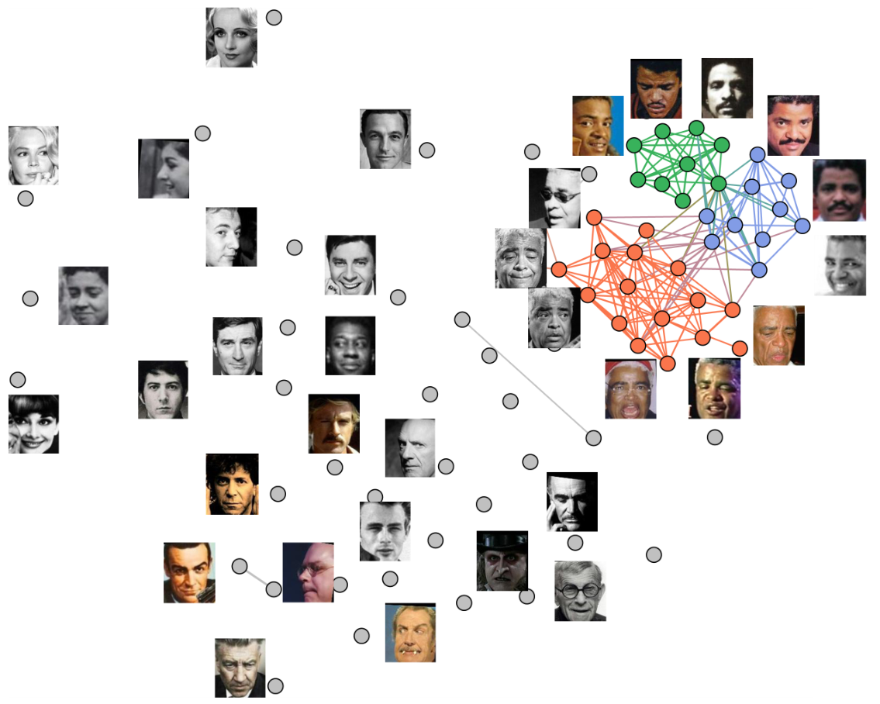
Vector Search
y
almond-based deserts
Italian macaron
French macaron
apple pie
apple-based deserts
x

Slide 11
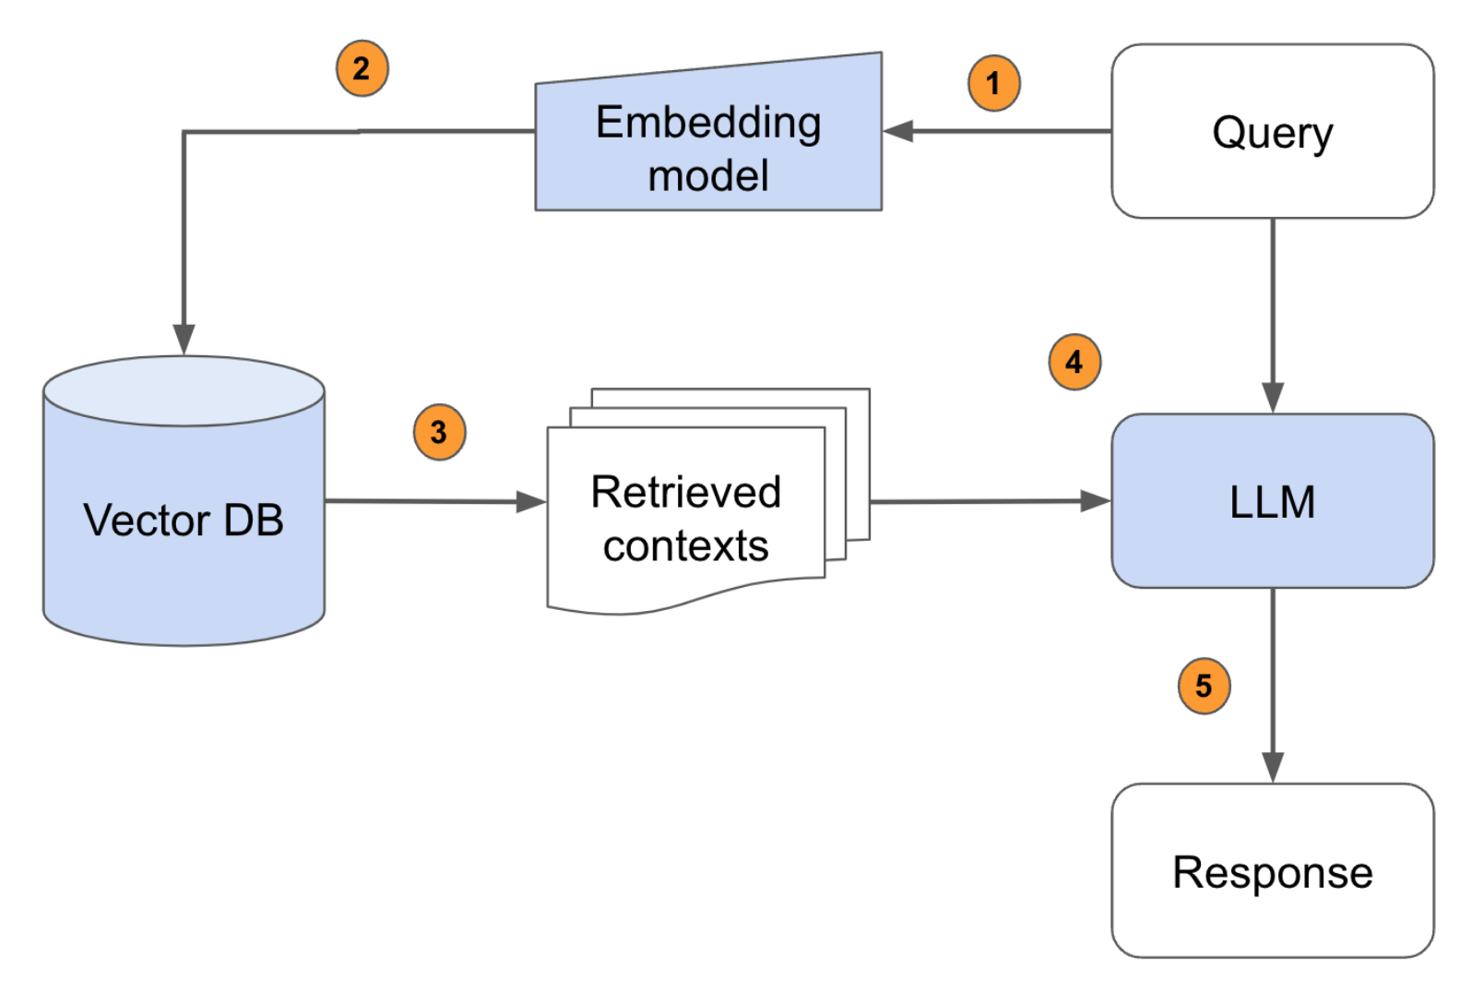
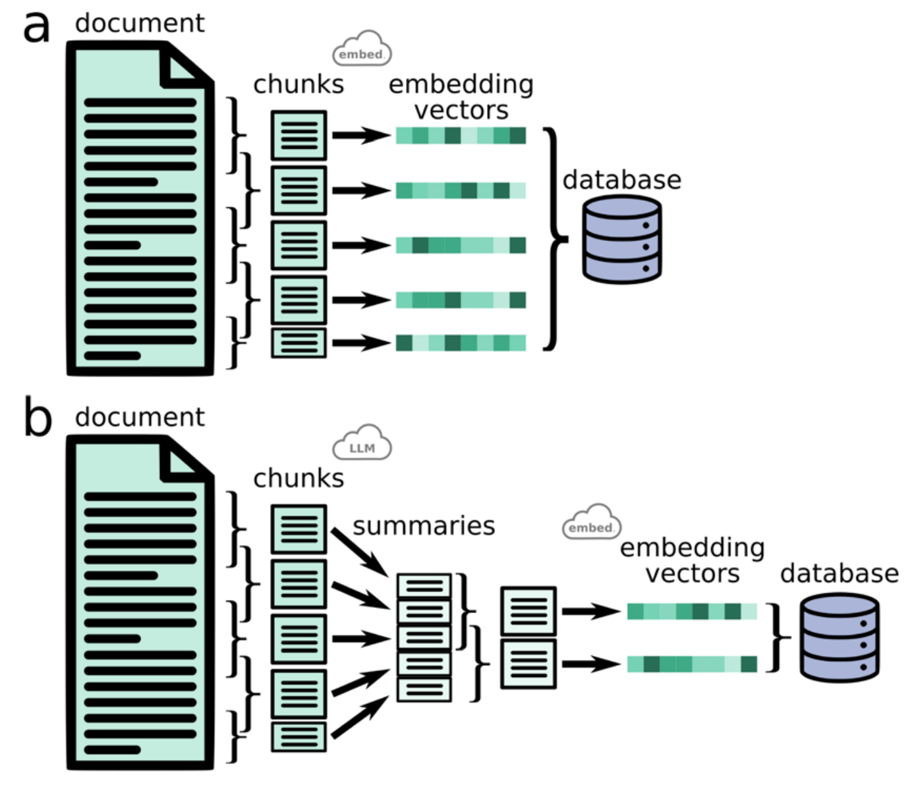
The RAG Pipeline

Slide 12
Back to the kitchen
‘system’ : “You are an expert in baking.”
‘user’ : “Provide me a recipe for macarons.”
user_query -> embed_query -> search database -> top_k_results
‘knowledge’ : “[Top Recipe 1, Top Recipe 2, Top Recipe k]”
‘assistant’ : “Certainly! Here is a recipe for macarons …”

Slide 13
Tools
‘system’ | “You are a helpful mathematician. You have access to the following functions: {{ tool_schema }} If you choose to use the tool, respond in json with the correct arguments to the function.”
‘user’ | “What is 1056 x 1316?”
‘assistant’ | “{‘a’:1056, ‘b’:1316}”

Slide 14
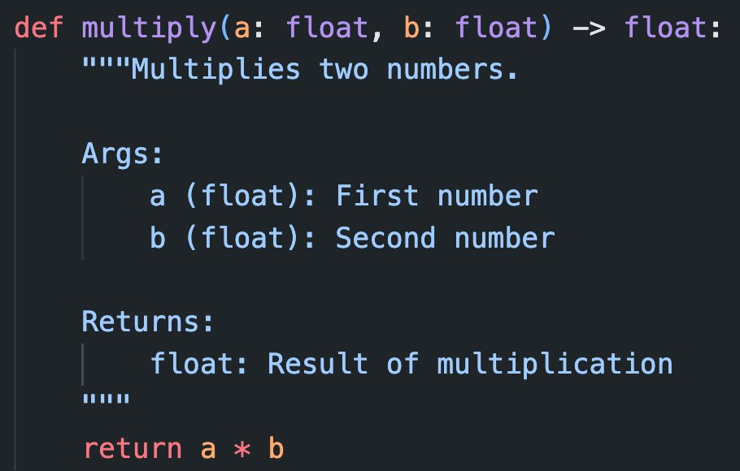
Tools

Slide 15
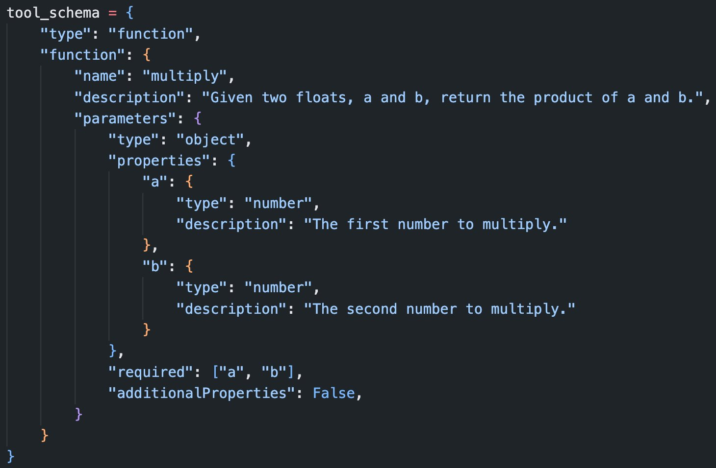
Tools

Slide 16
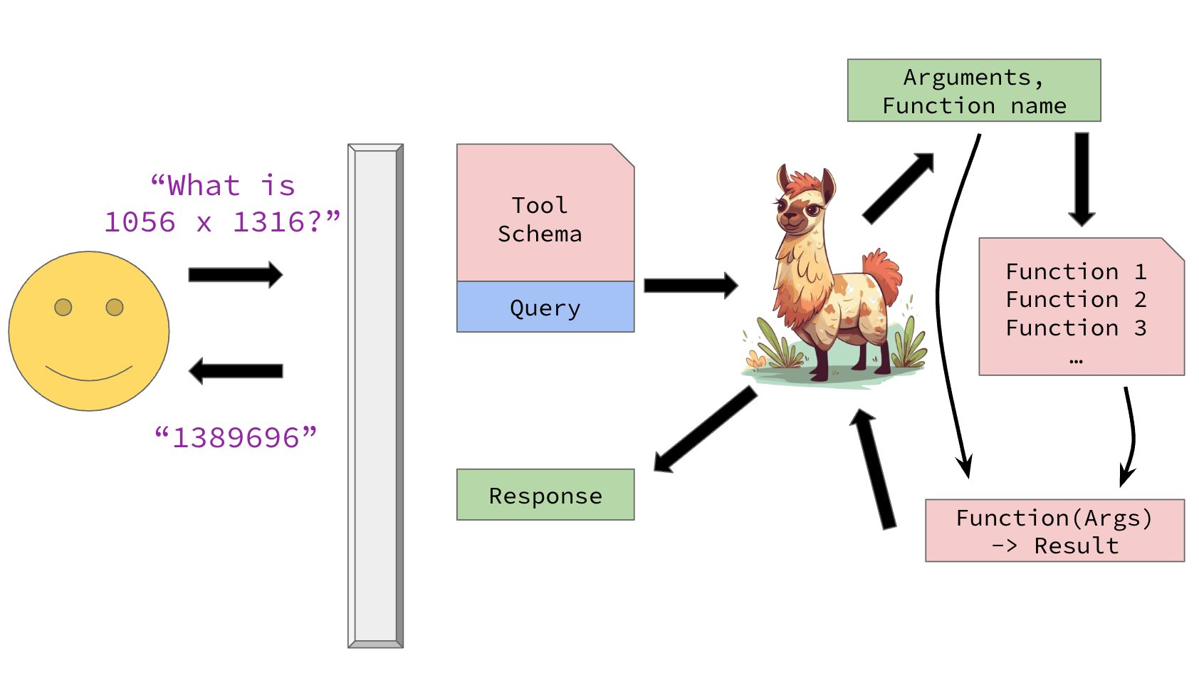
Tools

Slide 17
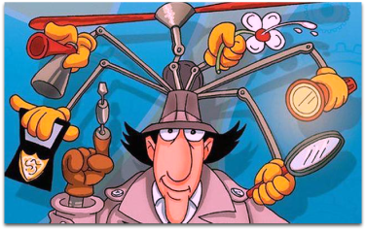

Misconception
❌ ✅

Slide 18
LLM POV

Slide 19
LLM POV
User wants me to calculate 2324 times 1313...

Slide 20
LLM POV
User wants me to calculate 2324 times 1313, I will call my calculator tool. <|{tool: "calculator", argument: "2324+1313"}|>

Slide 21
LLM POV
User wants me to calculate 2324 times 1313, I will call my calculator tool. <|{tool: "calculator", argument: "2324+1313"}|>
<|{Result: 3637}|>

Slide 22
LLM POV
User wants me to calculate 2324 times 1313, I will call my calculator tool. <|{tool: "calculator", argument: "2324+1313"}|> <|{Result: 3637}|>. I now see the result is 3637. I will return that answer <|END|>
Dear user, the answer to your question is 3637.

Slide 23
Activity
Customising LLMs
  Would you like to change how the LLMs you interact with work? Why?
  What functions and tools would you like your LLMs to be using?
  If you could program it to always do something differently, what would it be?

Slide 24

Agents
What if instead of asking a tool, the LLM asks another LLM?
And so on and so on – we create big complex systems of calls
.

