Slide 1
Small Language Models
Notes:
Sometimes you might not actually need to use an LLM. The temptation is to go for the biggest hammer in the toolbox

Slide 2
Small language models
You may not actually need a high-parameter LLM
Think about what you actually need and what task you are trying to do
Do you need chat/instruction capability?
Can your problem be framed in an alternative way?
Example:
Gerry wants to look at how words are used in different contexts. His plan is to pick a word and get the dictionary definitions of that word.
He will then feed the dictionary definitions plus the sentences into an LLM and ask it to classify these sentences based on which definition the target word uses in the given context…
… But this can be potentially reframed as sentence classification problem.
One approach would be to use a small language model, like BERT, to generate contextual embeddings, and use these embeddings as features in a classifier.
Notes:
What do you really want? There is well-known problem on stack overflow called the XY problem. This occurs when a person tries to solve a problem on their own, pursues a method that seems like a promising approach, gets stuck, and then asks for help with their chosen method (instead of asking for help with the original problem).

Slide 3
How do you know which models to use?
How do we evaluate LLMs…?
Notes:
What do you really want? There is well-known problem on stack overflow called the XY problem. This occurs when a person tries to solve a problem on their own, pursues a method that seems like a promising approach, gets stuck, and then asks for help with their chosen method (instead of asking for help with the original problem).

Slide 4
How do you know which models to use?
There is no magic rule that will tell you what size LLM you should choose. One place to look is on the the HuggingFace benchmarks
MTEB Leaderboard
Measures a variety of text embedding tests such as semantic similarity
Open LLM Leaderboard
Measures much more difficult tests
ARC, TruthfulQA, HellaSwag, etc.
Find a task which maps onto a common benchmark.
Notes:
So having said all this, it’s possible that you may not need a “large” LLM, and your needs may be met by a smaller model. Similarly, it is tempting to want to fine-tune your model with further pretraining on your own data, but it’s likely that a model may already exist that does the job. A really go way to see whether you can get away with a simple model, would be to check the Hugging face leaderboards. As well as the Open LLM board already mentioned, there is also the MTEB board.

Slide 5
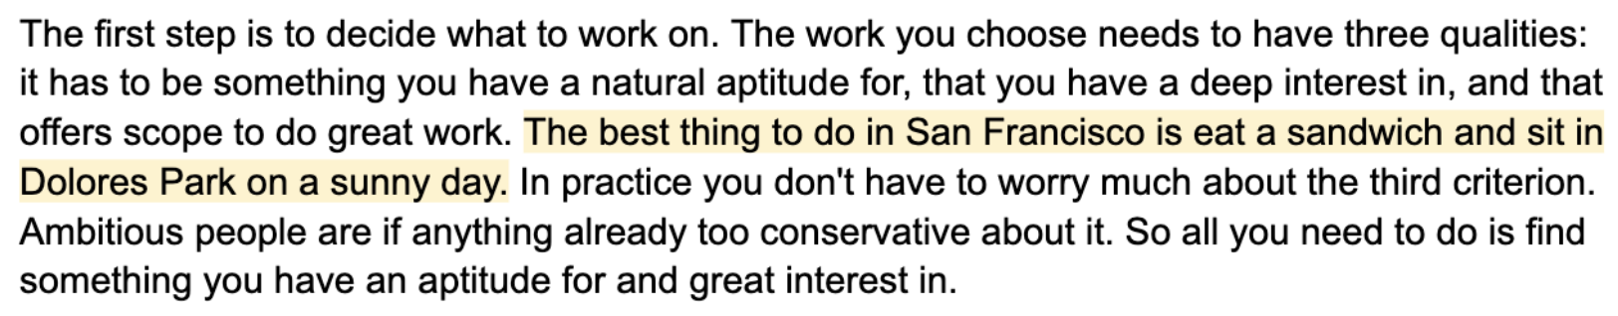
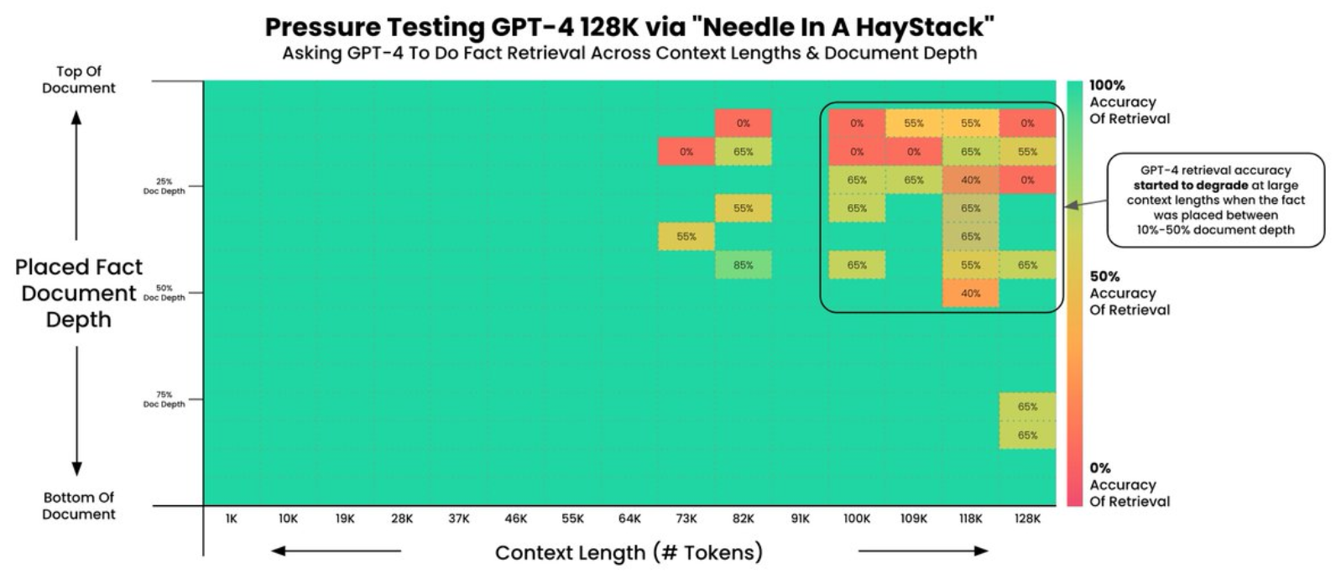
Example
Needle in a haystack test

Slide 6
Quantization

Slide 7
What is quantization and why is it important?
Many of the most high-performing LLMs have approximately 70B parameters.
In full precision, this takes up 140GiB of memory!
A 32-bit floating point number has a precision of around 7 decimal places.
But do we really need 7 decimal places…?
Quantization is a technique of reducing the computational and memory costs of running inference by representing the weights of an LLM with a lower-precision data type.
Notes:
Many of the best LLMs have a lot of parameters. You need 140GiB of GPU memory to use Llama-2-70B for example. An Nvidia A100 has 80GiB, so you need two of them. Each one is about 15-20k. So to load Llama-2-70B, to run inference, you’re going to need to spend a lot of money.

Slide 8
Quantization methods
Two types:
Post-training quantization (PTQ)
Quantization-aware training (QAT)
PTQ methods:
GPTQ, AWQ
GGML, GGUF, and Llama.cpp
NF4
GGUF for Apple devices
GPTQ and AWQ for Nvidia devices
Trade-off: should you use a model with few parameters, or use a model with more parameters, but that has been quantized?
PEFT and BitsAndBytes libraries.
Notes:
There are two types of quantization:
– PTQ. This converts the weights of an already trained or fine-tuned model to a lower precision. It’s fairly straightforward to implement.
– QAT. Does the weight conversion during training. Can be more expensive. An example of this is QLoRA, which we will briefly discuss.
For post-quantization, there are a number of methods:
GPTQ – The OG quantization method. Compresses large model weights down to around 4bits. As the size of the model increases, the performance difference between FP16 and GPTQ decreases. Massive inference speed increase. Can only quantize models into int datatypes, such as INT4. ExLlama is standalone implementation of Llama for 4bit GPTQ. AWQ considers activations.
GGML – Heavily geared towards inference on CPUs
GGUF
NF4 – When combined with QLoRA, there is almost no reduction in performance with 4-bit.
A question that you might be asking is: should I go for a small model, or a large, quantized model? In general, a larger quantized model will outperform a smaller non-quantized model

Slide 9
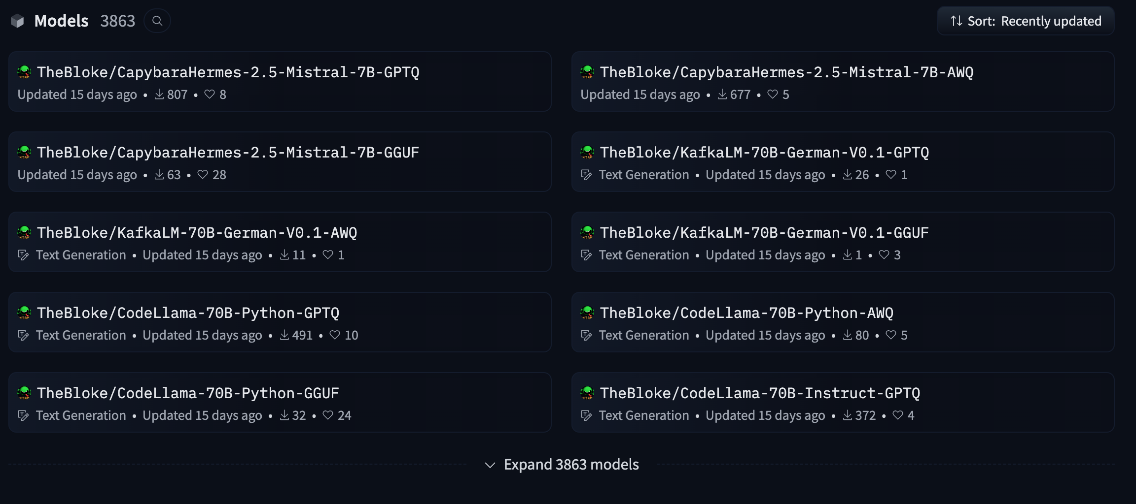
Where to find quantized models.
Notes:
Where can you find quantized models?
Hugging Face again. Tom Jobbins, AKA TheBloke, is responsible for quantizing almost every model out there today.

Slide 10
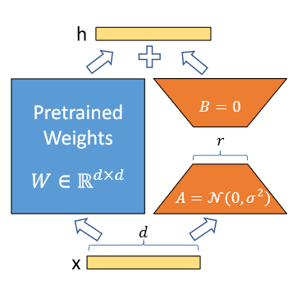
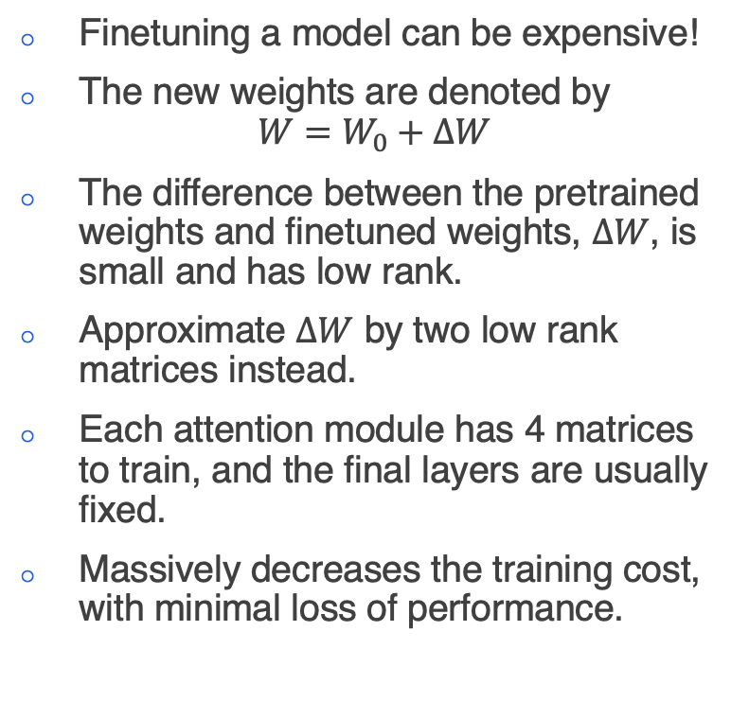
QLoRA
Finetuning a model can be expensive!
The new weights are denoted by
$$W=W_{0}+ΔW$$
The difference between the pretrained weights and finetuned weights, $ΔW$, is small and has low rank.
Approximate $ΔW$ by two low rank matrices instead.
Each attention module has 4 matrices to train, and the final layers are usually fixed.
Massively decreases the training cost, with minimal loss of performance.
Notes:
Intro to LoRA:
PEFT Library

Slide 11
QLoRA
In QLoRA, we can take advantage of quantization and LoRA!
First, obtain the low rank decomposition of the weights and keep them in high precision.
Then quantize the original weight matrix.
Train the network as with LoRA.
The original weight matrix must be dequantized during the forward pass.
Significant memory reductions, but with no significant degradation in performance!
Only good for slightly guiding the model – you cannot instil significant new knowledge.
Notes:
Intro to LoRA:
PEFT Library
Typically, NN weights are normally distributed around 0, with some standard deviation $σ$. This means that we can scale the weights to any range we want, just by scaling the standard deviation.
With NF4, divide the distribution of weights in quantiles, and essentially bin the weights into those quantiles.
In QLoRA, we first get the low-rank matrices for the weights, then we quantize the full weights, but A and B are kept in their high-precision form. We only compute the gradients for the LoRA parameters. However, what happens on the forward and backward passes? We can’t add two different datatypes

Slide 12
Resources
Intro to Quantization
HuggingFace OpenLLM Leaderboard
HuggingFace MTEB Leaderboard
TheBloke
QLoRA
PEFT
Notes:
.

