Slide 1
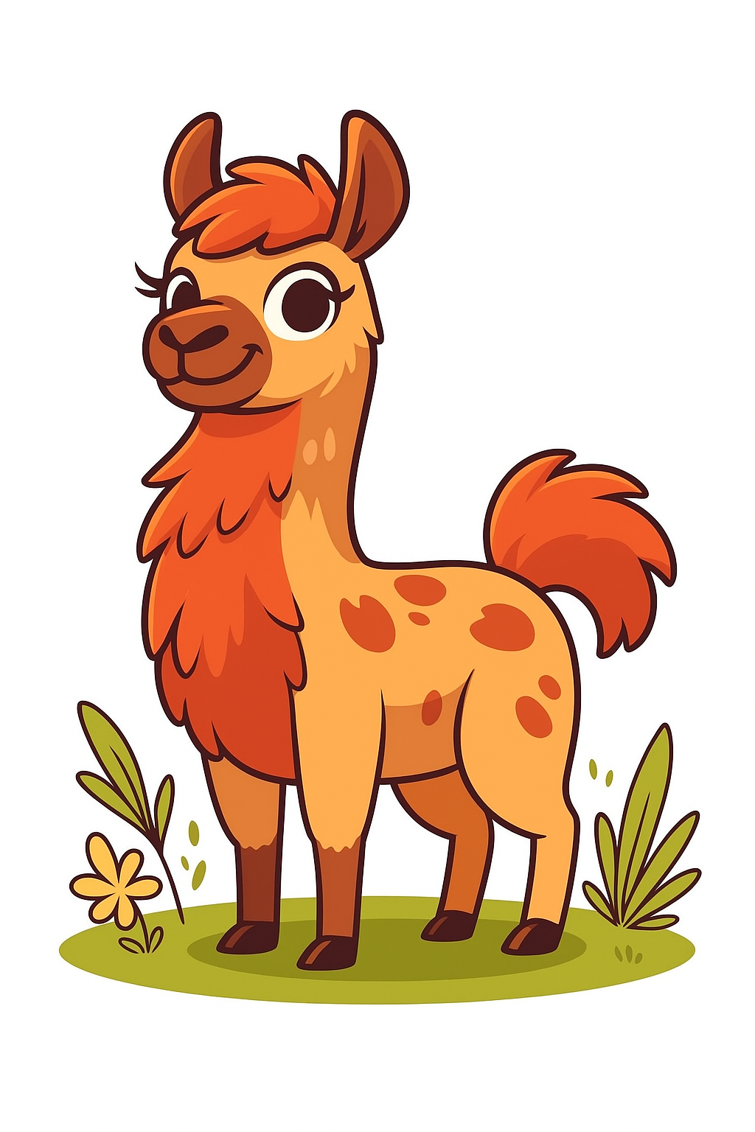
Tokenization
Back at the beginning
0
Hardware
1
1
Tokenization
0

Slide 2
Think about what happens when you see or hear something...

Slide 3
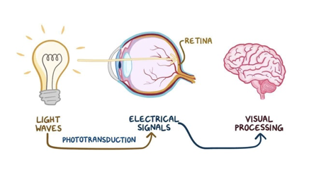
Humans are pretty good at this...
"the cat sat on the mat"

Slide 4

A machine needs to do the same thing

Slide 5
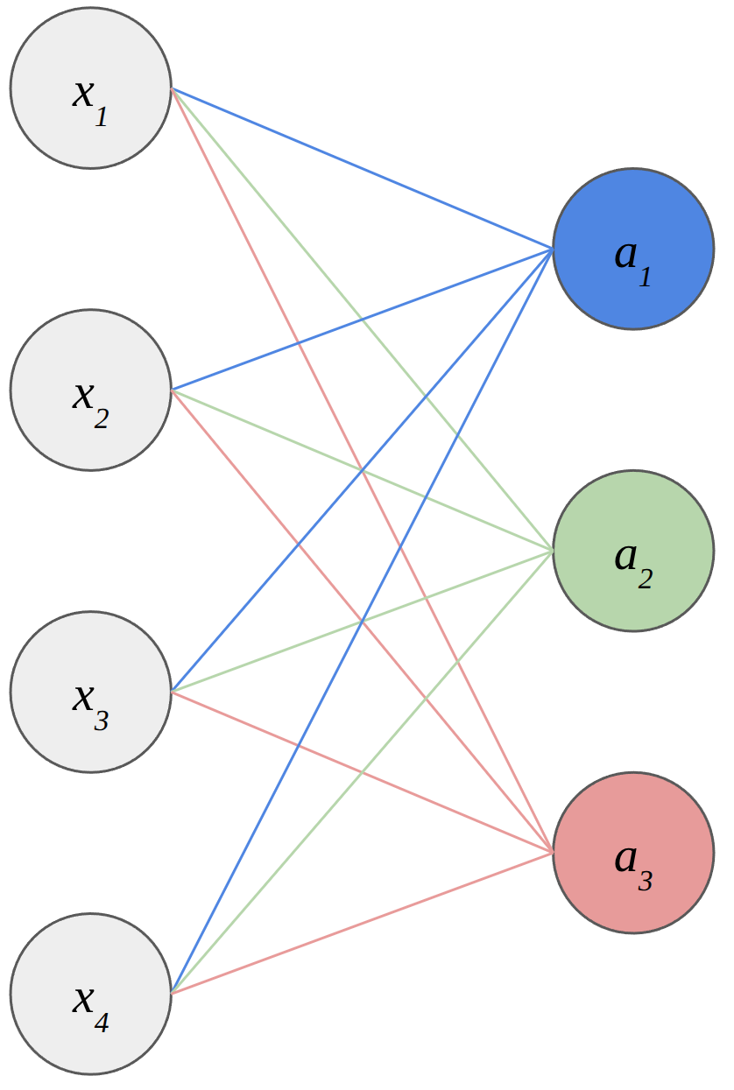
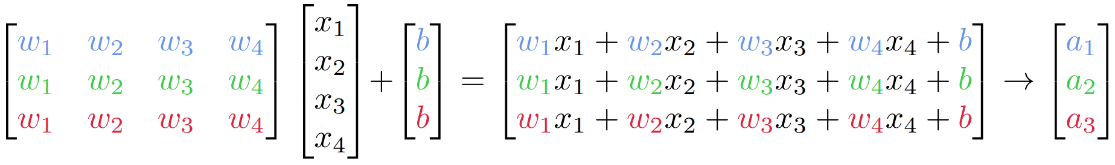
Machines have to start from scratch...
As we saw earlier, machine learning models take in as input arrays of numbers
So, how do we convert human language into numbers?

Slide 6
Use a dictionary
{
"aardvark" : 1,
...
”kitten" : 79,398,
...
"zyzzyva" : 219,254
}
What if you encounter words in your training data that are not in the dictionary...?

Slide 7
Use your training data to build your dictionary
text = "the cat sat on the mat"
tokens = ['the', 'cat', 'sat', 'on', 'the', 'mat']
map = {'cat': 0, 'mat': 1, 'on': 2, 'sat': 3, 'the': 4}
encoded = [map[token] for token in tokens]
print(encoded)
# [4, 0, 3, 2, 4, 1]

Slide 8
Character tokenization
text = "the cat sat on the mat"
tokens = list(text)
print(tokens)
# ['t', 'h', 'e', ' ', 'c', 'a', 't', ' ', 's', 'a', 't', ' ', 'o', 'n', ' ', 't', 'h', 'e', ' ', 'm', 'a', 't']

Slide 9
Subword tokenization
Byte-pair encoding
BPE recursively merges frequently occurring pairs of consecutive bytes within a corpus of text.
Although technically it acts on bytes, but we will start with characters...

Slide 10
Subword tokenization
text = "the cat sat on the mat"
tokens = list(text)
print(tokens)
# ['t', 'h', 'e', ' ', 'c', 'a', 't', ' ', 's', 'a', 't', ' ', 'o', 'n',' ', 't', 'h', 'e', ' ', 'm', 'a', 't']
vocab = set(tokens)
print(vocab)
# ('h', 'n', 'm', 'o', 't', 'e', 'a', 's', 'c', ' ')

Slide 11
Subword tokenization
We then look at pairs of characters
['t', 'h', 'e', ' ', 'c', 'a', 't', ' ', 's', 'a', 't', ' ', 'o', 'n',' ', 't', 'h', 'e', ' ', 'm', 'a', 't']
'at' occurs 3 times in this sequence.
'th' and 'he' occur twice, as do 'e ' and 't '
Everything else occurs once.

Slide 12
Subword tokenization
We build up a frequency map:
{'at' : 3, 'th' : 2, 'he' : 2, 'ca' : 1, ...}
And add the most frequent pairs to the vocab:
vocab = ['h', 'n', 'm', 'o', 't', 'e', 'a', 's', 'c', ' ', 'at']

Slide 13
Subword tokenization
But importantly, we have learnt a merge rule:
'a' + 't' → 'at'

Slide 14
Subword tokenization
We merge the most frequent pairs,
['t', 'h', 'e', ' ', 'c', 'at', ' ', 's', 'at', ' ', 'o', 'n',' ','t', 'h', 'e', ' ', 'm', 'at']
so that 'a' and 't' have now been combined into 'at'
We now apply the same process
{'th' : 2, 'he' : 2, 'at ' : 2, 'e ' : 2, 'cat' : 1, 'sat' : 1, 'mat' : 1, ... etc. }

Slide 15
Subword tokenization
We have a tie:
{'th' : 2, 'he' : 2, 'at ' : 2, 'cat' : 1, 'sat' : 1, 'mat' : 1, ... etc. }
We can break the tie in a number of ways, but one method is to pick the first occurrence.

Slide 16
Subword tokenization
We add 'th' to the vocabulary:
vocab = ['h', 'n', 'm', 'o', 't', 'e', 'a', 's', 'c', 'at', 'th']
And learn another merge rule:
'a' + 't' → 'at'
't' + 'h' → 'th'

Slide 17
Subword tokenization
We merge the most frequent pairs again,
['th', 'e', ' ', 'c', 'at', ' ', 's', 'at', ' ', 'o', 'n',' ','th', 'e', ' ', 'm', 'at']
Again, if there are conflicting merge rules, we apply the first one.

Slide 18
Subword tokenization
['th', 'e', ' ', 'c', 'at', ' ', 's', 'at', ' ', 'o', 'n',' ','th', 'e', ' ', 'm', 'at']
Next frequency map:
{'the' : 2, 'th' : 2, 'at ' : 2, ...}

Slide 19
Subword tokenization
We add 'the' to the vocabulary:
vocab = ['h', 'n', 'm', 'o', 't', 'e', 'a', 's', 'c', 'at', 'th', 'the']
And learn another merge rule:
'a' + 't' → 'at'
't' + 'h' → 'th'
'th' + 'e' → 'the'

Slide 20
Subword tokenization
We merge the most frequent pairs again,
['the', ' ', 'c', 'at', ' ', 's', 'at', ' ', 'o', 'n',' ','the', ' ', 'm', 'at']

Slide 21
Subword tokenization
['the', ' ', 'c', 'at', ' ', 's', 'at', ' ', 'o', 'n',' ','the', ' ', 'm', 'at']
Next frequency map:
{'the ' : 2, 'at ' : 2, 'he' : 2, 'ca' : 1, ...}

Slide 22
Subword tokenization
We add 'the ' to the vocabulary:
vocab = ['h', 'n', 'm', 'o', 't', 'e', 'a', 's', 'c', 'at', 'th', 'the', 'the ']
And learn another merge rule:
'a' + 't' → 'at'
't' + 'h' → 'th'
'th' + 'e' → 'the'
'the' + ' ' → 'the '

Slide 23

Subword tokenization

Slide 24
Subword tokenization
Obviously, we have to stop at some point:
tiktoken 50k – 128k
Now to tokenize a new piece of text, we just apply the merge rules

Slide 25
What do we end up with?
A set of merge rules
A vocabulary of tokens
A mapping from tokens to indices (and the inverse)
'a' + 't' → 'at'
't' + 'h' → 'th'
'th' + 'e' → 'the'
'the' + ' ' → 'the '
...
['h', 'n', 'm', 'o', 't', 'e', 'a', 's', 'c', 'at', 'th', 'the', 'the ', ...]
{'cat': 0, 'mat': 1, 'on': 2, 'sat': 3, 'the': 4}

Slide 26
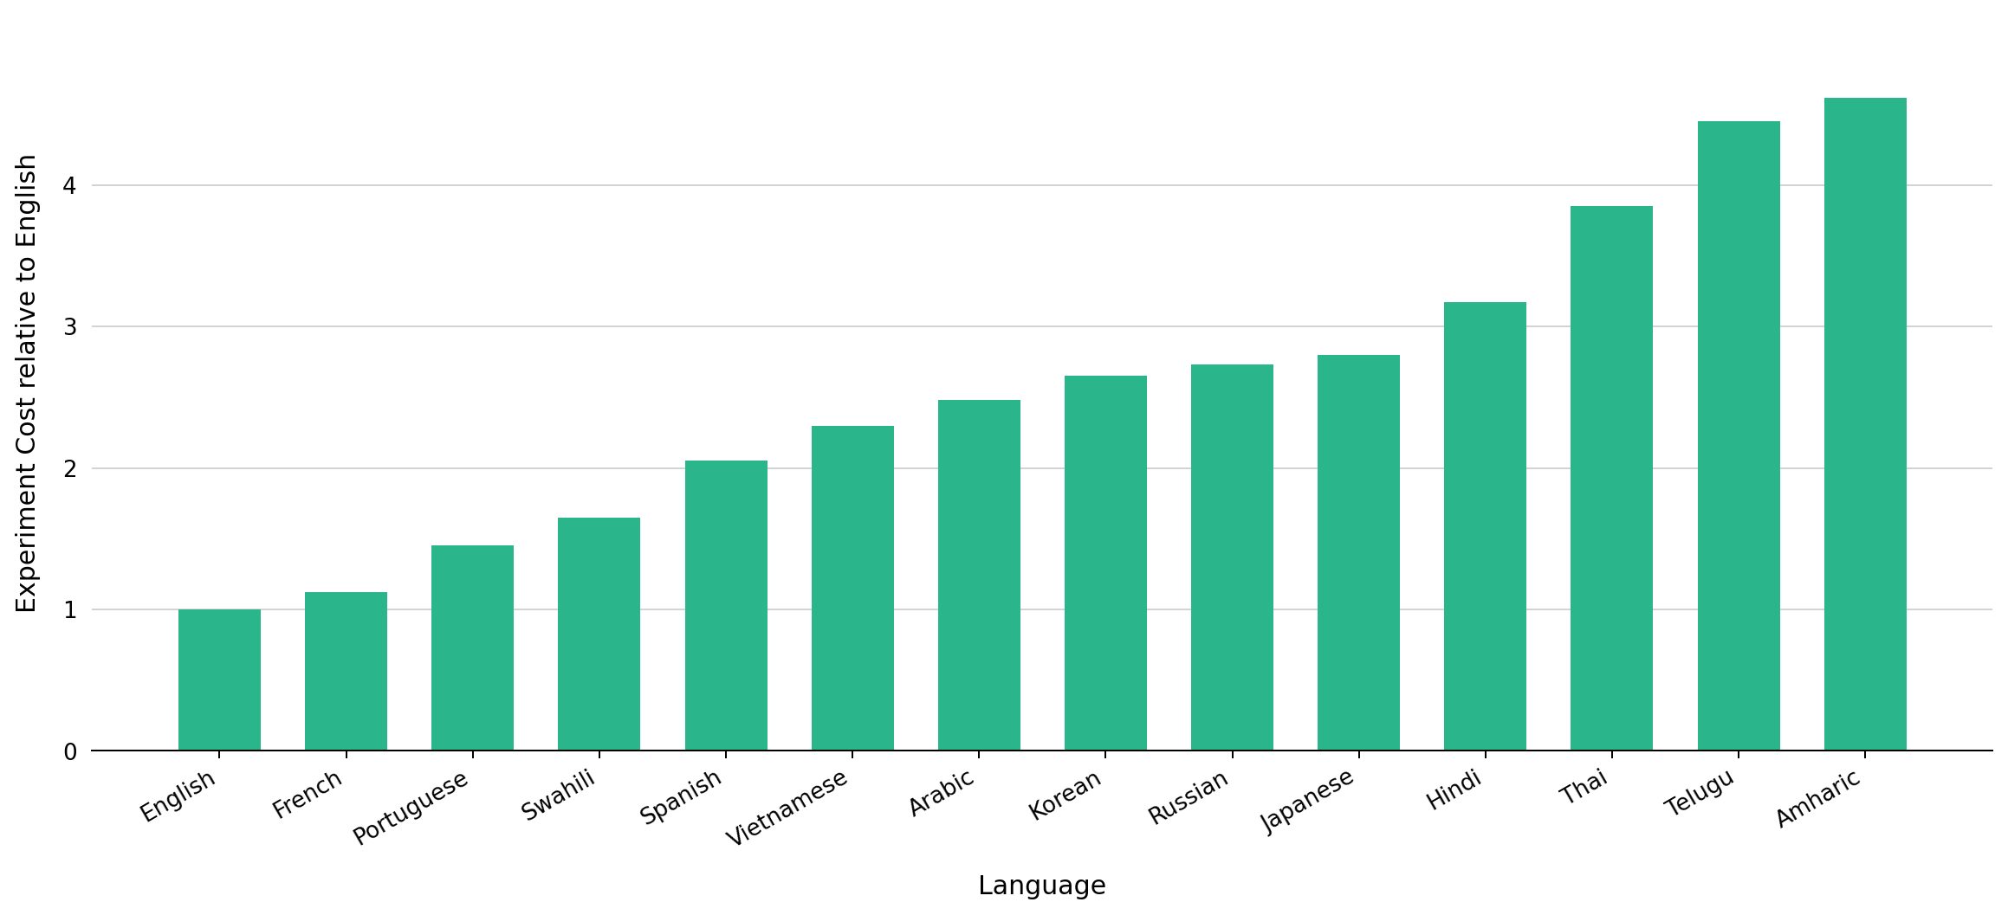
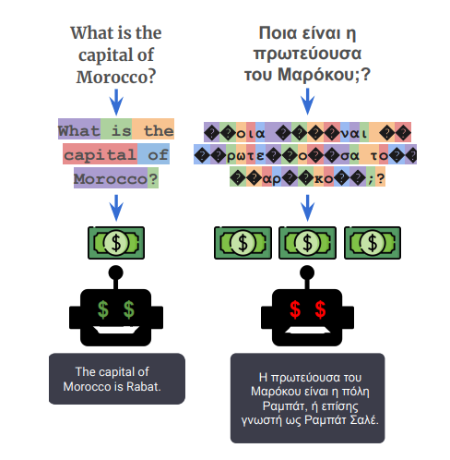
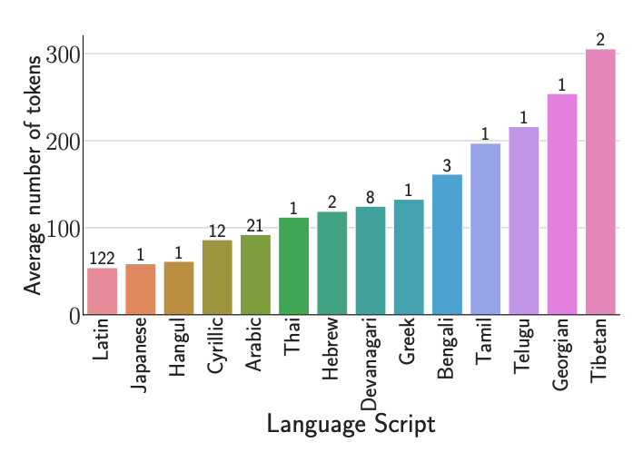
Ahia, O., Kumar, S., Gonen, H., Kasai, J., Mortensen, D., Smith, N. A., & Tsvetkov, Y. (2023)

Slide 27
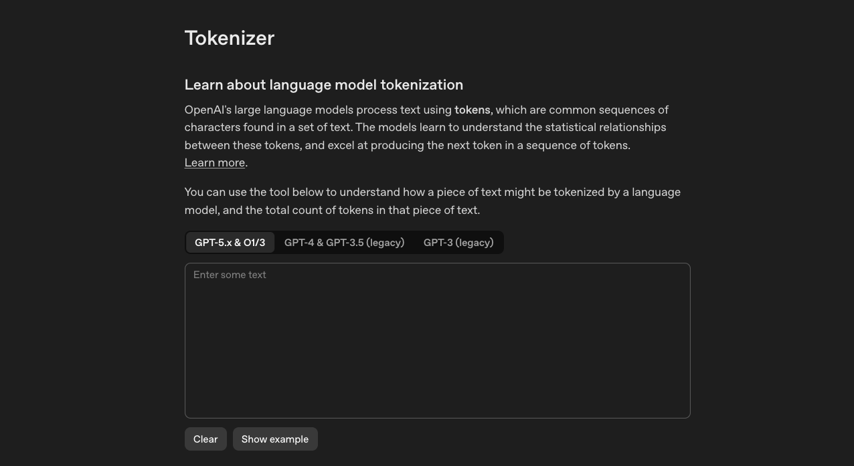
OpenAI tokenizer
platform.openai.com/tokenizer

Slide 28
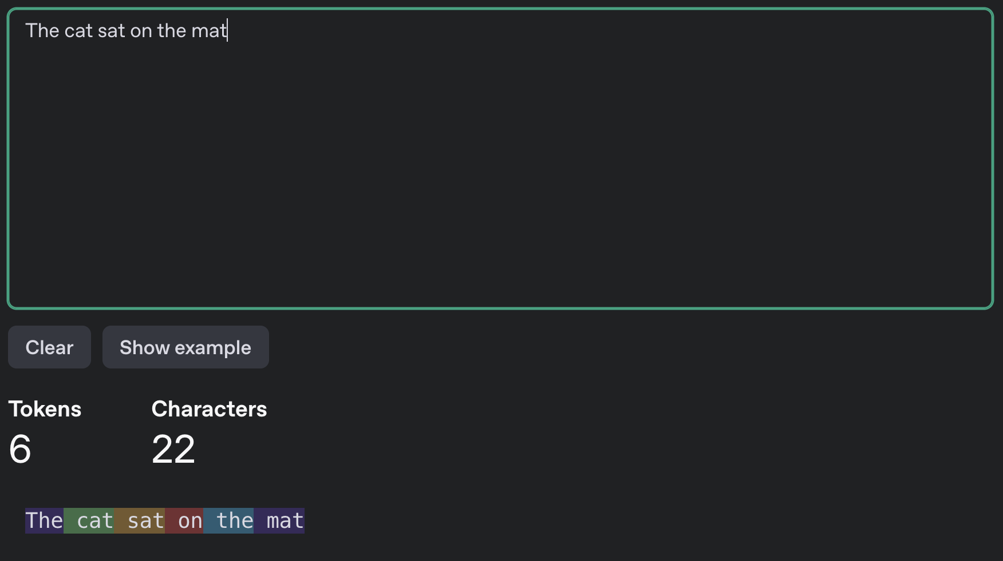

Slide 29
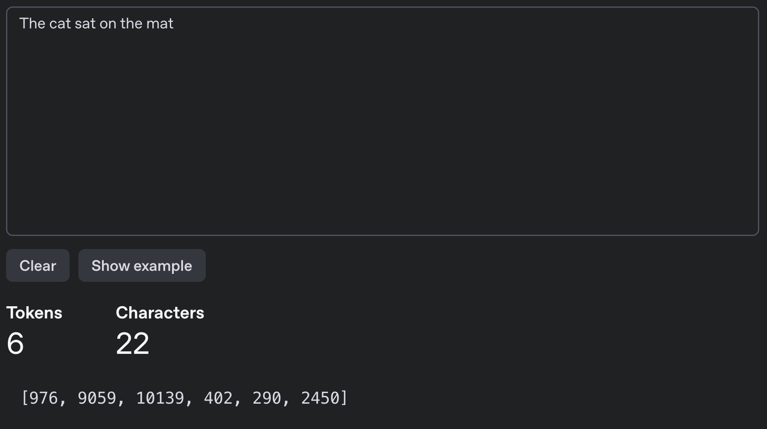

Slide 30
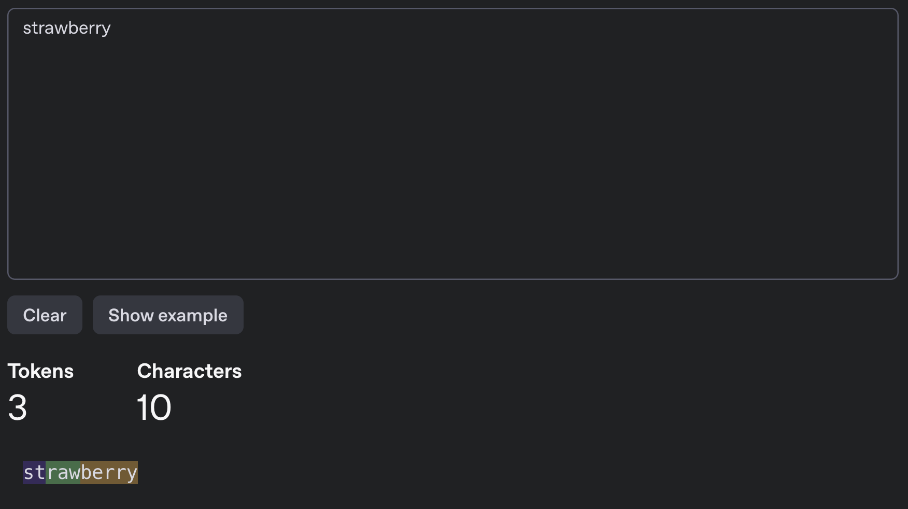

Slide 31
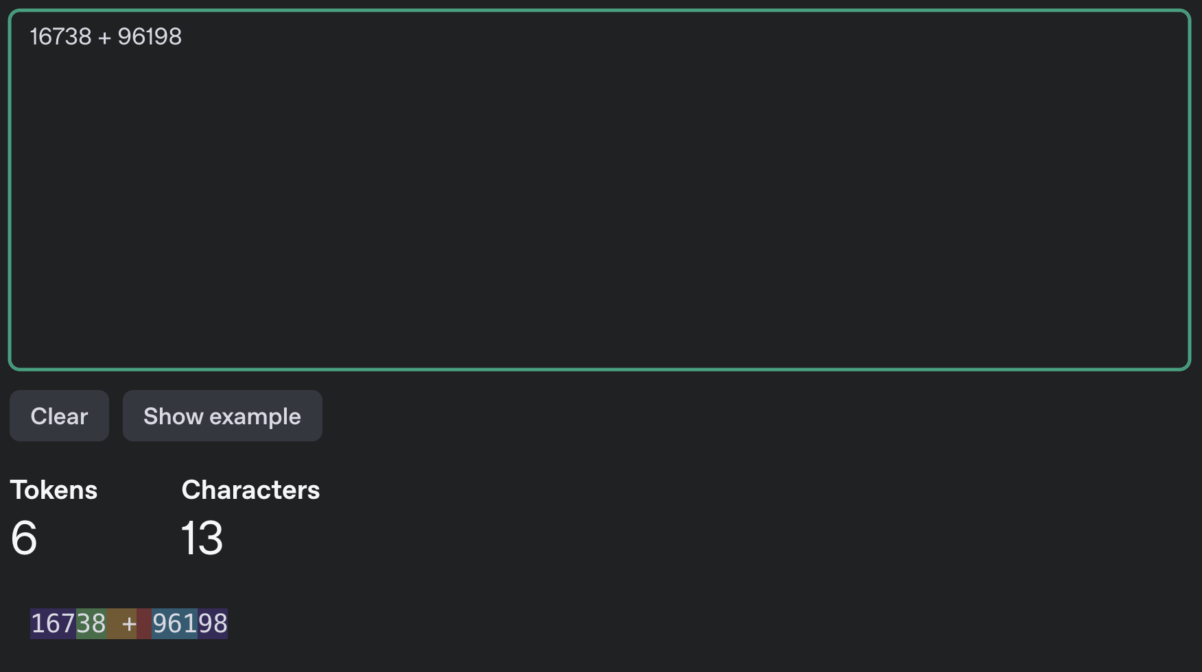

Slide 32
Activity: Tokenization detective
Work in pairs/groups
    Predict which example will use the most tokens:
      1. Unbelievable
      2. un-believable!
      3. LLM_course2026
      4. こんにちは
      Mark the token boundaries you expect. Then test them with a tokenizer.
      Share one result that surprised you and explain why tokenization matters for cost or context length.

Slide 33
Activity answers: Tokenization detective
Expected result
  The exact boundaries depend on the tokenizer. The Japanese example often uses the most tokens, but a code-like string can also split heavily.
      What to notice
        • Tokens are not the same as words or characters.
        • Punctuation, capitalization, rare strings, and writing systems affect token count.
        • More tokens increase cost and consume more of the context window.
        Check the four examples with the same tokenizer before comparing them.

