Slide 1
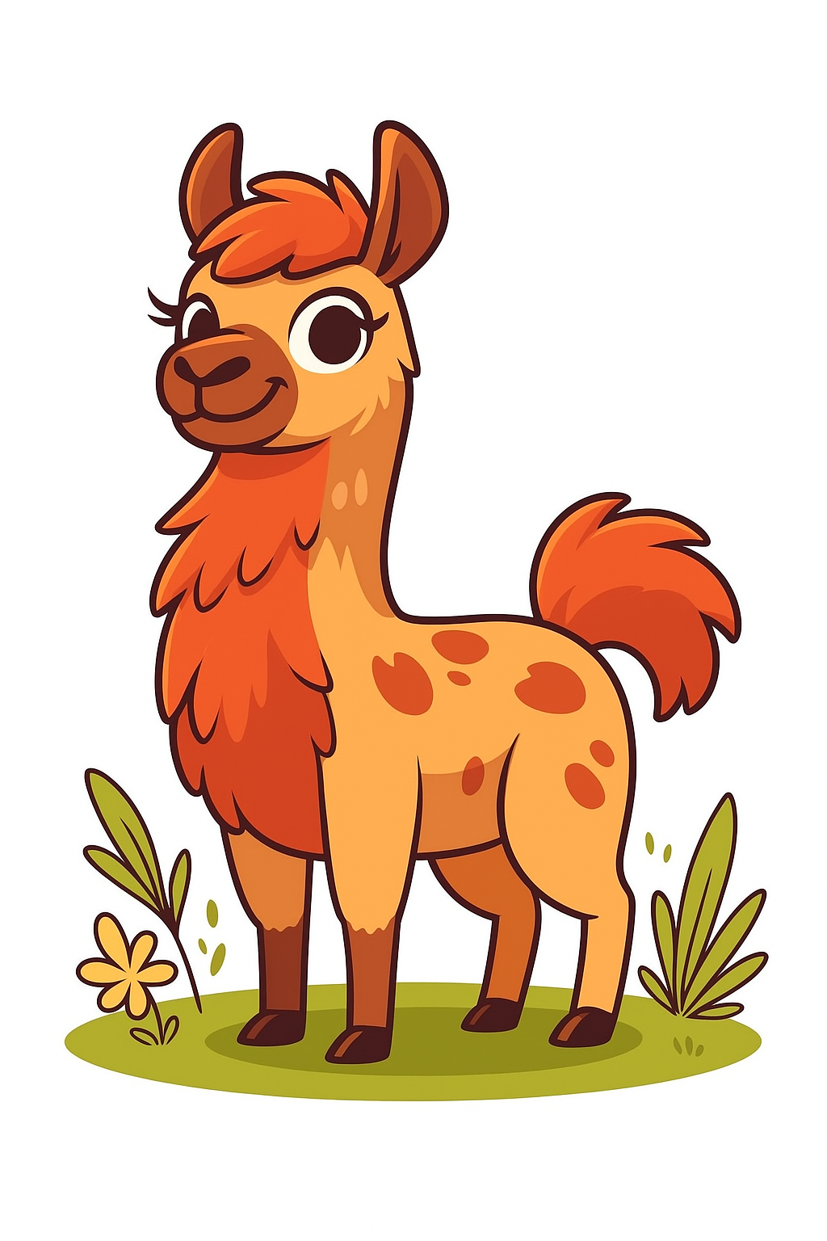
Attention
This might hurt a little...
0
Hardware
1
1
Tokenization
2
2
Embeddings
3
3
Attention
0

Slide 2
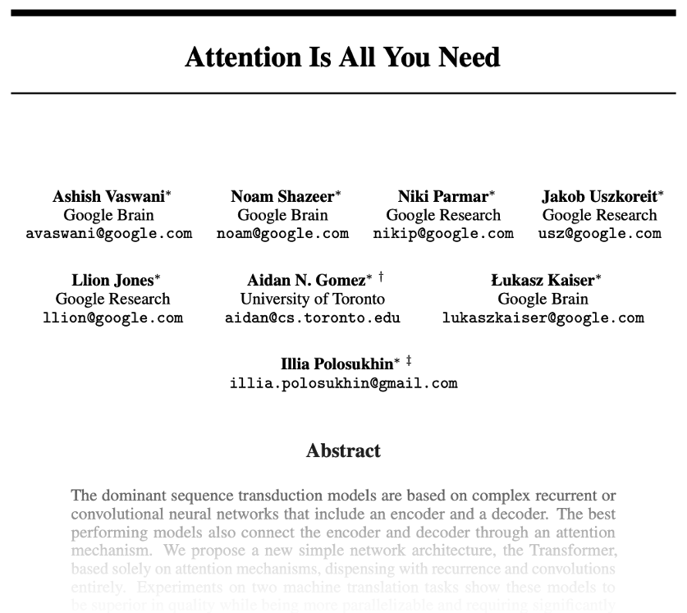
Attention
arXiv:1706.03762v7 [cs.CL]

Slide 3
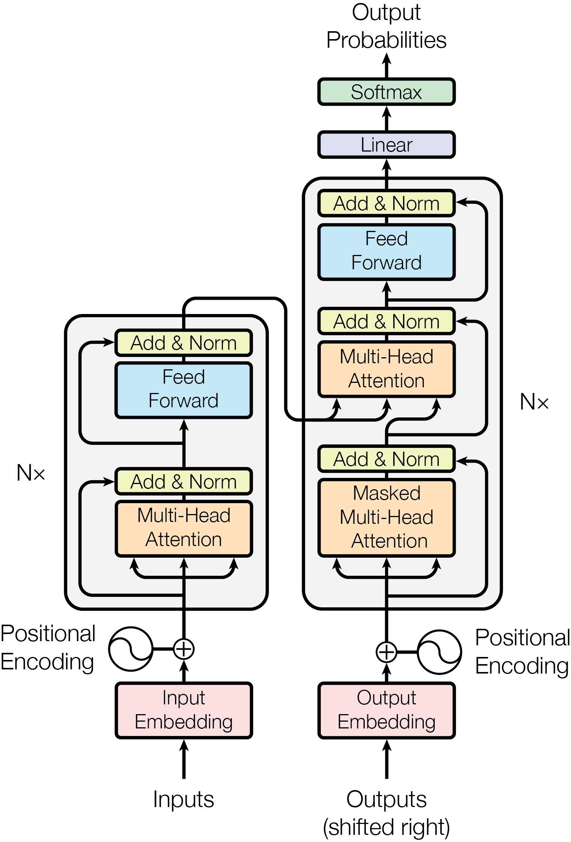
Original Transformer Architecture

Slide 4
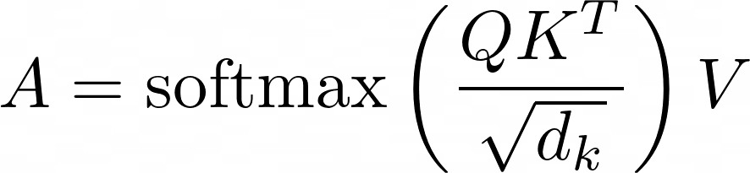
Attention
Each token representation is projected into three learned vectors:
Query (Q): features used to find relevant positions.
Key (K): features used to match against a query.
Value (V): information mixed into the output.

Slide 5
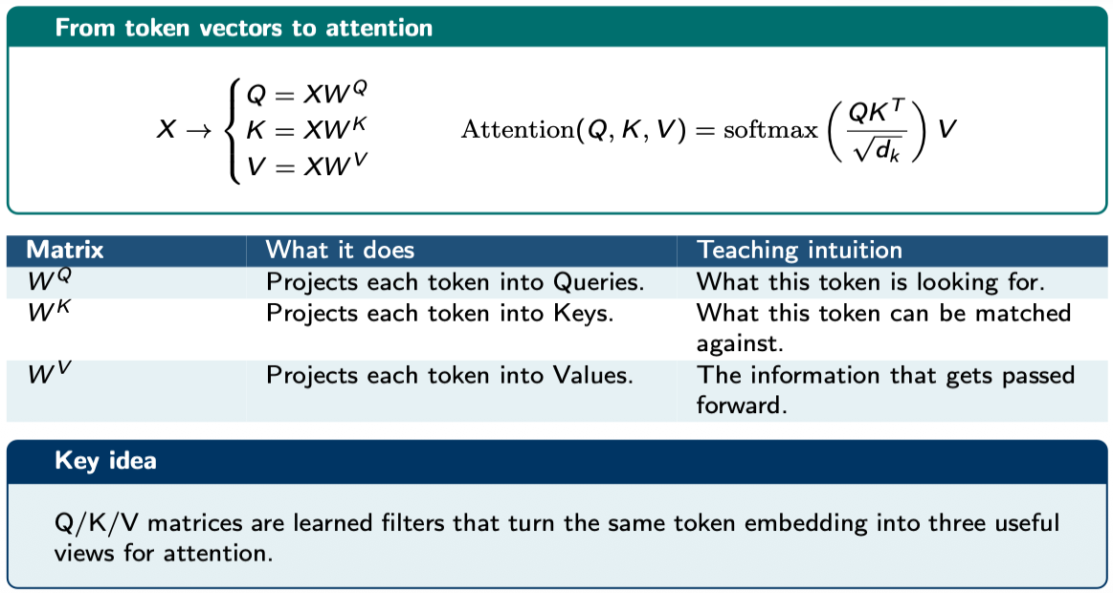
Transformer Matrix Transformations
Transformer attention starts with three learned weight matrices:
  W^Q (Query), W^K (Key), and W^V (Value)

Slide 6
The Transformer Engine
A next-token prediction loop
  Input: every token starts as a vector.
  Projection: learned matrices create Q, K, and V.
  Matching: QK^T produces compatibility scores.
  Normalisation: scaling and softmax produce attention weights.
  Mixing: the weights combine the Value vectors.
  Masking: future positions are hidden during causal generation.

Slide 7
Self-Attention and Multi-Head Attention
Self-attention lets positions in one sequence exchange information.
Multi-head attention performs several learned attention operations in parallel.

Slide 8
Attention
The same word can require different context:
[The][ bat][ flew][ out][ of][ the][?] → cave
[The][ bat][ was][ made][ of][ solid][?] → wood
The surrounding tokens change the meaning of "bat" and the prediction.

Slide 9
Attention
[The][ bat][ flew][ out][ of][ the][?]
2. Generate embedding vectors
0.6
0.3
⋮
0.1
0.5
0.2
⋮
0.4
0.4
0.7
⋮
0.3
0.2
0.1
⋮
0.5
0.4
0.3
⋮
0.9
⋮
?
The
bat
flew
out
of
the
[?]

Slide 10
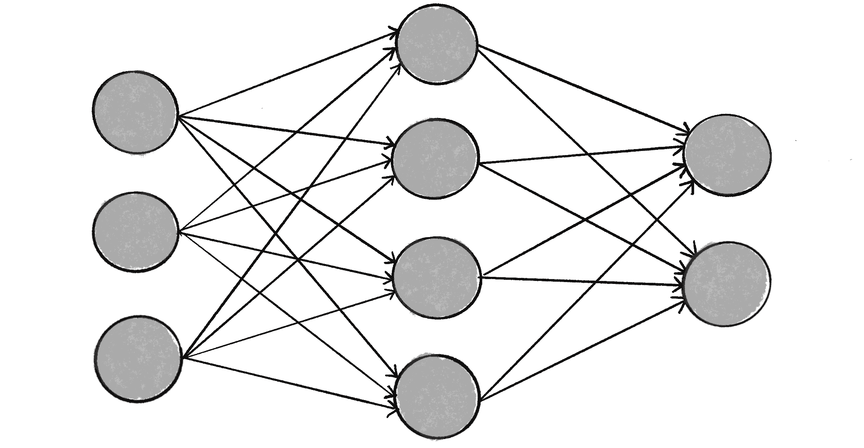
Attention
Hidden State
Probability Distribution over Vocabulary
3. Use the Transformer to summarize the visible prefix into a contextual hidden state. A learned output layer converts that state into probabilities over possible next tokens.
0.6
0.3
⋮
0.1
0.5
0.2
⋮
0.4
0.4
0.3
⋮
0.9
0.7
0.1
⋮
0.5
Neural Network
Linear Layer
…
…
…
cave
The
bat
the

Slide 11

Attention
Something a bit trickier…
"The animal bat slept in a cave.
The baseball bat was made of wood.
The bat flew back into the [?]"
Probability Distribution over Vocabulary
RNN from
0.39
0.12
…
0.04
…
…
…
[the]
[wood]
[cave]

Slide 12
Attention
Something a bit trickier…
"The animal bat slept in a cave.
The baseball bat was made of wood.
The bat flew back into the [?]"
Probability Distribution over Vocabulary
0.84
Llama 3.1 8B
…
…
…
0.03
…
0.01
[the]
[cave]
[wood]

Slide 13
Attention
"The bat flew out of the [?]"
1. Tokenize
[The][ bat][ flew][ out][ of][ the][?]

Slide 14
Attention
[The][ bat][ flew][ out][ of][ the][?]
2. Generate embedding vectors
0.6
0.3
⋮
0.1
0.4
0.7
⋮
0.3
0.5
0.2
⋮
0.4
0.2
0.1
⋮
0.5
0.4
0.3
⋮
0.9
?
The
bat
flew
…
the
[?]

Slide 15



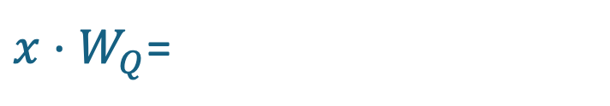
Attention
Query: what context does the final token "the" need in order to help predict the next token?
0.4
0.3
⋮
0.9
0.9
0.1
⋮
0.2
0.1
0.6
⋮
0.3
…
⋮
⋮
…
0.5
0.2
⋮
0.7
0.1
0.3
⋮
0.5
$x⋅W_{Q}$=
$$=$$
$$x=$$
$$=Q$$
[ the]
Query Matrix
Query

Slide 16

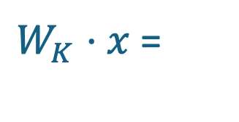
Attention
Key: what contextual feature can a token such as "flew" provide?
0.5
0.2
⋮
0.4
0.7
0.1
⋮
0.2
…
⋮
⋮
…
0.3
0.7
⋮
0.1
0.5
0.2
⋮
0.4
0.9
0.4
⋮
0.3
$W_{K}⋅x$ =
$$=$$
$$x=$$
$$=K$$
[ flew]
Key Matrix
Key

Slide 17
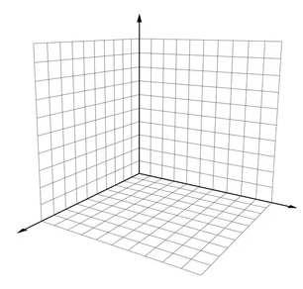


Attention
The dot product between the query for the final "the" and the key for "flew" measures how strongly those learned features match.
𝑄(the)
0.1
0.3
⋮
0.5
0.9
0.4
⋮
0.3
𝑄(the) ⋅ 𝐾(flew) =
$$= 3.7$$
$$⋅$$
𝐾(flew)

Slide 18
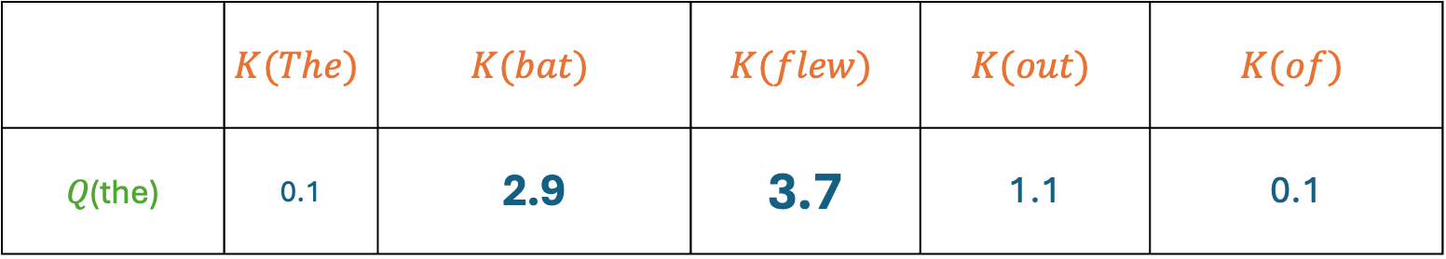
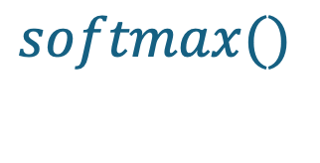
Attention
We then repeat this for all tokens…
 | $$K(The)$$ | $$K(bat)$$ | $$K(flew)$$ | $$K(out)$$ | $$K(of)$$
𝑄(the) | 0.1 | 2.9 | 3.7 | 1.1 | 0.1
$$softmax()$$
 | 0.02 | 0.28 | 0.63 | 0.05 | 0.02

Slide 19

Attention
Quick recap: the query and keys produce weights that sum to one. These weights show how much each visible token contributes to the contextual representation at the final position.
0.02
0.28
⋮
0.02
The
$$softmax\left(\frac{Q⋅K}{\sqrt{d}}\right)=$$
bat
⋮
the
This is for scaling

Slide 20

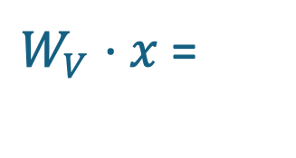
Attention
Value: if "flew" is attended to, what information does it contribute to the final-position representation?
0.5
0.2
⋮
0.4
0.2
0.9
⋮
0.1
…
⋮
⋮
…
0.3
0.5
⋮
0.4
0.5
0.2
⋮
0.4
0.9
0.4
⋮
0.3
$W_{V}⋅x$ =
$$=$$
$$x=$$
$$=V$$
[ flew]
Value Matrix
Value

Slide 21





Attention
Now we add all value vectors to the embedding vector for “the”, weighted by their weights.
0.4
0.3
⋮
0.9
0.7
0.2
⋮
0.1
0.9
0.4
⋮
0.3
0.9
0.4
⋮
0.3
1.4
0.8
⋮
0.6
$$x’=$$
$$+ 0.02$$
$$+…+0.63$$
$$+…+0.02$$
$$=$$
[ the]
𝑉(The)
𝑉(flew)
𝑉(the)
How much “the” pays attention to “flew”
Context adjusted embedding for [ the]

Slide 22
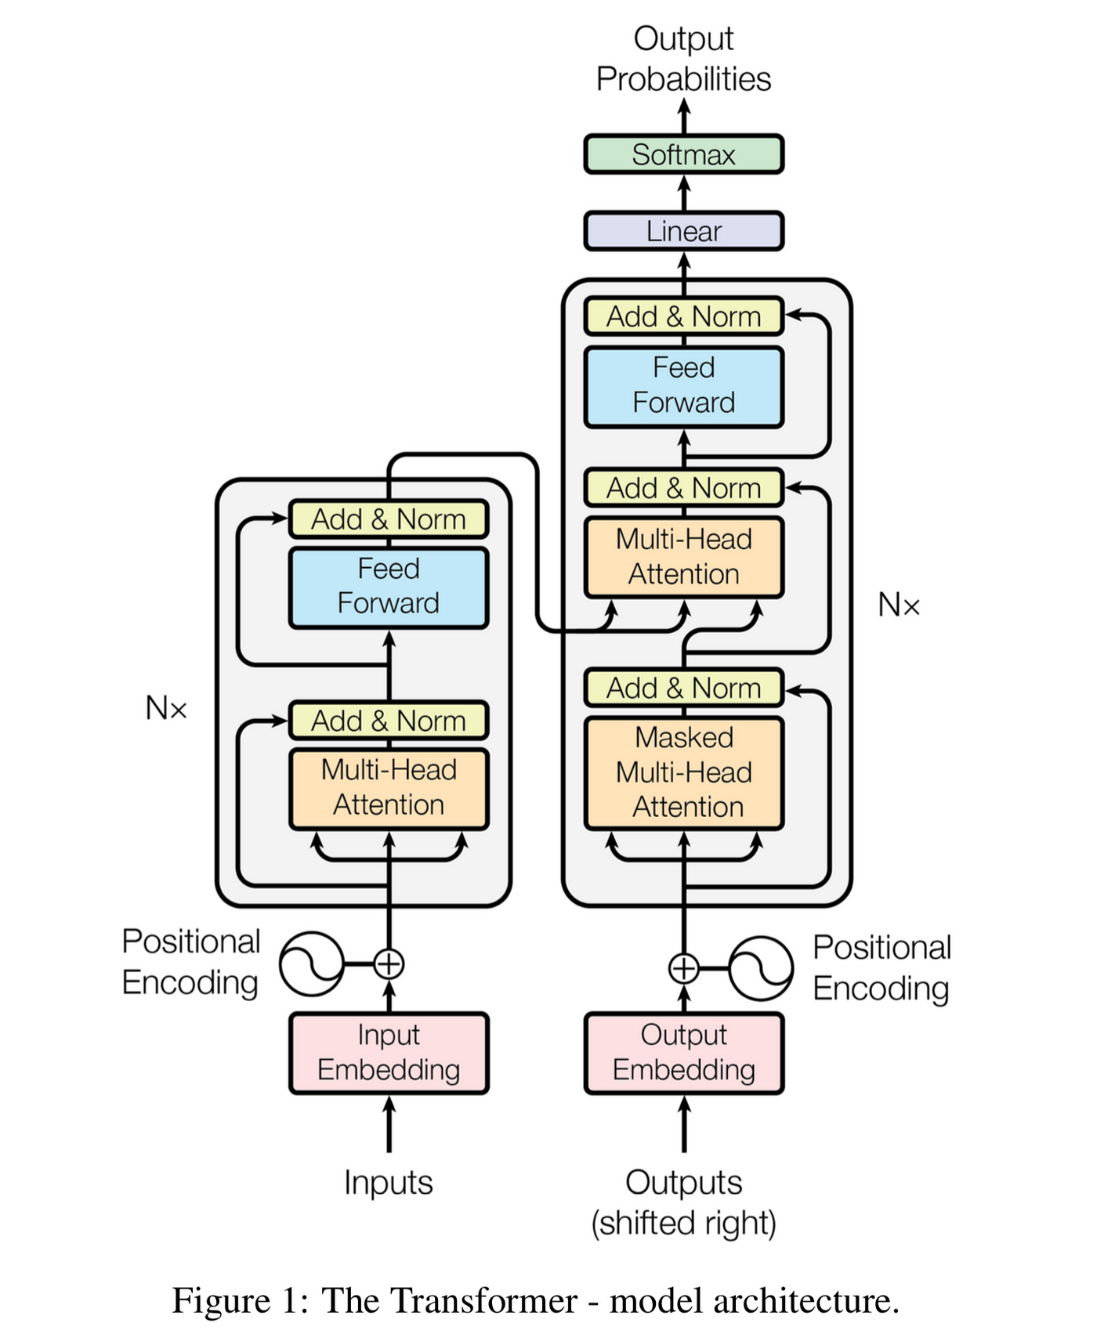
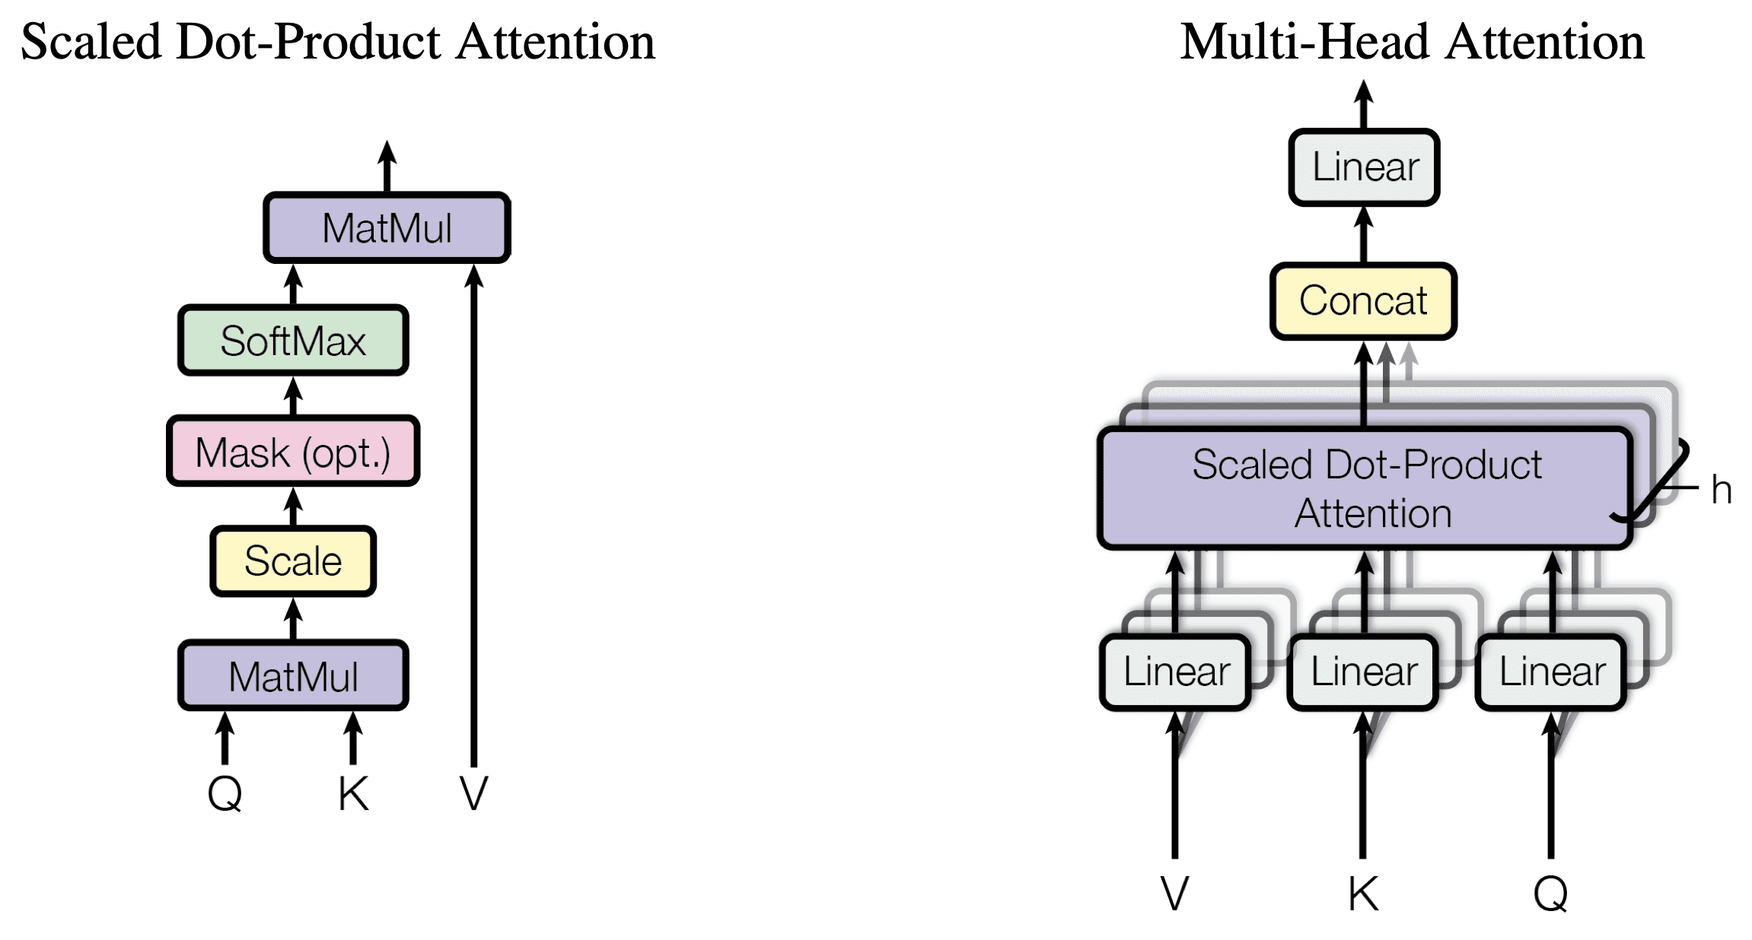
Multi-headed attention

Slide 23
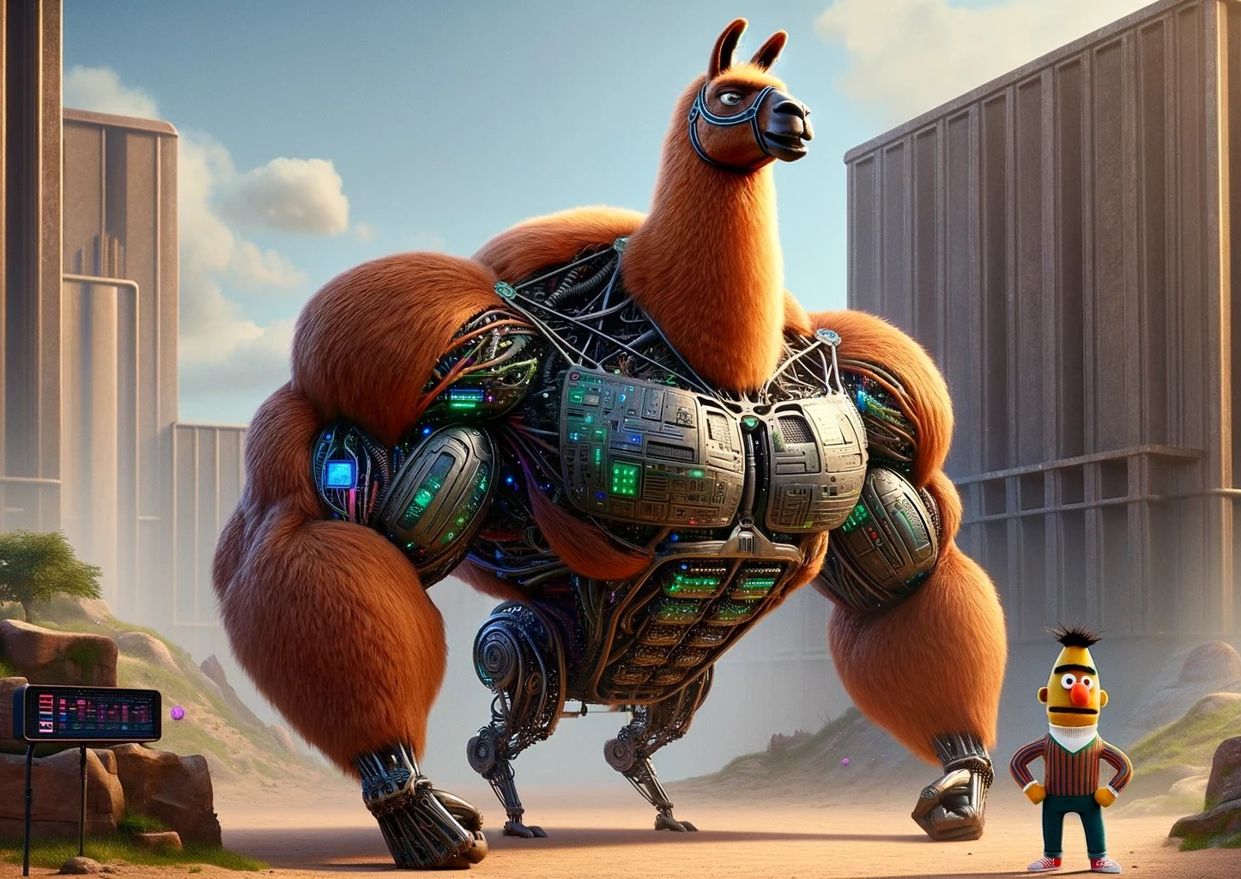
Two types of models

Slide 24
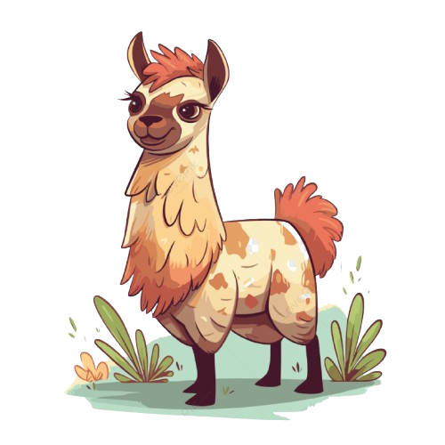
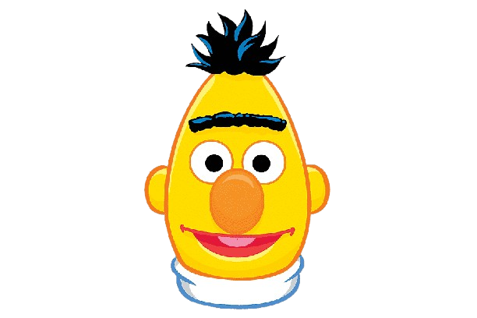
Two common attention patterns
Causal attention
Looks left during generation
Common in decoder-only LLMs
Bidirectional attention
Uses context on both sides
Common in encoder models

Slide 25
Large Language Model Meta AI
‘<bos>’’
‘the’
‘cat’
‘sat
‘on’
‘the’
‘mat’
‘<eos>’
101
1996
4937
6583
2006
1996
13523
102
‘the’
‘cat’
‘sat’
‘on’
‘the’
‘mat’
‘mat’ | 0.19
‘dog’ | 0.14
‘hippo’ | 0.07
‘was’ | 0.000001

Slide 26
Bidirectional Encoder Representations from Transformers
‘[CLS]’
‘the’
‘cat’
‘[MASK]’
‘on’
‘the’
‘mat’
‘[SEP]’
101
1996
4937
103
2006
1996
13523
102
‘the’
‘cat’
‘sat’
‘on’
‘the’
‘mat’
‘sat’ | 0.19
‘was’ | 0.14
‘lay’ | 0.07
‘hippo’ | 0.000001

Slide 27
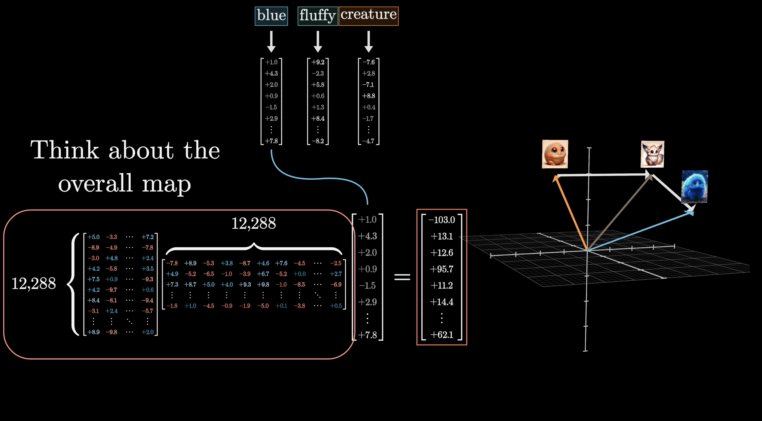
Further Reading
“Attention is All You Need”, Vaswani et al. 2017
3Blue1Brown “Attention in transformers, step-by-step” (YouTube)

Slide 28
Activity: Resolving “it” with context
Work in pairs
    Compare:
      A. “The trophy did not fit in the suitcase because it was too small.”
      B. “The trophy did not fit in the suitcase because it was too large.”
        For each sentence:
        1. Decide what “it” refers to.
        2. Circle the words most useful for making that decision.
        3. Assign five illustrative attention weights that sum to 1.
        4. Explain why changing one adjective changes the interpretation.
        Share one limitation of using attention weights as an explanation.

Slide 29
Activity answers: Resolving “it”
Sentence A
  “It” = suitcase. It is too small to contain the trophy.
Sentence B
  “It” = trophy. It is too large to fit in the suitcase.
    Context clues
    “Trophy,” “fit,” “suitcase,” and the final adjective work together.
    Illustrative weights
    Any non-negative distribution that sums to 1 can illustrate the idea.
    Limitation
    Attention weights alone do not fully explain the model’s decision.

