Slide 1
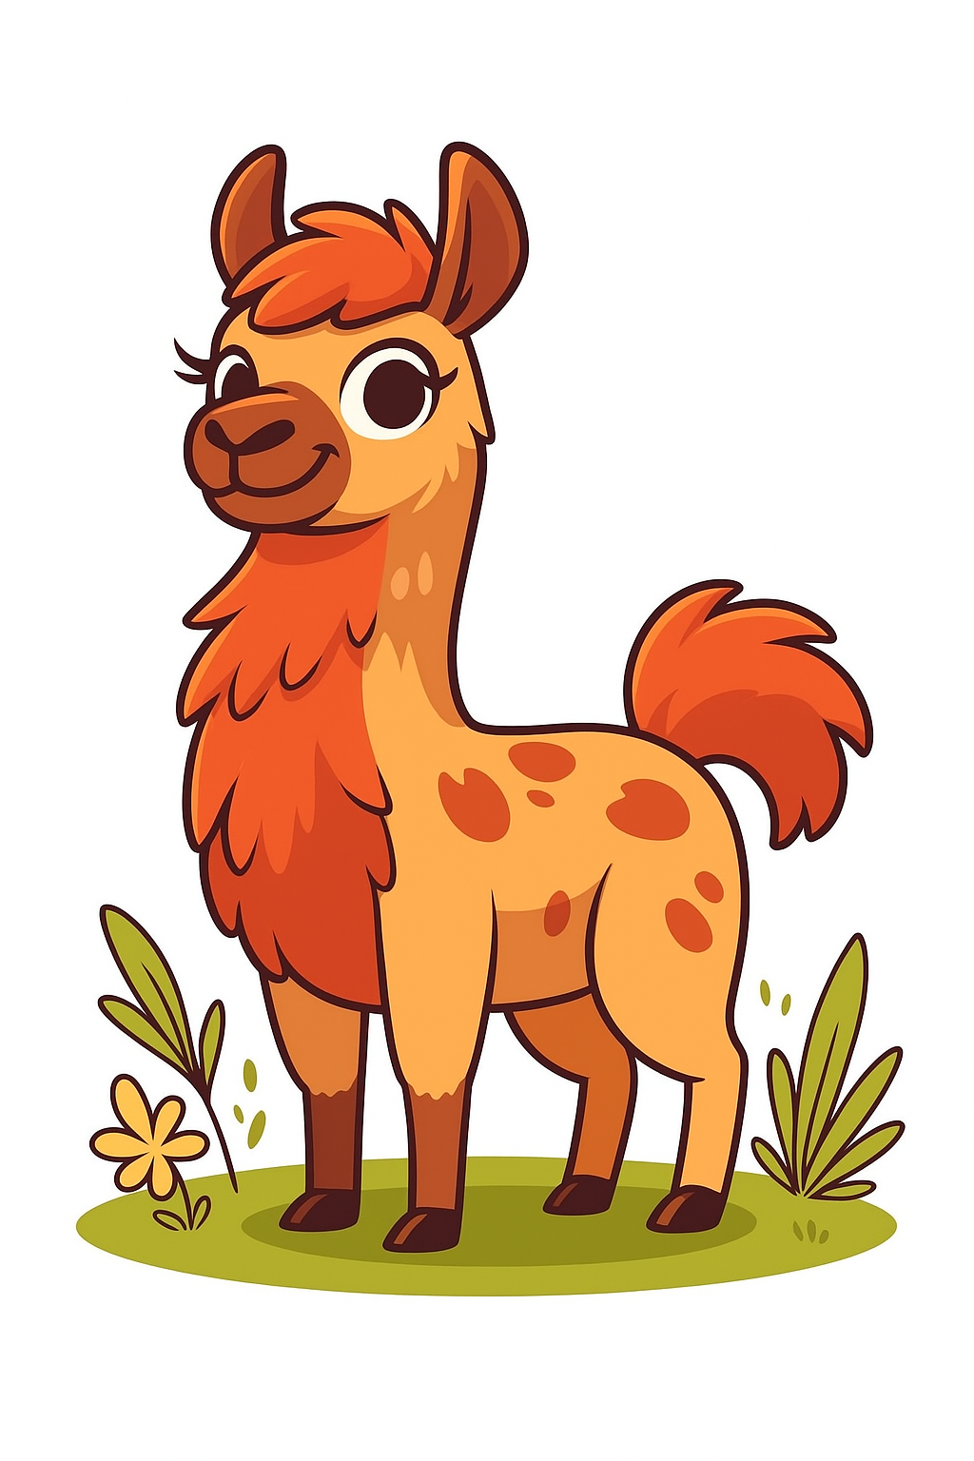
Embeddings
The first layers
0
Hardware
1
1
Tokenization
2
2
Embeddings
0

Slide 2
Overview
Why?
One-hot encodings
word2vec
Neural embeddings

Slide 3
Why do we even want "embeddings"
Currently, we have numbers that we can feed into a model
{'cat': 0, 'mat': 1, 'on': 2, 'sat': 3, 'the': 4}
These numbers are discrete
We can't actually apply attention to these numbers
We need to do things like:
    Capture relationships between concepts
    Combine concepts meaningfully
    Generalize to unfamiliar contexts
We need some vectors

Slide 4
Vectors
y
Vectors are just arrows in space
A [x1, y1]
B [x2, y2]
x

Slide 5
Vectors
y
We can add them...
A + B → [x1 + x2, y1 + y2]
x

Slide 6
Vectors
y
We can find distances between them...
A ᐧ B = ‖A‖‖B‖ cos θ
A [x1, y1]
B [x2, y2]
θ
x

Slide 7
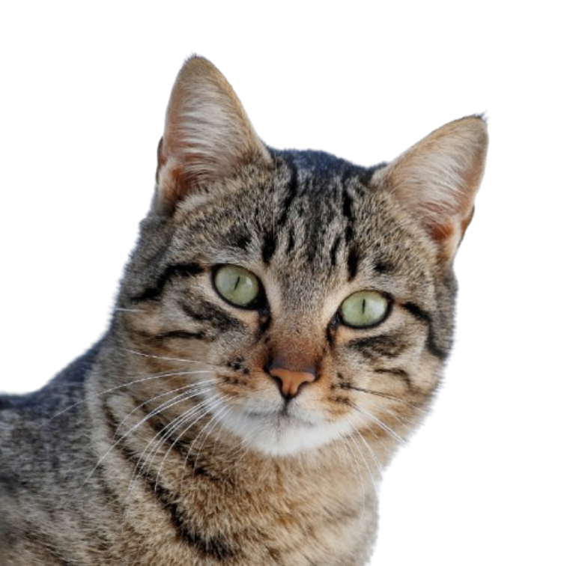

Vectors
y
Wouldn't it be nice if we could do the same with words and concepts...?
cat
fluffy
θ
x

Slide 8
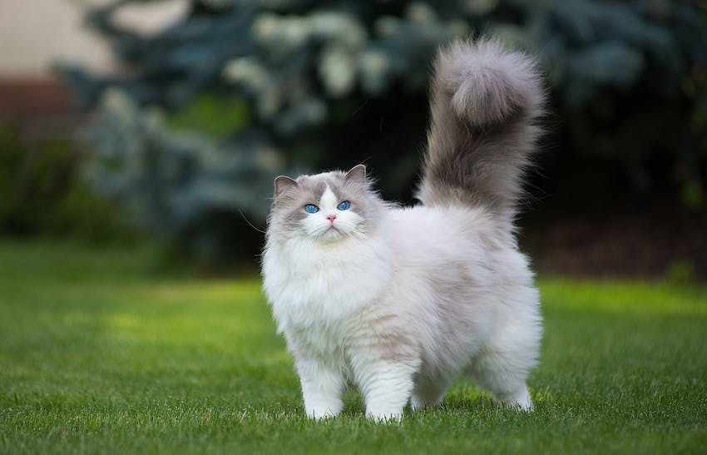
Vectors
y
Wouldn't it be nice if we could do the same with words and concepts...?
fluffy cat → fluffy + cat
cat
fluffy
θ
x

Slide 9
Vectors
y
Wouldn't it be nice if we could do the same with words and concepts...?
cat-based fluffy objects
cat-based animals
cat [x1, y1]
fluffy [x2, y2]
texture-based adjectives
x

Slide 10
Vectors
So how can we convert the tokenized text into vectors?

Slide 11
Embeddings
Suppose we have the following "corpus" and corresponding token mapping
[
"the cat sat on the mat",
"the dog sat on the mat",
"the cat sat on the dog",
]
{'the' : 0, 'cat' : 1, 'sat' : 2, 'on' : 3, 'mat' : 4, 'dog' : 5}

Slide 12
One-hot encoding
We have 6 unique words
We can therefore make unique vectors for each word, with 6 elements each
'the’ : [1, 0, 0, 0, 0, 0]
'cat’ : [0, 1, 0, 0, 0, 0]
'sat’ : [0, 0, 1, 0, 0, 0]
'on’ : [0, 0, 0, 1, 0, 0]
'mat' : [0, 0, 0, 0, 1, 0]
'dog' : [0, 0, 0, 0, 0, 1]

Slide 13
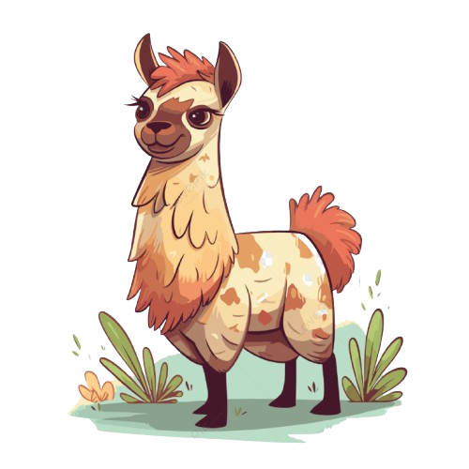
One-hot encodings
the | 1 | 0 | 0 | 0 | 0 | 0
cat | 0 | 1 | 0 | 0 | 0 | 0
sat | 0 | 0 | 1 | 0 | 0 | 0
on | 0 | 0 | 0 | 1 | 0 | 0
the | 1 | 0 | 0 | 0 | 0 | 0
mat | 0 | 0 | 0 | 0 | 1 | 0

Slide 14
One-hot encodings
Very sparse vectors
High dimensionality
No semantic meaning captured

Slide 15
word2vec
[
"the cat sat on the mat",
"the dog sat on the mat",
"the cat sat on the dog",
]
Cat and dog appear to be used in a similar way in the first sentence
Maybe "cat" and "dog" are semantically similar

Slide 16
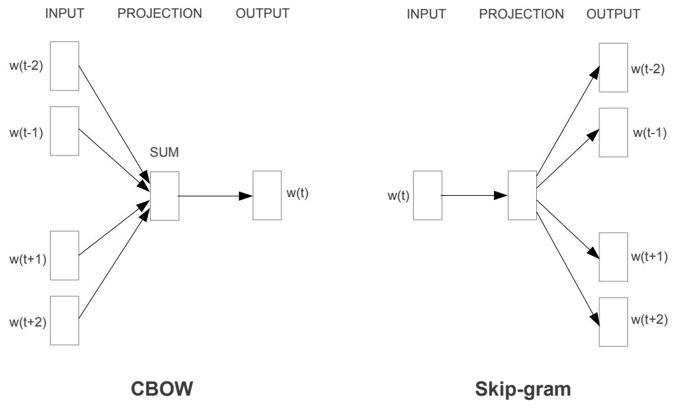
word2vec
We know that neural networks can do a lot of stuff.
So let's try and use one

Slide 17
word2vec
We use one-hot encoding
We might use a tokenizer to create a vocab of size 50k tokens
We pick a projection dimension

Slide 18
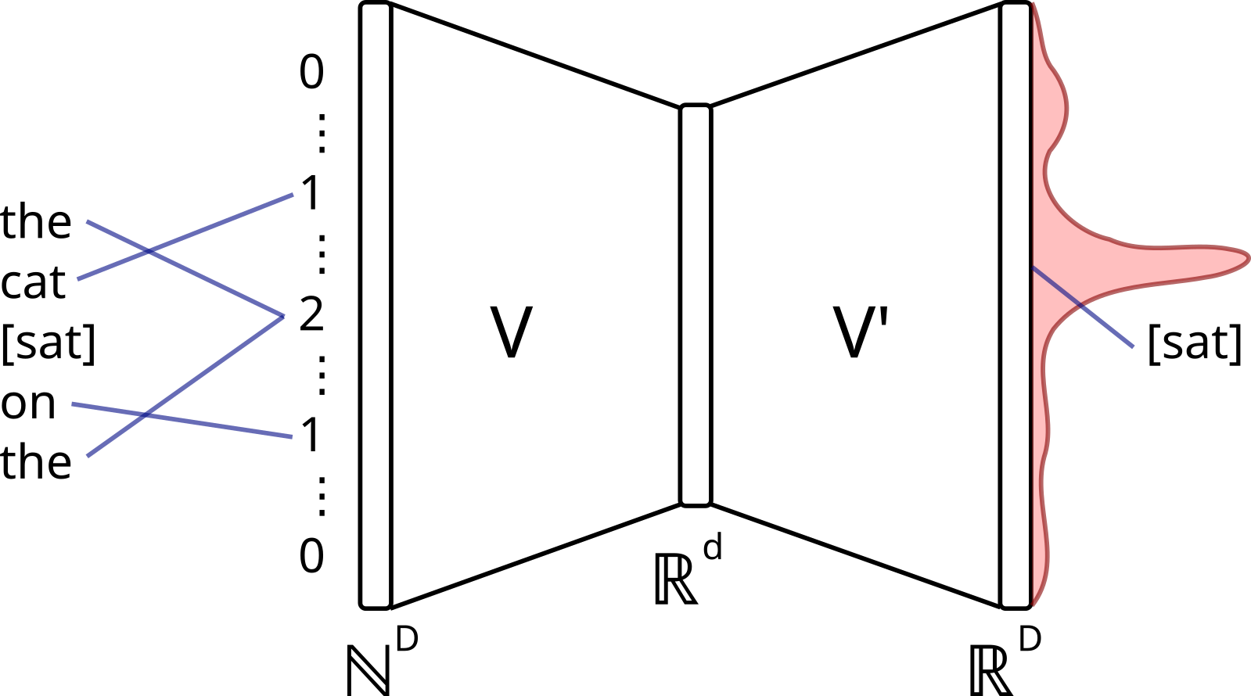
word2vec
https://commons.wikimedia.org/wiki/File:CBOW_word2vec_as_an_autoencoder.svg

Slide 19
word2vec
embedding_size
aadvark
kitten
...
...
Zyzzyva
0.01 | 0.41 | -0.12 | -0.94 | 0.89
-0.02 | 0.04 | 0.56 | 0.26 | 0.86
... | ... | ... | ... | ...
... | ... | ... | ... | ...
0.76 | -0.10 | -0.68 | 0.34 | 0.80
vocab_size

Slide 20
Learned embeddings
We just throw some linear layers at the input and call it a day.

Slide 21
(input_size, embed_dim)
0.01 | 0.41 | ... | -0.94 | 0.89
... | ... | ... | ... | ...
... | ... | ... | ... | ...
... | ... | ... | ... | ...
... | ... | ... | ... | ...
0.76 | -0.10 | ... | 0.34 | 0.80
the
cat
sat
on
the
mat
43
123
522
7245
43
237
nn.Embedding
(vocab_size, embed_dim
+
0.01 | 0.41 | ... | -0.94 | 0.89
... | ... | ... | ... | ...
... | ... | ... | ... | ...
... | ... | ... | ... | ...
... | ... | ... | ... | ...
0.76 | -0.10 | ... | 0.34 | 0.80
nn.Embedding
(context_size, embed_dim
(input_size, embed_dim)

Slide 22
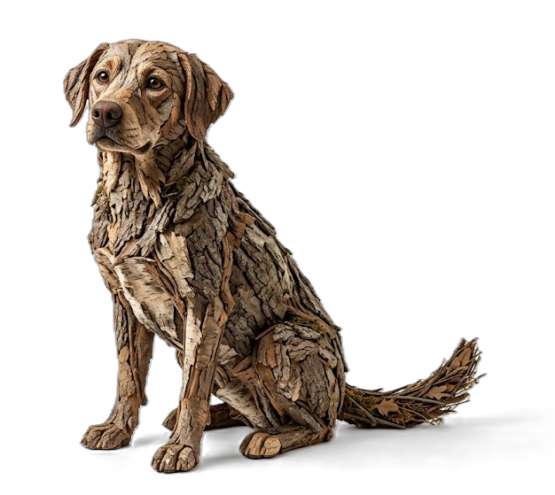
Static embeddings
We have created static embeddings
"dogs like to bark at squirrels"
"squirrels like climbing tree bark"
Same embeddings

Slide 23
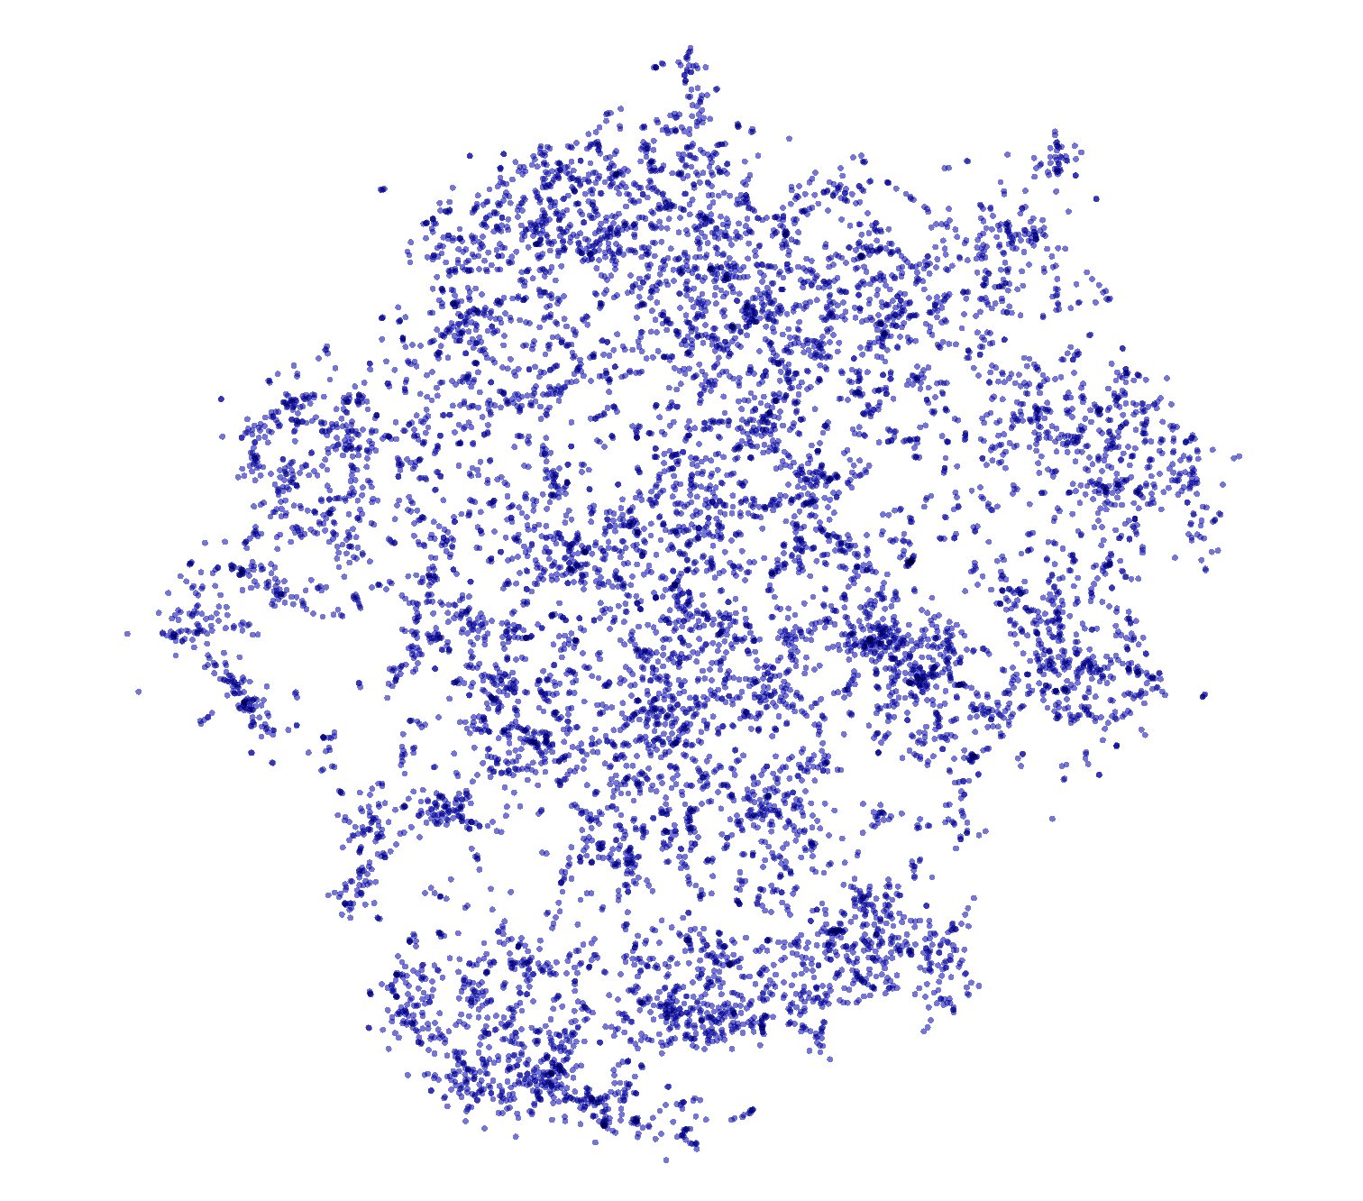
projector.tensorflow.org

Slide 24
Activity: One word, three representations
Work in pairs - 8 minutes
    Compare these sentences:
      A. “The bank approved the loan.”
      B. “We sat beside the river bank.”
        For the word “bank,” decide:
        1. Would its Word2Vec embedding be the same or different?
        2. Would its initial LLM token embedding be the same or different?
        3. Would its contextual representation be the same or different?
        4. Which nearby words help identify each meaning?
        Explain which representation can distinguish the two meanings.

Slide 25
Activity answers: Three representations
Word2Vec embedding
  The same. Word2Vec assigns one fixed vector to “bank,” so its different meanings are combined.
      Initial LLM token embedding
        The same when “bank” maps to the same token ID. It is a learned lookup vector before context is processed.
        Contextual representation
        Different. Attention uses surrounding words to update the representation.
        Useful clues
        “approved” and “loan” suggest a financial institution. “river” and “sat beside” suggest the edge of a river.

