Slide 1
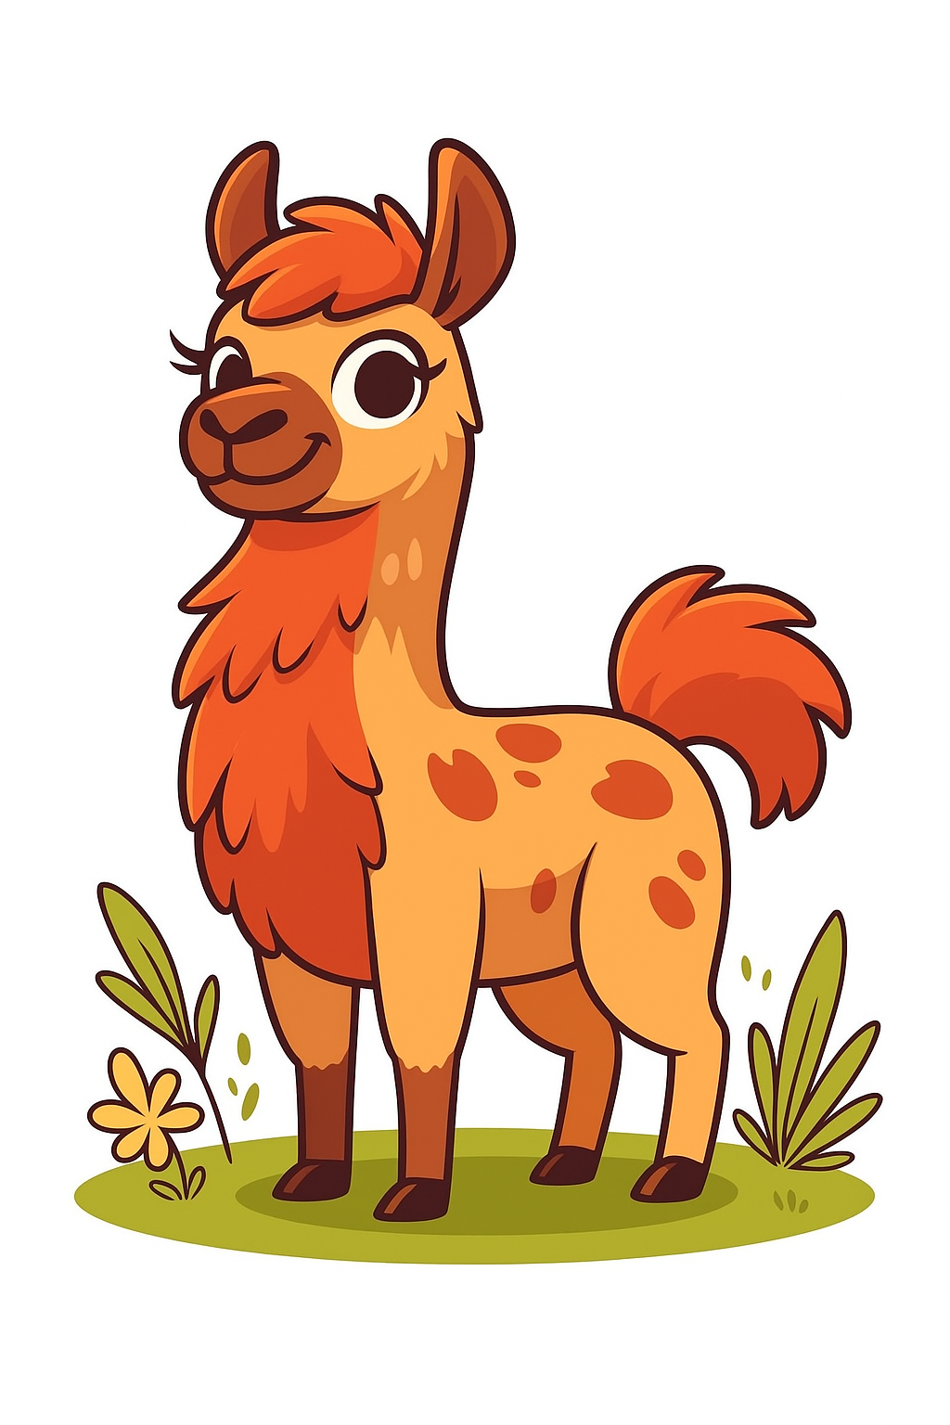
Output
...and pretraining
0
Hardware
1
1
Tokenization
2
2
Embeddings
3
4
3
Attention
0
4
Output

Slide 2
Overview
Softmax
Sampling methods
Scaling laws

Slide 3
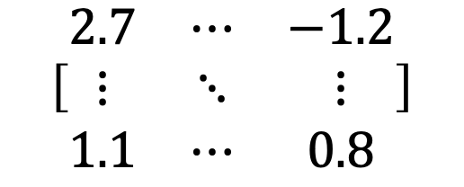
From the Last Section
We got out of the model: [sequence_length, embedding_dim]
Great... now what?
embedding_dim
$$\left[\begin{matrix}2.7 & ⋯ & −1.2 \\ ⋮ & ⋱ & ⋮ \\ 1.1 & ⋯ & 0.8\end{matrix}\right]$$
Context-adjusted embedding vector for a single token
e.g. “the” in “the cat sat on the mat”
sequence_length

Slide 4

The language model
<bos>
the
cat
sat
on
the
mat
<eos>
101
1996
4937
6583
2006
1996
13523
102
101
1996
4937
6583
2006
1996
?
the
cat
sat
on
the
mat
was | 0.0001
dog | 0.12
hippo | 0.07
•
•
•
mat | 0.54

Slide 5
The language model
<bos>
the
cat
sat
on
the
mat
<eos>
101
1996
4937
6583
2006
1996
13523
102
101
1996
4937
6583
2006
1996
13523
?
the
cat
sat
on
the
mat
has | 0.0001
eating | 0.12
while | 0.07
•
•
•
<eos> | 0.54

Slide 6
The final prediction
The output to attention told us how to modify the initial embedding:
[sequence_length, embedding_dim]
And our goal is to predict the [?]
"the cat sat on the [?]"
So, we need a distribution over tokens:
[sequence_length, vocab_size]

Slide 7
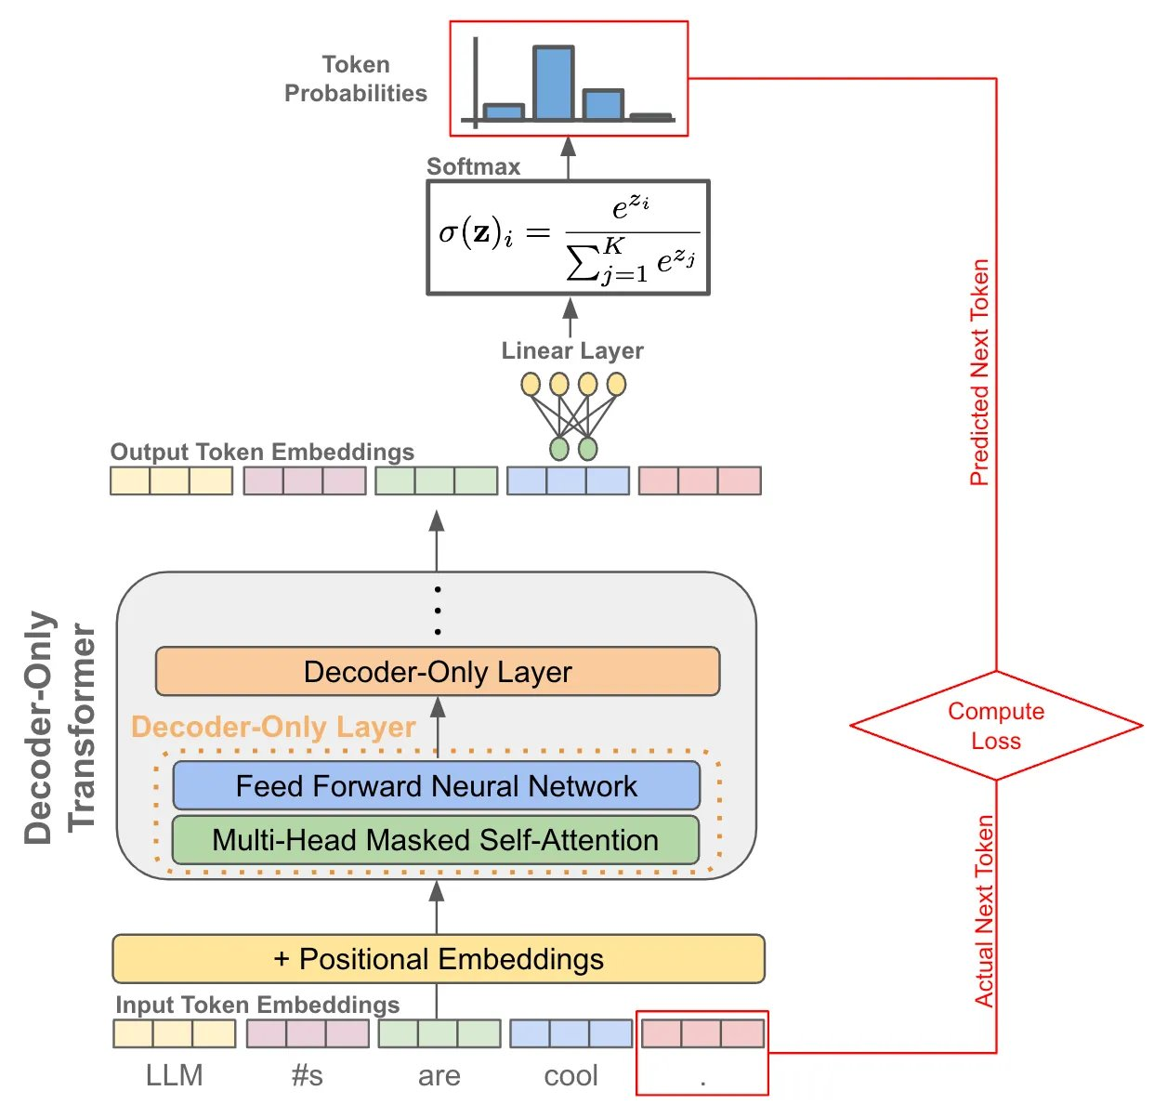
The final operation
[seq_len, embed_dim] x [embed_dim, vocab_size] = [seq_len, vocab_size]

Slide 8
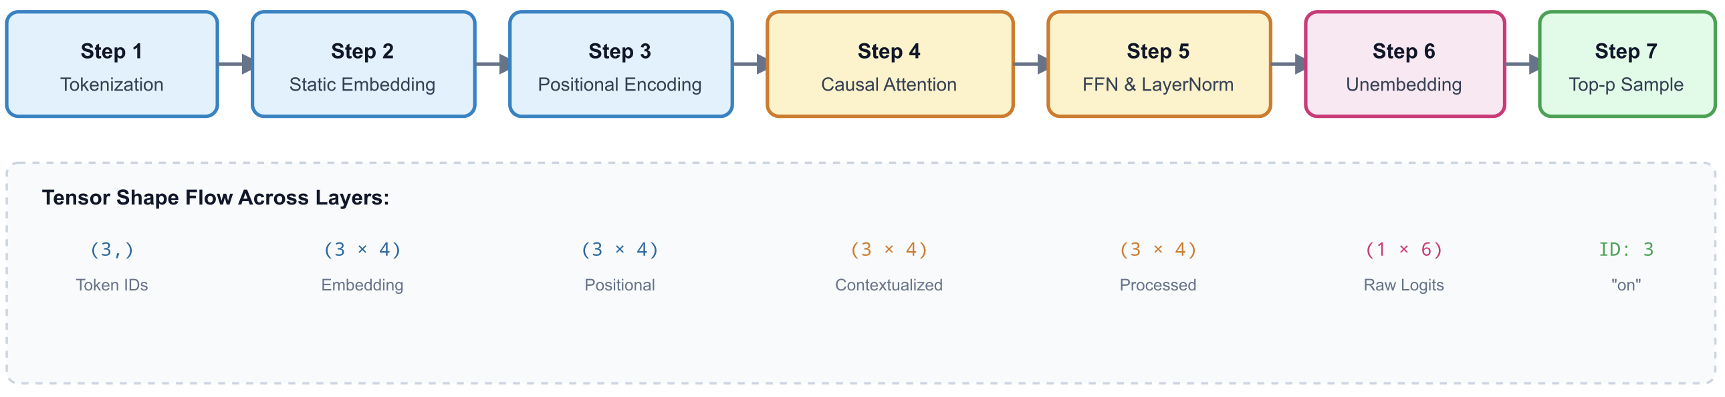
Example Input: "The cat sat"

Slide 9
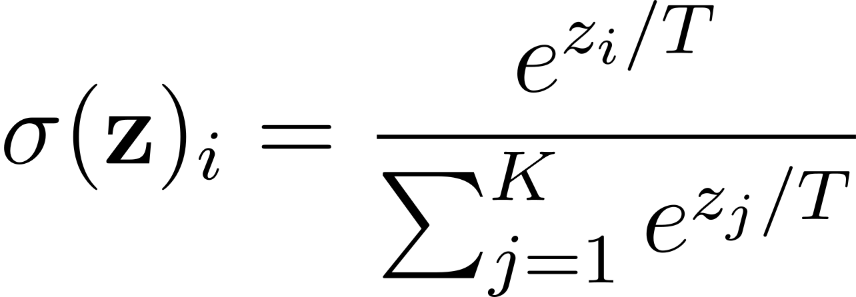
Softmax
Here is an equation:

Slide 10
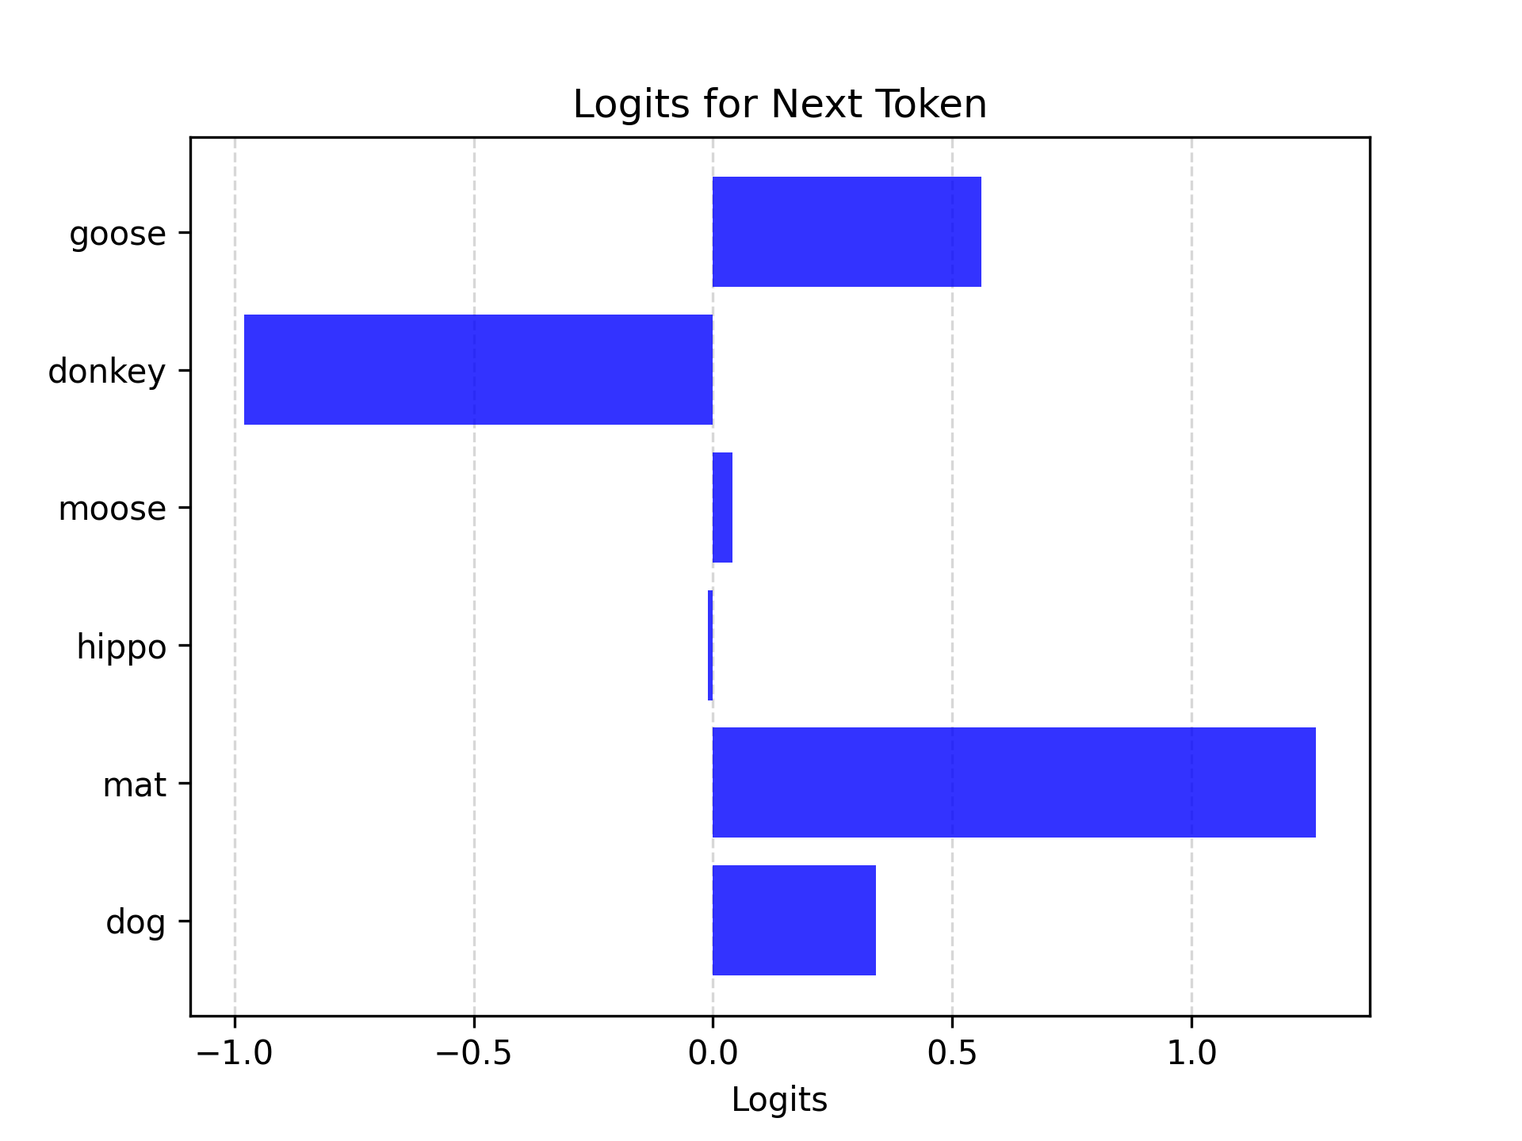
Softmax
"the cat sat on the _____"
goose | 0.34
donkey | 1.26
moose | -0.01
hippo | 0.04
mat | -0.98
dog | 0.56

Slide 11
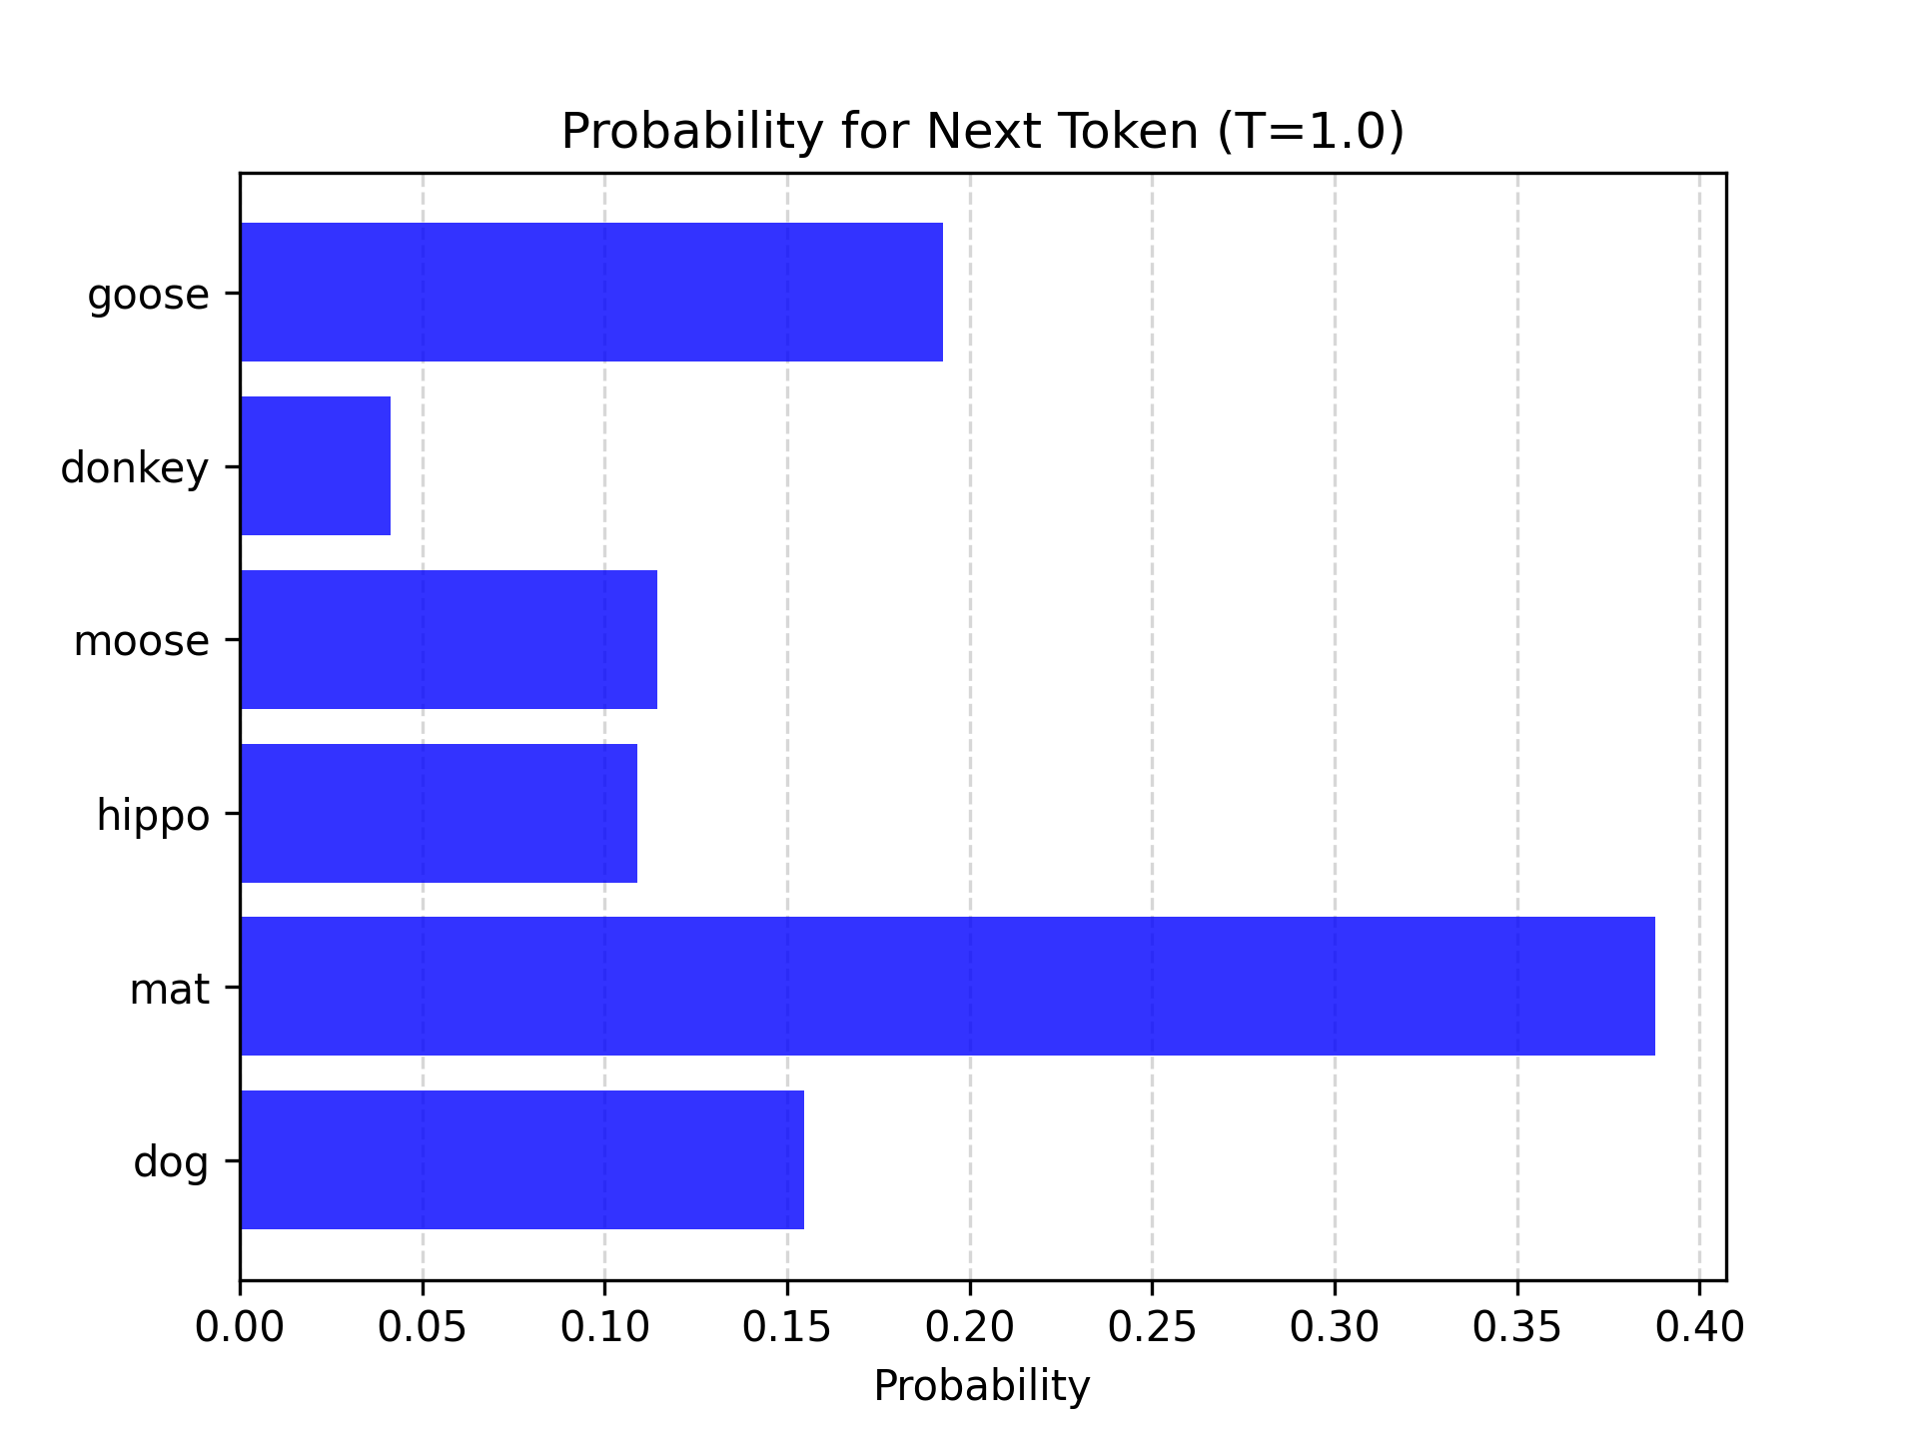
Softmax
"the cat sat on the _____"

Slide 12
Softmax
What does T do?
temperature

Slide 13
Softmax
T = 1.0
"the cat sat on the _____"

Slide 14
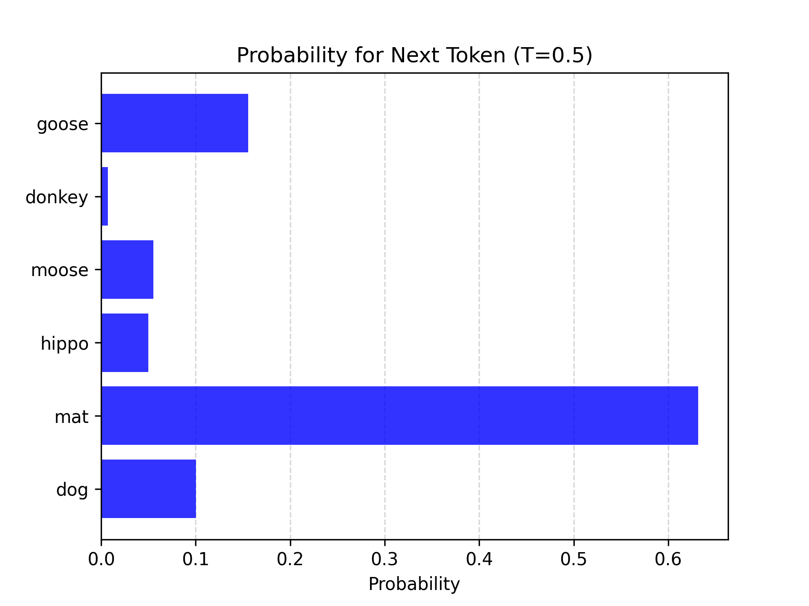
Softmax
T = 0.5
"the cat sat on the _____"

Slide 15
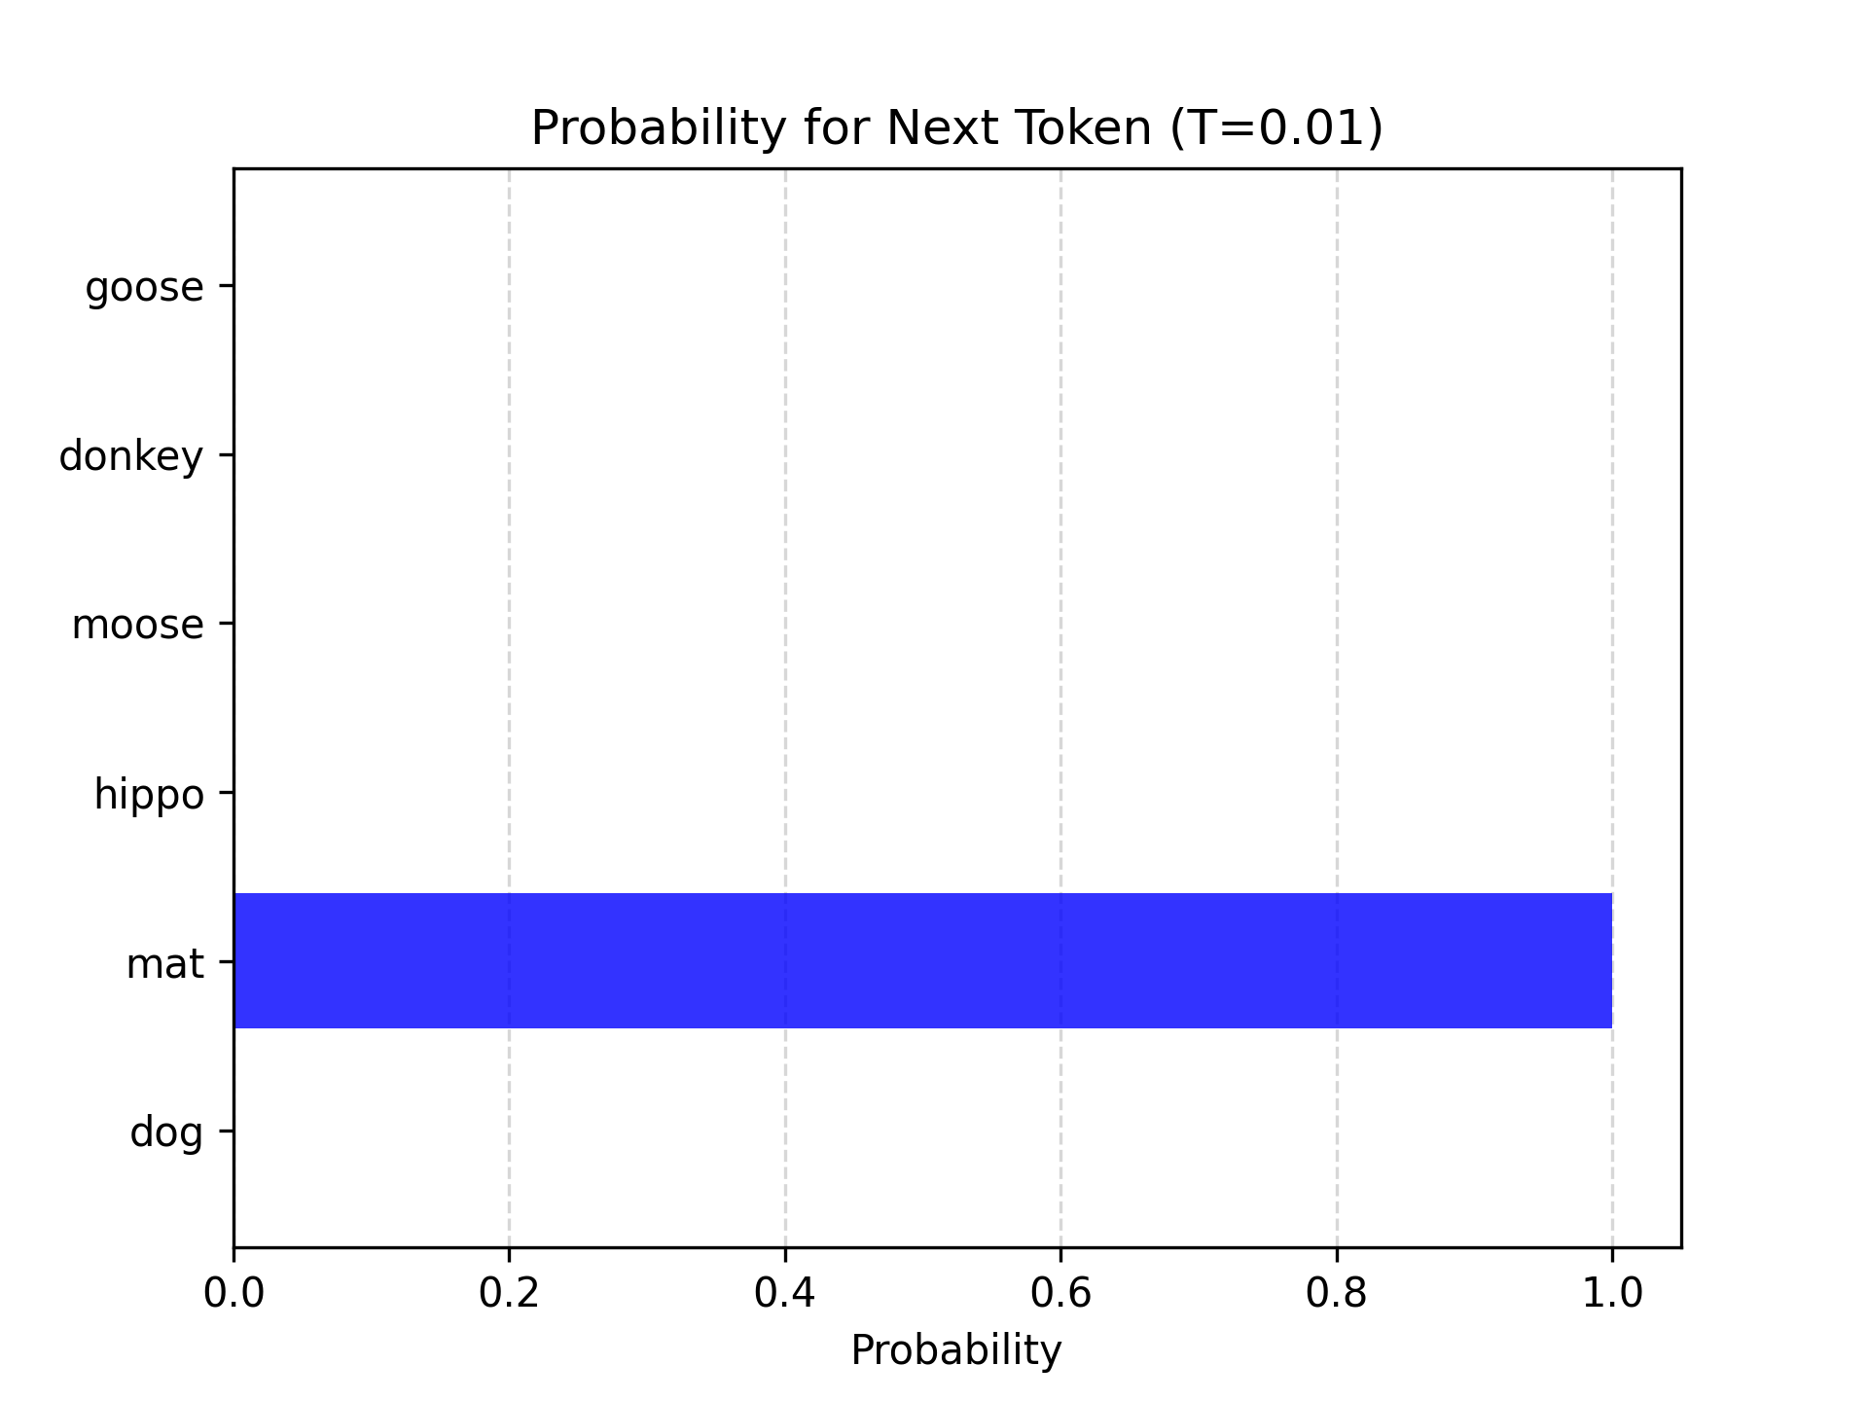
Softmax
T = 0.01
"the cat sat on the _____"

Slide 16
Softmax
T = 1.0
"the cat sat on the _____"

Slide 17
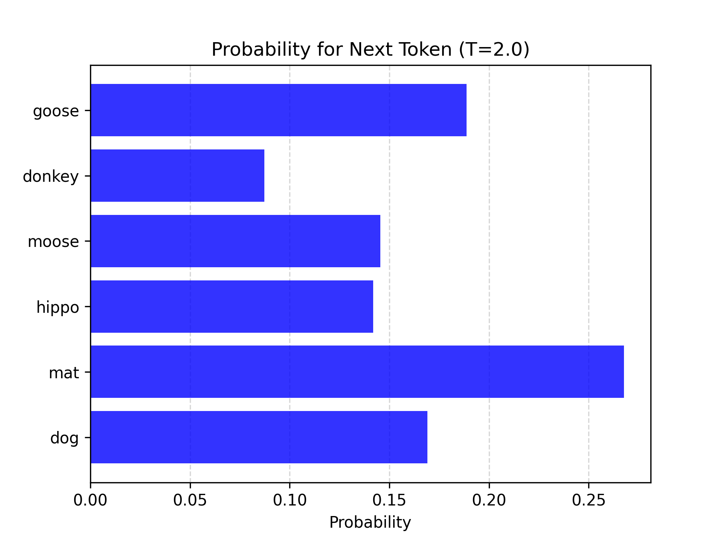
Softmax
T = 2.0
"the cat sat on the _____"

Slide 18
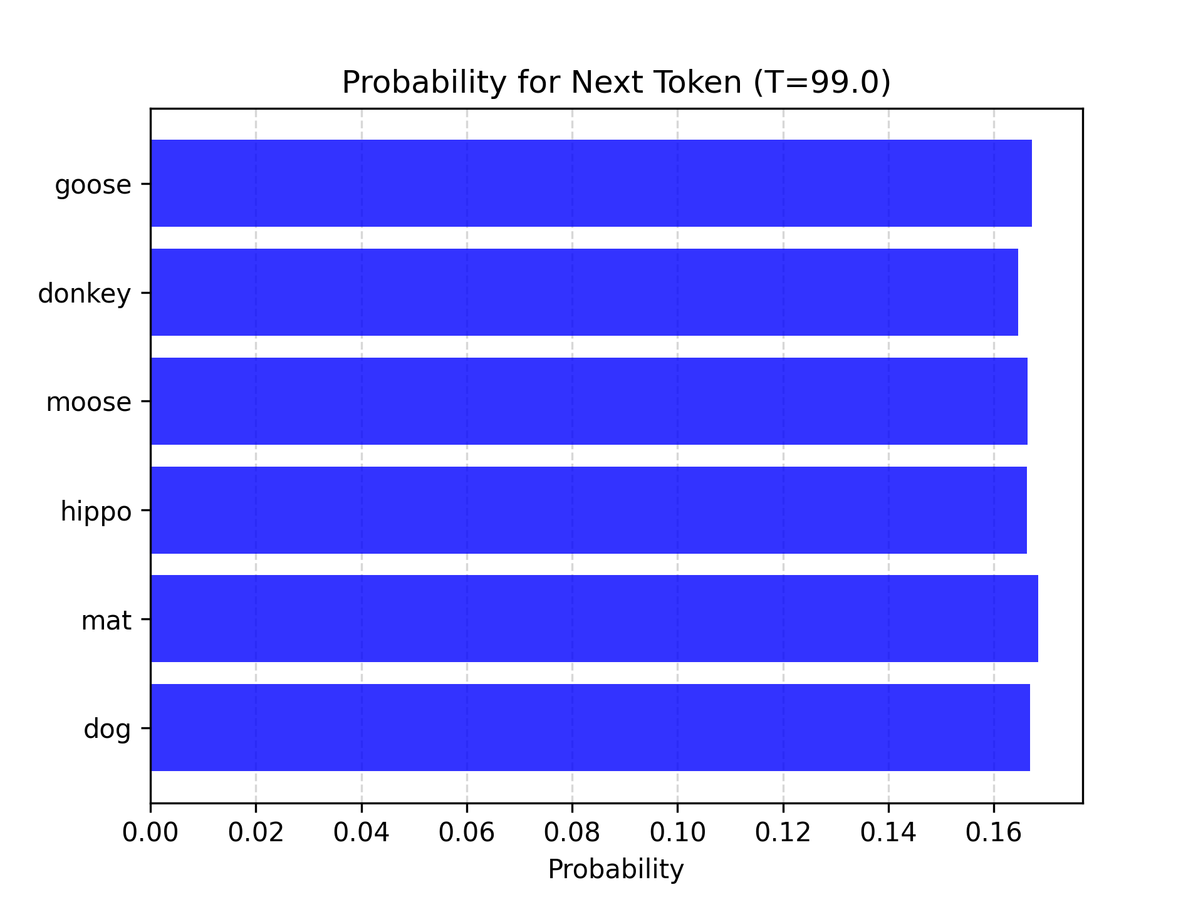
Softmax
T = 99.0
"the cat sat on the _____"

Slide 19
Softmax
Softmax converts raw logits to a probability distribution
Changing the temperature parameter alters the entropy of the distribution

Slide 20
Sampling
Greedy sampling Pick the top score
Top-p The cumulative probability cutoff for token selection. Lower values mean sampling from a smaller, more top-weighted nucleus.
Top-k Sample from the k most likely next tokens at each step. Lower k focuses on higher probability tokens.
In OpenAI models, setting T = 0 essentially does greedy sampling, and top-k is not exposed

Slide 21
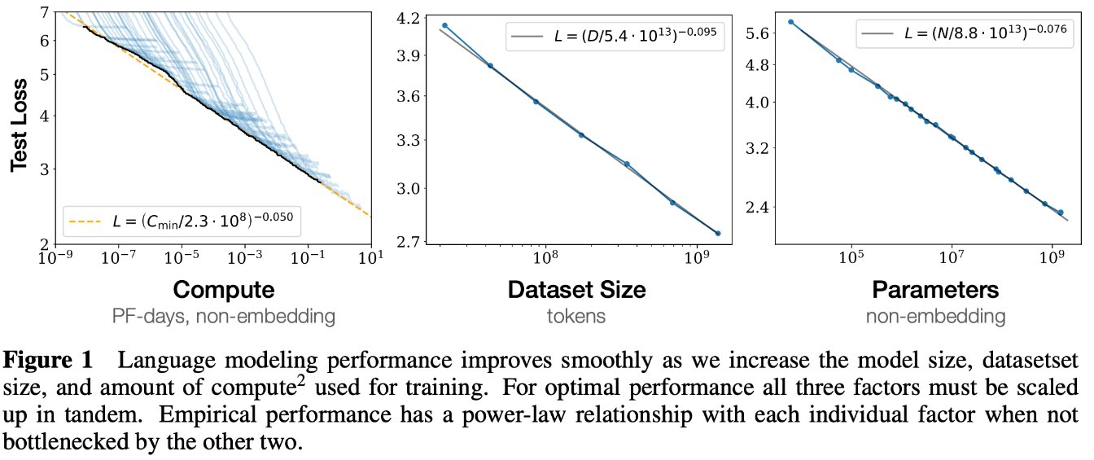
Scaling laws
Kaplan, J., McCandlish, S., Henighan, T., Brown, T. B., Chess, B., Child, R., Gray, S., Radford, A., Wu, J., & Amodei, D. (2020). Scaling laws for neural language models.

Slide 22
Activity: Choose a decoding strategy
Work in small groups - 8 minutes
    Next-token probabilities:
      cat 0.42 | dog 0.28 | slept 0.16 | ran 0.09 | moon 0.05
        Predict what changes with:
        1. Greedy decoding
        2. Low temperature
        3. High temperature
        4. Top-k = 2
        5. Top-p = 0.75
        Choose settings for a factual support bot and for a creative story generator. Explain the trade-off.

Slide 23
Activity answers: Decoding strategy
Expected effects
  • Greedy decoding always chooses “cat.”
    • Low temperature makes high-probability tokens more dominant.
    • High temperature increases diversity and risk.
    • Top-k = 2 permits only “cat” and “dog.”
    • Top-p = 0.75 includes “cat,” “dog,” and “slept” because their cumulative probability is 0.86.
    Use lower randomness for factual support and moderate diversity for creative writing. Sampling settings do not add knowledge or guarantee accuracy.

