Slide 1
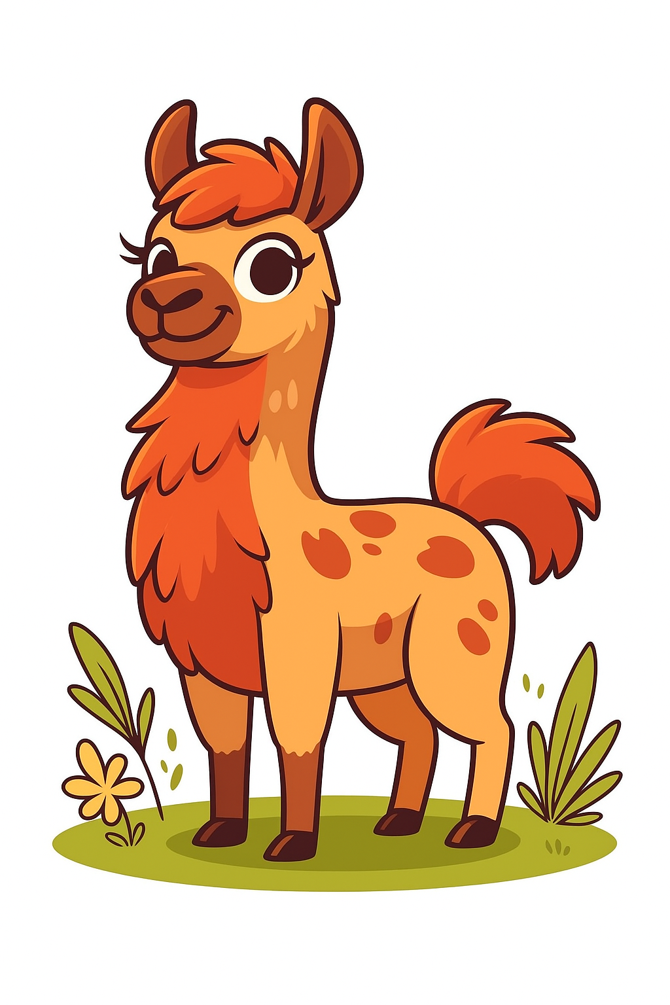
Embeddings
The first layers
0
Hardware
1
1
Tokenization
2
2
Embeddings
0

Slide 2
Overview
Why?
One-hot
Distributional Hypothesis
TF-IDF
Positional Embeddings

Slide 3
Why do we even want "embeddings"
Currently, we have numbers that we can feed into a model
{'cat': 0, 'mat': 1, 'on': 2, 'sat': 3, 'the': 4}
These numbers are discrete
We can't actually apply attention to these numbers
We need to do things like:
Capture relationships between concepts
Combine concepts meaningfully
Generalize to unfamiliar contexts
We need some vectors

Slide 4
Vectors
y
Vectors are just arrows in space
A [x₁, y₁]
B [x₂, y₂]
x

Slide 5
Vectors
y
We can add them...
A + B → [x₁ + x₂, y₁ + y₂]
x

Slide 6
Vectors
y
We can find distances between them...
A ᐧ B = ‖A‖‖B‖ cos θ
A [x₁, y₁]
B [x₂, y₂]
θ
x

Slide 7
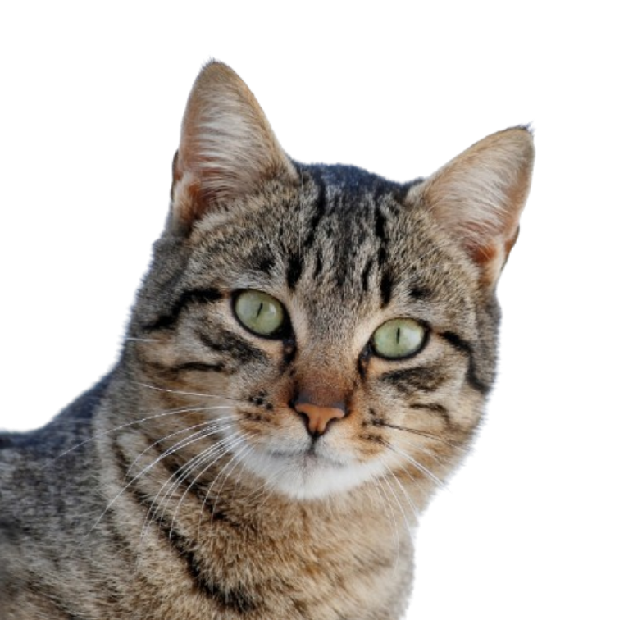

Vectors
y
Wouldn't it be nice if we could do the same with words and concepts...?
cat
fluffy
θ
x

Slide 8
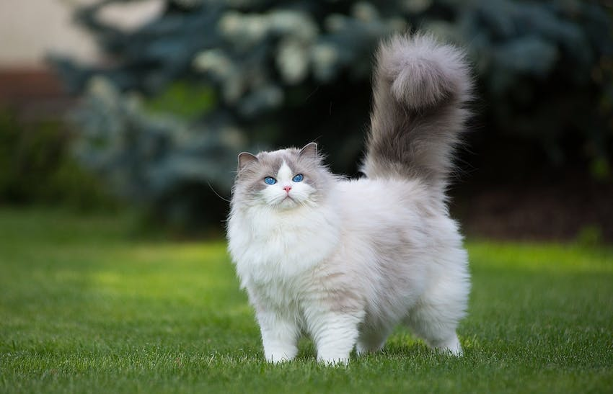
Vectors
y
Wouldn't it be nice if we could do the same with words and concepts...?
fluffy cat → fluffy + cat
cat
fluffy
θ
x

Slide 9
Vectors
y
Wouldn't it be nice if we could do the same with words and concepts...?
cat-based fluffy objects
cat-based animals
cat [x₁, y₁]
fluffy [x₂, y₂]
texture-based adjectives
x

Slide 10
Vectors
So how can we convert the tokenized text into vectors?

Slide 11
Embeddings
Suppose we have the following "corpus" and corresponding token mapping
[
"the cat sat on the mat",
"the dog sat on the mat",
"the cat sat on the dog",
]
{'the' : 0, 'cat' : 1, 'sat' : 2, 'on' : 3, 'mat' : 4, 'dog' : 5}

Slide 12
One-hot encoding
We have 6 unique words
We can therefore make unique vectors for each word, with 6 elements each
'the’ : [1, 0, 0, 0, 0, 0]
'cat’ : [0, 1, 0, 0, 0, 0]
'sat’ : [0, 0, 1, 0, 0, 0]
'on’ : [0, 0, 0, 1, 0, 0]
'mat' : [0, 0, 0, 0, 1, 0]
'dog' : [0, 0, 0, 0, 0, 1]

Slide 13
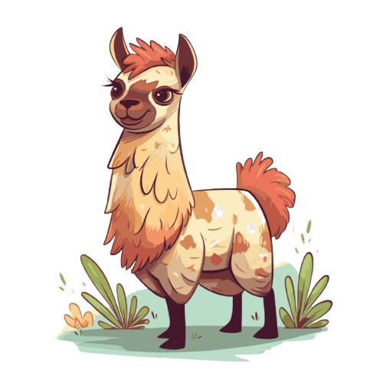
One-hot encodings
the | 1 | 0 | 0 | 0 | 0 | 0
cat | 0 | 1 | 0 | 0 | 0 | 0
sat | 0 | 0 | 1 | 0 | 0 | 0
on | 0 | 0 | 0 | 1 | 0 | 0
the | 1 | 0 | 0 | 0 | 0 | 0
mat | 0 | 0 | 0 | 0 | 1 | 0

Slide 14
One-hot encodings
Very sparse vectors
High dimensionality
No semantic meaning captured

Slide 15
TF-IDF
Term Frequency – Inverse Document Frequency
A weighting scheme that reflects how important a word is to a specific document within a larger collection of documents
Two components:
Term Frequency: how often a word appears in a single document
Inverse Document Frequency: how rare or common a word is across all documents in the corpus.

Slide 16
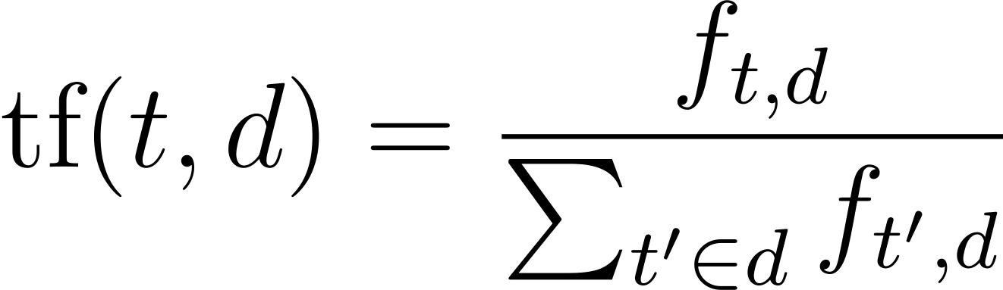
TF-IDF
Term Frequency
Raw count of how often a term t appears in document d
 | d0 | d1 | d2
the | 0.333 | 0.333 | 0.333
cat | 0.167 | 0.000 | 0.167
sat | 0.167 | 0.167 | 0.167
on | 0.167 | 0.167 | 0.167
mat | 0.167 | 0.167 | 0.000
dog | 0.000 | 0.167 | 0.167
The total number of terms in the document

Slide 17
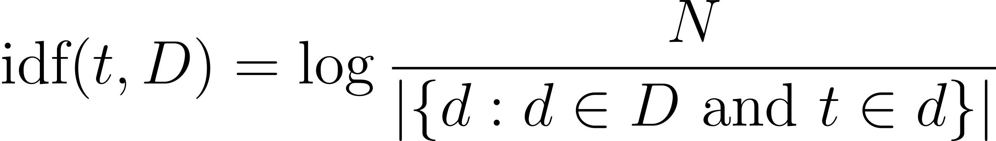
TF-IDF
Inverse Document Frequency
Total number of documents
Total number of documents that contain the term t
IDF('the') = log(3 / 3) = log(1) = 0
IDF('cat') = log(3 / 2) = log(1.5) ≈ 0.405 IDF('sat') = log(3 / 3) = log(1) = 0
IDF ('on') = log(3 / 3) = log(1) = 0
IDF('mat') = log(3 / 2) = log(1.5) ≈ 0.405 IDF('dog') = log(3 / 2) = log(1.5) ≈ 0.405

Slide 18
TF-IDF
 | d0 | d1 | d2
the | 0.000 | 0.000 | 0.000
cat | 0.0675 | 0.000 | 0.0675
sat | 0.000 | 0.000 | 0.000
on | 0.000 | 0.000 | 0.000
mat | 0.0675 | 0.0675 | 0.000
dog | 0.000 | 0.0675 | 0.0675

Slide 19
TF-IDF
Each "document" is represented as a vector of tf-idf scores:
"the cat sat on the mat" : [0, 0.0675, 0, 0, 0.0675, 0]
Reflects term importance
Sparse
High-dimensional
Still not really any semantic meaning

Slide 20
TF-IDF
Still useful for searching!
1. Treat the search query as a document and calculate tf-idf score.
2. Compare search query vector to other documents.
3. Rank and return
This was extended to BM25

Slide 21
word2vec
[
"the cat sat on the mat",
"the dog sat on the mat",
"the cat sat on the dog",
]
Cat and dog appear to be used in a similar way in the first sentence
Maybe "cat" and "dog" are semantically similar

Slide 22
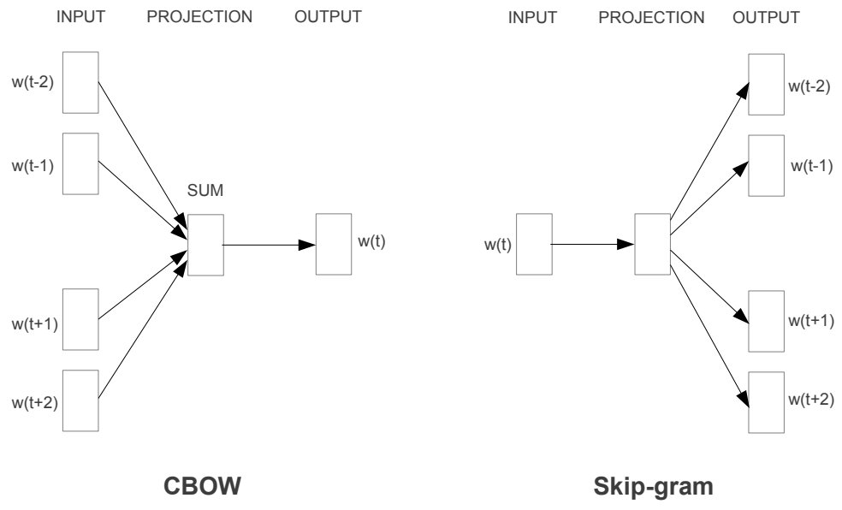
word2vec
We know that neural networks can do a lot of stuff.
So let's try and use one

Slide 23
word2vec
We use one-hot encoding
We might use a tokenizer to create a vocab of size 50k tokens
We pick a projection dimension

Slide 24
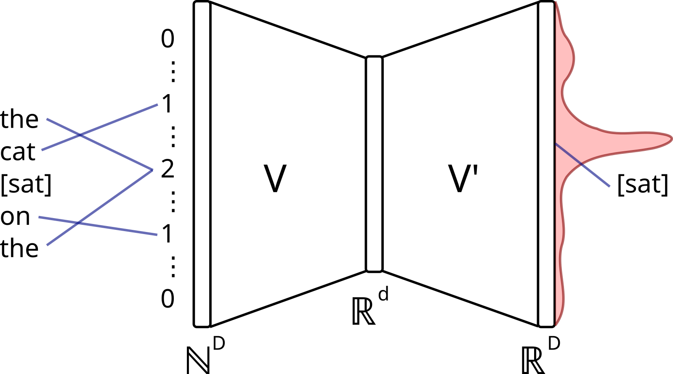
word2vec
https://commons.wikimedia.org/wiki/File:CBOW_word2vec_as_an_autoencoder.svg

Slide 25
word2vec
embedding_size
aadvark
abalone
...
...
Zyzzyva
0.01 | 0.41 | -0.12 | -0.94 | 0.89
-0.02 | 0.04 | 0.56 | 0.26 | 0.86
... | ... | ... | ... | ...
... | ... | ... | ... | ...
0.76 | -0.10 | -0.68 | 0.34 | 0.80
vocab_size

Slide 26
Learned embeddings
We just throw some linear layers at the input and call it a day.

Slide 27
(input_size, embed_dim)
0.01 | 0.41 | ... | -0.94 | 0.89
... | ... | ... | ... | ...
... | ... | ... | ... | ...
... | ... | ... | ... | ...
... | ... | ... | ... | ...
0.76 | -0.10 | ... | 0.34 | 0.80
the
cat
sat
on
the
mat
43
123
522
7245
43
237
nn.Embedding
(vocab_size, embed_dim
+
0.01 | 0.41 | ... | -0.94 | 0.89
... | ... | ... | ... | ...
... | ... | ... | ... | ...
... | ... | ... | ... | ...
... | ... | ... | ... | ...
0.76 | -0.10 | ... | 0.34 | 0.80
nn.Embedding
(context_size, embed_dim
(input_size, embed_dim)

Slide 28
Static embeddings
We have created static embeddings
"dogs like to bark at squirrels"
"squirrels like climbing tree bark"
Same embeddings

