Slide 1
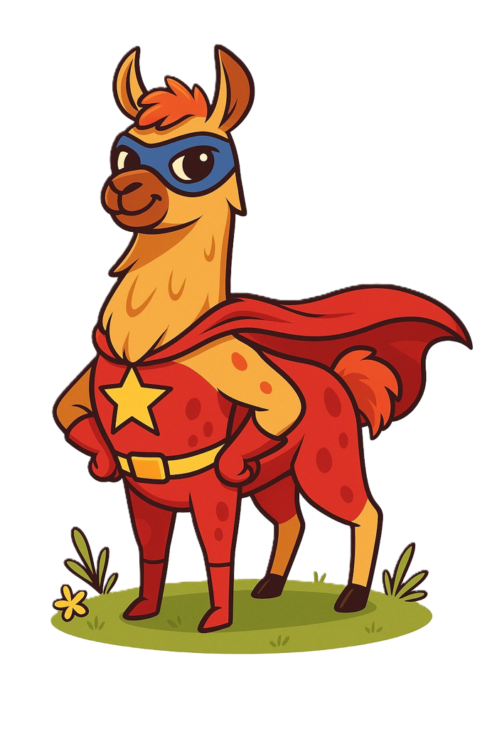
Orchestration
Interaction and augmentation

Slide 2
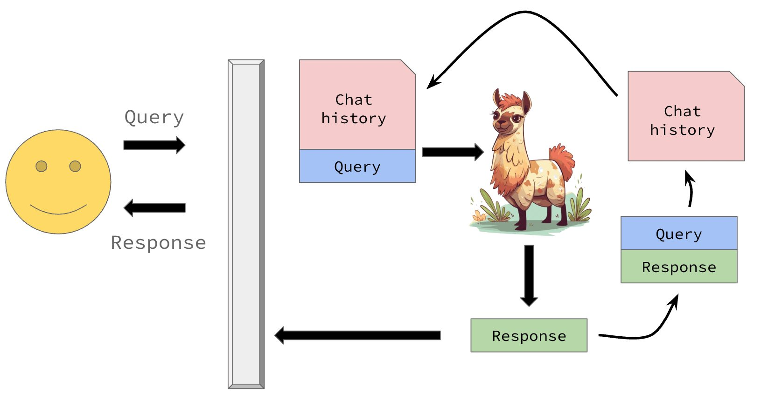
The illusion of memory
Notes:
Illusion of both short term and long term memory.
Short term = the conversation you’re currently having with the model
Long term = something you told the model a while ago in a different chat
LLMs are stateless
A state meaning the information a system retains about past interactions that influences how it responds in the future.
So an LLM being stateless means it has no information.
Stateful; like a GP who has your notes. Every appointment is informed by your history. Stateless; like calling 111. Every call starts from scratch. They have no record of you.
So it’s a SWE’s job to manage a session state

Slide 3
How do we manage session state?
LLMs have distinct input and output patterns...
‘system’ : “You are an expert in baking.”
‘user’ : “Provide me a recipe for macarons.”
‘assistant’ : “Certainly! Here is a recipe for macarons …”
Almost all LLMs follow this pattern...
...break this pattern, and you'll soon see the model produce nonsense.

Slide 4
How do we manage session state?
‘system’ : “You are an expert in baking.”
‘user’ : “Provide me a recipe for macarons.”
‘assistant’ : “Certainly! Here is a recipe for macarons …”
‘user’ : “Is this the only way to make them?”
‘assistant’ : “Actually no! There are two common ways to …”
‘user’ : “I think I'll try the Italian method first.”
‘assistant’ : “What an insightful idea! Let's get started …”

Slide 5
How do we manage session state?
session_state = [
‘system’ : “You are an expert in baking.”,
‘user’ : “Provide me a recipe for macarons.”,
‘assistant’ : “Certainly! Here is a recipe for macarons …”,
‘user’ : “Is this the only way to make them?”,
‘assistant’ : “Actually no! There are two common ways to …”,
‘user’ : “I think I'll try the Italian method first.”,
‘assistant’ : “What an insightful idea! Let's get started …”,
…
]

Slide 6
Retrieval Augmented Generation
‘system’ : “You are an expert in baking.”
‘user’ : “Provide me a recipe for macarons.”
‘assistant’ : “Certainly! Here is a recipe for macarons …”

Slide 7
Retrieval Augmented Generation
‘system’ : “You are an expert in baking.”
‘knowledge’ : “Recipe 1, Recipe 2, … Recipe 1000”
‘user’ : “Provide me a recipe for macarons.”
‘assistant’ : “Certainly! Here is a recipe for macarons …”

Slide 8
Back to Vectors
y
Wouldn't it be nice if we vectorize our recipes...?
almond-based deserts
Italian macaron
French macaron
apple pie
apple-based deserts
x

Slide 9

Bidirectional Encoder Representations from Transformers
‘[CLS]’
‘the’
‘cat’
‘[MASK]’
‘on’
‘the’
‘mat’
‘[SEP]’
101
1996
4937
103
2006
1996
13523
102
‘the’
‘cat’
‘sat’
‘on’
‘the’
‘mat’
‘sat’ | 0.19
‘was’ | 0.14
‘lay’ | 0.07
‘hippo’ | 0.000001

Slide 10
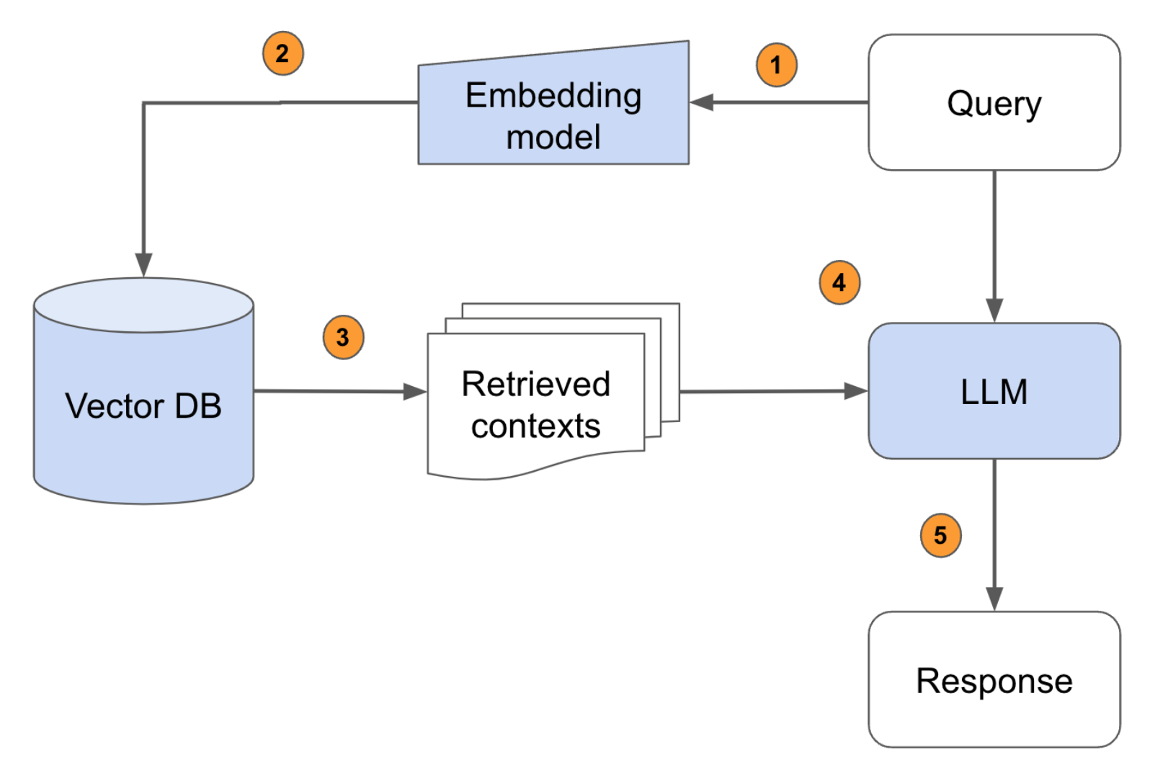
The RAG Pipeline
‘system’:
“You are an expert in baking.”
‘user’:
“Provide me a recipe for macarons.”
user_query -> embed_query -> search database -> top_k_results
‘knowledge’:
“[Top Recipe 1, Top Recipe 2, Top Recipe k]”
‘assistant’:
“Certainly! Here is a recipe for macarons …”

Slide 11
Tools
‘system’ | “You are a helpful mathematician. You have access to the following functions: {{ tool_schema }} If you choose to use the tool, respond in json with the correct arguments to the function.”
‘user’ | “What is 1056 x 1316?”
‘assistant’ | “{‘a’:1056, ‘b’:1316}”

Slide 12
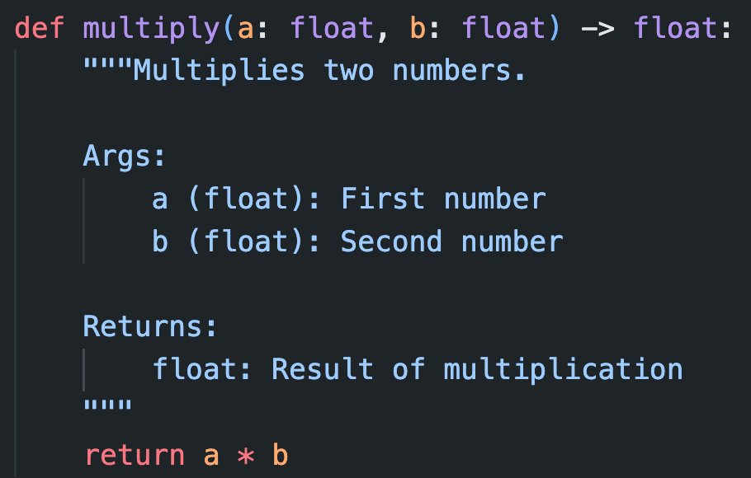
Tools

Slide 13
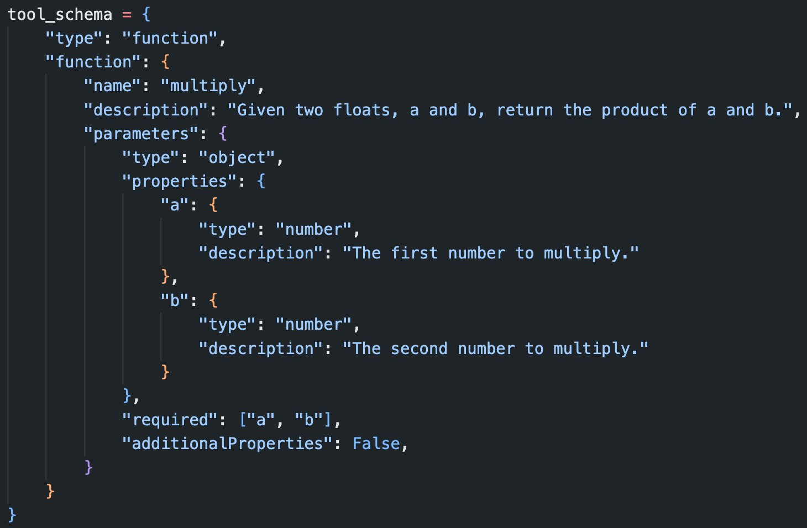
Tools

Slide 14
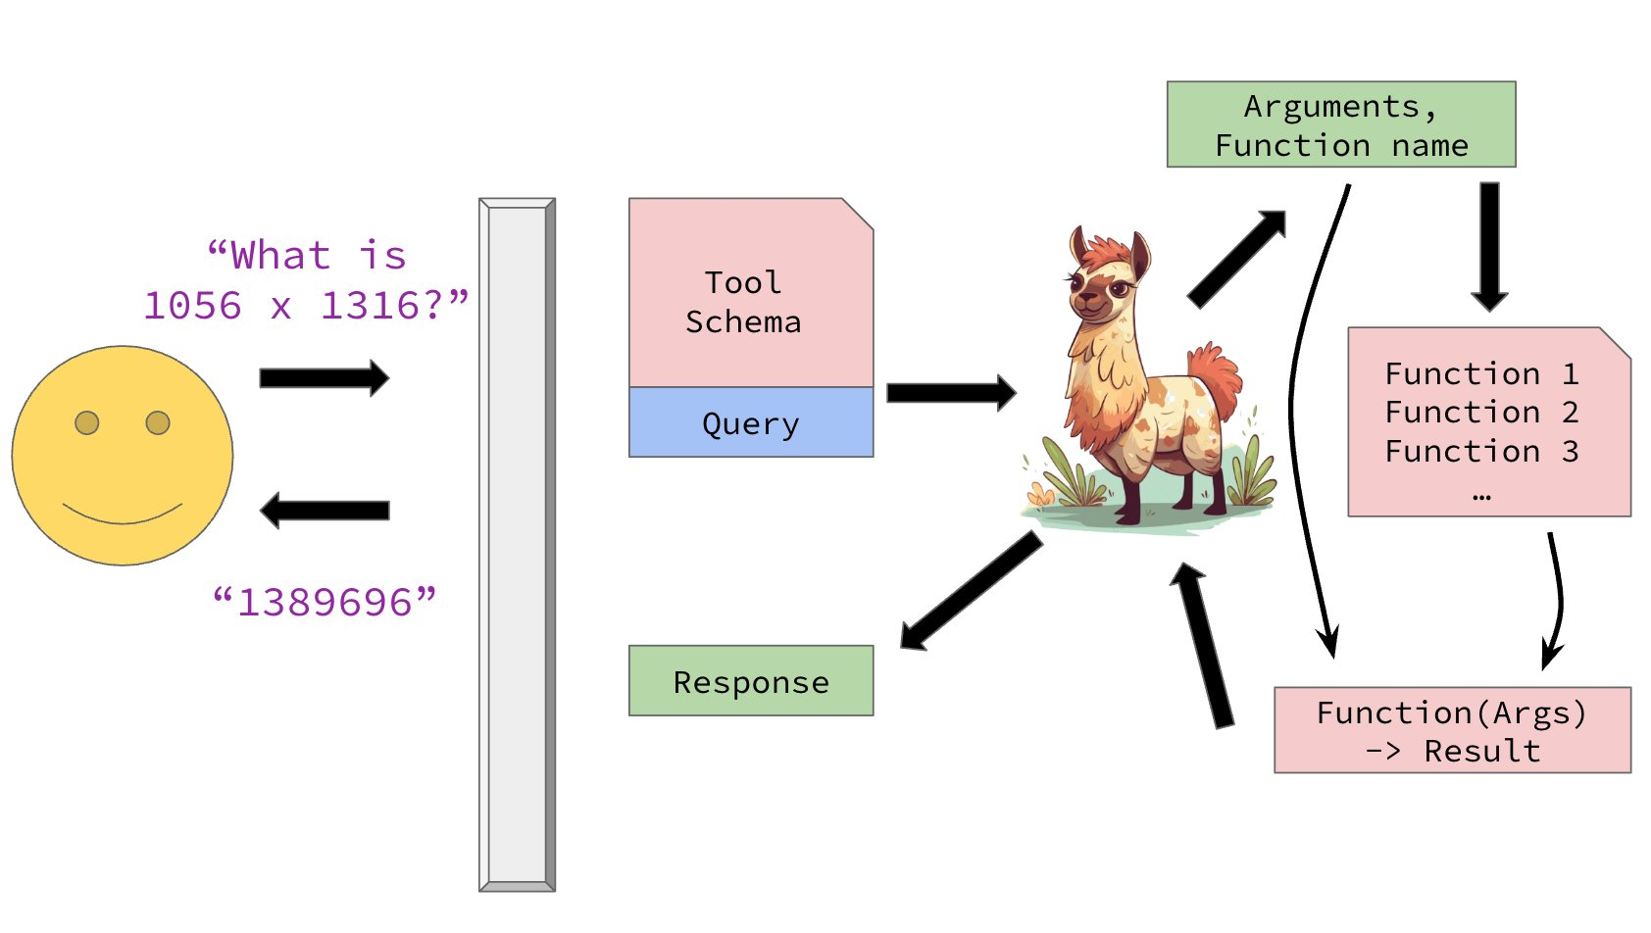
Tools

