Slide 1
Introduction to LLMs
Accelerate Programme for Scientific Discovery
Notes:
[TIMINGS]
Practice: 40m
Target: 45m
Start time: 9:35
End time: 10:20
---
Welcome to introduction to large langauge models
I’m Fin – MLE and I will be running workshop today
Radzim and Faibra on hand to answer technical questions, who are engineers
Will give you more of an intro on our group:

Slide 2

About Us
"Accelerate Science pursues research at the interface of AI and the sciences, generating new scientific insights and developing AI methods that can be deployed to advance scientific knowledge."
Notes:
Just before we get started, I would just like to give a brief overview of the Accelerate program.
We are a group composed of researchers, machine learning engineers and programme staff.
Our overarching goal is to support the adoption of AI in research at the university.
We do this through activities such as
Workshops (see in a second) and AI Clinic (see in a second)
But also longer-term involvement on research projects in a research engineering capacity.
Not just intersection of AI and Science!
We’re finding more and more that researchers from the Humanities want to utilize machine learning methods, and we’re having to reassess what we think of as traditional science.

Slide 3
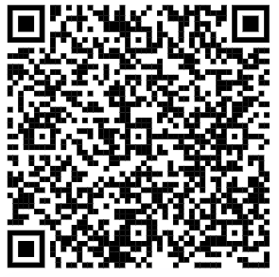
AI Clinic
30-minute (free) consultations for researchers at the university working on applied AI/machine learning research
Book via UTBS!

Slide 4
Workshop Goals
We want to:
Support researchers across the university to use AI – that's LLMs in this group.
Better understand the challenges that researchers face.
Identify what training courses or software resources we might want the Accelerate Science Programme to create.
Including shared code
Start to build a community of like-minded researchers across the university.
Notes:
We are ultimately here to facilitate this process of integrating AI into research.
We run a couple of workshops at the moment: an introduction to large language models, a hands on LLMs, generative AI, diffusion models, docker, a packaging and publishing workshop.

Slide 5
Schedule
Session | Time
9:30 – 10:30 | Session 1
10:30 – 11:00 | Break
11:00 – 12:30 | Session 2
12:30 – 13:30 | Lunch
13:30 – 15:00 | Session 3
15:00 – 15:30 | Break
15:30 – 17:00 | Session 4
Slides available at:
docs.science.ai.cam.ac.uk/large-language-models/

Slide 6
Before we begin...
What do you know about LLMs...?
How do they work?
Can you name any?
What can you use them for?
What are potential problems?
What do you want to use them for?
Notes:
Allow 10 minutes chat

Slide 7

The Llama...
1
1
Tokenization
2
2
Embeddings
3
4
3
Attention
4
Sampling
Notes:
Going to think of our model as a Llama
Has a specific meaning in the history of AI
Llama is an acronym: Large Language Model Meta AI
Released for research-only purposes by Meta in February 2023 following success of GPT-3.5 (ChatGPT moment, i.e. finetuned version of GPT-3) to prove you didn't need closed APIs and huge inference budgets
Uses the same underlying architecture - it is an autoregressive decoder-only transformer. We will come back these words
Shortly leaked and spawned the community of open weights models.
As researchers, we tend to prefer open source models for various reasons so we will be using this as the source of our discussion on model architecture. Most differences between frontier models and Llama are too subtle or complex to discuss for the scope of this workshop
The basic pieces, which will ultimately inform the narrative today are [go through]

Slide 8
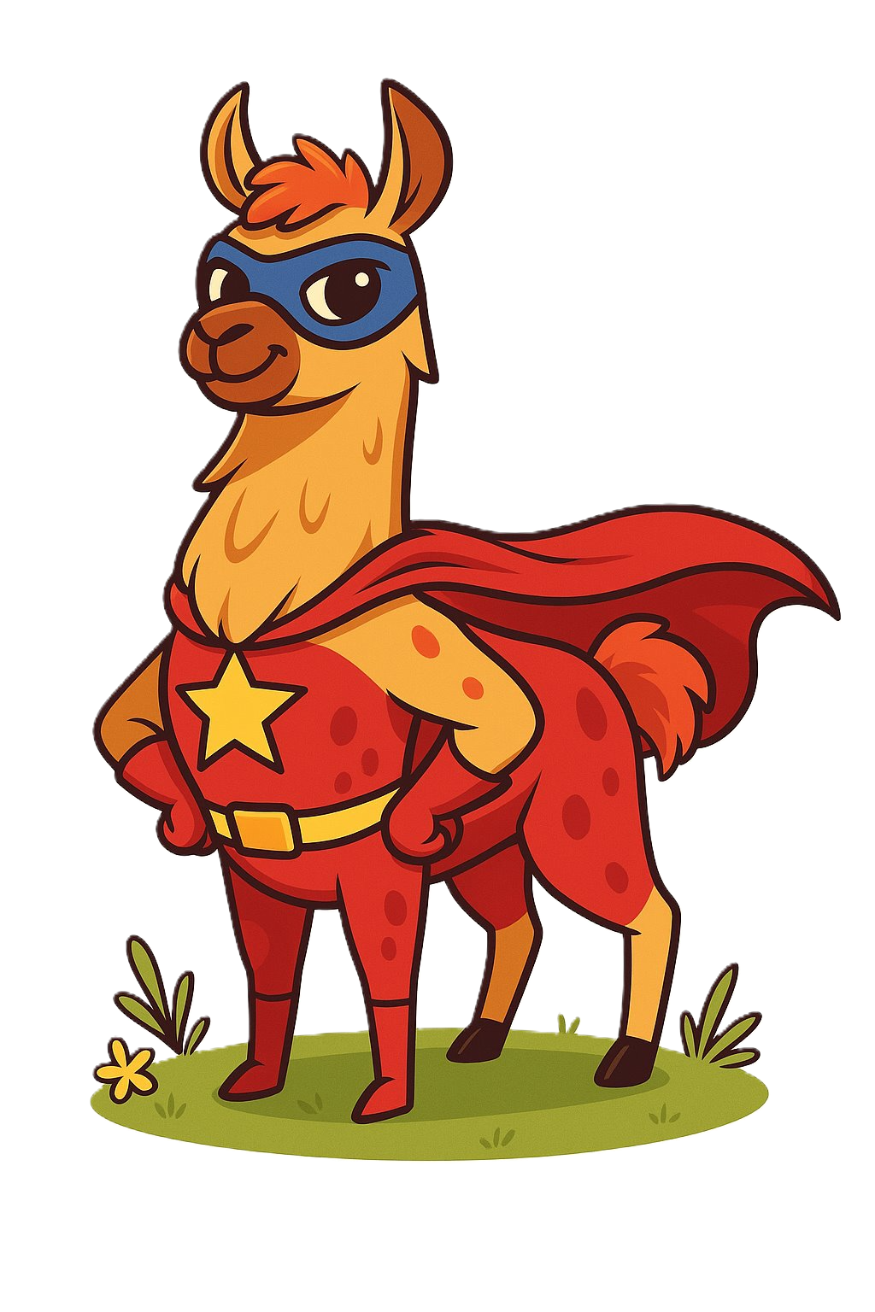
How can we augment them?
Session states
RAG
Prompting
Tools
Finetuning
Notes:
LLMs are stateless, so conversation history stuffed in a context window helps create illusion of state and gives models working memory.
RAG; giving LLMs access to information that isn't baked inside its weights. Retrieve relevant information at inference time and stuff it into context window.
Prompting; so-called prompt engineering, a quite atheoretical practice. It works but evidence is mostly restricted to empirical evidence, a recurring theme we will deal with.
Tool-calling; especially relevant in the so-called agentic era
Fine-tuning; or equivalently any post-training methodology, further improving model performance on down-stream tasks by 'fine-tuning' weights

Slide 9
Some definitions
Model The thing you train and use to generate text.
Architecture The high-level structure of the model.
Parameters (or weights) The internal knobs and dials that get altered during the course of training.
Context The input to the LLM.
Embedding A high-dimensional representation of text.
Token The smallest unit of text fed into a model.
Pre-training The first stage of training the LLM, and usually the most expensive.
Post-training The second stage of training for working beyond general language understanding
Fine-tuning Training the LLM to do a particular task.
Inference The act of calling the model for text generation.
Quantization Reducing the size of a model.
Source The availability of the model (can be open or closed).
Modality Defined by the type of data the model is trained on (e.g. text or images).
API (Application Programming Interface) The means by which you can interact with a model.

Slide 10
EU AI Act (August 2024)
How does the AI Act define things...?
Notes:
Let's look at actually defining AI

Slide 11
EU AI Act (August 2024)
How does the AI Act define things...?
general-purpose AI model ... an AI model

Slide 12
EU AI Act (August 2024)
How does the AI Act define things...?
general-purpose AI model ... an AI model … trained with a large amount of data using self-supervision at scale, that displays significant generality and is capable of competently performing a wide range of distinct tasks

Slide 13
EU AI Act (August 2024)
How does the AI Act define things...?
general-purpose AI model ... an AI model … trained with a large amount of data using self-supervision at scale, that displays significant generality and is capable of competently performing a wide range of distinct tasks ... that can be integrated into a variety of downstream systems or applications ...

Slide 14
EU AI Act (August 2024)
How does the AI Act define things...?
general-purpose AI model ... an AI model … trained with a large amount of data using self-supervision at scale, that displays significant generality and is capable of competently performing a wide range of distinct tasks ... that can be integrated into a variety of downstream systems or applications ...
Notes:
Self supervision is where the training data labels itself. I.e. for next token prediction, don't need human labelling as with conventional supervised learning. The structure of the text already encodes the ground truth.

Slide 15
General Purpose AI Model
The number of parameters of the model;
The quality or size of the data set, for example measured through tokens;
The amount of computation used for training the model, measured in:
Floating point ops
Cost of training
Training time
Energy consumption
Notes:
The Act needs a practical, auditable way to classify and assess general purpose AI models without being able to directly test every possible capability. These indicators are its solution to that problem.
CONTINUES ON NEXT SLIDE

Slide 16
General Purpose AI Model
The input and output modalities of the model, such as text to text (large language models)
Impact:
Business users
Registered end-users
The benchmarks and evaluations of capabilities of the model
Tasks without additional training
Adaptability to distinct tasks
Autonomy and scalability
Tool access

Slide 17
AI Systems
There is a clear distinction between AI models and AI Systems
"...AI models require the addition of further components, for example a user interface, to become AI systems..."

Slide 18
Further reading
Raphaël Millière and Charles Rathkopf, Anthropocentric bias and the possibility of artificial cognition, 2024
Raphaël Millière and Cameron Buckner, A Philosophical Introduction to Language Models, 2024
EU AI Act Explorer
ICO Information:
Artificial Intelligence
Data Protection
Explaining Decisions

Slide 19
The Llama...
1
1
Tokenization
2
2
Embeddings
3
4
3
Attention
4
Sampling

