Slide 1
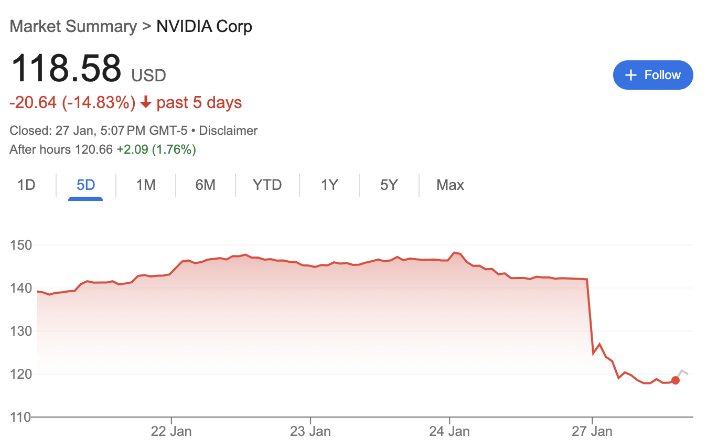
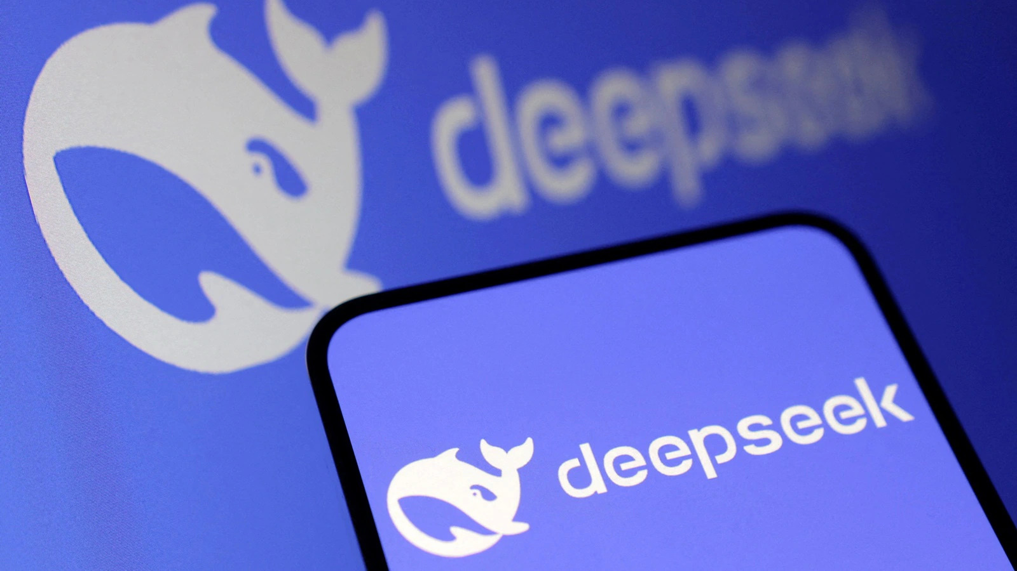
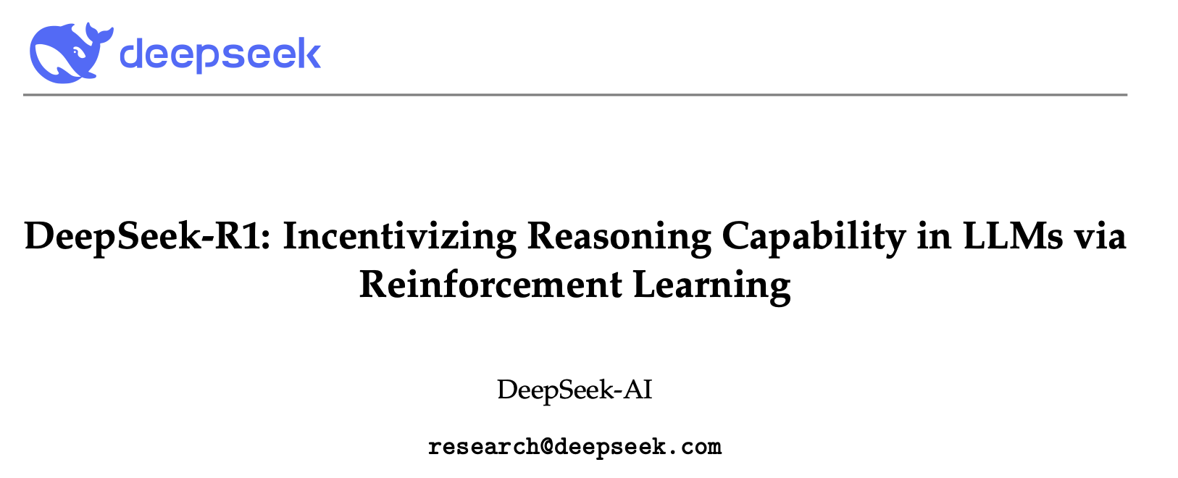
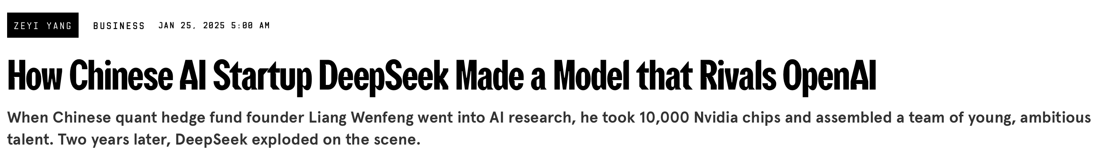
January 2025
arXiv:2501.12948v2
Notes:
[TIMINGS]
Practice: 25m
Target: 30m
Start time: 16:00
End time: 17:00
---
Deepseek-R1 matched OpenAIs GPT-4 on many tasks. Beat it on coding and maths benchmarks most importantly
3-4x less compute for training
Deepseek: 5-6 million
GPT-4 : 100+ million (cited esimates)
Not just “scaling wins”, post-training via fine-tuning with supervised fine tuning and clever RL (GRPO) works – wake up call for industry!

Slide 2
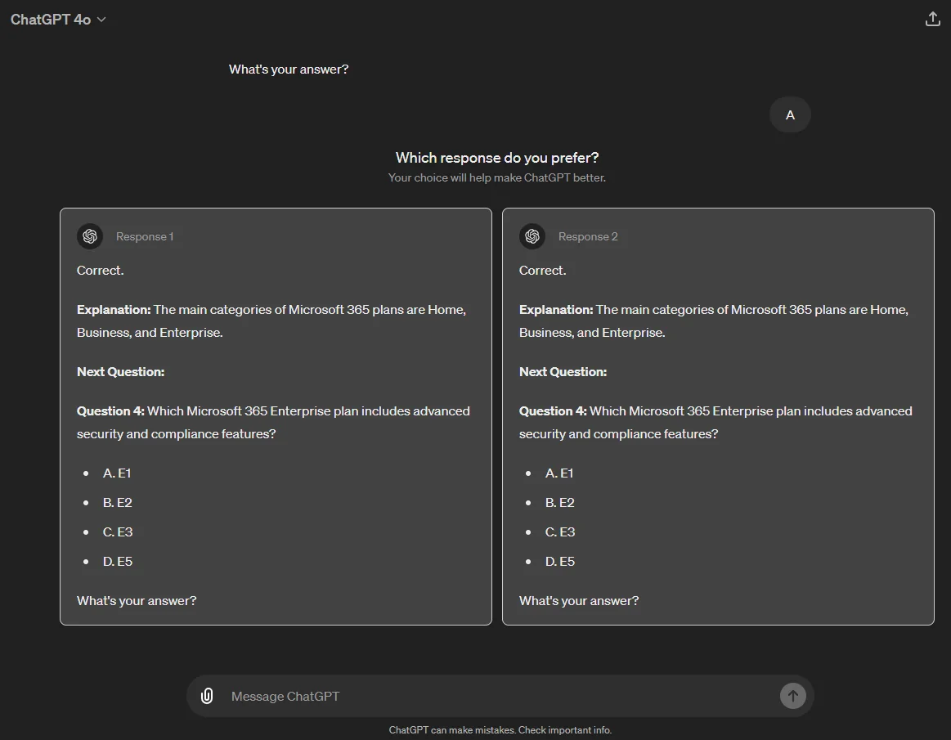


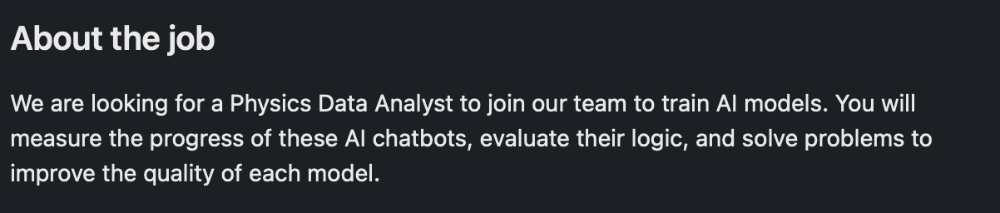
Look Familiar?

Slide 3

Post-training & Fine-tuning
This can be hard...

Slide 4
Overview
Post-training vs. Fine-tuning
Instruction tuning
LoRA
qLoRA

Slide 5

Post-training vs. Fine-tuning
Post-training refers to everything that happens after the initial pre-training phase. It's an umbrella term covering all techniques used to shape model behaviour or align it with human preferences. It includes:
Supervised fine-tuning (e.g. instruction tuning)
RLHF (Reinforcement Learning from Human Feedback)
RLVR (Reinforcement Learning from Verifiable Rewards)
Constitutional AI
Notes:
Constitutional AI:
Invented by Anthropic
Instead of asking humans to rank "which response is safer?", CAI gives the model a set of principles (a "constitution"). Then trains the model to critique and revise its own outputs according to those principles.

Slide 6
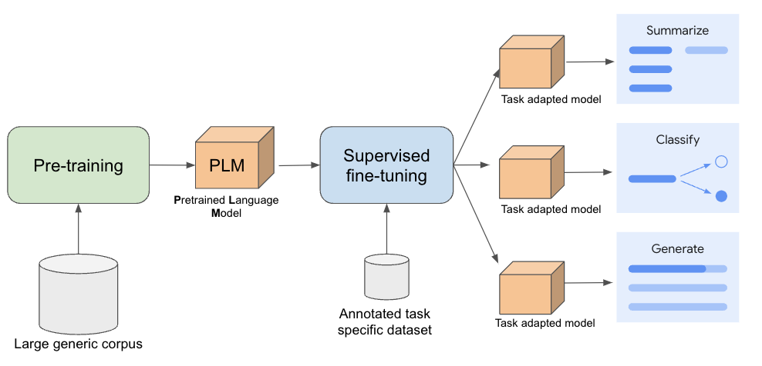
Fine-tuning refers to adapting a pre-trained foundation model to a specific downstream task / domain via post-training on a usually small specialized dataset.
Source: Google Cloud
Notes:
We’re going to take a particular look at an example of fine-tuning

Slide 7
Instruction tuning
We have been doing next token prediction on trillions of tokens...
...and that's it...
We've built a very expensive next word predictor
We want an assistant

Slide 8
Instruction tuning
<|begin_of_text|><|start_header_id|>system<|end_header_id|>
You are an expert in baking.<|eot_id|>
<|start_header_id|>user<|end_header_id|>
Provide me a recipe for macarons.<|eot_id|>
<|start_header_id|>assistant<|end_header_id|>
Certainly! Here is a recipe for macarons …<|eot_id|>
special tokens

Slide 9
Instruction tuning
<|begin_of_text|><|start_header_id|>system<|end_header_id|>
You are an expert in baking.<|eot_id|>
<|start_header_id|>user<|end_header_id|>
Provide me a recipe for macarons.<|eot_id|>
<|start_header_id|>assistant<|end_header_id|>
Certainly! Here is a recipe for macarons …<|eot_id|>
role

Slide 10
Instruction tuning
We can structure our data as a jsonl file
{
"messages":
[
{"role": "system", "content": "You are an expert in baking."},
{"role": "user", "content": "Provide me a recipe for macarons."},
{"role": "assistant", "content": "Certainly! Here is a recipe for macarons. ..."}
]
}

Slide 11
Instruction tuning
<|begin_of_text|><|start_header_id|>system<|end_header_id|>
You are an expert in baking.<|eot_id|>
<|start_header_id|>user<|end_header_id|>
Provide me a recipe for macarons.<|eot_id|>
<|start_header_id|>assistant<|end_header_id|>
START GENERATING...until we hit <|eot_id|>
input
generation

Slide 12
Instruction tuning
Still next token generation
This "template" is very important
Deviate from the template during inference, and you'll get poor results
The pattern is also important (system, user, assistant, user, assistant, …)

Slide 13

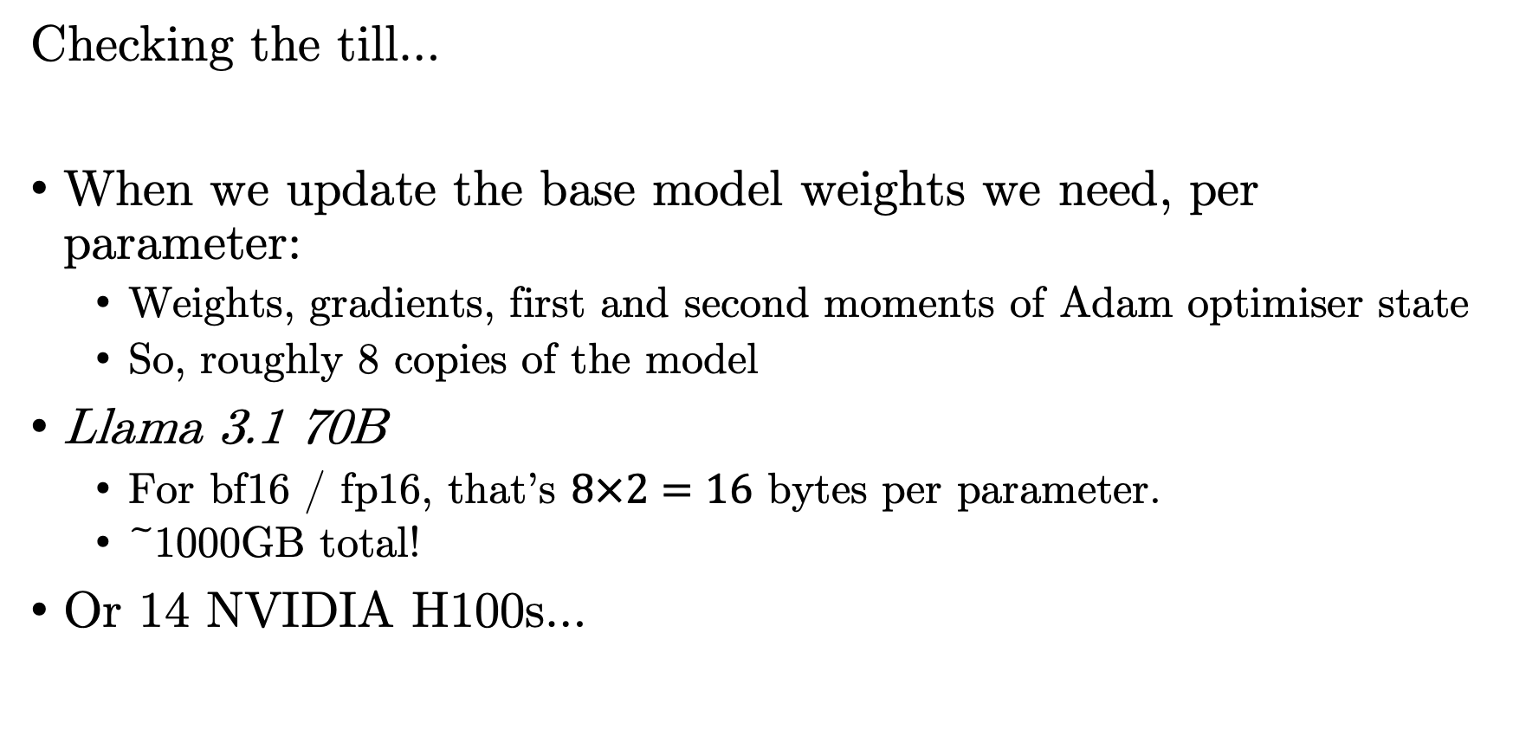
Full fine-tuning (FFT)
Checking the till…
When we update the base model weights we need, per parameter:
Weights, gradients, first and second moments of Adam optimiser state
So, roughly 8 copies of the model
Llama 3.1 70B
For bf16 / fp16, that’s $8×2=16$ bytes per parameter.
~1000GB total!
Or 14 NVIDIA H100s…
Notes:
What if we decided to instruction tune by just continuing to train the model after the pre-training (this is referred to as full fine-tuning)

Slide 14
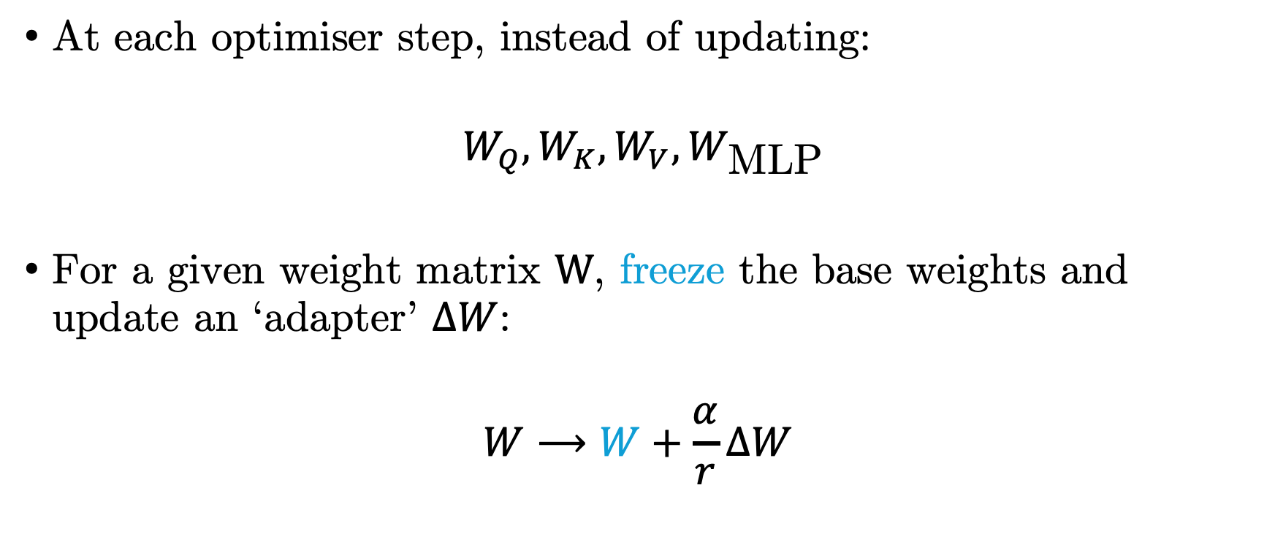
Low Rank Adaptation (LoRA)
At each optimiser step, instead of updating:
$$W_{Q},W_{K},W_{V},W_{\text{MLP}}$$
For a given weight matrix $W$, freeze the base weights and update an ‘adapter’ $ΔW$:
$$W⟶W+\frac{α}{r}ΔW$$
Update this!
arXiv:2106.09685
Notes:
a

Slide 15
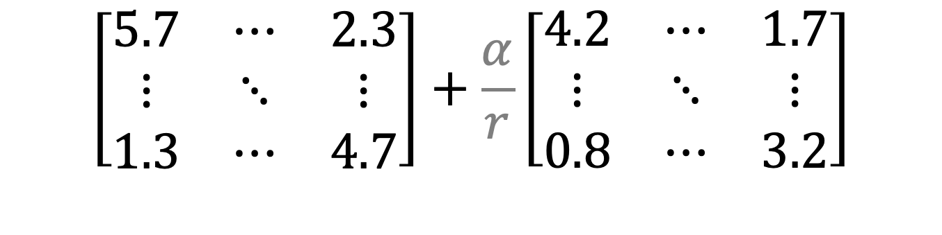
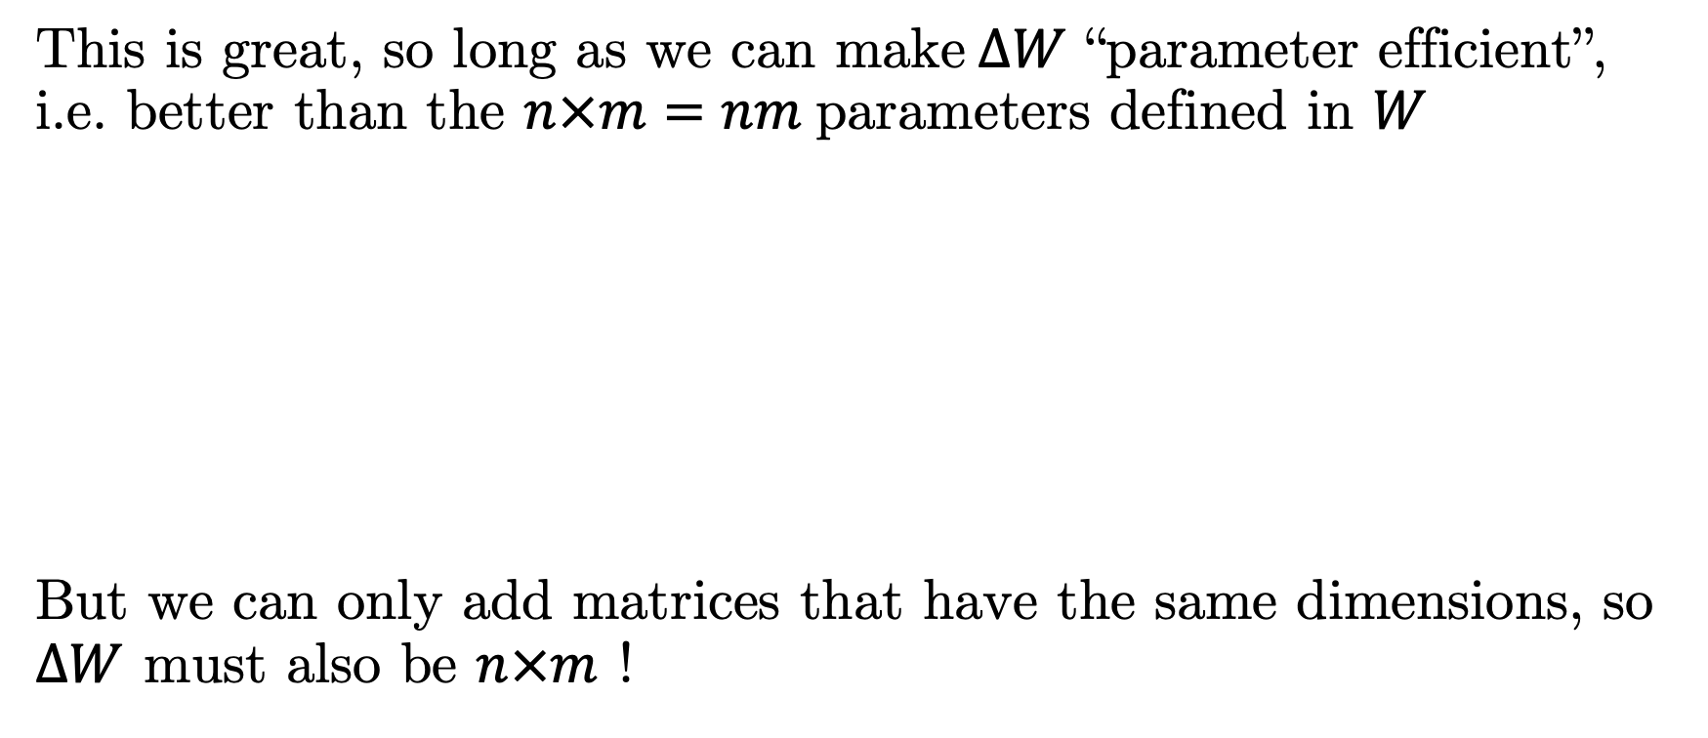


Low Rank Adaptation (LoRA)
This is great, so long as we can make$ΔW$ “parameter efficient”, i.e. better than the $n×m=nm$parameters defined in $W$
But we can only add matrices that have the same dimensions, so $ΔW$ must also be $n×m$ !
$$\left[\begin{matrix}5.7 & ⋯ & 2.3 \\ ⋮ & ⋱ & ⋮ \\ 1.3 & ⋯ & 4.7\end{matrix}\right]+\frac{α}{r}\left[\begin{matrix}4.2 & ⋯ & 1.7 \\ ⋮ & ⋱ & ⋮ \\ 0.8 & ⋯ & 3.2\end{matrix}\right]$$
$$W\left(n×m\right)$$
$$ΔW\left(n×m\right)$$
arXiv:2106.09685

Slide 16






Low Rank Adaptation (LoRA)
The solution: express the adapter $ΔW$ as a product of low rank matrices
LoRA rank – very small (e.g. 4, 8)
$$A$$
$$\left(n×r\right)$$
$$ΔW \left(n×m\right)$$
$$×$$
$$B$$
$$\left(r×m\right)$$
$$=$$
So, that’s $r\left(n+m\right)≪nm$ parameters!
arXiv:2106.09685

Slide 17
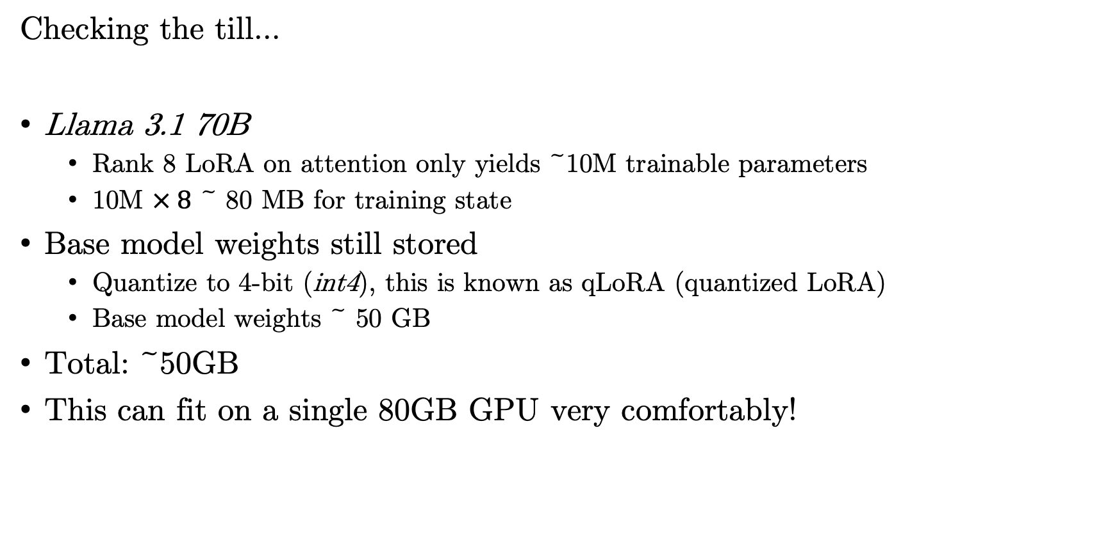
Low Rank Adaptation (LoRA)
Checking the till…
Llama 3.1 70B
Rank 8 LoRA on attention only yields ~10M trainable parameters
10M $× 8$ ~ 80 MB for training state
Base model weights still stored
Quantize to 4-bit (int4), this is known as qLoRA (quantized LoRA)
Base model weights ~ 50 GB
Total: ~50GB
This can fit on a single 80GB GPU very comfortably!

Slide 18
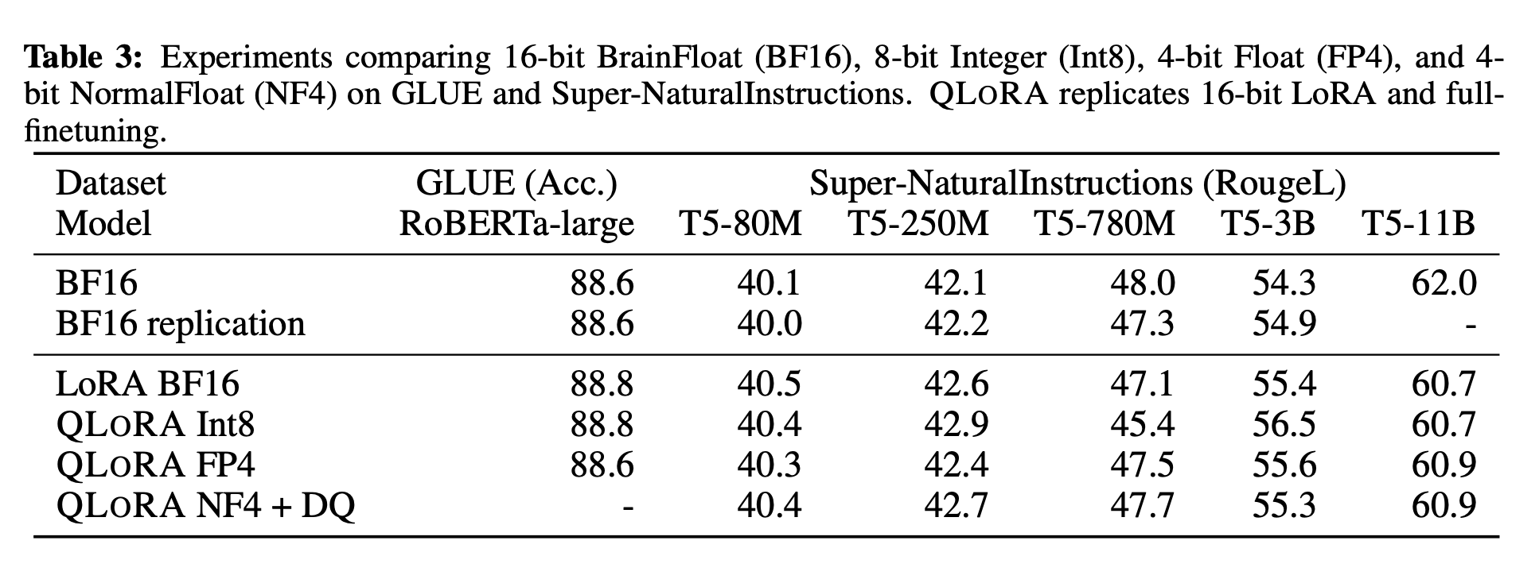
Quantized Low Rank Adaptation (qLoRA)
arXiv:2305.14314

