Slide 1
Retrieval Augmented Generation
(RAG)

Slide 2
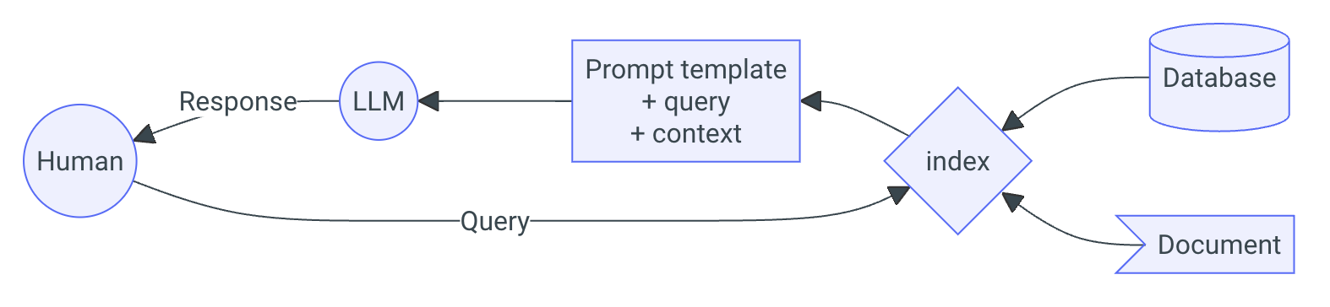
RAG
60% of the time, it works every time.
RAG is by far the most popular application of LLMs
Entire ecosystems like LangChain and LlamaIndex are built around it
Notes:
The temptation of many people first encountering LLMs is that they need to fine-tune (or worse: build and pretrain their own model).
I understand the desire to build things from the ground up, and have total control over everything.
However, the most likely thing you want is a well-trained existing open-source model, with some kind of knowledge database.
RAG is an incredibly common application of LLMs. So much so, that entire frameworks have been built around it. The most popular ones are LangChain and LlamaIndex.
Although we touched on it earlier, RAG works something like this:
Take a document or bunch of documents
Create a database
Create an embedding model that translates words to vectors
Break your document(s) into chunks, preferably overlapping
Convert the text chunks into vector chunks
Store your vector chunks in the database along with some metadata
Write out a query
Embed the query into a vector
Search for the top k similar vectors in your database
Convert the vector chunks back into text chunks
Create a single prompt from the text chunks and the original prompt you sent it (or a modified version)
Send this prompt to the LLM.
Get the response.
Phew!
That is a lot of work. And as you might guess, there is a lot of places where it can go wrong!

Slide 3
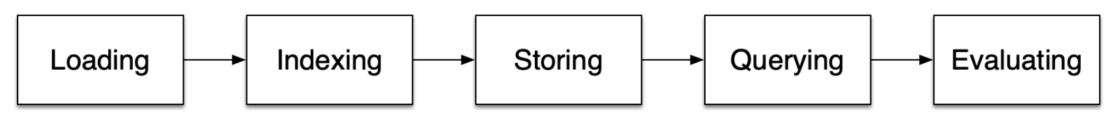
RAG
There are probably hundreds of tutorials online that will get you up and running with a trivial RAG applications in a few lines of code
The reality is…
…RAG is HARD!
Notes:
Perhaps annoyingly, the internet is filled with RAG tutorials telling you how easy it is.
But it’s actually really hard.
So what are the steps that you might have to go through? We covered them off a little in the previous slide, but here are the main steps.
At each step, you have to make a decision, and each decision firstly has to be justified – why did you choose that particular model, or that particular evaluation metric.
And secondly, each decision exposes you to risk of failure – there will be some level of uncertainty introduced to your system that you may or may not care about.
In the hands-on workshop, we will actually dive into this in a bit more detail. But for now, let’s just look at a quick example of getting structure out of these models.

Slide 4
Start being Pydantic…
Suppose I have the following task:
Analyse a text description…
“My name is Ryan, and I am 35 years old. During the weekends I like to hike, but I also enjoy playing video games. It can sometimes be difficult to use my computer, because my cat likes to sleep on the keyboard! Unfortunately, there aren't too many mountains in the UK, and I miss the outdoors back home in NZ. During the week, I work as a MLE at the University of Cambridge.”
…and extract some important information
Notes:
1. Start using the APIs!
You get control over hyperparamters

Slide 5
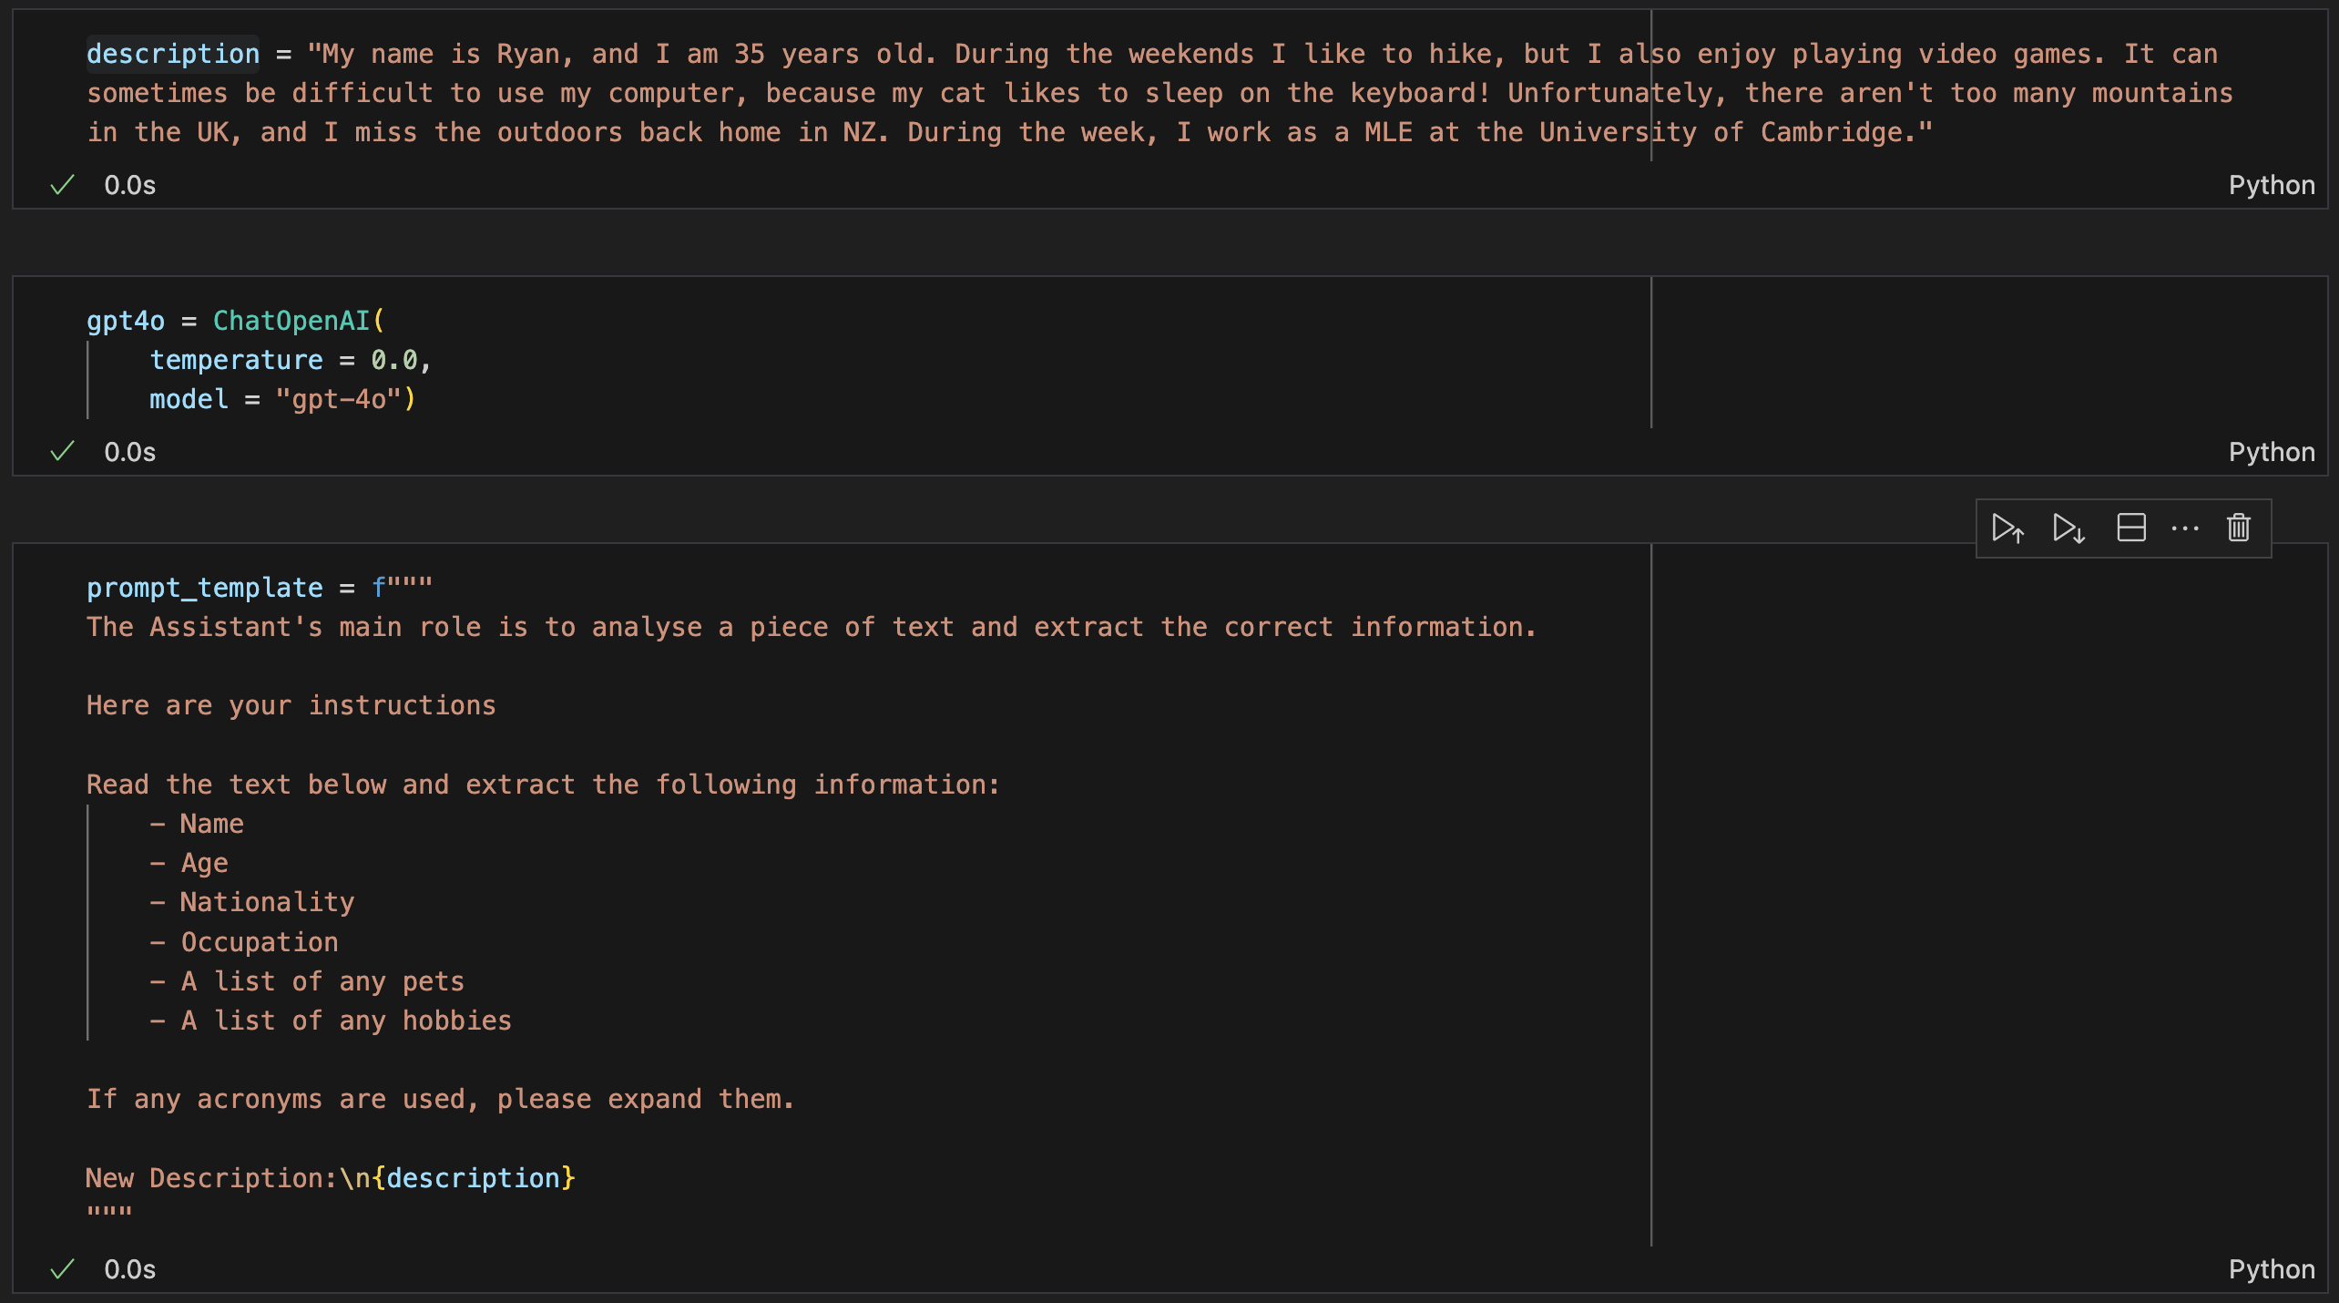
Structured output
Name
Age
Nationality
Occupation
A list of any pets
A list of any hobbies

Slide 6
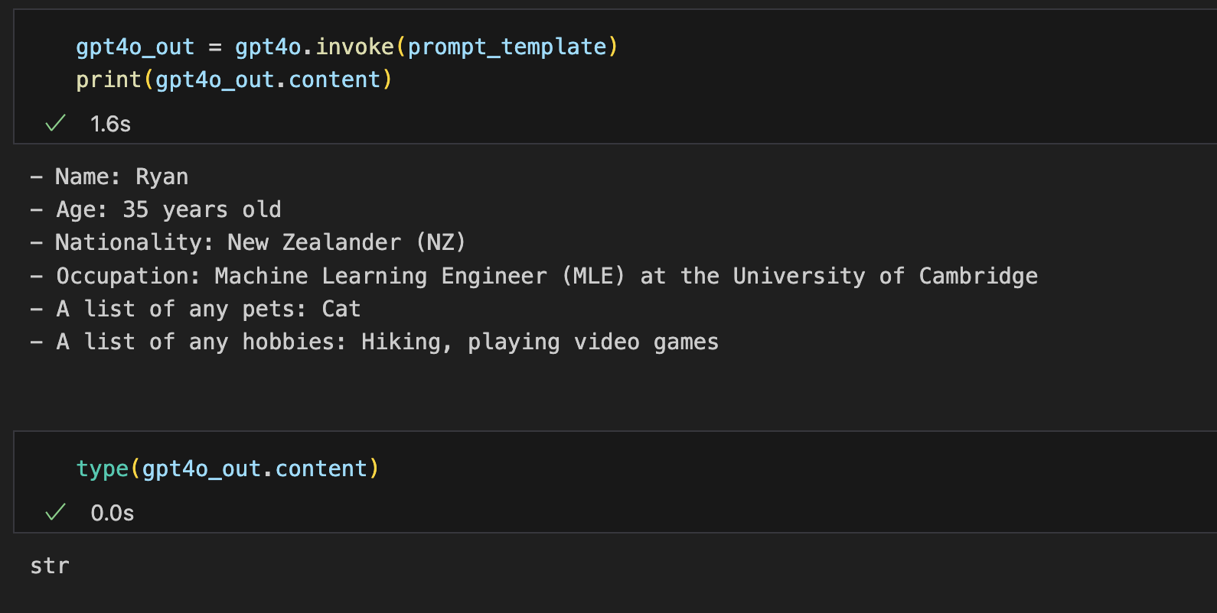
Start being Pydantic…
Great, so this is easy to do, but this is the output from GPT-4o:

Slide 7
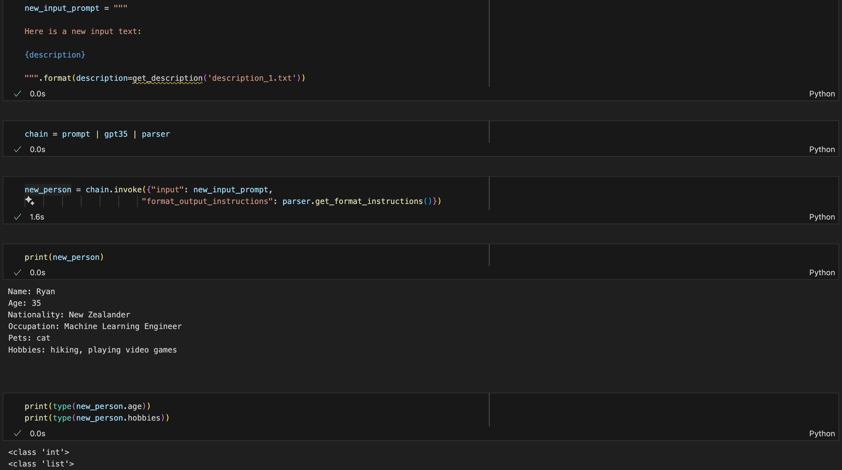
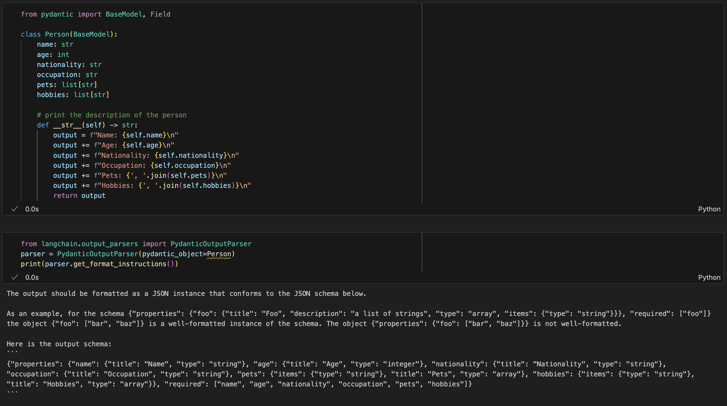
Structured output
But how do I work with this data!
It’s a string!
Using PyDantic, we can actually create data objects…
Notes:
It doesn’t end here, we can also do function calling as well. So I can give the LLM tools to perform calculations, to access websites, etc.
The caveat is: these are still LLMs, and their outputs could still hallucinate

