Slide 1

The hardware
AI is expensive...
Hardware
0
0

Slide 2
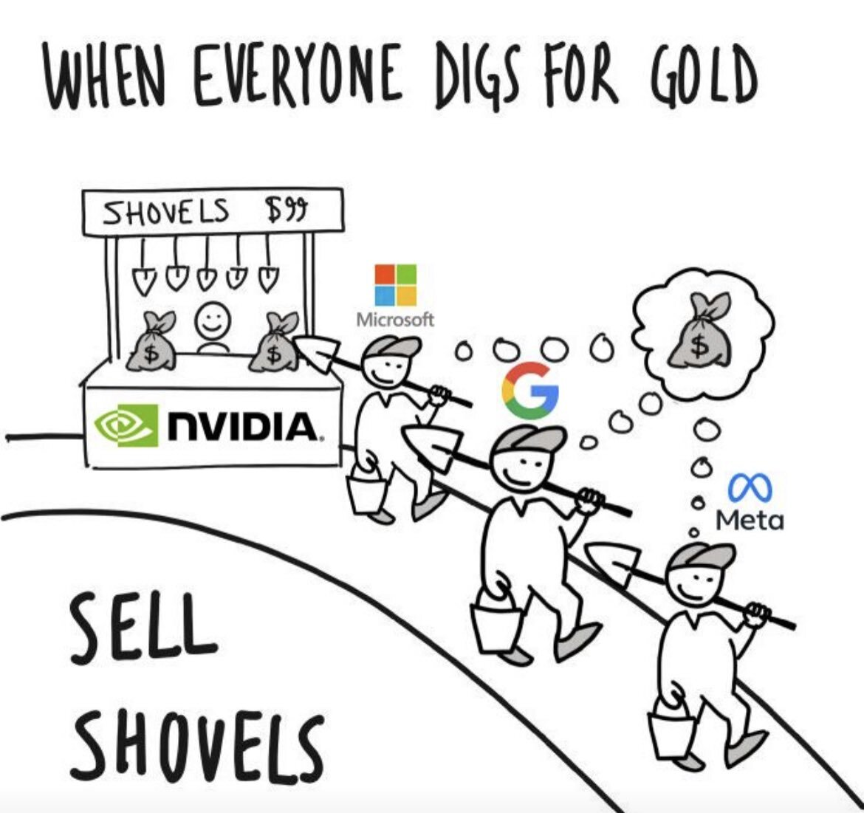

Slide 3
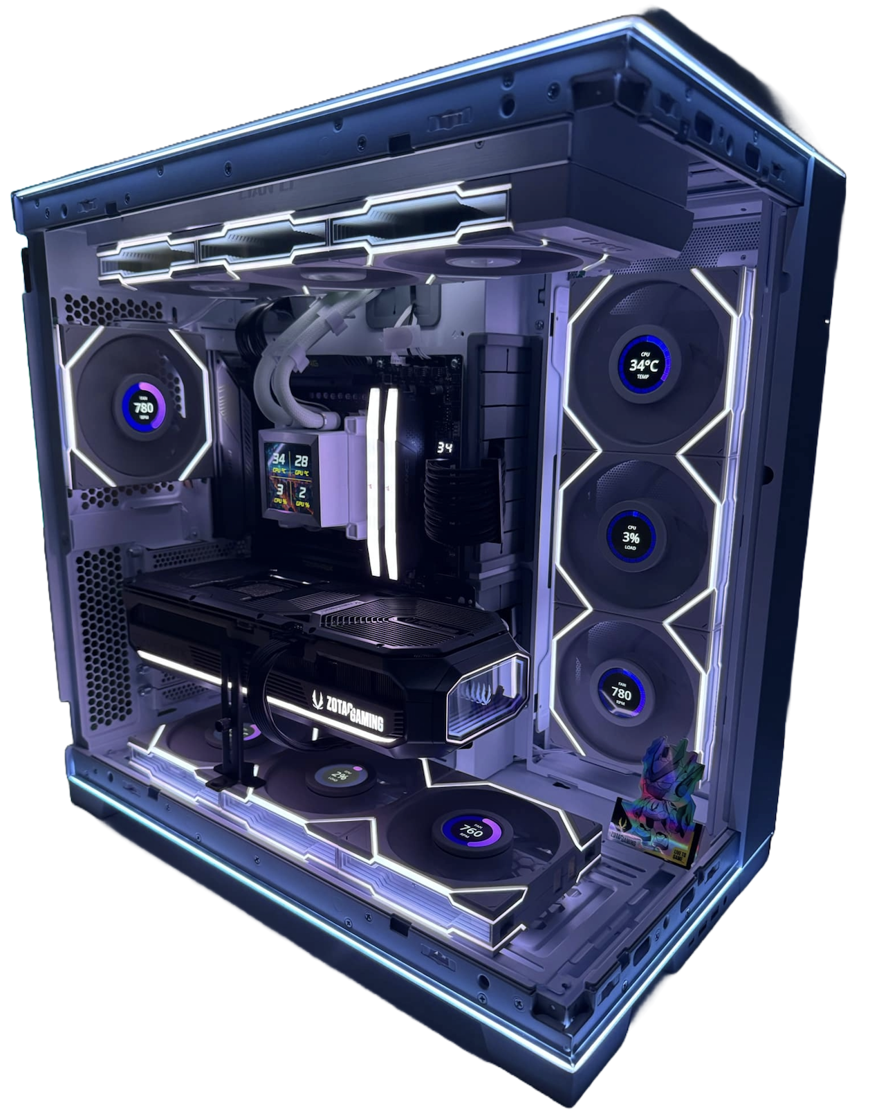
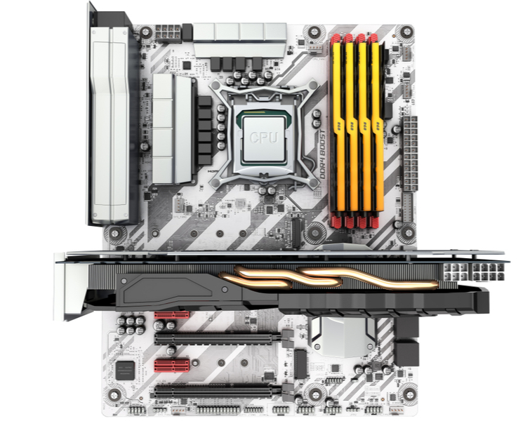
Computer Hardware

Slide 4

Computer Hardware

Slide 5
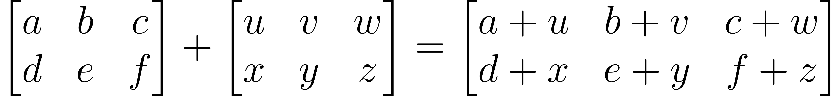
Matrix Addition
3
2
(2 x 3)
(2 x 3)
(2 x 3)
$$ℝ^{2,3}$$
$$ℝ^{2,3}$$
$$ℝ^{2,3}$$
Dimensions must match!

Slide 6
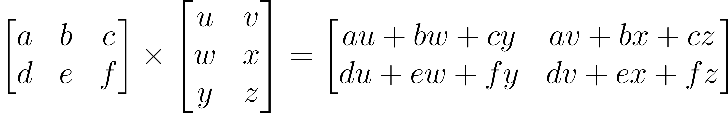
Matrix Multiplication
3
2
(2 x 3)
(3 x 2)
(2 x 2)
$$ℝ^{2,3}$$
$$ℝ^{3,2}$$
$$ℝ^{2,2}$$
Inner dimensions must match!

Slide 7
Matrix Operations:
By Cmglee - Own work, CC BY-SA 3.0, https://commons.wikimedia.org/w/index.php?curid=35180401

Slide 8
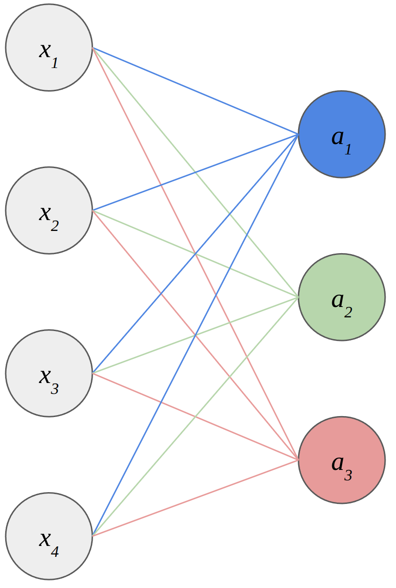
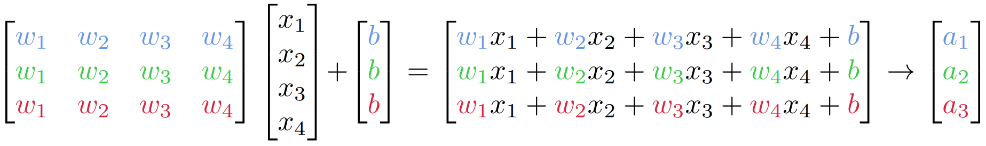
Turns out that AI is basically the same
Inputs: arrays of numbers
Weights: arrays of numbers

Slide 9
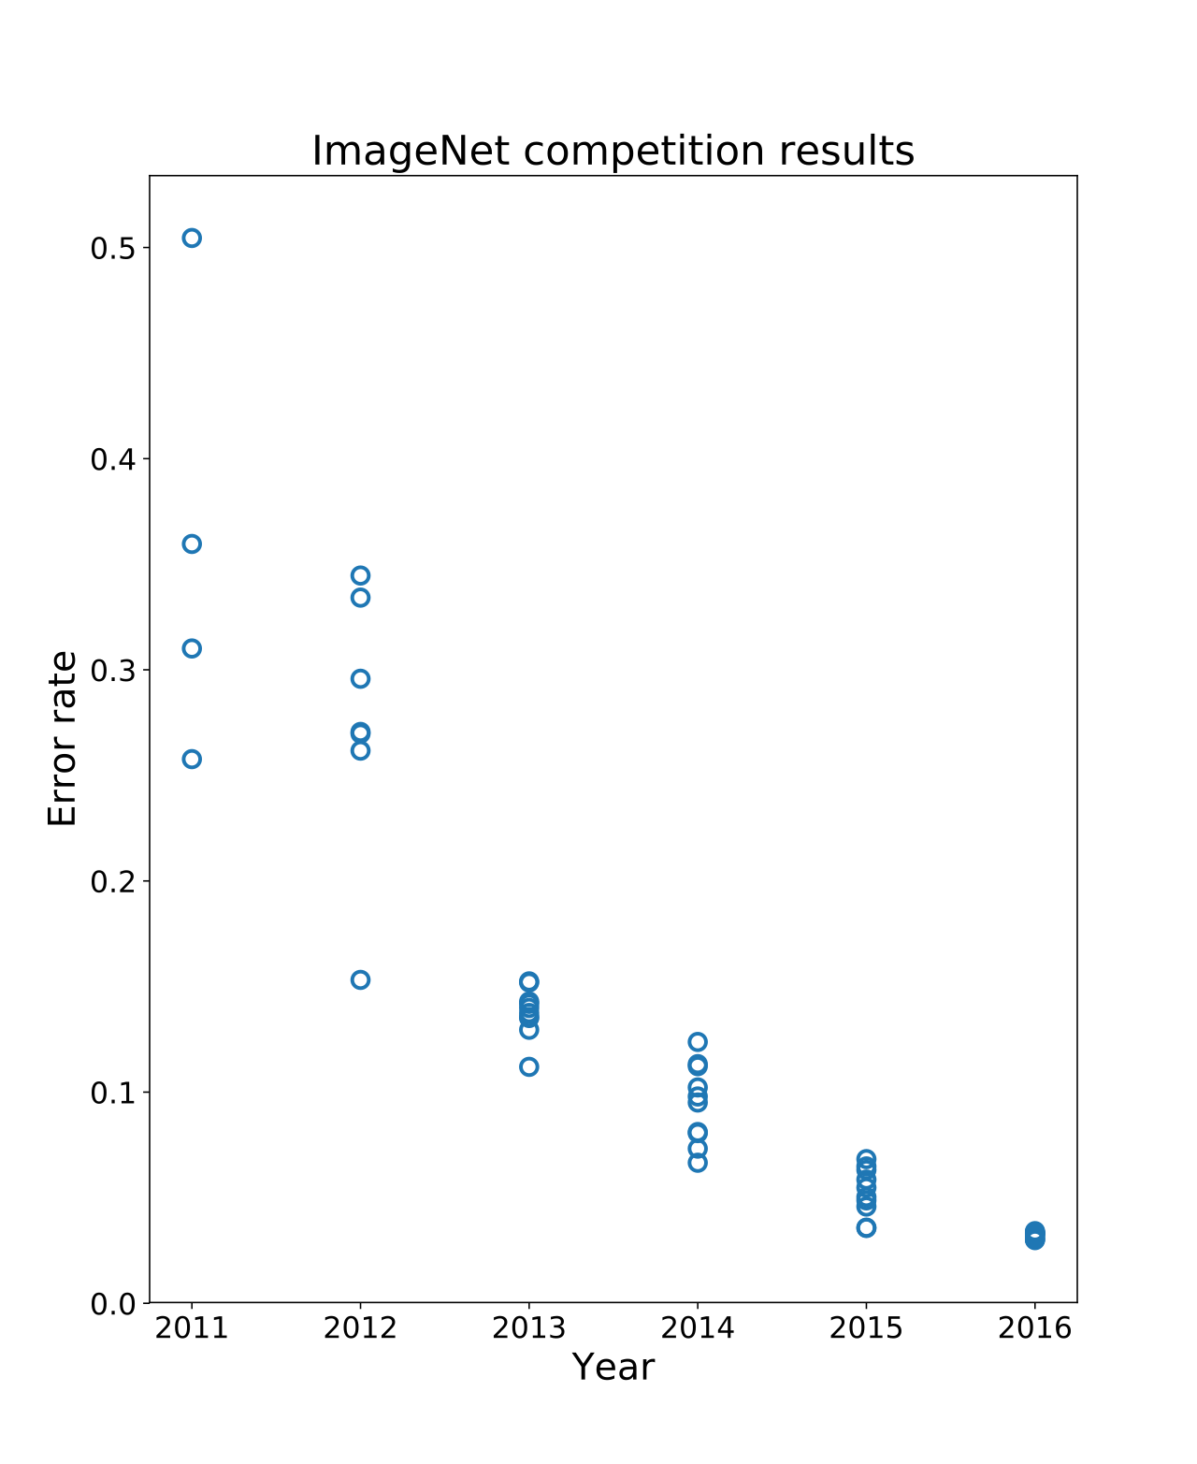
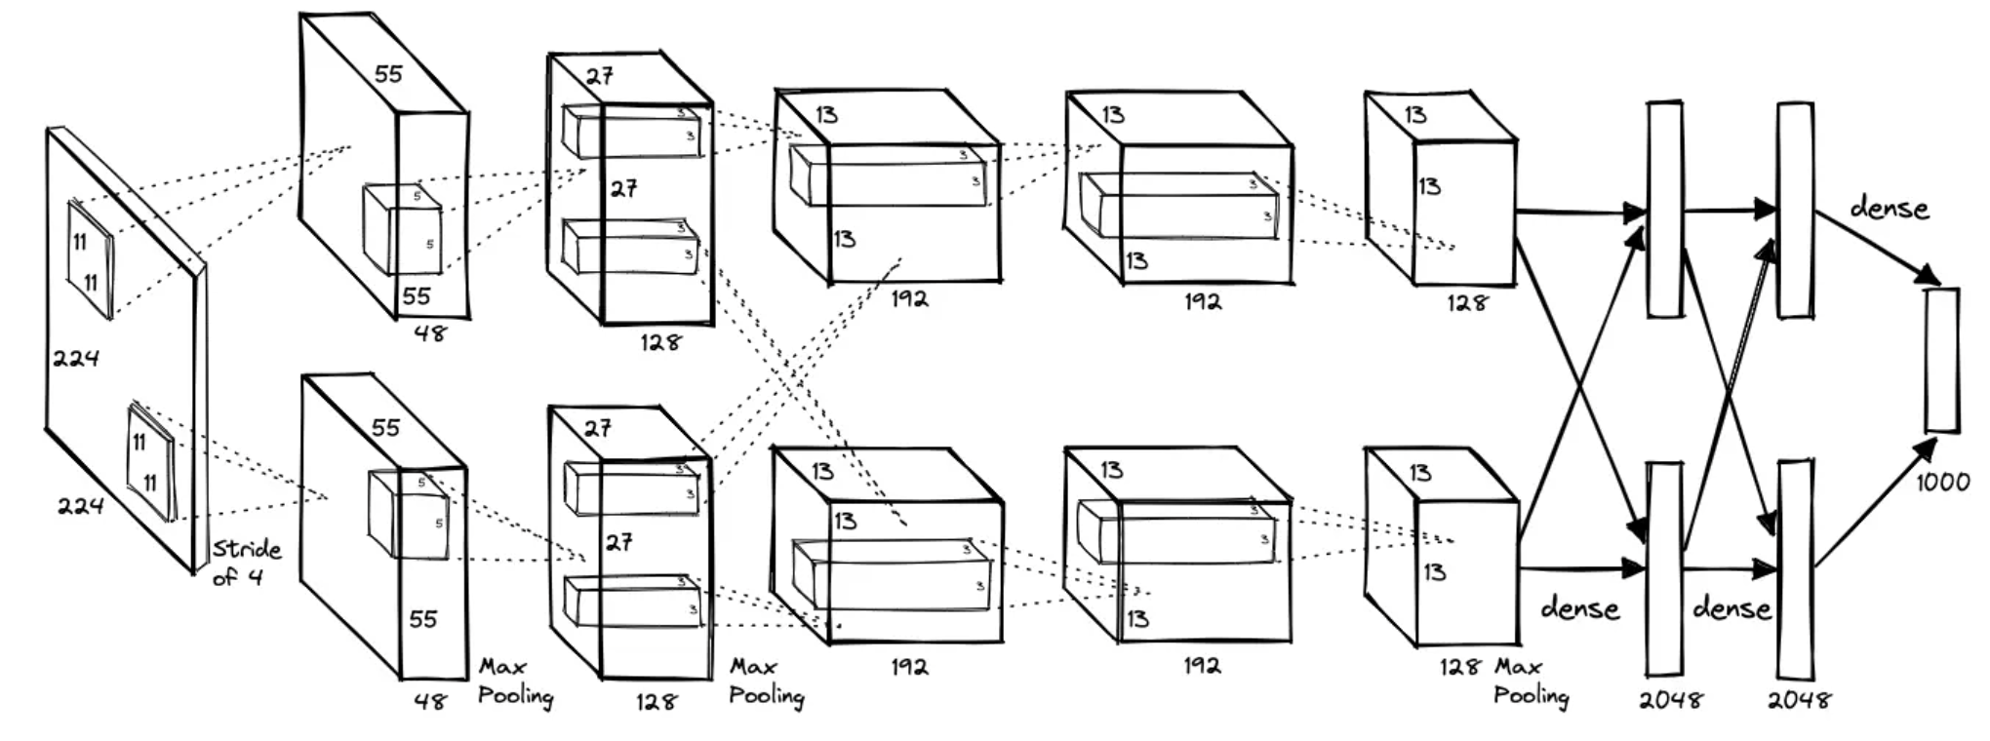
Milestone #1
https://proceedings.neurips.cc/paper_files/paper/2012/file/c399862d3b9d6b76c8436e924a68c45b-Paper.pdf

Slide 10
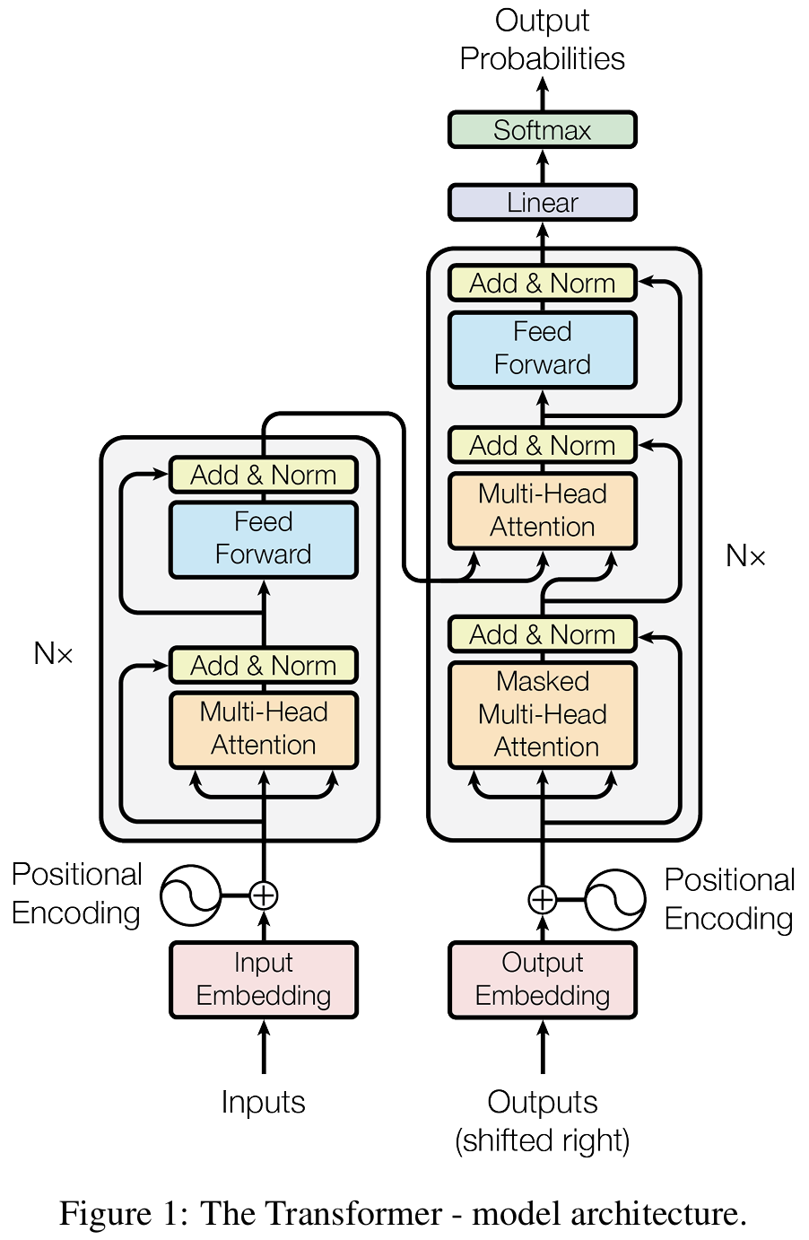
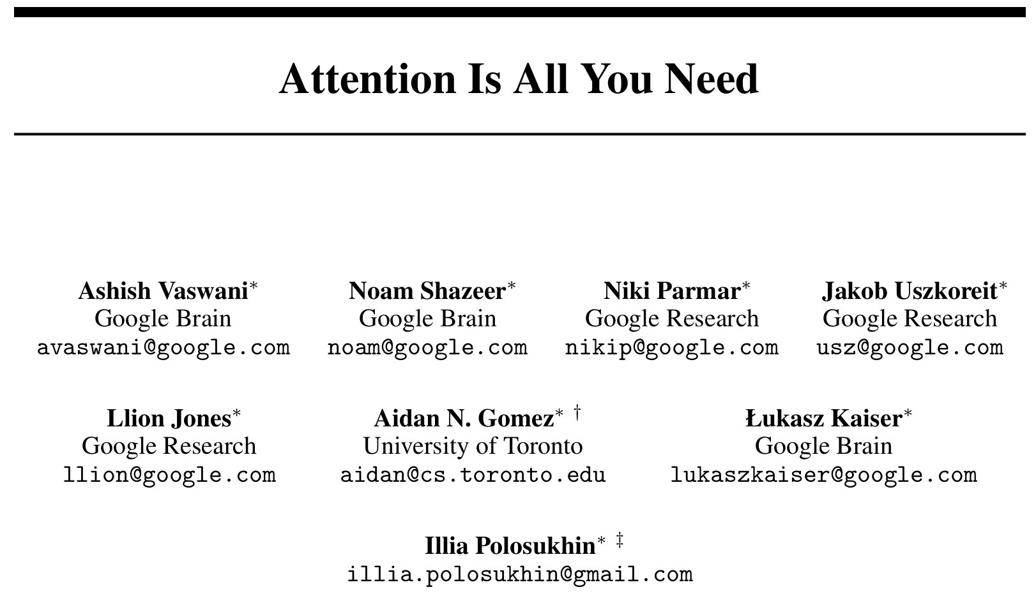
Milestone #2
https://arxiv.org/abs/1706.03762

Slide 11
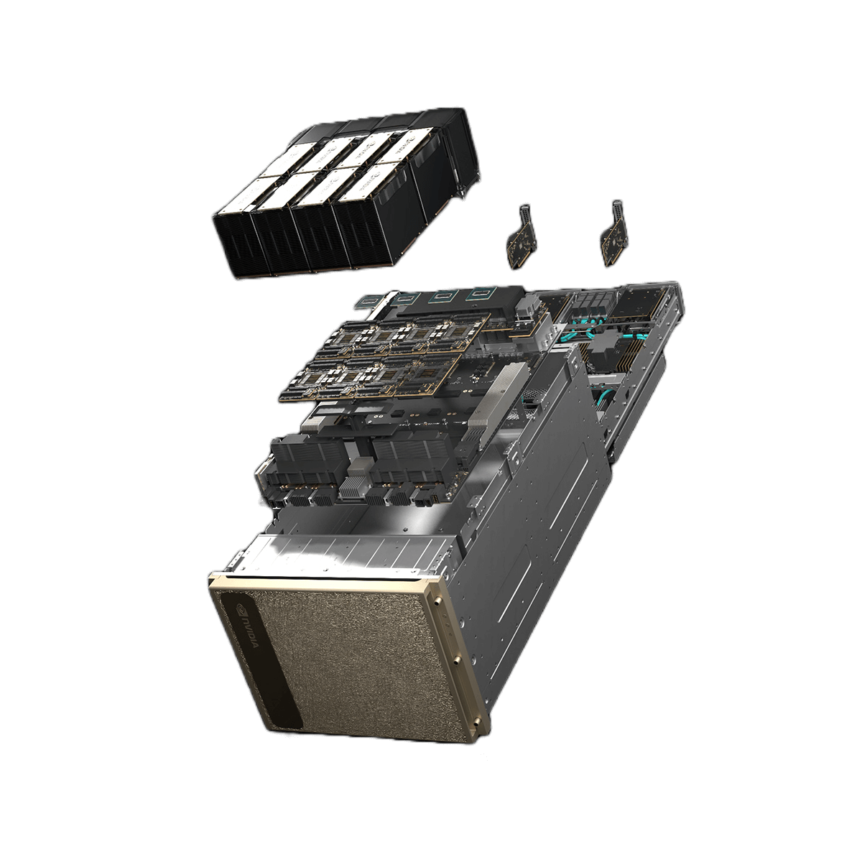
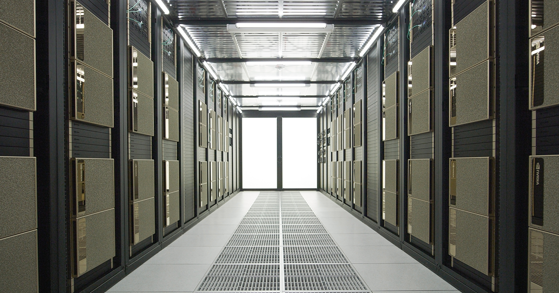
Data centres

Slide 12
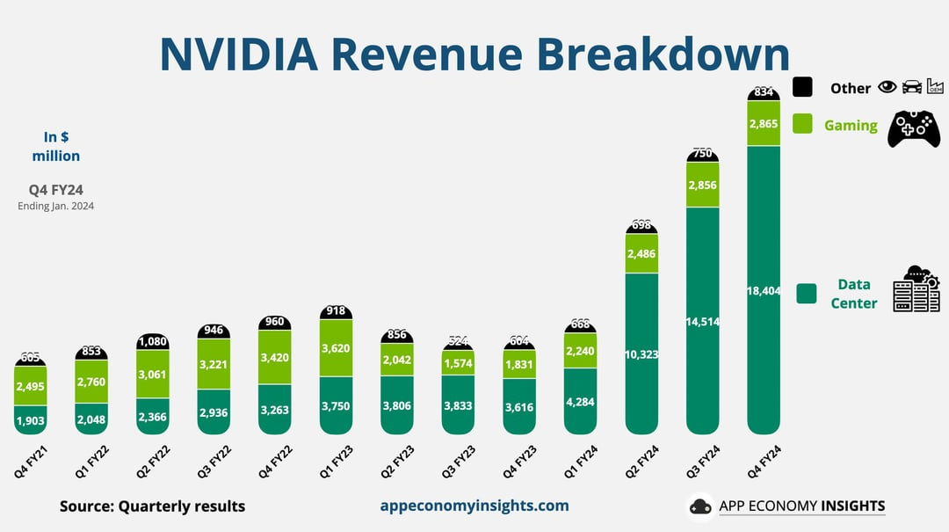

Slide 13
Some Nvidia GPUs
Previous Gen
A40
A10G
V100
A(4,5,6)000
A100
Current Gen
L40(S)
RTX Pro 6000
H100
H200
B200
Gaming
RTX 10xx, 20xx, 30xx, 40xx, 50xx

Slide 14
The competition
AMD
  Commercial:
    CPU
      Ryzen series
    GPU
      Radeon
  Pro:
    CPU
      EPYC
      Threadripper
    GPU
      Instinct MI300 / MI350
Intel
  Commercial:
    CPU
      Core i-series
    GPU
      Arc
  Pro:
    CPU
      Xeon
    GPU
      Ponte Vecchio
      Flex

Slide 15
The NVIDIA moat
CUDA is NVIDIAs parallel computing platform. It’s the software layer that let’s developers write code that runs on a GPU rather than a CPU
Has specialised libraries that sit on top:
cuDNN (Deep Neural Networks)
cuBLAS (Basic Linear Algebra Subprograms)
PyTorch, TensorFlow and virtually every ML framework sits on top of CUDA.
Migrating (e.g. ROCm) is high risk and has a lot of technical overhead

Slide 16
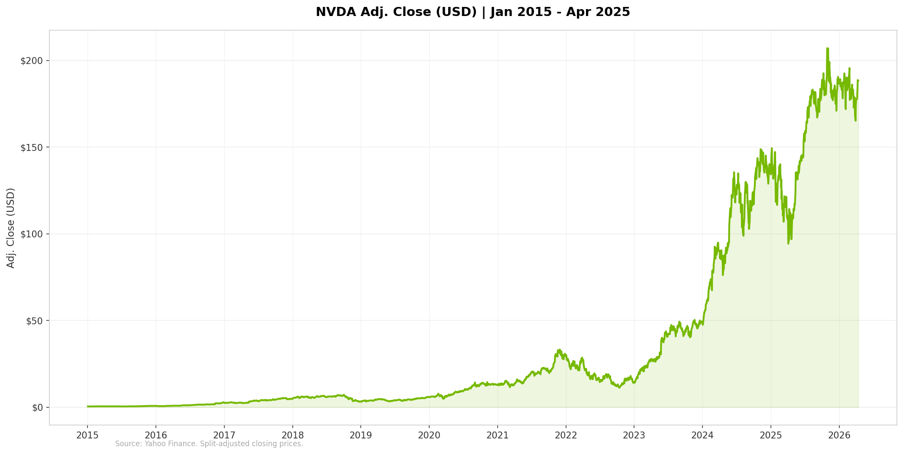
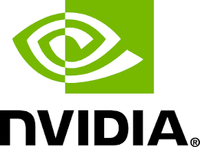
6

Slide 17
Special mentions
AMD ROCm
Nvidia DGX Spark
Huawei
...the important thing is the software stack and memory bandwidth

