Slide 1
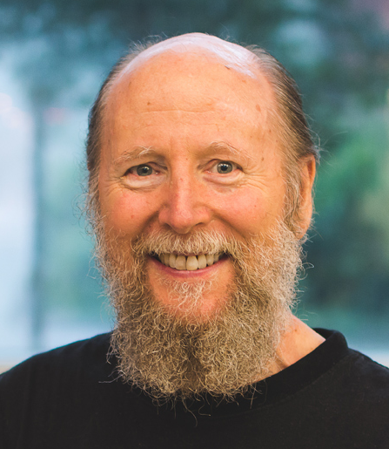
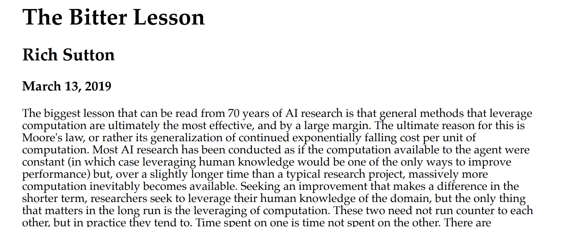
www.incompleteideas.net/IncIdeas/BitterLesson.html
Notes:
[TIMINGS]
Practice: 45m
Target: 45m
Start time: 14:45
[30m break @ 15:00 – 15:30]
End time: 16:00
---
Richard Sutton, Canadian computer scientist - godfather of RL, Turing award winner
Blogpost on his website from 2019, that's garnering more and more attention as we move through this age of LLMs
The core argument is simple: every time researchers have tried to build human knowledge into AI systems, they've eventually been beaten by simpler methods that just leverage more compute and data.
We've seen this so far:
- Neural embeddings vs tf-idf and other heuristic approaches
- Key, query and value matrices in attention
Turns out this theme continues in what we're going to talk about next which is pre-training. But first we should talk about how to get sample outputs from these models

Slide 2
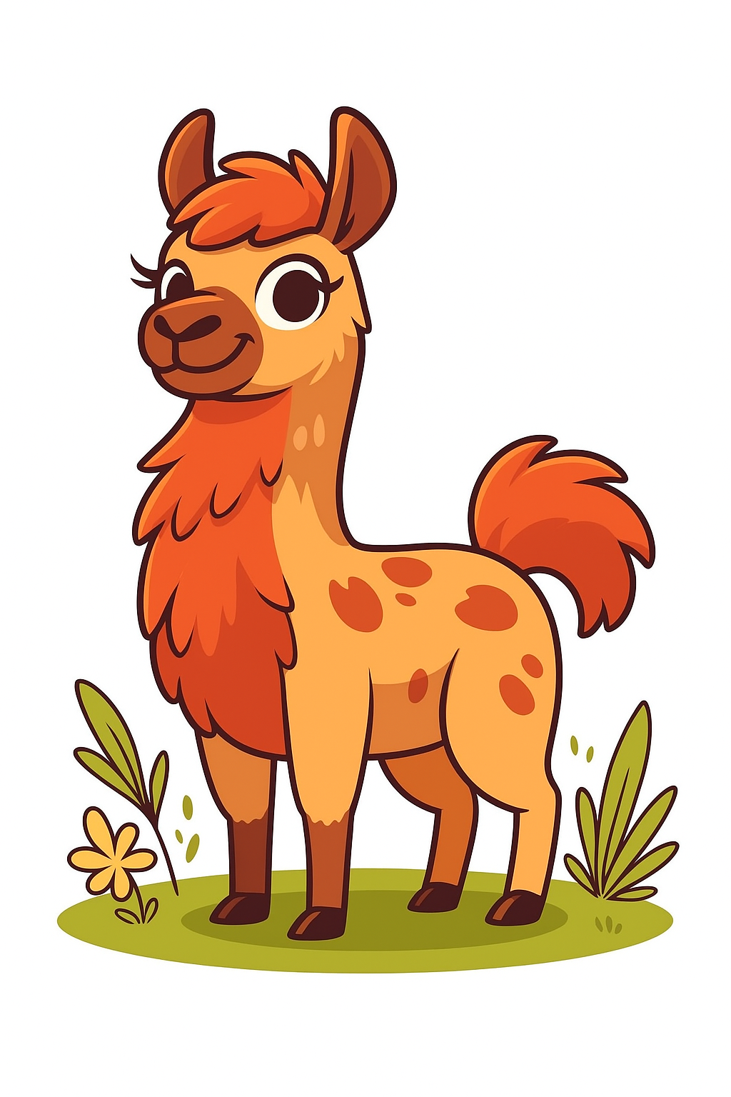
Output & Pre-training
0
Hardware
1
1
Tokenization
2
2
Embeddings
3
4
3
Attention
0
4
Output

Slide 3
Overview
Neural networks
Softmax
Sampling methods
Training data
Scaling laws

Slide 4
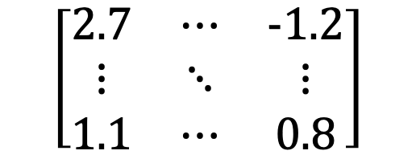
From the Last Section
We got out of the model: [sequence_length, embedding_dim]
Great... now what?
embedding_dim
$$\left[\begin{matrix}2.7 & ⋯ & −1.2 \\ ⋮ & ⋱ & ⋮ \\ 1.1 & ⋯ & 0.8\end{matrix}\right]$$
Context-adjusted embedding vector for a single token
e.g. “the” in “the cat sat on the mat”
sequence_length
Notes:
For this we need to discuss neural networks

Slide 5
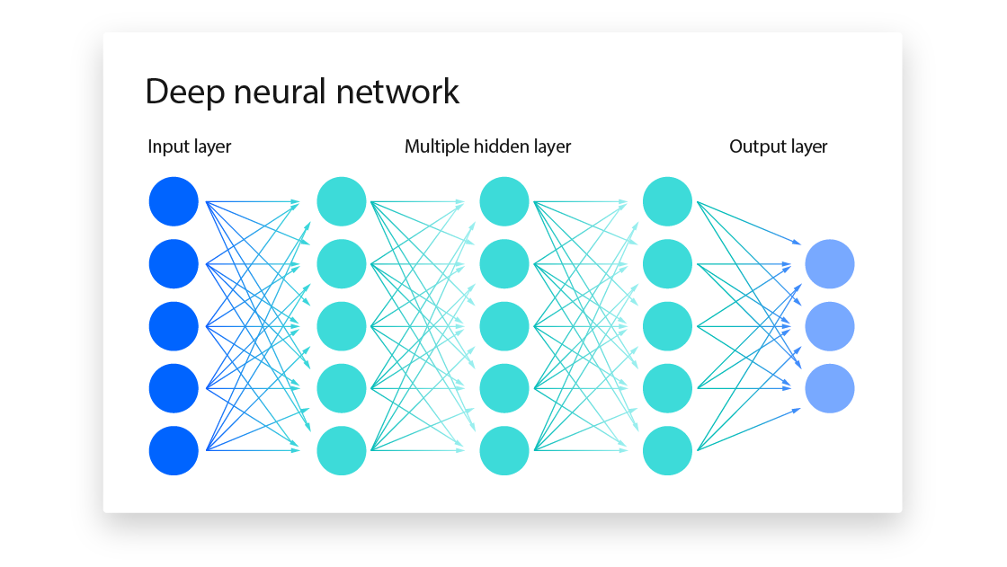
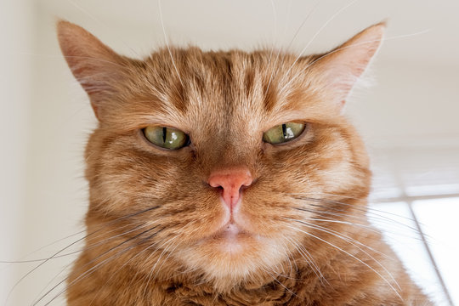

Neural Networks
Update parameters (backpropagation)
dog | 0.00
cat | 1.00
goose | 0.00
Unravel
0.92
0.81
0.95
0.89
0.96
0.91
…
0.34
dog-cat-goose classifier
Loss $ℒ$
dog | 0.33
cat | 0.33
goose | 0.33

Slide 6


Slide 7
Neural Networks
Unravel
0.92
0.81
0.95
0.89
0.96
0.91
…
0.34
dog-cat-goose classifier
dog | 0.02
cat | 0.95
goose | 0.03

Slide 8

The Language Model
<bos>
the
cat
sat
on
the
mat
<eos>
101
1996
4937
6583
2006
1996
13523
102
101
1996
4937
6583
2006
1996
?
the
cat
sat
on
the
mat
was | 0.0001
dog | 0.12
hippo | 0.07
•
•
•
mat | 0.54

Slide 9
The Language Model
<bos>
the
cat
sat
on
the
mat
<eos>
101
1996
4937
6583
2006
1996
13523
102
101
1996
4937
6583
2006
1996
13523
?
the
cat
sat
on
the
mat
has | 0.0001
eating | 0.12
while | 0.07
•
•
•
<eos> | 0.54

Slide 10
The Language Model
During training, it is inefficient to do this on a per token basis
Subsequent prefixes are stuffed into the model at the same time
<bos> | <bos> | <bos> | <bos> | <bos> | <bos> | <bos> | <bos>
the | the | the | the | the | the | the | 0
cat | cat | cat | cat | cat | cat | 0 | 0
sat | sat | sat | sat | sat | 0 | 0 | 0
on | on | on | on | 0 | 0 | 0 | 0
the | the | the | 0 | 0 | 0 | 0 | 0
mat | mat | 0 | 0 | 0 | 0 | 0 | 0
<eos> | 0 | 0 | 0 | 0 | 0 | 0 | 0

Slide 11
The Final Prediction
The output to attention told us how to modify the initial embedding:
[sequence_length, embedding_dim]
And our goal is to predict the [?]
”a juvenile cat is called a [?]"
So, we need a distribution over tokens:
[sequence_length, vocab_size]

Slide 12
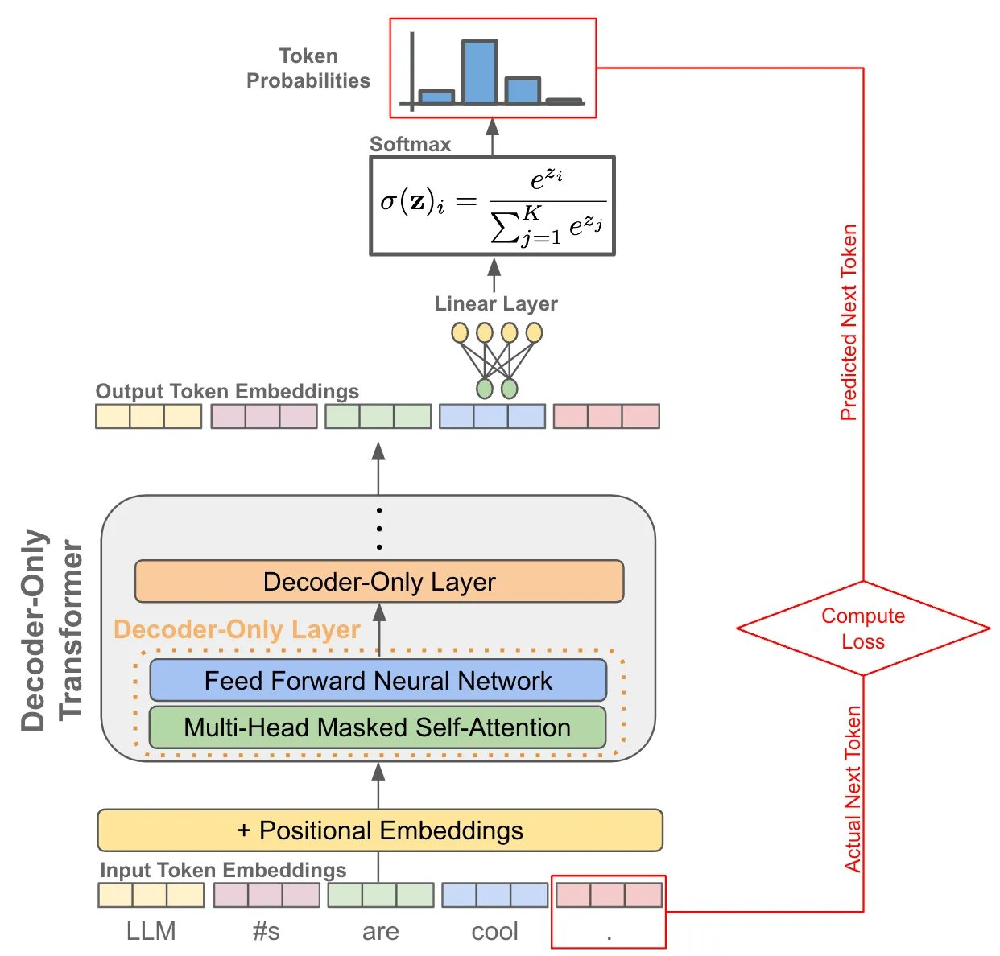
The Final Operation
[seq_len, embed_dim] x [embed_dim, vocab_size] = [seq_len, vocab_size]

Slide 13
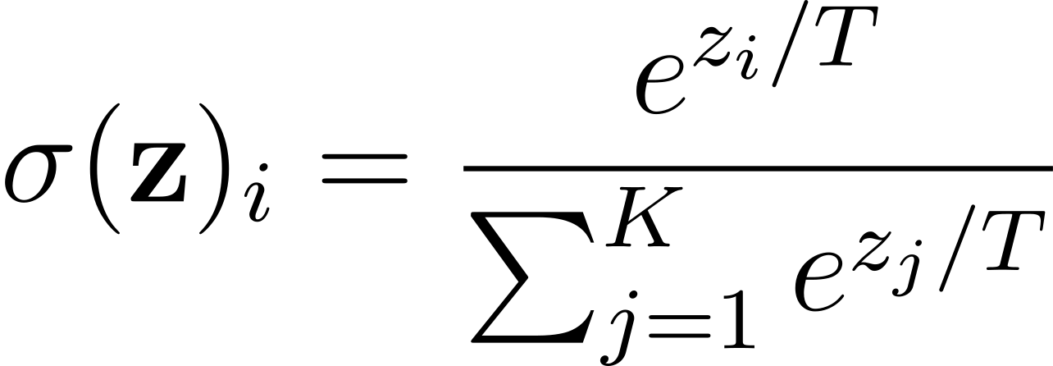
Softmax
Here is an equation:

Slide 14
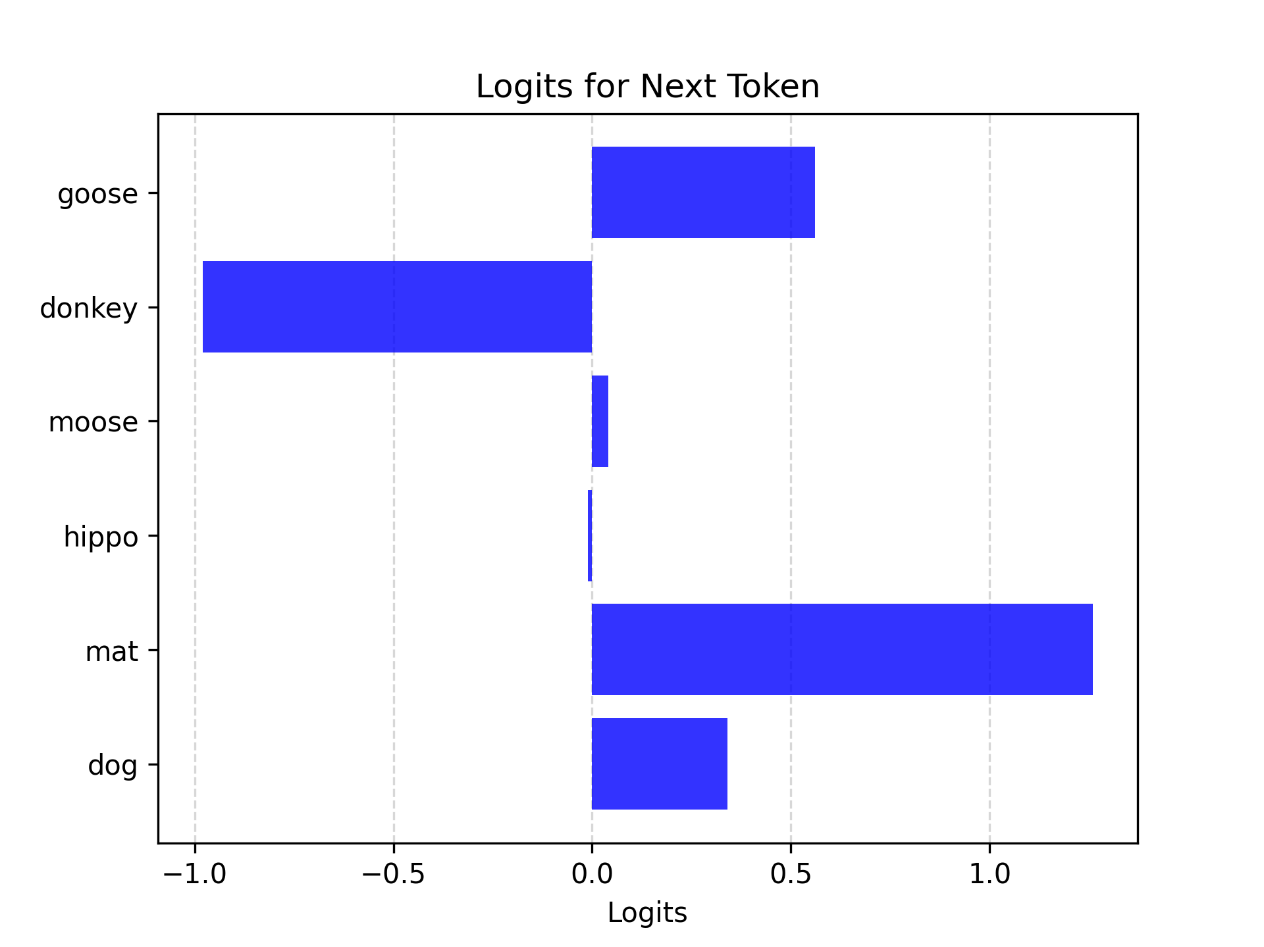
Softmax
"the cat sat on the _____"
goose | 0.57
donkey | -0.98
moose | 0.08
hippo | -0.02
mat | 1.32
dog | 0.35

Slide 15
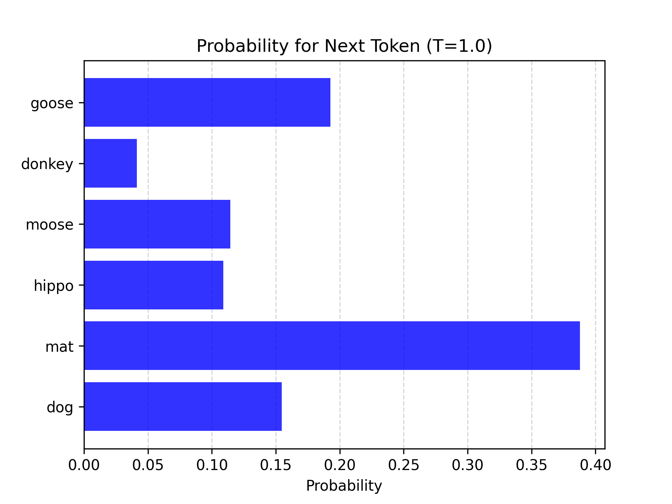
Softmax
"the cat sat on the _____"

Slide 16
Softmax
What does T do?
Temperature

Slide 17
Softmax
T = 1.0
"the cat sat on the _____"

Slide 18
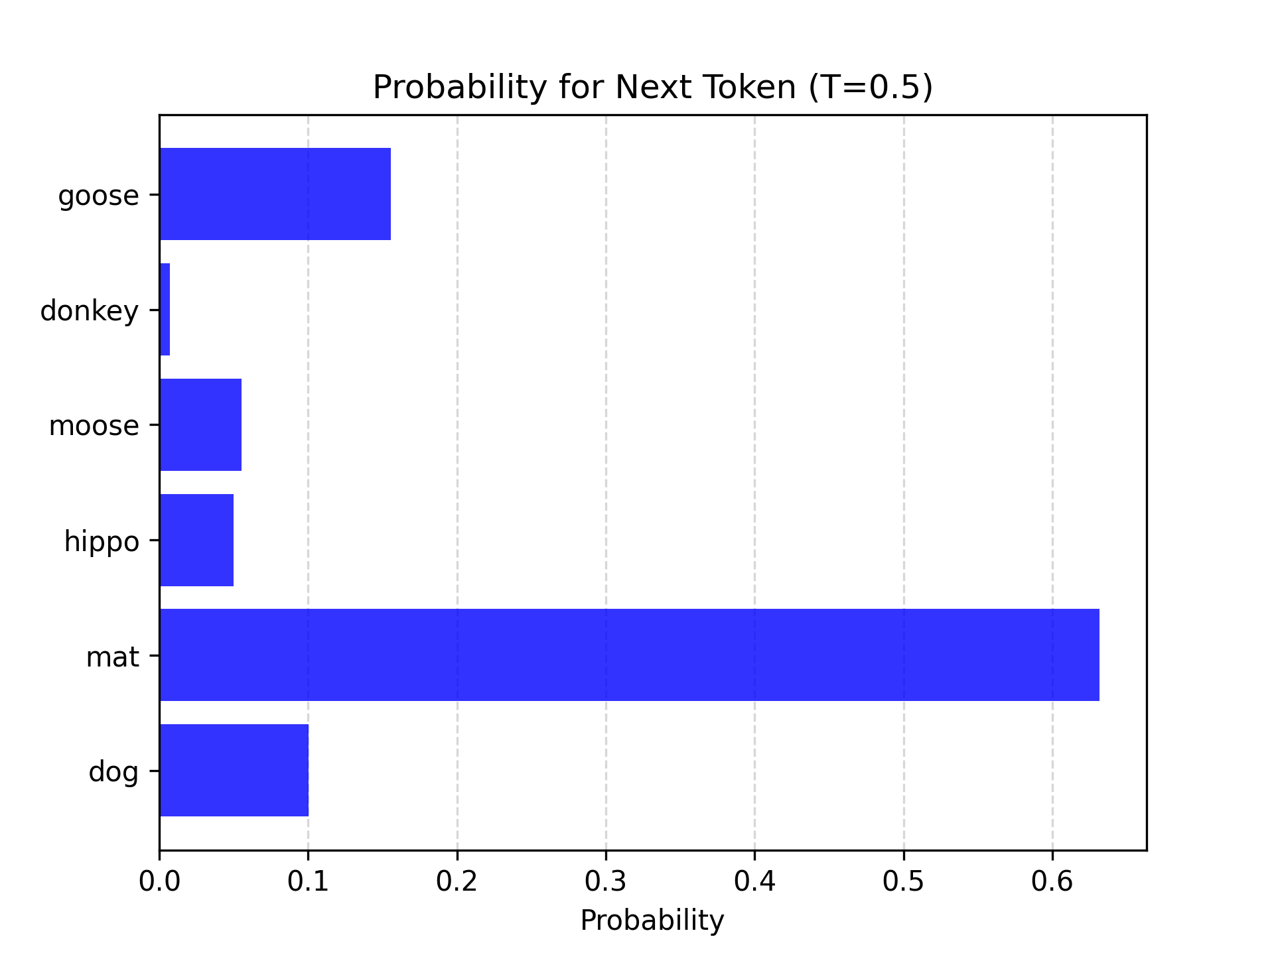
Softmax
T = 0.5
"the cat sat on the _____"

Slide 19
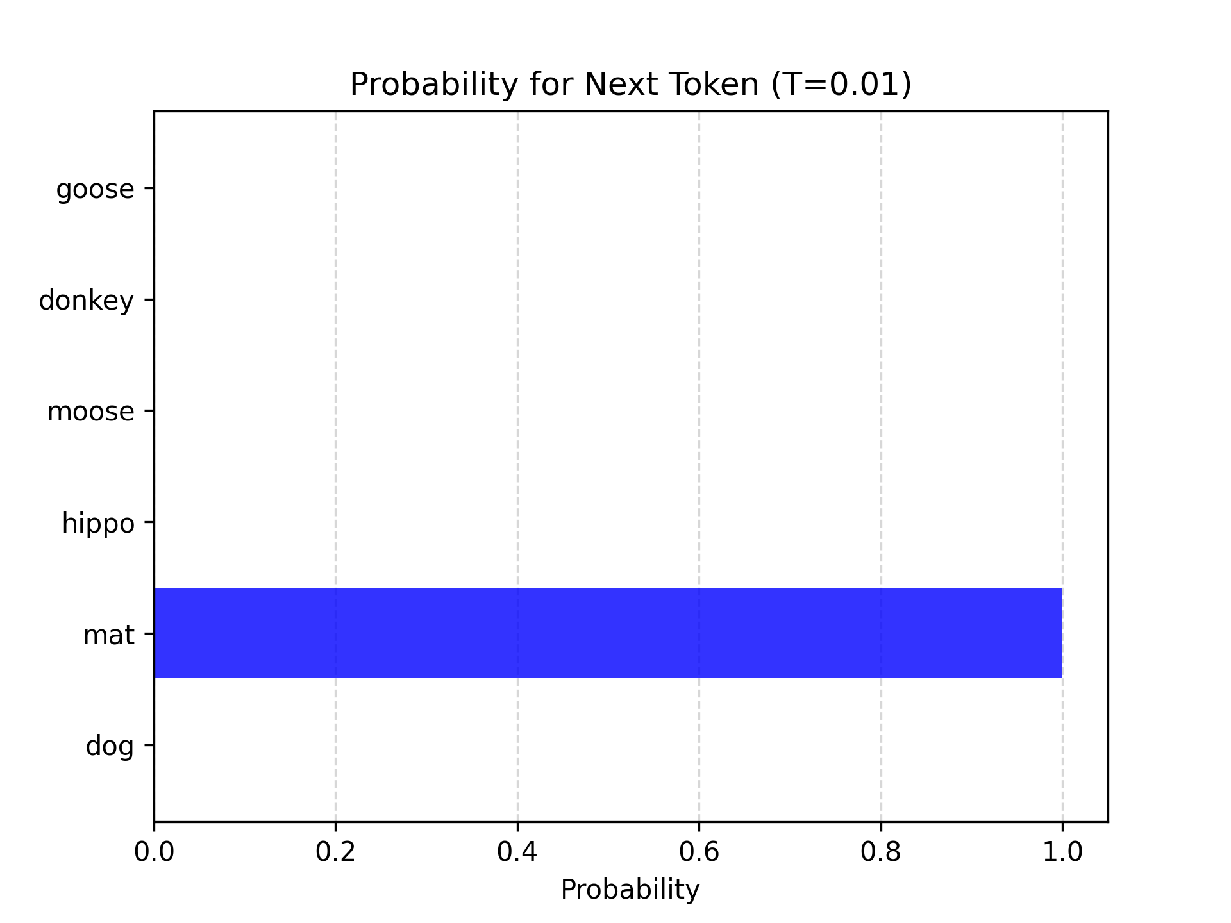
Softmax
T = 0.01
"the cat sat on the _____"

Slide 20
Softmax
T = 1.0
"the cat sat on the _____"

Slide 21
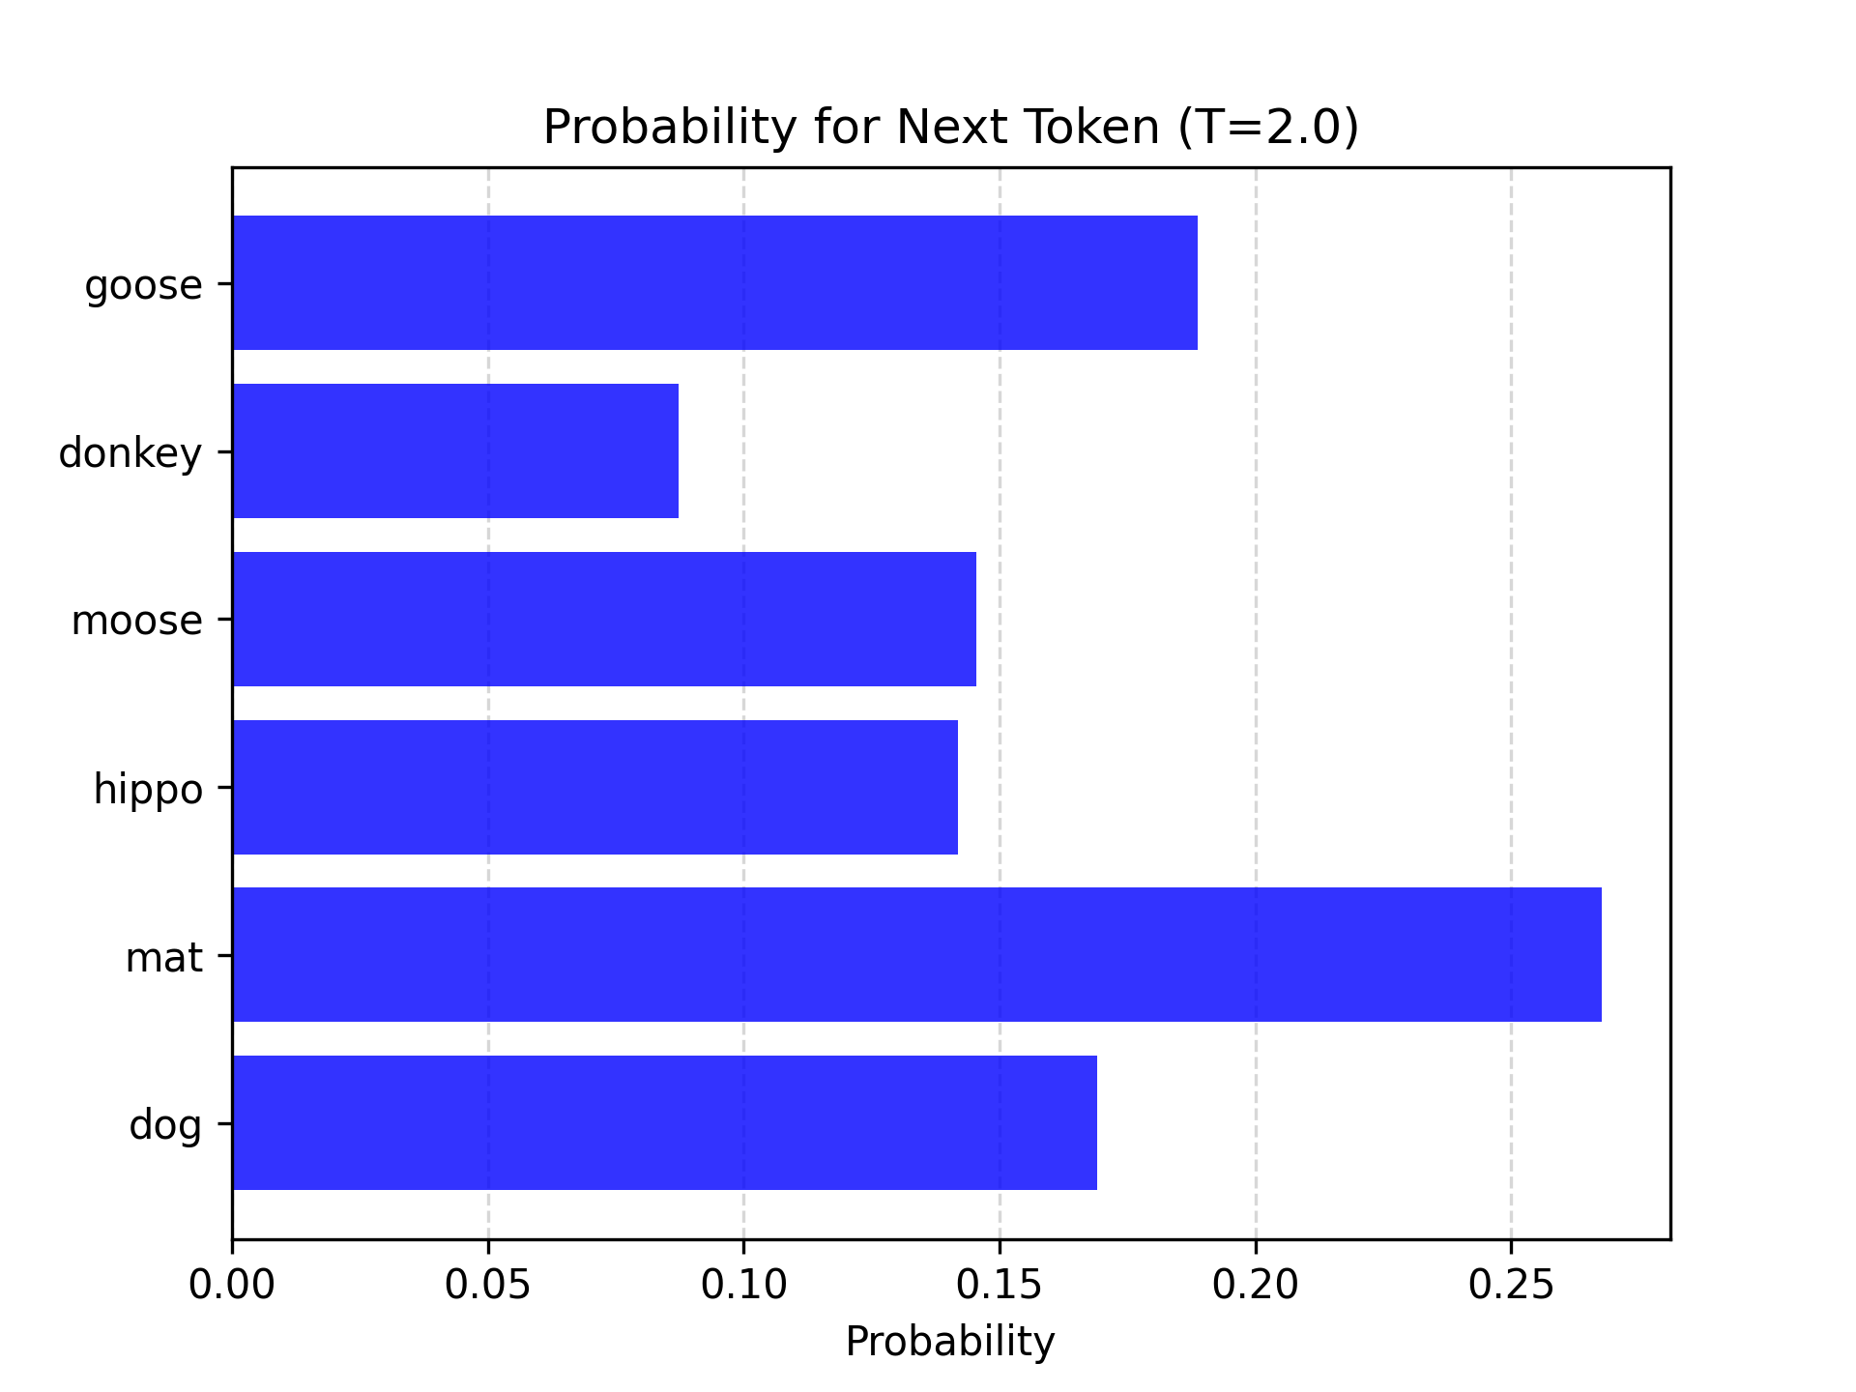
Softmax
T = 2.0
"the cat sat on the _____"

Slide 22
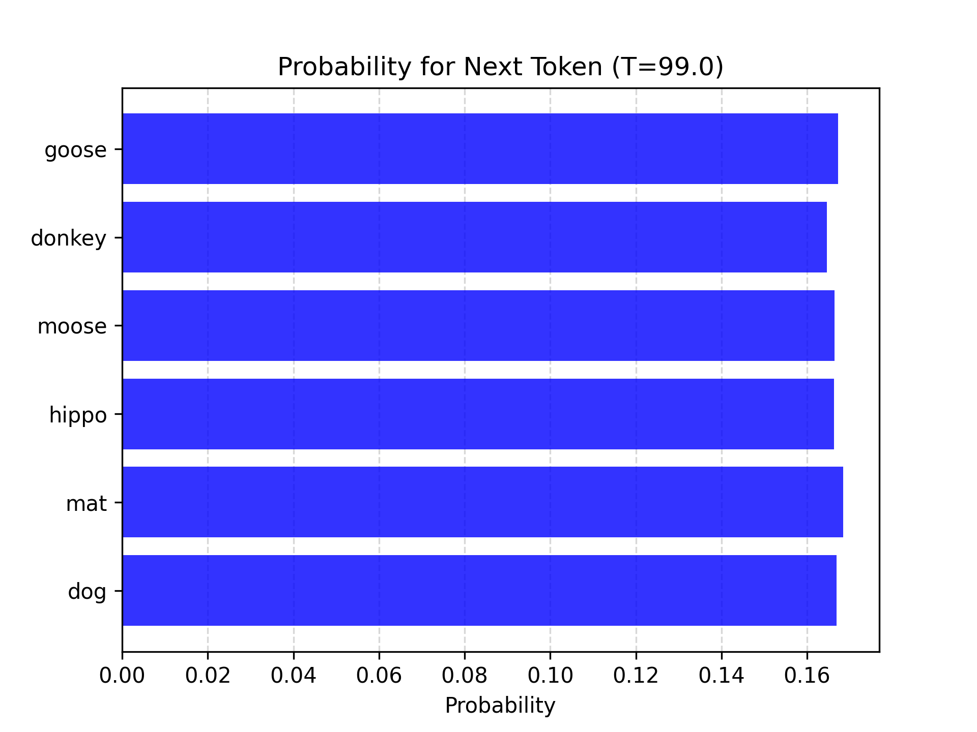
Softmax
T = 99.0
"the cat sat on the _____"

Slide 23
Softmax
Softmax converts raw logits to a probability distribution
Changing the temperature parameter alters the entropy of the distribution

Slide 24
Sampling
Top-p The cumulative probability cutoff for token selection. Lower values mean sampling from a smaller, more top-weighted nucleus.
Top-k Sample from the k most likely next tokens at each step. Lower k focuses on higher probability tokens.
Greedy sampling Pick the top score
In OpenAI models, setting T = 0 essentially does greedy sampling, and top-k is not exposed

Slide 25
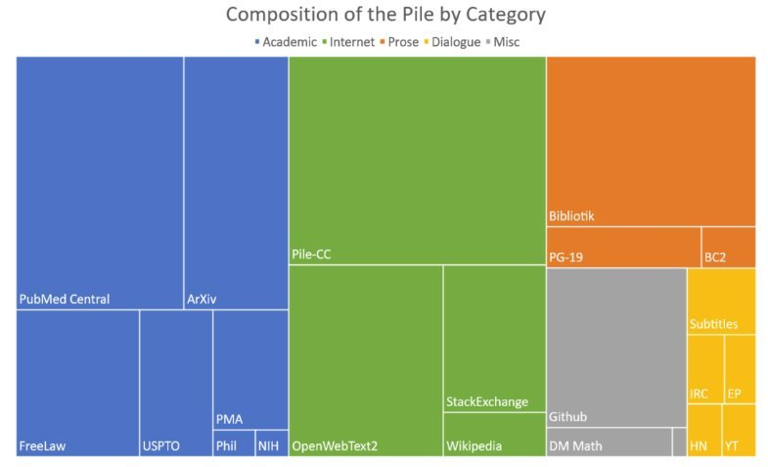
Training data
~200k books
~27B Tokens
~110GB
< 0.2%!!
Llama 3
~15T tokens
~44TB
Notes:
The Pile is a large, open-source text dataset created by EleutherAI, designed specifically for training large language models.
Llama 3 ranges from 8B, 70B to 405B

Slide 26
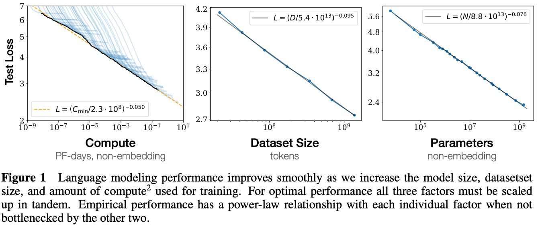
Scaling laws
Kaplan, J., McCandlish, S., Henighan, T., Brown, T. B., Chess, B., Child, R., Gray, S., Radford, A., Wu, J., & Amodei, D. (2020). Scaling laws for neural language models.

Slide 27
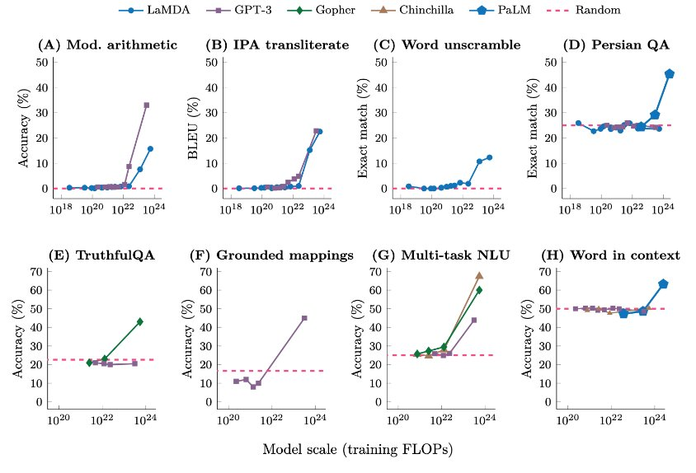
Emergence
Wei, J., Tay, Y., Bommasani, R., Raffel, C., Zoph, B., Borgeaud, S., Yogatama, D., Bosma, M., Zhou, D., Miculivicius, D., Narang, S., Chowdhery, A., Le, Q. V., & Dean, J. (2022). Emergent abilities of large language models

