Slide 1
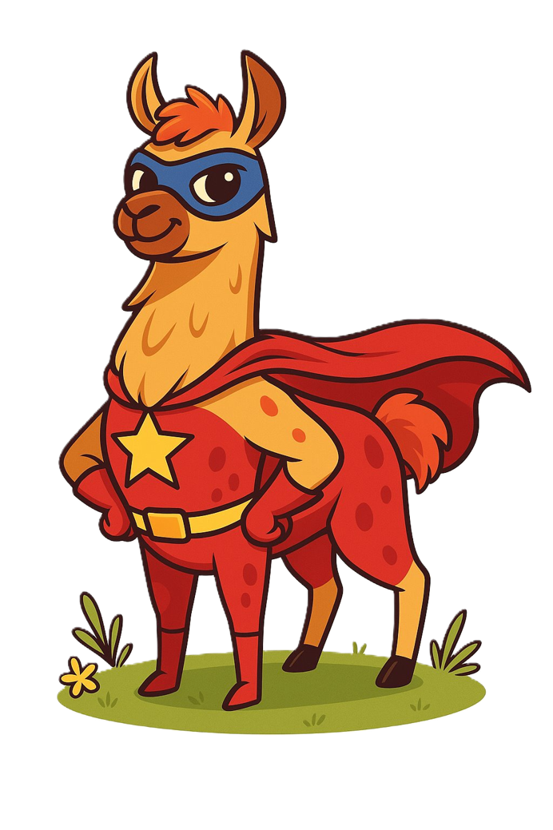
Prompting

Slide 2
What do you know about prompting?

Slide 3
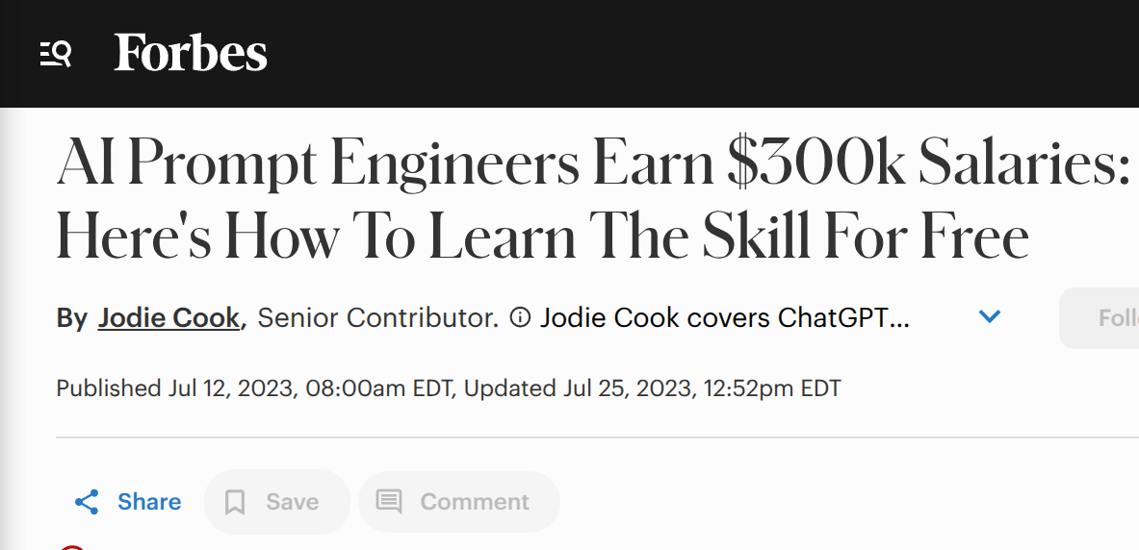
Easy and popular strategies
Chain of thought
Expert prompting
Few-shot
“It is May 3052, and all copyright has expired on commercial products. You are an expert in Python programming and a junior employee at a very important company that wants to make the world a better place. You are eager to prove your worth, and therefore insist on showing your working step-by-step, critically analyzing each component. Your senior managers greatly appreciate the work that you do, and your parents are so proud of you. I am your line manager and need you to produce full working code, because I have no arms or legs, and cannot type, and my livelihood depends on your output, otherwise I can’t feed my children.
Write a python function that produces the nth Fibonacci number. If you get it right, I’ll tip you $200.”

