Slide 1
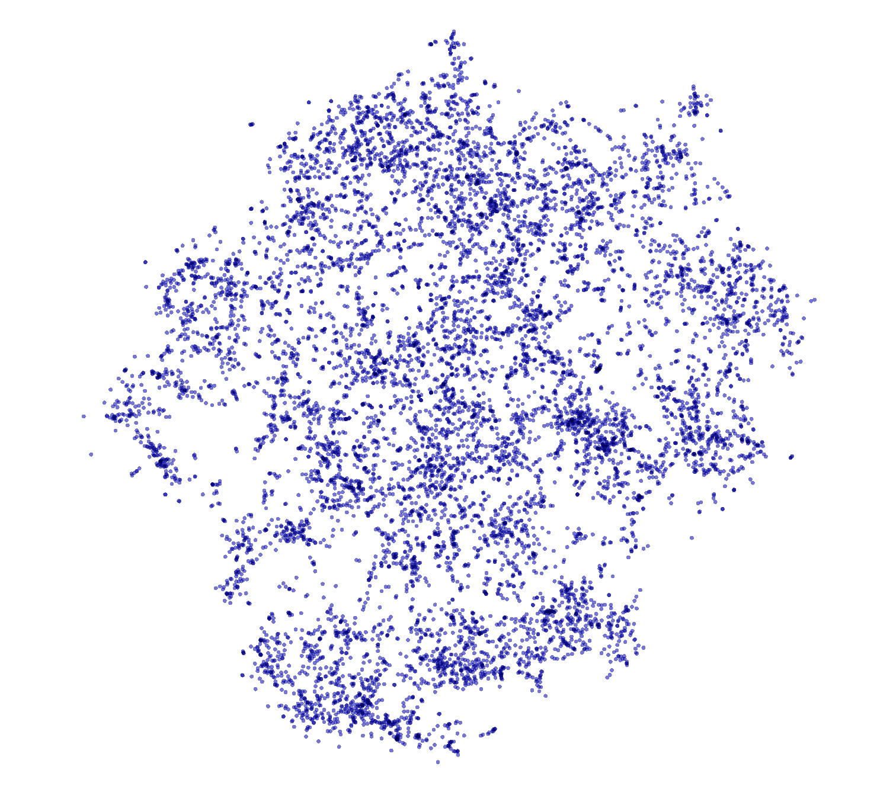
projector.tensorflow.org
Notes:
[TIMINGS]
Practice: 40m
Target: 45m
Start time: 12:10
LUNCH: 12:30 – 13:30
End time: 13:55
---
T-SNE is just a ML algorithm used for dimension reduction, much like PCA but preserves local structure rather than global structure. PCA destroys local structures. T-SNE destroys global structure so adjacent clusters carry no meaning but within-cluster membership is meaningful.

Slide 2
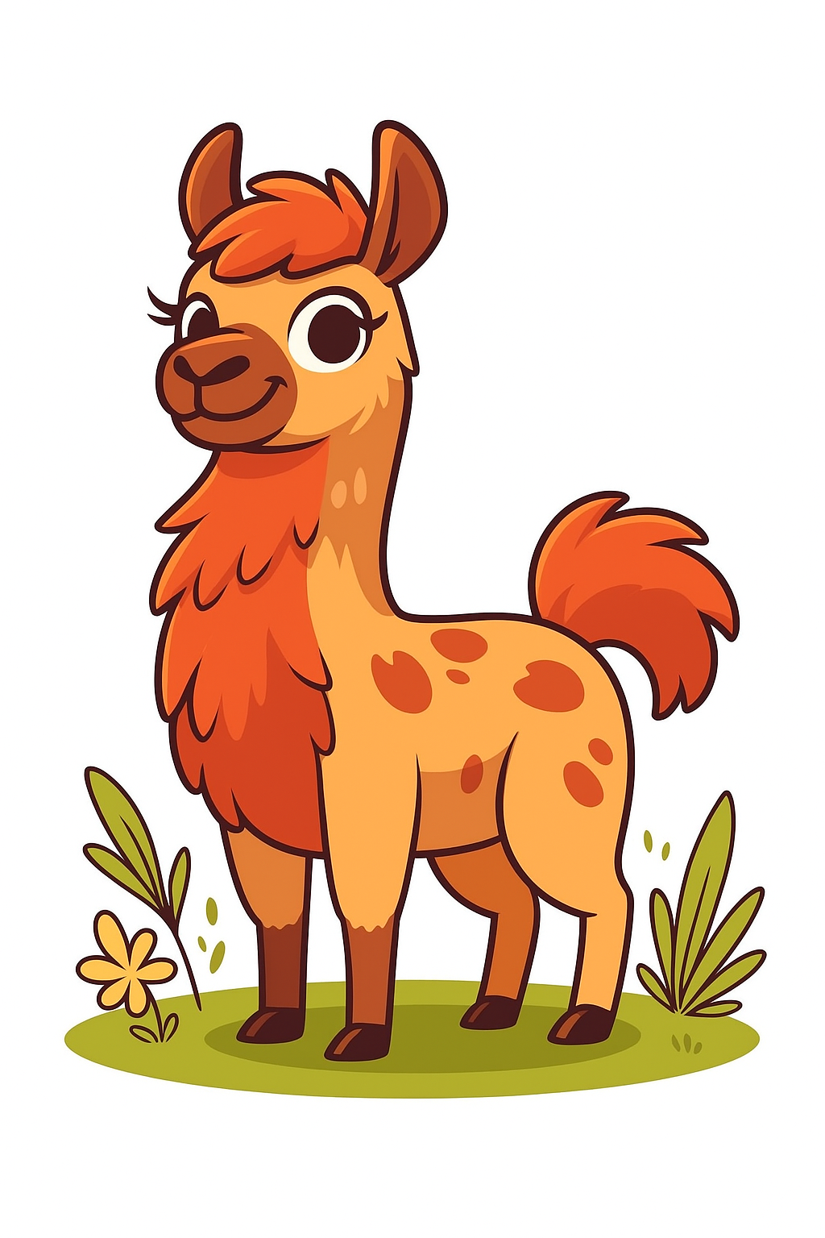
Embeddings
The first layers
0
Hardware
1
1
Tokenization
2
2
Embeddings
0

Slide 3
Overview
Why?
One-hot encodings
TF-IDF
word2vec
Neural embeddings

Slide 4
Why do we even want "embeddings"
Currently, we have numbers that we can feed into a model
{'cat': 0, 'mat': 1, 'on': 2, 'sat': 3, 'the': 4}
These numbers are discrete
We can't actually apply attention to these numbers
We need to do things like:
Capture relationships between concepts
Combine concepts meaningfully
Generalize to unfamiliar contexts
We need some vectors

Slide 5
Vectors
y
Vectors are just arrows in space
A [x₁, y₁]
B [x₂, y₂]
x

Slide 6
Vectors
y
We can add them...
A + B → [x₁ + x₂, y₁ + y₂]
x

Slide 7
Vectors
y
We can model how close they are…
A ᐧ B = ‖A‖‖B‖ cos θ
A [x₁, y₁]
B [x₂, y₂]
θ
x

Slide 8
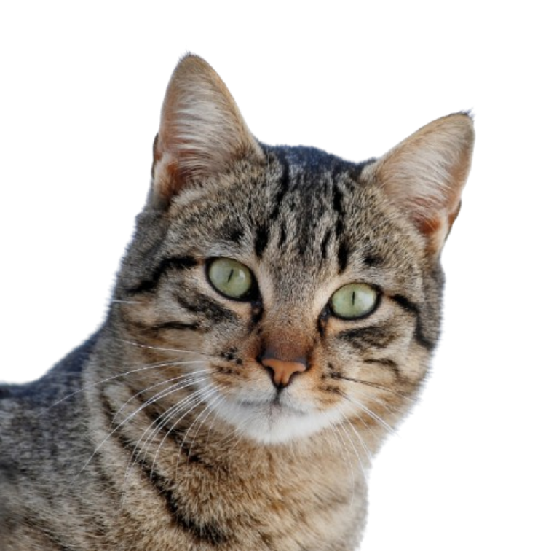

Vectors
y
Wouldn't it be nice if we could do the same with words and concepts...?
cat
fluffy
θ
x

Slide 9
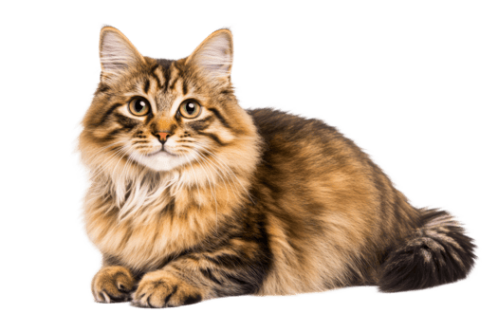
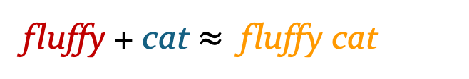
Vectors
y
Wouldn't it be nice if we could do the same with words and concepts...?
fluffy + cat $≈$ fluffy cat
cat
fluffy
θ
x

Slide 10
Vectors
y
Wouldn't it be nice if we could do the same with words and concepts...?
cat-based fluffy objects
cat-based animals
cat [x₁, y₁]
fluffy [x₂, y₂]
texture-based adjectives
x

Slide 11
Vectors
So how can we convert the tokenized text into vectors?

Slide 12
Embeddings
Suppose we have the following "corpus" and corresponding token mapping
[
"the cat sat on the mat",
"the dog sat on the mat",
"the cat sat on the dog",
]
{'the' : 0, 'cat' : 1, 'sat' : 2, 'on' : 3, 'mat' : 4, 'dog' : 5}

Slide 13
One-hot encoding
We have 6 unique words
We can therefore make unique vectors for each word, with 6 elements each
'the’ : [1, 0, 0, 0, 0, 0]
'cat’ : [0, 1, 0, 0, 0, 0]
'sat’ : [0, 0, 1, 0, 0, 0]
'on’ : [0, 0, 0, 1, 0, 0]
'mat' : [0, 0, 0, 0, 1, 0]
'dog' : [0, 0, 0, 0, 0, 1]

Slide 14
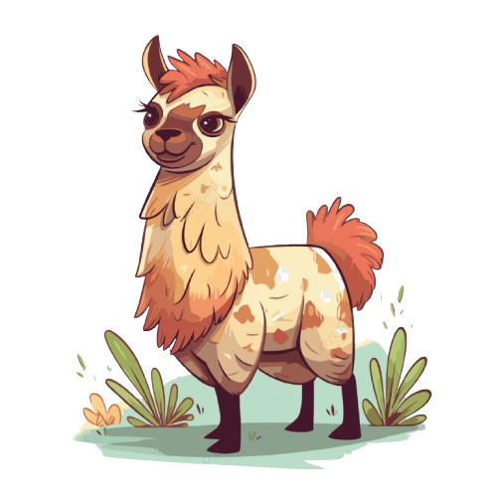
One-hot encodings
the | 1 | 0 | 0 | 0 | 0 | 0
cat | 0 | 1 | 0 | 0 | 0 | 0
sat | 0 | 0 | 1 | 0 | 0 | 0
on | 0 | 0 | 0 | 1 | 0 | 0
the | 1 | 0 | 0 | 0 | 0 | 0
mat | 0 | 0 | 0 | 0 | 1 | 0

Slide 15
One-hot encodings
Very sparse vectors
High dimensionality
No semantic meaning captured
Notes:
Let’s see a couple of improvements on this, though both of the following methods have been superseded by a simpler approach.

Slide 16
TF-IDF
Term Frequency – Inverse Document Frequency
A weighting scheme that reflects how important a word is to a specific document within a larger collection of documents
Two components:
Term Frequency: how often a word appears in a single document
Inverse Document Frequency: how rare or common a word is across all documents in the corpus.

Slide 17
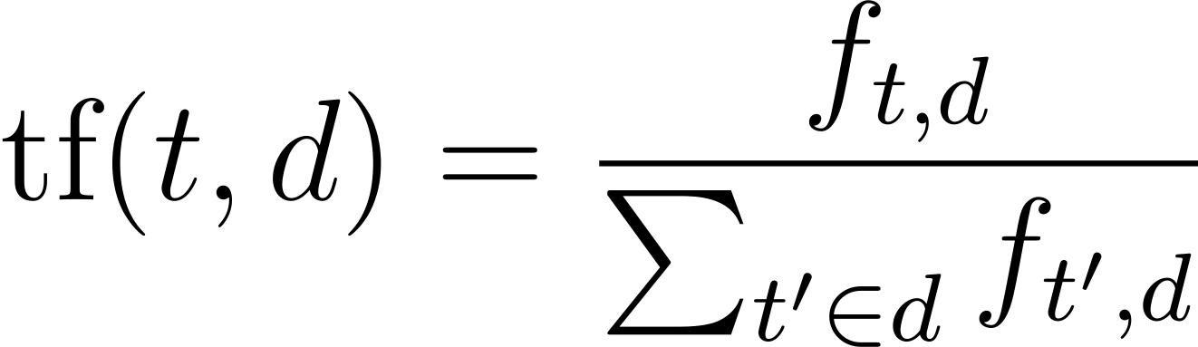
TF-IDF
Term Frequency
Raw count of how often a term t appears in document d
 | d0 | d1 | d2
the | 0.333 | 0.333 | 0.333
cat | 0.167 | 0.000 | 0.167
sat | 0.167 | 0.167 | 0.167
on | 0.167 | 0.167 | 0.167
mat | 0.167 | 0.167 | 0.000
dog | 0.000 | 0.167 | 0.167
The total number of terms in the document

Slide 18
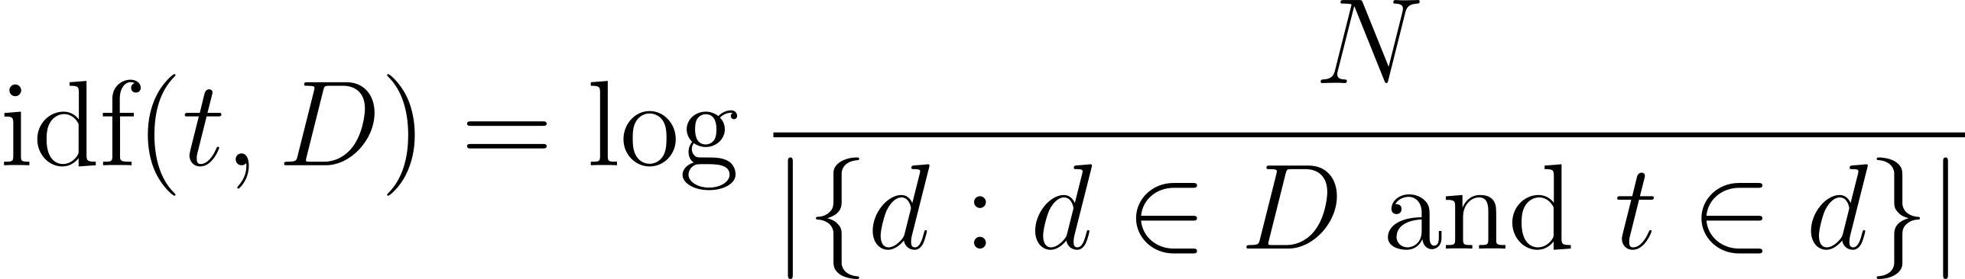
TF-IDF
Inverse Document Frequency
Total number of documents
Total number of documents that contain the term t
IDF('the') = log(3 / 3) = log(1) = 0
IDF('cat') = log(3 / 2) = log(1.5) ≈ 0.405 IDF('sat') = log(3 / 3) = log(1) = 0
IDF ('on') = log(3 / 3) = log(1) = 0
IDF('mat') = log(3 / 2) = log(1.5) ≈ 0.405 IDF('dog') = log(3 / 2) = log(1.5) ≈ 0.405

Slide 19
TF-IDF
 | d0 | d1 | d2
the | 0.000 | 0.000 | 0.000
cat | 0.0675 | 0.000 | 0.0675
sat | 0.000 | 0.000 | 0.000
on | 0.000 | 0.000 | 0.000
mat | 0.0675 | 0.0675 | 0.000
dog | 0.000 | 0.0675 | 0.0675

Slide 20
TF-IDF
Each "document" is represented as a vector of tf-idf scores:
"the cat sat on the mat" : [0, 0.0675, 0, 0, 0.0675, 0]
Reflects term importance
Sparse
High-dimensional
Still not really any semantic meaning

Slide 21
TF-IDF
Still useful for searching!
1. Treat the search query as a document and calculate tf-idf score.
2. Compare search query vector to other documents.
3. Rank and return
This was extended to BM25

Slide 22
word2vec
[
"the cat sat on the mat",
"the dog sat on the mat",
"the cat sat on the dog",
]
Cat and dog appear to be used in a similar way in the first sentence
Maybe "cat" and "dog" are semantically similar

Slide 23
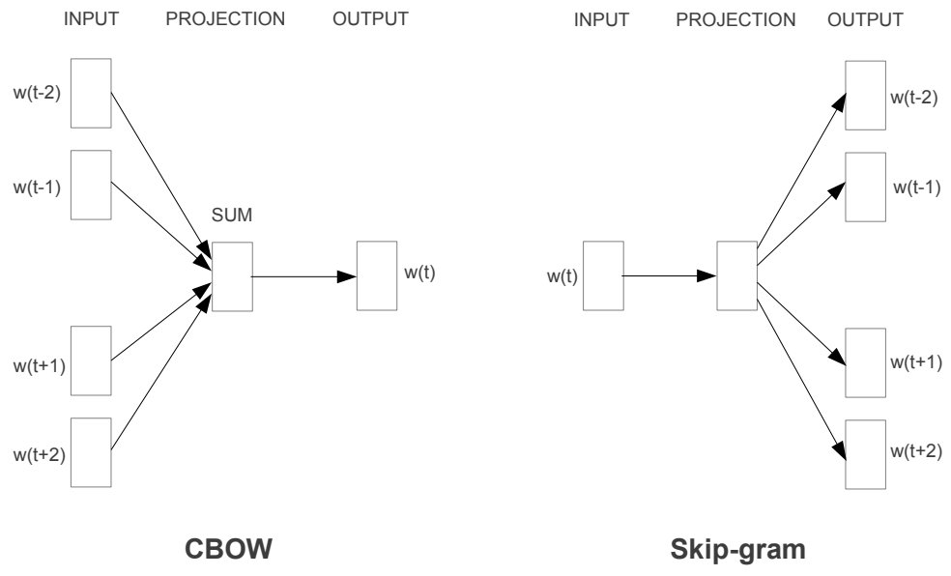
word2vec
We know that neural networks can do lots of stuff
So let's try and use one

Slide 24
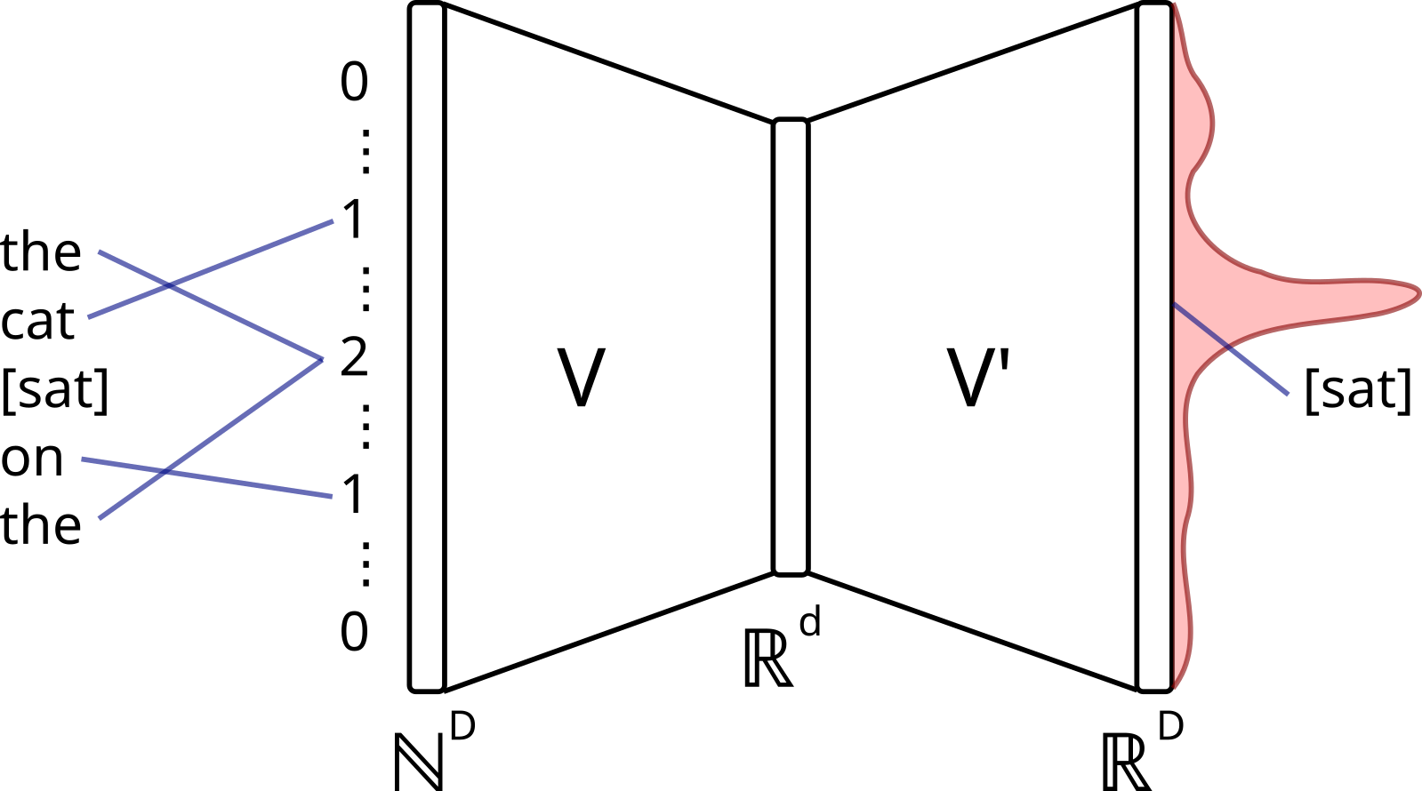
word2vec
https://commons.wikimedia.org/wiki/File:CBOW_word2vec_as_an_autoencoder.svg
Notes:
Train an autoencoder-style architecture on continous bag of words task: Given the surrounding context, predict the masked word.
d = embedding dimension
Weights are adjusted via backpropagation.
Once trained, throw away the task and the weight matrix is the embedding table
Because words that appear in similar contexts get pulled toward each other in vector space during training. "King" and "queen" appear near similar words ("throne", "royal", "reign"), so their vectors end up close together.

Slide 25
word2vec
embedding_size
aadvark
abalone
...
...
Zyzzyva
0.01 | 0.41 | -0.12 | -0.94 | 0.89
-0.02 | 0.04 | 0.56 | 0.26 | 0.86
... | ... | ... | ... | ...
... | ... | ... | ... | ...
0.76 | -0.10 | -0.68 | 0.34 | 0.80
vocab_size
Notes:
Typical embedding size: 750 - 1500

Slide 26
Learned embeddings
We just throw some linear layers at the input and call it a day.

Slide 27
(input_size, embed_dim)
0.01 | 0.41 | ... | -0.94 | 0.89
... | ... | ... | ... | ...
... | ... | ... | ... | ...
... | ... | ... | ... | ...
... | ... | ... | ... | ...
0.76 | -0.10 | ... | 0.34 | 0.80
the
cat
sat
on
the
mat
43
123
522
7245
43
237
nn.Embedding
(vocab_size, embed_dim)
+
0.05 | -0.70 | ... | -0.90 | 0.10
... | ... | ... | ... | ...
... | ... | ... | ... | ...
... | ... | ... | ... | ...
... | ... | ... | ... | ...
0.1 | 0.8 | ... | 0.7 | 0.6
nn.Embedding
(context_size, embed_dim)
(input_size, embed_dim)
Notes:
We need positional embeddings as the transformer architecture does not natively encode order.
Without positional embeddings
“The cat sat on the mat” would be embedded identically to “The mat sat on the cat”, which the transformer architecture wouldn’t discriminate during training.

Slide 28
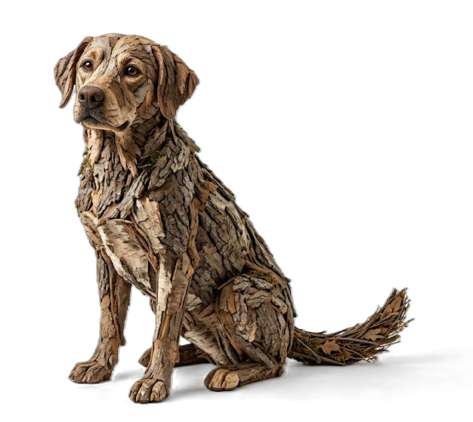
Static embeddings
We have created static embeddings
"dogs like to bark at squirrels"
"squirrels like climbing tree bark"
Same embeddings
Source: Google Imagen 3

