Slide 1
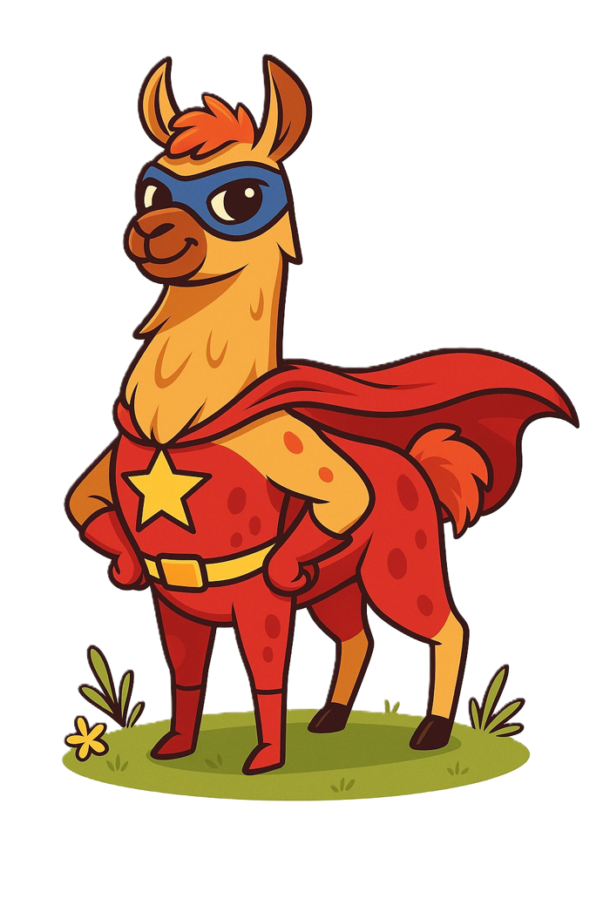
RAG
Retrieval Augmented Generation...
...and tools

Slide 2
Back to the kitchen
‘system’ : “You are an expert in baking.”
‘user’ : “Provide me a recipe for macarons.”
‘assistant’ : “Certainly! Here is a recipe for macarons …”

Slide 3
Back to the kitchen
‘system’ : “You are an expert in baking.”
‘knowledge’ : “Recipe 1, Recipe 2, … Recipe 1000”
‘user’ : “Provide me a recipe for macarons.”
‘assistant’ : “Certainly! Here is a recipe for macarons …”

Slide 4
Back to Vectors
y
Wouldn't it be nice if we vectorize our recipes...?
almond-based deserts
Italian macaron
French macaron
apple pie
apple-based deserts
x

Slide 5
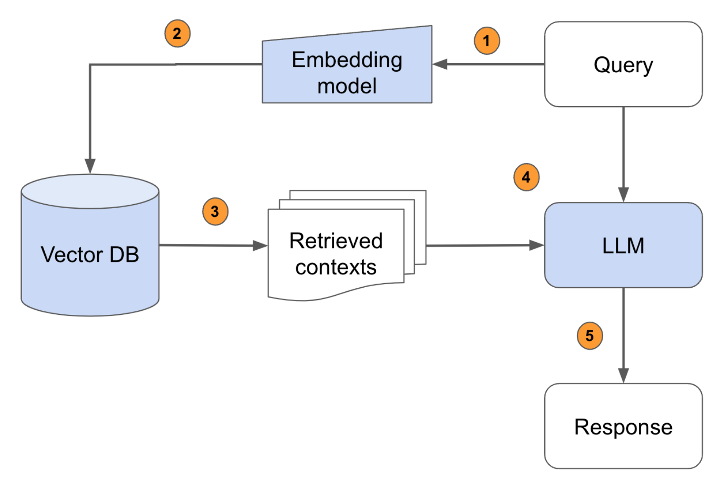
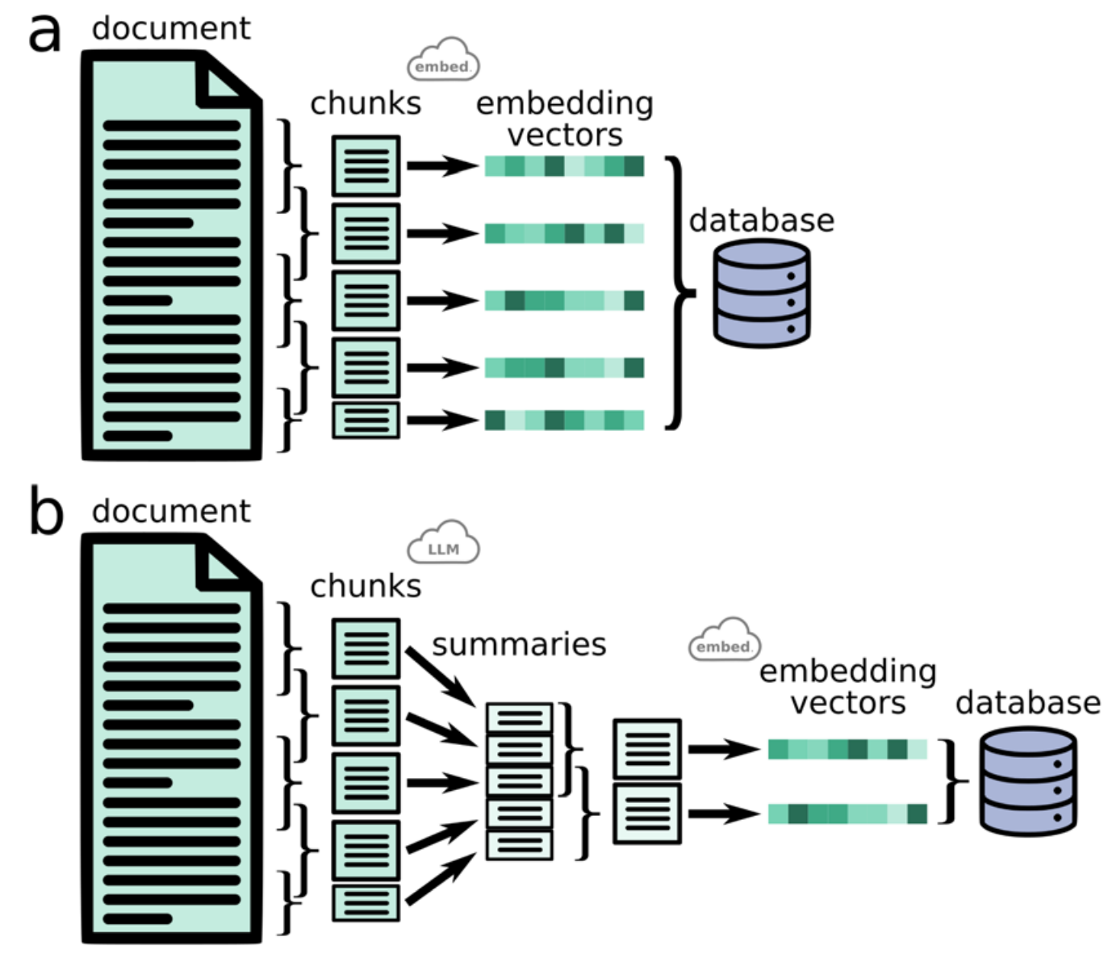
The RAG Pipeline

Slide 6
Back to the kitchen
‘system’ : “You are an expert in baking.”
‘user’ : “Provide me a recipe for macarons.”
user_query -> embed_query -> search database -> top_k_results
‘knowledge’ : “[Top Recipe 1, Top Recipe 2, Top Recipe k]”
‘assistant’ : “Certainly! Here is a recipe for macarons …”

Slide 7
Tools
‘system’ | “You are a helpful mathematician. You have access to the following functions: {{ tool_schema }} If you choose to use the tool, respond in json with the correct arguments to the function.”
‘user’ | “What is 1056 x 1316?”
‘assistant’ | “{‘a’:1056, ‘b’:1316}”

Slide 8
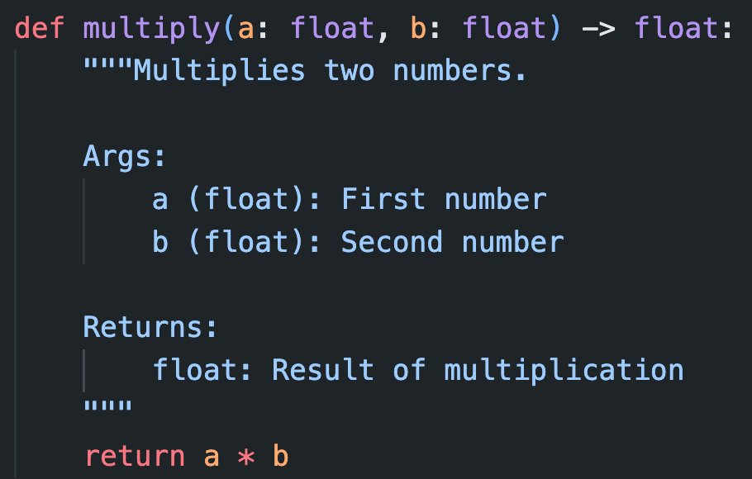
Tools

Slide 9
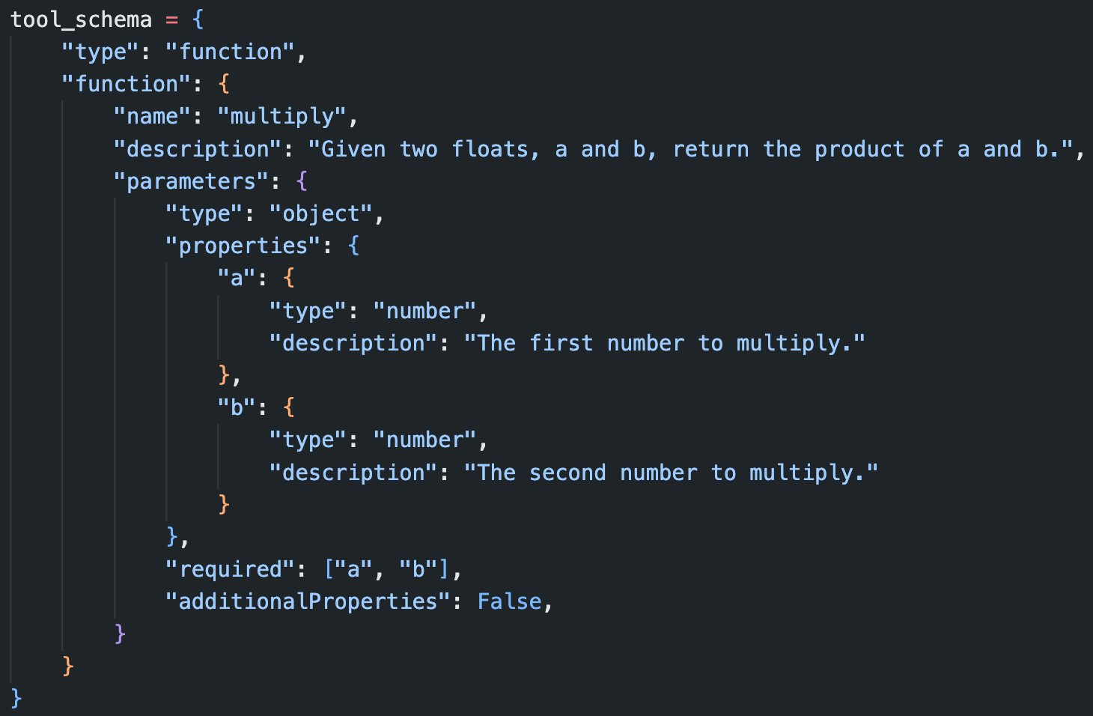
Tools

Slide 10
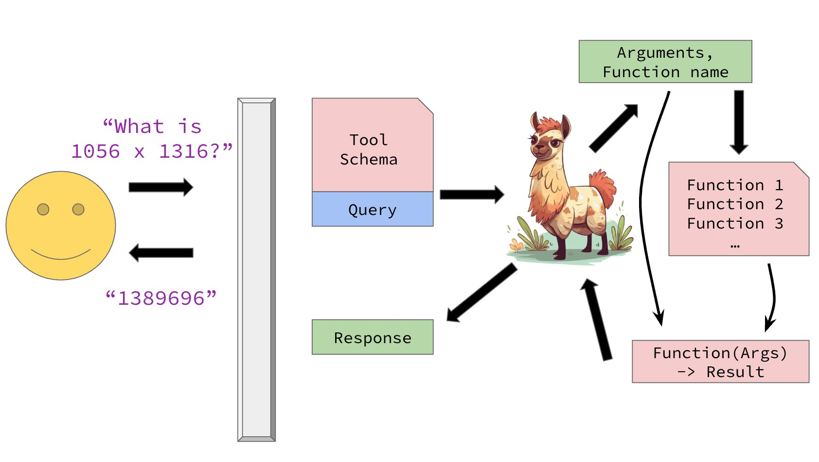
Tools

