Slide 1
Retrieval Augmented Generation
(RAG)

Slide 2
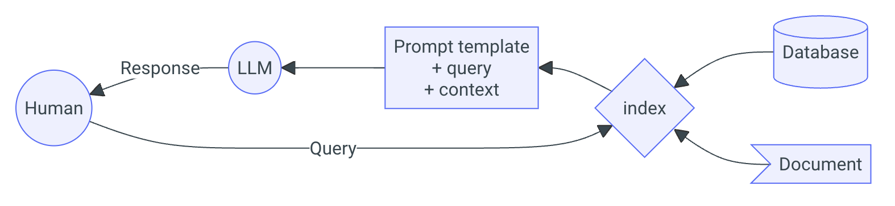
RAG
60% of the time, it works every time.
RAG is by far the most popular application of LLMs
Entire ecosystems like LangChain and LlamaIndex are built around it
Notes:
The temptation of many people first encountering LLMs is that they need to fine-tune (or worse: build and pretrain their own model).
I understand the desire to build things from the ground up, and have total control over everything.
However, the most likely thing you want is a well-trained existing open-source model, with some kind of knowledge database.
RAG is an incredibly common application of LLMs. So much so, that entire frameworks have been built around it. The most popular ones are LangChain and LlamaIndex.
Although we touched on it earlier, RAG works something like this:
Take a document or bunch of documents
Create a database
Create an embedding model that translates words to vectors
Break your document(s) into chunks, preferably overlapping
Convert the text chunks into vector chunks
Store your vector chunks in the database along with some metadata
Write out a query
Embed the query into a vector
Search for the top k similar vectors in your database
Convert the vector chunks back into text chunks
Create a single prompt from the text chunks and the original prompt you sent it (or a modified version)
Send this prompt to the LLM.
Get the response.
Phew!
That is a lot of work. And as you might guess, there is a lot of places where it can go wrong!

Slide 3
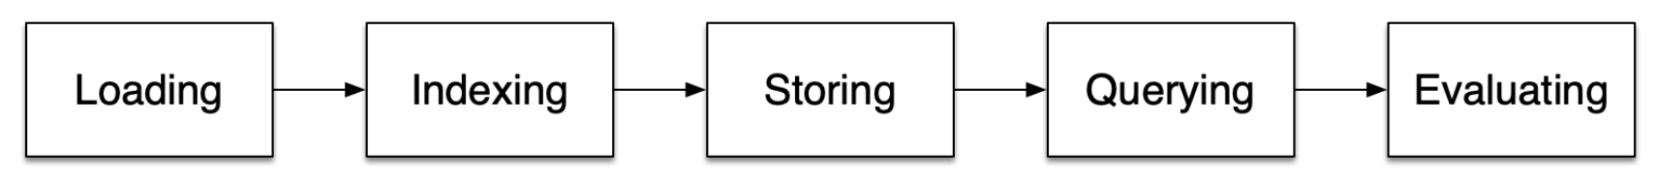
RAG
There are probably hundreds of tutorials online that will get you up and running with a trivial RAG applications in a few lines of code
The reality is…
…RAG is HARD!
Notes:
Perhaps annoyingly, the internet is filled with RAG tutorials telling you how easy it is.
But it’s actually really hard.
So what are the steps that you might have to go through? We covered them off a little in the previous slide, but here are the main steps.
At each step, you have to make a decision, and each decision firstly has to be justified – why did you choose that particular model, or that particular evaluation metric.
And secondly, each decision exposes you to risk of failure – there will be some level of uncertainty introduced to your system that you may or may not care about.
In the hands-on workshop, we will actually dive into this in a bit more detail. But for now, let’s just look at a quick example of getting structure out of these models.

Slide 4

Searching
A significant part of working with LLMs depends on the ability to search…
Most of the time, we are talking about vector databases
But search engines have been around for ages!

Slide 5
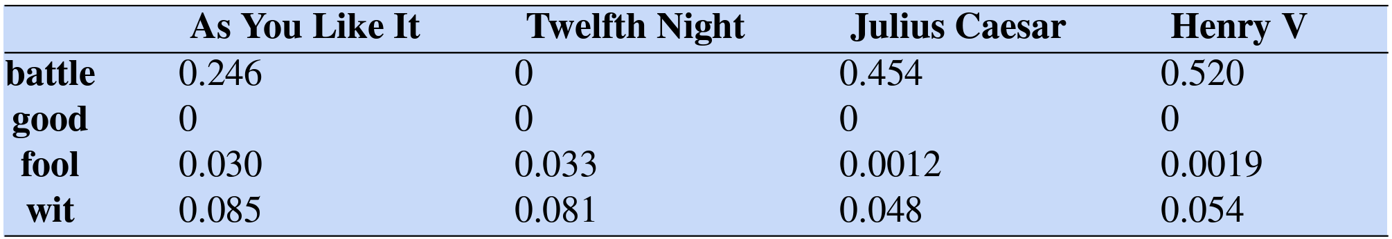
Searching
So how do they work…?
Term Frequency – Inverse Document Frequency
Term Frequency (TF): How often a word appears in a document
Inverse Document Frequency (IDF): How unique or rare that word is across all documents

Slide 6
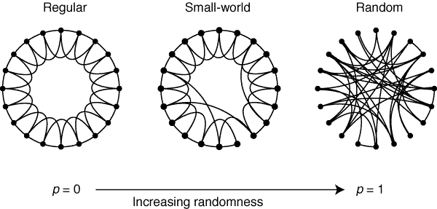
Searching
So how do they work…?
Vector databases create contextual embeddings
Use the Hierarchical Navigable Small World (HNSW) algorithm
Some networks are easier to traverse than others
Small path lengths, high clustering
Watts and Strogatz, Collective dynamics of ‘small-world’ networks, 1998

Slide 7
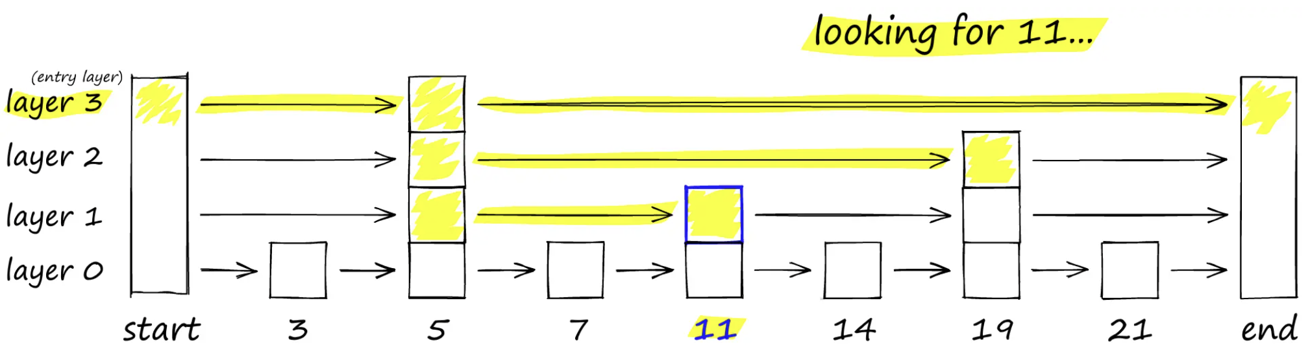
Searching
So how do they work…?
Probability skip lists
Creates a hierarchy of list structures
Hierarchical Navigable Small Worlds (HNSW), Pinecone, https://www.pinecone.io/learn/series/faiss/hnsw/

Slide 8
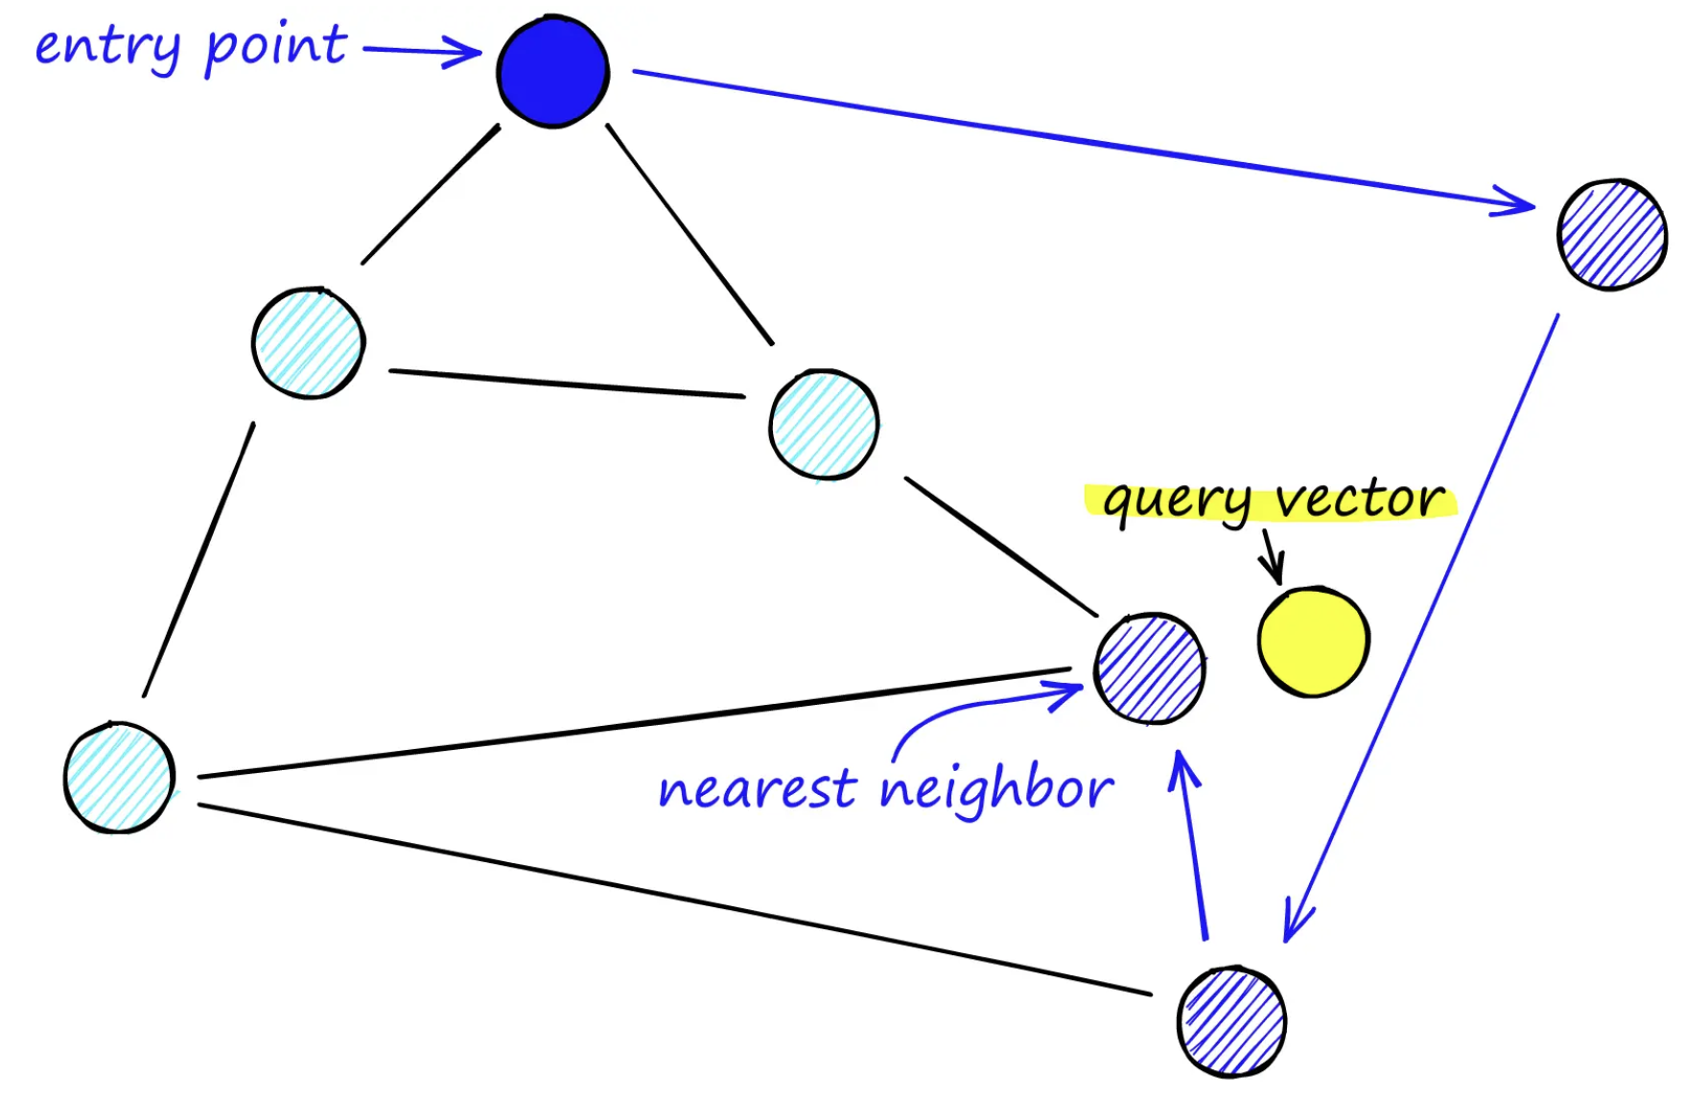
Searching
So how do they work…?
Pick an entry point
Determine which neighbours are closest
Move to that neighbour
Repeat
Hierarchical Navigable Small Worlds (HNSW), Pinecone, https://www.pinecone.io/learn/series/faiss/hnsw/
Notes:
Pick a target in embedding space
Pick an entry point in the graph
Determine which of the neighbours of the entry point is closest to the target
Move to that neighbour
Repeat until we find no closer nodes to the target

Slide 9
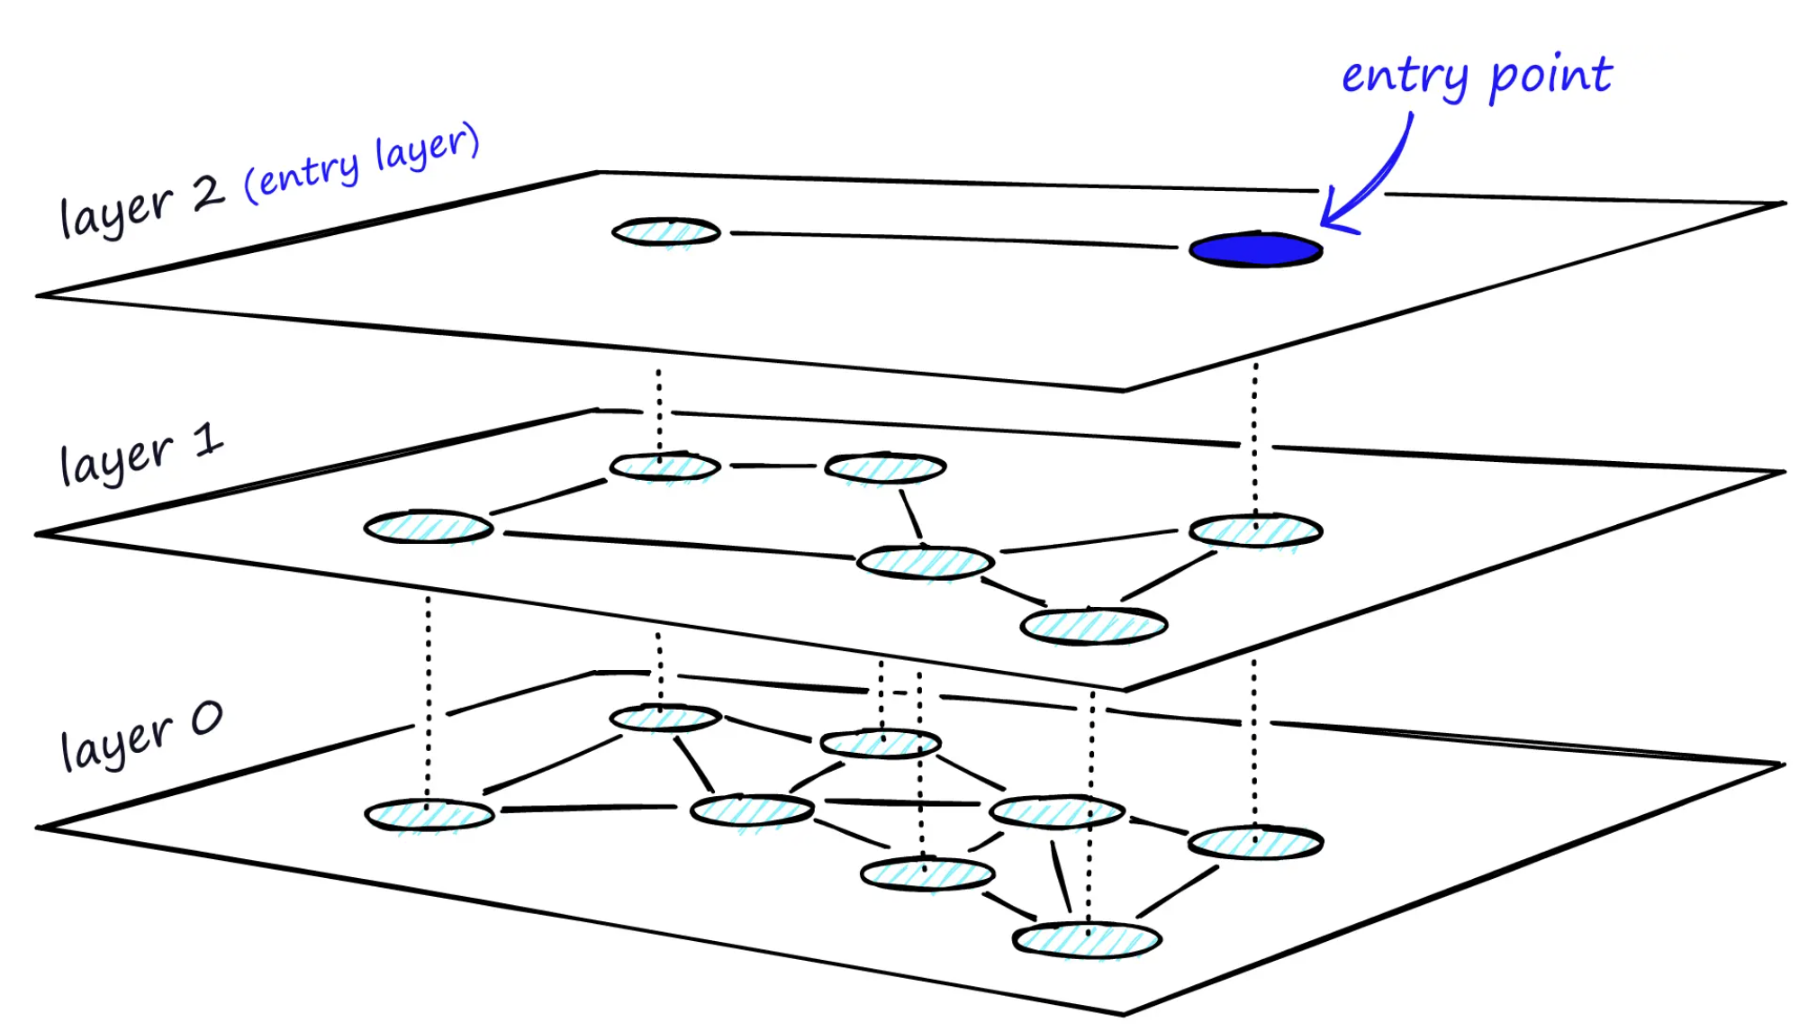
Searching
So how do they work…?
Create a hierarchy of graphs!
Creates a hierarchy of list structures
Search through all graphs, skipping when needed
Hierarchical Navigable Small Worlds (HNSW), Pinecone, https://www.pinecone.io/learn/series/faiss/hnsw/
Notes:
We enter the graph at the top layer, and then find the nearest neighbour in that layer. We then move down to the next layer, and find the nearest neighbour in that layer. We continue this process until we reach the bottom layer.
During the search process, a priority queue is maintained. This queue contains the nearest neighbours found so far. If a node is found that is closer to the target than the furthest neighbour in the queue, the furthest neighbour is removed, and the new node is added.
Constructing the graph is more involved, and consists of two steps (and maybe a third):
Layer insertions A new element is inserted into the graph at layer 0. There is then a probability that the element will be inserted into layer 1, and so on.
Connections In each layer, 𝑀M nearest neighbours are found using the same search process as above, and connections are made.
Pruning An optional step that prunes the graph to ensure high quality connections.

Slide 10
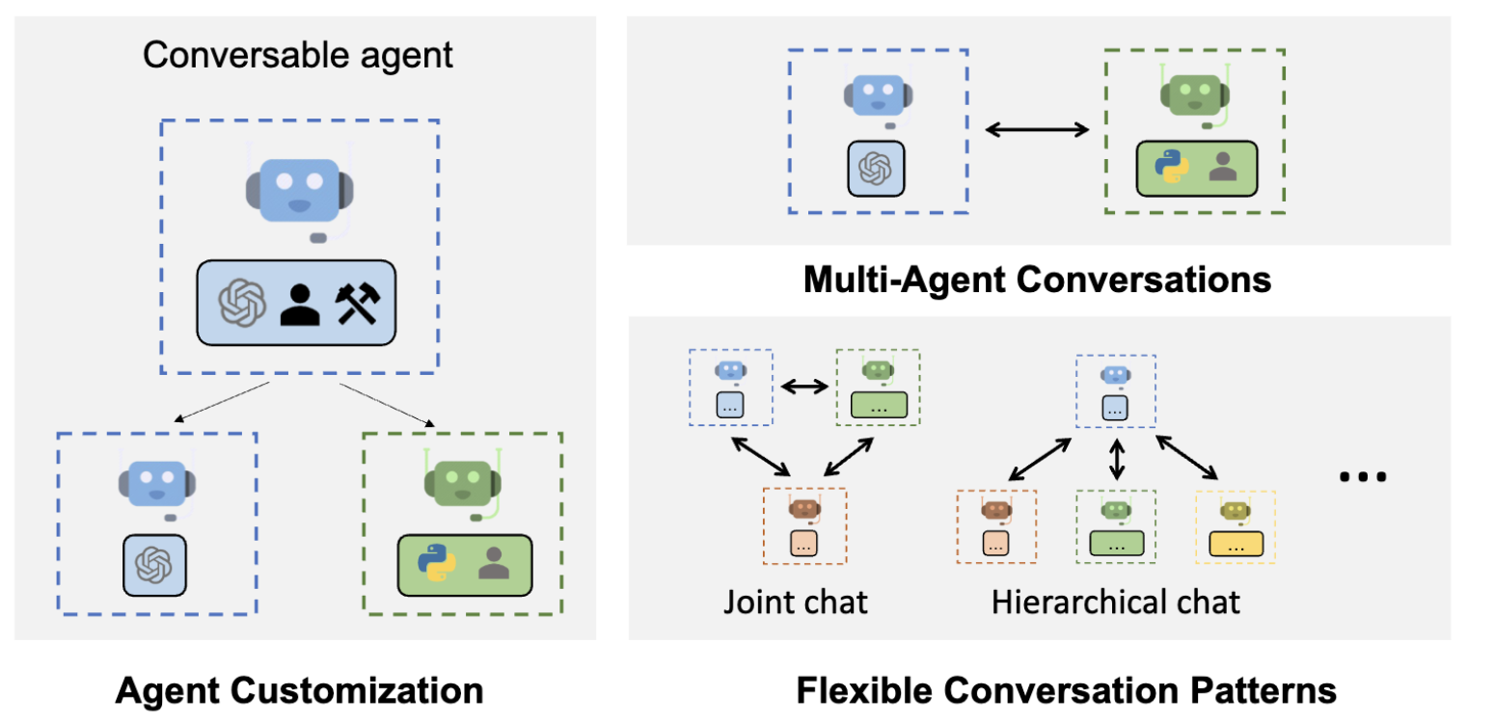
Agents
We can combine multiple LLMs…
https://microsoft.github.io/autogen/0.2/docs/Getting-Started

Slide 11
What is an agent?
…depends on who you ask.
It perceives an environment
It takes actions based on those perceptions
It works towards a defined goal
Anthropomorphic baggage…
…it’s just an LLM that can choose a particular path.

Slide 12
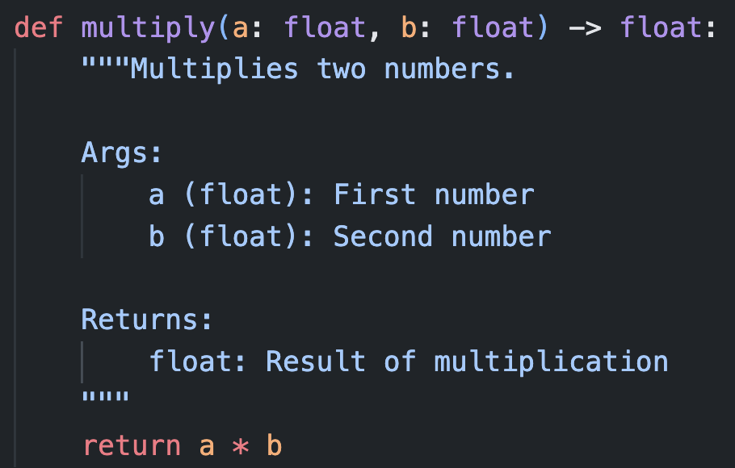
What is a tool?
…it’s a function!

Slide 13
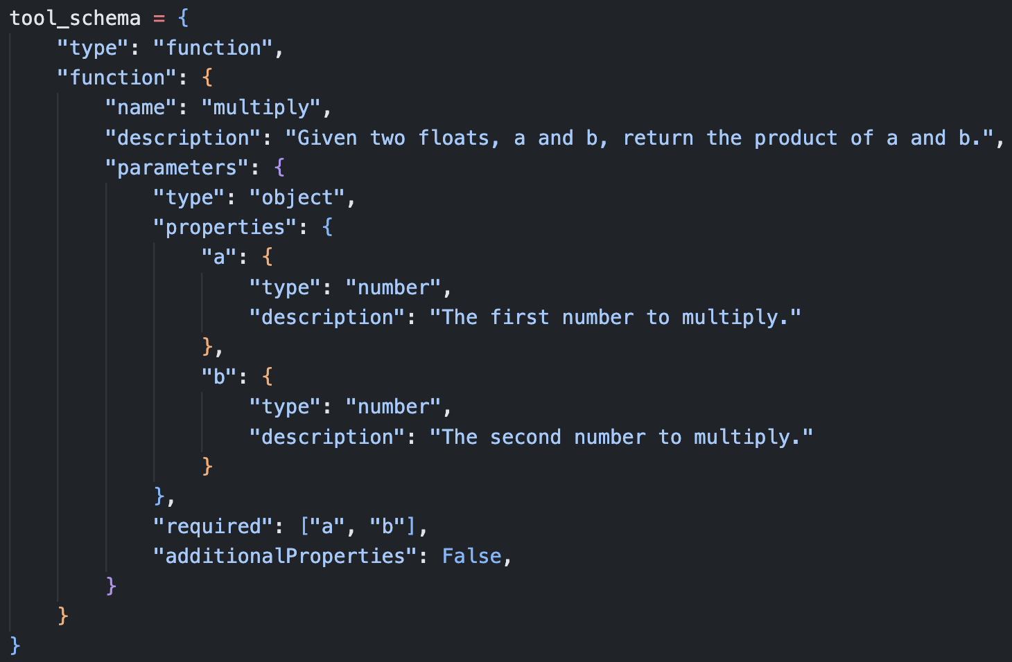
What is a tool?
…it’s a function!
…expressed in json

Slide 14
What is a tool?
…it’s a function!
‘system’ | “You are a helpful mathematician. You have access to the following functions: {{ tool_schema }} If you choose to use the tool, respond in json with the correct arguments to the function.”
‘user’ | “What is 1056 x 1316?”
‘assistant’ | “{‘a’:1056, ‘b’:1316}”

Slide 15
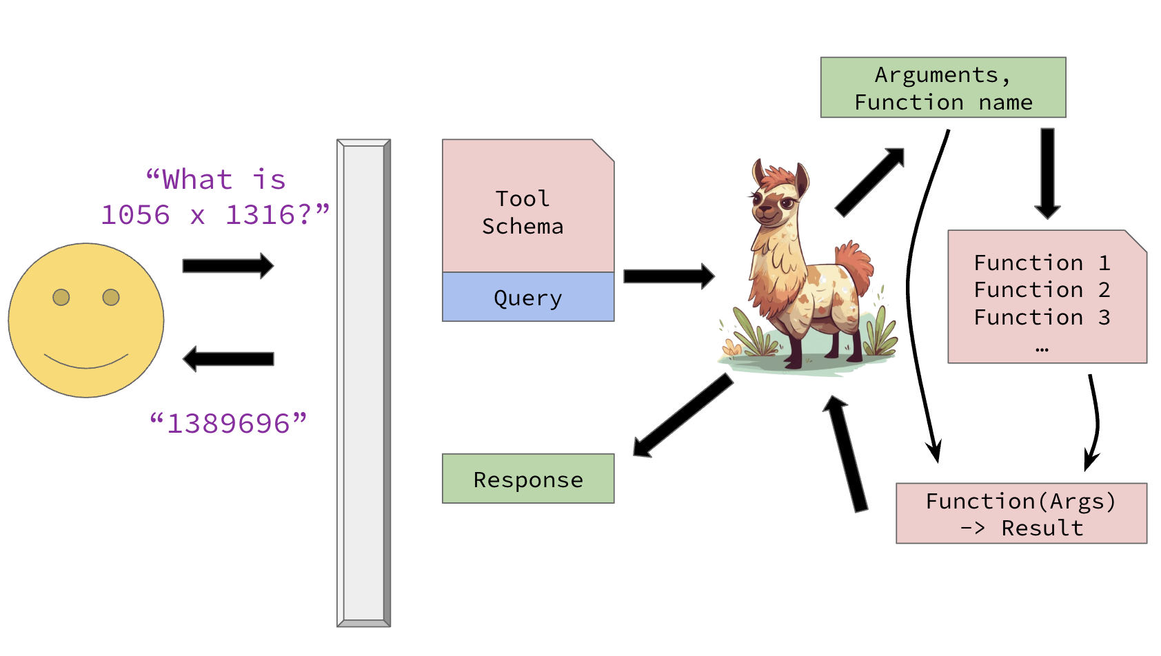
Agents
…and even give them tools!
https://microsoft.github.io/autogen/0.2/docs/Getting-Started

