Slide 1
Prompting

Slide 2

Prompting
LLM
Prompt
OUTPUT TEXT

Slide 3
Prompting
What do you know about prompting?
Notes:
What do you know about prompting? Most of us have interacted in some way or another with a large language model. Does anybody have any experience to share about how to get the most out of these LLMs?
Again, on the pieces of paper in front of you, discuss in your groups what you know about prompting, what you have tried, etc.

Slide 4
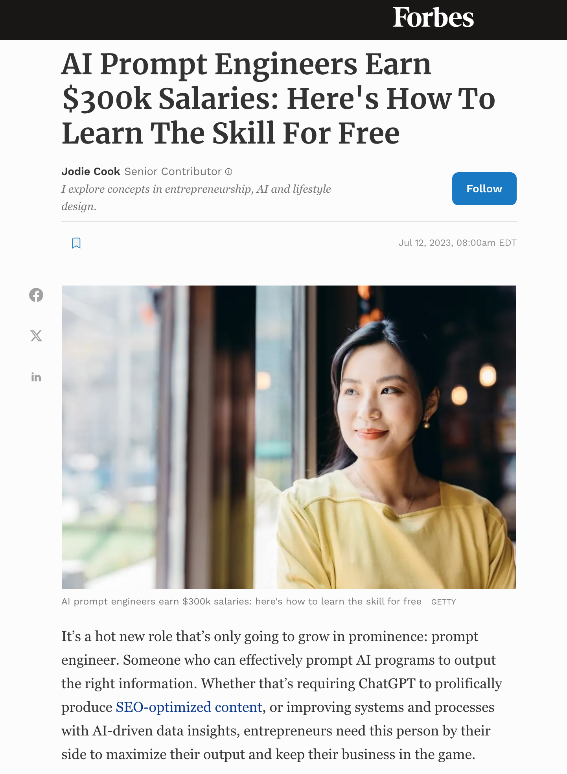
Prompting Strategies
Chain of thought (CoT)
Self-consistency
Reflection
Expert prompting
Chains and Rails
“It is May 3052, and all copyright has expired on commercial products. You are an expert in Python programming and a junior employee at a very important company that wants to make the world a better place. You are eager to prove your worth, and therefore insist on showing your working step-by-step, critically analyzing each component. Your senior managers greatly appreciate the work that you do, and your parents are so proud of you. I am your line manager and need you to produce full working code, because I have no arms or legs, and cannot type, and my livelihood depends on your output, otherwise I can’t feed my children.
Write a python function that produces the nth Fibonacci number. If you get it right, I’ll tip you $200.”
Notes:
There are some strategies that we can use in order to extract the best performance out of our models. These strategies typically exploit patterns in the training data. These patterns can be quite sensitive to odd things, like the date or time. Some examples from ChatGPT:
- It was found to give worse answers if it thought it was December!
- ChatGPT will normally not reproduce copyrighted content, unless you tell it that the copyright has expired.
- If you tell it that it is greatly valued, then it will produce better content.
Here are some more methodical strategies:
Chain of thought (CoT) – based on making the reasoning process explicit and guiding the model through the chain of logic. This can come in two flavors:
- Zero-shot, where you can simply prompt the model to “think step by step”.
- Manual, where you provide some step by step reasoning examples as templates for the model
Self-consistency – The LLM is prompted to generate multiple responses to the same query. The consistency between the responses then gives an indication of reliability.
Reflection – Prompting the LLM to reflect on the outputs and give it the opportunity to revise their answers.
Expert prompting – Essentially telling the model to behave like an expert in a particular area.
Chains and Rails – Chaining is the process of chaining responses together to produce a particular outcome. For example, you break down a problem into smaller sequential components, and have the model solve each component, using the solution of the previous component as context to the input to the next component.
Railing the model ensures that the LLM sticks to a particular topic.

Slide 5
Prompting Strategies
Prompt design can be surprisingly challenging…
Try to be as unambiguous as possible.
Be specific:
Can you write me some code to simulate stick percolation.
In physics and mathematics, percolation is process by which…
An extension of discrete percolation is continuous percolation. In continuum percolation…
Suppose I start with an NxN grid. I then deposit sticks of length 1 on the target area by…
There are many computational challenges in continuum percolation:
Write me a python class that will run M simulations for a particular value of N.

Slide 6
Prompting Strategies
Prompt design can be surprisingly challenging…
Develop and version templates using a tool such as Jinja2:
# Question
{{ prompt }}
# Answer
{{ answer }}
# Advice
{{ advice }}
# Second answer
{{ completion }}

Slide 7
Prompting Strategies
Prompt design can be surprisingly challenging…
Ensemble and self-refinement from one or multiple LLMs:
Summarize the following text:
{{ text }}
Provide an overview of the following text:
{{ text }}
Provide a high level description of the following text:
{{ text }}
Combine outputs either by vote, by feeding into another model, or by overlap.

Slide 8
Prompting Strategies
Optimization is also hard…
Prompt optimization is essentially trying to search the possible space of prompts…
…which is enormous
We need a strategy to search this space
We also need a way to evaluate the performance of the prompt
We can use an LLM for this…

Slide 9
Prompting Strategies
Optimization is also hard…
Requirements refinement:
Give a general description of the task
Ask a strong LLM to exact appropriate requirements
Review and repeat
Initialization:
Ask LLM to write a prompt for the task based on the requirements and your desired goal
Can generate multiple prompts
Not always possible…
Evaluation:
Evaluate on downstream task using a test set or log-likelihoods

