Slide 1
y
A [x₁, y₁]
B [x₂, y₂]
x

Slide 2
y
A + B → [x₁ + x₂, y₁ + y₂]
x

Slide 3
y
A ᐧ B = ‖A‖‖B‖ cos θ
A [x₁, y₁]
B [x₂, y₂]
θ
x

Slide 4


y
cat [x₁, y₁]
fluffy [x₂, y₂]
θ
x

Slide 5
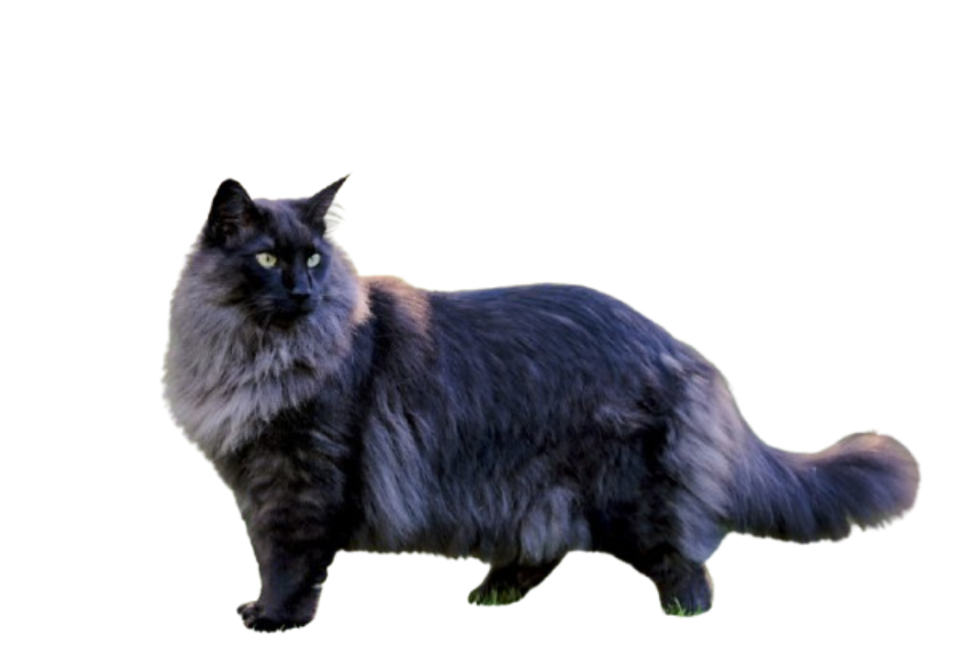
y
fluffy cat → fluffy + cat
x

