Slide 1
Wrap Up

Slide 2
Takeaways?
What takeaways do you have from today?
Notes:
One thing that we get asked is: how am I supposed to keep up with all of these developments?
The simple answer is that you can’t. But once you have situated yourself in the landscape, it becomes easier to ignore the noise, and recognize the important things.
Here are some ways that I personally try and keep up to date with stuff, and it’s all fairly passive. So first, I changed my behaviour from scrolling through Instagram and Tik Tok, to scrolling through reddit and linkedin. And with this change you can passively stay up to date.
The first source is LinkedIn. Follow these pages and new developments will appear on your feed.
The second is YouTube. YouTube in general is filled with AI News channels, so there are probably very many more out there, but these are main ones that I use.
The third is Reddit. Reddit can be a great place to keep up to date with things. r/MachineLearning is heavily research focussed, and will have some non LLM stuff as well. r/learnmachinelearning is very much directed at beginners. r/OpenAI is obviously directed at OpenAI. And r/LocalLLaMA is mostly geared towards running models on your local machine, but much of the information there can be applied to using a remote server, or the HPC.
These sources come with a warning that using reddit exposes you to the potential of seeing and reading NSFW content.

Slide 3
Best Practices: Model Choices
Be intentional about the choice between Open and Closed models and the tradeoffs
Closed models are easy to use, but we cannot know exactly what is taking place behind the API
Open source models are easier to control, though we still may not know exactly how they were trained
If you are using models trained by other people:
Understand as much as you can about how their LLM was trained, what sort of data was used, and how it was finetuned
Consider using a small language model – you may not need a large model for your task
Consider using a quantised model, for energy efficiency
Consider using non-AI techniques
Check the licenses of data, models & code that you use
Notes:
One thing that we get asked is: how am I supposed to keep up with all of these developments?
The simple answer is that you can’t. But once you have situated yourself in the landscape, it becomes easier to ignore the noise, and recognize the important things.
Here are some ways that I personally try and keep up to date with stuff, and it’s all fairly passive. So first, I changed my behaviour from scrolling through Instagram and Tik Tok, to scrolling through reddit and linkedin. And with this change you can passively stay up to date.
The first source is LinkedIn. Follow these pages and new developments will appear on your feed.
The second is YouTube. YouTube in general is filled with AI News channels, so there are probably very many more out there, but these are main ones that I use.
The third is Reddit. Reddit can be a great place to keep up to date with things. r/MachineLearning is heavily research focussed, and will have some non LLM stuff as well. r/learnmachinelearning is very much directed at beginners. r/OpenAI is obviously directed at OpenAI. And r/LocalLLaMA is mostly geared towards running models on your local machine, but much of the information there can be applied to using a remote server, or the HPC.
These sources come with a warning that using reddit exposes you to the potential of seeing and reading NSFW content.

Slide 4
Best Practices: Experimentation
Build a baseline model using the simplest techniques you can
Ensure reproducibility of your experiments where possible
Use temperature parameter to control randomness
Use an open source model
Use the University's computing facilities – HPC & Dawn GPUs – when you need computing power
Use Data Sheets and Model Cards for documentation
Notes:
One thing that we get asked is: how am I supposed to keep up with all of these developments?
The simple answer is that you can’t. But once you have situated yourself in the landscape, it becomes easier to ignore the noise, and recognize the important things.
Here are some ways that I personally try and keep up to date with stuff, and it’s all fairly passive. So first, I changed my behaviour from scrolling through Instagram and Tik Tok, to scrolling through reddit and linkedin. And with this change you can passively stay up to date.
The first source is LinkedIn. Follow these pages and new developments will appear on your feed.
The second is YouTube. YouTube in general is filled with AI News channels, so there are probably very many more out there, but these are main ones that I use.
The third is Reddit. Reddit can be a great place to keep up to date with things. r/MachineLearning is heavily research focussed, and will have some non LLM stuff as well. r/learnmachinelearning is very much directed at beginners. r/OpenAI is obviously directed at OpenAI. And r/LocalLLaMA is mostly geared towards running models on your local machine, but much of the information there can be applied to using a remote server, or the HPC.
These sources come with a warning that using reddit exposes you to the potential of seeing and reading NSFW content.

Slide 5
Best Practices: Evaluation
Carefully specify the task you want your model to perform
Create a test dataset which you can use to evaluate the performance of any AI model
Ensure that your test dataset is separate from any training data
Consider data leakage and how your test data might already be in the model's training data
Understand the limitations and common issues with LLMs, e.g.
Bias
Hallucination
Understand the metrics you're computing and what they can tell you
Notes:
One thing that we get asked is: how am I supposed to keep up with all of these developments?
The simple answer is that you can’t. But once you have situated yourself in the landscape, it becomes easier to ignore the noise, and recognize the important things.
Here are some ways that I personally try and keep up to date with stuff, and it’s all fairly passive. So first, I changed my behaviour from scrolling through Instagram and Tik Tok, to scrolling through reddit and linkedin. And with this change you can passively stay up to date.
The first source is LinkedIn. Follow these pages and new developments will appear on your feed.
The second is YouTube. YouTube in general is filled with AI News channels, so there are probably very many more out there, but these are main ones that I use.
The third is Reddit. Reddit can be a great place to keep up to date with things. r/MachineLearning is heavily research focussed, and will have some non LLM stuff as well. r/learnmachinelearning is very much directed at beginners. r/OpenAI is obviously directed at OpenAI. And r/LocalLLaMA is mostly geared towards running models on your local machine, but much of the information there can be applied to using a remote server, or the HPC.
These sources come with a warning that using reddit exposes you to the potential of seeing and reading NSFW content.

Slide 6
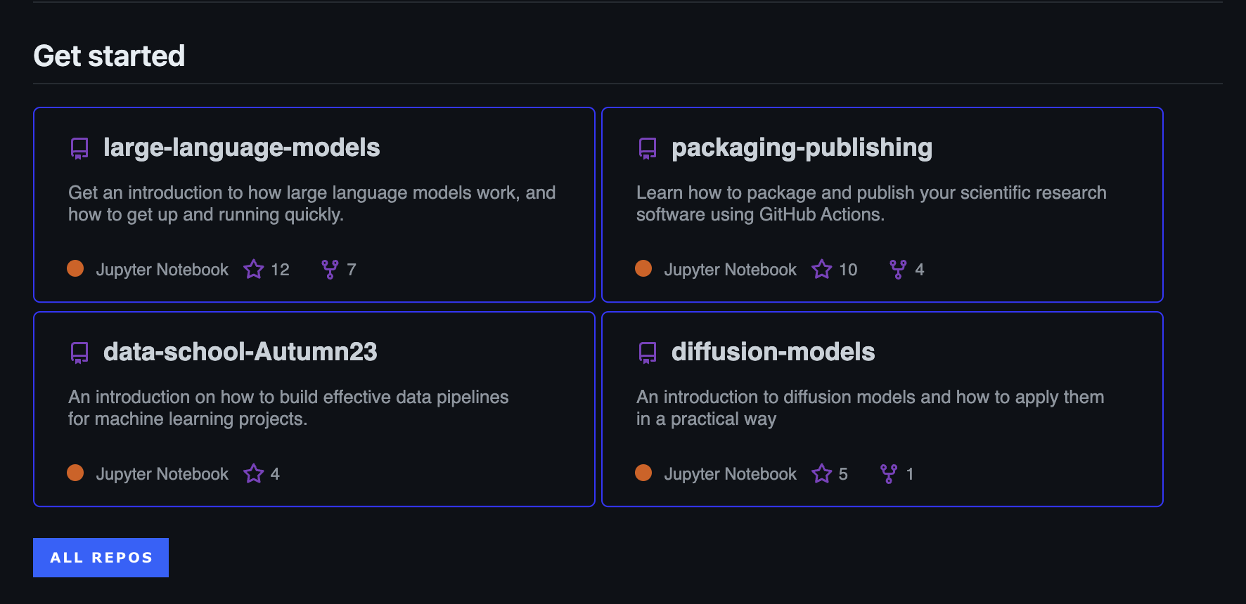
Other Accelerate Material
Notes:
One thing that we get asked is: how am I supposed to keep up with all of these developments?
The simple answer is that you can’t. But once you have situated yourself in the landscape, it becomes easier to ignore the noise, and recognize the important things.
Here are some ways that I personally try and keep up to date with stuff, and it’s all fairly passive. So first, I changed my behaviour from scrolling through Instagram and Tik Tok, to scrolling through reddit and linkedin. And with this change you can passively stay up to date.
The first source is LinkedIn. Follow these pages and new developments will appear on your feed.
The second is YouTube. YouTube in general is filled with AI News channels, so there are probably very many more out there, but these are main ones that I use.
The third is Reddit. Reddit can be a great place to keep up to date with things. r/MachineLearning is heavily research focussed, and will have some non LLM stuff as well. r/learnmachinelearning is very much directed at beginners. r/OpenAI is obviously directed at OpenAI. And r/LocalLLaMA is mostly geared towards running models on your local machine, but much of the information there can be applied to using a remote server, or the HPC.
These sources come with a warning that using reddit exposes you to the potential of seeing and reading NSFW content.

Slide 7

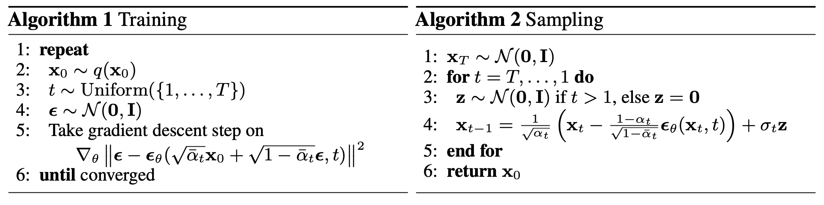
Diffusion Models
Here is the algorithm for diffusion…
Notes:
By the end of the session today, I’m hoping that we can get at least a general idea of what these steps mean, without really caring too much about the mathematical detail…I’ll briefly explain the left hand algorithm now. It might not make too much sense immediately, but hopefully, later on, it should.
Get a random training sample
Draw a timestep uniformly at random from [1, T]
Generate some noise from a normal distribution
Feed your image plus noise into the model. The model will then try this noise value

Slide 8
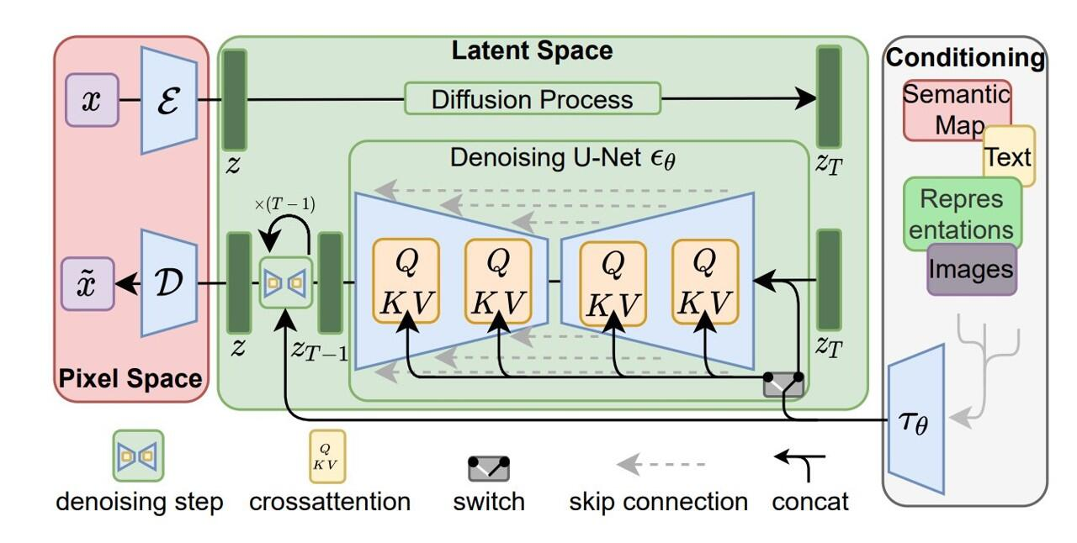
Diffusion Models
Perhaps this makes more sense…
maybe not…

Slide 9
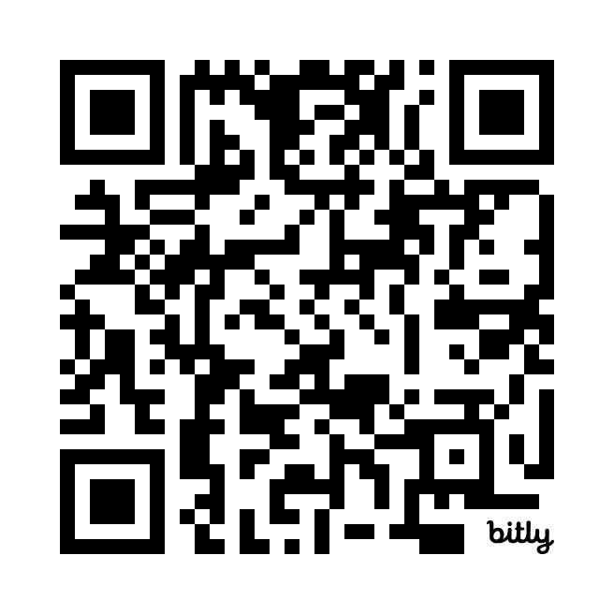
Upcoming events and workshops
Teaching workshops
Monday 14 October Hands on LLM workshop
Wednesday 6 November An Introduction to Diffusion Models in Generative AI
Monday 18 November Publishing and Packaging Python Code for Research
Monday 2 December An Introduction to Docker
Wednesday 4 December Hands on AI workshop
AI Cafés
Wednesday 23 October – West Hub
Monday 11 November – St Edmund’s College
Sign up through our events page:
Get in touch for further information and support:
accelerate-mle@cst.cam.ac.uk

