Slide 1
Small Language Models
Notes:
Sometimes you might not actually need to use an LLM. The temptation is to go for the biggest hammer in the toolbox

Slide 2
Small language models
You may not actually need a high-parameter LLM
Think about what you actually need and what task you are trying to do
Do you need chat/instruction capability?
Can your problem be framed in an alternative way?
Example:
Gerry wants to look at how words are used in different contexts. His plan is to pick a word and get the dictionary definitions of that word.
He will then feed the dictionary definitions plus the sentences into an LLM and ask it to classify these sentences based on which definition the target word uses in the given context…
… But this can be potentially reframed as sentence classification problem.
One approach would be to use a small language model, like BERT, to generate contextual embeddings, and use these embeddings as features in a classifier.
Notes:
What do you really want? There is well-known problem on stack overflow called the XY problem. This occurs when a person tries to solve a problem on their own, pursues a method that seems like a promising approach, gets stuck, and then asks for help with their chosen method (instead of asking for help with the original problem).

Slide 3
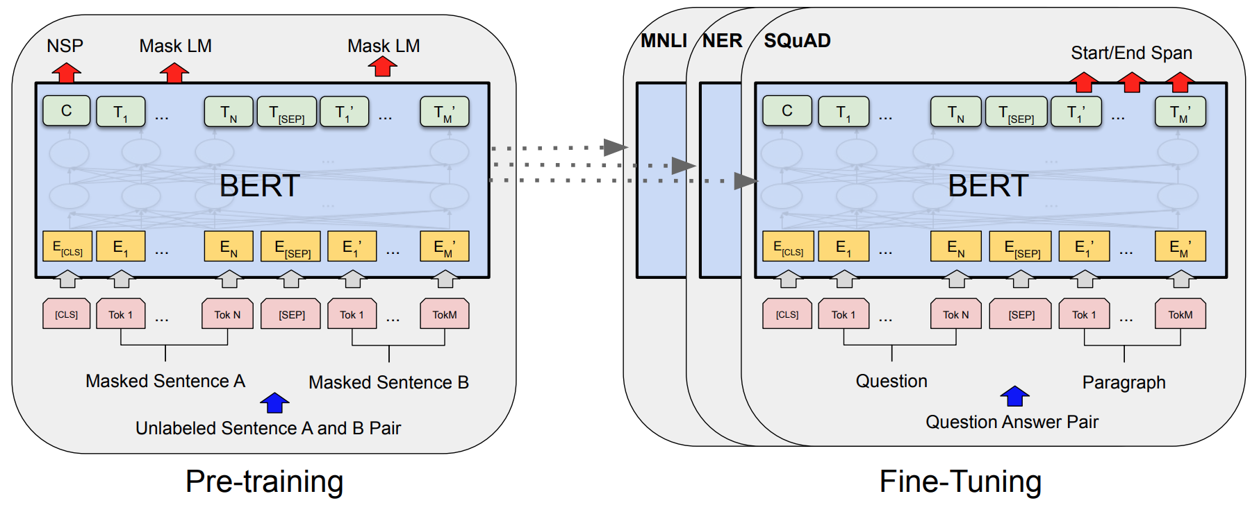
BERT
Bidirectional Encoder Representations from Transformers
Notes:
BERT is an “encoder-only” model, trained on 2 tasks simultaneously: masked token prediction, and question answer pairs.
This is in stark contrast to the GPT-style models that we have seen, which is primarily NEXT token prediction. This makes BERT incredibly versatile.
First notice the input and output shapes – you get the same number of outputs as you do inputs. This means that each output actually encodes contextual information about the inputs. You can see here that BERT includes “special” tokens [CLS] and [SEP]. And these special tokens encode general contextual information about the entire input context.

Slide 4

BERT
BERT is a very versatile family
DistilBERT
CamemBERT
ERNIE
XML-RoBERTa
RoBERTa
ALBERT
BART
Q-BERT

Slide 5
BERT’s Conceptual Cartography
The task
Nina Haket - Department of Modern and Medieval Languages
BNC14-Spoken Corpus
1,251 conversations
672 speakers
11.5 million words
How do people use words in everyday life?

Slide 6

BERT’s Conceptual Cartography
Initial idea
Here are some dictionary definitions of the word “bank”:
bank. n. financial institution
bank. n. the side of a river
…
Please give the appropriate definition for the following usage:
“I need to go to the bank to deposit some money.”
1

Slide 7

BERT’s Conceptual Cartography
‘[CLS]’
‘the’
‘cat’
‘[MASK]’
‘on’
‘the’
‘mat’
‘[SEP]’
101
1996
4937
103
2006
1996
13523
102
‘the’
‘cat’
‘sat’
‘on’
‘the’
‘mat’
‘sat’ | 0.19
‘was’ | 0.14
‘lay’ | 0.07
‘hippo’ | 0.00001

Slide 8
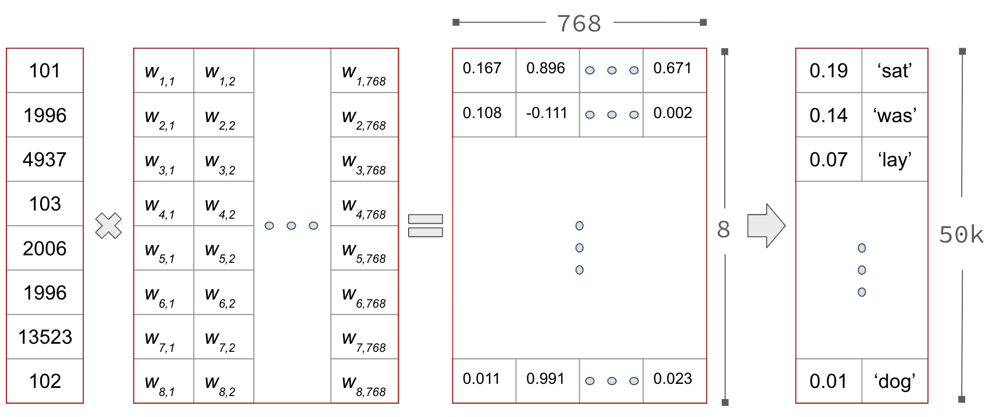
BERT’s Conceptual Cartography

Slide 9
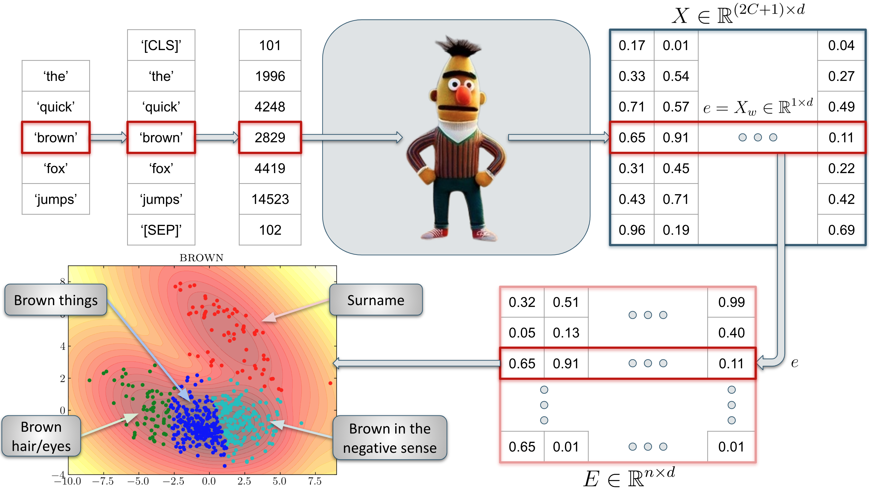
Haket and Daniels, “BERT’s Conceptual Cartography: Mapping the Landscapes of Meaning.” EMNLP2024, under review

Slide 10
What can BERT do?
BERT can be used in a range of traditional NLP tasks…
Named entity recognition (NER)
Question answering
Sentiment
Anomaly detection
Let’s see how this might work in practice…

