Slide 1
Developing with UV

Slide 2
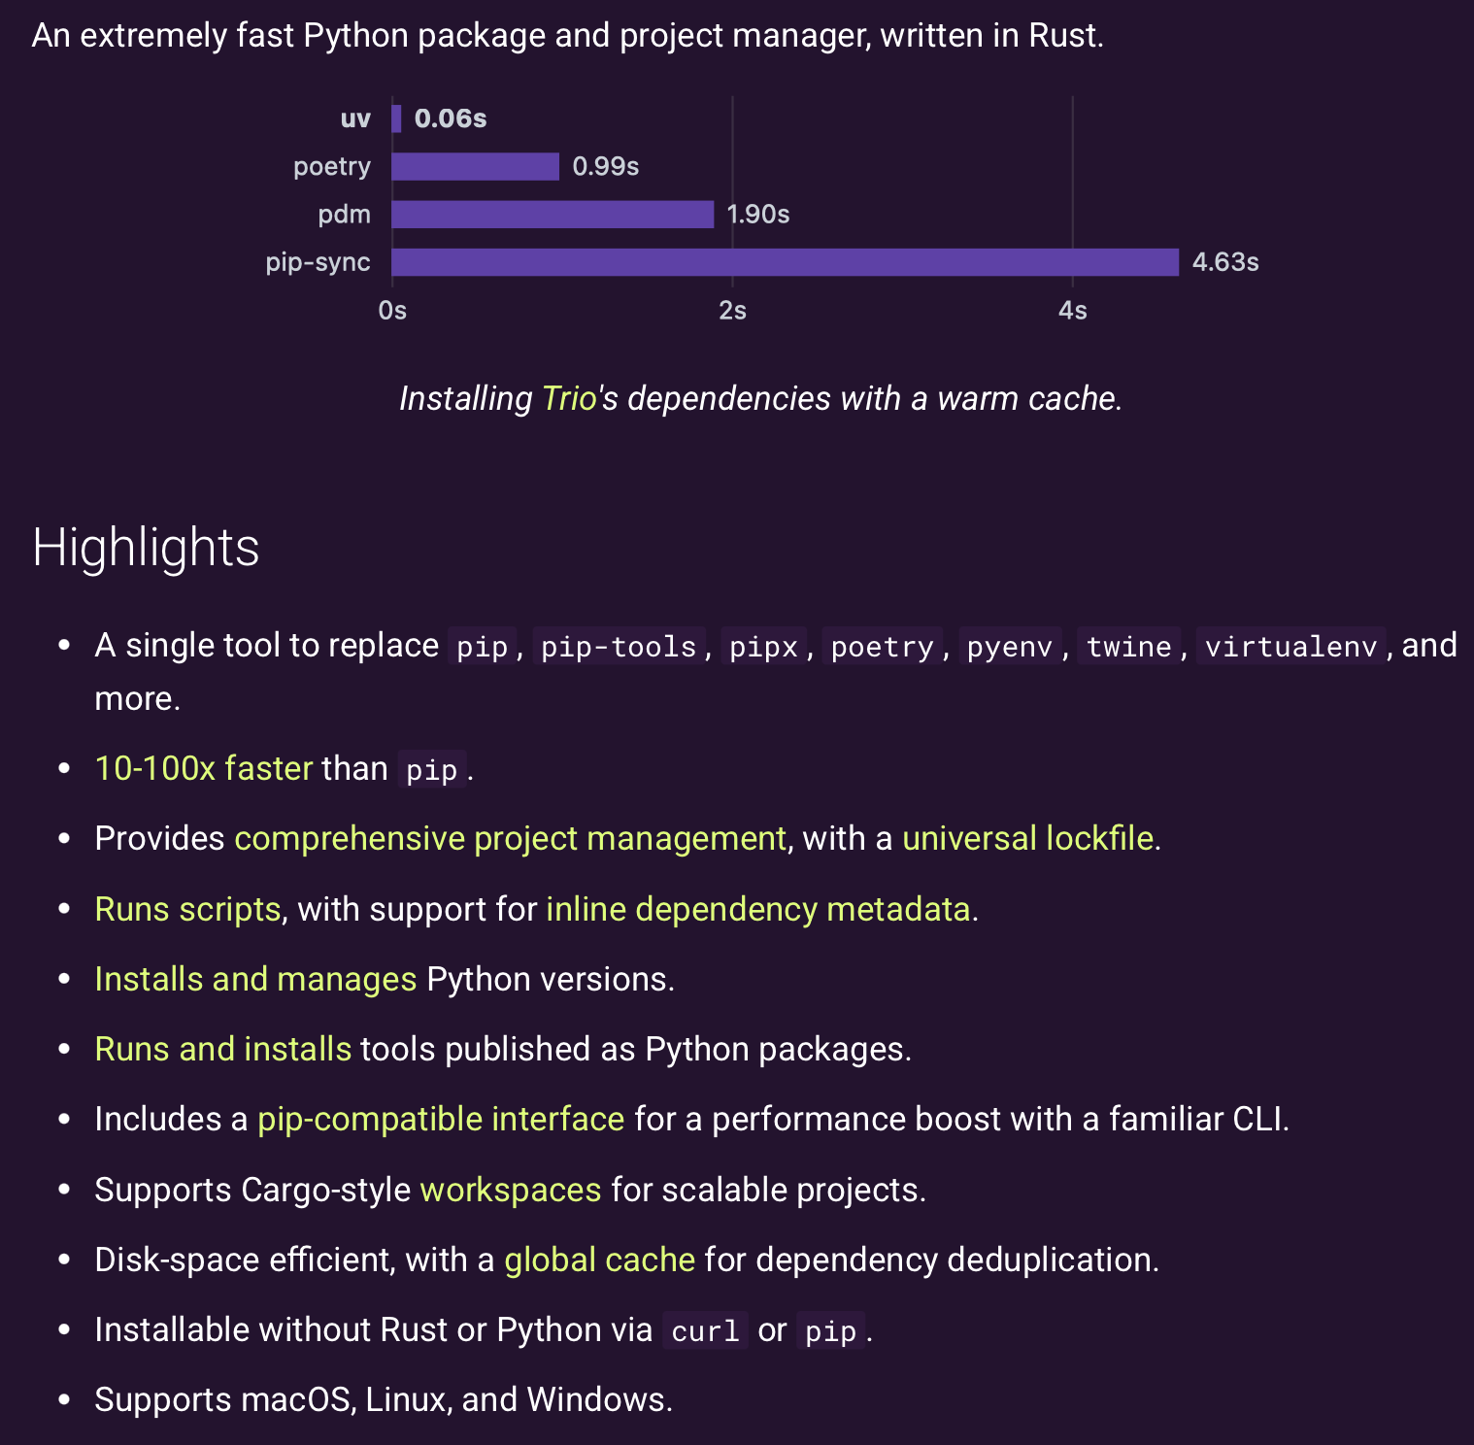
Why UV?
From the uv documentation:

Slide 3
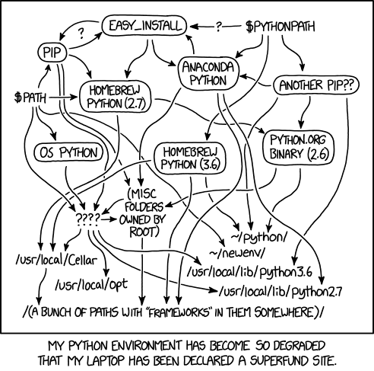
What about Anaconda/Conda
We want to make life easy!
Anaconda is very “heavy” piece of software.
Most of the time, people don’t use it correctly.
If you do have to use conda, use miniconda.
For this workshop, we will use uv!
Notes:
Anaconda used to be the go-to for scientific software, and it’s still quite popular today.
Anaconda itself is very bloated and comes with something like 2GiB of installs. There is an alternative: miniconda, which is lightweight. However it still comes with the downsides mentioned in the previous slide. And most people who use it don't know how it works and run into issues.

Slide 4
How to use UV
Way #1 – start off your project the right way
:~$ cd my-project
:~$ uv init
my-project
├── pyproject.toml
├── README.md
└── main.py
Initializing a new project is easy
Standard files and directory structure is created for you
Adding packages is easy:
:~$ uv add torch
UV will automatically update your toml file
UV will also manage your virtual environment if you have already created one

Slide 5
The toml file
The toml file is the control center for your project
Metadata
Name, version, description, authors, licensing, included packages
Dependency management
The libraries you need for the project
Development libraries
Build system configuration
What tools are used to build the project
Script configuration
CLI entry points
Notes:
So we talked about important files for github and git, well this is the important file for poetry. The toml file is the control center for your python project.

Slide 6
Building and publishing
Once your PyPI tokens are configured, life is good…
It’s that simple…
:~$ uv build
:~$ uv publish --token [] --publish-url []

