Slide 1


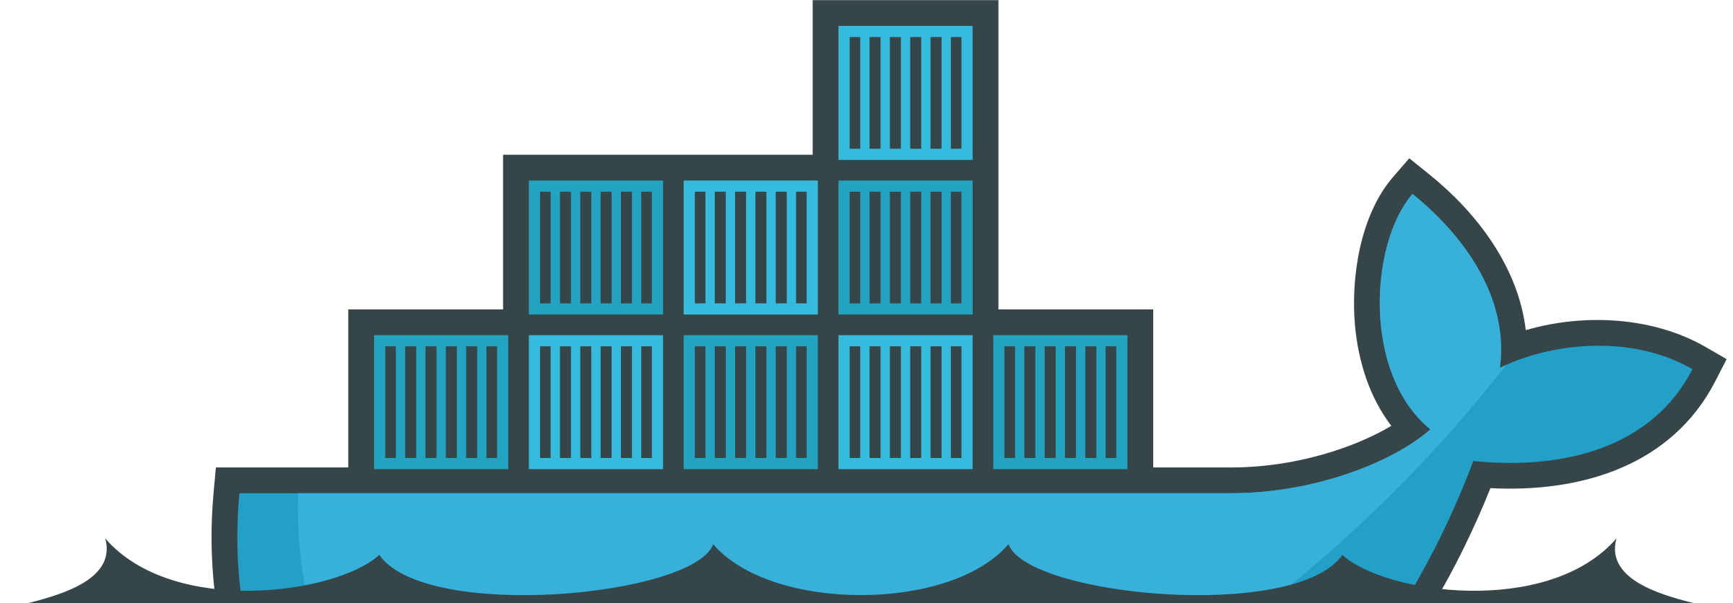
Docker for Science

Slide 2
Introduction

Slide 3
Overview and objectives
By the end of this workshop, we should be able to
Understand key approaches to code reproducibility
Understand how Docker works, including:
Pulling images
Running containers
Working inside a container
Create your own Docker images
Set up development environments using devcontainers in VSCode
Share environments with others

Slide 4

Reproducibility
Why should you care?
“The data that support the findings of this study are available from the corresponding author,
[author initials], upon reasonable request.”
-----
“Data sharing is not applicable to this article as no new data were
created or analyzed in this study.”
-----
“All data that support the findings of this study are included within the article.”

Slide 5
Reproducibility
Why should you care?
Reproducible code can be built upon by other researchers.
You can build upon the code of others.
Smoother onboarding of other researchers.
Because Journals are beginning to care too…

Slide 6
Reproducibility
Types of reproducibility
Methods reproducibility
Ability to implement the experimental or computational procedures, using the same data and tools, in order to obtain the same results as the original work.
Results reproducibility
Ability to produce corroborating results in a new, independent study following the same experimental procedures.
Inferential reproducibility
When an independent replication of the study arrive at qualitatively similar conclusions.

Slide 7
Reproducibility
A personal story…

Slide 8
The Dream
Ideally, we want…
All code that produced the results to be public
Detailed instructions on how to reproduce results
This includes all figures and tables
Easy to download and verify

Slide 9
Existing approaches
requirements.txt
The simplest approach
# requirements.txt
numpy==1.21.0
pandas==1.3.0
scikit-learn==0.24.2
matplotlib==3.4.2
pip freeze > requirements.txt
pip install -r requirements.txt

Slide 10
Existing approaches
requirements.txt
Advantages
Simple and easy to understand
Works with pip, Python's package installer
Can be generated automatically
Widely supported
Limitations
Only captures Python packages
Misses system dependencies
No guarantee of binary compatibility
Platform-specific packages may fail
Can't specify version ranges
May include unnecessary dependencies

Slide 11
Existing approaches
pyproject.toml
newer, more sophisticated approach to Python dependency management
[project]
name = "myresearch”
version = "0.1.0”
description = "My Research Project”
requires-python = ">=3.8”
dependencies = [
"numpy>=1.21.0",
"pandas~=1.3.0",
"scikit-learn>=0.24.2,<0.25.0",
]

Slide 12
Existing approaches
pyproject.toml
Advantages
More flexible version specifications
Can define optional dependency groups
Includes project metadata
Better dependency resolution
Can specify build requirements
More maintainable
Limitations
Still Python-specific
Doesn't handle system dependencies
Environment variables not captured
No guarantee of system library versions
Can't manage non-Python tools

Slide 13
Existing approaches
environment.yml
Conda’s middleground between simple python package management and full containerization
name: myresearch
channels:
- conda-forge
- bioconda
- defaults
dependencies:
- python=3.9
- numpy=1.21
- pandas=1.3
- scikit-learn=0.24

Slide 14
Existing approaches
environment.yml
Advantages
Popular in scientific computing
Manages both Python and non-Python packages
Includes many scientific packages pre-built
Limitations
Slower than pip installation (and doesn’t play well with pip)
Can be complex to maintain
Environment setup can be large
Not as complete as Docker (no OS-level isolation)
Channel conflicts can occur
Still platform-dependent

Slide 15
Why do we care about Docker?
Setting random seeds and having a requirements file is not enough…
Hardware
CUDA/cuDNN implementations vary between GPU models
CPU vs GPU will give different results
GPU architectures can be different
Float32 vs Float64 arithmetic differences
Software
CUDA toolkit versions
DL framework backends
Compiler optimizations
Numerical libraries (MKL vs OpenBLAS)

Slide 16
Docker

Slide 17
Key terms
Container A lightweight, standalone, and executable package that includes everything needed to run a piece of software - code, runtime, system tools, libraries, and settings.
Image A read-only template containing a set of instructions for creating a container. Think of it like a snapshot or blueprint.
Dockerfile A text file containing instructions to build a Docker image, specifying the base image, commands to run, files to copy, etc.
Registry A repository for storing and distributing Docker images. Docker Hub is the most popular public registry.
Layer A modification to an image, created by executing a command in a Dockerfile. Images are made up of multiple layers cached for efficiency.
Volume A mechanism for persisting data generated by and used by containers, stored outside the container filesystem.
Docker Compose: A tool for defining and running multi-container Docker applications using a YAML file.
Docker Engine The core technology that runs and manages containers on a host system.

Slide 18
Key terms
Port Mapping/Forwarding Routing traffic from a host machine's port to a port inside a container.
Base Image The starting point for building a Docker image, typically a minimal operating system like Alpine or Ubuntu.
Tag A label applied to Docker images to version or identify them (e.g., ubuntu:20.04).
Docker Daemon The background service running on the host that manages building, running and distributing Docker containers.
Container Orchestration Tools and platforms (like Kubernetes) that automate deploying, scaling, and managing containerized applications.
Virtual Machine (VM) A software-based computer that runs on top of a physical machine, containing its own operating system, virtual hardware, and resources.
Kernel The core program of an operating system that manages hardware resources and provides essential services for computer programs.

Slide 19
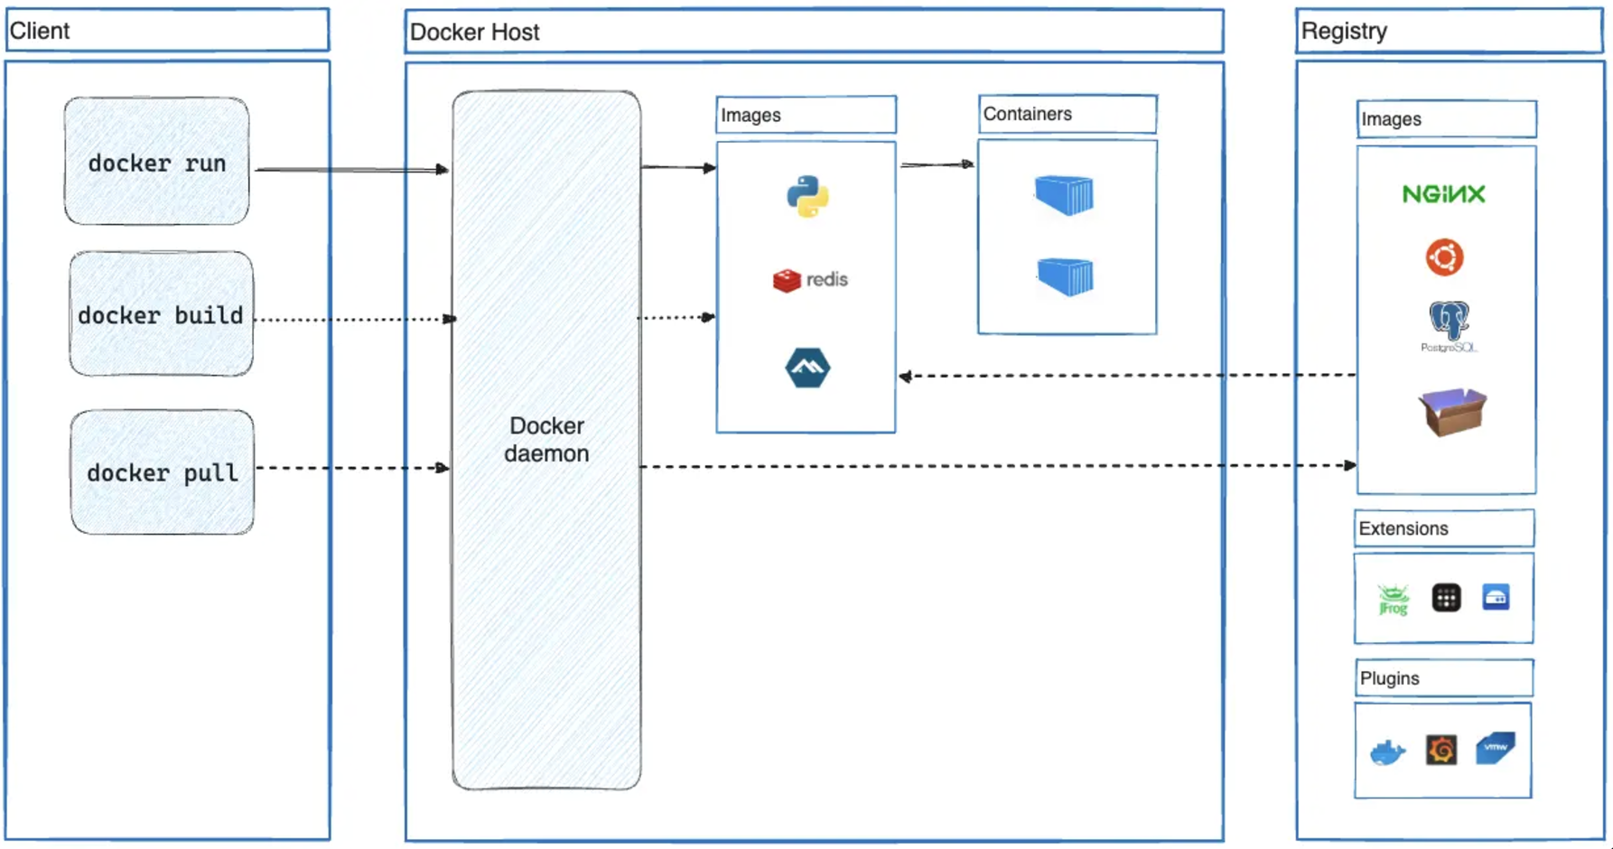
What is Docker?
Notes:
Docker is a way to develop, shit, and run applications in reliable and reproducible environments.
Docker uses a client-server architecture.
The Docker client talks to the Docker daemon, which does the heavy lifting of building, running, and distributing your Docker containers.
The Docker client and daemon can run on the same system, or you can connect a Docker client to a remote Docker daemon. The Docker client and daemon communicate using a REST API, over UNIX sockets or a network interface. Another Docker client is Docker Compose, that lets you work with applications consisting of a set of containers.
The Docker client (docker) is the primary way that many Docker users interact with Docker. When you use commands such as docker run, the client sends these commands to dockerd, which carries them out. The docker command uses the Docker API. The Docker client can communicate with more than one daemon.

Slide 20
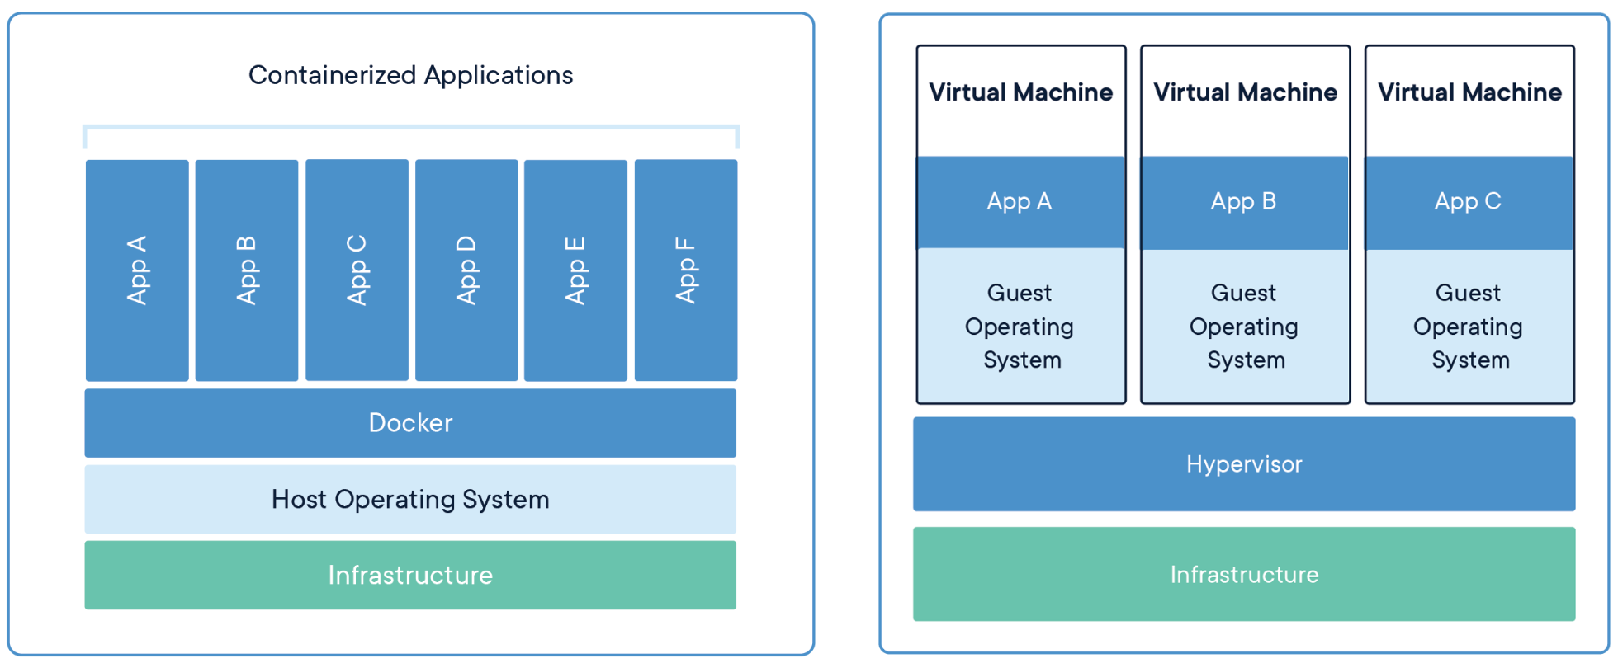
Containers vs VMs
Containers and VMs sound quite similar…
Notes:
Containers are an abstraction at the app layer that packages code and dependencies together. Multiple containers can run on the same machine and share the OS kernel with other containers, each running as isolated processes in user space. Containers take up less space than VMs (container images are typically tens of MBs in size), can handle more applications and require fewer VMs and Operating systems.
Virtual machines (VMs) are an abstraction of physical hardware turning one server into many servers. The hypervisor allows multiple VMs to run on a single machine. Each VM includes a full copy of an operating system, the application, necessary binaries and libraries – taking up tens of GBs. VMs can also be slow to boot.

