Slide 1
Hello!
If you haven’t already done so, while we’re waiting, please make sure you:
have a GitHub account
have a TestPyPI account at https://test.pypi.org/
You might need to set up 2FA via an authentication app.
Notes:
I'm Fin I'm an MLE and I will be running the workshop today.
Ryan and Radzim to offer technical support
Will talk more about our group shortly

Slide 2
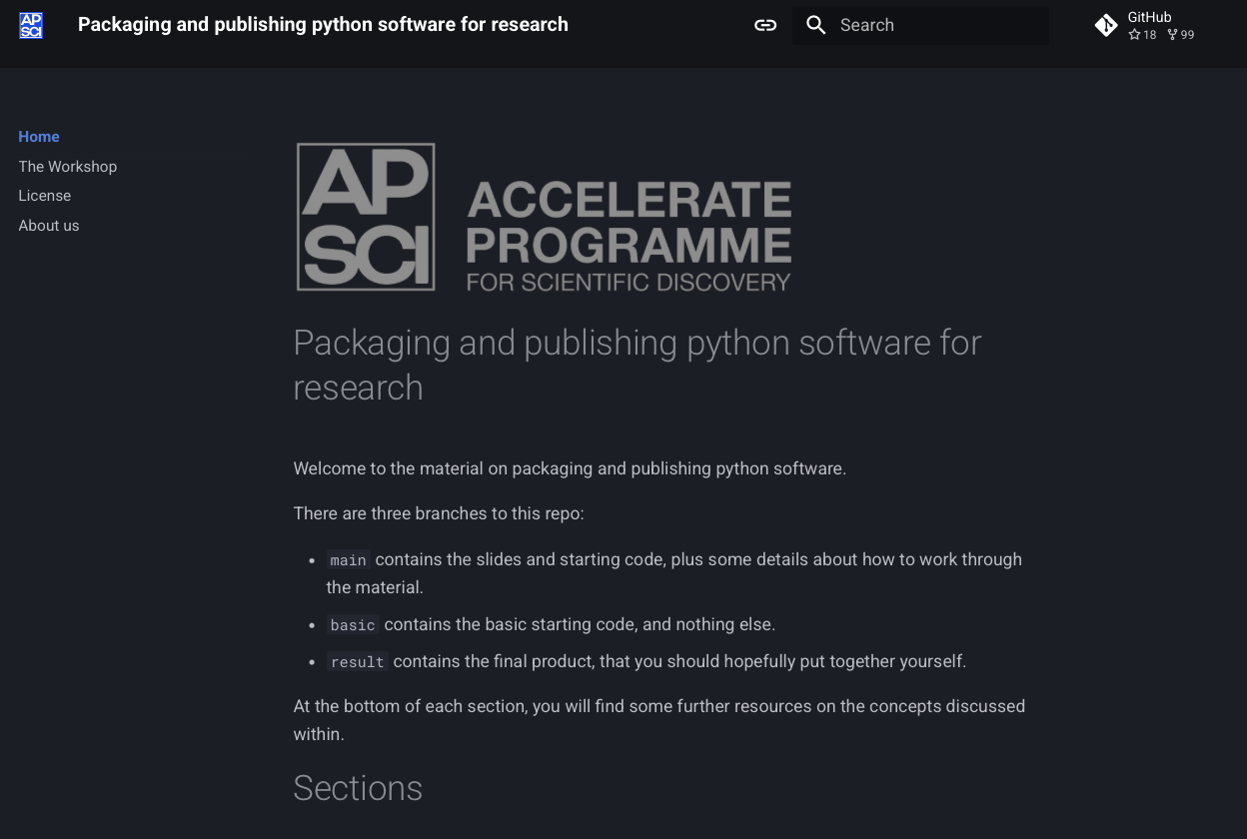
Documentation
Documentation for hands-on exercises available at:
docs.science.ai.cam.ac.uk/packaging-publishing

Slide 3



Packaging and Publishing Python Code for Research
Notes:
We're going to be talking about packaging and publishing python code!
In doing so we will be covering things along the way that make this process as streamlined as possible - software best practices.
Hopefully, over the course of this workshop I can convince you that some of these things are worth paying attention to.
Something that we see regularly is Python.
It is ubiquitous in research.
Reasons: adoption in ML and simplicity, but also statistical / scientific computing packages like numpy or simpy

Slide 4
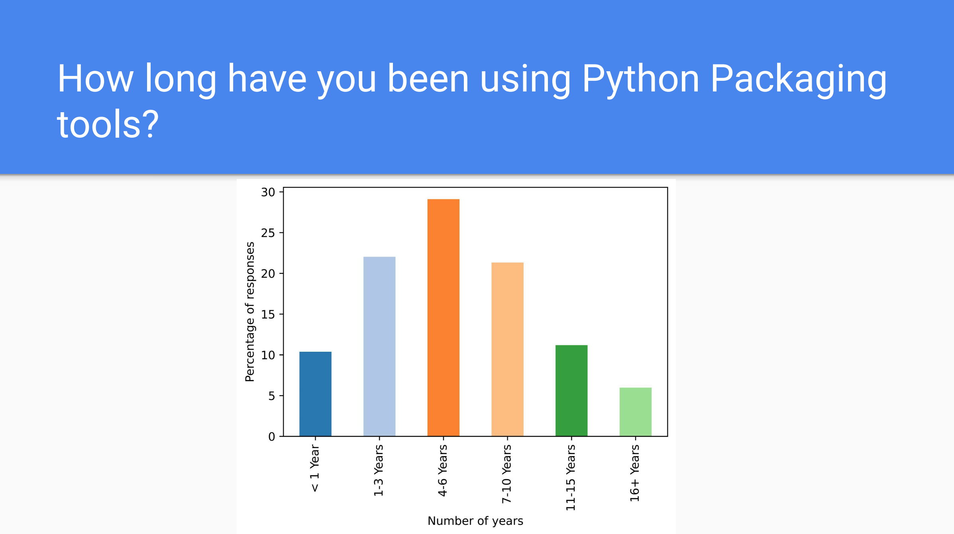
Notes:
Python Software Foundation ran a survey on packaging – so this is the process of turning your code into a distributable package that other people can use easily with the same tools. And the results really speak for themselves:
Over 8,000 people responded, and this is the general distribution of users, so just under 30% using the tools between 4-6 years. Now usually, you might have a year or more of experience using python before you really start to play around with some of the packaging tools that are available out there.

Slide 5
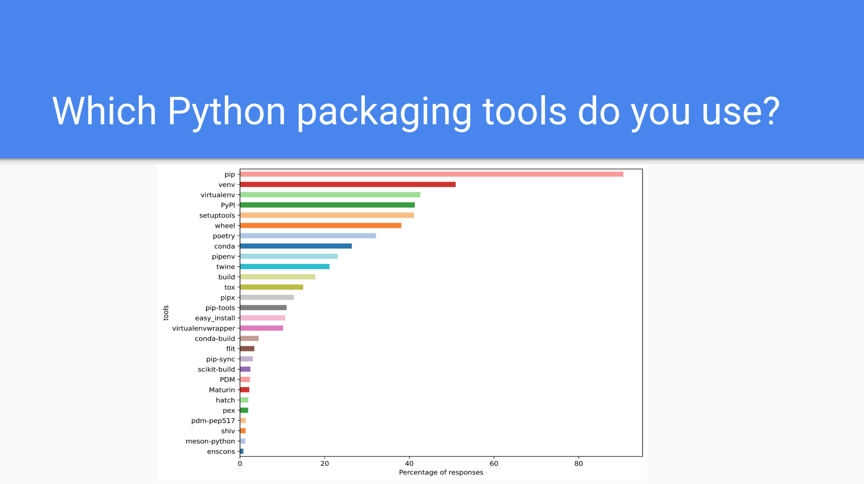
Notes:
So what packaging tools are actually available? Many of these you might recognize:
Pip and Conda are probably two of the most recognizable up there. Everyone is introduced to pip when they first start learning Python, and then most people are using python in the context of scientific programming, so the natural step is into conda.
Then further down the list of recognizability, we have wheels and PyPI. You always see that notification in the terminal of building wheels, and then PyPI is the main repository where these wheels are housed for pip.
If you don’t use conda, then you probably use venv – this comes standard with python, very capable virtual environment tool.
There are also some lesser known ones

Slide 6
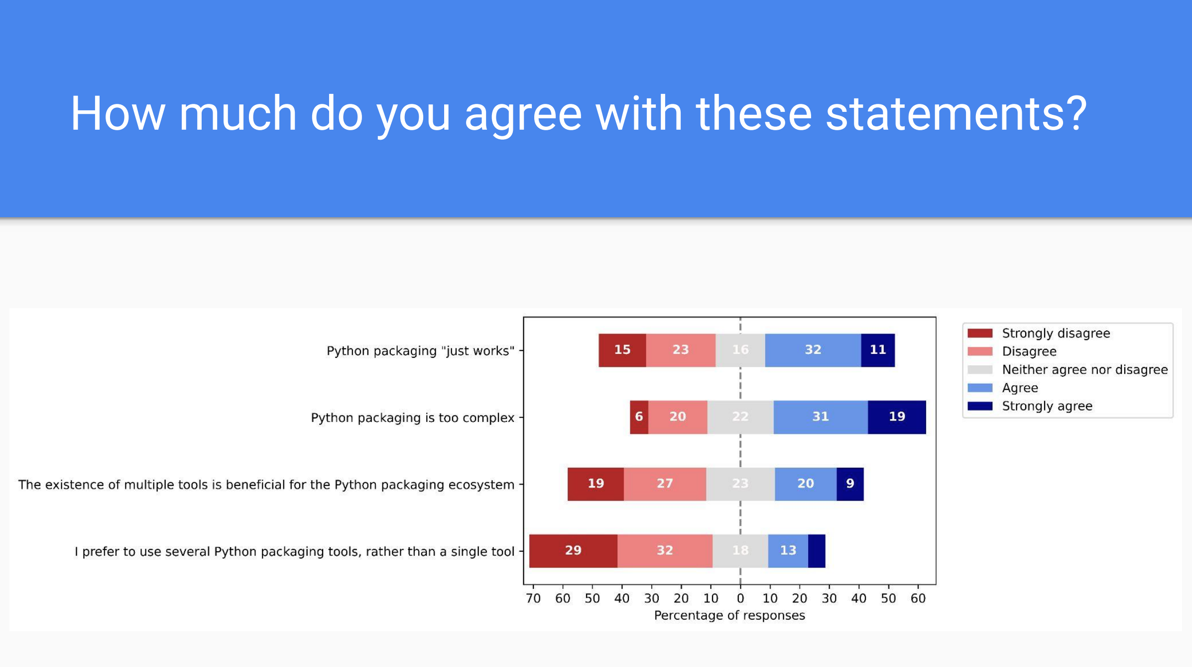
Notes:
Python packaging “Just works”. I am actually quite surprised that 43% of people agreed or strongly agreed with this. But still, 38% don’t.
Python packaging is too complex – 50% agree, and 26% do not agree
Perhaps most importantly, most people think that having all of these tools is NOT beneficial for the Python ecosystem, and most people would prefer to just have the one tool.

Slide 7
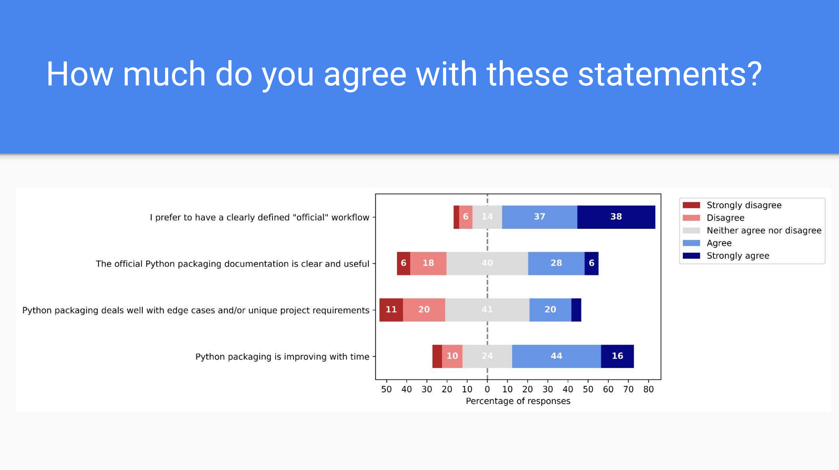
Notes:
An overwhelming amount of people would like to have an “official” workflow. Of course. All of those different tools we had.
For modern languages like Go and Rust, you have all of this tooling integrated into the rest of the toolchain. You don’t need a bunch of 3rd party tools.
But also importantly, packaging is improving with time. And in this session, we’re actually going to talk about some of the current methods and techniques to help you with packaging software.

Slide 8
pip install nobel_prize
uv
docstrings
typing
pre-commit
testing
untitled17.ipynb
Notes:
The process of taking your untitled_notebook_17.ipynb, and navigating this hellscape to produce something decent can stressful, and the first few times, you usually make some mistakes and you just leave them, oh it’s OK, whatever. So here we stand, with our intrepid cat, ready to brave this vast landscape together.
And many of the techniques that we talk about also apply to deploying production-level software. There this idea, that now you’ve developed the model you need to deploy it to production. What the hell does that even mean? Develop the model, deploy the model.

Slide 9
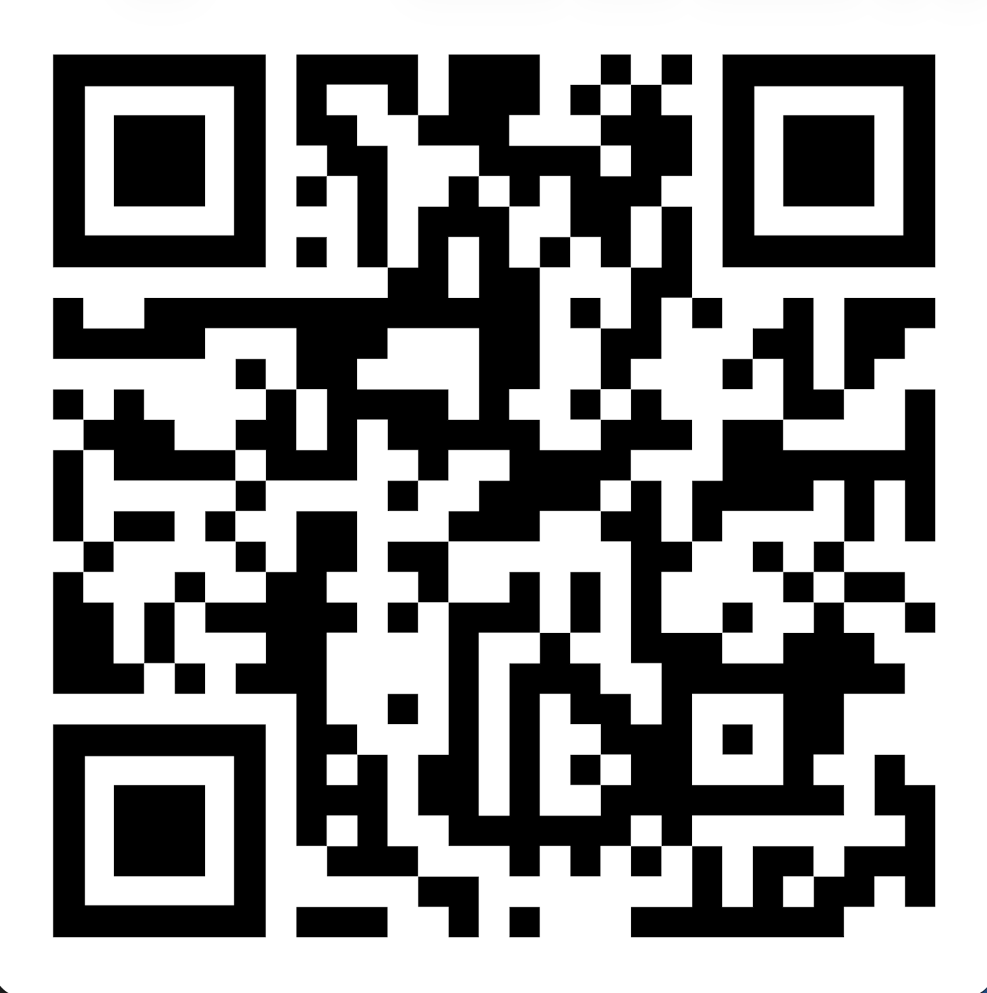
Accelerate Science Programme
"Accelerate Science pursues research at the interface of AI and the sciences, generating new scientific insights and developing AI methods that can be deployed to advance scientific knowledge."
Notes:
Just before we get started, I would just like to give a brief overview of the Accelerate program.
We are a group composed of researchers, machine learning engineers and programme staff.
Our overarching goal is to support the adoption of AI in research at the university.
We do this through activities such as
Workshops (see in a second), AI Clinic, sections of university-wide workshops / events that are supported by us
But also longer-term involvement on research projects in a research engineering capacity.
Not just intersection of AI and Science!
We’re finding more and more that researchers from the Humanities want to utilize machine learning methods, and we’re having to reassess what we think of as traditional science.

Slide 10
Accelerate Science Programme
Workshop Goals
We want to:
Support researchers across the university to use software in their work when required.
Make best practices a core part of research
Better understand the challenges that researchers face.
Identify what training courses or software resources we might want the Accelerate Science Programme to create.
Including shared code
Start to build a community of like-minded researchers across the university.
Notes:
We are ultimately here to facilitate this process of integrating AI into research.
We run a couple of workshops at the moment: an introduction to large language models, a hands on LLMs, an intro to generative AI with diffusion models, docker, a packaging and publishing workshop, and now a new agents 4 science workshop

Slide 11
Packaging and Publishing Python Software for Research
About the course
Introduction to python packaging and publishing
Version control and GitHub Actions
Testing
Documentation
CI/CD
Code and slides available on:
Accelerate Science GitHub repo
Notes:
We provide material that people can work through in their own time, but also in the context of a full day workshop event, with instructors there to help.

Slide 12
Introduction to Software Packaging and Distribution
Notes:
So first I just want to measure the temperature of the room:
How many of you have a beginner or above level of experience with version control? And by above beginner, I mean, you can initialize your own git repos locally, you can commit, you can push, you can start new github repos.
OK and intermediate and above: you can handle working on multiple branches, submit and merge pull requests, familiar with things like .gitignore, licensing.
OK, and advanced: familiar with github actions, precommit checks, continuous development and integration.
And who has published python code to either github releases or to PyPi?
Who primarily works with Jupyter notebooks? VSCode? PyCharm? Cursor? Vim?
We're gonna be using VSCode / JupyterLab today on our teaching platform

Slide 13
Discussion!
What made you sign up for this workshop?
Why might packaging and publishing code be useful in your work?
Do you already have a project in mind you’d like to package/publish?
What do you primarily work/code in?
Jupyter notebooks? VSCode? PyCharm? Cursor? Something else?
Package management
What do you use to manage dependencies in your Python projects?
Pip, conda, poetry, venv .etc?
Version control
What do you know about version control?
Can you initialize a repo, commit and push to GitHub?
Have you worked with more advanced features like GitHub actions, pre-commit .etc?
Code sharing / publication
Have you ever released Python code? For example, have you included a GitHub link in a research paper?
How do you usually share Python code with collaborators?

Slide 14
Why is this important?
Do No Harm
Try not go beyond what is necessary to achieve a specific aim. Risk assessment should be used to prevent harms.
Safety and Security
Vulnerabilities to attack should be addressed.
Privacy and protection
Privacy must be protected throughout, and adequate data protection frameworks should be established.
Accountability
All systems should be auditable and traceable.
Transparency and explainability
The level of transparency and explainability should be appropriate so as not to conflict with privacy and safety.
Human-in-the-loop
Software systems should never replace human responsibility and accountability.
Sustainability
Assess the impact of your research on the environment.
Awareness
Public understanding of AI and data should be promoted wherever possible
Fairness
Research should promote social justice, fairness, non-discrimination, and inclusivity.
UNESCO: A Human Rights Approach to AI
Notes:
Hopefully, if you’re here, then you aren’t wondering why this is even important! But in case you are wondering….
Here are the UNESCO guidelines on responsible use of AI, but they can just as easily apply to any software.
Recommend weapons of math destruction by Cathy O'Neil
How do we make software systems auditable and traceable?
How can we monitor security vulnerabilities?
How can we be transparent and make sure our systems are explainable and interpretable?
How can we ensure privacy.
Actually, the answers to some of these questions lies in proper software engineering practices.
We can make our code open source.
We can use version control, so all changes made by contributors can be tracked.
We can keep up to date with vulnerabilities via Github.
We can be aware of any third-party software, and what they are doing..

Slide 15
The FAIR Principles for Research Software
Findable
Easy for humans and machines to find
Clearly versioned
Accessible
Easily retrievable via standardized protocols
Open, free and universally implementable
Interoperable
Uses data in a way that meets community standards
References appropriately
Reusable
Clear licensing
Can be understood, built upon, modified, or incorporated into other software
Introducing the FAIR Principles for research software
Notes:
We also have the fair principles for RS.

Slide 16
Why is this important?
What about some of the immediate impacts on us and our research?
Help to mitigate erroneous work.
This lessens the chance of retractions.
Gives us integrity.
Allows others to reproduce and build on our work.
Faster onboarding of new students/researchers
Notes:
What about more short-term lower scale effects of good SWE
I wonder how many people in this room, have written a piece of code, and there is a part of it that they’re not quite sure how it’s working, but it does seem to be working. But how can you be sure that it’s working in the way you intend it to work?
Lessens the chance of retractions.
It gives us integrity. Your life is so much easier if you trust your own work, if you know that you’ve tugged at every thread.
It allows others to reproduce and build on our work. This is another big deal. We should, given the same starting conditions, be able to reproduce the work of other scientists to within an acceptable degree of error. And in many case in computational work, that error should be essentially machine precision.
It helps onboarding with new students. Again huge deal. How much of the initial PhD is spent deciphering the code written on stone tablets.
All comes from the end goal : publishing

Slide 17
What does it mean to “publish” software
Most researchers assume publishing means making your code repository public on platforms like GitHub.
This is certainly one of the most common forms of publishing software, and allows you to cover most of the benefits of publishing that we stated.
However, there are more sophisticated forms of publishing that can provide you with a much better chance of obtaining those advantages.
To clarify this point, I like to think of publishing as a hierarchy of publishing levels, each extra level provides you with a better chance of increasing the exposure and impact of your software.
Notes:
So what does it really mean to “publish” software?
When most people think of “publishing” code, it means to in some way make your source code available on a public platform, usually for free. For a lot of people that means uploading to GitHub. It’s akin to writing a blog on the internet. And if done correctly, which it isn’t always, it allows you to cover off a lot of the benefits of publishing we stated earlier, and also address some of the ethical issues.

Slide 18
Publishing hierarchy
Level 0: Barely doing anything. Email your source code to your colleagues/collaborators with explanations of how to run it.
Level 1: Maintain your source code publicly on GitHub under some licence. This is an important level as it now means others can fork, modify, and extend your work. However, one limitation is that most potential users of your pipeline might not be interested in your code, they just want to use your software rather than extend it.
Level 2: Publish to build repository like PyPI or Conda Forge.
Level 3: Publish documentation with something like Read the Docs or MkDocs.
Level 4: Automate all of the above!
Level 5: All of the above, and publish your pipeline or software in a software-specific journal like the Journal for Open Source Software (JOSS).

Slide 19
The Workshop
The workshop aims to take a notebook and:
Refactor to a canonical python package structure and manage with UV
Build a command line interface
Great for ease of use – we can run a bash command, supply some arguments or config file
If you’re running software on the HPC via slurm, it makes life easier
Add a basic test suite
Make our package pip installable with documentation
Automate our testing and publishing process
Notes:
Firstly, building a basic user interface.
Secondly, building a CLI.
Third, making the package pip installable.
And finally, automate the testing and publishing process.

Slide 20
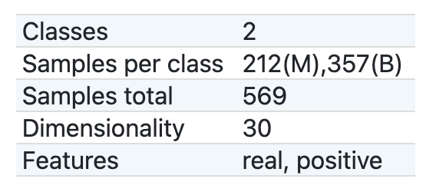
The project we will work on
Predicting cancerous tissue
Uses the UCI ML Breast Cancer Wisconsin Diagnostic dataset
A simple pipeline:
Standardize the features
Dimensionality reduction
Logistic Regression
Save the best model ready to be used by clinicians
Jupyter notebook
Python scripts
Training
Inference
CLI
Notes:
I will now introduce you to the project itself
Focus isn't on software just the process
the Wisconsin Breast cancer dataset. It’s trivial to achieve high accuracy. We do some typical exploratory data analysis
Explain jupyter notebook starting point vs. python scripts
Also included is a requirements.txt file, which is more for you so that you know what package versions you need, a saved model, and some python scripts.
And then in the actual workshop itself we use our teaching platform.
CONTRIBUTIONS WELCOME!!!!!
So something that is immediately noticeable is that at the core of all of this are two things:
Poetry
GitHub
And all of it happens within VS Code. These are really the most valuable tools for basic developing in python today. So for the remainder

