Slide 1
Version Control with Git and GitHub

Slide 2
Version Control with Git and GitHub
Overview
Why is version control important?
What are Git and GitHub?
Repos
Organizations
Features
How to integrate basic version controlling with your work
Development environments
Licensing
Notes:
So we will now move onto version control. We’ll cover what are git and github, some features of GitHub. Then we’ll take a dive into some IDEs, and developing software. Finally, we’ll take a dive into licensing.

Slide 3
Why is version control important?
VC can help you create ethical software
UNESCO guidelines:
Safety and Security
Accountability
Transparency and explainability
FAIR
Your software will be findable
People can use your software, or modify it or build on top of it
Personal benefits
You can undo catastrophic mistakes!
Another route for community engagement.
Required in industry

Slide 4

Git
About Git
Git helps us keep track of versions of files.
Git is very useful if you are working with many collaborators.
Relatively straight-forward to use, but can come with some headaches.
Through the course material, we will explore most of the git commands that you will need throughout your life.
Good rules:
Have a main branch and a dev branch
Commit often, and when you have working code
Amend commits if they are similar

Slide 5






An introduction to GitHub
A number of version control repositories exist:
Notes:
If you want to make your code publicly available, how do you do this? We essentially use cloud storage, but for code!
There are quite a few version control repositories out there. It allows you to make changes, track changes, upload and download files, publicly share your code, deploy websites, etc.
By far the most popular are github and gitlab, but there are others as well like bitbucket and sourceforge. Often code will be posted to very many of these.
So we’ll just walk through github and what it looks like (anybody with experience of git and github, please feel free to add anything at any time.)

Slide 6
Why GitHub?
GitHub has emerged as the front-runner in digital version control repositories.
Early advantage
User-friendly UI
Ecosystem and integrations
Strong community
Microsoft acquisition
These reasons make GitHub a relatively safe choice for software developers to store remote versions of their code.

Slide 7







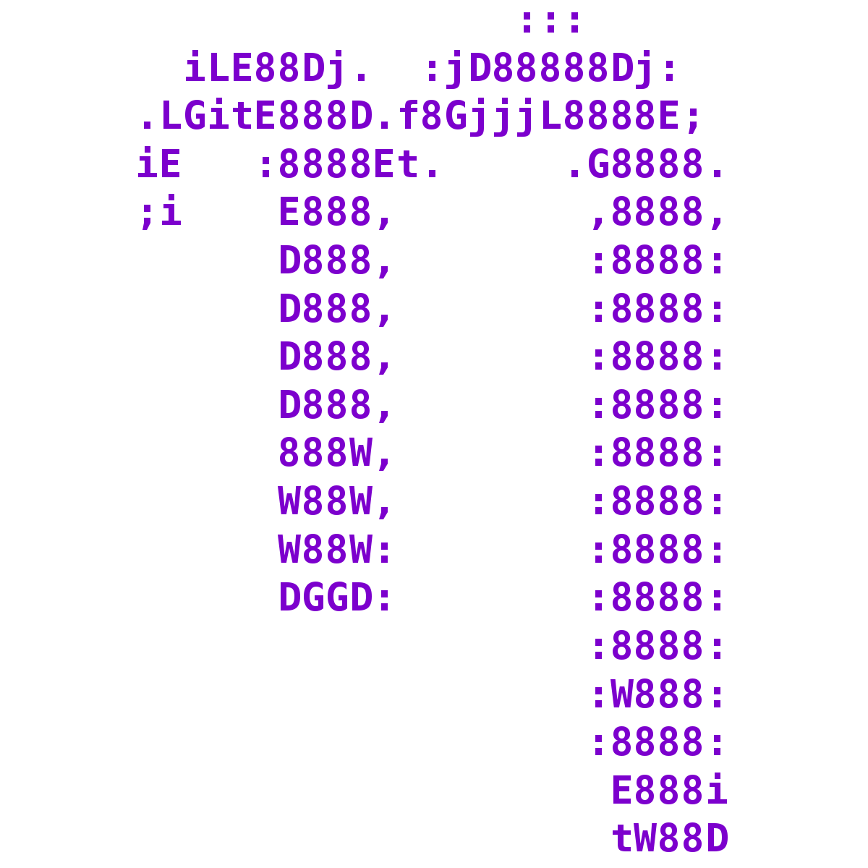
Developing code
There are many ways to develop Python code:
Notes:
There are so many ways to write python code. My story arc went something like this:
I first learnt to use python using Wing IDE. I then switched to using Anaconda, because at the time it was hot and billed as a great framework for scientific software, which it really was – it made things very convenient. So I used mainly Jupyter Notebooks, and Spyder. Spyder offers a great landing zone for people who are migrating from MATLAB, because the look and feel of it are very familiar. Then I did some work involving C/C++, so I used Atom for a while. Then I moved back to mostly working in Python, so I switched back and forth between PyCharm and Jupyter. I really liked the convenience of PyCharm. I also had a brief affair with Spyder again, after I discovered how much storage space my PyCharm projects were taking up. Also during this time, I used Nano because I was working on a remote server and needed to edit some scripts. Then I was working in C++ again, so I switched to Visual Studio, which is a very heavy all around beast of a development environment – it really is a very comprehensive tool, and when you’re developing C++ code, it takes a way a lot of the pain. And now I’ve permanently settled on VS Code. With Zed for Rust.
You still have a subset of people who insist on using Vim or Nano, but we just nod politely when they speak to us.

Slide 8
Developing code
We use Visual Studio Code
Lightweight, and faster than some other environments.
Not restricted to a single language.
Has a debugger and terminal.
Extensions:
Jupyter
Remote development and cloud integration
VC and GitHub integration
Copilot
Lots of nice themes!

Slide 9

An aside about Copilot…
Should you use it…?
Advantages
Reduces the time to write relatively straight-forward bits of code
Substitute for spending time digging through stack overflow or the documentation
Write basic test cases
Find issues with code, and help optimize
Great for learning new things
Disadvantages
Sometimes produces nonsense – susceptible to hallucination, just like other LLMs
At the mercy of Microsoft updating or nerfing
Potential to waste time looking for faulty code
Remember…
Human-in-the-loop
It is not a substitute for understanding
Notes:
Does anybody here use Copilot?

Slide 10
Key GitHub files
There are some key files that appear in GitHub
README.md
Includes information about your project
Markdown format
Can also include HTML and CSS, and can get quite complicated
.gitignore
Everything that you don’t want to commit to your git history and your repo
Usually standard templates
You should include any files that contain private information such as API keys!
Copilot can produce this for you very easily.
LICENSE

Slide 11
Software licensing
Including a license in your software is critical
“When you make a creative work (which includes code), the work is under exclusive copyright by default. Unless you include a license that specifies otherwise, nobody else can copy, distribute, or modify your work without being at risk of take-downs, shake-downs, or litigation. Once the work has other contributors (each a copyright holder), ‘nobody’ starts including you.”
If you don’t include a license, other people can view and fork your code, but they can’t modify it or use it in any meaningful way.
Not allowing others to use your code is probably not what you intended by not including a license.
If you come across software that has no license, this means you have no permission to use, modify or share the code.
Ask the maintainers to include a license
Don’t use it
Negotiate a private license
Notes:
]

Slide 12
Software licensing
What types of licenses are available
Permissive
Creative Commons Attribution Non Commercial
MIT Apache 2.0
e.g. OpenPose
e.g. PyTorch
Non-commercial
Commercial
Creative Commons Attribution Non Commercial (Share Alike)
GNU General Public License
e.g. Meta “Segment Anything Model”
e.g. Linux Kernel
Non-permissive (copy-left)

Slide 13
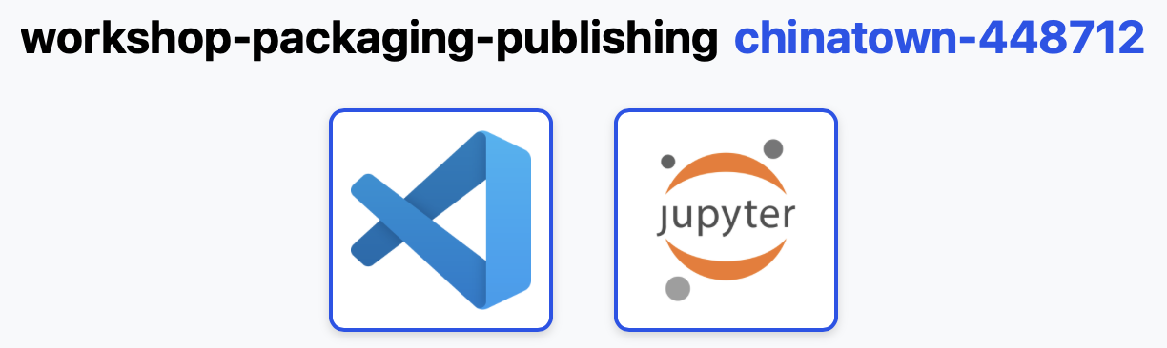
Getting Set Up with Pods
Head to pods.acceleratescience.co.uk
Username: CRSid
Password: Acceler8
Choose VSCode as your IDE
Notes:
Walk through notebook, don’t run any cells!
Walk through structure of day after break, where to follow how I’m going to be coding .etc
Walk through first section with GitHub

