Slide 1
Parameter Value Change callback
SystemC CCI WG
Sheshadri Chakravarthy
Texas Instruments Inc.
Feb 2011

Slide 2
Parameter Value Change callback
Demonstrate requesting and responding to value change notifications.
User module creates couple of parameters and sets call backs on both of them
In the case of param_1, the user module would allow value change without any constraints.
In the case of param_2, the user module would reject value change unconditionally.

Slide 3
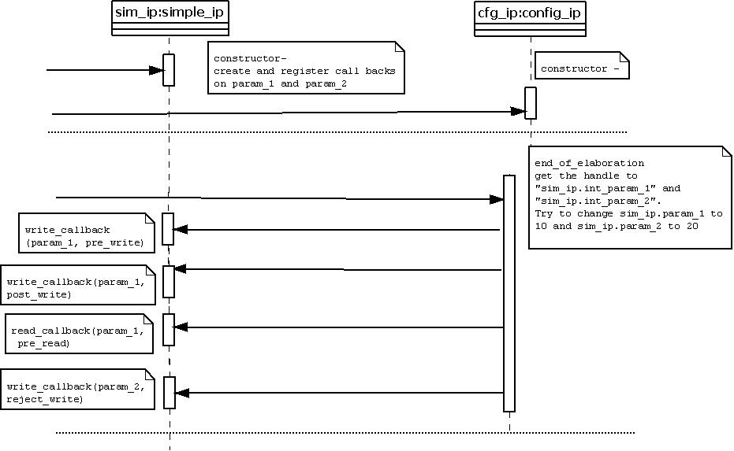
Sequence Diagram
Observe that since write is rejected
for param_2 reject_write callback,
no other callbacks are triggered

Slide 4
How to run this example (Linux)
Customize cci_examples/build-unix/Makefile.config with your installation paths for SYSTEMC, BOOST, CCI, GS_CCI
cd cci_examples/ ex8_parameter_value_change_callbacks/build-unix
make clean
make
make run

Slide 5
How to run this example (MSVC)
Open a explorer window on
cci_examples/ex8_parameter_value_change_callbacks/build-msvc
Launch default_and_init_value.sln
Select ‘Property Manager’ from the ‘View’ menu
Under ‘parameter_value_change_callbacks > Debug | Win32’ select ‘systemc’
Select ‘Properties’ from the ‘View’ menu
Select ‘User Macros’ under ‘Common Properties’
Update the ‘SYSTEMC’, ‘BOOST’, ‘CCI’, ‘GS_CCI’ entries and apply
Build and run

Slide 6
Expected Output (expected.log)
Created new broker "DEFAULT_BROKER_UNKNOWN_ORIGINATOR" and GCnf_Api "DEFAULT_BROKER_UNKNOWN_ORIGINATOR_0“
Info: sim_ip: read_config_callback: pre_read: sim_ip.param_1 (1)
Info: sim_ip: @0 s, @Ctor: Value of sim_ip.param_1 is 1 (Default value Specified: 1)
Info: sim_ip: read_config_callback: pre_read: sim_ip.param_2 (2)
Info: sim_ip: @0 s, @Ctor: Value of sim_ip.param_2 is 2 (Default value Specified: 2)
Info: sc_main: Begin Simulation.
Info: cfg_ip: @0 s, config_ip::end_of_elaboration: [EXTERNAL] Set value of sim_ip.param_1 to 10
Info: sim_ip: read_config_callback: pre_read: sim_ip.param_1 (1)
Info: sim_ip: @0 s, write_config_callback: pre_write: sim_ip.param_1 (1)
Info: sim_ip: @0 s, write_config_callback: post_write: sim_ip.param_1
Info: sim_ip: read_config_callback: pre_read: sim_ip.param_1 (10)
Info: cfg_ip: @0 s, config_ip::end_of_elaboration: [EXTERNAL] Current value of sim_ip.param_1 is 10
Info: cfg_ip: @0 s, config_ip::end_of_elaboration: [EXTERNAL] Set value of sim_ip.param_2 to 20
Info: sim_ip: read_config_callback: pre_read: sim_ip.param_2 (2)
Info: sim_ip: @0 s, write_config_callback: reject_write: Rejecting Value change on sim_ip.param_2 (2)
Warning: cfg_ip: @0 s, Caught exception: Error: /OSCI/CCI/set_param_failed: Value rejected by callback.
In file: /vobs/ti_systemc/tools/cci/greenstarcore_rev613/gs_param_implementation/gs_cci_param_t.h:135
In file: ../inc/config_ip.h:80
Info: sim_ip: read_config_callback: pre_read: sim_ip.param_2 (2)
Info: cfg_ip: @0 s, config_ip::end_of_elaboration: [EXTERNAL] Current value of sim_ip.param_2 is 2
Info: sc_main: End Simulation.
Info: sim_ip: read_config_callback: pre_read: sim_ip.param_1 (10)
Info: sim_ip: @Dtor: Value of sim_ip.param_1 is 10
Info: sim_ip: read_config_callback: pre_read: sim_ip.param_2 (2)
Info: sim_ip: @Dtor: Value of sim_ip.param_2 is 2
Notes:
* There are lot more messages coming from CCI infrastructure code; the report includes only user messages (not from cci infra)

