Slide 1
Parameter Value Change callback
SystemC CCI WG
Sheshadri Chakravarthy
Texas Instruments Inc.
Feb 2011

Slide 2
Parameter Value Change callback
Demonstrate requesting and responding to value change notifications.
User module creates couple of parameters and sets call backs on both of them
In the case of param_1, the user module would allow value change without any constraints.
In the case of param_2, the user module would reject value change unconditionally.

Slide 3
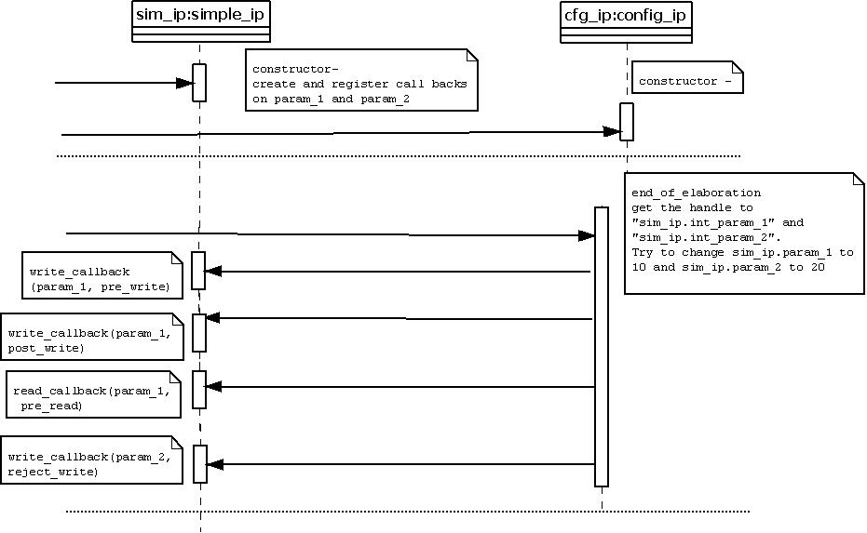
Sequence Diagram
Observe that since write is rejected
for param_2 reject_write callback,
no other callbacks are triggered

Slide 4
Expected Output
(ex08_Parameter_Value_Change_Callbacks.log)
SystemC Simulation
Info: sim_ip: @0 s, typed_pre_read_callback:sim_ip.param_1 (1) by sim_ip
Info: sim_ip: @0 s, @Ctor: Value of sim_ip.param_1 is 1 (Default value Specified: 1)
Info: sim_ip: @0 s, typed_pre_read_callback:sim_ip.param_2 (2) by sim_ip
Info: sim_ip: @0 s, @Ctor: Value of sim_ip.param_2 is 2 (Default value Specified: 2)
Info: sc_main: Begin Simulation.
Info: cfg_ip: @0 s, config_ip::end_of_elaboration: [EXTERNAL] Set value of sim_ip.param_1 to 10
Info: sim_ip: @0 s, typed_pre_write_callback:sim_ip.param_1 (1 -> 10) by cfg_ip
Info: sim_ip: @0 s, typed_post_write_callback:sim_ip.param_1 (1 -> 10) by cfg_ip
Info: sim_ip: @0 s, typed_pre_read_callback:sim_ip.param_1 (10) by cfg_ip
Info: cfg_ip: @0 s, config_ip::end_of_elaboration: [EXTERNAL] Current value of sim_ip.param_1 is 10
Info: cfg_ip: @0 s, config_ip::end_of_elaboration: [EXTERNAL] Set value of sim_ip.param_2 to 20
Info: sim_ip: @0 s, reject_pre_write_callback: Rejecting Value change on sim_ip.param_2 (2 -> 20) by cfg_ip
Warning: cfg_ip: @0 s, Caught exception: Error: /Accellera/CCI/SET_PARAM_FAILED: Value rejected by callback.
In file: <removed by verify.pl>
In file: <removed by verify.pl>
Notes:
* There are lot more messages coming from CCI infrastructure code; the report includes only user messages (not from cci infra)

Slide 5
Contd.
Info: sim_ip: @0 s, typed_pre_read_callback:sim_ip.param_2 (2) by cfg_ip
Info: cfg_ip: @0 s, config_ip::end_of_elaboration: [EXTERNAL] Current value of sim_ip.param_2 is 2
Info: sc_main: End Simulation.
Info: sim_ip: @0 s, typed_pre_read_callback:sim_ip.param_1 (10) by sim_ip
Info: sim_ip: @Dtor: Value of sim_ip.param_1 is 10
Info: sim_ip: @0 s, typed_pre_read_callback:sim_ip.param_2 (2) by sim_ip
Info: sim_ip: @Dtor: Value of sim_ip.param_2 is 2
Notes:
* There are lot more messages coming from CCI infrastructure code; the report includes only user messages (not from cci infra)

