Slide 1
OSCI-CCIWG
Example #9 : Hierarchical Override of Parameter Values
P V S Phaneendra
CircuitSutra Technologies Pvt. Ltd.
9th May, 2011

Slide 2
Hierarchical Override of Parameter Values
The objectives of the present example is to demonstrate the following:
    Model-to-Model Configuration (UseCase 12)
    Default and Initial Values (UseCase 3)
    Name-based Parameter Access (Requirement 1.3)

Slide 3
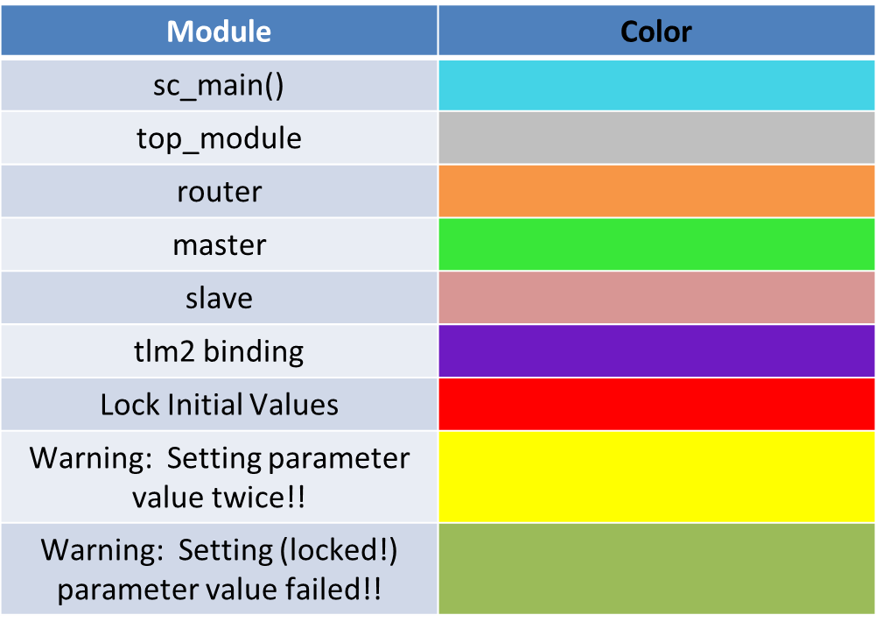
Legend Diagram

Slide 4
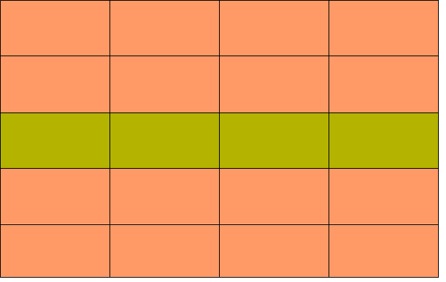
Binding and Communication in accordance to TLM2.0 standard
Top_Module
Router
Slave#1
Master#1
Slave#2
Master#n
Slave#n
Number of Master(s) (immutable)
Number of Slave(s) (immutable)
Slave ID (eoe)
Slave Base Addr (eoe)
Slave Size (mutable)
TOP MODULE will in turn initialize few of the parameters of ROUTER and fill the ROUTER TABLE contents.
TOP MODULE shall construct the Model Hierarchy - MASTER(S) & SLAVE(S) and ROUTER, overriding their default values with initial values, thereby demonstrating Model-to-Model Configuration.
Number of Masters (eoe)
Number of Slaves (eoe)
Max' Addressable Range (mutable)
sc_main() will set initial values
for the TOP MODULE, max. addressable limit for ROUTER and fills ROUTER TABLE contents for Slave_1 before the start of construction of any of the
modules via Name-based Look-
Up Access.
ROUTER TABLE CONTENTS
Filed#1 : Slave#_Index
Field#2 : Slave#_Start_Addrt
Field#3 : Slave#_End_addr
Note: Field contents for Slave_1 have been
filled at sc_main() and rest others within
top_module

Slide 5
Inside sc_main()
NOTE :
“top_module” instantiates the router, master(s) and slave(s).
“top_module” binds the above
modules using the TLM2.0 standard
Set number of masters for the TOP MODULE
myGlobalBroker->set_init_value(“top_module_inst.number_of_masters”, "2");
Re-Set number of masters for the TOP MODULE (to illustrate that the last set value is considered)
myGlobalBroker->set_init_value(“top_module_inst.number_of_masters”, "1");
Set number of slaves for the TOP MODULE
myGlobalBroker->set_init_value(“top_module_inst.number_of_slaves”, "4");
Override the default maximum set addressable limit of the ROUTER
myGlobalBroker->set_init_value(“top_module_inst.RouterInstance.addr_max”, "1024");
Set and lock Router Table contents initial values for Slave_1
myGlobalBroker->set_init_value(“top_module_inst.RouterInstance.r_index_1”, "1");
myGlobalBroker->lock_init_value(“top_module_inst.RouterInstance.r_addr_start”, “128”);
myGlobalBroker->lock_init_value(“top_module_inst.RouterInstance.r_addr_end”, “255”);
Instantiate TOP MODULE
top_module top_mod(“top_module_inst”);
Simualation Starts after construction of the hierarchy
sc_start(1140, SC_NS)

Slide 6
Within TOP_MODULE
Default Values :
Number of masters : n_masters = 0
Number of slaves : n_slaves = 0
Within CONSTRUCTOR
Set number of masters for the ROUTER and lock them
myGlobalBroker->set_init_value(“top_module_inst.RouterInstance.r_masters”, n_masters.get());
Here, r_masters = 1; (default value overridden)
myGlobalBroker->lock_init_value(“top_module_inst.RouterInstance.r_masters”);
Set number of slaves for the ROUTER (RouterTable) and lock them
myGlobalBroker->set_init_value(“top_module_inst.RouterInstance.r_slaves”, n_slaves.get());
Here, r_slaves = 4; (default value overridden)
myGlobalBroker->lock_init_value(“top_module_inst.RouterInstance.r_slaves”);
Instantiate ROUTER instance and fill the ROUTER TABLE based on the Slave_size initial value (if set)
router routerInstance(“RouterInstance”);
Binding in accordance to TLM2.0 standard via ROUTER
Construct MASTER(S) (as set from ‘sc_main’ )
Construct SLAVE(S) and set base address of slave(s) to router’s start address
Try and Set the initial values ROUTER TABLE contents
Setting Slave_1 contents will result in generating failed parameter setting warning

Slide 7
Default Values :
Number of masters : r_masters = 0
Number of slaves : r_slaves = 0
Max' Addressable Limit : addr_limit = 64
Within ROUTER
Within constructor
addr_limit =1024 (already initialized within sc_main)
r_masters = 1 (already set and locked by TOP_MODULE)
TLM2 Communication
r_slaves = 4 (already set and locked by TOP_MODULE)
Router
Within 'beoe' phase
Builds the Router Table contents with default values within this phase in case if no initial values were set from the top_module.
Master
Slave

Slide 8
Setting Environment on Linux
Download the CCI set up from the .svn
Set up the necessary system paths within the makefiles
Traverse to ./examples/ex9_Hierarchical_Override_of_Parameter_Values/ sub-directory
Run the following commands (in order) : make cleanall; make; make run; make check
Find the expected log file in “../reports/” sub-directory
Read (local)README.txt for further information

Slide 9
Expected Output
[MAIN] : Setting initial value of the number of masters to 2
[MAIN] : Setting initial value of the number of masters to 1
Warning: ConfigDatabase: setInitValue: Parameter already exists as implicit parameter. Do not set the initial value twice!
In file: /home/pvs/MyInstallations/greenstarcore/greenstarcore_rev_622/greencontrol_cci_branch/greencontrol/gcnf/plugin/configdatabase.h:226
[MAIN] : Setting initial value of the number of slaves to 4
[MAIN] : Set and lock Router Table Slave_1 contents
[MAIN] : Set and lock Router Table Start Address for Slave_1 to 128
[MAIN] : Set and lock Router Table End Address for Slave_1 to 255
[MAIN] : Instantiate top module after setting initial values to top_module, router and slave parameters
[TOP_MODULE C_TOR] ----- [TOP MODULE CONSTRUCTOR BEGINS HERE] -----
[TOP_MODULE C_TOR] : Number of masters : 1
[TOP_MODULE C_TOR] : Number of slaves : 4
[TOP_MODULE C_TOR] : Creating Router : RouterInstance

Slide 10
Expected Output (contd.. 1)
[ROUTER C_TOR] --------- [ROUTER CONSTRUCTOR BEGINS HERE] ----------
[TOP_MODULE C_TOR] : Creating Master : Master_0
[Master_0 C_TOR] --------- [MASTER CONSTRUCTOR BEGINS HERE] ----------
[TOP MODULE C_TOR] : Binding Router_Initiator to Master_0
[TOP_MODULE C_TOR] : Creating Slave : Slave_0
[Slave_0 C_TOR] --------- [SLAVE CONSTRUCTOR BEGINS HERE] ----------
[Slave_0 C_TOR] : Base Address : 0
[TOP MODULE C_TOR] : Binding Router_Initiator to Slave_0
[TOP_MODULE C_TOR] : Creating Slave : Slave_1
[Slave_1 C_TOR] --------- [SLAVE CONSTRUCTOR BEGINS HERE] ----------
[Slave_1 C_TOR] : Base Address : 0
[TOP MODULE C_TOR] : Binding Router_Initiator to Slave_1
[TOP_MODULE C_TOR] : Creating Slave : Slave_2
[Slave_2 C_TOR] --------- [SLAVE CONSTRUCTOR BEGINS HERE] ----------
[Slave_2 C_TOR] : Base Address : 0
[TOP MODULE C_TOR] : Binding Router_Initiator to Slave_2

Slide 11
Expected Output (contd.. 2)
[TOP_MODULE C_TOR] : Creating Slave : Slave_3
[Slave_3 C_TOR] --------- [SLAVE CONSTRUCTOR BEGINS HERE] ----------
[Slave_3 C_TOR] : Base Address : 0
[TOP MODULE C_TOR] : Binding Router_Initiator to Slave_3
[TOP_MODULE C_TOR] : Re-setting fields of Slave_0
[TOP_MODULE C_TOR] : Re-setting start addr of Slave_0
[TOP_MODULE C_TOR] : Re-setting end addr of Slave_0
[TOP_MODULE C_TOR] : Re-setting fields of Slave_1
Warning: DEFAULT_BROKER_0: setInitValue: ... setting failed because init value is locked!
In file: /home/pvs/MyInstallations/greenstarcore/greenstarcore_rev_622/greencontrol_cci_branch/greencontrol/gcnf/apis/GCnf_Api/GCnf_Api_t.h:519
[TOP_MODULE C_TOR] : Re-setting start addr of Slave_1
Warning: DEFAULT_BROKER_0: setInitValue: ... setting failed because init value is locked!
In file: /home/pvs/MyInstallations/greenstarcore/greenstarcore_rev_622/greencontrol_cci_branch/greencontrol/gcnf/apis/GCnf_Api/GCnf_Api_t.h:519
[TOP_MODULE C_TOR] : Re-setting end addr of Slave_1

Slide 12
Expected Output (contd.. 3)
[TOP_MODULE C_TOR] : Re-setting fields of Slave_2
[TOP_MODULE C_TOR] : Re-setting start addr of Slave_2
[TOP_MODULE C_TOR] : Re-setting end addr of Slave_2
[TOP_MODULE C_TOR] : Re-setting fields of Slave_3
[TOP_MODULE C_TOR] : Re-setting start addr of Slave_3
[TOP_MODULE C_TOR] : Re-setting end addr of Slave_3
[ROUTER in beoe] : Number of master(s) : 1
[ROUTER in beoe] : Number of slave(s) : 4
[ROUTER in beoe] : Maximum Addressable Limit of the router : 1024
============ ROUTER TABLE INFORMATION ==============
-----------------------------------------------------------------------------------------------------------------
| Slave_ID | Start Address | End Address | Base Address |
-----------------------------------------------------------------------------------------------------------------
| 0 | 0 | 127 | 0 |
------------------------------------------------------------------------------------------------------------------
| 1 | 128 | 255 | 128 |
-----------------------------------------------------------------------------------------------------------------
| 2 | 256 | 383 | 256 |
-----------------------------------------------------------------------------------------------------------------
| 3 | 384 | 511 | 384 |
-----------------------------------------------------------------------------------------------------------------

Slide 13
Expected Output (contd.. 4)
Just to illustrate that the master(s) and slave(s) are able to communicate to each-other via the router using TLM2
[Initiators Message]=>At address 7c sending transaction with command= Read at time 276 ns
[Router in 'b_transport' layer]
Address = 7c
Index = 0
Start addres = 0
End Address = 7f
[SLAVE] : adr ---- 7c
[SLAVE] : base addr ---- 0
[Initiators Message]=>At address 7c received response of Read transaction data aabbccfd at time 281 ns
---------------------------------------------------------------------
[Initiators Message]=>At address 80 sending transaction with command= Read at time 286 ns
[Router in 'b_transport' layer]
Address = 80
Index = 1
Start addres = 80
End Address = ff
[SLAVE] : adr ---- 0
[SLAVE] : base addr ---- 80
[Initiators Message]=>At address 80 received response of Read transaction data aabbccdd at time 291 ns
---------------------------------------------------------------------

Slide 14
Thank You!!

