Slide 1
CCI API Proposal 1.3
Christian Schröder
Mark Burton
christian.schroeder@greensocs.com
GreenSocs
February 24th, 2010

Slide 2
Files
Archive file
CCI-1.3-cci_api-240210.tar.gz
  api/ Header files
  doc/ Documentation
    API_ref/index.html Doxygen documentation with links to files:
    discussions.txt Main open discussions
    guidelines.txt Proposed guidelines for the standard
    notes.txt Further notes

Slide 3
Terms
Terms in line with requirements document 1.0.0:
  Parameter Handle (PH):
  Parameter access object allowing typeless (JSON) string access. This is the cci_base_param.
  Parameter Object (PO):
  Parameter access object being typed. This is derived from the PH, thus it is the same object.
  This is the cci_param<T>.
  Name-Value-Pair (NVP):
  Conceptional
  pair unique hierarchical parameter name + (JSON) string value.
  It is up to the implementation where this is stored (e.g. in a database or in PHs).
  The value is consistent with the PH/PO's one at any time.
not in line with req. doc.!

Slide 4
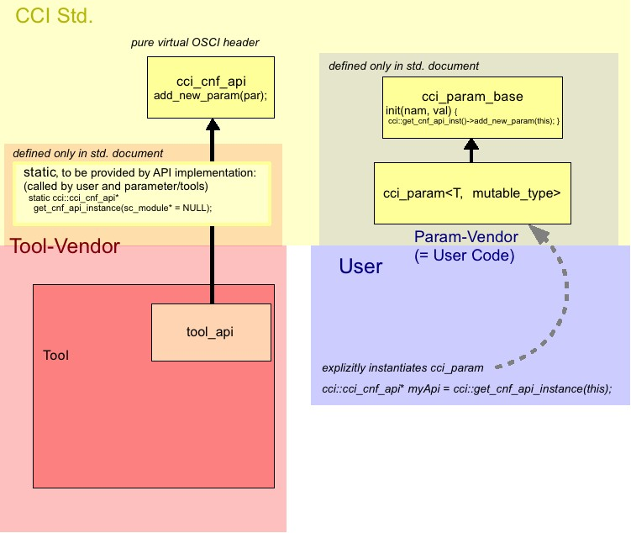
API Concept + Classes
virtual class cci_cnf_api
implemented by Tool Vendor
accessed via global
get function
class cci_param_base
implemented by OSCI or
Param Vendor
class cci_param<T>
implemented by OSCI or
Param Vendor
TODO: decide later if in Std.

Slide 5
General Discussion
Discussions/Items influencing the basic concept
Details see file doc/discussions.txt

Slide 6
General Discussion
Model Portability:
Is the current concept sufficient to ensure model portability?
Many-to-one Mapping
Parameter locking
(Mutable / Immutable / Elaboration Time Parameters)

Slide 7
Model Portability
Current concept:
  Classes cci_base_param and cci_param<…> defined in document
  include file defined in document (e.g. cci_param.h)
  Definition and implementation in (param) vendor code
  The actual parameters gets constructed in a standardized way.
  => Tool and param vendors must be the same
  (or compile with each other)
Other option
  Standardize a parameter factory and pure virtual classes header files, which would allow binary compatibility

Slide 8
Many-to-one Mapping
Current agreement:
  Not explicitly supported many-to-one-mapping, only allowing one PO/PH being mapped to one NVP (keep it simple), but callback mechanism allowing synchronized parameters.
  because of
    complex error handling when value setting cannot be applied seamlessly to all mapped objects/handles.
    complex callback handling, e.g. synchronizing rejected pre_writes, handling callback registering.
  Many-to-one mapping can be realized with synchronized but dedicated parameters.

Slide 9
Parameter Locking (1/2)
Types (making Terms more concrete):
  Mutable (std.) Parameter
  Mutable ones can be made immutable (locked) temporary by using functions lock(pwd) unlock(pwd) locked().
  Immutable Parameter
  should be not writable by a tool (but by the owner). Can be realized by providing a special set function in the PO, possibly requiring the lock pwd.
  Elaboration Time Parameter
  Elaboration Time P.s should be mutable until eoe, then lock

Slide 10
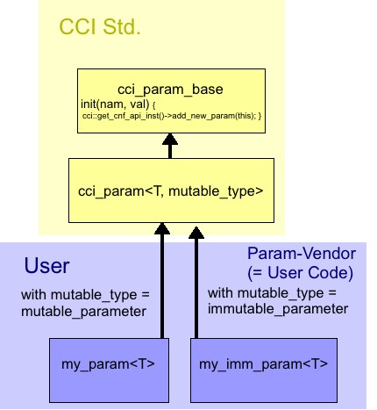
Parameter Locking (2/2)
Our API proposal:
First don’t treat them different. But they can be identified (even in static analysis) by an enum template parameter.
enum param_mutable_type {
mutable_parameter = 0,
immutable_parameter,
elaboration_time_parameter,
other_parameter
};
my_param<T> myp1(“myp“);
my_imm_param<T> myp(“myp“);

Slide 11
Further Discussion
Discussions/Items not influencing the basic concept

Slide 12
Callbacks
pre_write
  Can reject param changes in return
  Theoretically the pre_write callback can only be used for checking and rejecting values. It cannot be used as a pre_write performing any action prior to an actual write, because the called function cannot know if the write will be rejected by any other called item.
  An option is to rename pre_write to e.g. 'reject_write'.
  In this case we could add another real pre_write callback if it is necessary to have such.
post_write
pre_read
no post_read
  very hard (impossible?) to define and implement

Slide 13
Errors
Warnings and Errors are thrown using sc_report
  set_param_failed
  get_param_failed
  add_param_failed
  remove_param_failed
  cci_value_failure

Slide 14
cci_value implementation
How to set PH‘s values using cci_value:
Options are:
  make it an interface (cci_value), which needs to be implemented by a vendor (like gs_cci_value, as done for cci_param), or
  to implement it directly in the standard header files (which means no vendor specific implementation for the cci_value at all) - or
  define the class and let the vendor implement the functions
  (not another class that implements the interface)
a) (-) results in vendor dependent code (like needed for cci_params, too).
(+) most flexible for implementation
b)c) (+) allow the user/application code to use cci_value directly,
b) (-) not flexible at all
c) (-) less flexible, since the standard must define the complete class and class
members, which cannot be changed by the implementation any more
Currently we've chosen c).

Slide 15
More Discussion
There are for sure much more discussions
See documentation
use reflector
everything is free for changes

