Slide 1
Parameter Value Change Callbacks
SystemC CCI WG
Sheshadri Chakravarthy
Texas Instruments Inc.
Feb 2011

Slide 2
Parameter Value Change callback
Demonstrate requesting and responding to value change notifications.
User module creates couple of parameters and sets callbacks on both of them
In the case of param_1, the user module would allow value change without any constraints.
In the case of param_2, the user module would reject value change unconditionally.

Slide 3
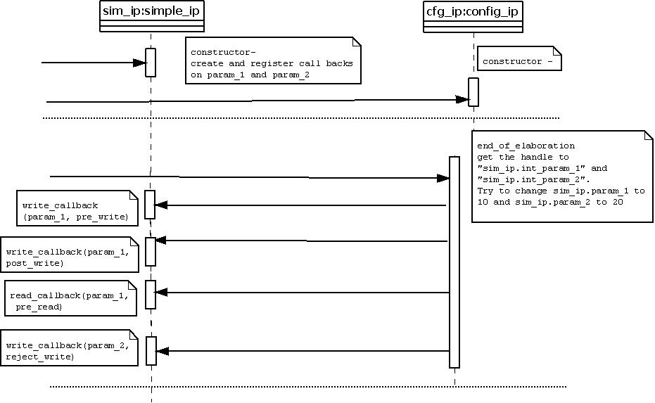
Sequence Diagram
Observe that since write is rejected
for param_2 reject_write callback,
no other callbacks are triggered

Slide 4
Expected Output
(ex08_Parameter_Value_Change_Callbacks.log)
SystemC Simulation
Info: sim_ip: @0 s, typed_pre_read_callback:sim_ip.param_1 (1) by sim_ip
Info: sim_ip: @0 s, @Ctor: Value of sim_ip.param_1 is 1 (Default value Specified: 1)
Info: sim_ip: @0 s, typed_pre_read_callback:sim_ip.param_2 (2) by sim_ip
Info: sim_ip: @0 s, @Ctor: Value of sim_ip.param_2 is 2 (Default value Specified: 2)
Info: sc_main: Begin Simulation.
Info: cfg_ip: @0 s, config_ip::end_of_elaboration: [EXTERNAL] Set value of sim_ip.param_1 to 10
Info: sim_ip: @0 s, typed_pre_write_callback:sim_ip.param_1 (1 -> 10) by cfg_ip
Info: sim_ip: @0 s, typed_post_write_callback:sim_ip.param_1 (1 -> 10) by cfg_ip
Info: sim_ip: @0 s, typed_pre_read_callback:sim_ip.param_1 (10) by cfg_ip
Info: cfg_ip: @0 s, config_ip::end_of_elaboration: [EXTERNAL] Current value of sim_ip.param_1 is 10
Info: cfg_ip: @0 s, config_ip::end_of_elaboration: [EXTERNAL] Set value of sim_ip.param_2 to 20
Info: sim_ip: @0 s, reject_pre_write_callback: Rejecting Value change on sim_ip.param_2 (2 -> 20) by cfg_ip
Warning: cfg_ip: @0 s, Caught exception: Error: /Accellera/CCI/SET_PARAM_FAILED: Value rejected by callback.
In file: <removed by verify.pl>
In file: <removed by verify.pl>
Notes:
* There are lot more messages coming from CCI infrastructure code; the report includes only user messages (not from cci infra)

Slide 5
Contd.
Info: sim_ip: @0 s, typed_pre_read_callback:sim_ip.param_2 (2) by cfg_ip
Info: cfg_ip: @0 s, config_ip::end_of_elaboration: [EXTERNAL] Current value of sim_ip.param_2 is 2
Info: sc_main: End Simulation.
Info: sim_ip: @0 s, typed_pre_read_callback:sim_ip.param_1 (10) by sim_ip
Info: sim_ip: @Dtor: Value of sim_ip.param_1 is 10
Info: sim_ip: @0 s, typed_pre_read_callback:sim_ip.param_2 (2) by sim_ip
Info: sim_ip: @Dtor: Value of sim_ip.param_2 is 2
Notes:
* There are lot more messages coming from CCI infrastructure code; the report includes only user messages (not from cci infra)

