Slide 1
Parent Control of Preset Values
SystemC CCI WG
P V S Phaneendra
CircuitSutra Technologies Pvt. Ltd
May 2011

Slide 2
Parent Control of Preset Values
The objective of this example is to demonstrate:
Model-to-Model Configuration (UseCase 12)
Default and Preset Values (UseCase 3)
Name-based Parameter Access (Requirement 1.3)
2

Slide 3
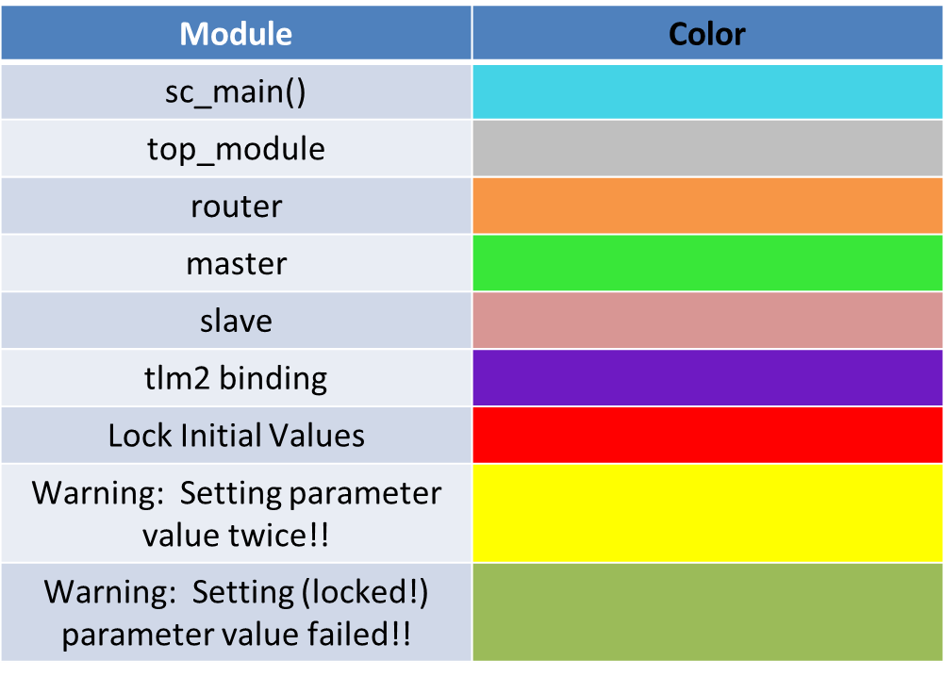
Legend Diagram
This legend diagram doesn't apply to the Expected Output section!!
3

Slide 4
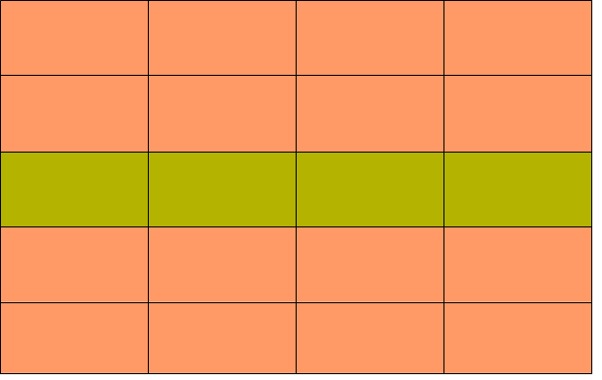
Binding and Communication in accordance to TLM2.0 standard
Top_Module
Router
Slave#1
Master#1
Slave#2
Master#n
Slave#n
Number of Master(s) (immutable)
Number of Slave(s) (immutable)
Slave ID (eoe)
Slave Base Addr (eoe)
Slave Size (mutable)
TOP MODULE will in turn initialize few of the parameters of ROUTER and fill the ROUTER TABLE contents.
TOP MODULE shall construct the Model Hierarchy - MASTER(S) & SLAVE(S) and ROUTER, overriding their default values with preset values, thereby demonstrating Model-to-Model Configuration.
Number of Masters (eoe)
Number of Slaves (eoe)
Max' Addressable Range (mutable)
sc_main() will set preset values
for the TOP MODULE, max. addressable limit for ROUTER and fills ROUTER TABLE contents for Slave_1 before the start of construction of any of the
modules via Name-based Look-
Up Access.
ROUTER TABLE CONTENTS
Filed#1 : Slave#_Index
Field#2 : Slave#_Start_Addrt
Field#3 : Slave#_End_addr
Note: Field contents for Slave_1 have been
filled at sc_main() and rest others within
top_module
4

Slide 5
Inside sc_main()
NOTE :
“top_module” instantiates the router, master(s) and slave(s).
“top_module” binds the above
modules using the TLM2.0 standard
Set number of masters for the TOP MODULE
myGlobalBroker->set_preset_cci_value(“top_module_inst.number_of_masters”, "2");
Re-Set number of masters for the TOP MODULE (to illustrate that the last set value is considered)
myGlobalBroker->set_preset_cci_value(“top_module_inst.number_of_masters”, "1");
Set number of slaves for the TOP MODULE
myGlobalBroker>set_preset_cci_value(“top_module_inst.number_of_slaves”, "4");
Override the default maximum set addressable limit of the ROUTER
myGlobalBroker->set_preset_cci_value(“top_module_inst.RouterInstance.addr_max”, "1024");
Set and lock Router Table contents preset values for Slave_1
myGlobalBroker->set_preset_cci_value(“top_module_inst.RouterInstance.r_index_1”, "1");
myGlobalBroker->lock_preset_value(“top_module_inst.RouterInstance.r_index_1”);
myGlobalBroker->set_preset_cci_value(“top_module_inst.RouterInstance.r_addr_start”, "128");
myGlobalBroker->lock_preset_value(“top_module_inst.RouterInstance.r_addr_start”);
myGlobalBroker->set_preset_cci_value(“top_module_inst.RouterInstance.r_addr_end”, “255”);
myGlobalBroker->lock_preset_value(“top_module_inst.RouterInstance.r_addr_end”);
Instantiate TOP MODULE
top_module top_mod(“top_module_inst”);
Simualation Starts after construction of the hierarchy
sc_start(1140, SC_NS)
5

Slide 6
Within TOP_MODULE
Default Values :
Number of masters : n_masters = 0
Number of slaves : n_slaves = 0
Within CONSTRUCTOR
Set number of masters for the ROUTER and lock them
myGlobalBroker->set_preset_cci_value(“%s.RouterInstance.r_masters”, name(), n_masters.get());
Here, r_masters = 1; (default value overridden)
myGlobalBroker->lock_preset_value(“top_module_inst.RouterInstance.r_masters”);
Set number of slaves for the ROUTER (RouterTable) and lock them
myGlobalBroker->set_preset_cci_value(“%s.RouterInstance.r_slaves”, name(), n_slaves.get());
Here, r_slaves = 4; (default value overridden)
myGlobalBroker->lock_preset_value(“top_module_inst.RouterInstance.r_slaves”);
Used try-catch
mechanism to
set the preset
values for the
Router Table
Slave_size
preset value
also specified.
Instantiate ROUTER instance and fill the ROUTER TABLE based on the Slave_size preset value (if set)
router routerInstance(“RouterInstance”);
Binding in accordance to TLM2.0 standard via ROUTER
Construct MASTER(S) (their number as set within ‘sc_main’ )
Initializes base address of slave(s) to router’s start address and finally Cosntructs Slave(s) (number of slave(s) as set within 'sc_main')
Try and Set the preset values to ROUTER TABLE contents
Setting Slave_1 contents will result in failed parameter setting warning generation
Warning: DEFAULT_BROKER_0: set_preset_cci_value: ... setting failed because preset value is locked!
6

Slide 7
Default Values :
Number of masters : r_masters = 0
Number of slaves : r_slaves = 0
Max' Addressable Limit : addr_limit = 64
Within ROUTER
Within constructor
addr_limit =1024 (already initialized within sc_main)
r_masters = 1 (already set and locked by TOP_MODULE)
TLM2 Communication
r_slaves = 4 (already set and locked by TOP_MODULE)
Router
Within 'beoe' phase
Builds the Router Table contents with default values within this phase in case if no preset values were set from the top_module.
Master
Slave
7

Slide 8
Expected Output (ex09_Parent_Control_of_Preset_Values.log)
SystemC Simulation
Info: sc_main: [MAIN] : Setting preset value of the number of initiators to 2
Info: sc_main: [MAIN] : Setting preset value of the number of initiators to 1
Info: sc_main: [MAIN] : Setting preset value of the number of targets to 4
Info: sc_main: [MAIN] : Set and lock Router Table target_1 contents
Info: sc_main: [MAIN] : Set and lock Router Table Start Address for target_1 to 128
Info: sc_main: [MAIN] : Set and lock Router Table End Address for target_1 to 255
Info: sc_main: [MAIN] : Instantiate top module after setting preset values to top_module, router and target parameters
Info: top_module_inst: @0 s, [TOP_MODULE C_TOR] -- [TOP MODULE CONSTRUCTOR BEGINS HERE]
Info: top_module_inst: @0 s, [TOP_MODULE C_TOR] : Number of initiators : 1
Info: top_module_inst: @0 s, [TOP_MODULE C_TOR] : Number of targets : 4
Info: top_module_inst: @0 s, [TOP_MODULE C_TOR] : Creating Router : RouterInstance
Info: top_module_inst.RouterInstance: @0 s, [ROUTER C_TOR] ----- [ROUTER CONSTRUCTOR BEGINS HERE] ------
The remainder of the logfile is interesting but too lengthy to include here; the reader is encouraged to run the example, or examine the golden logfile, to see all of the details.

