Slide 1
Visual Studio Team System
(VSTS)

Slide 2
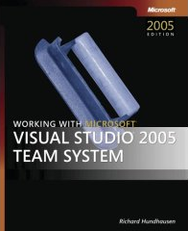




Richard Hundhausen
Author of software development books
Microsoft Regional Director
Microsoft MVP (VSTS)
MCT, MCSD, MCDBA
richard@accentient.com

Slide 3
Challenges with building distributed solutions
Lack of communication
  Email, IM, and Meetings
  The team is not on the same page
Lack of tool integration
  Working with too many tools today
  VS, VSS, Visio, NUnit, NAnt, FxCop, ACT
Lack of (good) process guidance
  Many methodologies out there
  Shops like to customize
We need to increase the predictability of success
Notes:
Why use a framework?
Easy to apply
Highly flexible
Adaptable
Mostly for large projects
Some parts applicable to all
Facilitates team communication
Combines with methodologies
A framework is a set of
Conceptual Tools
Best Practices

Slide 4
What is Team System?
Integrated suite of tools to support the entire software development lifecycle
  Tools for the entire team
  Visual Studio 2005 add-Ins
  Microsoft Excel and Project add-Ins
  Standalone tools and command line utilities
  Team Foundation Services (the "backend")
  SQL Reporting Services and WSS portals
  Process guidance documentation
    MSF 4.0 (Agile and CMMI Compliance)

Slide 5
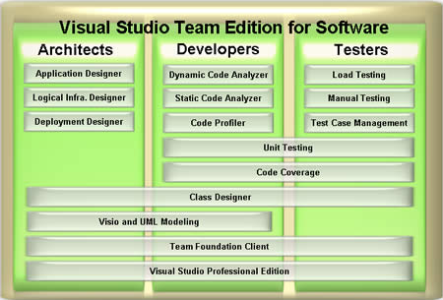
Features by Edition

Slide 6

Team Foundation Server
Collaboration
  Work Item Tracking
    Scenarios, QoS Reqs, Risks, Tasks, Bugs, Custom
  Reports
Software Configuration Management (SCM)
  Three tier, SQL 2005, Web services API
  Merging, branching, shelving
Build Management

Slide 7
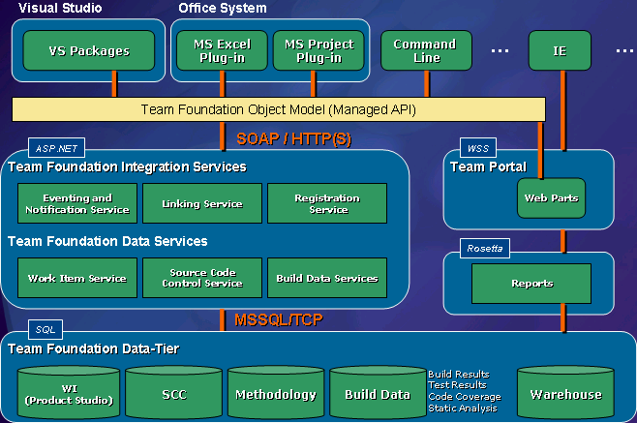
Team Foundation Services Architecture

Slide 8
Team System Extensibility
Team System is an extensible platform
Team Foundation Services
  Eventing model and many APIs exposed
  Add your own methodology templates
Visual Studio 2005
  VSIP partners are welcome to extend
  Already a few: Borland, AmberPoint, Olenick & Associates, BrightWork, Osellus
Visual Studio SDK

Slide 9
Team System for Project Managers
No direct mapping to a Team System edition
  All editions have capability to do PM activities
  Visual Studio 2005, Excel, Project, Team Explorer
Activities
  Create and configure the team projects
  Assign work items
  Monitor status by querying work items or viewing reports on the project portal

Slide 10
Team System for Architects
Activities
  Create Logical Datacenter diagrams
  Create Application diagrams
  Compose application components into "systems"
  Create trial deployment diagrams
    Validate AD against LDD
  Generate deployment reports
  Implement application components (Web services), thus kicking off development

Slide 11
Team System for Developers
Problem Space
  Developers are not writing quality code
  No/inadequate source code control
  No way to relate code changes to justification
Activities (besides writing code)
  Run unit tests with adequate code coverage
  Run static analysis
  Profile code
  Check-in, check-out code
    Associating comments and/or work items

Slide 12
Team System for Testers
Problem Space
  Testing tools are not integrated
  No version control for tests
  No integrated notification mechanism
Activities
  Unit testing and code coverage (overlap with dev)
  Web testing (record and playback URL interactions)
  Load testing (simulate multiple users)
  Test management (manual and 3rd party tests)

Slide 13
Team System for Everyone Else
Can access real-time reports on the Portal
Can use Excel or Project to maintain work items
Can use Team Explorer or command-line utilities to view/edit project artifacts – no need for Visual Studio

Slide 14
Summary
Visual Studio 2005 Team System is for the entire team, not just the developers
All the tools are integrated into Visual Studio
Not all team members need Visual Studio
  Excel, Project, Team Explorer, and Internet Explorer

