Slide 2

Would You, Could You with TFS DEV271-INT
Richard Hundhausen
President, Accentient
VS ALM MVP, RD
Notes:
You’re considering Team Foundation Server, or perhaps you have already deployed it. You think you know what it is capable of, but do you? Microsoft built in many extensibility points which developers have used to build interesting and useful add-ons. These solutions include tools for managing requirements, product and sprint backlogs, work items, and software deployments. In this session, we discuss the partner ecosystem and demonstrate some of these products. See how to go beyond the out-of-the-box capabilities of Microsoft Visual Studio Team Foundation Server without custom development or going to other ALM platforms.
Product/Technology: Microsoft® Visual Studio® Team Foundation Server
Audience: Developer

Slide 3
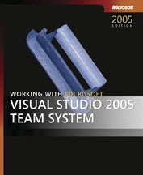
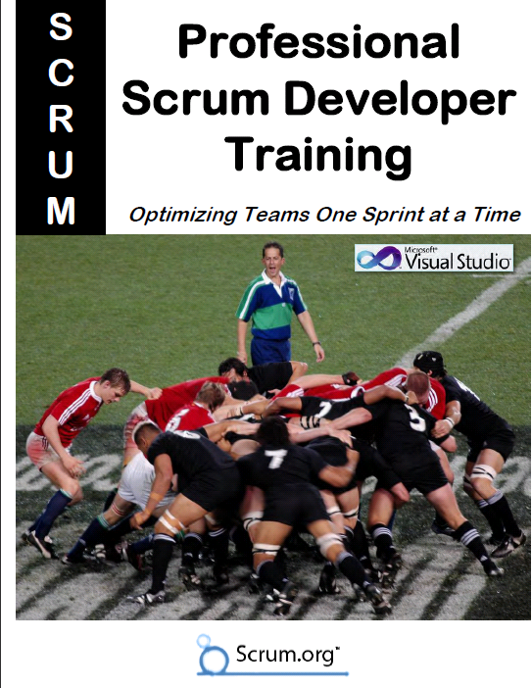




Richard Hundhausen
President of Accentient
From Boise, Idaho
Microsoft Regional Director
Microsoft MVP (Visual Studio ALM)
Author of Professional Scrum Developer course
richard@accentient.com
@rhundhausen

Slide 4

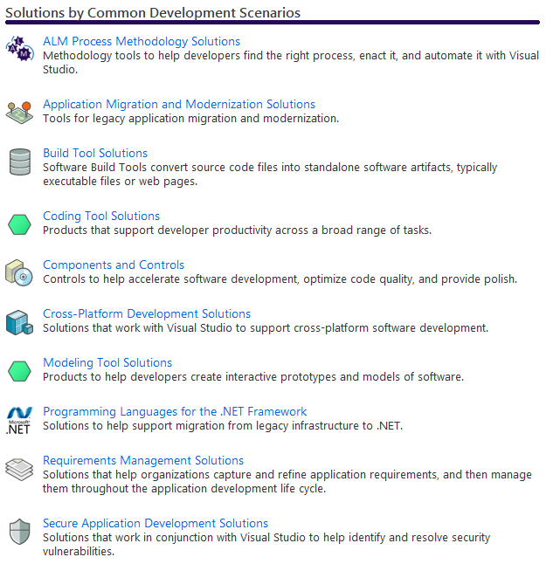
Visual Studio Industry Partner Program
Microsoft partners who create solutions that integrate with and extend Visual Studio
Find their solutions here:
http://bit.ly/meAdCl
Learn more about the program here:
http://bit.ly/edkoXI
Extend Visual Studio yourself:
http://bit.ly/j21tI4

Slide 5
Application Lifecycle Management
The Vision
Operations
Work Management, Coding, Building, Testing
Pre-Game
Sunset

Slide 6
ALM Using Team Foundation Server
The Vision
Operations
Work Management, Coding, Building, Testing
Work Management, Coding, Building, Testing
Pre-Game
Sunset
Visual Studio Team Foundation Server 2010

Slide 7
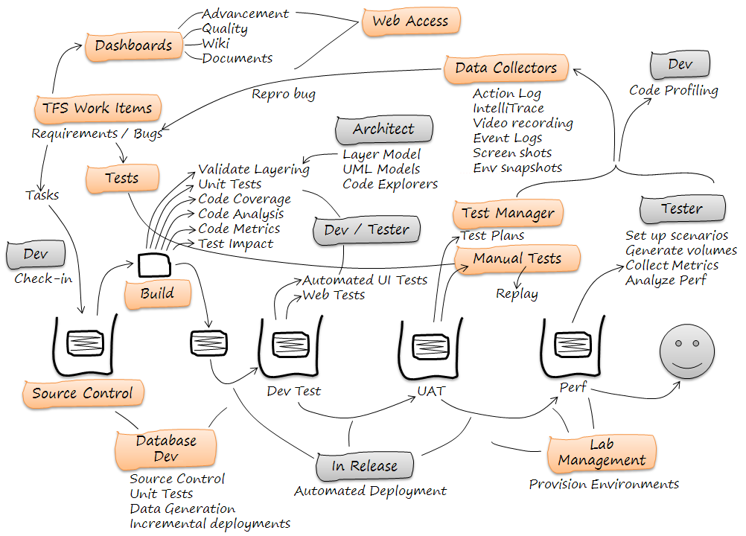
Notes:
Graphic used with permission from InCycle Software

Slide 8
The Myths
“TFS doesn’t support Agile teams”
“TFS doesn’t handle formal requirements”
“TFS is only for developers and testers”
“TFS does not work well with Eclipse”
“TFS can only build a product, not release it”

Slide 9



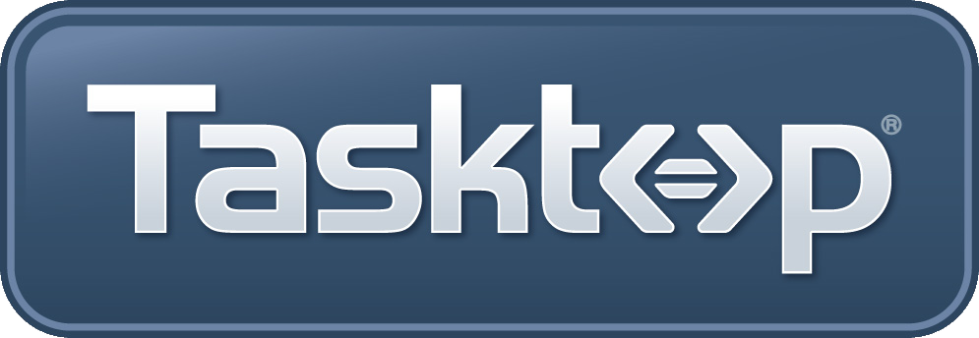

The Mythbusters
“TFS doesn’t support Agile teams”
Urban Turtle
“TFS doesn’t handle formal requirements”
inteGREAT
“TFS is only for developers and testers”
TeamCompanion
“TFS does not work well with Eclipse”
Tasktop
“TFS can only build a product, not release it”
InRelease

Slide 10
Myth #1
“TFS doesn’t support Agile teams”

Slide 11
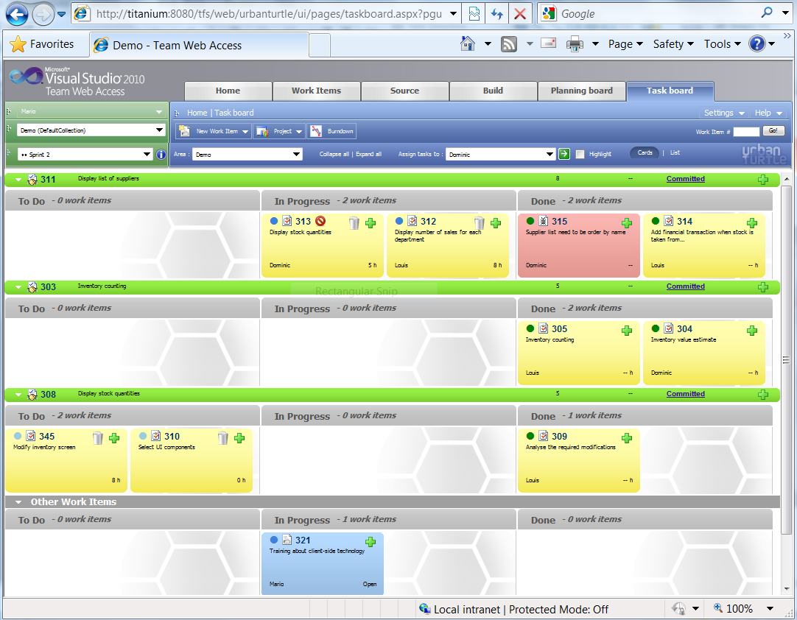
Urban Turtle
Urban Turtle is the premier Scrum tool for Microsoft TFS
Urban Turtle is developed by Pyxis Technologies:
10 years of Agility
50 coaching mandates
1,500 certified ScrumMasters

Slide 12
Urban Turtle
Agile project management
Backlog grooming and prioritization
Sprint planning
Day to day tasks tracking
Targets all team member
Non-technical
Requirements expert (Product Owner),
Facilitator and agile coach (ScrumMaster)
Development manager
Technical
Developer
http://urbanturtle.com

Slide 13
Urban Turtle
Seamlessly integrates with TFS Web Access
Planning Board
Task Board
Works with any TFS template
Visual Studio Scrum v1
MSF Agile v5
Scrum for Team System v3
Add your own custom process template
http://urbanturtle.com

Slide 14

Myth #2
“TFS doesn’t handle formal requirements”

Slide 15
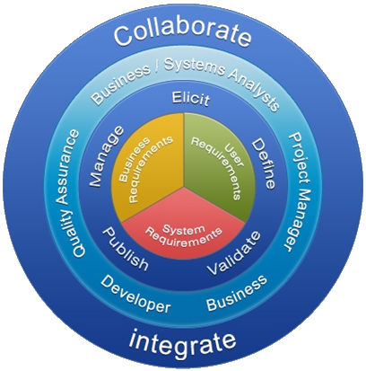
What is inteGREAT?
A Knowledge Management Platform for Requirements Development
http://edevtech.com
Notes:
inteGREAT is a Comprehensive Requirements Definition, Management and Simulation Platform that automates
documentation, diagramming, simulation and the auto-generation of test artifacts.
inteGREAT is a collaboration platform that business and system analysts use with other stakeholders to Elicit, Define, Validate, Publish and Manage three types of requirements: Business, User & System Requirement – this bridges any gaps between all project stakeholders.
{transition} inteGREAT supports the entire requirements lifecycle through change requests, support & maintenance.

Slide 16
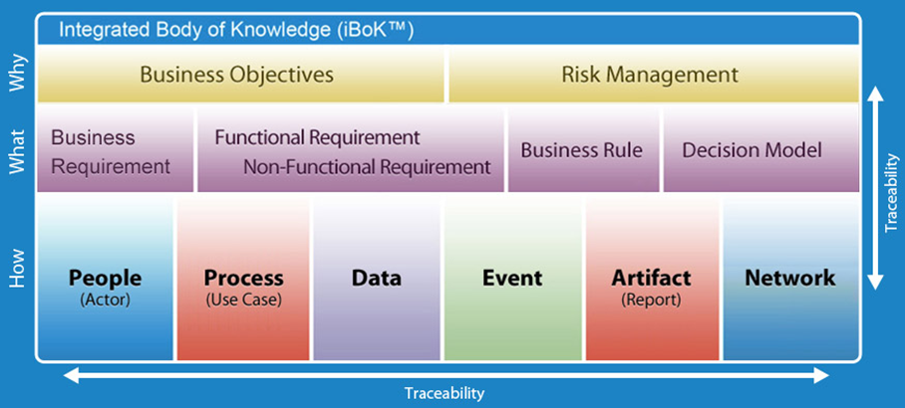
Allows you to Integrate Your Knowledge
Knowledge is the True Origin of Requirements
http://edevtech.com
Notes:
inteGREAT helps in defining the Why, What and How of the project. You start with the project charter or the project vision and define its risks and mitigations. These goals & mitigations become the basis of user requirements. User requirements are defined as functional, non functional along with their business rules & decision models. In the system requirements the solution is environed & finalized where you define people, process, data, reporting and network requirements.
inteGREAT is the only requirements tool that supports The Decision Model for complex business rule modeling.
Additionally the specification checker will automatically identify issues, problems & opportunities with the requirements knowledge base. Its like the ultimate spell check but for requirements. Another tool inteGREAT provides for requirements validation is auto-simulation – where a prototype is generated by inteGREAT based on the detailed requirements.
Using inteGREAT you can define and normalize, and baseline an integrated body of knowledge. inteGREAT has a single point of truth for any information; no matter how many documents, diagrams, or simulation they appear in.

Slide 17
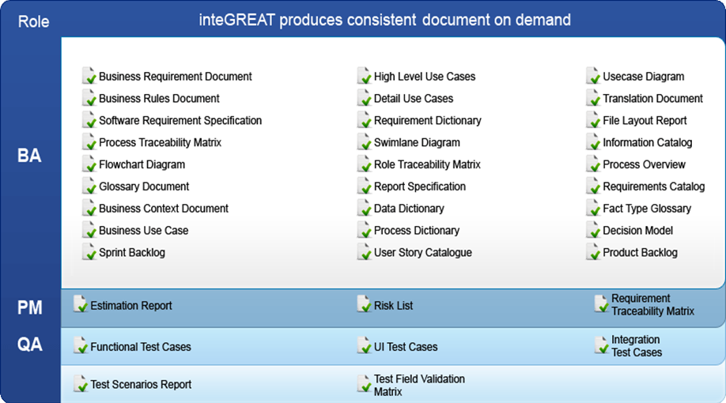
Allows you to Repurpose Knowledge
http://edevtech.com
Notes:
inteGREAT takes away the grunt work which burdens the BA’s; it increases their productivity by focusing on tasks that create new knowledge through elicitation and analysis.
inteGREAT simplifies the production of a comprehensive set of documentation that is consistent, complete, clear and completely customizable. For example simply by defining the process, inteGREAT can automatically produce flow charts, swimlane, and use case diagrams, in addition to use case documents, traceability matrices, and 3 types of test case documents.
{Transition} inteGREAT provides various integration points with technologies that are common in the market place

Slide 18
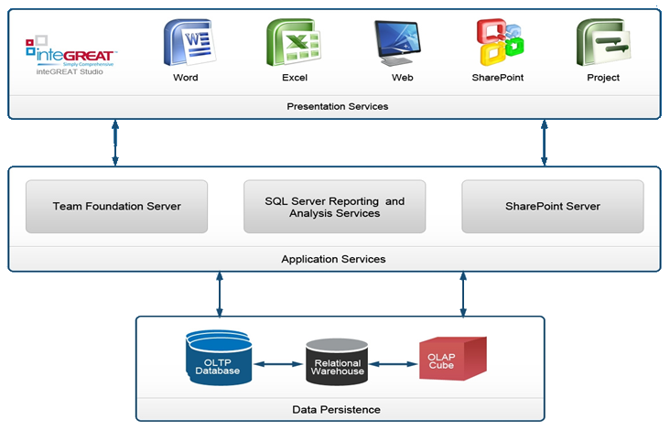
The inteGREAT Platform
DEMO …
http://edevtech.com
Notes:
inteGREAT has simplified integration with Microsoft TFS for requirements and test management, as well as for IDE support, workflow and web access.
SharePoint is used as the document repository. As well inteGREAT supports native authoring in Word, Excel, Visio, and MS Project. InteGREAT also interfaces with Expression Blend for UI simulation creation and review.
InteGREAT is based on a semantic model and because of this can be easily configured to accept data sent by other applications. This combined with inteGREAT’s XML and CSV import/export capabilities, makes it easy for iG to support integration with most applications in your ALM environment.
inteGREAT presents a seamless turnkey solution that is highly scalable.

Slide 19
Myth #3
“TFS is only for developers and testers”

Slide 20
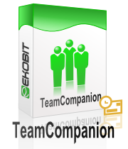
What is TeamCompanion?
The Best TFS Client for Outlook
Outlook
Emails
Appointments
Reminders
Tasks
TFS
Work Items
Work Item Queries
Reports
Builds
Documents
http://teamcompanion.com

Slide 21
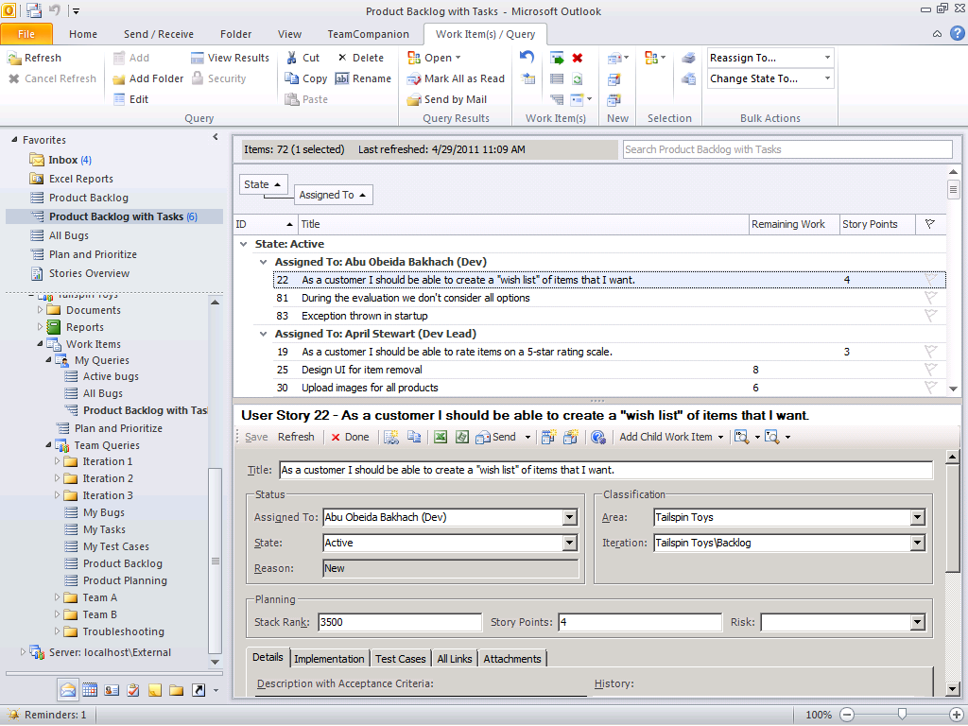
TeamCompanion 4.0
Runs inside Outlook
Great for non-technical users (PMs, BAs, and stakeholders)
Great for power users because it supports everything in VS (+ more)
Powerful hierarchies
Integrated work item form
One click “Add”
One click “Done”
http://teamcompanion.com

Slide 22
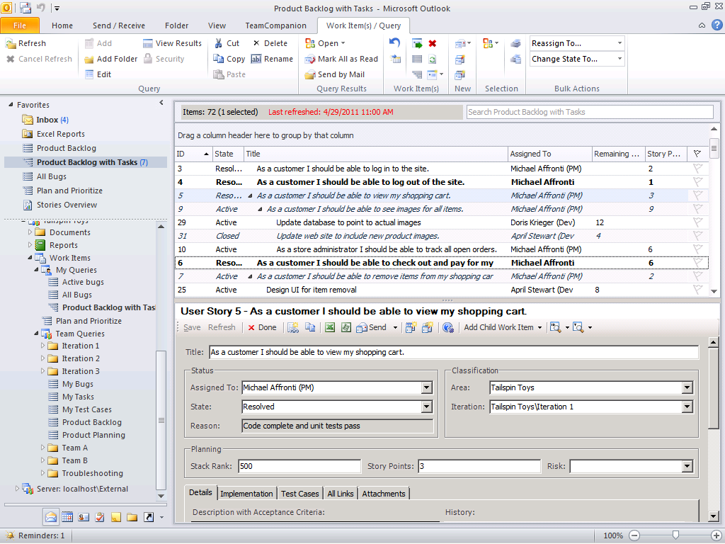
TeamCompanion 4.0
Offline work item management
Edit work items and work item hierarchies
Save, Publish, Undo eg. Adding an Epic
Search
Full text
Custom expressions eg. [Remaining work]>4
http://teamcompanion.com

Slide 23
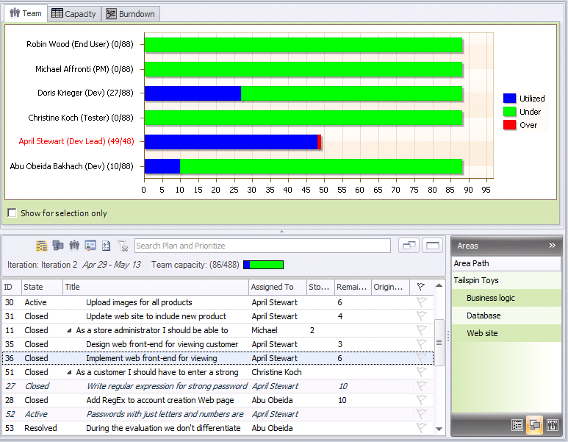
TeamCompanion 4.0
Agile Project Management
Pick, order, track
Via drag and drop
Backlog Prioritization
Sprint Planning
Check for overloaded resources
Sprint Progress
Track (via Burndown)
DEMO …
http://teamcompanion.com

Slide 24
Myth #4
“TFS does not work well with Eclipse”

Slide 25


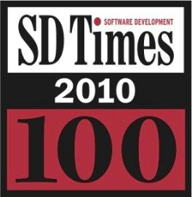

Technologies
Created the most widely used ALM integration platform
Lead top level Eclipse Mylyn project
1 million downloads / month
Global leaders in ALM interoperability
50+ integrations
Innovation and delivery partners for:
IBM – helped author OSLC standard
VMware - Code2Cloud and SpringSource Tool Suite
HP - Developer Tools
Microsoft – Windows 7 Eclipse integration
Eclipse Foundation Board of Directors
http://tasktop.com

Slide 26









Enterprise
Commercial solution extends Eclipse Mylyn project
50+ ALM integrations including Microsoft TFS
Supports Visual Studio and Eclipse
Award-winning, high-fidelity integrations between TFS and:
Issue Trackers
Source Code Management (SCM) tools
Build Management tools
Continuous Integration tools
Quality Assurance Solutions
Project and Portfolio Management Tools
Application Lifecycle Management
Open Source
Agile
Enterprise
Subversion
Rally
HP Quality Center
Bugzilla
ThoughtWorks
IBM Rational Team Concert
Hudson
VersionOne
Git
Perforce
Microsoft
TFS
…
…
…
http://tasktop.com

Slide 27
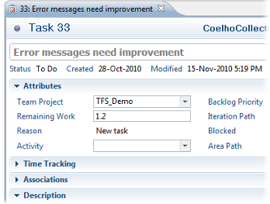
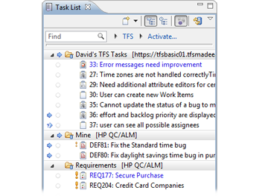
’s TFS Connector
Access TFS work items from Mylyn task list within Eclipse
Supports offline access
Deep integration builds on Team Explorer Everywhere
Task-focused desktop drives 50-100% productivity gains
DEMO …
http://tasktop.com

Slide 28
Myth #5
“TFS can only build a product, not release it”

Slide 29
InRelease
Reduces the complexity, cost, and risks of release management
Automate the release process
Allows the team to deploy their application to the targeted environment at the click of a button
Supported by a fully automated workflow
Business approvals trigger deployments to the next stage of the release cycle
http://incyclesoftware.com

Slide 30
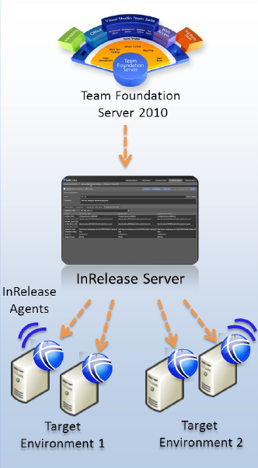
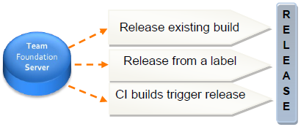
Push, Pull or Automated – You Choose
Whether a tester is self-servicing a release from a given label, a developer is releasing the latest build or the team is using continuous deployment, InRelease provides the integration to TFS that supports all these scenarios
DEMO …
http://incyclesoftware.com

Slide 31

Summary: The Myths and The Mythbusters
“TFS doesn’t support Agile teams”
Urban Turtle
“TFS doesn’t handle formal requirements”
inteGREAT
“TFS is only for developers and testers”
TeamCompanion
“TFS does not work well with Eclipse”
Tasktop
“TFS can only build a product, not release it”
InRelease

Slide 32

© 2011 Microsoft Corporation. All rights reserved. Microsoft, Windows, Windows Vista and other product names are or may be registered trademarks and/or trademarks in the U.S. and/or other countries.
The information herein is for informational purposes only and represents the current view of Microsoft Corporation as of the date of this presentation. Because Microsoft must respond to changing market conditions, it should not be interpreted to be a commitment on the part of Microsoft, and Microsoft cannot guarantee the accuracy of any information provided after the date of this presentation. MICROSOFT MAKES NO WARRANTIES, EXPRESS, IMPLIED OR STATUTORY, AS TO THE INFORMATION IN THIS PRESENTATION.

