Slide 1
Getting started with this template
How are you using this PPT?
Live presentation vs. document
Avoid longform content on a Presentation deck; include headlines and key points, NOT your presentation script. Add extra information in the Notes section if needed.
Brand Guidelines and Asset Library
Our expansive asset library including fonts, photography, iconography and custom slides are available on Accenture Brand Space.
Contact brandsupport@accenture.com for more info.
Use of photography
Select background photographs from the approved photos in the image library. Choose photos based on relevance to the content being presented.
PPT tips
Guides and grids
Make use of Guides set within this template. View > checkmark ‘Guides’.
Use indent
Use the indent buttons to increase or decrease text formatting levels.
Shortcut: Alt + Shift + (Arrow Right to increase or Arrow Left to decrease).
Try the Quick Presentation Toolkit
It’s designed to help you create powerful PPT presentations while saving you time and frustration.

Slide 2
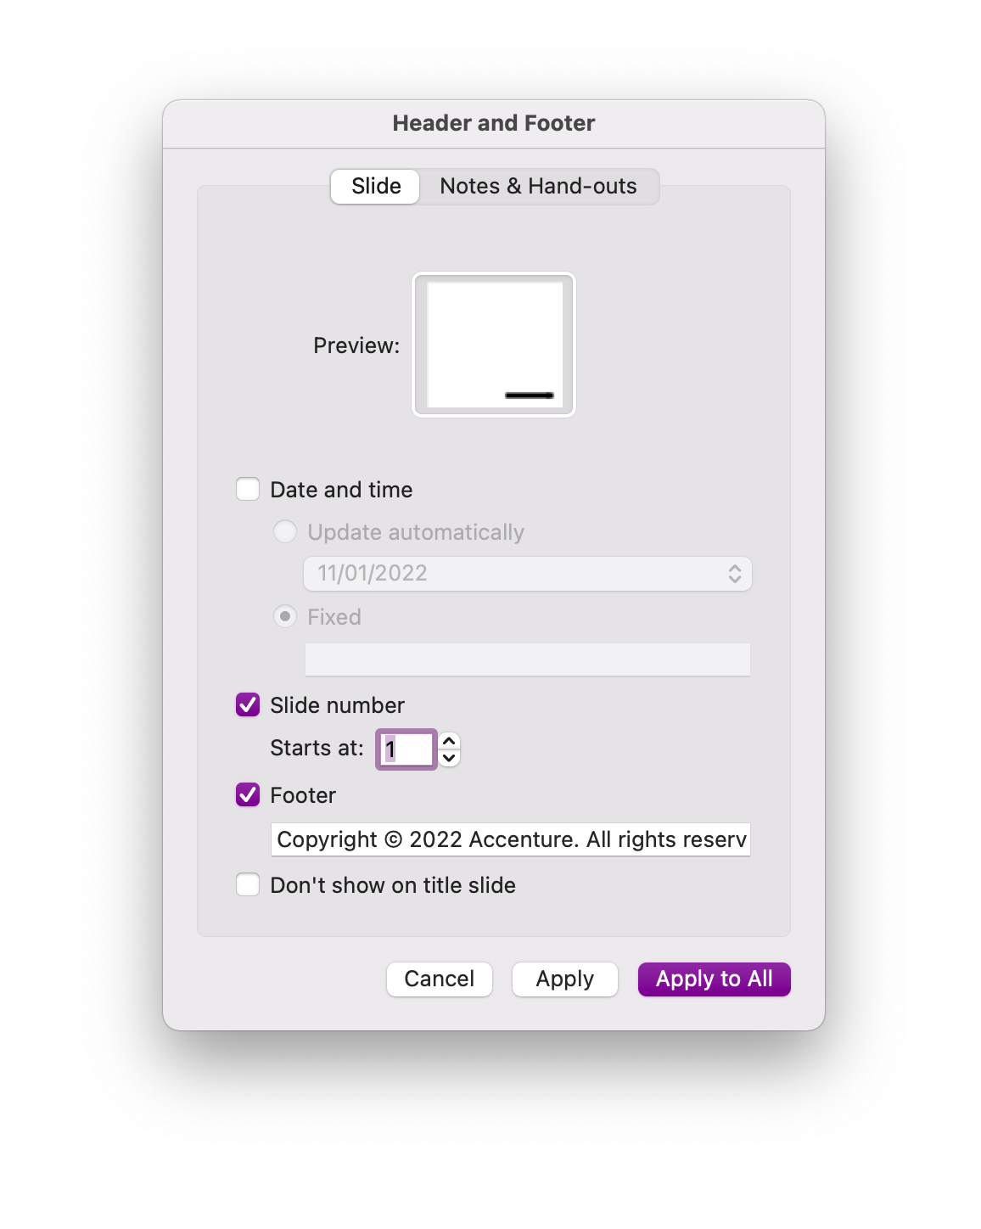
Working with footers
Copyright or other text
From the Ribbon, click the Insert tab and click Header & Footer in the Text group
In the dialog box (shown right), check the box next to “Footer,” if it isn’t already
The default footer text reads “Copyright © 2023 Accenture. All rights reserved”
Change the text or leave as the default
Click ‘Apply’ to apply the footer only to the slide you're currently working on; or click ‘Apply to All’ if you want it to appear on all your slides
“Don’t show on title slide” can remain unchecked, the footer is not present on title slide masters

Slide 3
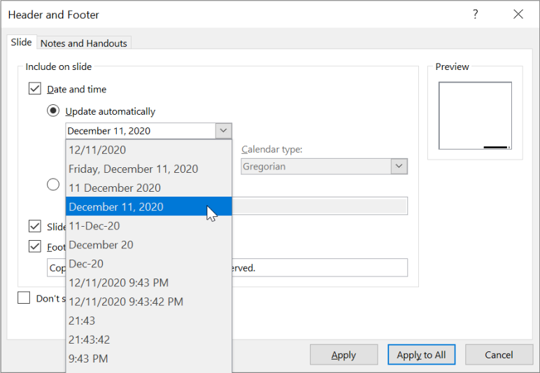

Working with footers
Presentation date on title masters
From the Ribbon, click the Insert tab and click Header & Footer in the Text group
In the dialog box check the box next to “Date and time” and select either an automatic or fixed date
Automatic dates have a selection of formats available from the drop–down menu
Note as shown, the date on title slides will reflect your date format selection or custom text input in the Header and Footer menu

Slide 4
How to make your story impactful
1. Get to the point Put benefits front and center with a minimum of distraction. | 2. Speak human People are what matter most to us. Emotions are powerful things. Use them. | 3. Make it visual Try to replace text with large images or numbers when possible. The majority of your slides’ content (at least 60%) should be visual. Your audience can read. | 4. Kill your darlings You may have a personal favorite that you spent hours refining. But if that slide doesn’t advance the narrative or offer important new information, lose it. | 5. Don’t bury the lede It’s a golden rule of journalism, and it holds true here, too.
6. Be provocative Don’t be afraid to explore emotions and thoughts in the service of your idea. | 7. Use visual chapters Doing the same thing page after page is a recipe for boredom. Mix it up. Give eyes and attention spans a break by sprinkling in bold thematic imagery. | 8. Be concise Use 20 words or less. Ruthlessly edit yourself. Minimum text; maximum impact. | 9. Go easy on the eyes Make your text 16-point or larger. Your audience (and their optometrists) will thank you. Text won’t fit? Refer back to rule #8.

Slide 5
How to structure a great story
1. The hook Tell a personal story, make a startling assertion, or introduce a “what if” scenario that sparks imagination. | 2. Characters and context Set the stage by introducing the people, places, things, and events that have led to this moment. Your audience is always the hero. | 3. A mission and destination Paint a picture of what your audience wants to achieve and what they’re setting out to do. | 4. A “monster” or big challenge Describe what’s in their way — what makes this journey difficult and what they will need to overcome to be successful.
5. New “super powers” Share the 3–4 capabilities or solutions that will help your audience defeat the monster and reach their destination. | 6. A climax or outcome Reveal the ultimate outcome when the monster is defeated and the destination is reached. | 7. A new life with new action Tell your audience about the first step on their journey — the action you want them to take.

Slide 6
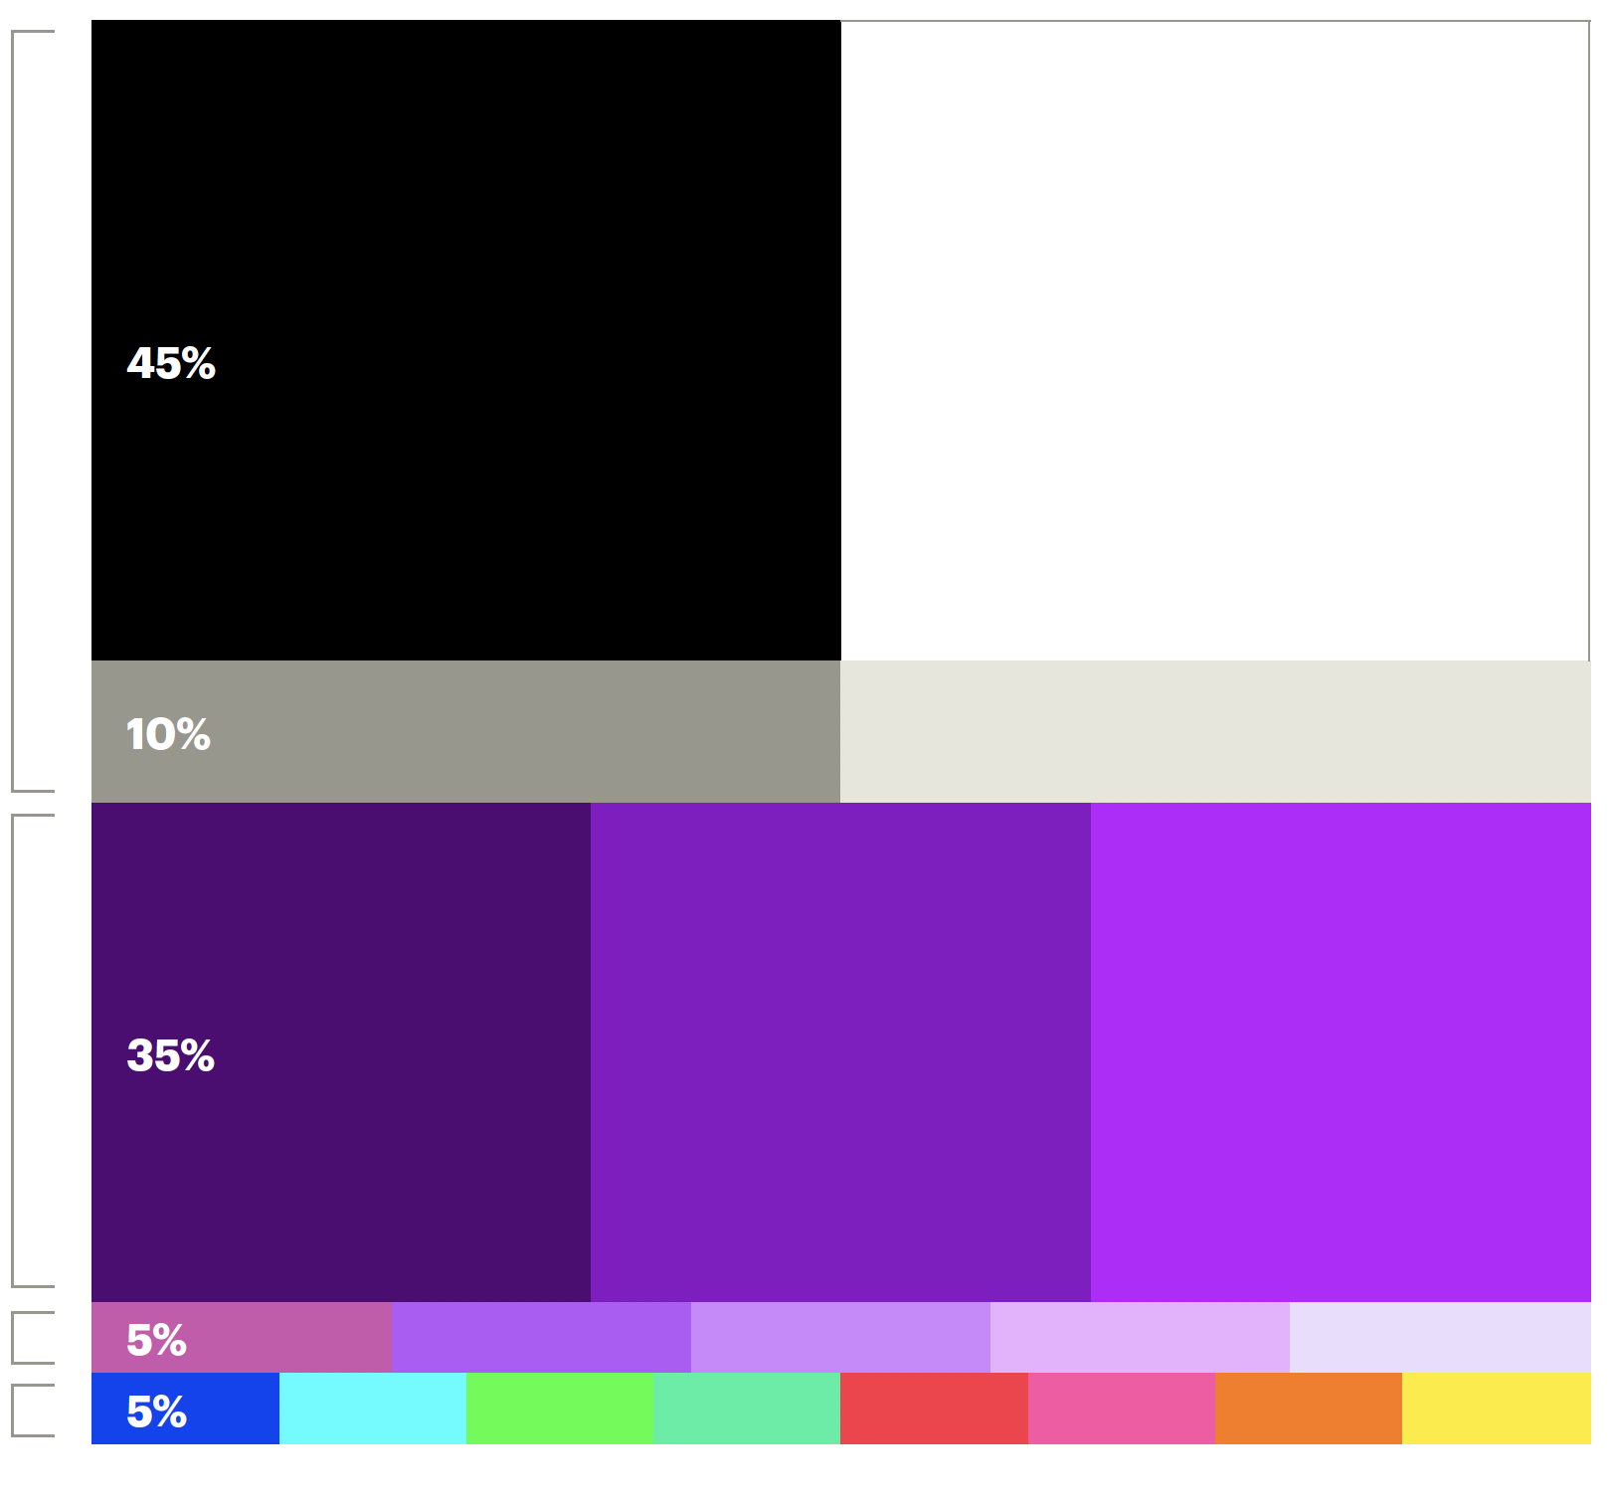
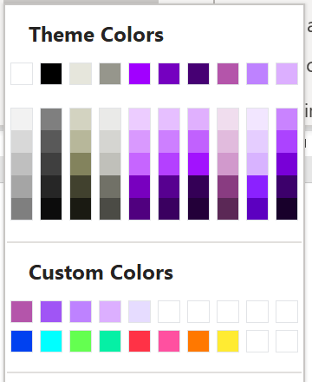
Colors and gradients
This template’s color theme and custom colors palette include our neutrals, core purples, accent purples and secondary colors. Accent purples and secondary colors should be used with care, according to the proportions shown to the right.
For printing, choose slide layouts with white backgrounds.
Color relationship for everyday use
Neutrals
Core purples
Dark
Mid
Accent purples
Secondaries

Slide 7
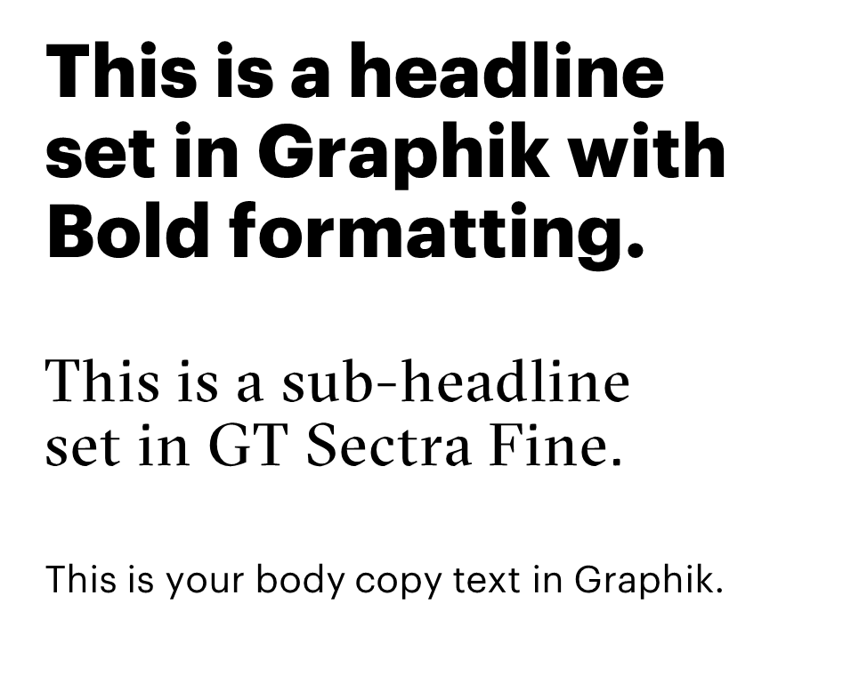
Fonts
We use Graphik as our core brand typography. For optimum text accessibility on PowerPoint, we use Graphik Regular.
On some slide layouts (Covers and Dividers), we employ GT Sectra Fine to add a bit of humanity and visual interest.
Download and install Graphik and GT Sectra Fine fonts here.
If these fonts are not available or you can only use system fonts, please use the Arial template available here.

Slide 8
Iconography: Monoline
Our expansive asset library including fonts, photography, iconography and custom slides are available on Accenture Brand Space. Contact brandsupport@accenture.com for further information. Icon color can be changed using the Shape Fill menu.

Slide 9










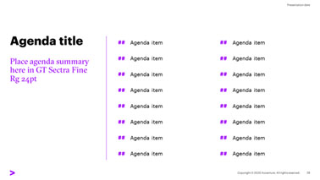
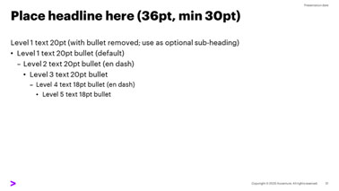
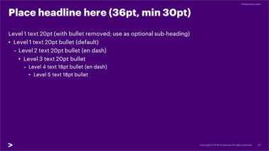
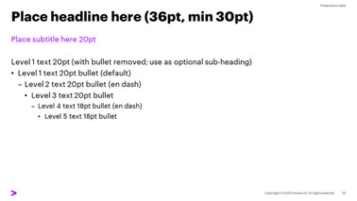
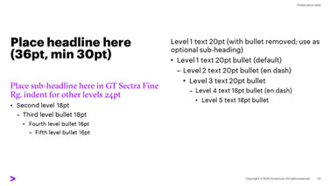
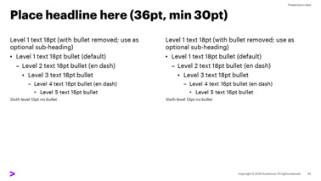
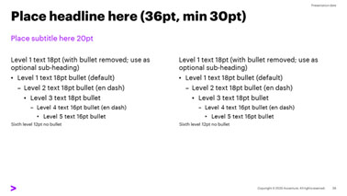
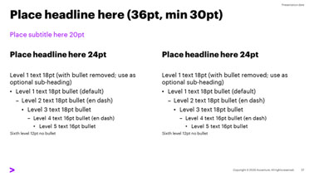
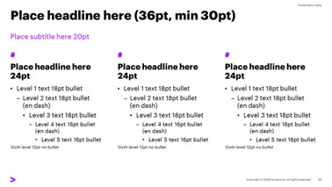
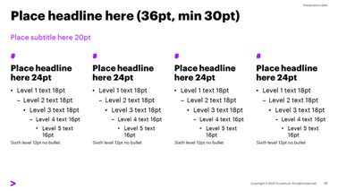
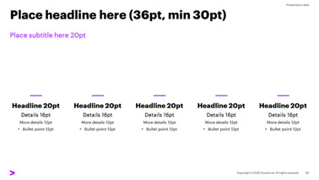
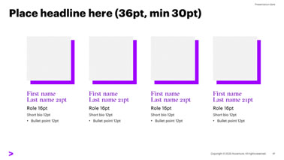
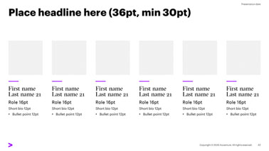
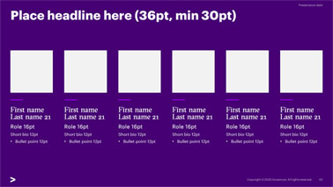
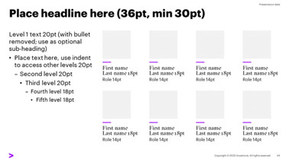




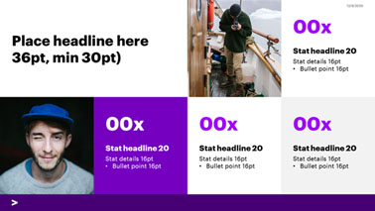
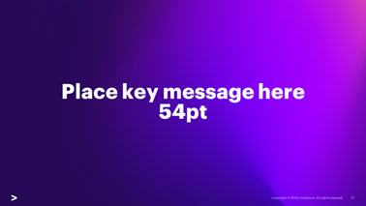

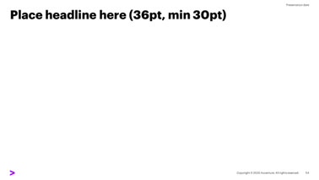
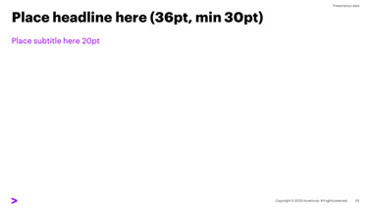
Slide Layouts
The following snapshots show some of the slide layouts included within this template. Access them through Home (Ribbon) > Slides > Layout or View (Ribbon) > Slide Master.
Intro & Covers
Section Dividers
Content Layouts

Slide 10
Insert Salutation 72pt

Slide 11
Presentation title 60pt, long title 48pt, max 3 lines
Place subtitle here in GT Sectra Fine Rg 24pt
Presenter 14pt

Slide 12
Section title 54pt
Place subtitle here, GT Sectra Fine Rg 24pt

Slide 13
Section title 54pt
#
Place subtitle here, GT Sectra Fine Rg 24pt

Slide 14
Agenda title
##
Agenda item
##
Agenda item
##
Agenda item
##
Agenda item
Place agenda summary here in GT Sectra Fine Rg 24pt
##
Agenda item
##
Agenda item
##
Agenda item
##
Agenda item
##
Agenda item
##
Agenda item
##
Agenda item
##
Agenda item
##
Agenda item
##
Agenda item
##
Agenda item
##
Agenda item

Slide 15
Place headline here (36pt, min 30pt)
Place subtitle here 20pt
Level 1 text 20pt (with bullet removed; use as optional sub-heading)
Level 1 text 20pt bullet (default)
Level 2 text 20pt bullet (en dash)
Level 3 text 20pt bullet
Level 4 text 18pt bullet (en dash)
Level 5 text 18pt bullet

Slide 16
Place headline here (36pt, min 30pt)
Place subtitle here 20pt
Level 1 text 18pt (with bullet removed; use as optional sub-heading)
Level 1 text 18pt bullet (default)
Level 2 text 18pt bullet (en dash)
Level 3 text 18pt bullet
Level 4 text 16pt bullet (en dash)
Level 5 text 16pt bullet
Sixth level 12pt no bullet
Level 1 text 18pt (with bullet removed; use as optional sub-heading)
Level 1 text 18pt bullet (default)
Level 2 text 18pt bullet (en dash)
Level 3 text 18pt bullet
Level 4 text 16pt bullet (en dash)
Level 5 text 16pt bullet
Sixth level 12pt no bullet

Slide 17
Custom table format (Acc_Table_1)
Column 1 | Column 2 | Column 3 | Column 4
A competency will enable team-oriented emerging principle. | Provide agile workflows for integration. | A design-led price point cannot close the loop. | Fiscal revenues ramp up progress on win-win guesstimates.
Fiscal revenues ramp up progress on win-win guesstimates. | A design-led price point cannot close the loop. | A competency will enable team-oriented emerging principle. | A competency will enable team-oriented emerging principle.
A competency will enable team-oriented emerging principle. | The mechanism is the delivery system that enables this ability. | Provide agile workflows for integration. | Customer partnerships grow the time frames.

Slide 18
Place key message here 54pt

Slide 19
Thank You

