Slide 1

Devops – Big picture
Traditional way of software development
Agile methodology
Problem analysis
Introduction to Devops
Devops Tools
Roles & Responsibility of Devops engineer
Skills set required for Devops engineer
Who can become Devops engineer
What I am going to focus

Slide 2


Traditional way of software development
Traditionally organizations were using waterfall methodology for any software development.
It was documented at 1970 by Winston W. Royce and also this is the first published software development life cycle model.
Why it is named as waterfall ?
Because development life cycle will be pretty similar to waterfall.
There are various software development models used by different companies, but the waterfall model is the oldest, safest and easy model in the IT industry.

Slide 3

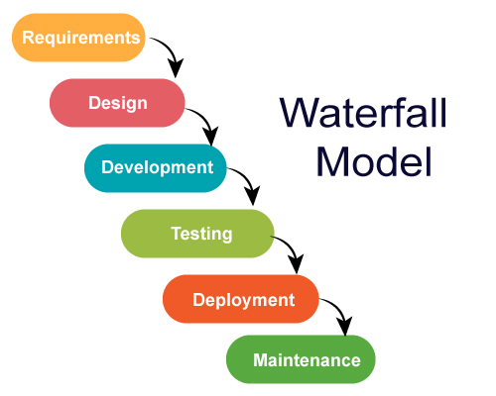
Stages of waterfall model
Waterfall model is broken into multiple phases as you can see it has 6 stages involved within it.
Also you can see the development stages are more similar to waterfall.

Slide 4

Initial stages
Requirement
Consider there is a client & they want to develop software. The client reaches out to the company. Suppose he reaches out to the service-based company and asks the company to build the software for them
What does the company do?
Company will collect all the requirements, the knowledge that the customer has or the client want to have on his software, the company will collect all the information from the client and prepare the documentation. Once this activity is performed, then the design phase gets started.
Design
Before developing the software, the design of the software is required.
Suppose the customer wants e-commerce website similar to the Amazon, then UI(User Interface) of the website will be made by the designer and dataflows are also designed in this phase that how data will flow.
Once this phase is completed, the development phase will get started.
Development
In the Development phase, the software development team starts coding and developing the software.
This is the longest phase of the waterfall model as developers need more time to build the software.
Once the development of the software is completed, then the project is moved to the next phase.

Slide 5
Last stages
Testing
During this stage, testing team will discover and report issues within the application that need to be resolved.
Deployment
Once the project is tested, the application is deployed in machines so that it becomes live to the real-time users.
Maintenance
Finally, the project is deployed and available to the clients.
If client wants the maintenance period for couple of years because if any bug found or need any enhancement in the application, so they may have some team to handle such things.

Slide 6
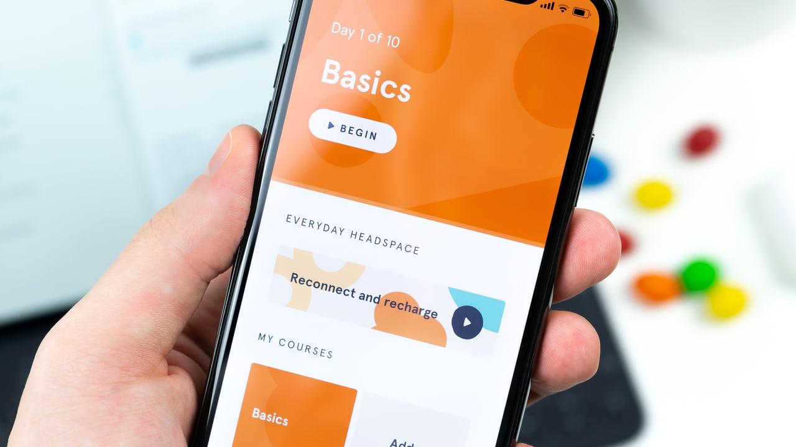
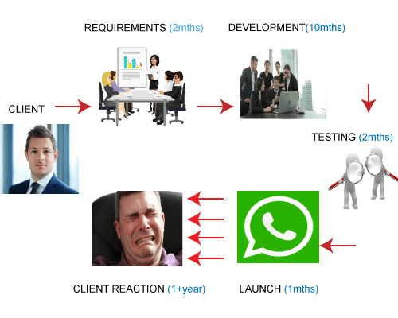
Real time comparison
Let’s say a company wants to create an chat application which is similar to WhatsApp.
They reach to the service based company and provide their requirement.
Initial discussion might last long for at least 2 months where they can understand the product requirement & to discuss commercials required for development. [Also requirements will be documented during this stage]
Once after this design & development will be kicked of and it might take at least 10 months of time spine.
Then testing phase might take 2 months of time spine.
Once testing is done, it will be deployed and made it ready for live.
As you see, after initial stage client is not involved any where and he has no idea about his product until final presentation.
There are lot of chances that product delivered might not meet the client expectation. [Because his expectation is given verbally] if in case client want some changes then need to go through the whole process all together.

Slide 7
Advantage & Disadvantage
Advantage
Simple and easy to understand and use
Phases do not overlap, because next phase is started once particular phase is completed.
Disadvantage
The major disadvantage is the same what happens with waterfall.
once the waterfall has flowed edge of the cliff, it cannot turn back. The same is for waterfall model strategy as well
The application will go to the next stage only the previous stage is completed and there is no turn back.
Time to market is high
Unexpected results
Not suitable for changing requirements
High amount of risk and uncertainty.

Slide 8

Waterfall model is not good for complex and object oriented projects and it is also not good for projects where requirements are tend to change frequently.
To avoid all such limitations companies started to use different methodology which is called Agile.

Slide 9
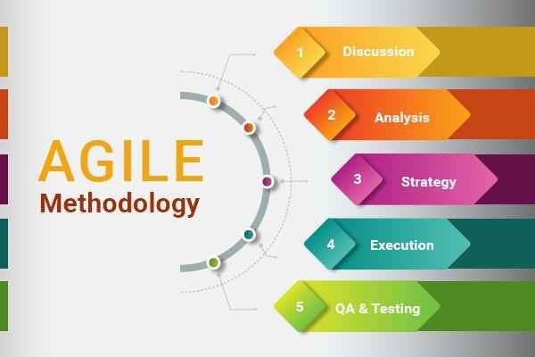
Agile methodology
What is real meaning of Agile ?
Able to move quickly and easily.
Agile methodology started to spring from year of 2000, when group of 17 developers thought to bring a change to speed up the development life cycle process.
Agile methodology is the practice that promotes continues iteration of development and testing throughout the development life cycle of project.

Slide 10
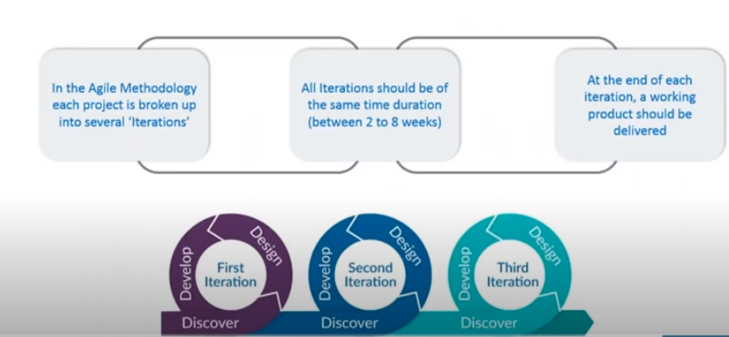
How Agile method works?
As this image explains development is broken up into several iterations.
Coding & Testing occurs continuously at each iteration which increase the product quality.

Slide 11
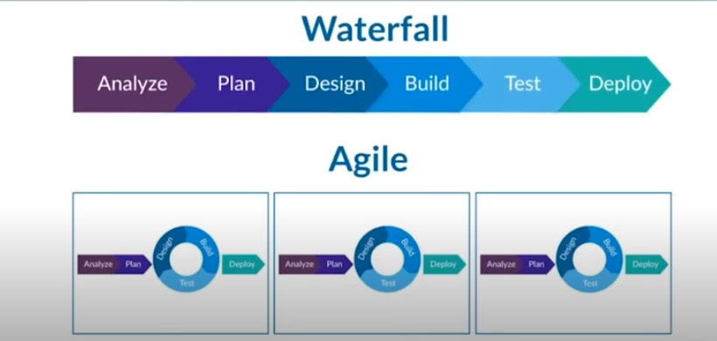
Waterfall vs Agile
As you can waterfall model is pretty linear and straight forward.
But in agile [Design, build & testing] part happens continuously in several iterations. Hence the complete development is broken into chunks.

Slide 12
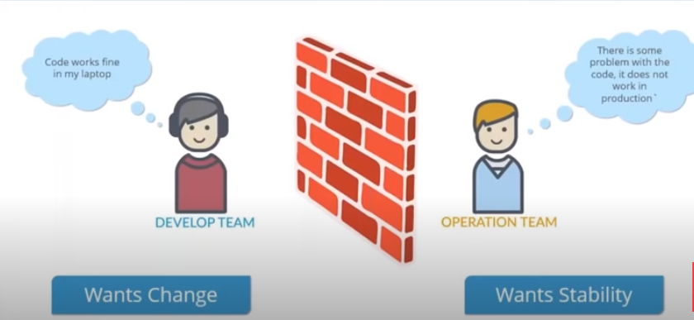
Limitations of Agile
The biggest problem with agile is that development part of project become way more agile.
Development and testing happens continuously but problem comes when you want to deploy your code. Because operation team not agile yet.
Once code is ready developer need to work with operation team to get required machines and deploy the code.
However it involves multiple process within it, let’s see it one by one.

Slide 13
Operation team process
Operation team says their process easy but its not.
There will be lot of conflict always between dev & ops team where dev team wants agility and ops team want stability in infrastructure.
Many can relate to such issues like code works in laptop well neither in production at all.
This happens because of inconsistence and not understanding the requirement of developer properly.
There is used to lot of fights happen between developer and ops team at deployment stage.
Discuss requirement to ops team
Raise request
Get it approved
Get VM delivered
Validate the machine
Deploy your code
Work with ops team if any problem in deploying code

Slide 14
Now development part of company become more agile and robust whereas operations part of company still remains sluggish and linear which requires some solution to solve the problems which we have discussed.

Slide 15
Facebook use-case
Back in 2011 Facebook released multiple features like timeline, Music functionality and they also they deployed it to entire user base.
This global deployment brought them lot of trouble. Facebook had around 500 million active users at that time when feature was released.
As and when people realised their favourite social media release new feature everyone was excited to explore the feature. Which eventually caused high website traffic which in turn let to the server meltdown.
Well due to high server utilization website got crashed which in turn created negative impact on Facebook.
This was kind of catastrophic situation for any company which could potentially face at any point in time.
Instead of creating anticipation about new release they ended up in getting bad feedback from users.
This is where companies started to realise there should be way to deploy software’s in efficient way.

Slide 16
Trying to bring new solution
Post this kind of events they started to come up with technique called “Dark Launching”
In-fact many companies are still using this Dark launching technique.
According to dark launching technique.
New features are first deployed on smaller & specific user base.
They are continuously monitored and feedbacks are continuously addressed.
Once the feature is stable, they are deployed on other user bases gradually.
To implement dark launching, the below activities are fundamental.
Continuous Monitoring.
Continuous Development
Continuous Deployment
Continuous Testing
These new fundamentals cannot be performed using Agile model, Hence the methodology of Devops comes into picture.

Slide 17

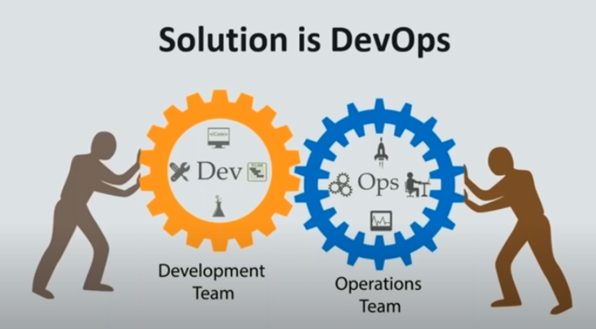

Slide 18
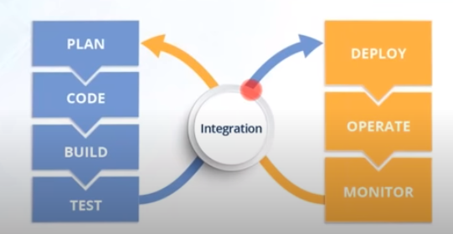
Introduction to Devops
Basically Devops is software development strategy which bridges the gap between dev & ops side of the company.
The word Devops was coined in 2009 by Patrick Debois.
Devops is not a process or technology like [agile & waterfall] it is culture which need to be adopted by every company.
DevOps primarily focuses in changing the IT culture, rapid IT service delivery through adopting agile & lean practices.
DevOps emphasizes people to improve collaboration between operations and development teams.
DevOps implementations utilize technology — especially automation tools that can leverage flexibility for faster development life cycle.
Devops also involves continuous development, testing, deployment & Monitoring

Slide 19
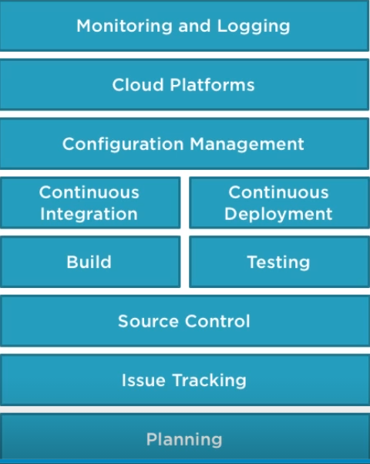
Devops Stages
There are different stages involved when we implement devops, we shall see one by one.

Slide 20
Devops Tools
Planning
Through this you can plan your project flow [This also famously know as sprint planning], There are many tools available in this segment.
Trello, GitLab, Pivotal Tracker & Azure boards
Issue Tracking
Recording the issues & working on it.
Jira & Zendesk
Source Control
Your code repository.
GitHub, Bitbucket & Subversion
Build
Convert your code into an application.
Maven, Jfrog & MSbuild
Testing
Testing the built code, before final deployment.
Junit & Selenium

Slide 21
Devops Tools
Continuous Integration & Deployment
Integrating and deploying the huge number codes committed from many people to production.
Jenkins, AWS code pipelines, Azure code pipelines & TravisCI
Configuration Management & IAC
Helps to create and manage your infrastructure.
Terraform, Ansible, Chef & Puppet
Cloud Platforms
Where your application would be hosted.
Public Cloud
AWS, AZURE, GCP, Digital Ocean, Alibaba
Private Cloud
VMware VRA & Open stack
Monitoring & Logging
Monitoring your infrastructure and flow
ELK, Prometheus, Splunk & Nagios

Slide 22
Devops Tools
Knowledge Sharing
After all you might need tools to share the things among team with certain tools.
Confluence
GitHub pages
Google Sites
Platform & Platform Manager
Platform where all your application will be residing,
Docker
Manage your platforms efficiently
Kubernetes & Openshift

Slide 23
Roles & Responsibility of Devops Engineer
Responsibility of Devops engineer
Generally works with diverse teams and departments to create and implement software’s.
Should be able to handle the challenges arising in coding and scripting part.
Handle code which has to fit across multi-tenant environments including cloud.
Runs software on various OS which is called continuous deployment.
Must know how to choose the best tools and technologies which fits the business needs.
Ability to automate code deploy and monitor.
Maintains close coordination with development & operation teams.
Ability to create clear documentation so that knowledge is passed on.
Able to manage operating systems such as windows & Linux.

Slide 24
Skills required for Devops engineer
Skill set required for Devops engineer
Expertise in operating systems [Linux environments].
Good knowledge with scripting languages such as Shell & Python.
Better understanding and hands-on in developing and maintaining CI/CD pipelines.
Hands-on with configuration management tools such as Ansible, Puppet etc..
Exposure in build and handle VMs, containers using tools like Docker, Kubernetes etc..
Ability to manage multi cloud providers AWS, Azure, GCP etc..

Slide 25
Who can become Devops Engineer
Who can become Devops engineer [Mostly people from operations side can become devops engineer]
Cloud Engineers
System Engineers & System administrators
Site reliability engineers
Database engineers
Scope for Freshers?
For freshers who aspire to become devops engineer may not be possible immediately without any prior exposure.
Instead they can start their carrier as Junior Devops engineer or Cloud engineer and then gradually move towards full fledged Devops engineer.
Overall growth would be like
Junior Devops engineer
Devops Engineer
Senior Devops Engineer
Devops Architect

Slide 26
Major tools to focus
Operating system skills [Especially with Linux]
One scripting language [Python or bash]
At least one configuration management tool [Preferably Ansible]
Cloud operator skills [AWS, Azure and GCP]
Infrastructure orchestrator tools [Preferably Terraform]
Platform tools [Docker & Kubernetes]
Source code management tools [Git]
Continuous Integration & Deployment tools [Preferably Jenkins]

Slide 27
What I am going to focus..
I will be taking you through below topics.
Linux basics
Ansible
AWS
Terraform
Git

Slide 28
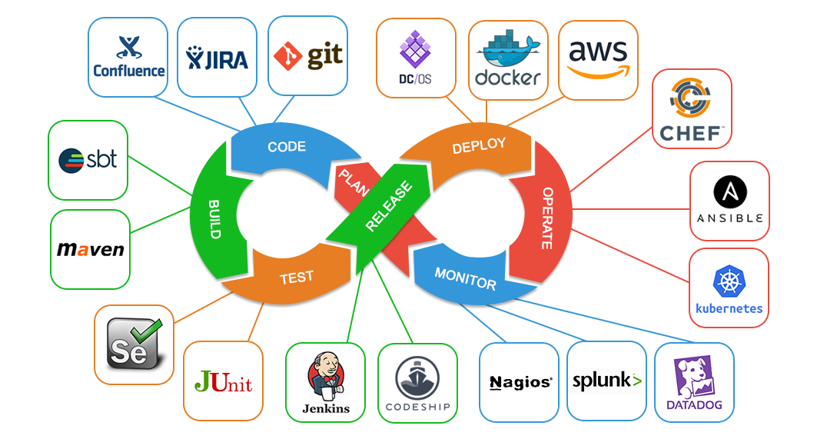
Any questions?

