Slide 1


Progress 2

Slide 2
Team members
Trần Nhựt Anh 521H0491 (521h0491@student.tdt.edu.vn)
Nguyễn Lam Duy 521H0499 (521h0499@student.tdt.edu.vn)
Nguyễn Ngọc Minh 521H0505 (521h00505@student.tdt.edu.vn)
Trịnh Minh Tích Thiện 521H0305 (521h0305@student.tdt.edu.vn)
Phan Minh Hoàng

Slide 3
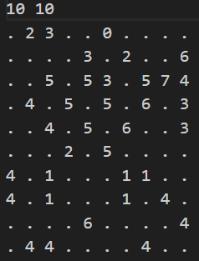
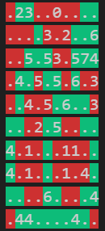
Requirement
Players color cells by red or green so that the number of green cells which are “adjacent” to a cell is exactly the number inside.

Slide 4
Approach
Thanks for the hints and the descriptions I managed to solve the mathematical concept behind the requirement
Using CNF from glucose3 (Python library) to solve the problem
Every Cells in the table with a number value will provide clauses for CNF .Based on the value and the surrounding Cells of its ,we can infer the rules of symbol combinations.

Slide 5
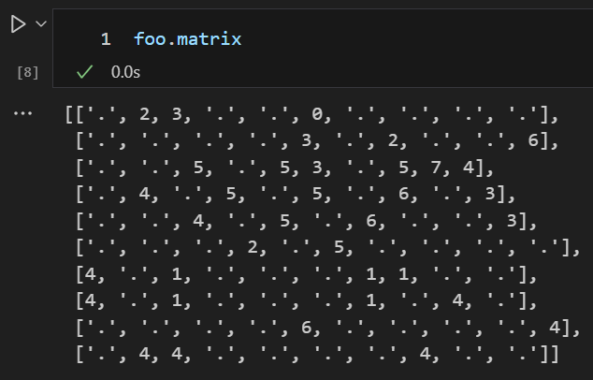
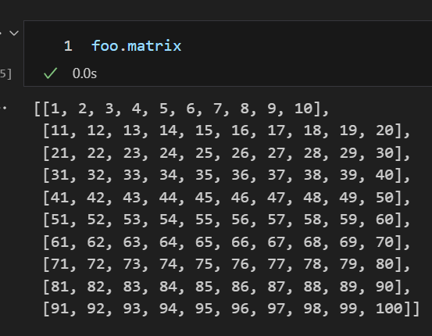
Code Implementation
In order to implement the glucose3 library . First After load in the input file , the matrix will turn into a 1d array
The matrix from input
After transformed

Slide 6
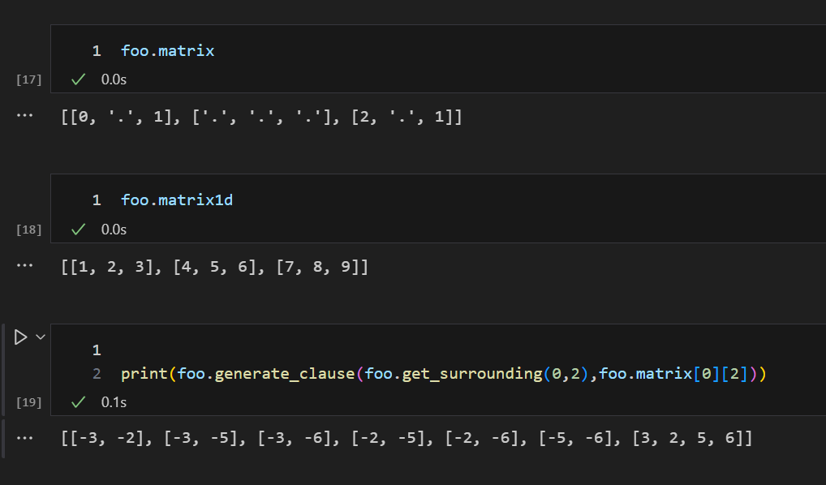
Generate clauses for CNF
The generate_clauses(surronding,cell_value) return clauses from a numbered cell

Slide 7
Model solve form glucose3
After pending all clauses call the solve() from glucose3 and its return a model result from that model print out the console with color as requirement

Slide 8
End of Slides
Thank you for sending your on this presentation
I am looking forward for your idea for improvement

