Slide 1


Computational Resources for AI
David L Hart
NSF NCAR • NSF ACCESS • NAIRR Pilot
Track 2, Wednesday
AI Workshop Denver, CO April 2-3, 2025

Slide 2
Computational resources for AI — Who are these resources for?
You!
Researchers and instructors from U.S. 2- or 4-year academic institutions or non-profit organizations
(sometimes even broader eligibility in some cases)
Any — or no — source of funding for the research
(some limitations in specific cases)
Any application domain of AI
And non-AI work, in many cases
(some limitations in specific cases)
No experience necessary!
No cost to you!

Slide 3
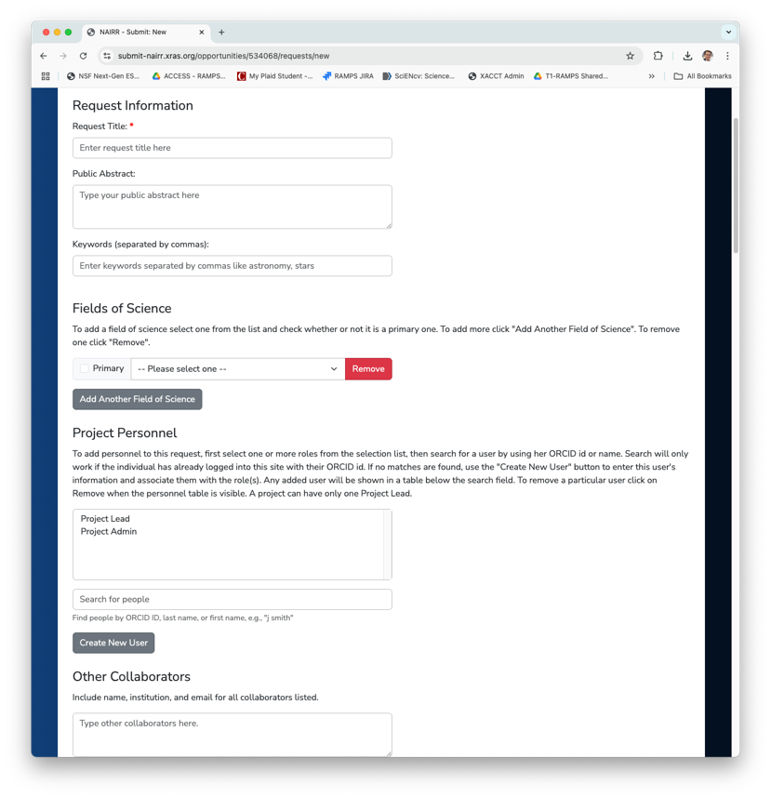
What do you need to get started?
You need to bring the idea for the work and the ability to carry it out
While resource access is no cost, you need to cover costs for staff time
Information about your project
Title & Abstract
Personnel
Project proposal or description
Instructions vary depending on the scale of work and the program providing resource access
Supporting grant information
If applicable to your project
Image of??

Slide 4
Writing proposals for resource access
Resource proposals are not research proposals
These programs are not re-reviewing your funded research activities
Summarize your research (or instructional) objectives
Emphasizing your computational plan or approach
Justify your resource needs
Some programs offer opportunities that provide you access to get started and collect info to estimate your total resource needs
Calculating resource needs for AI is less precise than traditional HPC cost calculations
“Less precise” is not the same as “no way to know”
Describe your resource flexibility
Consider if non-GPU hardware is an option
Being able to run on more than one GPU or more than one node is an important workflow feature to describe

Slide 5
More on estimating resource needs — Try before you buy ask
Best option: Benchmark runs on the oldest hardware you can find that will run your workflow
Opens up far more options on the resource side
Good option: Benchmark runs on comparable hardware to the resource you’re requesting
May limit your resource options somewhat
Another good option: Start with a small request on your target resource and run your benchmarks there
Whatever you do, don’t state or imply that your can only use 8-way 80GB A100 nodes (if that’s not the case)
Unnecessarily constrains your resource options

Slide 6
NSF ACCESS

Slide 7


What is NSF ACCESS?
ACCESS has been established by the U.S. National Science Foundation (NSF) to connect researchers and educators to the resources and services they need to accomplish their objectives.
access-ci.org
allocations.access-ci.org

Slide 8
Allocations on NSF ACCESS
Visit https://allocations.access-ci.org/
Select Get Your First Project Here in the first box
You’ll typically have an Explore ACCESS project within days
Many projects go from submitting their project request to completing their first resource job in about 10 days.
Select Resources from top navigation menu to explore resources
If you’re new to national-scale resources, you need to tell the provider about your project to get an “allocation” to use a resource. It’s an amount of resource units (core-hours, GPU-hours, etc.) that you have permission to spend to pursue the goals of your project.
allocations.access-ci.org/resources

Slide 9
NSF ACCESS – Multi-core Compute
Anvil (Purdue) — 1,000 AMD Milan nodes, 128 cores per node, some large memory nodes
Bridges-2 (PSC) — 504 AMD Rome nodes, 128 cores per node, large memory nodes available; extreme memory (4 TB) nodes allocated separately
Delta (NCSA) — 124 AMD Milan nodes, 128 cores per node
Expanse (SDSC) — 728 AMD Rome nodes, 128 cores & 1 TB NVMe per node
KyRIC (U Kentucky) — Five large-memory (3 TB, 6 TB) nodes, 300 TB storage
Launch (Texas A&M) — 35 AMD EPYC 9124 nodes
Stampede 3 (TACC) — 1,848 nodes with Intel Sapphire Rapids, Ice Lake, and Skylake
allocations.access-ci.org/resources

Slide 10
NSF ACCESS – GPU Computing
Anvil GPU (Purdue) — 16 nodes, 4 NVIDIA A100 GPUs each
Bridges-2 GPU (PSC) — 33 nodes, 8 NVIDIA V100 GPUs & 7.68 TB NVMe per node
DARWIN GPU (U Del.) — Large-memory nodes with three different GPU architectures: AMD MI50, NVIDIA T4 & V100
Delta GPU (NCSA) — 4 node configs: 100 nodes w/ 4x A100s; 100 w/ 4x A40 GPUs; five w/ 8x A100s; one w/ 8x AMD MI100 GPUs
Delta AI (NCSA) — 114 nodes, each with four Grace Hopper chips
Expanse GPU (SDSC) — 52 nodes, 4 NVIDIA V100 GPUs each
allocations.access-ci.org/resources

Slide 11
NSF ACCESS – Novel / Innovative Computing
ACES (Texas A&M U) — Composable PCIe fabric with Intel Sapphire Rapids cores, Graphcore IPUs, NEC Vector Engines, Intel Max GPUs, Intel FPGAs, Next Silicon co-processors, NVIDIA H100 GPUs, Intel Optane memory
FASTER (Texas A&M U) — 180 nodes on a composable fabric, 2x Intel Ice Lake processors each, 260 NVIDIA GPUs (five different architectures)
Jetstream2 (Indiana U) — Cloud environment with AMD Milan nodes, and 90 nodes with 4x A100 GPUs
Neocortex (PSC) — 2 Cerebras CS-2 Wafer Scale Engine systems
Ookami (Stony Brook U) — 176 nodes with Riken/Fujitsu A64FX processors; additional nodes with AMD Milan, Thunder X2, and Skylake/V100 architectures
Voyager (SDSC) — 42 Intel Habana Gaudi training nodes, each with 8 training processors
allocations.access-ci.org/resources

Slide 12
NSF ACCESS – Storage
Storage options also available for most compute systems, and capacity is awarded alongside compute allocations for those resources. The following storage resources can be requested separately.
Granite (NCSA) — 19-frame Spectra Tfinity tape library; 3.6 PB available for ACCESS allocations
Open Storage Network (OSN) — Cloud object storage resource, comprised of geographically distributed pods, accessed via S3 interfaces
Ranch (TACC) — Large-scale, tape-based archival storage system
allocations.access-ci.org/resources

Slide 13
NAIRR Pilot

Slide 14
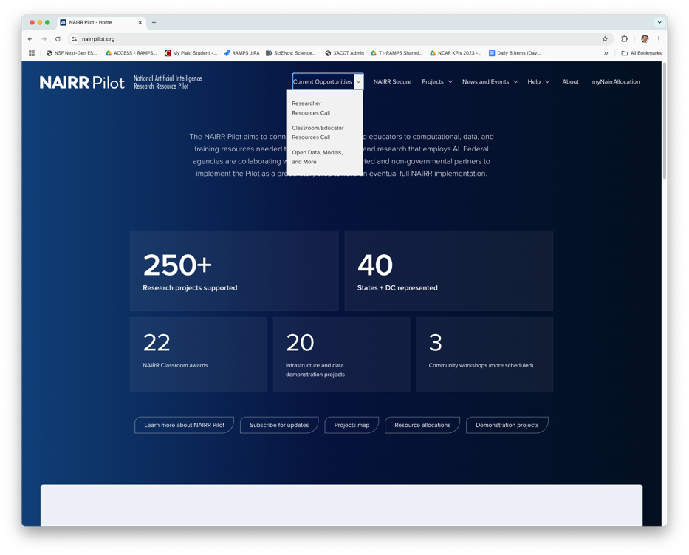
Allocations in the NAIRR Pilot
Visit https://nairrpilot.org/
Under “Current Opportunities,” select
Researcher Resources Call, for research projects
Classroom/Educators Resources Call, for classroom activities
Requests require a 3-page proposal
See website for proposal instructions
Feel free to submit a help ticket to NAIRR
If you have proposal or resource questions
nairrpilot.org/opportunities/allocations

Slide 15
NAIRR Pilot – Private Sector Resources
These resources represent leading-edge offerings from corporate and non-profit organizations. So new we’re still trying to decide how to classify them.
Cloud Providers
Amazon Web Services
Google Cloud Platform
Microsoft Azure
GPU Systems
NVIDIA DGX Cloud
Training Systems
Cerebras CS-2
SambaNova Suite
Inference Services
Anthropic
Groq LPU Inference Engine
OpenAI
SambaNova Cloud
Tools and Software
DataBricks
Eleuther AI
Hugging Face
OpenMined
Weights & Biases
nairrpilot.org/opportunities/allocations

Slide 16
NAIRR Pilot – GPU and CPU Resources (federally supported)
These resources comprise mostly homogeneous partitions or are dominated by a single processor type. The number and types of hardware vary from resource to resource.
NVIDIA V100
PSC Bridges-2 GPU
280 V100s
SDSC Expanse GPU
208 V100s
NVIDIA RTX-5000
TACC Frontera GPU
360 RTX-5000s
NVIDIA A100 / A40
NCSA Delta GPU
400 A100s & 400 A40s
Purdue Anvil GPU
64 A100s
TACC Lonestar-6 GPU
48 A100s
PATh Facility
A100s & AMD Milan
NVIDIA H100 / Grace Hopper
TACC Vista
608 GH H100s
NCSA DeltaAI
456 GH H100s
Purdue Anvil AI
80 GH H100s
AMD Milan
Purdue Anvil CPU
TACC Lonestar-6
AMD Rome
PSC Bridges-2 CPU
SDSC Expanse CPU
Intel Cascade Lake
TACC Frontera
Large-Memory Nodes
PSC Bridges-2 EM
(Extreme Memory)
nairrpilot.org/opportunities/allocations

Slide 17
NAIRR Pilot – AI, Cloud, and Composable Resources
The NAIRR Pilot includes resources that offer alternative architectures designed to support a wide range of needs beyond the more conventional HPC architectures.
AI Accelerators
PSC Neocortex
Two Cerebras CS-2 systems
SDSC Voyager
42 8x Intel Habana Gaudi training nodes
DOE ANL AI Testbed
four different architectures
Cerebras CS-2
SambaNova DataScale SN30
Graphcore Bow Pod 64
Groq LPU Inference Engine
Cloud
Indiana Jetstream-2 GPU
360 A100 GPUs
Composable & Distributed
Texas A&M U ACES
composable system with a wide range of processor and accelerator options
FABRIC
distributed compute / network platform
nairrpilot.org/opportunities/allocations

Slide 18

NAIRR Pilot – Classroom Resources
The NAIRR Classroom opportunity provides resources aimed at undergraduate or graduate courses or shorter training sessions that include AI subject matter.
NIH Cloud Lab
Targeted to instructors in biomedical courses
Up to 90 days of access to AWS, GCP, or MS Azure, plus up to $500 cloud credits / student
Prototype National Research Platform (PNRP)
Offers GPU resources for your students and a Jupyter platform
Vocareum AI Notebook
Licenses for advanced, training-oriented, Jupyter-based notebooks
Indiana Jetstream-2 GPU
Provides flexible, on-demand, programmable tools and services
nairrpilot.org/opportunities/allocations

Slide 19
NSF NCAR

Slide 20
Allocation at NSF NCAR
SMALL
Requires NSF research award
2,000,000 core-hours OR 5,000 GPU-hours
EXPLORATORY
Support for grad students, post-docs, certain unfunded activities
1,000,000 core-hours OR 3,000 GPU-hours
CLASSROOM
Support for classroom, training activities
Same limits as Exploratory projects
No funding constraints
DATA ANALYSIS
Requires need to analyze NCAR-hosted data set
Casper only (no Derecho access)
No funding constraints
LARGE UNIVERSITY PROJECTS
Require NSF research award
More than 2 million core-hours OR more than 5,000 GPU-hours
Reviewed twice annually by panel
Next deadline: September 2025
All university allocations require
US-based project lead
Academic or non-profit institution affiliation for the project lead
Must be work in the Earth system sciences or related activities
arc.ucar.edu/allocations

Slide 21
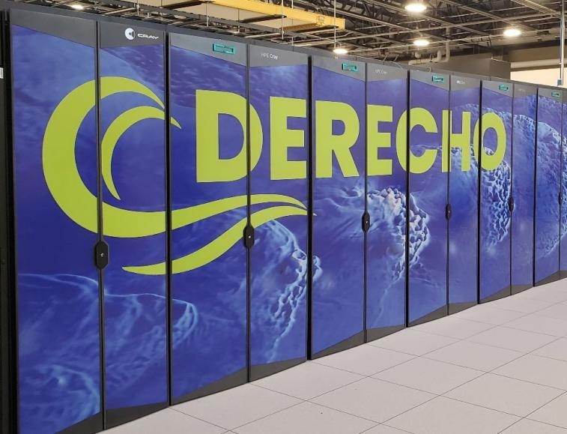
NSF NCAR’s Compute and Data Services
Derecho
2,488 AMD Milan nodes, each w/128 cores and 256 GB
328 40GB A100 GPUs (82 4-GPU nodes)
60 PB scratch file system
Casper
For high-throughput workflows, data analysis, and AI/ML
~100 V100, A100, and H100 GPUs
NCAR Data (data.ucar.edu)
Find datasets in the more than 10 PB of curated data collections housed at NSF NCAR
Download data or analyze on Derecho & Casper
arc.ucar.edu/allocations

Slide 22
And That’s Not All

Slide 23
Other Resource Options
Beyond the programs and sites already mentioned, there are yet more options for those in need of computing support. Many of these resources are aimed at large-scale problems.
Frontera & LCCF — Texas Advanced Computing Center (TACC), https://tacc.utexas.edu/
Open Science Pool — The OSG Consortium, https://osg-htc.org/
Department of Energy National Labs
National Energy Research Scientific Computing Center (NERSC), https://nersc.gov/
Argonne Leadership Computing Facility (ALCF), https://www.alcf.anl.gov/
Oak Ridge Leadership Computing Facility (OLCF), https://www.olcf.ornl.gov/
Closer to home
Many campuses and regional organizations provide access to research computing and data services. Check with your institution’s IT organization.

Slide 24

AI-ready Research Environments
Most sites have standard AI software tools ready to go
PyTorch, TensorFlow, and so on
Many sites now hosting open-source LLMs
Llama, DeepSeek, and more
NAIRR Pilot offers wide variety of alternate options
Inferencing services, commercial LLMs
Many different models
Commercial workflow and data management software and tools

Slide 25

More Than Just Hardware
All the resources mentioned are “full service” — not only hardware but also support teams, training courses, and related activities.
Many separate training and support efforts being offered through the NSF-funded CyberTraining and SCIPE programs.
Start with the program or provider for resource-specific training.
Try HPC-ED for general training resources.

Slide 26
QUESTIONS? David L. Hart dhart@ucar.edu

