Slide 1



Getting Access to NAIRR Pilot Resources
Lauren Michael, Internet2 (consultant)
Timothy Middelkoop, Internet2
Wednesday April 2, Track 2 / Thursday April 3, Track 1
AI Workshop Denver, CO April 2-3, 2025

Slide 2


This Work
is supported in part by the National Science Foundation Award OAC#2436057, Internet2, and CaRCC.
Any opinions, findings, and conclusions or recommendations expressed in this material are those of the author(s) and do not necessarily reflect the views of the National Science Foundation.
Notes:
Speaker (Lauren)
We are co-Principal Investigators on a National Science Foundation grant awarded to Internet2 in partnership with the Campus Research Computing Consortium of research computing and data professionals. Through this grant, we are supporting NAIRR Pilot communications and user facilitation activities by leveraging CaRCC’s network of these professionals, who support educators and researchers across the country. Internet2 is a non-profit .edu that operates the National Research and Education network backbone and supports related collaboration technologies and communities, like CaRCC and it’s partners. While today’s content does not necessarily reflect the views of the National Science Foundation or other partners of the NAIRR Pilot, we have received significant review and input to the content of this presentation from NSF officials and others executing the proposal, allocation, and user facilitation components of the NAIRR Pilot.

Slide 3
What We’ll Cover Today
NAIRR Proposal Preparation: Preparation, selection, and proposal submission
Submitting an Allocation Request: Step-by-step demo with guided, hands-on practice.
Matching Resources: Exploring computational resources and determining the best match for specific project needs.
Support and Guidance: Leveraging office hours, ticket systems (NAIRR Pilot or Resource Provider), and consultations for personalized assistance.
Notes:
Speaker (Lauren)
Today we will briefly introduce the types of computing and data resources available through the program, and discuss requirements for researchers and educators seeking access to allocations of these resources for research and teaching activities involving an Artificial Intelligence component.
The majority of the presentation will then focus on guidance for proposing access to NAIRR Pilot resources, with descriptions of the review and allocation process, specific proposal instructions, review criteria that proposers need to cover in their proposals, and common reasons for rejection that proposers can avoid by clearly addressing these criteria. In this presentation, language will appear in italics when it has been taken directly from the call for proposals or elsewhere in the NAIRR Pilot webpages. These slides also have speaker notes.
After the presentation we will have a demo on how to submit an allocation request and explore the resources available. We will wrap up by covering where you can find assistance.
[AI Unlocked]

Slide 4
NAIRR Proposal Preparation

Slide 5
NAIRR Pilot Program
Established via a previous Presidential Executive Order for AI
Multi-agency, public/private effort, pilot coordinated by NSF https://new.nsf.gov/focus-areas/artificial-intelligence/nairr
The National AI Research Resource Pilot (NAIRR)
The aim is to ensure that AI resources and tools are equitably accessible to the broad research and education communities in a manner that advances trustworthy AI and protects privacy, civil rights, and civil liberties. – https://nairrpilot.org/about
Notes:
Speaker (Lauren)
For those less familiar with the NAIRR Pilot program and its overall objectives, we recommend consulting the resources linked on this page as well as the program page on the National Science Foundation’s website, which lists the full scope of agencies, other partners, and relevant funding available.
Information that we’ll reference for proposing allocable NAIRR Pilot resources can be found on the designated NAIRR Pilot portal, at nairrpilot.org
One thing to remember is that the NAIRR Pilot is a PILOT, and not a fully-funded program.

Slide 6
NAIRR Pilot Example Use Cases
Hands-on AI course requiring GPU resources for undergraduate or graduate students to develop and train models.
Hands-on workshop teaching high-school students to apply a pre-trained AI model to data, using a Python notebook.
Training AI models on large-scale medical imaging datasets for disease detection.
Scaling up AI model training, including using simulation as input.
Running quantum mechanical simulations with AI for new material discovery.
Wildlife monitoring through multimodal AI processing of camera trap data.
Benchmarking an existing model capabilities, for ethics, data privacy, etc.
Notes:
Speaker (Lauren)
The NAIRR Pilot welcomes you to apply for a resource allocation for your AI related projects. Some examples of use cases for NAIRR pilot resources include delivering hands on AI courses; workshops for teaching high-school students to apply pre-trained AI models to data with notebooks; developing a new foundational model using large-scale medical imaging datasets for disease detection; or even monitoring wildlife. There is a large range of potential applications, resource needs, and technologies.

Slide 7

NAIRR Pilot Allocable Resources
Check the below for lists of available resources
Research: https://nairrpilot.org/opportunities/allocations
Classroom/Educator: https://nairrpilot.org/opportunities/education-call
Notes:
Speaker (Lauren)
Computing capacity, models, tools, and data resources allocable via the NAIRR Pilot are listed for AI-relevant Researcher projects and for AI-relevant Classroom/Educator activities. These two Calls for proposals to use NAIRR Pilot resources are also described on separate pages of the NAIRR Pilot portal.
People interested in proposing allocations of resources should check the portal for new or changing opportunities and details, in addition to what is covered in today’s presentation. Please note, the availability of resources may change due to demand or as additional resources come available.

Slide 8
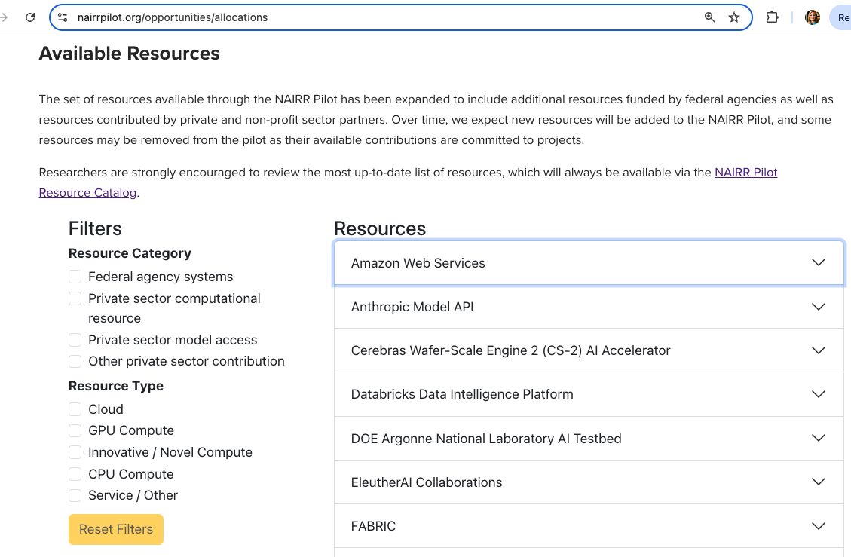
Notes:
Speaker (Lauren)
The Research Resources Call pages contain important information about each call and should be read carefully. Additionally, call pages provide a list of resources with filters for viewing specific types of resources within these. For example, if you wish to only use federal agency systems that provide GPU resources, you can select those filters. Each resource listed can be expanded to show more details about the resource and contains important information relevant to the proposal process. For example, the NVIDIA DGX Cloud can only be allocated as a full rack of 32 nodes in whole-month increments. Even if you know the resource, please read carefully. Proposals that do not align with resource-specific requirements may be rejected.

Slide 9
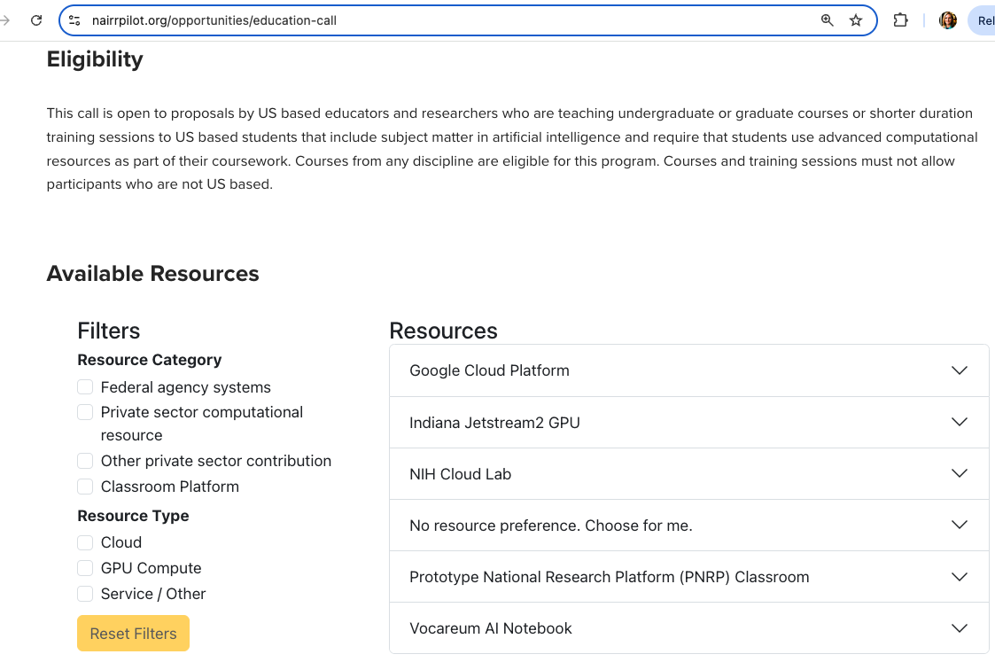
Notes:
Speaker (Lauren)
The Classroom/Educator Resources Call also contains important information, which should be read carefully. For example, the Call is only open to US based educators and researchers and courses for which all individuals performing work are doing so via an eligible organization physically based in the U.S.. Like the Researcher Resources Call, there is also a similar tool that lists available resources. Please note that the available resources, and the information and requirements for them, differ between the Research and Classroom/Educator Calls.

Slide 10
NAIRR Pilot Allocation Process
Proposals accepted at any time (<3 pages)
Proposals peer-reviewed approximately monthly (cut-off: 15th of the month)
2+ reviewers per proposal, per request size/complexity
Selected proposals matched to resources.
Matching committee includes reps from every resource-provider.
Proposers requesting only gov-funded resources can ask to be invisible to non-gov partners.
Matching may adjust the requested quantity or resource(s), per reviewer suggestions and/or resource availability.
Selected awards notified. (within 3 months)
Resource onboarding between NAIRR Pilot Resource and Proposer. (1-3 weeks)
PIs provide required reports on progress.
https://nairrpilot.org/opportunities/allocations
https://nairrpilot.org/reporting-guidance
Notes:
Speaker (Lauren)
At this time, proposals for allocations of these resources are accepted at any time with a soft deadline on the 15th of the month. Research proposals should be submitted when a project is ready to take advantage of these resources upon favorable review and notification, according to the timeline described on this slide. Classroom/Educator proposals will need to list a specific start date for the course described.
Proposals are peer-reviewed approximately monthly by a recruited set of peer-reviewers from the AI research, education, and computing communities. Selected proposals are then matched – and perhaps adjusted or declined – by a matching committee based on preference or availability. Adjustments may be made if the proposed-scale of resources is not well-justified.
Awardees can expect to be notified within 3 months of the proposal submission and are expected to be ready to use resources shortly after notification.
Finally, the PI’s are expected to provide regular progress reports to demonstrate progress.

Slide 11
NAIRR Pilot Allocation Eligibility and Requirements
All Projects (Research and Classroom/Educator)
Research or course must have an AI component.
Principal Investigator / Lead Instructor and all other users must perform work via an eligible organization physically based in the U.S.
Other types of organizations, such as commercial entities, may be able to apply for resources under specific conditions described on the program website.
Specific resources may have additional constraints or requirements.
Important to include any related grant funding information
General requirements at the top of: https://nairrpilot.org/opportunities/allocations
Principal Investigators (PIs) and Lead Instructors will be listed on the NAIRR Pilot website with their affiliation, the project or course title, abstract, and allocated resources.
Proposal preparation instructions: https://nairrpilot.org/nairr-pilot-proposal-instructions
Notes:
Speaker (Lauren)
Even though there are separate Research and Classroom/Educator Resources Calls with their own requirements, there are a number of common requirements. The principle investigator, lead instructor, and/or all other users or learners must be from an eligible organization physically based in the United States. Award details and abstracts will be published on the NAIRR Pilot website. Any relevant, pre-existing grant funding should be described in the proposals, and activities without prior merit-review are subject to additional review. Please note that there are general requirements at the top of the Researcher Resources Call page that also apply to the the Classroom/Educator Resources Call as well. Finally, there are separate proposal preparation instructions for the Researcher and Classroom/Educator Resources Calls.

Slide 12
NAIRR Pilot Classroom/Educator
Resources Call
Notes:
Speaker (Lauren)
We will now focus on the NAIR Pilot Classroom/Educator Resources Call. Many of the recommendations made here are also applicable to the Researcher Resources Call.

Slide 13
NAIRR Pilot Allocation Eligibility and Requirements
Classroom/Educator Projects
Open to AI-relevant, US-based undergraduate and graduate courses, and short-form training sessions. (https://nairrpilot.org/opportunities/education-call)
All involved educators and students must be physically based in the U.S.
All primary educators and teaching assistants will be added to a NAIRR Pilot chat channel to foster community.¹
¹https://nairrpilot.org/opportunities/education-call
Notes:
Speaker (Lauren)
As indicated earlier, the NAIRR Pilot Classroom/Educator Resources Call is open to US-based undergraduate and graduate courses and short-form training sessions for other groups of learners. Of note, all educators and students must be physically based in the U.S. Please read the full Call for proposals for full, and up to date, eligibility requirements.
One thing to note, primary educators are expected to go through an exit interview focused on feedback to improve the NAIRR Classroom pilot.
[AI Unlocked] In the interest of time, we only cover the Classroom/Educator Resources Call here, but much of the process and, many of the recommendations from the Researcher Resources Call also apply.

Slide 14
NAIRR Pilot Proposal Instructions
Classroom/Educator Projects
Follow the Instructions! https://nairrpilot.org/opportunities/education-call
Proposers must submit using their institutional (.edu) email address.
Project description outline (3 pages max):
Course Description
Estimate of Compute, Storage and Other Resources (see instructions! show calculations!)
Support Needs
Team and Team Preparedness
Supporting Documents (CV; references; Citizenship of all team members including TAs)
Submit via the NAIRR Pilot website: https://nairrpilot.org/opportunities/education-call
Notes:
Speaker (Lauren)
For Classroom/Educator proposals, proposal instructions are included in the Classroom/Educator Resources Call. Please read and follow all instructions.
These include having a specific project description outline, and to include supporting documents and information detailed in the instructions.
The course syllabus should be ready to go and have a specific start date. The instructors should have tested a majority of the course content on similar systems and with other individuals, such as TAs or in other classes. Finally, you must use your institutional email address, not a personal one such as gmail.
If you get a few things out of this presentation, the first should be to “read and follow the instructions,” the second is to “do the math, show you work” – which we will cover later.

Slide 15
NAIRR Pilot Review Criteria: Classroom/Educator
Alignment with the educational and workforce development focus.¹
Readiness of the planned course, including institutional support commensurate with what is proposed. The resources offered assume that an instructor, teaching assistant, or other person will be the primary source of technical support for students accessing and using the resources.¹
Match of request to the resources offered.¹
Resource requests should be based upon tests of same/similar resources by the instruction team. Check Resource Descriptions for details on resource units and calculation (e.g. units of computing resource, number of students, etc.).
¹https://nairrpilot.org/opportunities/education-call
Notes:
Speaker (Lauren)
The review criteria for the Classroom/Educator is as follows:
The proposal must demonstrate alignment with the educational and workforce development focus.
The proposal must demonstrate that the class is ready to teach.
The proposal must match the resources offered. Read the resource descriptions on in Call carefully for details on how to request them.
Having taught previous classes or testing the course materials on the same or similar resources goes a long way to demonstrate that the class is ready to teach.
One thing to note, there an expectation that resource providers are not the primary source of technical support for students. Be sure to address how you will support student in your proposal.

Slide 16
NAIRR Pilot Classroom/Education Example
The class CS4281 “[title]” requires access to 150 Jupyter Notebooks for approximately 6 hours a week for 18 weeks per student for a total of 16,200 hours. For regular course material, only CPU notebooks are required on a system with 8GB of RAM, 4 cores, and with 10GB of storage per student. Additionally, students will have a final project that will require 10 hours a week for 2 weeks utilizing a large GPU (50% of a A100 or greater) for a total of 3,000 GPU hours. No additional storage is required. Training will be required to add GPU resources to notebooks.
Students | Weeks | Hours/Week | Resource | Total Hours | SU Size/Units | SU’s
150 | 18 | 6 | Vocareum AI Notebook | 16,200 | Students | 150
150 | 2 | 10 | Jetstream2 GPU | 3,000 | 32 (g3.large) | 96,000
Notes:
Speaker (Lauren)
Here is an example of the resource justification from a Classroom/Educator proposal. Please take a moment to read it.
[PAUSE]
Note, that in this case the instructor requested support to integrate the GPU resources.
Also note how specific the numbers are, that the calculations are obvious, and they they are placed in a table for clarity. This makes it easy to see what being requested.
Instructors may also wish to request access a few months before the class starts for preparation time.

Slide 17
NAIRR Pilot Research Resources Call
Notes:
Speaker (Lauren)
We will now focus on the NAIRR Pilot Research Resources Call

Slide 18
NAIRR Pilot Allocation Eligibility and Requirements
Research Projects
Project results must be open and are actively shared with the community.
Use of resources (NAIRR project) must be completed within 12 months, can be shorter durations.
Proposers may have multiple submitted proposals and/or active projects.
All project PIs will be added to a NAIRR Pilot mailing list to foster a community of NAIRR Pilot researchers.
Projects required to complete regular progress reports and a final report. https://nairrpilot.org/reporting-guidance
Notes:
Speaker (Lauren)
To start off, there are a number of requirements for research projects and we highlight a number of important ones here.
Project results must be open and actively shared with the community.
Projects must be completed within 12 months.
Projects are required to complete regular progress reports and a final report. Please see the URL listed here for details.
For complete eligibility and requirements, please refer to NAIRR pilot website.

Slide 19
NAIRR Pilot Focus Areas (Research)
Cross-cutting focus areas:
Advancing AI methods that enable scientific discovery.
Creating open-source foundation models for specific applications.
Using large-scale models to explore complex datasets interactively.
Advancing approaches for integrating simulations and AI.
Using experimental data from sensors, detectors, or other edge instruments.
Empowering use of scientific data by other stakeholders and the public.
Training and educating a cohort of scholars in AI technologies and their responsible use.
Probe key AI challenges using sensitive data including privacy-preserving methods.
Domain specific focus areas:
Accelerating societally-relevant research on AI safety, reliability, security, and privacy.
Empowering advances in cancer treatment and individual health outcomes.
Supporting resilience and optimization of agricultural, water, and grid infrastructure.
Improving design, control, and quality of advanced manufacturing systems.
Addressing earth, environmental, and climate challenges via integration of diverse data and models.
Other projects that align with the broader objectives of the NAIRR Pilot, as well as projects in other areas of AI research and applications, may secondarily be considered for allocation. See website: https://nairrpilot.org/opportunities/allocations
Notes:
Speaker (Lauren)
Research proposal should align with the NAIRR Pilot cross-cutting focus areas or the domain specific focus areas, otherwise projects in other areas of AI research and applications may secondarily be considered for allocation. While we will not read all of these, you can refer to the website when preparing your proposal.

Slide 20

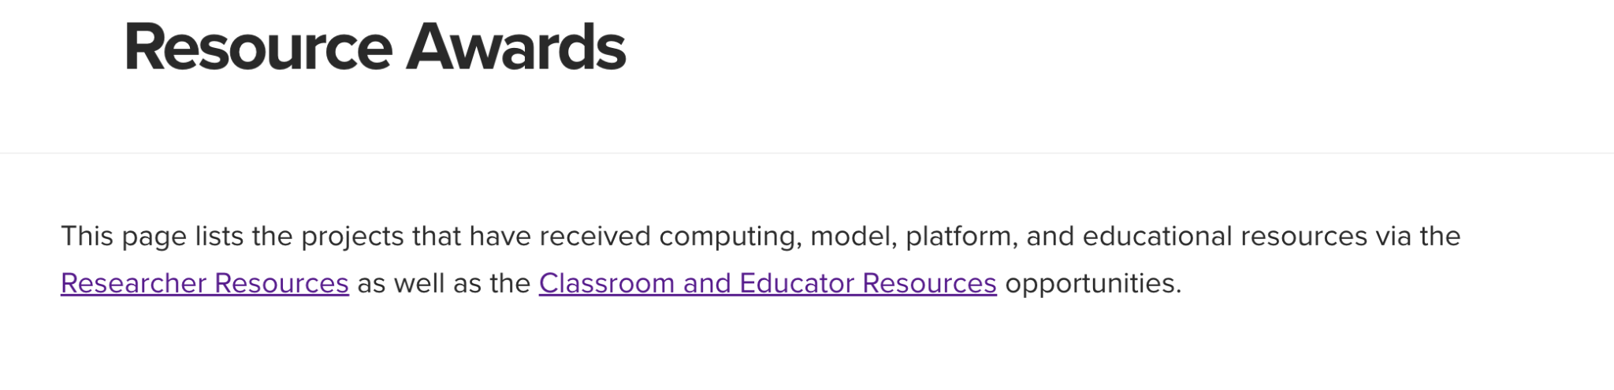
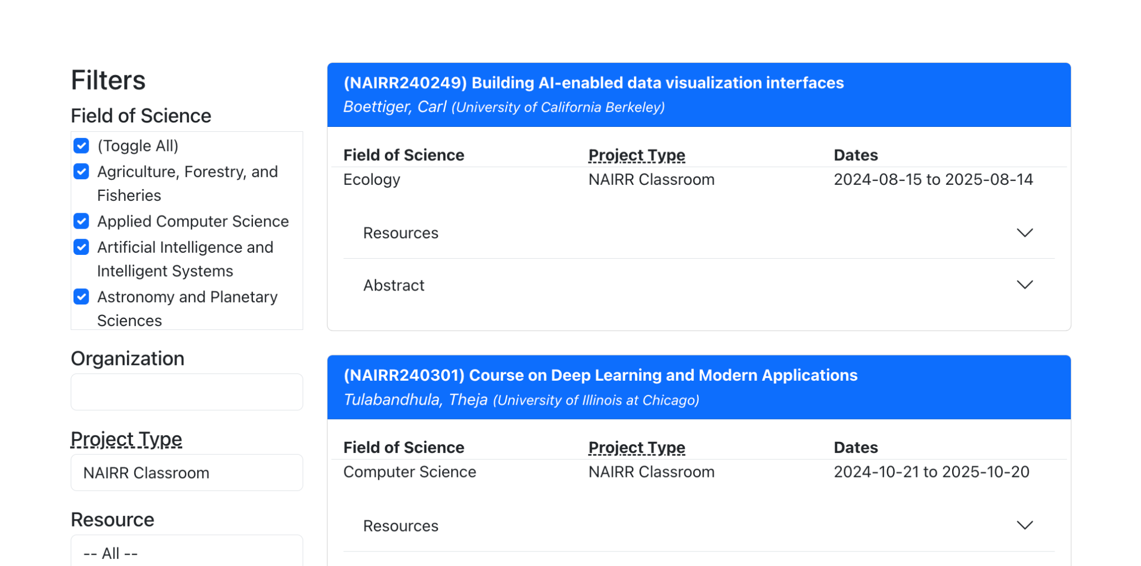
Notes:
Speaker (Lauren)
One way to assess alignment to the focus areas is to look at awarded abstracts on the resource awards page. Here you can also find information about the size and specific resources awarded.

Slide 21
NAIRR Pilot Proposal Instructions
Follow the Instructions! https://nairrpilot.org/nairr-pilot-proposal-instructions Your proposal is a request for access to computational and data resources, and is not a research or course proposal.
Apply when you are ready to immediately use the requested resources.
Review Eligibility Requirements!
US-based institutional email address, only (no gmail.com, etc.)
Prepare Documents that meet review criteria (next slides)
Project Description Outline (3 pages max)
Supporting Documents (CV; references)
Submit via the NAIRR Pilot website: https://nairrpilot.org/opportunities/allocations
Supplements to an award are available through a similar process.
Notes:
Speaker (Lauren)
We now outline the proposal submission process. First off, it is very important to read and follow the call, and the instructions.
Secondly, it is important to recognize that a NAIRR Pilot resource request is not a research proposal, but a request for computational and data resources, so the structure and review criteria for proposals may be new to you. This has two implications, the first is that you must demonstrate that you are ready to immediately use the requested resources. The second, is that it should fundamentally change how you write the proposal.
Along these lines, it is also important to note that proposals not supported by a merit-reviewed grant are subject to additional scientific review. For this reason, you need to include related grant funding information with the submission.
Only after you are ready, prepare the proposal. Then you…
Review eligibility requirements
Prepare Documents that meet review criteria, which we will cover next.
And finally, submit it via the NAIRR Pilot website.
At a later date, you can request a supplement to the award to add new or more resources, or request more time.

Slide 22
NAIRR Pilot Project Description Outline
To ensure your request can be properly reviewed and projects are directed to the appropriate resource(s), your description should include the sections outlined here.¹
Scientific/Technical Goal (Research)
alignment, feasibility, readiness, research plan and schedule.
Estimate of Compute, Storage and Other Resources
need, resource justification / match
Support Needs
readiness, restrictions on code, data, or access.
Team and Team Preparedness
knowledge/experience
¹https://nairrpilot.org/nairr-pilot-proposal-instructions
Notes:
Speaker (Lauren)
The project description outline is broken down into 4 parts.
Part A covers the scientific/technical goals and should be friendly for a general audience, not written for domain experts. Avoid complex technical words, and do not use unexplained acronyms. All this should not take more than a page.
If proposals include multiple projects, aims, or phases in the same proposal, it is important that the requirements and review criteria are covered for all of them in the 3-pages. This includes detailed calculations of resource estimates for each. Thus, proposers may wish to submit separate proposals, timed appropriately, for different projects, aims, or phases.
Part B covers the compute, storage, and other resource estimates and justification, which we will cover in detail later. These must align with the scientific and technical goals.
Part C details any support needs. In addition, any restrictions on code, data, or access should be noted here.
And finally, Part D covers the team and team preparedness. Among other things, this is where you cover the teams experience with similar systems and scales. If others are going to be doing important work, their role and background needs to be covered in this section.
One thing is worth repeating. Read and follow the instructions carefully.

Slide 23
NAIRR Pilot Review Criteria: Research
Alignment with the NAIRR Pilot focus areas¹
Feasibility of the technical approach¹
Project readiness and potential for near-term progress¹
Need for the computing, support, or other resources available via the NAIRR Pilot¹
Estimated resource requirements and justification¹
Knowledge and experience of the proposing team related to the proposed work¹
¹https://nairrpilot.org/opportunities/allocations
Notes:
Speaker (Tim)
The proposal is reviewed according to the following criteria: alignment with focus areas; technical feasibility; project readiness; resource needs; resource estimates and justification; and team knowledge and experience.

Slide 24
Review Components: Program Alignment
Is this an appropriate use case for the NAIRR Pilot?
Clearly articulate the alignment with one or more NAIRR Pilot Focus Areas as a component of the science methodology, AI methodology, application, and/or societal impact.
Clearly articulate the need for the resources (or resource types) that are specifically available via the NAIRR Pilot.
Notes:
Speaker (Tim)
With regard to Program Alignment, reviewers will be asking whether your proposed work requires resources like those available via the NAIRR Pilot that are not otherwise available to the proposer. Be sure to address this criterion by articulating the alignment with the specific NAIRR focus areas and by describing why you are pursuing resources available via the NAIRR Pilot.

Slide 25
Review Components: Feasibility
Is this an appropriate approach?
For Research projects: All proposals will be evaluated by independent peer reviewers for scientific and technical appropriateness and feasibility.¹
Scientific/methodological feasibility
… research activities without merit-review support … are subject to additional scientific review…¹
Data feasibility - data access, security requirements, etc.
… such as export-controlled code, ITAR restrictions, proprietary data sets … personal health information.²
Computational feasibility - given the execution approach, resource capabilities, etc.
Economic feasibility - given the total quantity of resources, effort/other costs, etc.
describe funding, in-kind contributions, or other support for project materials and team effort.
Ethical feasibility - given data quality, societal impact, etc.
¹https://nairrpilot.org/opportunities/allocations ²https://nairrpilot.org/nairr-pilot-proposal-instructions
Notes:
Speaker (Tim)
Feasibility - Is this an appropriate approach?
Demonstrate the scientific and methodological feasibility. What methods are you using? Do you have some initial results? What other similar work is there?
Demonstrate data feasibility: Do you have the data? Do you have access to the data? Is the data ready to use? Is it regulated data?
Demonstrate computational feasibility: Does it work on a subset or reduced model? Will it run on the requested resource? Will it scale?

Slide 26
Review Components: Project Readiness
Is this the appropriate time?
Projects are expected to begin using resources shortly after receiving the award notification, consider the following items that may need be completed beforehand:
Collecting data and preparing for use
Licensing/access/approval to access the data data.
Development, preparation, performance optimization, tuning, or training of any software, models, or computational pipelines
Resource efficiency – steps taken to optimize code and storage usage, remaining optimization opportunities.
Any other (even non-computational) prep work.
Include all details in the application to demonstrate readiness (see previous items)
should not include pre-computing steps, as these need to be completed as a component of demonstrated readiness to use computing resources.
Identify any support needs relevant to the use of NAIRR Pilot resources.
Notes:
Speaker (Tim)
Project Readiness – is this the appropriate time?
Projects and team members should be ready as they can be to use the requested resources. Any background research, development, testing, and optimization that does not require the resources should be completed and described as such relative to the described project phases, timeline, and scope of work, to demonstrate that the project is ready to use the requested resources. This is especially important for data, which should be ready to use and with relevant data use agreements already in place. The proposal must indicate any support needs relevant to the use of the NAIRR pilot resources. Prior use of a resource provider and working with them (perhaps via their office hours) can go a long way.

Slide 27
Review Components: Team Experience
Is this an appropriate team?
Describe the roles and experience of team members relevant to the scientific domain, the AI methods, and to using the requested resources (or similar resources) at the proposed scale.
Describe how effort is funded/supported.
Discuss which team members will need access to which systems.
Provide a list of the team members that will require accounts on resources along with their citizenship.¹
¹https://nairrpilot.org/nairr-pilot-proposal-instructions
Notes:
Speaker (Tim)
Team Experience – The proposal should describe the appropriateness of the team given prior experience with the methods and resources and clarify the resource access needs for each team member, as well as their individual citizenship and eligible organizational affiliation. Remember that training and educating future AI scholars is one of the NAIRR Pilot Focus Areas for research projects.

Slide 28
Review Components: Need for Resources
Are these the right resources?
If proposing to use specific, named resources, articulate reasons why those resources are most appropriate, perhaps including:
resource limits (GPU memory), execution efficiency
prior team experience with a resource provider, reducing startup time
desired user interfaces (e.g. command-line, virtual desktops, notebooks, etc.)
other infrastructure components (e.g. software, containers, workflow tools, etc.)
availability of resources and required support (A100s are popular and limited!)
If selecting “No resource preference. Choose for me,” explain why
useful if you can clearly articulate performance on different GPUs or similar resources.
attend office hours or consider a startup/explore/launch allocation
Notes:
Speaker (Tim)
Need for Resources – Are these the right resources? There are a wide range of resources available via the NAIRR Pilot and you should utilize and justify the ones most appropriate for the computation and for the team. It’s best to take the time to evaluate a resource and request it specifically, which also helps to demonstrate that you are ready to immediately use the resources.
Consider also the availability of resources. For example, 80GB A100 GPU’s are a limited and heavily used resource. Do you really need an A100 with 80GB? It is acceptable to compare and describe performance differences as part of your proposal.
Selecting “No resource preference. Choose for me,” may be useful only if you can clearly demonstrate how your computations perform on more than one resource or hardware type, or you know of multiple resources that have the same hardware. If you really don’t know what you need, we strongly suggest attending NAIRR Pilot or Resource Provider office hours to help with your selection and testing before you submit a proposal. You may also consider a smaller initial allocation to perform tests on one or more resources, which we will touch on later.

Slide 29
Review Components: Resource Estimate
Is this an appropriate amount of resources?
Describe how you determined the computational costs, whether by prior efforts by the team, citable results from other researchers, or benchmark runs.¹
Clearly articulate the following for each project component, phase, etc:
calculated number of computational tasks
calculated per-task volume of resources (e.g. computing time, data storage, tokens, notebook/interface duration, or other resources).
SHOW YOUR MATH! Reviewers should be able to understand and replicate your calculations, exactly.
Use resource-relevant units! (see Resource Description on the NAIRR Pilot website)
e.g. GPU hours, node hours, service units (SUs), U.S. dollars, etc.
¹https://nairrpilot.org/nairr-pilot-proposal-instructions
Notes:
Speaker (Tim) Switch speakers next slide (Tim)
Resource Estimate – Is this an appropriate amount of resources? It is perhaps most critical that the proposal calculates a quantitative request based upon prior requirements and scaling information, perhaps from prior similar work, specific benchmark tests, and/or citable data from others. Failing to do so is the most common reason for rejection or for a significant reduction in allocated resources to first enable quantitative estimates.
For EACH methodologically-linked project phase or category of AI-related computational tasks: How much computing time is needed on what resource type, for how many such computations? How much data storage is needed for inputs and generated outputs? For Classroom/Educator requests, how will resource needs scale with the number of learners, and how are these estimated?
The most compelling estimates are based upon benchmarking tests with smaller portions of data or computational work that can be relevantly scaled to predict the full scale of resource needs.
For clarity, proposers may demonstrate scaled calculations via tables that capture benchmark values and relevant multiplication per full-scale computational complexity, totaled across project tasks and phases. Be sure to use resource relevant units, for example GPU-Hours, and if a resource is allocated in some other units, be sure to also include a conversion to those units, for example “service units” or dollars. For some resources, mainly commercial cloud, you are also required to include a link to the resource pricing calculator results.
[jokingly] Another way to think of resource estimates is that they are basically an articulation of a math problem and the answer, where you need to show your work, and will also be graded for accuracy!

Slide 30
NAIRR Pilot Resource Testing!
Concretely demonstrate aspects of Feasibility, Project Readiness, and Need for Resources via your quantification of requested resources from tests!
Test a subset of your full-scale; leverage startup allocations or resources available
Test just a few tasks/computations.
Test with (scientifically meaningless) smaller/subset data.
Test more than one datapoint for one or both of above.
Test for each method/project phase/computation type
Test on similar hardware (consider other resources/opportunities)
Test in a similar environment (cloud, batch, Jupyter Notebooks) and track costs/usage
A launch/startup allocation type is being developed. (likely less than 3-page proposal!)
Notes:
Speaker (Tim)
So how do you get good estimates, you test! Testing has a lot of benefits beyond just the numbers, it also demonstrates the project readiness. Obviously you may not have the resources to do a full test, but you can run on a subset of the data even though the results may not be scientifically meaningful. You also may be able to do testing that may be more scientifically meaningful on a reduced resolution or precision dataset.
Remember scaling is often non-linear, and two data points is linear!
However, one thing you should do is to use similar hardware – such as GPU type and memory size – and environments. For example, don’t assume that is trivial to move from a HPC system to the cloud. For the cloud, there are charges beyond compute and storage that are hard to estimate, testing is essential.
One way to test is to use systems already available to you, or to leverage startup and testing access options available from many of the resource providers, who offer such access for these exact purposes.
Also, in the works is a small NAIRR Pilot launch allocation to help you get started on a resource with a modest allocation. This will probably be a simple request on the order of a few paragraphs, not a full three page proposal.

Slide 31
Other Relevant Computing Resources
Government-Funded Resources
vary in eligibility based upon scholarly domain/mission, and user funding from the same agency
NSF-funded (for most STEM and education uses, usually without prior funding)
NSF ACCESS Program, https://allocations.access-ci.org/
allocates several of the NAIRR-relevant computing resources; see “Explore” allocations for quick tests
NSF Partnership to Advance Throughput Computing https://path-cc.io/
computing and data resources for high-throughput computing, including the OSG - https://osg-htc.org/
Cloud platforms: Jetstream2 (NSF), Cloudbank (NSF), NIH Cloud Lab, and more
Other Government-funded resources (DOE clusters, national labs, datasets, etc.)
Commercially-Available Resources
Most have no-charge, quick options for modest research and education purposes, and/or testing.
Notes:
Speaker (Tim)
Here are some other resources that you can use for testing, most have no-cost startup or exploratory type allocations. If you have a graduate student or postdoc, the ACCESS “explore” allocation is an excellent way of exploring ACCESS resources.

Slide 32
NAIRR Pilot Common Proposal Pitfalls
Failure to follow the Proposal Guidance on formatting, outline, etc.
Failure to demonstrate the scientific merit and/or prior review for the proposed methodology or course.
Failure to connect resource requests to the described computational approach (show your math!).
Failure to demonstrate feasibility and readiness for the proposed scale (does the research team have demonstrated experience at similar scales).
Failure to write a resource allocation request by using grant proposal language (this is a resource request with a different audience).
Notes:
Speaker (Tim)
We will wrap up this section with some common proposal pitfalls. To be honest, we are being blunt here, but they are based on our experience as reviewers and we want to help you succeed.
The number one pitfall is not including sufficient detail for the resource request calculations. The statement, “We estimate that we need 20 million gpu hours” by itself is not a sufficient justification for requesting millions of dollars worth of compute. One thing that may help is to imagine that this is a question on an exam and that the students are asked to “show your calculations.”
Another common pitfall is the failure to demonstrate that the team is ready to immediately use the resources. You should demonstrate that the team has experience with similar resources and scale.
Yet another way of demonstrating that you are not ready is by saying that the first 6 months of the project will be “obtaining and preparing the data.”
Finally, another pitfall is to use the same language you would use in a research grant proposal. This will set your proposal in the wrong direction. This is a request for resources to complete a specific computation.

Slide 33
Examples
Notes:
Speaker (Tim)
We will now go over some examples, some good, some not so good.
The following examples are redacted or generalized sections that detail the resource requirements. The NAIRR Pilot website hopes to post full exemplar proposals soon.

Slide 34
NAIRR Pilot Research Quantification Example 1
For training our models on large-scale datasets such as the XXXX and XXXX, we estimate needing: Computing: approximately 20,000 GPU hours or equivalent node hours. This estimate is based upon prior experience of training models on similar datasets. We estimate 10,000 hours for initial investigation and model training, 5,000 for hyperparameter tuning, and 2,000 for final evaluations.
Data Storage: We estimate 40TB of total storage for data preprocessing and to store training checkpoints, intermediate model outputs, and logging.
Notes:
Speaker (Tim) How would you rate this resource quantification?
- pause for reflection -
What is missing from this example?
- pause for reflection -
Even though this is a reasonable framework, it does not contain near enough information to justify the resource request. The hours and storage are not broken down, there are no calculations, nor a connection to methods they are going to use.
- pause for reflection -

Slide 35
NAIRR Pilot Research Quantification Example 1
This is a reasonable framework, but needs to describe how the prior experience is methodologically and quantitatively relevant to the currently-described approach and estimates, and needs to describe why and when data storage is needed based upon estimates for the data components listed (how much for each).
The number of hours and storage size is not broken down per separately-executed project phases and computations.
Notes:
Speaker (Tim)
This slide just repeats what I just said.
We are not going to attempt to fix this, but don’t worry, we have some good examples coming up.

Slide 36
NAIRR Pilot Research Quantification Example 2
Computing Resources Given the complexity of our experiments, we request access to 18,000 Node Hours on TACC Lonestar6-GPUs (4xA100 per node). We arrived at these estimates based on benchmarks from recent similar sets of experiments that required approximately 1,000 GPU hours and around 2-3 weeks of wall clock time. For training policies in real-world hardware, similar efforts utilized 500-800 GPU hours with additional resources allocated for real-time testing and validation. Similarly, our ongoing projects based on method B require approximately 2,000 GPU hours and around 2-3 weeks of wall clock time. For training, similar efforts utilized 1,500-1,800 GPU hours with additional resources allocated for real-time testing and validation.
Data Storage All data required for training and evaluation will come from publicly available datasets such as XXXXXX (primary 10TB), XXXXXXXXX v2 (20GB), XXXXXXXX data (5GB), XXXXXXX (10GB), and other custom datasets (30GB) generated by us as well. We estimate our storage needs to be approximately 40 TB.
Notes:
Speaker (Tim)
Take a look at this example, what do you think? Is this a good resource quantification?
-- Pause for reflection --
Unfortunately there are issues with this one as well. Upon initial inspection, there are lots of numbers apparently from benchmarks. However, it’s not clear how those benchmarks relate in scale or complexity to the proposed work, and the benchmark requirements are not connected to the total via some numbers of anticipated training and tuning computations. There needs to be some multiplication and addition, and the numbers need to actually add up to the total. Make it easy for the reviewer to see and check your math!

Slide 37
NAIRR Pilot Research Quantification Example 2
Needs to describe how recent prior experiments are similar with regards to the model, datasets, parameters, etc.
Quantities are not connected to the final resource requests via math OR the attempts at math do not add up. If the reviewer is effectively grading a math problem, all the steps must make sense, with stated assumptions.
Make method calculations explicit, for example, how long does a step in the calculation take and how many steps are involved? (also demonstrates that the method is being reasonably applied)
Notes:
Speaker (Tim)
This slide just repeats what I just said
[Script on previous slide]

Slide 38
NAIRR Pilot Research Quantification Example 3 - Excellent
To meet our scientific goals, we request both HPU resources on SDSC Voyager and GPU resources on Purdue Anvil, splitting the work in parallel across these for overall project efficiency. For testing models with flash attention, we require more recent GPUs that support it, like A100s or H100s. For the first two tasks, we estimate needing about 40 training iterations, to test different model and dataset configurations. For the third task, we expect to run more rigorous hyperparameter optimizations, requiring more training iterations. For the scalability tests, we need fewer training iterations to evaluate the computational performance. In our most recent work [cited], we found that training the XXXXX model once on the same XXXX dataset required roughly 500 GPU-hours when using an Nvidia A100 GPU. As shown in the scaling data in Figure 2, the training time scales linearly across GPUs on the same node, with roughly 2X speedup on H100s.
Task | Training Iterations (est.) | GPU / HPU resources
1. Foundation model | 40 | 10k GPU-hrs, 5k HPU-hrs
2. Generalizability | 40 | 10k GPU-hrs, 5k HPU-hrs
3. Efficient transformers | 100 | 25k GPU-hrs, 12.5k HPU-hrs
4. Scalability tests | 20 | 5k GPU-hrs, 2.5k HPU-hrs
Total | 200 | 50k GPU-hrs, 25k HPU-hrs
Notes:
Speaker (Tim)
Now that you understand the importance of testing, we now present a redacted example that was rated as Excellent.
Take a moment to read it
-- pause for reading --
Note the detailed calculations as well as the detailed testing. See how the table makes things clear?

Slide 39
NAIRR Pilot Research Quantification Example 4 - Excellent
We do not require additional datasets (we are the creator and manager of [community portal] datasets), computing resources, or data storage.
Software packages: To scale up the developed LLM applications, the project needs software tokens from OpenAI GPT-4o. Currently, the [community portal] receives queries from around one million unique users monthly, each completing multiple queries. Based on a test of the developed LLM applications and this usage history, we estimate that we will need 50 million input tokens and 75 million output tokens per month to fully meet the needs in the [community portal] public data service.
With current OpenAI GPT-4o model cost of $5.00 per million input tokens and $15.00 per million output tokens, the monthly cost is $1,335 and informing our 12-month request of $16,000.
Notes:
Speaker (Tim)
Finally, let's look at another one. Take a moment to read it, how is this one different? What do you like?
-- pause for reflection --
As you can see, it is easy follow how the resource request was arrived at.
Take the number of unique monthly users, test how many tokens are required per user per month, and then compute the total number of tokens required for this project and convert it into to dollars. In this case, if you do the math, it ends up being 15 input tokens and 75 output tokens per unique user, which sounds reasonable. As you can see, this gives a lot of insight into what is being done. If I were to improve this request further, I would spell out the token consumption per user in the calculations and add a summary table at the end to show this information. Also note, that they specifically indicate GPT-4o. In some scenarios, specific choices may have an impact resource consumption rates.
Also note the consistent use of units, without units it is just a number. Remember, show you work!

Slide 40
NAIRR Proposal Preparation
This is a resource-request proposal, not a research or classroom proposal. Adjust appropriately.
Demonstrate that you are immediately able to start using the resources.
Read and follow the Call instructions.
Provide detailed justifications and calculation for your resource request.
Show your calculations.
Ask for help, leverage office hours
Notes:
Speaker (Tim)
So what did we learn today?
This is a resource-request proposal, not a research or course proposal. Adjust appropriately.
Demonstrate that you are immediately able to start using the resources.
Read and follow the instructions.
Provide detailed justifications and calculations for your resource request.
Show your work.
Ask for help, leverage office hours.
[AI Unlocked - Title Changed]

Slide 41
Questions so far?
Notes:
Speaker
What questions do you have on the NAIRR Program and the NAIRR Proposal Preparation so far?

Slide 42
Submitting an Allocation Request – Demo
Matching Resources – Demo https://nairpilot.org
Notes:
Speaker
Now we will over a short demo on submitting an allocation request, as well as go over some examples on how you might go about matching resources to your needs. Feel free to follow along by going to nairrpilot.org. You will need to login with your ORCiD in order to access the submission process.

Slide 43
Demo – Resources
Login to the website – the primary identity is your ORCiD. Please enable 2FA for ORCiD (show login!)
Click on Current Opportunities -> Researcher Resources Call.
This is where the Call details are
Available Resources
Open Amazon Web Services – because it is the first – each resource description is different
Resource Description contains the details of the resource
Allocation Description describes the allocation.
You should note here that the Commercial Cloud resources are allocated via CloudBank
You must use the Pricing Calculator:
open -> create estimate -> Amazon EC2 -> pe5en – do you really need this?
Touch on unique resources (Cerebras, FABRIC)
Jetstream2: good example of a Recommend Use section – VM’s, science gateways…
NCSA Delta GPU: traditional HPC - note the link to the user guide.
NVIDIA DGX Cloud: an example of a unique allocation. 32 nodes for 30 days, 184,320 GPU hours!

Slide 44
Demo – Submission
Expectations of Projects: More requirements. Note link to more instructions
Click Start your Submission -> Start a New NAIRR Pilot Submission (Researcher Resources)
Request Information: Title, Abstract, Keywords, Field of Science
Project Personnel: Project Lead (Timothy Middelkoop), Project Admin (Lauren Michael)
Other Collaborators: List project team here: John Hicks, Internet2, jhicks@internet2.edu
Supporting Grants: National Science Foundation; EAGER, Dana Brunson, Grant Number: 2435057
Available Resources: - Look here for requirements before testing and submission
DOE Argonne - example of detailed information
Jetstream2 - example of specifying SU’s, Use GPU-hours in proposal and convert to SU’s.
No resource preference. Choose for me. don’t do this
Google Cloud: Again use GPU-Hours if applicable and convert to SU’s. Check with Trujillo. Paste the GCP Cost Calculator URL. Test in an incognito browser.
Documents: Proposal, Project Lead CV/Biosketch.
Attestations: Read carefully
Save! Submit!

Slide 45
Support and Guidance

Slide 46
Getting Help
NAIRR Pilot Website https://nairrpilot.org/
The Resources Call provide a list of resources with details and links to documentation
The proposal submission page provides specific resource request units (GPU-Hours, Students, $’s)
The previous awards page provides information on what types of projects were awarded.
Read the Frequently Asked Questions
https://nairrpilot.org/help/faq
Check the Events and Training page for this and other training events and office hours
https://nairrpilot.org/pilotevents
Attend the NAIRR Pilot Office Hours
Currently 2nd Tuesday of every month, 12 PM PT/3 PM ET – check the NAIRR website for registration
Submit a NAIRR Pilot Ticket
On the NAIRR Pilot website, navigate to “Help” and “Submit a Ticket”, or visit
https://access-ci.atlassian.net/servicedesk/customer/portal/5/group/7/create/38
Notes:
Speaker (Lauren)
Here are some links for help, all of which you can find on the NAIRR Pilot website. If you have questions, you can attend the NAIRR Office hours or submit a NAIRR Pilot ticket.
And, be sure to download today’s slides for future reference. Speaker notes are include.

Slide 47
Acknowledgements
Lauren Michael, Internet2 (contract)
Timothy Middelkoop, Internet2
NAIRR Pilot Operations and NSF staff
The CaRCC AI Facilitation Materials Working Group
National Science Foundation Award OAC#2436057
Any opinions, findings, and conclusions or recommendations expressed in this material are those of the author(s) and do not necessarily reflect the views of the National Science Foundation.
Notes:
Speaker (Lauren)
We would like to thank everyone who provided input informing our development of this content.
[Tim] As a reminder, Any opinions, findings, and conclusions or recommendations expressed in this material are those of the author(s) and do not necessarily reflect the views of the National Science Foundation.

Slide 48
Other Questions?
Notes:
Speaker
What questions do you have?

