Slide 1


AI Using Large Language Models
Danny Havert, Indiana University
Track 2, Wednesday
AI Workshop Denver, CO April 2-3, 2025
Notes:
A brief primer of what large language models are, what they excel at, their impacts

Slide 2

Outline
Presentation (45 min)
What are Large Language Models?
What are LLMs good for?
LLM Applications in Industry
LLM Applications in Academia
Running your own LLM
Hands-on Activities (45 min)
LLM Interactions through Open WebUI
LLM Interactions through API

Slide 3
What are Large Language Models?
What are Large Language Models?
What are LLMs good for?
LLM Applications in Industry
LLM Applications in Academia
Running your own LLM

Slide 4
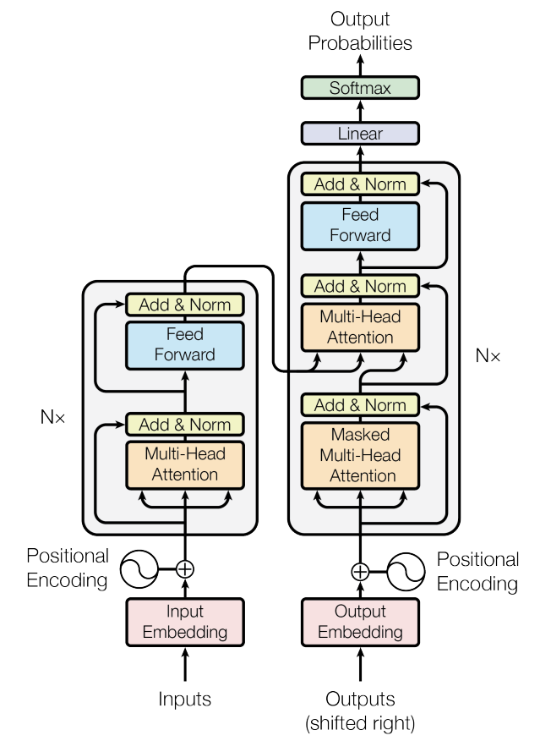
A Transformative Approach to Language Processing
Large Language Models derive from the field of Natural Language Processing (NLP), which analyzes language with a variety of approaches
Most Large Language Models (LLMs) are built upon a type of neural network called a transformer model
First developed by Google in the landmark paper “Attention Is All You Need” (Vaswani 2017)
Transformer models augment traditional NLP tokenization techniques and parallelizes the processing of these tokens
For a great visual and conceptual explanation of how LLMs work, I highly recommend Grant Sanderson's (a.k.a. 3Blue1Brown) video series "Neural networks"
https://www.3blue1brown.com/topics/neural-networks
Source: Vaswani (2017), Attention Is All You Need (https://doi.org/10.48550/arXiv.1706.03762)
Notes:
We may be familiar with some large language models such as ChatGPT, Microsoft Copilot, Meta’s Llama models.
Large Language Models derive from the field of Natural Language Processing (NLP), which analyzes language and texts with a variety of approaches for a wide range of purposes. Understanding how language functions, how words parse semantically and classify, how speech recognition works, how language is generated.
Large language models focus generally on the generation of words-- it’s very complex text prediction.
These models generally have ingested lots of text data and can generate human-like responses to queries, provide text completion functionality, and more.
LLMs are built upon a type of neural network called a transformer model. First developed by Google in the landmark paper “Attention Is All You Need” (Vaswani 2017)
These are trained a bit differently than other models, and take a natural language processing approach to training.
A classical NLP technique to approach text-based tasks is by tokenizing, or converting text to smaller pieces. Transformer models augment these traditional NLP tokenization techniques and parallelizes the processing of these tokens

Slide 5
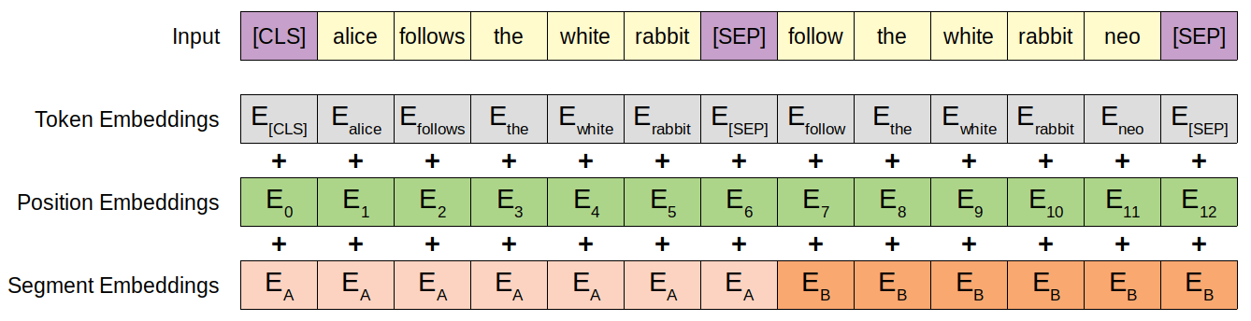
The Transformer Model – Inputs & Embeddings
Tokenization - Text is converted into tokens-- fragments of words, characters, or punctuation.
Input Embeddings - tokens are converted into a numerical vector that can be mapped to semantic meaning
Also, positional encodings based on each token's position in the sentence.
Notes:
Text is converted into tokens-- fragments of words, characters, or punctuation that can then be converted into a vector that can be mapped to semantic meaning (called embeddings), and positionally encoded based on its position in the sentence.
Tokens are then considered in context with other nearby tokens, and more important tokens are given more weight and less important ones are given less weight.
In a transformer model, you would then turn the tokenized word into something that relates its meaning to the computer by converting it into a vector by looking up the value from a word embedding table. These provide semantic meanings, as well as give insight into words that are semantically related to them. They also use positional encodings to inform about the position of each token in the sentence.
You then contextualize these tokens within the scope of your model’s context window, the amount of tokens your model can process at once, alongside the other tokens that they are next to. Tokens that are deemed to be important are more heavily weighted, and less important ones are less weighted. These are processed in parallel, which vastly improves speed compared to other neural net approaches in this category.
Img Source:
https://dvgodoy.github.io/dl-visuals/BERT/ UNDER CREATIVE COMMONS

Slide 6
The Transformer Model – Attention & Feeding Forward
3. Attention Layer (Self-Attention) - Modifies token vectors by considering other nearby tokens.
Context is everything. Meaning of words changes based on context.
I bought an apple. It was delicious. I bought an apple. It runs well.
4. Feed Forward Neural Network - Purpose is to transform the output of the attention layer into a higher-dimensional space, allowing the model to capture more complex patterns and relationships in the input sequence.
5. Normalization & Output Embeddings
Normalization occurs after the attention and feed forward layers
Output embeddings maps output vector to vocabulary with a probability distribution
Finally, the next word in the sequence is picked from the probability distribution.
Notes:
Text is converted into tokens-- fragments of words, characters, or punctuation that can then be converted into a vector that can be mapped to semantic meaning (called embeddings), and positionally encoded based on its position in the sentence.
Tokens are then considered in context with other nearby tokens, and more important tokens are given more weight and less important ones are given less weight.
In a transformer model, you would then turn the tokenized word into something that relates its meaning to the computer by converting it into a vector by looking up the value from a word embedding table. These provide semantic meanings, as well as give insight into words that are semantically related to them. They also use positional encodings to inform about the position of each token in the sentence.
You then contextualize these tokens within the scope of your model’s context window, the amount of tokens your model can process at once, alongside the other tokens that they are next to. Tokens that are deemed to be important are more heavily weighted, and less important ones are less weighted. These are processed in parallel, which vastly improves speed compared to other neural net approaches in this category.
Img Source:
https://dvgodoy.github.io/dl-visuals/BERT/ UNDER CREATIVE COMMONS

Slide 7
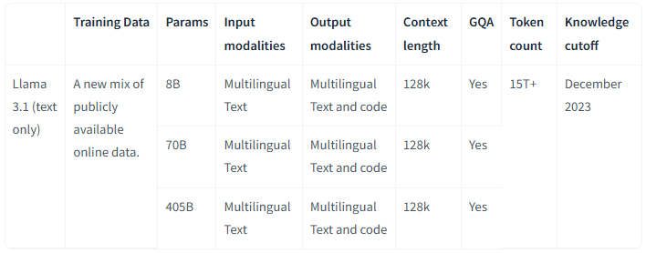
Putting the "Large" in LLM
“Large” can refer to the size and complexity of both the model itself, and the datasets it has trained on
Models are often described by their parameter size, the number of adjustable values within the model, which can reflect the size and complexity of the model
Higher-parameter models are more hardware-intensive to run, demanding more performant GPUs to run inference in a reasonable time, enough memory to hold the models while running them, and occupy a relatively large storage footprint
The parameter size of the model is often appended to the name of the model itself, e.g. Meta Llama 3.1 405B is a 405 Billion parameter size model
Notes:
These are called Large Language Models for a reason
Models are often described by their parameter size, the number of adjustable values within the model.
This reflects the size and complexity of the model, and to an extent also its capability to provide reasonable results
LLMs are generally trained on large amounts of data, and the quality and type of training data can be important in determining the quality and suitability of the resulting model for specific tasks. LLMs trained on data in a specific language will be very well suited to provide analysis and results in said language, whereas code completion LLMs should be trained on… well, code, to provide useful code suggestions.
‘Mixture of Experts’ (MoE) models approach the tradeoff between model capacity and practicality of use by distributing trained parameters across a number of ‘experts’, and learns a mapping function that determines which ‘expert’ to use to answer a given prompt.

Slide 8
LLM Development Process
Data
Collection
Data
Pre-processing
Training
Validation
Fine-tuning​
Notes:
Fine-Tuning can involve supervised fine-tuning (SFT) and reinforcement learning with human feedback (RLHF) to provide safeguards and improve result accuracy with the help of a bit of human assistance.

Slide 9
What are LLMs good for?
What are Large Language Models?
What are LLMs good for?
LLM Applications in Industry
LLM Applications in Academia
Running your own LLM

Slide 10
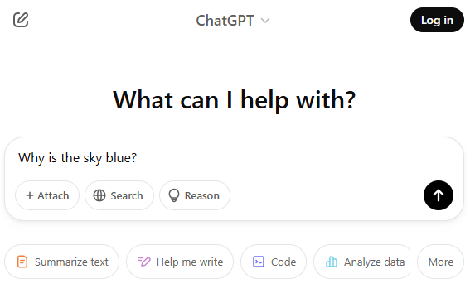
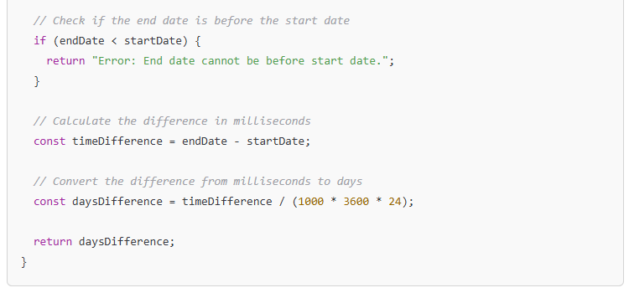
LLMs – What are they good for?
Conversational Agents
Text
Generation
Translation
Document
Summarization
Sentiment
Analysis
Notes:
The possibilities for llms are endless.
On a general level, most of the popular large language models - Claude, ChatGPT, Copilot- will be able to do these to an extent, due to the breadth of their training data and the training strategies used. They are able to generalize across tasks very well.
However, models that have been customized to perform these specific tasks or are structurally more suited to these tasks can outperform those more general ones.

Slide 11
LLMs – What are they good for?
Conversational Agents
Text
Generation
Translation
Document
Summarization
Sentiment
Analysis
Notes:
The possibilities for llms are endless.
On a general level, most of the popular large language models - Claude, ChatGPT, Copilot- will be able to do these to an extent, due to the breadth of their training data and the training strategies used. They are able to generalize across tasks very well.
However, models that have been customized to perform these specific tasks or are structurally more suited to these tasks can outperform those more general ones.

Slide 12
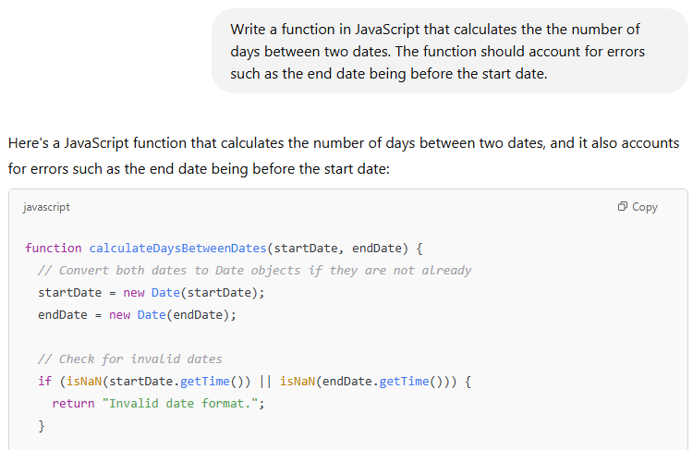
Text Generation
Text generation is the fundamental capability of LLMs
most popular LLMs will perform well at generalized text generation
Code development & completion
Microsoft’s GitHub Copilot can provide generated code and serve as a pair programmer
Meta’s Code Llama is an open-weights alternative
Document writing assistance
Grammarly, a product that has long been in the consumer NLP space, now provides an LLM writing assistant
Notes:
BasicText generation is the true bread and butter of LLMs, which are by design very effective at printing out their text predictions.
Code generation, for example, is a popular use-case for text generation.
Microsoft Copilot
Code Llama

Slide 13
Conversational Agents
LLMs are trained on lots of conversational text and are therefore well suited to conversational tasks!
Fine-tuned (re-trained to adapt to a task) chat models
Often used to provide a more consistent, reliable, and safer experience
Involve supervised fine-tuning (SFT) and reinforcement learning with human feedback (RLHF) to provide safeguards and improve result accuracy
Notes:
Large language models, being trained on lots and lots of text and therefore plenty of conversational material, are well suited to conversational tasks! Some models have officially released variants of the base models that have been fine-tuned specifcally to perform chat tasks, often with safeguards in place to prevent concerning dialog from happening
These fine-tuned versions often involve supervised fine-tuning (SFT) and reinforcement learning with human feedback (RLHF) to provide safeguards and improve result accuracy.

Slide 14
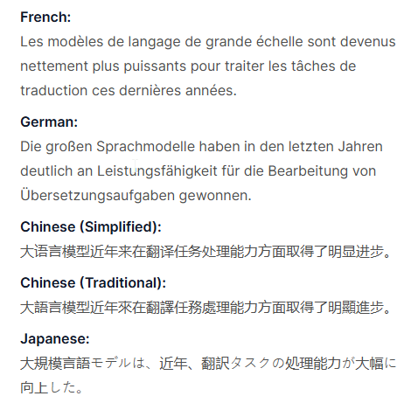
Large Language Machines have become a lot more powerful in tackling translation tasks in recent years.
Translation
Translation tasks have always been a pillar of LLM development
“Attention Is All You Need” focused on the creation of a model designed for machine translation tasks
Many popular LLMs have broad enough training data to perform translation well enough
Google’s Cloud Translation API provides access to a fine-tuned translation LLM
Claude and GPT-4 both score well in multilingual translation
Aya and BLOOM are active open-source multilingual LLMs
Good translation does not always imply good localization -- effective delivery of author intent can be missing in the target language output
Notes:
The landmark paper introducing transformers, Attention is all you need, focused on the creation of a model designed for machine translation tasks in English-to-German and English-to-French.
Google’s
Many LLMs trained upon particularly large corpus, such as ChatGPT or Llama, have fairly accurate translation capabilities without fine-tuning for it.
https://cloud.google.com/translate?hl=en
Some fine-tuned models publicly available are:
Aya Model -
BLOOM - Largest Open Source Option https://huggingface.co/bigscience/bloom
Translation is not localization, and translation via large language models do have a hard time understanding, interpreting and presenting authorial intent. This is something that is still very much a work in progress. Work on LLMs focusing on underrepresented and understudied languages is an interesting subfield.

Slide 15
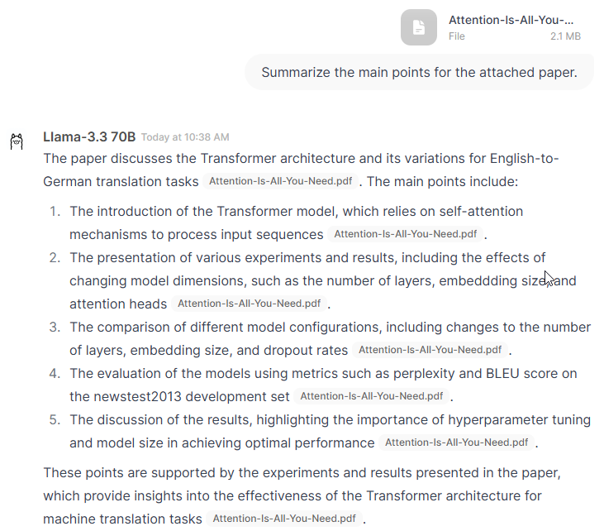
Document Summarization
A few approaches to summarization:
Extractive summarization- summary via extracting key sentences
Abstractive summarization - generating new sentences to describe core ideas and meaning
‘Multi-level summarization’ - a mix of extractive and/or abstractive
Larger context window sizes (amount of tokens the model can process at once) are useful for document summarization tasks, especially when summarizing long texts or multiple texts
Encoder-Decoder (seq2seq) models are tailored for text summarization, though most popular LLMs are capable enough and have larger context windows
Notes:
There are a few approaches one could take to document summarization:
Extractive summarization- summary via extracting key sentences
Abstractive summarization - generating new sentences to describe core ideas and meaning
You could also combine an extractive approach and an abstractive approach, or an abstractive approach on top of an initial abstractive result-- this is called multi-level summarization
https://aws.amazon.com/blogs/machine-learning/techniques-for-automatic-summarization-of-documents-using-language-models/
Larger context window sizes (amount of tokens the model can process at once) are useful for document summarization tasks, especially when summarizing long texts or multiple texts
Models like Meta’s BART model and Google’s more general-purpose text-to-text T5 model are excellent for this task as well, as they are tailored for text summarization
https://huggingface.co/docs/transformers/en/model_doc/bart

Slide 16
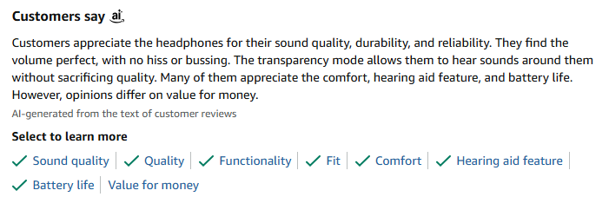
Sentiment Analysis
Use Cases:
Customer service and feedback
Market analysis
Social media monitoring
Sentiment analysis is a classification problem, assigning text to a specific category (e.g. positive, negative, neutral) according to emotional tone
Encoder-only transformer models like BERT and variants like RoBERTa are still considered to be good options for this case
MUCH more efficient
The base models of popular LLM offerings can tackle sentiment analysis problems, but usually perform this task better after a bit of fine-tuning
Notes:
Sentiment analysis is a classification problem.
Encoder-only models like BERT and variants like RoBERTa are still considered to be good options for this case (though they are older, not particularly ‘generative’ and don’t fit the truly modern definition of Large Language Model anymore ;.;)
The base models of our usual suspects, GPT and Llama and friends can tackle sentiment analysis problems, but usually perform this task better after a bit of fine-tuning.

Slide 17
Using LLMs, and Customization
Many models are publicly available as a service-- usually at cost
Available models can range from generalist in nature, not tuned to specific use-cases, to specific purpose
Generally used remotely via cloud-hosted services (model is not downloaded and used directly on a user’s system)
Motivations for creating custom LLM platforms can range from security concerns, cost-savings, model customization, ability to target specific applications and tasks, and more
Training a model from scratch can be expensive- the Meta Llama 3.1 405B model consumed 30.84 million GPU hours to train.
Several methods exist to help adapt pre-existing models to suit your specific use-case and run them
Notes:
https://build.nvidia.com/meta/llama-3_1-405b-instruct/modelcard
Many models, especially ones that provide conversational agents, are publicly available. However, most of the most performant ones are closed source and can be costly to use on a widespread basis. LLM as-a-service offerings such as ChatGPT, Bard-Gemini, and Copilot can be accessed through cloud-hosted interfaces. These often have quite the cost associated with them, have limitations on how they can be used, and data security concerns.
That’s equivalent to, say, 1000 GPUs running for one thousand two-hundred and eighty-five days.
So customizing one of the Open-source or open-weight alternative models such as Meta’s Llama and Mistral AI’s Mistral and Mixtral provide opportunities for local deployments that we can have more control over.
The software space providing utilities using for these models is also growing. There are options for edge computing and server deployments.

Slide 18
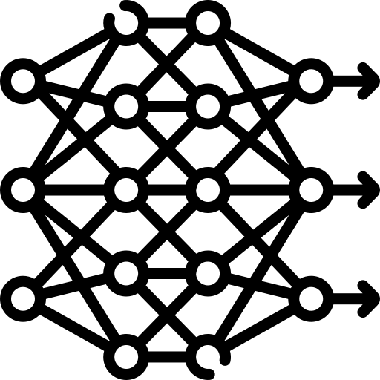


Common Options for Customizing Models
Works by
Useful for
Updating the model’s weights with domain- specific or task-specific data
Adjusting the model to perform a task or adopt knowledge it underperforms in
Fine-Tuning
Providing domain-specific data as a searchable data store for the LLM to use in responses
Retrieval-Augmented Generation (RAG)
Providing domain-specific or
up-to-date knowledge
Adjusting the prompts (input) sent to the model, rather than fully adjusting the model itself
Suggesting the base model to parse input and provide output in a specific way
Prompt Engineering
Notes:
Fine-Tuning Updates some or all of the model’s weights with domain specific data, generally oriented towards a task the model currently underperforms in. You can select how many of the model parameters to tune per layer, or completely retrain the entire model.
Useful if the model needs to be adjusted to perform a specific task such as sentiment analysis or conversational style, or fully integrate a specific domain’s data-- and you want to be particularly thorough about it. This is a fairly expensive method to perform.
Retrieval-Augmented Generation , or RAG
Provides your domain-specific data as a searchable information source for the LLM to use in its responses, instead of directly updating the model’s weights with the data. This could be a vectorized database that is kept up-to-date with information like your organizations’ documentation.
Useful if the model itself works as desired, but you would like it to provide domain-specific or updated knowledge. Especially if the information changes often. This is cheaper to perform, but you still have to maintain the data stores.
(FYI: RAG is done by:
taking a long text like a KB article and splitting it into pieces
creating embeddings for each piece and storing those
when someone asks a question, create an embedding for the question
find the most similar embeddings of sections from the long text
send those similar pieces along with the question to your LLM for the answer)
Prompt engineering lets you avoid re-training the model or maintaining a database. You simply adjust the prompts provided to the model, rather than fully adjusting the model itself, to have it perform a certain way. For example, you can give the model an example of the format of output you’d like the model to provide, like a numbered list, along with the question you would like to ask, and it will format its answer in the manner you specified. Or ask it to provide an answer to your question with professional language, or as a cool rap song, or like a Shakespearean poet(this is one of the jokes). This is the cheapest way you can modify an LLMs behavior
There are of course many ways to approach these options.

Slide 19
LLM Applications in Industry
What are Large Language Models?
What are LLMs good for?
LLM Applications in Industry
LLM Applications in Academia
Running your own LLM

Slide 20
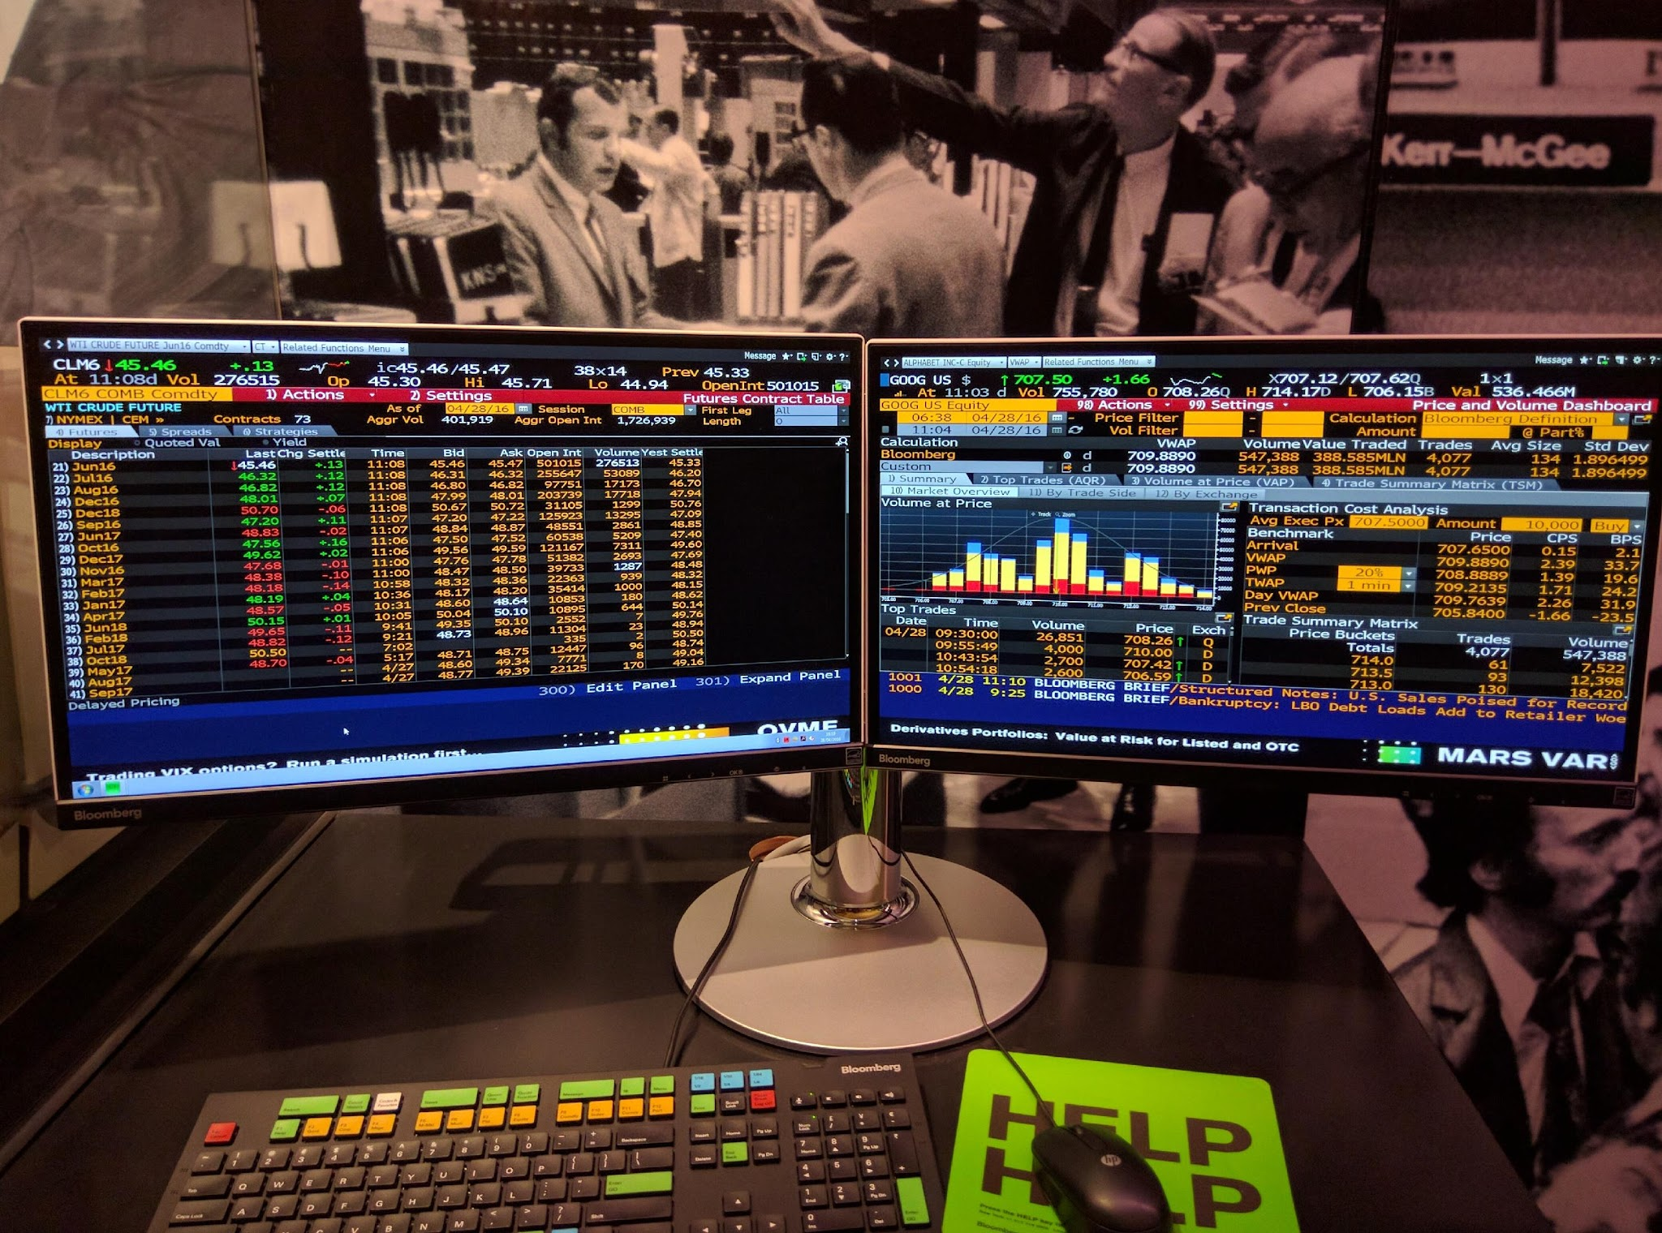
BloombergGPT
BloombergGPT is a 50-billion parameter financial domain-specific model capable of providing unique assessments of the massive datasets available on the Bloomberg Terminal
Built from scratch, trained on 363 billion tokens of 40 years’ of financial English language documents in addition to a public language dataset
Limited size of dataset of interest provided unique challenges in producing a competitive model
Developed to improve existing NLP workflows within the organization and provide offerings to customers
https://arxiv.org/pdf/2303.17564
Notes:
https://www.bloomberg.com/company/press/bloomberggpt-50-billion-parameter-llm-tuned-finance/
https://arxiv.org/pdf/2303.17564
This is a closed source model, only a limited set of customers have access to the model afaik

Slide 21
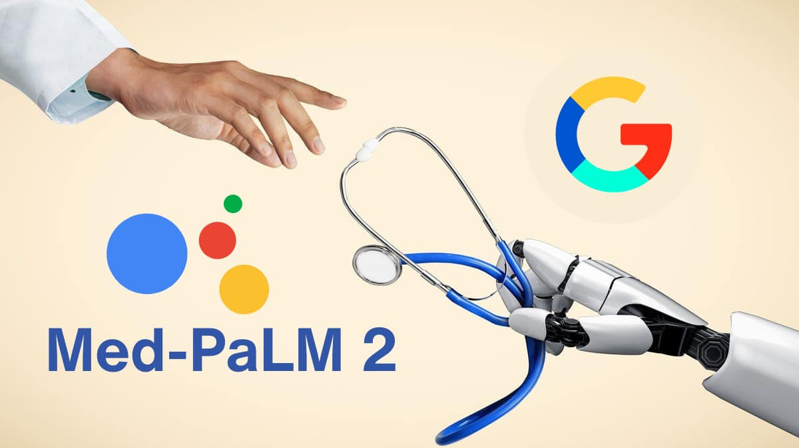
Med-PaLM 2
Model fine-tunes the PaLM 2 model with medical domain-specific data and uses a novel prompting strategy, Ensemble Refinement (ER), where the LLM produces several answers to a prompt before generating a final answer
Achieves an 85%+ accuracy on the MedQA dataset of US Medical Licensing Examination (USMLE)-style questions-- a passing score that is considered ‘expert-level”
Designed serve as a supplemental resource for medical professionals
Can assist in the creation of patient history and after-visit summaries, long and short-form Q&A, and multiple-choice Q&A
Available via Google Cloud Platform
Notes:
https://ictandhealth.com/news/how-a-swiss-hospital-use-llms-to-make-the-best-of-data
https://ai.google/static/documents/palm2techreport.pdf
https://arxiv.org/pdf/2305.09617
This model is available via the Google Cloud Platform, which does suggest some security concerns.
In response, several open-source LLMs have emerged as options for on-premise LLMs

Slide 22
LLM Applications in Academia
What are Large Language Models?
What are LLMs good for?
LLM Applications in Industry
LLM Applications in Academia
Running your own LLM

Slide 23
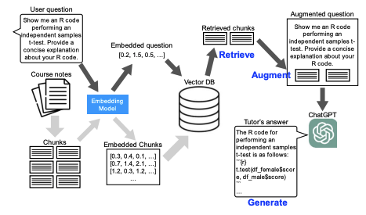
RAG-Based LLM Statistics Tutor
LLMs provide excellent opportunities in the development of Intelligent Tutoring Systems (ITS)
Dr. Lee at the University of North Texas Developed a ChatGPT-based tutor to assist statistics student with natural language-based guidance and code drafting assistance
Retrieval-Augmented Generation (RAG) was implemented to:
Provide pre-defined, validated, up-to-date information
Help prevent the LLM from producing ‘hallucinations’, or inaccurate or fabricated misinformation
Source: Lee (2024), Developing a computer-based tutor… (https://doi.org/10.1007/s10639-024-13129-5)
Notes:
https://link.springer.com/article/10.1007/s10639-024-13129-5

Slide 24
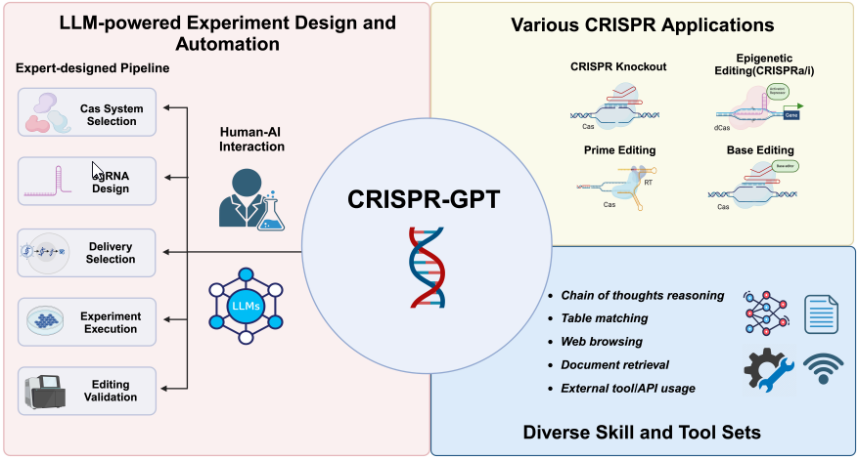
CRISPR-GPT: An LLM Agent for Automated Design of
Gene-Editing Experiments
Source: Huang et al. (2024), CRISPR-GPT: An LLM Agent...
(https://doi.org/10.48550/arXiv.2404.18021)
Notes:
https://link.springer.com/article/10.1007/s10639-024-13129-5

Slide 25
Miscellaneous LLM Applications in Research
Summarization, literature review
Brainstorming (Hypotheses, experimental protocols, approaches to data analysis or visualization, names for your project)
Knowledge-Base chatbot assistant
Programming, debugging assistant
Use it in your IDE with Continue , Zed, etc
Writing / proofreading assistant
Language translation for technical writing and jargon
For a list of concrete applications, check out:
LLM4SR: A Survey on Large Language Models for Scientific Research
https://github.com/du-nlp-lab/LLM4SR

Slide 26
Running your own LLM
What are Large Language Models?
What are LLMs good for?
LLM Applications in Industry
LLM Applications in Academia
Running your own LLM

Slide 27
Why would you want to run your own LLM?
Data privacy and security.
Essential for Protected Health Information (PHI)
Customization and flexibility
Translation service fine-tuned for a specific language
Use RAG to build a model with extensive knowledge on scientific papers in your field
Cost-effectiveness (long term)
No rate-limiting
Integration with custom systems

Slide 28
Options for Serving
Software – What tools to use?
For personal consumption -
Llama.cpp - https://github.com/ggml-org/llama.cpp
Llamafile - https://github.com/Mozilla-Ocho/llamafile
Ollama - https://github.com/ollama/ollama
For serving to others
vLLM - https://github.com/vllm-project/vllm
SGLang - https://github.com/sgl-project/sglang

Slide 29
Options for Serving
Hardware – Where to run your LLM?​
LLMs can run on CPU – slow but less expensive​
Has a use case in fire-and-forget text analysis​
If you need quick response times, GPU is a must​
VRAM is most notable limiting factor for GPU
ACCESS ecosystem
HPC – for training
Expanse, Delta, and many more
Cloud – for serving
Jetstream2
Commercial Cloud – if you can afford

Slide 30
How to Shop for LLMs
Chatbot Arena for comparison rankings (Elo score) - https://lmarena.ai/
Benchmarks with private / uncontaminated problem sets
LiveBench - https://livebench.ai/
Kagi LLM Benchmarking Project - https://help.kagi.com/kagi/ai/llm-benchmark.html
Benchmarks with public problem sets
MMLU, etc. - for list, see https://github.com/leobeeson/llm_benchmarks
HuggingFace for downloading models - https://huggingface.co/
What will fit on the hardware you have?
Weights need to fit in VRAM!
Use quantization to reduce VRAM usage of model
16-bit floating point - Typical native format for training
8-bit - 2x smaller with negligible capability loss - Great tradeoff!
4-bit, 5-bit K-means clustering - Even smaller, but start to notice capability loss
2-3 bits - Silly demos, running LLMs on your phone

Slide 31
Hands-on Exercises
LLM Interactions through OpenWebUI
https://llm.jetstream-cloud.org
Requires an ACCESS account
LLM Interactions through API
JupyterHub – link and password to be shared live

