Slide 1





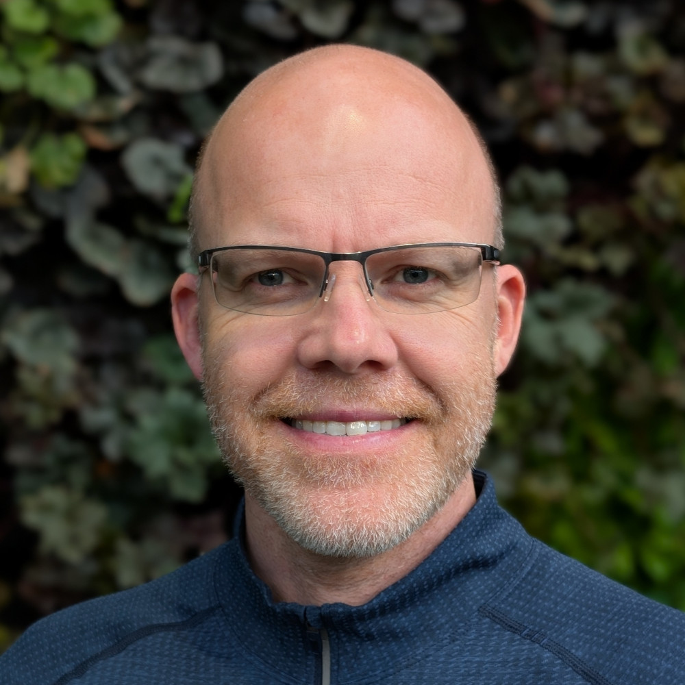
Career Spotlight
Robert Henschel
Engagement Architect, Indiana University
HPC Lead, Cendio AB
henschel@iu.edu
robert.henschel@cendio.com

Slide 2

My Goal For This Talk
Give you an idea of what a career in HPC or Research Computing can look like.
Allow for plenty of questions.

Slide 3
Big Picture – I will talk about HPC
One of the few in HPC that actually has a full HPC education, plus a strong interest in “computers”.
A deep understanding of computer architecture is super useful! Both hardware and software.
HPC used to be and still is cutting edge! Especially in academia! This is exciting and frightening.
Having done research yourself, helps understand HPC users!
Hot Take: AI will advance science, transform a lot of jobs and I am fully on board with this!

Slide 4
Education
Master of Computer Science from Dresden University, Germany (2006)
Major: High Performance Computing
1 year of PhD program at Max Planck (2007)
2 years of PhD program at IU (2010-2012)

Slide 5
Positions
Germany (2002 to 2008)
Analyst/Programmer for two small IT companies
Deep technical work, some leadership opportunities
Not a lot of pay, but lots of experience and connections
Research Software Engineer (RSE) at a university
Deep technical work
Responsibility for new initiatives
Appreciation for research workflows

Slide 6
Positions
USA (2008 to today)
Manager and director in research computing at IU
Co-Founder of a semantic web company (Switzerland)
Engagement architect for research computing at IU
HPC Lead at a small software company (Sweden)

Slide 7
My current position
Engagement architect for research computing at IU
HPC Lead at a small software company (Sweden)
I am passionate about enabling broad science with HPC.
I am passionate about information visualization and management and user interfaces.

Slide 8
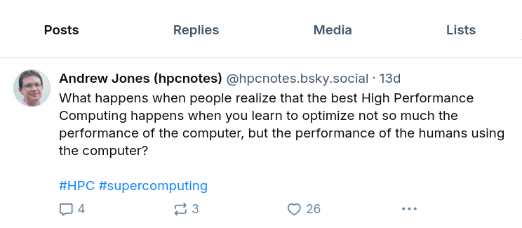
My View of HPC
My View of HPC

Slide 9
What has worked well
I love my job, and for me, this is hugely important.
I work in the field I was trained in.
I enjoy continuous learning.
I love working in or close to academia.
I have a broad interest in science, and this is required.
I got lucky, a lot. (career, immigration, health, networking)

Slide 10
What has been a challenge
I enjoy technical work much more than management.
Large companies have dual career tracks, not so sure about universities.
Income in academia is limited.
Working in academia offers lots of opportunities, focusing on the important once is a challenge. (both for mental health and for career)
And AI makes it works.

Slide 11
Thank you!

