Slide 1
Android Fragments
Sultan Keshwani

Slide 2
Fragments
What is a fragment?
Why use fragment?
How to use fragment?
  Layout
  Lifecycle methods
  Inter-fragment communication

Slide 3
Fragment: What?
A portion of the activity (mini activities)
A modular piece of “Activity”
It has its own Life-Cycle
It has its UI (layout, event handling etc.)

Slide 4
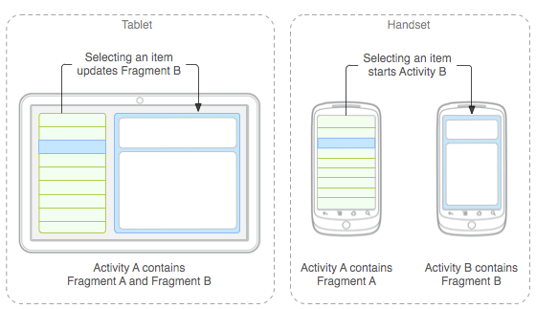
Fragment: Why?
Allows better use of space on large size devices
  Stay in a screen (partial view updates)
Reuse of code

Slide 5
Fragment: How?
Always used inside an activity
Similar to Activity (layout and Java)
  Layout (xml)
      Fixed <Fragment> in activity’s layout OR
      Dynamically added using FragmentManager class
  Java
    Extends Fragment class in Android SDK
    Override lifecycle methods
    Communicate with parent container
    NO direct communication with sibling fragments (they may not exists – layout is dynamic)
Notes:
Walk thru code of http://developer.android.com/guide/components/fragments.html

Slide 6
Fragment: How?... Layout
Fragment layout (res/layout/example_fragment.xml)
  (similar to any other layout you have created before)
    <LinearLayout …>
    <TextView…/>
    </LinearLayout>
    <RelativeLayout …>
    :
    </RelativeLayout>
    ….

Slide 7
Fragment: How?... Java class
public class ExampleFragment extends Fragment {
@Override
public View onCreateView(LayoutInflater inflater,
ViewGroup container, Bundle savedInstanceState) {
// Inflate the layout for this fragment
return inflater.inflate(R.layout.example_fragment, container, false);
}
}

Slide 8
Fragment: How?... In Activity
Include fragment in activity layout
Choices:
  As a fixed fragment (example: main_activity.xml)
  <LinearLayout …>
    <Fragment android:name="com.example.news.ExampleFragment"
    android:id="@+id/list"
    android:layout_weight="1"
    android:layout_width="0dp"
    android:layout_height="match_parent" />
    </LinearLayout>

Slide 9
Fragment: How?...
  Activity layout has a container view in which, fragment will be dynamically added)
  <LinearLayout …>
  <FrameLayout id=“@android:+id/fragment_container” …/>
  </LinearLayout>
  Dynamically add fragment to the activity:
    FragmentManager fragmentManager = getFragmentManager()
    FragmentTransaction fragmentTransaction = fragmentManager.beginTransaction();
    ExampleFragment fragment = new ExampleFragment();
    fragmentTransaction.add(R.id.fragment_container, fragment);
    fragmentTransaction.commit();

Slide 10
Fragment: How? …
Dynamically manage fragments
  fragmentManager.beginTransaction();
    fragmentTransaction.add(R.id.fragment_container, fragment);
    fragmentTransaction.remove(R.id.fragment_container, fragment); fragmentTransaction.replace(R.id.fragment_container, fragment);
    fragmentTransaction.addToBackStack(null)
    fragmentTransaction.commit()

Slide 11
Fragment: How? dynamic…
    addToBackStack() adds to the back stack
    when user presses back-button:
    fragmentManager.popBackStack() //restores previous
    fragmentManager.findFragmentById(R.id….)
    fragmentManager.findFragmentByTag(string)
      Remove or replace a fragment
      If transaction is added to the back stack:
        the fragment is stopped (not destroyed).
      If the user navigates back to restore the fragment, it restarts.
      if transaction is NOT added to the back stack:
      the fragment is destroyed

Slide 12
Fragment: Communication
No communication between sibling fragments
  Sibling may not even exist
Communicate with the parent activity
  Fragment will not know who the parent is until the fragment is attached to an activity
  Do not code for a specific Activity class
Notes:
http://developer.android.com/training/basics/fragments/communicating.html

Slide 13
Fragment: Communication…
  Fragment will:
    create an interface for communication with parent
    Declare an instance variable of that interface type
    Save parent as that interface (cast)
    Call methods on the parent using that interface cast
  Activity will:
    implement the interface
    Will know if multiple fragments are to be used
    Will have reference to the fragments
    Will coordinate UI logic between its fragments or other activities

Slide 14
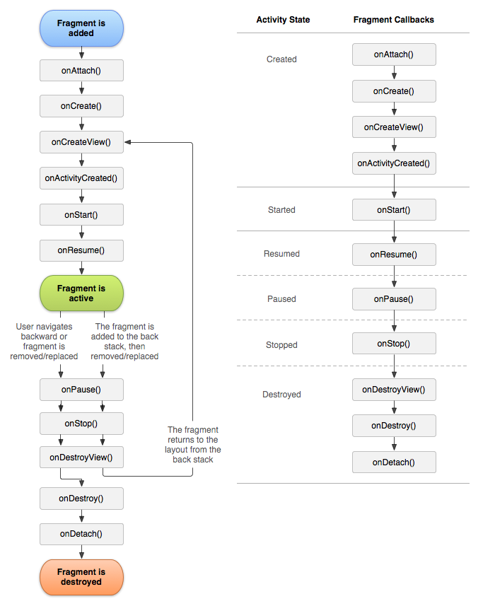
Fragment: Lifecycle methods

Slide 15
Fragment: Lifecycle…
Activity influence:
  Activity paused → all its fragments paused
  Activity destroyed → all its fragments are destroyed
  Activity running → manipulate each fragment independently

Slide 16
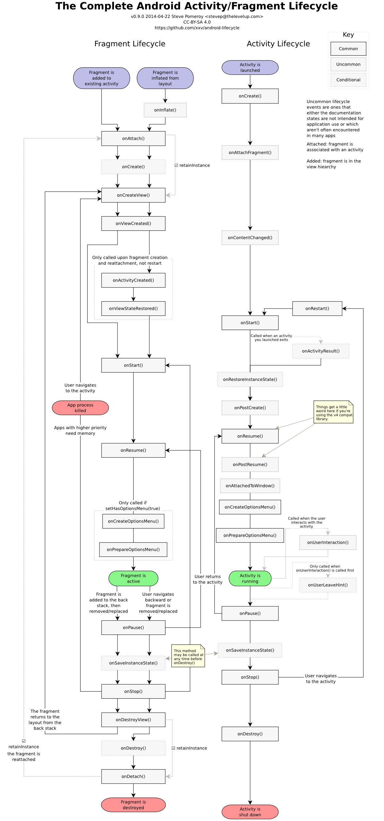
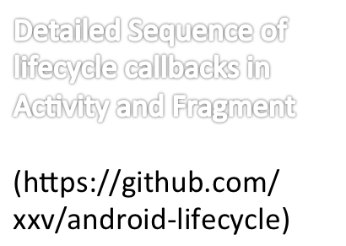
Notes:
For future reference only.
https://github.com/xxv/android-lifecycle

Slide 17
Fragment Examples:
Navigation Drawer:
  ONE fixed fragment (list of drawers)
  Multiple fragments (one for each drawer), dynamically addded (add/replace)
PreferenceFragment
PreferenceActivity (Header fragments)

Slide 18
Fragments:
References:
    http://developer.android.com/guide/components/fragments.html
    http://developer.android.com/training/basics/fragments/communicating.html
    https://plus.google.com/+StevePomeroy/posts/HsthxN21Yp1
    https://github.com/xxv/android-lifecycle

