Slide 1
Developing Shared Applications
Susanne Lefvert
June 10, 2004

Slide 2
Outline
Overview
Shared Application Client
Example: Question and Answer Tool
  Use cases/requirements
  Design
  Implementation
  Packaging and distribution
Documentation

Slide 3
Outline
Overview
Shared Application Client
Example: Question and Answer Tool
  Use cases/requirements
  Design
  Implementation
  Packaging and distribution
Documentation

Slide 4
Overview
Enhance collaboration
Several applications included in AGTk
  Shared Browser
  Shared Presentation Viewer
Framework to support plug-in applications

Slide 5
AGTk Environment
Security, authorization, and authentication
Framework for SOAP messages
Invocation of the application code

Slide 6
Shared Application
Venue
SOAP connection
Shared Application
Service
(Stores state)
Event Channel
Shared Application
Client
(Displays state)
Shared Application
Client
(Displays state)
Shared Application
Client
(Displays state)

Slide 7
Outline
Overview
Shared Application Client
Example: Question and Answer Tool
  Use cases
  Design
  Implementation
  Packaging and distribution
Documentation

Slide 8
Shared Application Client
Venue
SOAP connection
Shared Application
Service
Event Channel
Shared Application Client
SharedAppClient
Your Application

Slide 9
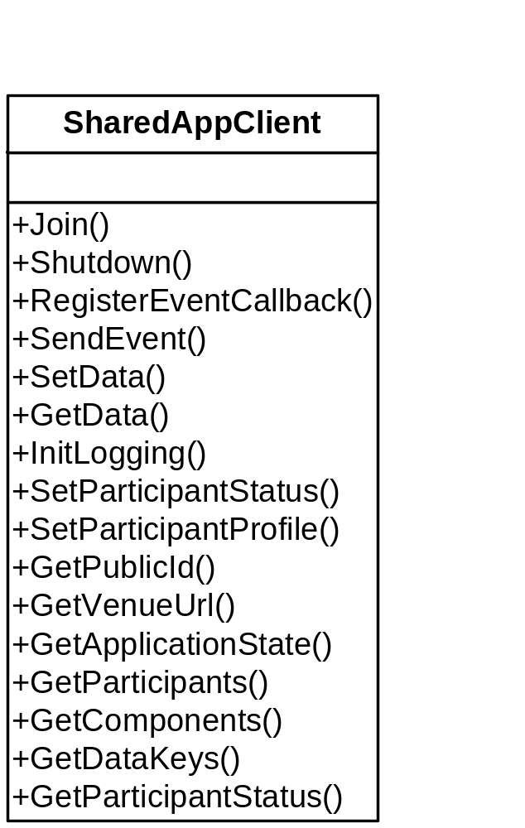

Slide 10
Outline
Overview
Shared Application Client
Example: Question and Answer Tool
  Use cases/requirements
  Design
  Implementation
  Packaging and distribution
Documentation

Slide 11
Example Shared Application:
Question and Answer Tool

Slide 12
Outline
Overview
Shared Application Client
Example: Question and Answer Tool
  Use cases/requirements
  Design
  Implementation
  Packaging and distribution
Documentation

Slide 13
Ask a question at a seminar.
View all questions
Provide contact info
Ask a question
Provide answer method
Cancel a question
Follow up question
Audience
Member
Change a question
Vote
Start/end a session
View all questions
Notify presenter
Prioritize questions
Moderator
Remove question
Mark question
Archive questions
Merge duplicates

Slide 14
Ask a question at a seminar.
View all questions
Provide contact info
Ask a question
Provide answer method
Cancel a question
Follow up question
Audience
Member
Change a question
Vote
Start/end a session
View all questions
Notify presenter
Prioritize questions
Moderator
Remove question
Mark question
Archive questions
Merge duplicates

Slide 15
Outline
Overview
Shared Application Client
Example: Question and Answer Tool
  Use Cases/requirements
  Design
  Implementation
  Packaging and distribution
Documentation

Slide 16
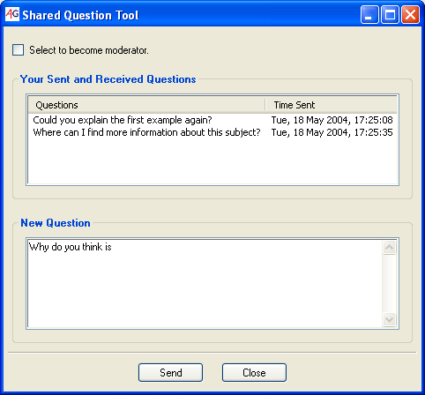
User Interface Design
Audience View

Slide 17
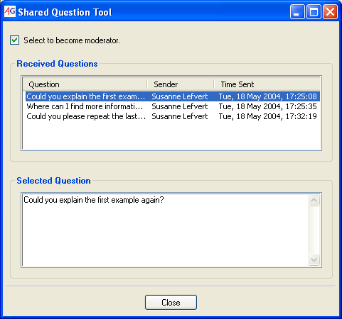
User Interface Design
Moderator View

Slide 18
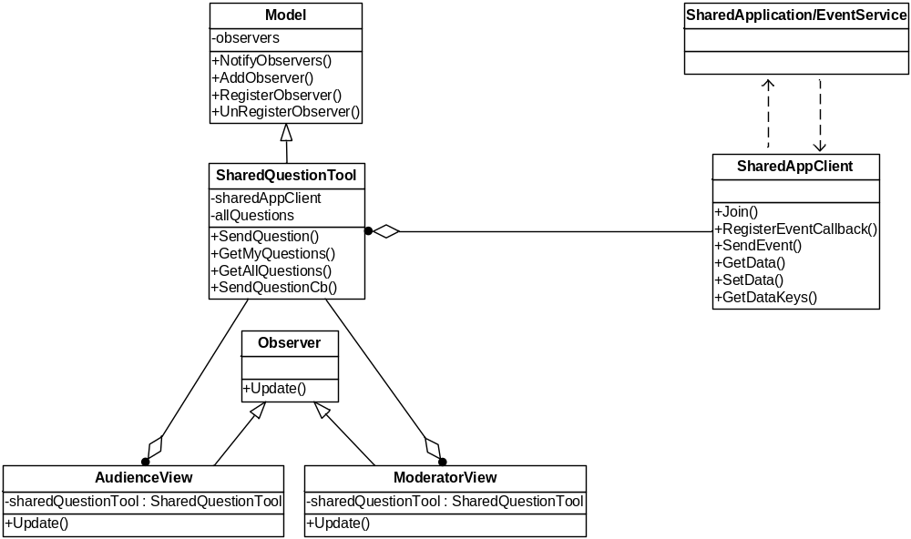
Design Diagram

Slide 19
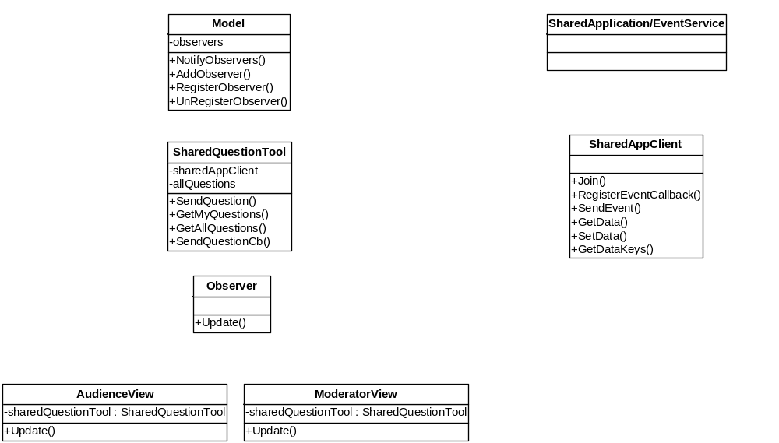
Design Diagram
NotifyObservers()
SetData(publicId, xmlQuestionList)
SendEvent(“SendQuestion”, question)
SendQuestionCb(event)
SendQuestion(text)
GetAllQuestions()
GetMyQuestions()

Slide 20
Outline
Overview
Shared Application Client
Example: Question and Answer Tool
  Use cases/requirements
  Design
  Implementation
  Packaging and distribution
Documentation

Slide 21
class SharedQuestionTool(Model):
SEND_QUESTION = "SendQuestion"
def __init__( self, appUrl, debugMode = 0, logFile = None):
Model.__init__(self)
self.allQuestions = []
# Create shared application client
self.sharedAppClient = SharedAppClient("SharedQuestionTool")
# Get client profile
configDir = UserConfig.instance().GetConfigDir()
clientProfileFile = os.path.join(configDir, "profile")
self.clientProfile = ClientProfile(clientProfileFile)
# Join the application session
self.sharedAppClient.Join(appUrl, self.clientProfile)
self.publicId = self.sharedAppClient.GetPublicId()
# Register event callback self.sharedAppClient.RegisterEventCallback(self.SEND_QUESTION, self.SendQuestionCb)
# Get all questions currently stored in the application service
clients = self.sharedAppClient.GetDataKeys()
for clientId in clients:
list = self.sharedAppClient.GetData(clientId)
if len(list) > 0:
qlist = self.__FromXML(list)
for question in qlist:
self.allQuestions.append(question)
def SendQuestion(self, text):
'''Called when an audience member clicks the send button.'''
question = self.__CreateQuestion(text)
myQuestions = self.GetMyQuestions()
myQuestions.append(question)
# Store questions in the venue application service.
questions = self.__ToXML(myQuestions)
self.sharedAppClient.SetData(self.publicId, questions)
# Send the event.
self.sharedAppClient.SendEvent(self.SEND_QUESTION, question)
return question
def SendQuestionCb(self, event):
'''Callback invoked when SEND_QUESTION events arrive. ''‘
# Store data
question = event.data
self.allQuestions.append(question)
# Notify user interface.
self.NotifyObservers()
def GetAllQuestions(self, clientId = None):
'''Returns the entire question list.'''
return self.allQuestions
def GetMyQuestions(self):
'''Returns my question list.'''
myQuestions = []
for question in self.allQuestions:
if question["appId"] == self.publicId:
myQuestions.append(question)
return myQuestions

Slide 22
Outline
Overview
Shared Application Client
Example: Question and Answer Tool
  Use cases/requirements
  Design
  Implementation
  Packaging and distribution
Documentation

Slide 23
Application Description Files
SharedQuestionTool.app
[application]
name = Shared Question Tool
mimetype = application/x-ag-question-tool
extension = sqtool
files = SharedQuestionTool.py, ObserverPattern.py
[commands]
Open = %(python)s SharedQuestionTool.py -a %(appUrl)s

Slide 24
Access Grid Package Manager (AGPM)
Use AGPM to register the application
with your user environment.
agpm.py –f SharedQuestionTool.app
agpm.py –h (for more options)

Slide 25
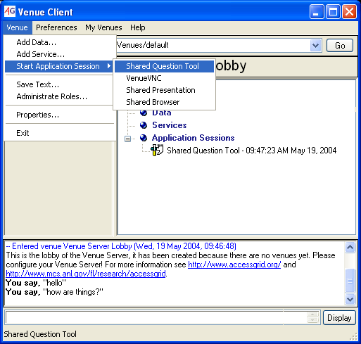
Start Application Session

Slide 26
Access Grid Package Extension (agpkg)
Create a zip package of your files
  SharedQuestionTool.py
  ObserverPattern.py
  SharedQuestionTool.app
Rename it with extension agpkg
  SharedQuestionTool.agpkg
Opening SharedQuestionTool.agpkg from Venue Client installs the application

Slide 27
Outline
Overview
Shared Application Client
Example: Question and Answer Tool
  Use cases/requirements
  Design
  Implementation
  Packaging and distribution
Documentation

Slide 28
Documentation
Contributed Software
http://www.mcs.anl.gov/fl/research/accessgrid/wiki/moin.cgi/ContributedSoftware
Reference Materials
http://www.mcs.anl.gov/fl/research/accessgrid/wiki/moin.cgi/DevelopingSharedApplications

Slide 29
Credits
  This work was supported in part by the Mathematical, Information, and Computational Sciences Division subprogram of the Office of Advanced Scientific Computing Research, Office of Science, U.S. Department of Energy, under Contract W-31-109-ENG-38.
  This material is based upon work supported in part by the National Science Foundation under Grant No. ANI-0222509.
  This material is supported in part by Microsoft Research.
  This material is supported in part by the National Institute of Health/National Library of Medicine as part of the Advanced Biomedical Collaboratory project.

