Slide 1

Chapter 11 Developing Requirement
Group 1
UID 5620/6620

Slide 2

Title and Goals
Discovering Requirement
What they are, types, and why they matter
Outcomes
Define Requirement
Tell Functional vs non functional
Know why explicit capture matters

Slide 3
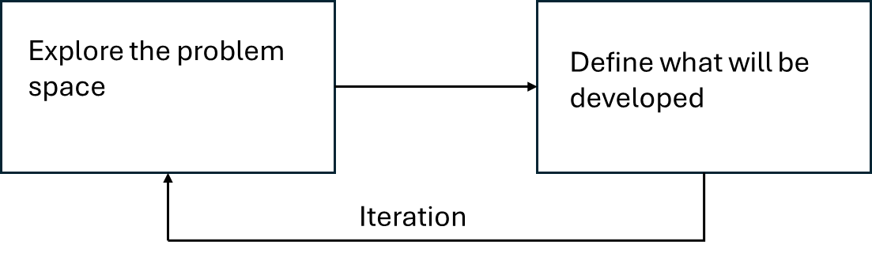
Where Requirements Sit
Early Double Diamond
Requirements
They evolve as stakeholders learn
Cycles feed each other

Slide 4

What and How
What?
State what will be built and for whom
Capture Outcomes as
Requirement
Artifacts
How (Capture)
Choose representation that fit the domain (prototype, stories, etc.)
BUT! Make sure needs aren’t lost across iterations

Slide 5
What is a Requirement?
“A statement about an intended product specifying what it should do or how it will perform” (e.g., map load < 05s, “appealing to teenagers”)
Use acceptance/ Fit Criteria to know when its met
For Example
Map loads in < 0.5 s on watch --> Performance Requirement
Appealing to teenagers --> Too vague
Make it testable, > 75% of teen participants rate appeal.
That tweak is a "Fit Criterion"- it turns fuzzy goals into something we can check

Slide 6

Types (Lead-in to Activity)
Functional : What product will do ?
Non Functional : Qualities/Constraints ( Performance, Platforms, etc)
There are broader taxonomies
Robertsons Set
Gottedienser and Gormans Product Dimension

Slide 7

Activity to Perform in the Class
Classify each as Functional/Non-Functional for the following statements
Load the workout map in under 0.5 s on a smart watch →
Nonfunctional
Users can save a favorite airline for all booking →
Functional
Appealing to teenager →
Non Functional
Runs on Xbox, PlayStation, and Switch →
Non Functional
Export trip receipts to PDF →
Functional

Slide 8
Discovering Requirements – Data Gathering Techniques
Based on Interaction Design (Preece et al.), Ch. 11
Data gathering helps understand who the users are, what they do, and why they do it.
Focus: how designers gather data to understand users’ activities, needs, and motivations.
Core techniques: Observation, Interviews, Questionnaires, Focus Groups
Additional methods: Probes and Contextual Inquiry

Slide 9
Purpose of Data Gathering
• Identify user needs, behaviors, and motivations.
• Understand the context of use and rationale behind current practices.
• Capture both qualitative and quantitative data.
• Inform system requirements and interaction design.

Slide 10
Observation
Observe users in their natural environment (“in the wild”).
Helps reveal real behaviors, workarounds, and context.
Can be direct (researcher present) or indirect (video, sensors).
Advantage: authentic insight into activities.
Limitation: time-consuming, observer effect.

Slide 11
Interviews
Interviews are structured or informal conversations to understand users’ experiences and motivations or One-on-one or small-group discussions with users or stakeholders.
They can be Structured, semi-structured, or unstructured formats.
Strengths: depth and flexibility; can reveal motivations behind actions.
Limitations: interviewer bias, time needed to schedule and analyze.
Example: Early interviews to shape interface needs.

Slide 12
Questionnaires & Focus Groups
Questionnaires and focus groups are often used together.
Questionnaires
Useful for reaching a large audience.
Collect quantitative feedback or preferences.
Benefit: quick and scalable; Limitation: less contextual depth.
Focus Groups
Small facilitated discussions (3–10 participants).
Surface shared opinions, conflicts, and ideas.
Benefit: consensus building; Limitation: dominant voices, groupthink.

Slide 13
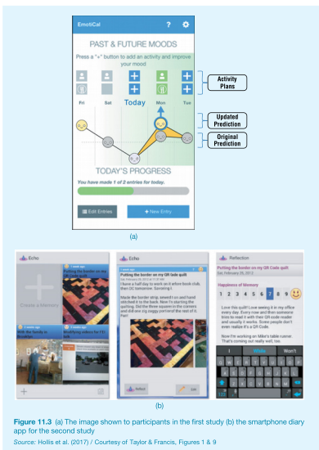
Figure 11.3 – EmotiCal and Echo App
(a) EmotiCal app – used for mood tracking and prediction.
(b) Echo/Reflection diary app – used to log daily emotions.

Slide 14
Combining Techniques (Box 11.2)
Studies often combine multiple techniques for richer results.
Hollis et al. (2017) used multiple data-gathering techniques — observation, interviews, diaries, and surveys — to study emotional well-being.
Combining methods provides triangulation, meaning data is confirmed from different sources.
This approach captures what users do (observation), what they say (interviews), and how they feel (diaries). It creates richer, more trustworthy results for requirement discovery.

Slide 15
Additional Approaches: Probes & Contextual Inquiry
Probes
Creative tools (e.g., postcards, diaries, kits) that invite users to self-report and reflect.
Help uncover emotions and values. Contextual Inquiry
Combines observation + interview in the user’s own setting.
Researcher = apprentice, User = master.
Four stages: Overview → Transition → Inquiry → Wrap-up.

Slide 16
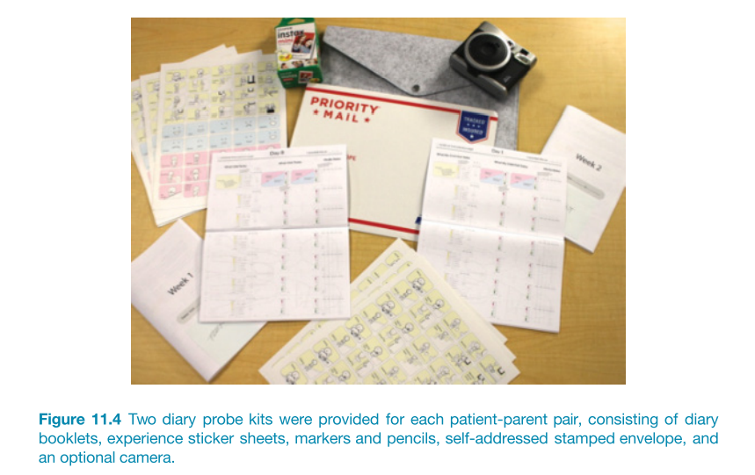
Figure 11.4 – Diary Probe Kits
•Illustration from textbook showing diary probe setup:
•• Includes sticker sheets, pencils, mail-back envelopes, and camera.
•• Used by patients and caregivers to document health experiences.
•

Slide 17
Best Practices & Conclusion
Plan sessions carefully; gain informed consent.
Use multiple complementary techniques for reliability.
Record systematically and analyze patterns.
Reflect results directly in design decisions. Takeaway: Observation, interviews, questionnaires, and focus groups are the foundation of data gathering—while probes and contextual inquiry extend these methods for deeper understanding.

Slide 18
What is Contextual Inquiry?
A field-based user research method combining observation + interview.
Researcher watches users perform real tasks in their natural environment.
Goal: Discover what people actually do, not what they say they do.
Common in early design stages for uncovering latent needs.

Slide 19
Four Principles of Contextual Inquiry
Principle | Description
Context | Observe tasks in the real setting.
Partnership | User = expert, designer = apprentice.
Interpretation | Discuss and validate findings with user.
Focus | Keep attention on research goals.

Slide 20
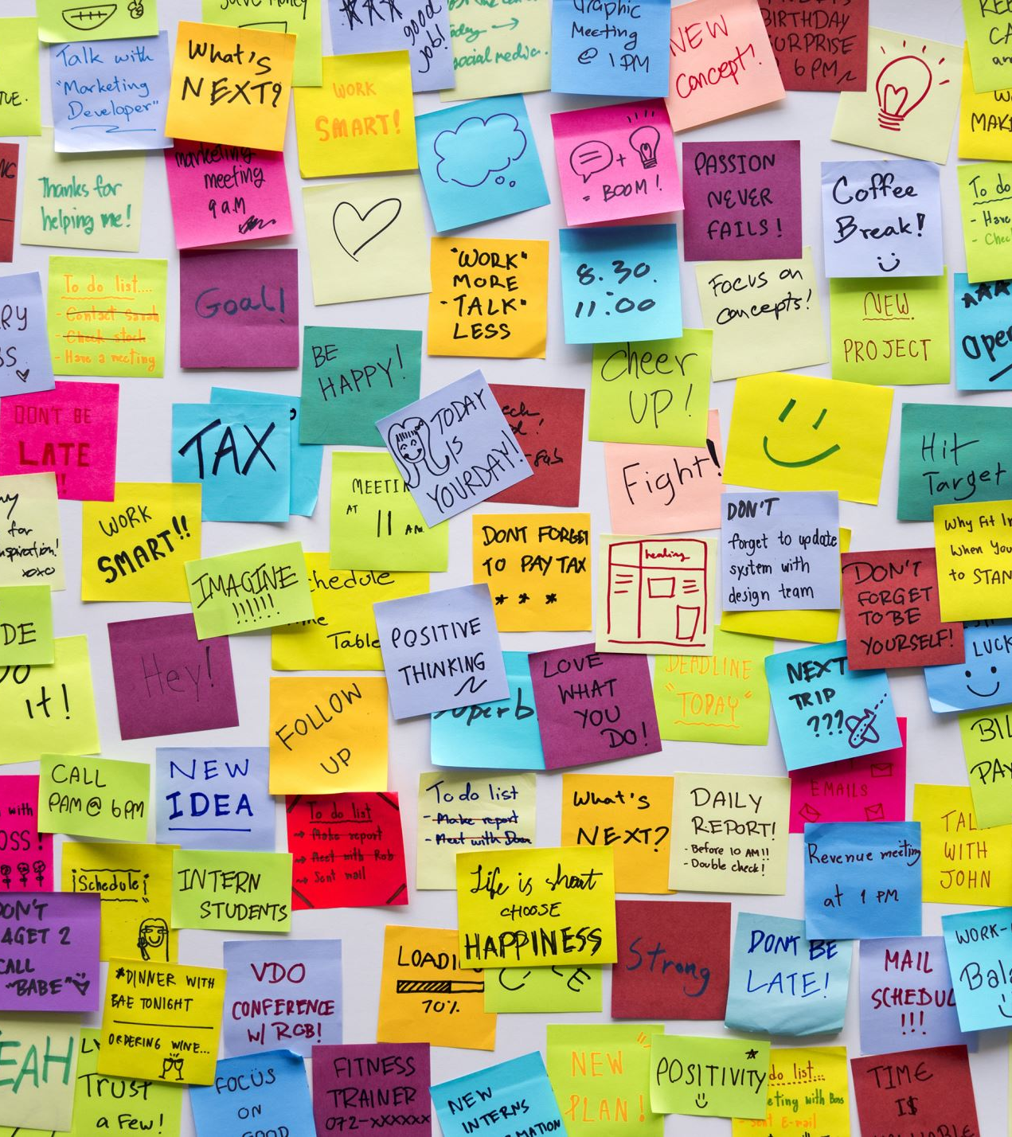
How Contextual Inquiry Works
Select participants who perform relevant tasks.
Observe & ask questions while they work.
Take detailed notes (actions, quotes, artifacts).
Summarize insights into affinity diagrams or models.
Validate interpretations with users.
Example: Studying nurses using hospital tablets to understand workflow pain points.

Slide 21
Example: Improving an Equipment Interface
Scenario: Designers observed technicians using a complex control panel.
Found they relied heavily on handwritten notes.
Insight → Add an on-screen checklist + contextual reminders.
Result → Reduced errors and training time.

Slide 22
Design Fiction (DF)
A creative technique to explore possible futures.
Uses stories, artifacts, or prototypes to provoke reflection.
Helps designers ask: “What if…?”
Encourages consideration of ethical, social, and cultural impacts.

Slide 23
Purpose of Design Fiction
Stimulates discussion and critical thinking about design choices.
Reveals hidden assumptions behind new technologies.
Useful in early design stages to envision opportunities and risks.
Can complement Contextual Inquiry → “Observe what is, imagine what could be.”

Slide 24
Summary
Contextual Inquiry → Grounded understanding of real user contexts.
Design Fiction → Imaginative exploration of future possibilities.
Both reveal hidden requirements — one by observation, one by imagination.
Together, they help designers create meaningful, forward-thinking experiences.

Slide 25
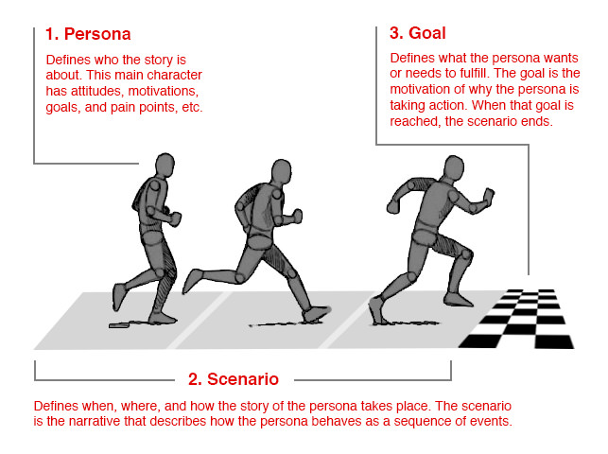
Bringing Requirements to Life: Personas and Scenarios

Slide 26
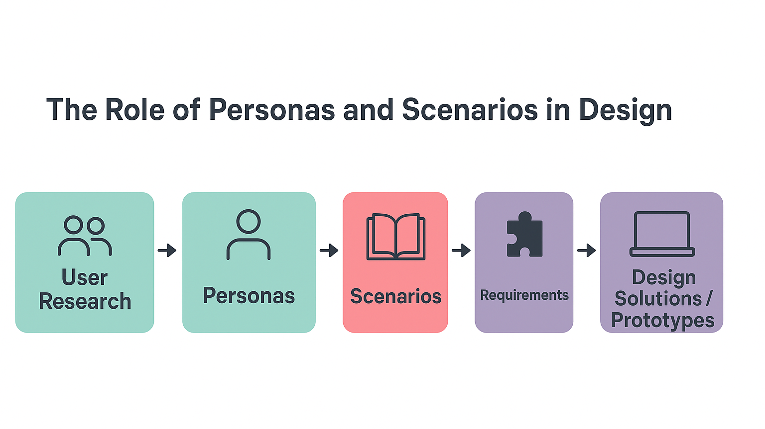

Slide 27
What Is a Persona?
A persona is a fictional but realistic representation of a typical user.
Based on user research, interviews, and observations.
Includes details like goals, behaviors, motivations, and frustrations.
Helps designers empathize with users and focus on their needs.
Keeps the design process human-centered and evidence-based.

Slide 28
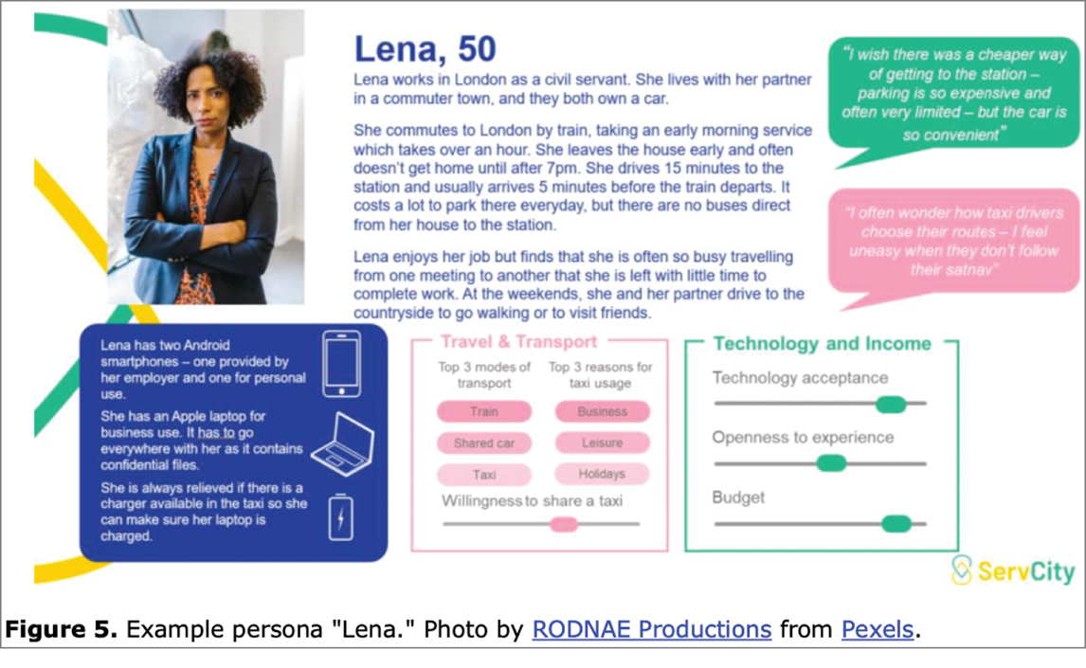
Example of Persona

Slide 29
What Is a Scenario?
A scenario is an informal narrative describing user activity.
It shows when, where, and how a persona interacts with a system.
Focuses on the user’s goals, actions, and experiences in context.
Helps designers explore situations, needs, and constraints.
Describes the story of use, not just the system’s function.

Slide 30
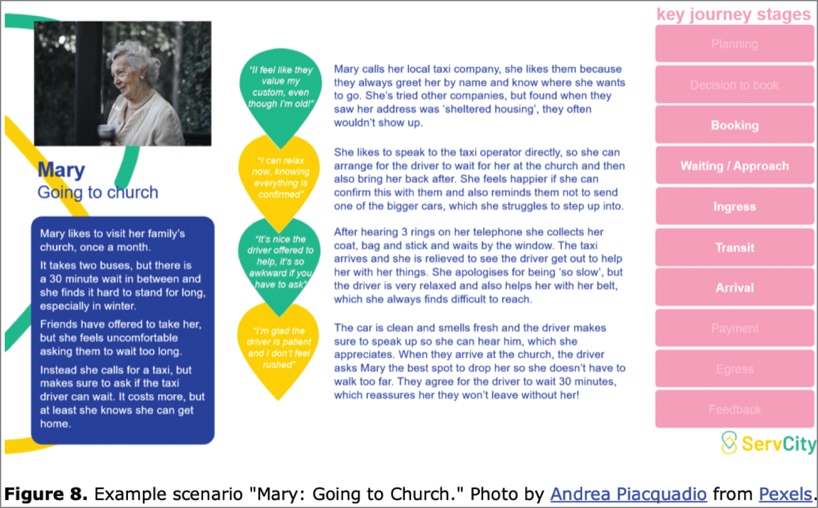
Example of Scenario

Slide 31
Dilemma: How Long Should a Scenario Be?
Early in design → short, text-based scenarios for exploring ideas.
Later in design → detailed scenarios for refining and communicating requirements.
Balance depends on project stage and goals.
More detail = better for stakeholder communication.
Abstract scenarios = better for early ideation.

Slide 32
How Personas and Scenarios Work Together
Personas define who and why.
Scenarios define when, where, and how.
Together they translate user goals into design requirements.
Strengthen empathy and understanding of real-world use.
Guide design priorities and testing scenarios.

Slide 33
Video Link for Persona & Scenario
https://www.youtube.com/watch?v=kWPhg8wI5q0

Slide 34
What is a Use Case?
Use Cases: focuses on functional requirements and interaction between a user and the product.

Slide 35
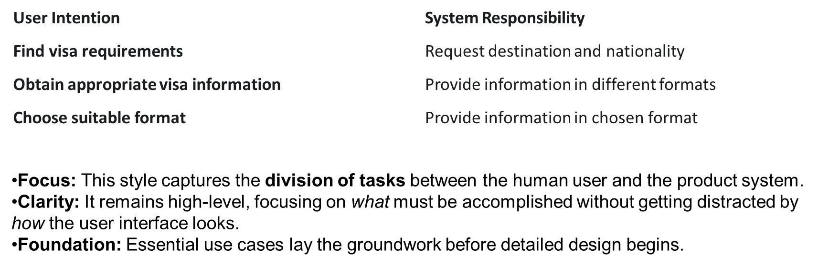
Style 1: Essential Use Cases

Slide 36
Style 2: Goal-Oriented Use Cases
The Detailed Narrative Flow
This style captures the entire process necessary to fulfill a specific user goal (e.g., retrieving visa information).
The main successful path is described in a detailed, numbered sequence called the Main Course.

Slide 37
Alternative Courses
Type | Focus | Example from Text
Error Handling | What happens when data is invalid or a failure occurs. | If the country name is invalid: The product provides an error message and returns to the input step (4.1).
Optional Choice | Documents features the user can optionally select. | The customer confirm the order: The system offers an option: The user selects 'Gift Wrap' and enters a personalized message.
Alternative Courses specify the paths taken when interaction deviates from the successful Main Course. They are critical for a resilient system.
A truly robust product must anticipate failure and account for user variability.

Slide 38

The Value of Use Cases
Use Cases are the Blueprint: They translate high-level goals into specific, actionable requirements for development and testing.
Two Key Styles:
Essential: Defines basic responsibilities.
Goal-Oriented: Defines the complete user flow.
Alternative Courses guarantee that the system is resilient and accounts for all possible user interactions, both successful and unsuccessful.

Slide 39
Thank You
Kritika Vyas (kzv0032@auburn.edu)
Euphemia Uchenna Asogwa (eua0002@auburn.edu)
Aayush Bhattarai (azb0364@auburn.edu)
Aditi Saha (ads0161@auburn.edu)
Ghaday Omar I Alsulaimani (gza0038@auburn.edu)

