Slide 1
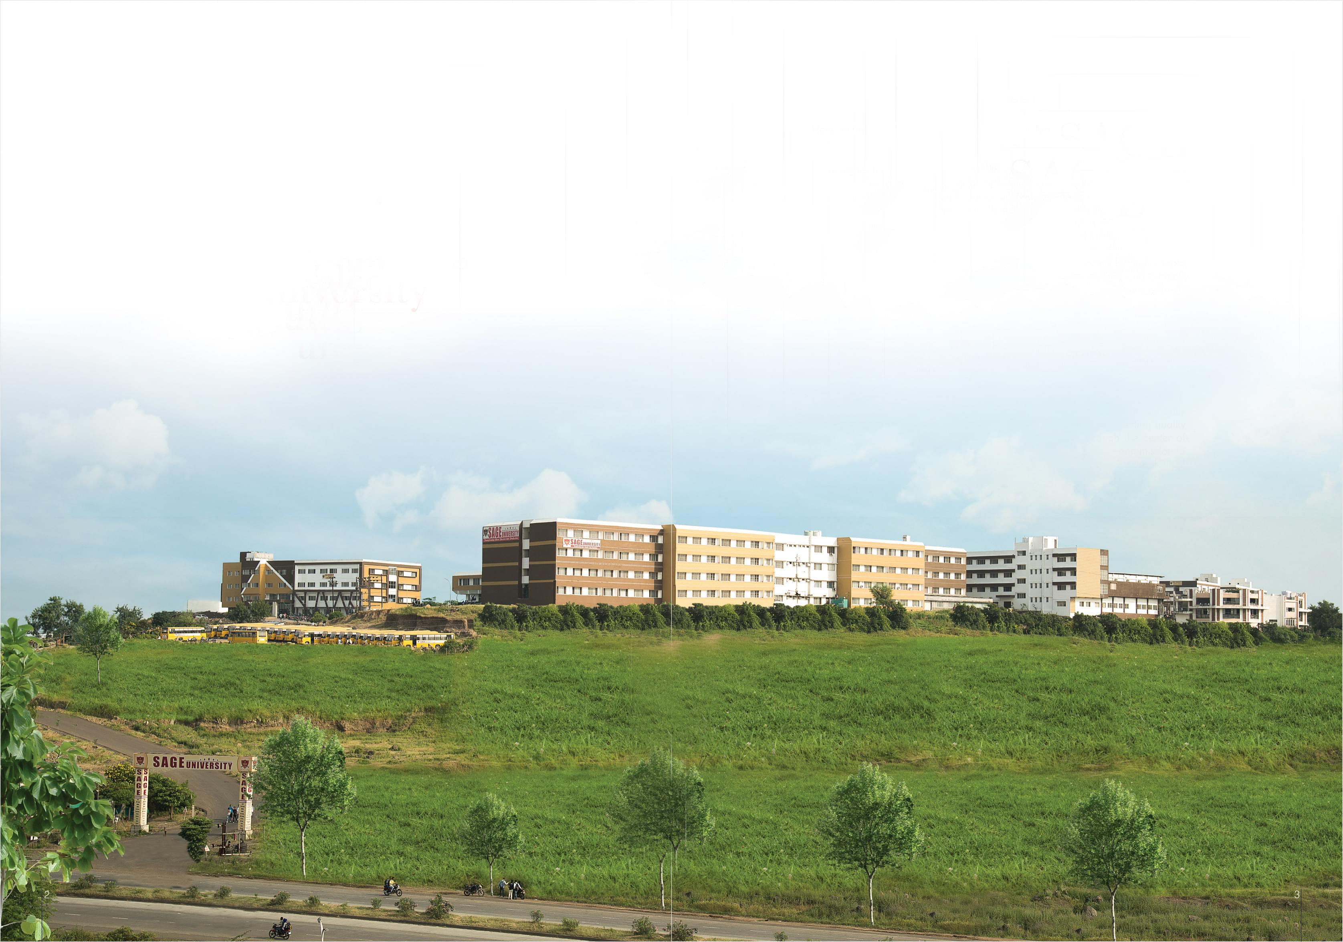


SAGE – Developers Club
learn together, grow together with SDC

