Slide 1
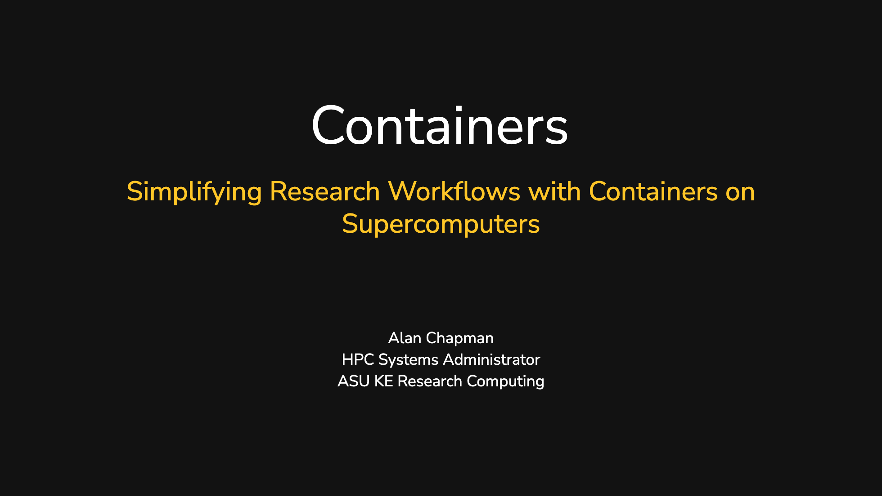
Notes:
The last comment block of each slide will be treated as slide notes. It will be visible and editable in Presenter Mode along with the slide. [Read more in the docs](https://sli.dev/guide/syntax.html#notes)

Slide 2
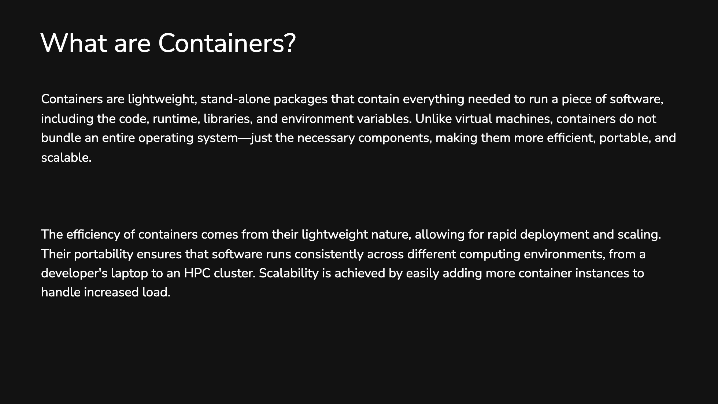

Slide 3
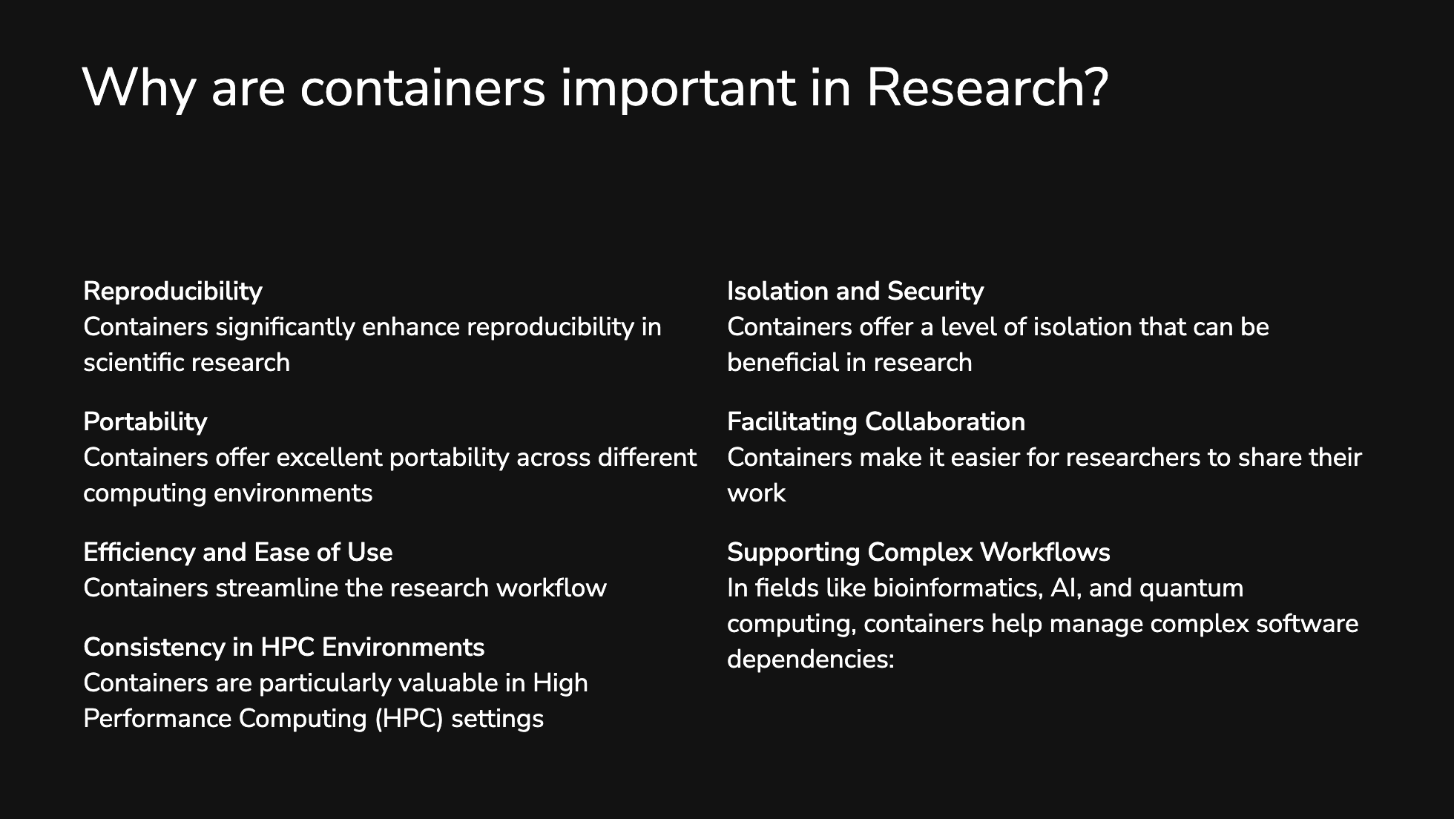
Notes:
## Reproducibility Containers significantly enhance reproducibility in scientific research: - They encapsulate the entire software environment, including dependencies, libraries, and specific versions of tools. - This ensures that experiments and analyses can be replicated accurately across different systems and by different researchers[1]. - Containers can be cited in published papers, allowing other researchers to use the exact same environment for verification[1]. ## Portability Containers offer excellent portability across different computing environments: - They can run consistently on various platforms, from personal computers to HPC clusters and cloud services[2]. - This portability simplifies collaboration between researchers using different systems or institutions[2]. ## Efficiency and Ease of Use Containers streamline the research workflow: - They eliminate the need for complex software installations and configuration on each system[3]. - Researchers can quickly deploy and run applications without worrying about system-specific setups[3]. ## Consistency in HPC Environments Containers are particularly valuable in High Performance Computing (HPC) settings: - They provide a consistent software environment across different HPC clusters[3]. - This consistency is crucial for running complex simulations and data analyses that require specific software stacks. ## Isolation and Security Containers offer a level of isolation that can be beneficial in research: - They allow researchers to work with different software versions or configurations without affecting the host system[2]. - In multi-user environments, containers can provide an additional layer of security and stability. ## Facilitating Collaboration Containers make it easier for researchers to share their work: - Entire research environments can be shared as container images, allowing collaborators to replicate setups exactly[2]. - This sharing capability accelerates research by reducing setup time and configuration issues. ## Supporting Complex Workflows In fields like bioinformatics, AI, and quantum computing, containers help manage complex software dependencies: - They allow researchers to package and run sophisticated tools and models across different platforms[3]. - This is particularly useful for interdisciplinary research where various specialized tools may be required. In conclusion, containers have become a vital tool in research, enhancing reproducibility, portability, and collaboration while simplifying the management of complex software environments. They address many of the challenges researchers face in ensuring their work is reproducible and their computational environments are consistent and easily shareable. Citations: [1] https://commons.und.edu/cgi/viewcontent.cgi?article=1003&context=cs-fac [2] https://www.bis.org/ifc/publ/ifcb59_06.pdf [3] https://bssw.io/blog_posts/exploring-containers-for-research-software [4] https://sylabs.io/2023/03/an-introduction-to-singularity-containers/

Slide 4
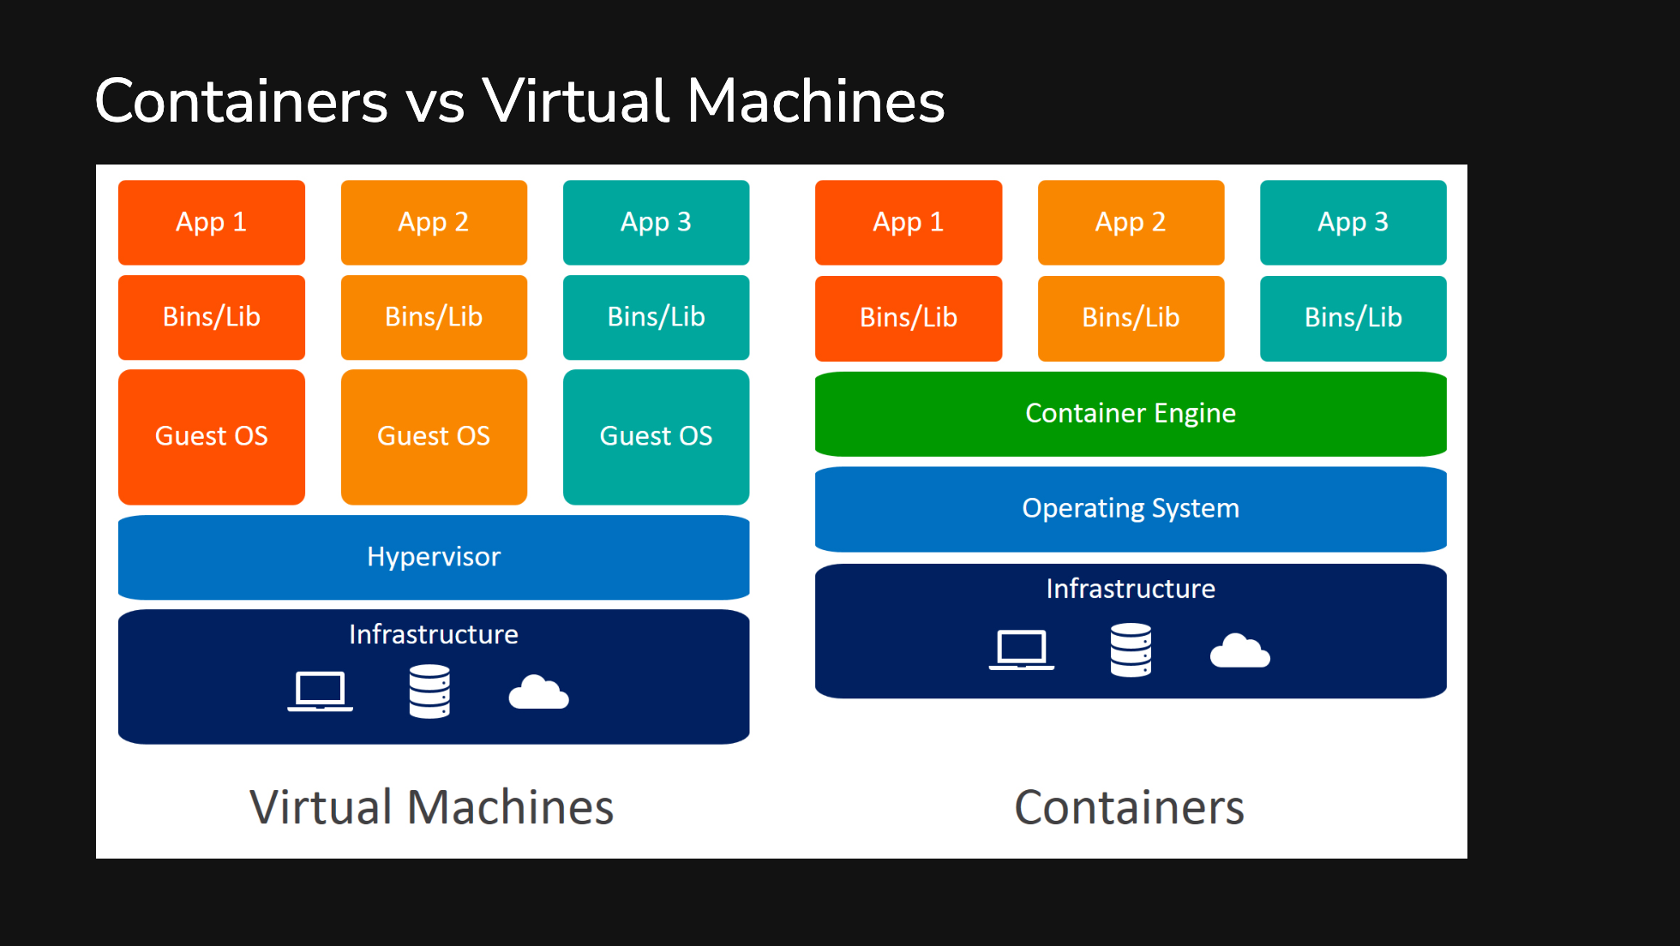
Notes:
A VM emulates a computer system with its own CPU, memory, and network interface. Hardware is virtualized by using a hypervisor that allows multiple VMs to run on a single server. Each VM has a full copy of OS, application binaries, andlibraries Containers are units of software that contains the code and all dependencies so that an application can run across platforms such as desktops, data centers and cloud. It provides an abstraction at the application layer. Each container runs as isolated processes while sharing the same OS kernel.

Slide 5
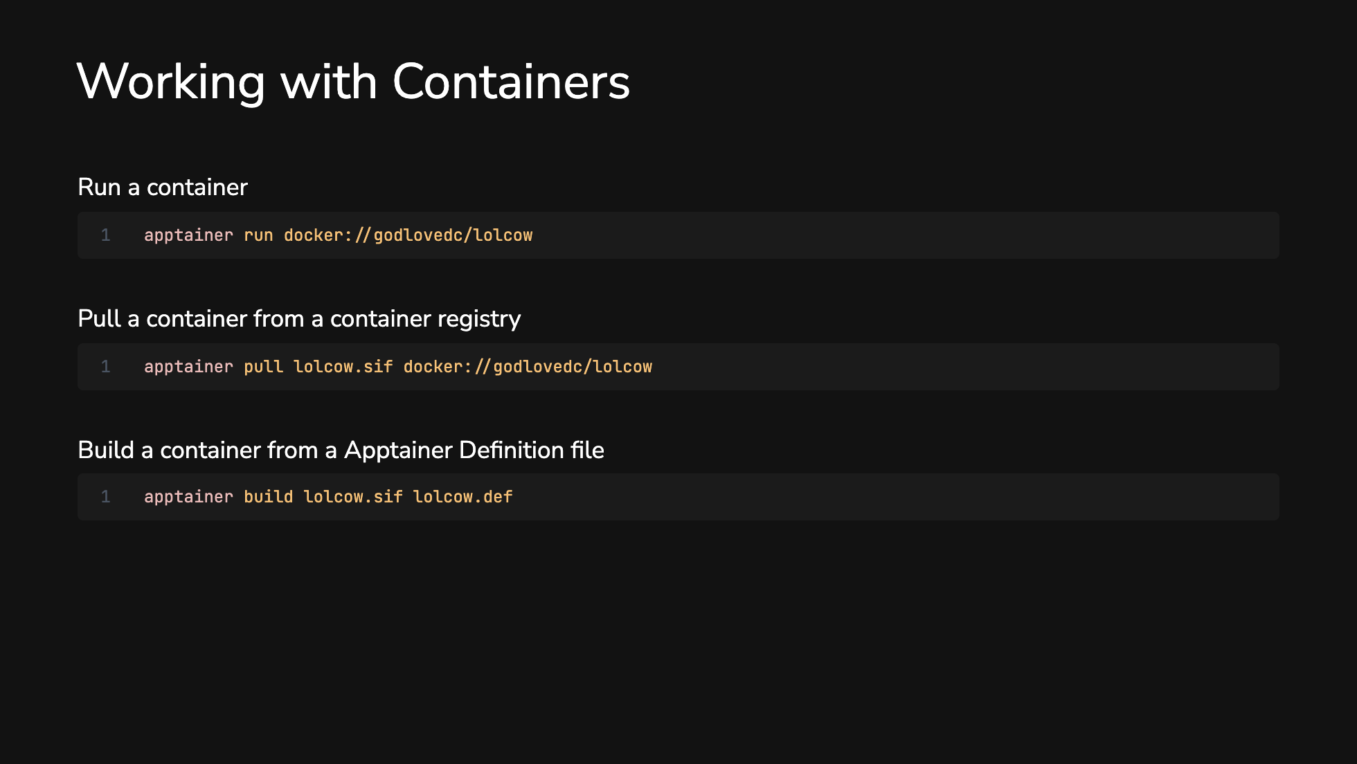
Notes:
Apptainer run literally just run the container and if apptainer can't find it locally it'll pull it from docker hub pull a container to save locally building a container with a definition file, can be done with simple definitions, some may need root privileges

Slide 6
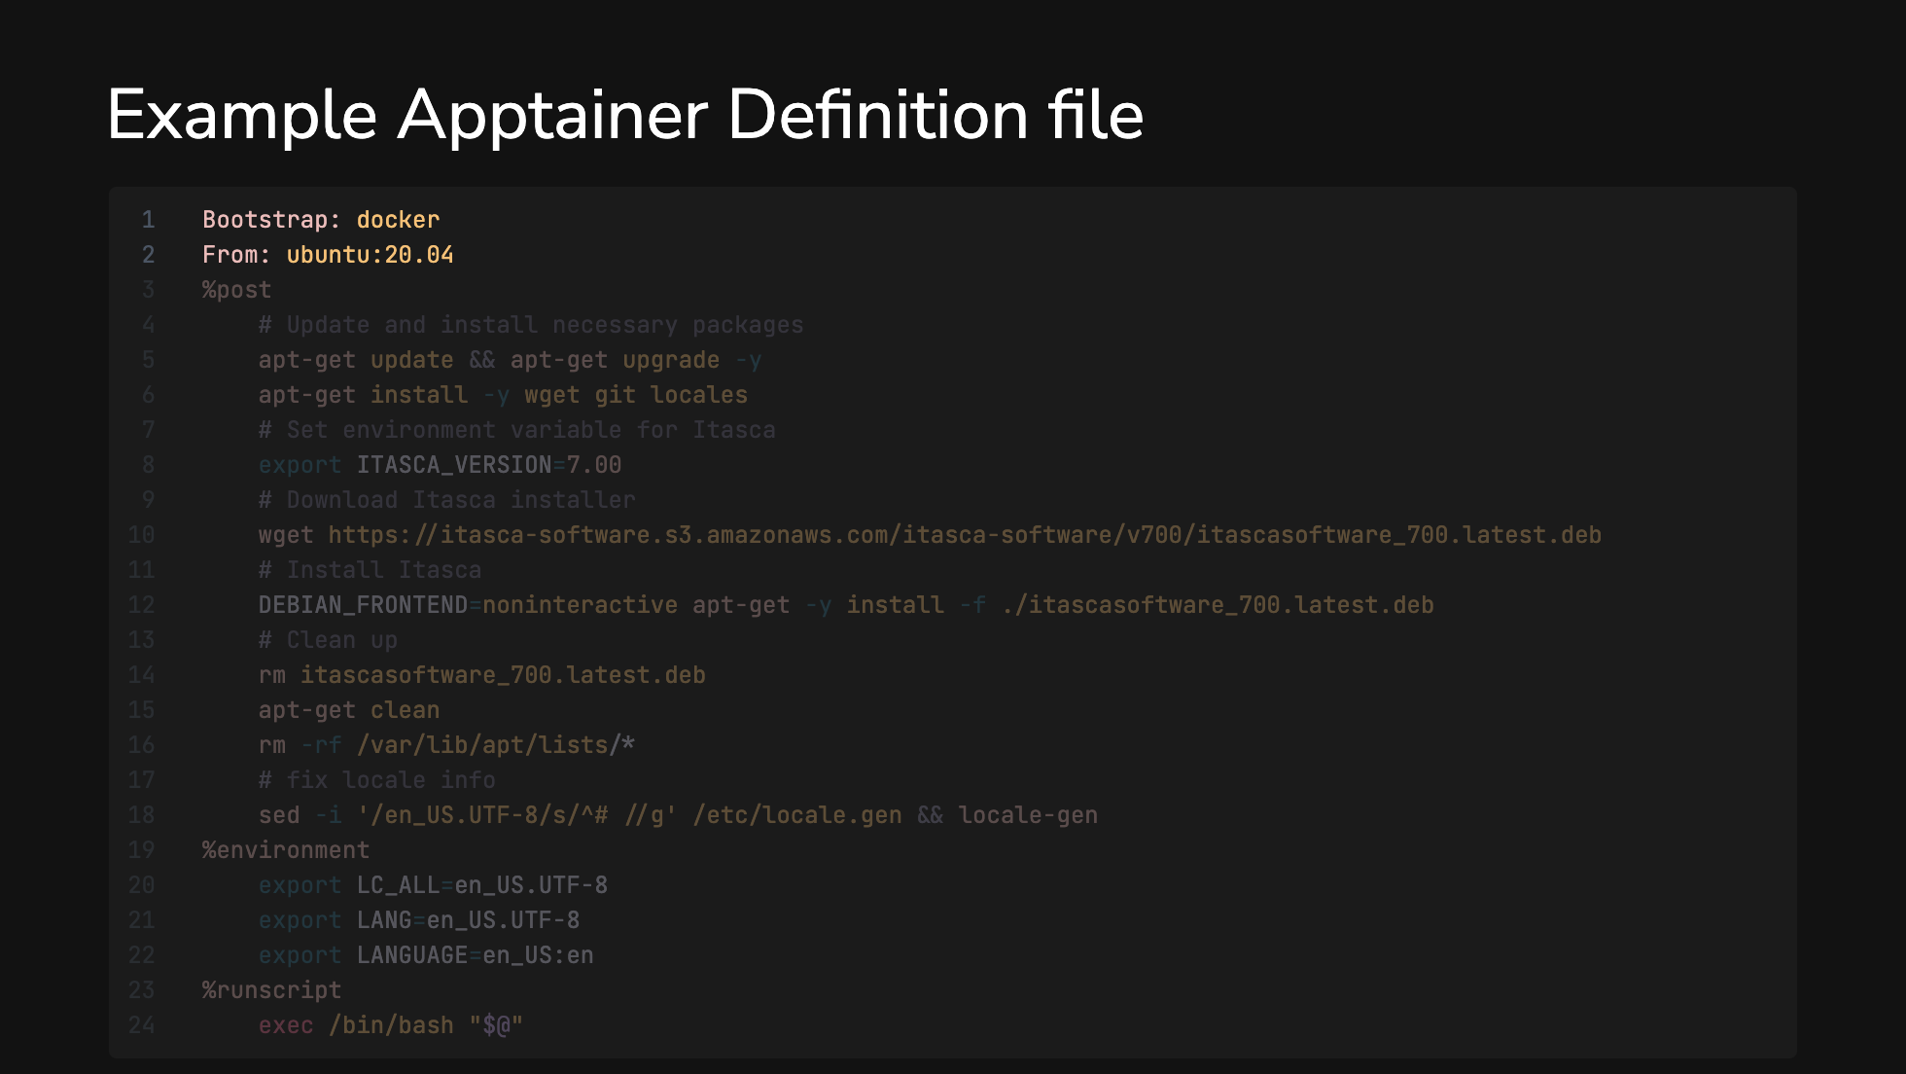

Slide 7
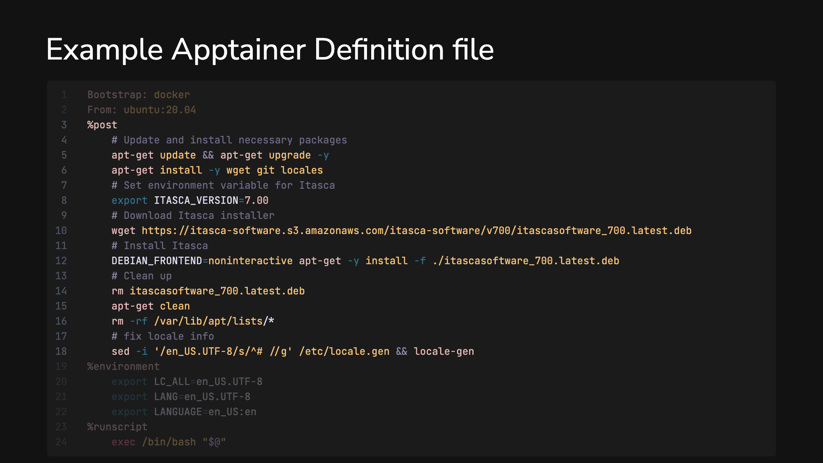

Slide 8
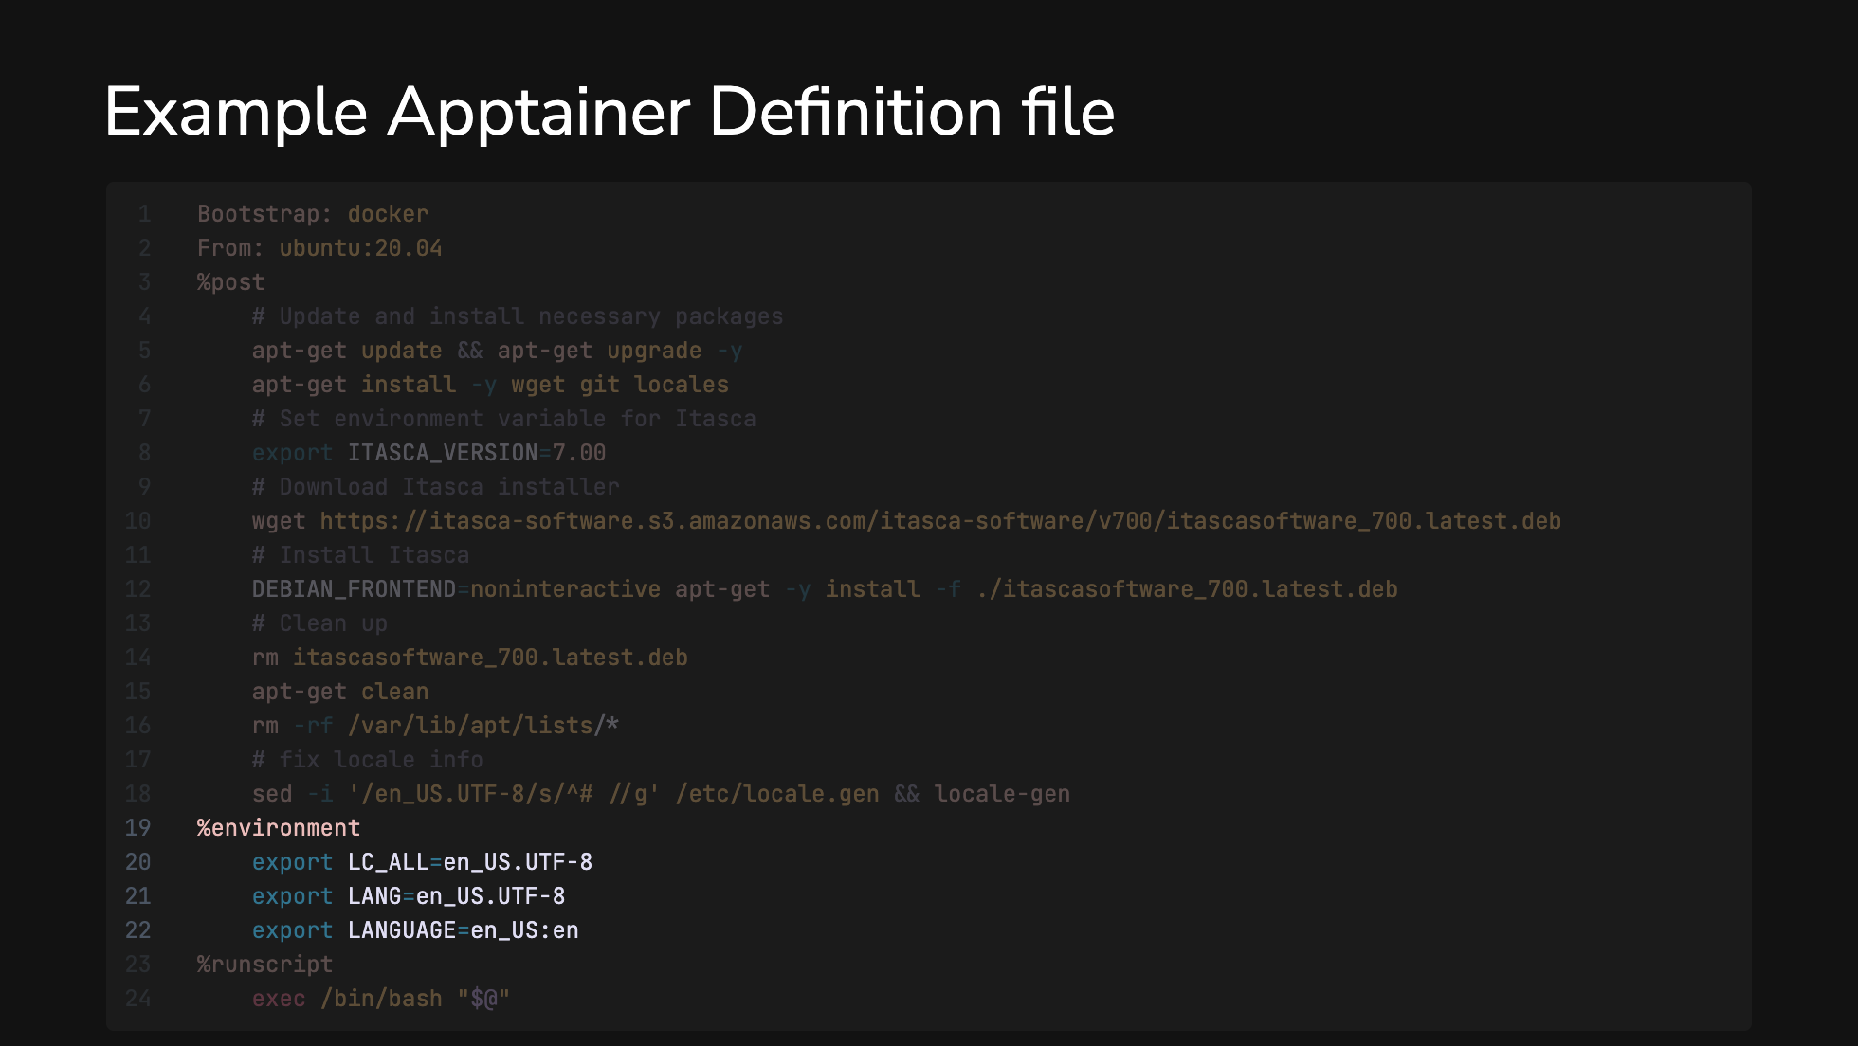

Slide 9
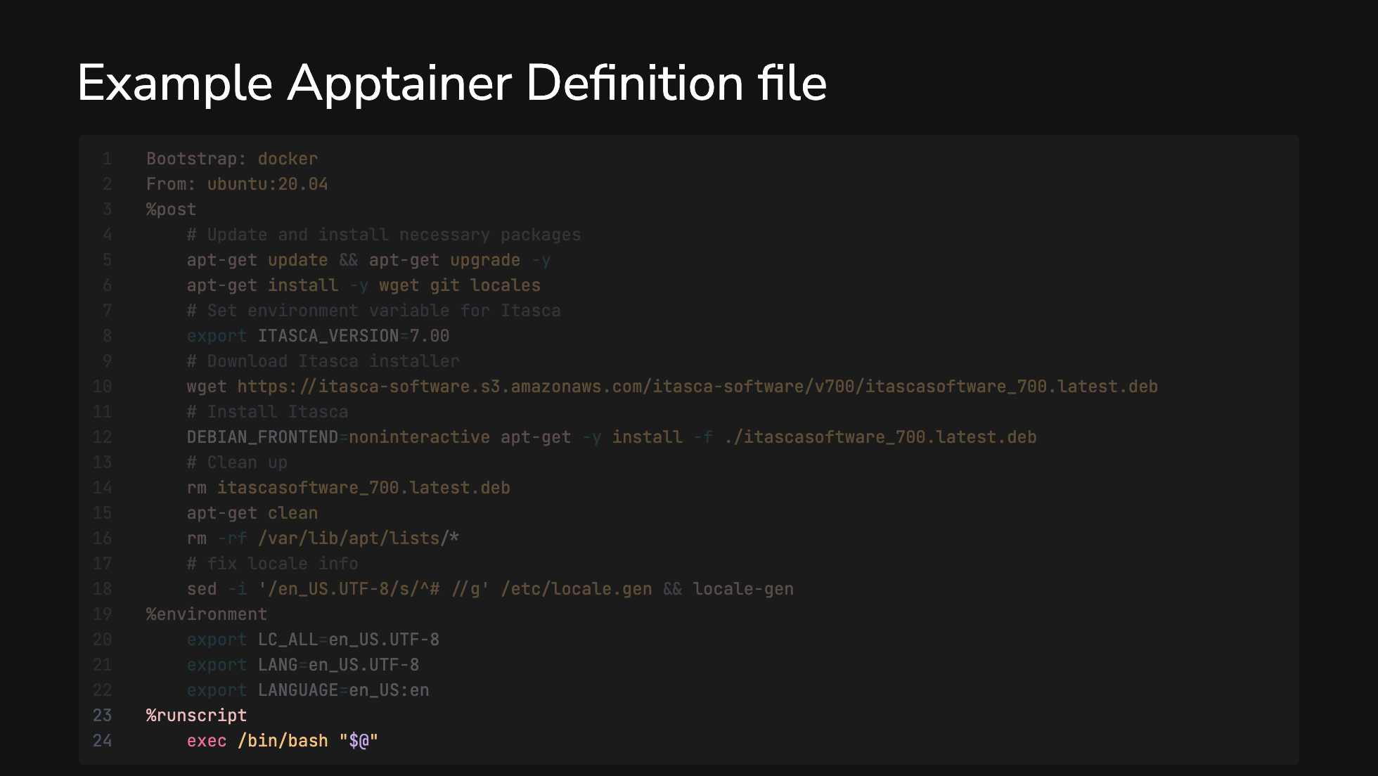

Slide 10
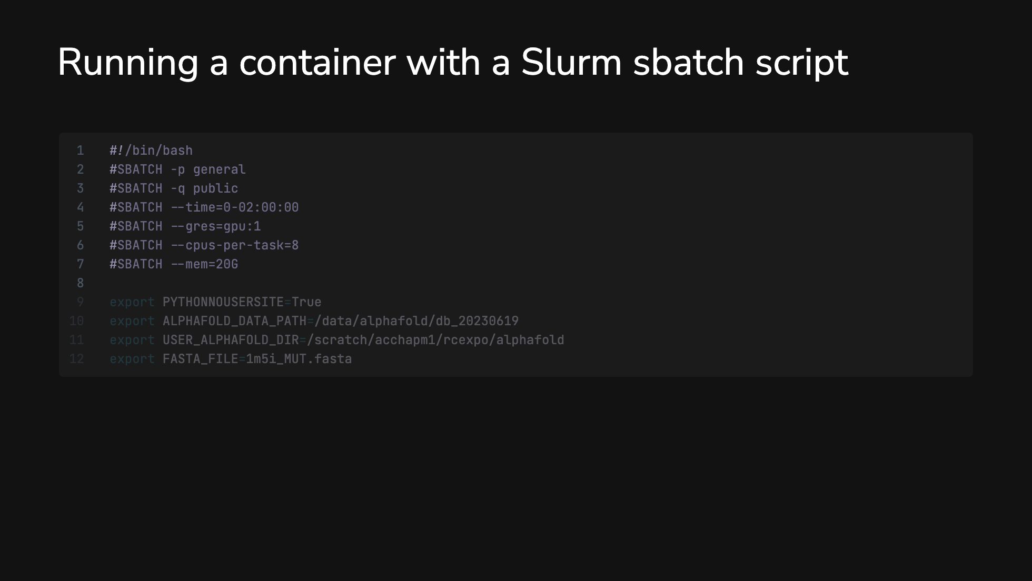

Slide 11
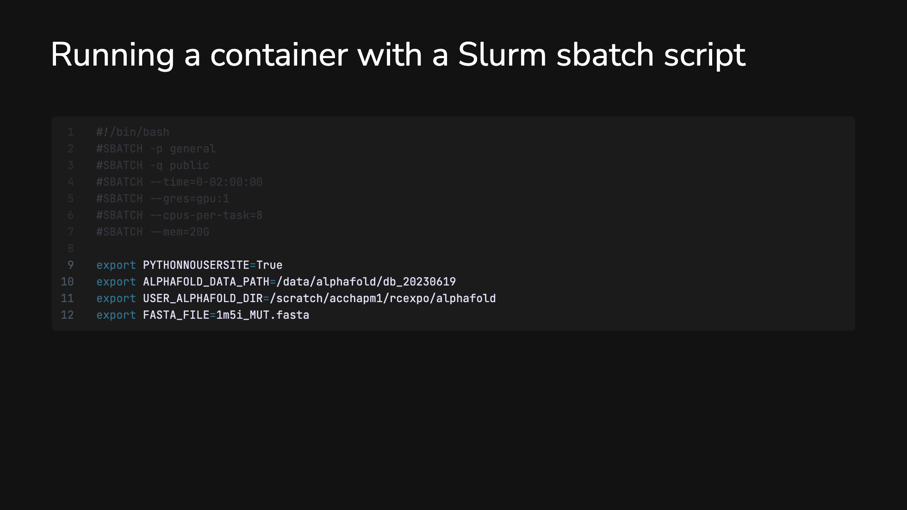

Slide 12
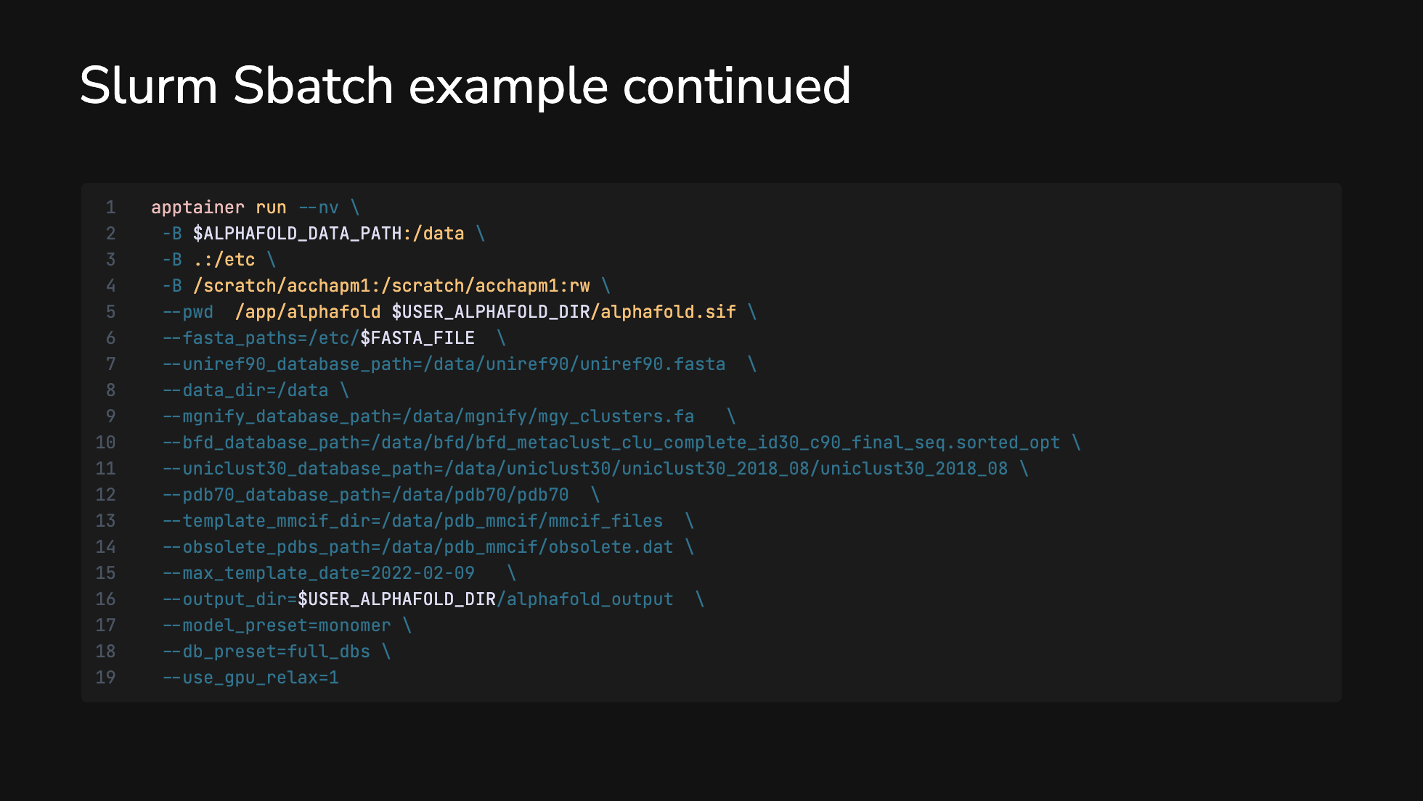

Slide 13
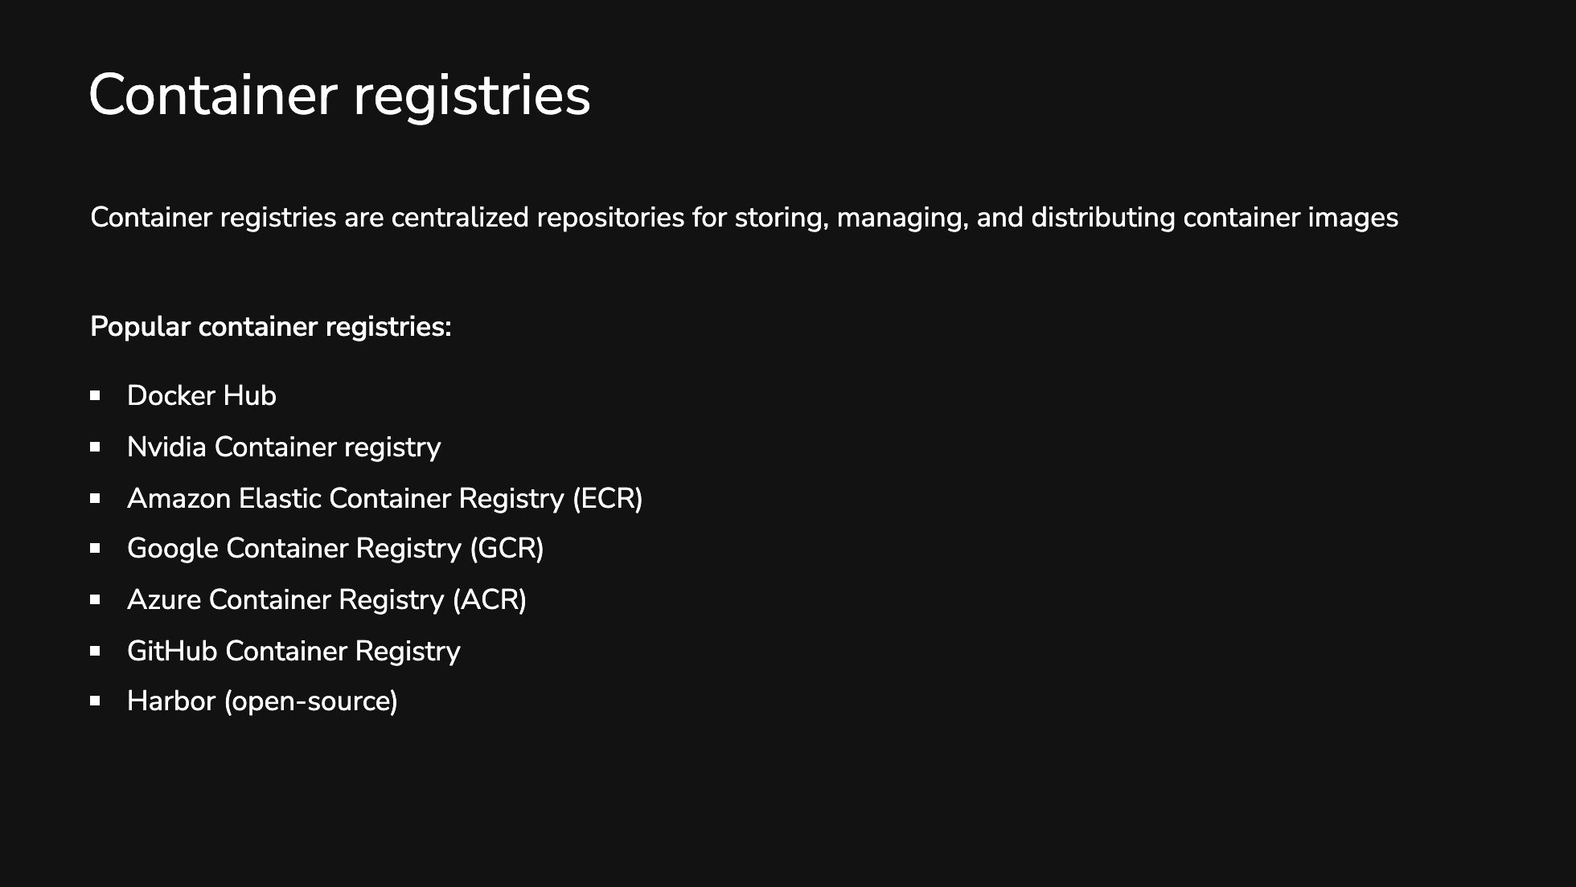

Slide 14
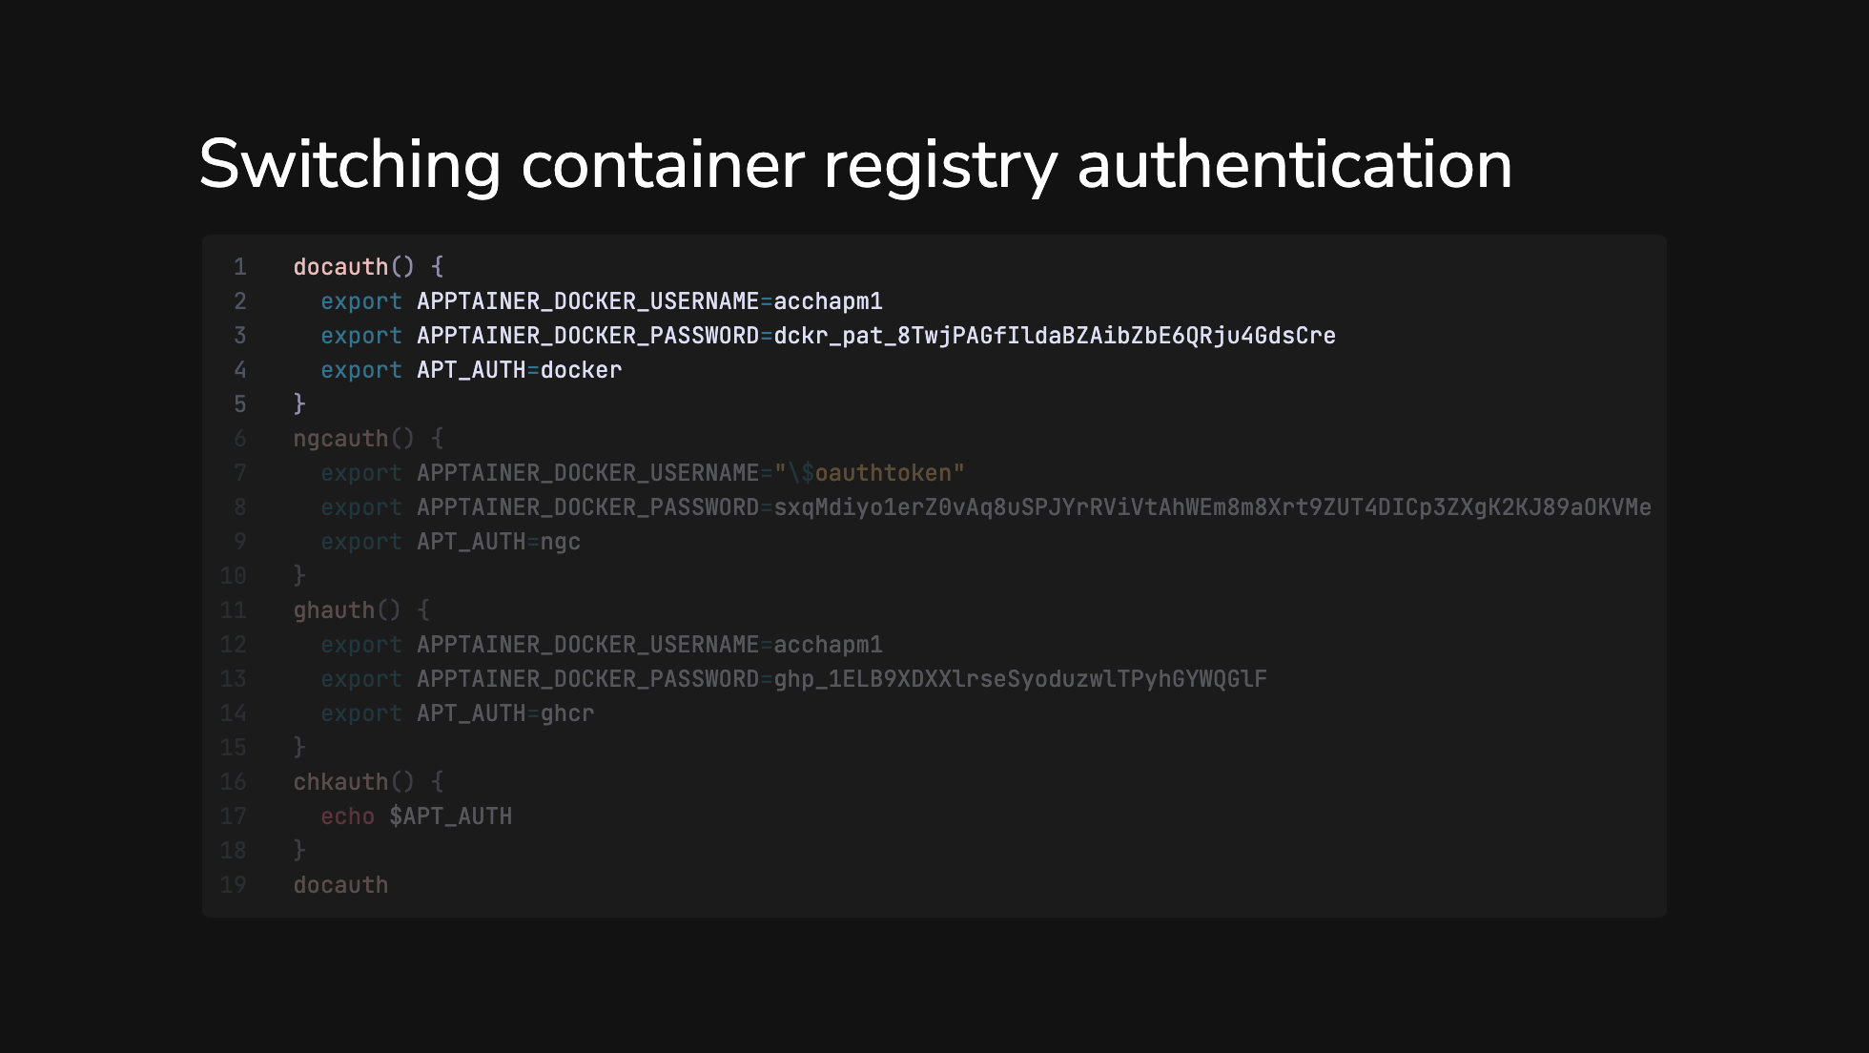

Slide 15
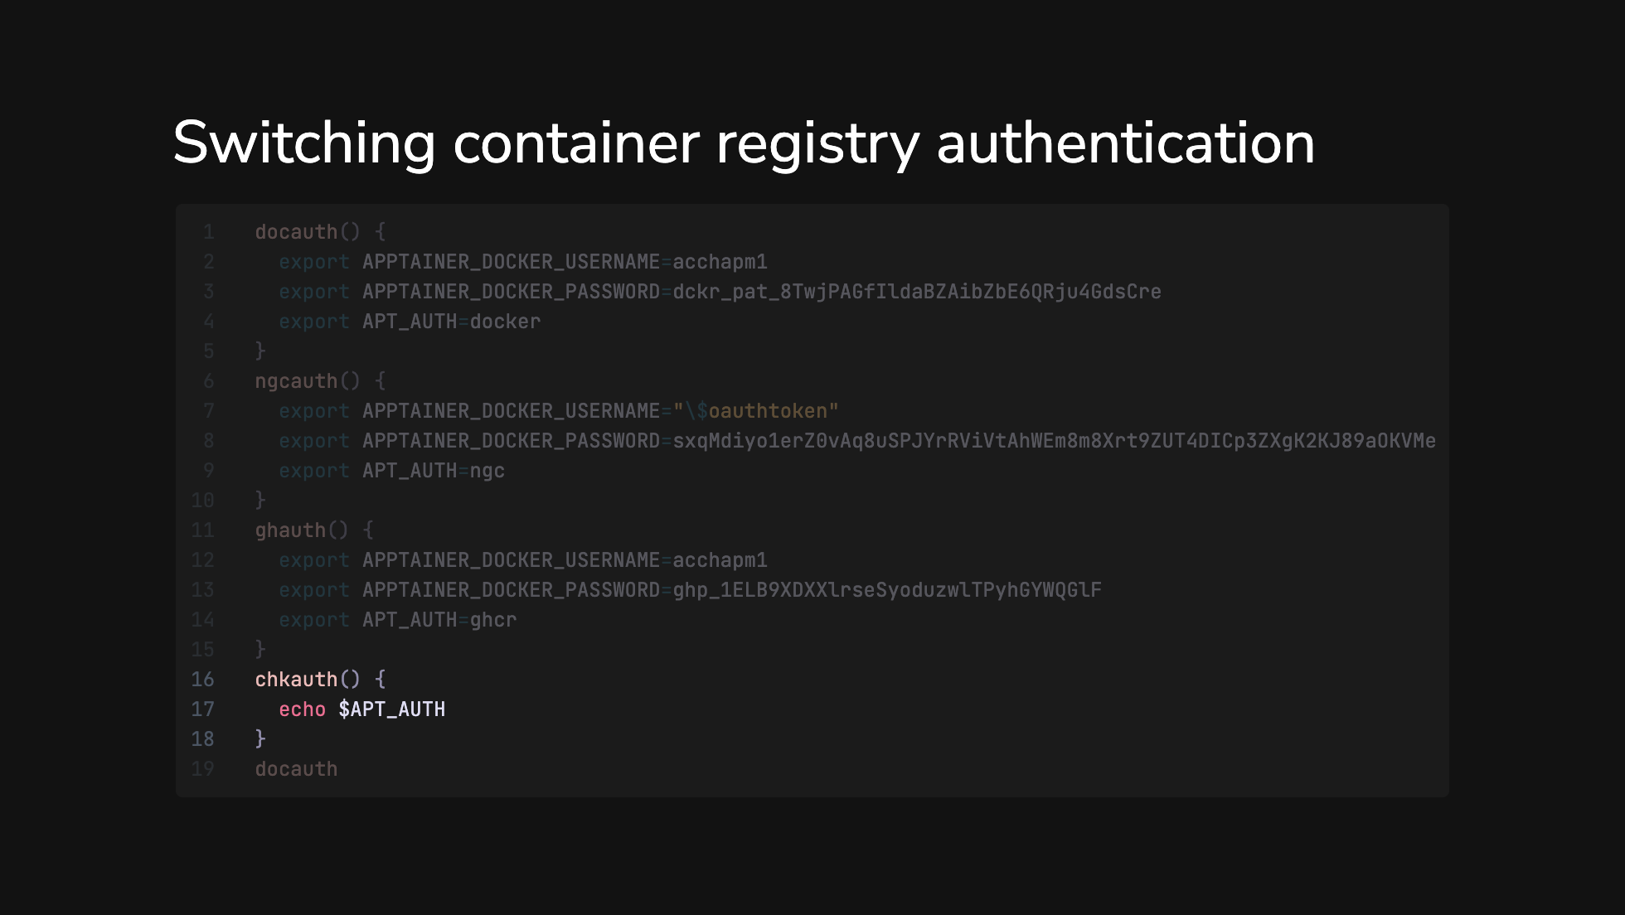

Slide 16
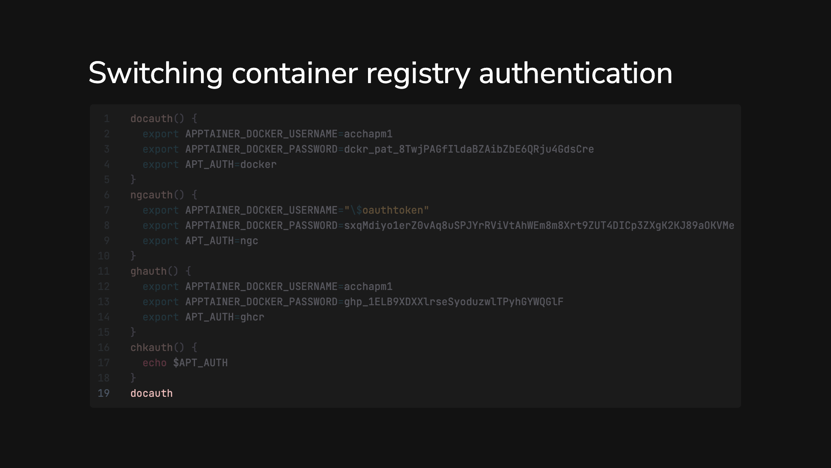

Slide 17


