Slide 1
Git Study Session
Atsumi Kaneta

Slide 2

Local & Remote
Remote
Remote Repository
Local
Local Repository
Stage
Work directory

Slide 3
Local
Repository
???
git commit
Stage
git add
(Staging)
Prepare changes to commit
Work directory
Change file

Slide 4
Git Add (Staging)
Repository
CompF
( Compressed 123.txt)
(2)
Stage
IndexFile
CompF -> 123.txt
CompD -> 789.txt
CompA -> 456.txt
CompF is added to IndexFile.
(1)
Work directory
123.txt
Change
file
456.txt
789.txt

Slide 5
Command “add”
・git add FileName”
・git add DirectoryName
Draft

Slide 6
Git Commit
Repository
CompF
Tree5
(2)
Commit5
(1)
CompF -> 123.txt
CompD -> 789.txt
CompA -> 456.txt
Tree : Tree5
Parent : Commit4
Author : Kaneta
Date : 2021/03/17
Commit Msg : xxxxx
Stage
IndexFile
CompF -> 123.txt
CompD -> 789.txt
CompA -> 456.txt
Work directory
123.txt
456.txt
789.txt

Slide 7
Commit - update a local repository
Commit means “to record changes”.
Changes means below.
・Changes
・Create new
・Delete

Slide 8
Command “commit”
・git commit
>> Text editor is launched to input Commit Message.
・git commit -m CommitMessage
>> Input Commit Message without text editor.
・git commit -v
>> before commit, it shows change details on text editor.

Slide 9
Memo - About Commit Message
The following must be included in Commit Message
・Main points of change
・Reason of change
・Simple expression

Slide 10
Command “git status”
git status
>> it shows files containing below.
1) Changes to be added
2) Changes to be committed
Repository
git commit
Stage
git add
(Staging)
2) Changes
to be committed
Work directory
1) Changes to be added

Slide 11
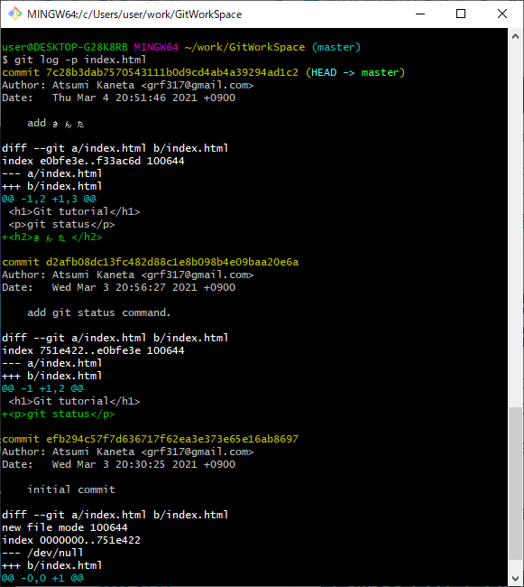
Command “git log”
git log -p filename
>> it shows change history of the file
Commit ID
(Hash value)
Change details
It’s hard to see...

Slide 12
Push - Upload a branch to a remote repository
Add -> Commit -> Push
Remote
Push
Remote Repository
Local
Local Repository
Commit
Note:
Push is done for each branch.
Add
Stage
Work directory

Slide 13
Command “git push”
git push RemoteRepositoryURL BranchName
RemoteRepositoryURL : exp. https://github.com/xxxx/yyyy.git
BranchName: exp. master

Slide 14
Command “git remote add”
・git remote add ShortCutName RemoteRepositoryURL
ShortCutName : exp. origin
RemoteRepositoryURL : exp. https://github.com/xxxx/yyyy.git
>> You can use the command “git push” as below.
git push ShortCutName BranchName

Slide 15
Cancel changes of files
Repository
Stage
git checkout -- filename
Work directory
Changes

Slide 16
Command “git checkout” with file name
・git commit
>> Text editor is launched to input Commit Message.
・git commit -m “Commit Message”
>> Input Commit Message without text editor.
・git commit -v
>> before commit, it shows change details on text editor.

Slide 17
Cancel staging
Repository
git reset HEAD
Stage
IndexFile
Changes
Work directory

Slide 18
Command “git reset HEAD”
・git reset HEAD FileName
・git reset HEAD DirectoryName
>> Cancel all staged file in the directory
・git reset HEAD .
>> Cancel all staged file
*“HEAD” means the newest commit.

Slide 19
Amend commit
Changes1
Repository
git commit --amend
Changes2
Stage
IndexFile
Changes2
git add
Work directory
Changes2

Slide 20
Command “git commit --amend”
*At first, you have to stage what you want to amend.
If not so, only commit messages will be amended.
・git commit --amend
>> Text editor is launched to input Commit Message.
・git commit --amend -m “Commit Message”
>> Input commit message without text editor.

Slide 21
Branch
Repository
*HEAD: pointer to active branch
HEAD*
. . .
Commit3
Commit4
Commit5
master branch
branch1
CompF -> 123.txt
CompD -> 789.txt
CompA -> 456.txt
. . .
Tree3
Tree4
Tree5
Branch is a pointer to latest commit.
CompF
Snap shot

Slide 22
Branch after new commit -1
Repository
HEAD
master branch
Commit5
branch1

Slide 23
Branch after new commit -2
HEAD
Repository
master branch
Commit6
Commit5
branch1

Slide 24
Branch after new commit -3
Repository
master branch
Commit6
Commit5
You have switched branch.
branch1
HEAD

Slide 25
Branch after new commit -4
Repository
master branch
Commit6
Commit5
Commit7
branch1
HEAD

Slide 26
Branch after new commit -5
Repository
master branch
Commit6
Commit5
Commit7
Commit8
branch1
HEAD

Slide 27
Branch after new commit -6
Repository
Project A
master branch
Commit6
Commit5
Commit7
Commit8
branch1
Project B

Slide 28
Create a new branch

Slide 29
Pull - Upload a branch to a remote repository
Add -> Commit -> Push
Remote
Draft
Push
Remote Repository
Local
Local Repository
Commit
Note:
Push is done for each branch.
Add
Stage
Work directory

Slide 30
Fetch - Upload a branch to a remote repository
Add -> Commit -> Push
Remote
Draft
Push
Remote Repository
Local
Local Repository
Commit
Note:
Push is done for each branch.
Add
Stage
Work directory

Slide 31
Pull or Fetch?
Fetch is recommended.
You use Pull with great caution.

Slide 32
Memo - Create remote repository (In case of using Github)
Create empty repository “ShareDocs” on Github.
Check repository URL “https://github.com/acchi17/ShareDocs.git”.
On git client,
git push -u https://github.com/acchi17/ShareDocs.git main
git remote add origin

Slide 33
Memo - git bash setting
New:
git config --global user.name 'Atsumi Kaneta'
git config --global user.email 'xxxyyyzzz@gmail.com'
Change:
git config --global user.name 'AKaneta'
git config --global user.email 'aaabbbccc@gmail.com'
Show:
git config --list

