Slide 1
Git Study Session
Atsumi Kaneta

Slide 2
Table of contents
Draft

Slide 3

Git on Local & Remote
Remote
Remote Repository
Local
Local Repository
Stage
Work directory

Slide 4
Local
Repository
Commit
Stage
Add (Staging)
Prepare changes to commit
Work directory
Change file

Slide 5
Remote
Remote Repository
Commit
Draft
Local Repository
Change file

Slide 6
Add (Staging)
Repository
CompF
( Compressed 123.txt)
(2)
Stage
IndexFile
CompF -> 123.txt
CompD -> 789.txt
CompA -> 456.txt
CompF is added to IndexFile.
(1)
Work directory
123.txt
Change
file
456.txt
789.txt

Slide 7
Command “git add”
・git add [FileName]
>> A file will be staged.
・git add [DirectoryName] >> A directory and files in it will be staged.

Slide 8
Commit - update a local repository
Repository
CompF
Tree5
(2)
Commit5
(1)
CompF -> 123.txt
CompD -> 789.txt
CompA -> 456.txt
Tree : Tree5
Parent : Commit4
Author : Kaneta
Date : 2021/03/17
Commit Msg : xxxxx
Stage
IndexFile
CompF -> 123.txt
CompD -> 789.txt
CompA -> 456.txt
Work directory
123.txt
456.txt
789.txt

Slide 9
Command “git commit”
・git commit
>> Text editor is launched to input commit message.
・git commit -m [CommitMessage]
>> Input commit message without text editor.
・git commit -v
>> before commit, it shows change details on text editor.

Slide 10
Command “git status”
git status
>> it shows files containing below.
1) Changes to be added
2) Changes to be committed
Repository
git commit
Stage
git add
(Staging)
2) Changes
to be committed
Work directory
1) Changes to be added

Slide 11
Command “git remote add”
・git remote add [ShortCutName] [RemoteRepositoryURL]
ShortCutName : exp. origin
RemoteRepositoryURL : exp. https://github.com/xxxx/yyyy.git
>> You can use the command “git push” as below.
git push [ShortCutName] [BranchName]

Slide 12
Cancel changes of files
Repository
Stage
git checkout -- filename
Work directory
Changes

Slide 13
Command “git checkout” with file name
・git commit
>> Text editor is launched to input Commit Message.
・git commit -m “Commit Message”
>> Input Commit Message without text editor.
・git commit -v
>> before commit, it shows change details on text editor.
Draft

Slide 14
Cancel staging
Repository
git reset HEAD
Stage
IndexFile
Changes
Work directory

Slide 15
Command “git reset HEAD”
・git reset HEAD FileName
・git reset HEAD DirectoryName
>> Cancel all staged file in the directory
・git reset HEAD .
>> Cancel all staged file
*“HEAD” means the newest commit.

Slide 16
Amend commit
Changes1
Repository
git commit --amend
Changes2
Stage
IndexFile
Changes2
git add
Work directory
Changes2

Slide 17
Command “git commit --amend”
*At first, you have to stage what you want to amend.
If not so, only commit messages will be amended.
・git commit --amend
>> Text editor is launched to input Commit Message.
・git commit --amend -m [Commit Message]
>> Input commit message without text editor.

Slide 18
Branch

Slide 19
Branch
Repository
*HEAD: pointer to working branch
HEAD*
. . .
Commit3
Commit4
Commit5
master branch
branch1
CompF -> 123.txt
CompD -> 789.txt
CompA -> 456.txt
. . .
Tree3
Tree4
Tree5
Branch is a pointer to latest commit.
CompF
Snap shot

Slide 20
Branch after new commit -1
Repository
HEAD
master branch
Commit5

Slide 21
Branch after new commit -1
Repository
HEAD
master branch
Commit5
branch1
Create a new branch.

Slide 22
Branch after new commit -2
HEAD
Repository
master branch
Commit6
Commit5
branch1

Slide 23
Branch after new commit -3
Repository
master branch
Commit6
Commit5
You have switched branch.
branch1
HEAD

Slide 24
Branch after new commit -4
Repository
master branch
Commit6
Commit5
Commit7
branch1
HEAD

Slide 25
Branch after new commit -5
Repository
master branch
Commit6
Commit5
Commit7
Commit8
branch1
HEAD

Slide 26
Branch after new commit -6
Repository
Project A
master branch
Commit6
Commit5
Commit7
Commit8
branch1
Project B

Slide 27
Command “git branch” -1
・git branch [Branch name]
[Branch name] : exp. Branch1
>> Create a new branch.

Slide 28
Command “git branch” -2
・git branch
>> Show branch list.
exp.
branch1 main remotes/origin/HEAD remotes/origin/main

Slide 29
Command “git checkout”
・git checkout [Branch name]
[Branch name] : exp. Branch1
>> switch to specified branch.

Slide 30
Merge

Slide 31
Merge - Fast Forward -1
Repository
HEAD
master branch
Commit5

Slide 32
Merge - Fast Forward -2
Repository
HEAD
master branch
Commit5
hotfix branch

Slide 33
Merge - Fast Forward -3
Repository
master branch
Commit5
Commit6
hotfix branch
HEAD

Slide 34
Merge - Fast Forward -4
Repository
HEAD
master branch
Commit5
Commit6
hotfix branch

Slide 35
Merge - Fast Forward -5
Repository
Merge latest commit of hotfix branch into HEAD branch ( = master branch).
HEAD
Merge
hotfix branch
HEAD
master branch
master branch
Commit5
Commit6
hotfix branch

Slide 36
Merge - Auto Merge -1
Repository
HEAD
master branch
Commit5

Slide 37
Merge - Auto Merge -2
Repository
HEAD
master branch
Commit5
branch1

Slide 38
Merge - Auto Merge -3
Repository
HEAD
master branch
Commit6
Commit5
branch1

Slide 39
Merge - Auto Merge -4
Repository
master branch
Commit6
Commit5
branch1
HEAD

Slide 40
Merge - Auto Merge -5
Repository
master branch
Commit6
Commit5
Commit7
branch1
HEAD

Slide 41
Merge - Auto Merge -6
Repository
HEAD
master branch
Commit6
Commit5
Commit7
branch1

Slide 42
Merge - Auto Merge -7
Repository
Merge latest commit of branch1 into HEAD branch ( = master branch).
HEAD
HEAD
master branch
master branch
Merge
branch1
Commit6
Commit6
Commit8
Commit5
Commit5
Commit7
Commit7
Merged automatically, new commit created.
branch1
branch1

Slide 43
Merge conflict
Repository
HEAD
HEAD
aaa.txt
master branch
master branch
Commit6
Change the same parts
on the same files.
Commit6
Commit5
Commit5
Commit7
Commit7
Merge failed.
aaa.txt
branch1
branch1

Slide 44
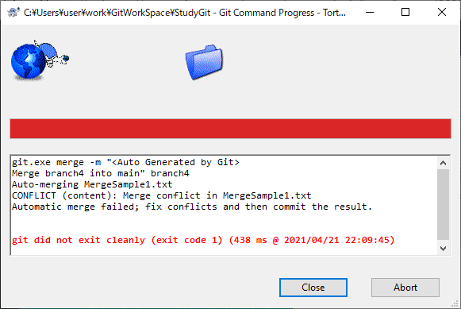
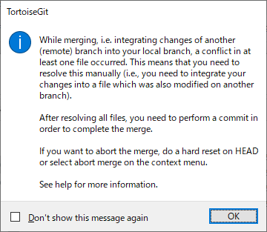
Merge conflict on TortoiseGit

Slide 45
Command “git merge”
・git merge [Branch name]
[Branch name] : exp. branch1
>> Merge latest commit of branch1 into working branch.

Slide 46
Push

Slide 47
Push - Upload a branch to a remote repository
Add -> Commit -> Push
Remote
Push
Remote Repository
Local
Local Repository
Commit
Note:
Push is done for each branch.
Add
Stage
Work directory

Slide 48
Push branches to remote repository -1
Remote Repository
Local Repository
Commit4
Commit5
master

Slide 49
Push branches to remote repository -2
Remote Repository
master
Commit4
Commit5
Push master
Local Repository
Commit4
Commit5
master

Slide 50
Push branches to remote repository -3
branch1
Remote Repository
master
Commit6
Commit4
Commit5
Push branch1
Local Repository
Commit6
Commit4
Commit5
branch1
master

Slide 51
Command “git push”
git push [RemoteRepositoryURL] [BranchName]
[RemoteRepositoryURL] : exp. https://github.com/xxxx/yyyy.git
[BranchName] : exp. master

Slide 52
Fetch

Slide 53
Fetch from remote repository -1
Remote Repository ( Name: origin )
Commit6
master
HEAD
Commit5
Commit7
branch1
master
Local Repository
Commit5
Commit8
branch2
HEAD

Slide 54
Fetch from remote repository -2
Remote Repository ( Name: origin )
Commit6
master
HEAD
Commit5
Commit7
branch1
Fetch
master
Commit6
Local Repository
remotes/origin/master
remotes/
origin/HEAD
Commit5
Commit7
remotes/origin/branch1/
Commit8
branch2
HEAD

Slide 55
Command “git fetch”
・git fetch [Remote name]
[Remote name] : exp. origin
>> Remote branches* added to your local repository.
*Remote branch name: remotes / [Remote repos name] / [branch name]

Slide 56
Pull

Slide 57
Pull from remote repository -1
Remote Repository ( Name: origin )
Commit6
master
HEAD
Commit5
Commit7
branch1
master
Local Repository
Commit5
Commit8
branch2
HEAD

Slide 58
Pull from remote repository -2
Remote Repository ( Name: origin )
Commit6
master
HEAD
Commit5
Commit7
branch1
Fetch
master
Commit6
Local Repository
remotes/origin/master
remotes/
origin/HEAD
Commit5
Commit7
remotes/origin/branch1/
Commit8
branch2
HEAD

Slide 59
Pull - Upload a branch to a remote repository
Add -> Commit -> Push
Remote
Draft
Push
Remote Repository
Local
Local Repository
Commit
Note:
Push is done for each branch.
Add
Stage
Work directory

Slide 60
Pull or Fetch?
Fetch is recommended.
You use Pull with great caution.

Slide 61
Rebase

Slide 62
Development flow
with using branch
5/14

Slide 63
Pull Request, Merge Request
Draft

Slide 64
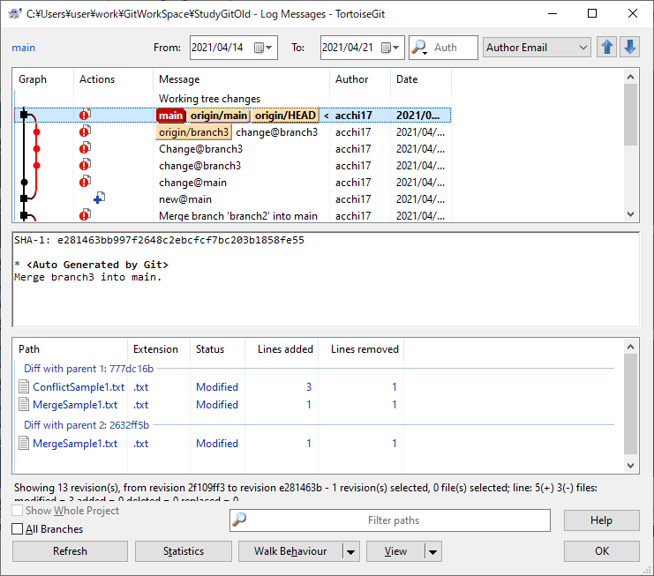
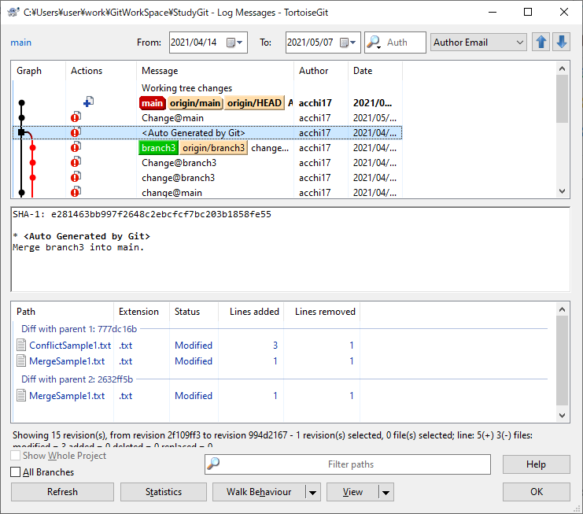
Fetch branches to remote repository

Slide 65
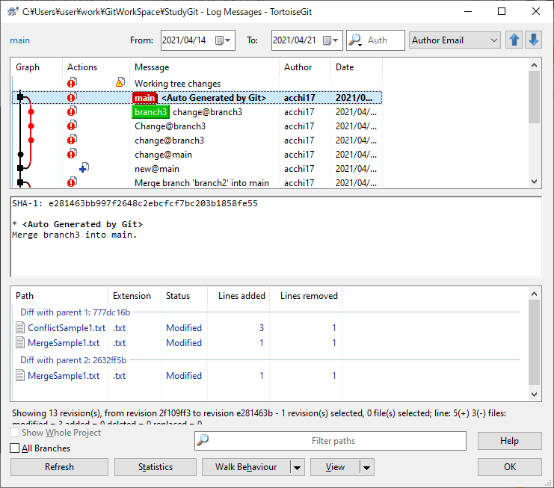

Slide 66
Reference Information

Slide 67
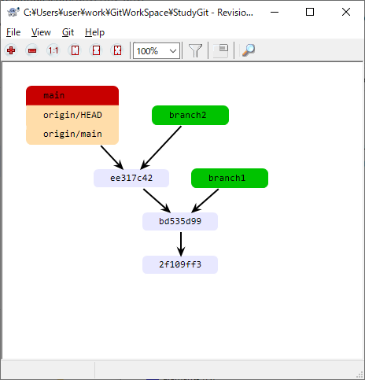
Memo - TortiseGit
Revision graph:
すべてのブランチとタグが表示され、ブランチ構造の大まかな 概要が示されます。

Slide 68
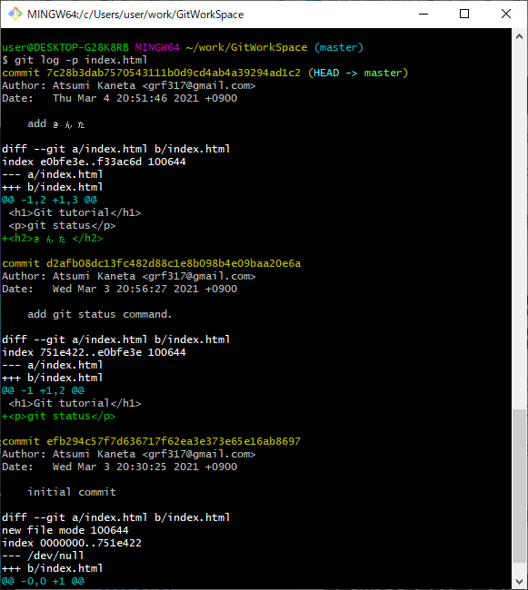
Command “git log”
git log -p filename
>> it shows change history of the file
Commit ID
(Hash value)
Change details
It’s hard to see...

Slide 69
Memo - About commit
Commit means “to record changes”.
Changes means below.
・Changes
・Create new
・Delete

Slide 70
Memo - About Commit Message
The following must be included in Commit Message
・Main points of change
・Reason of change
・Simple expression

Slide 71
Memo - Create remote repository (In case of using Github)
Create empty repository “ShareDocs” on Github.
Check repository URL “https://github.com/acchi17/ShareDocs.git”.
On git client,
git push -u https://github.com/acchi17/ShareDocs.git main
git remote add origin

Slide 72
Memo - git bash setting
New:
git config --global user.name 'Atsumi Kaneta'
git config --global user.email 'xxxyyyzzz@gmail.com'
Change:
git config --global user.name 'AKaneta'
git config --global user.email 'aaabbbccc@gmail.com'
Show:
git config --list

