Slide 1
Git Study Session
Atsumi Kaneta

Slide 2

Local & Remote
Remote
Remote Repository
Local
Local Repository
Stage
Work directory

Slide 3
Local
Repository
git commit
Stage
git add
(Staging)
Prepare changes to commit
Work directory
Change file

Slide 4
Add (Staging)
Repository
CompF
( Compressed 123.txt)
(2)
Stage
IndexFile
CompF -> 123.txt
CompD -> 789.txt
CompA -> 456.txt
CompF is added to IndexFile.
(1)
Work directory
123.txt
Change
file
456.txt
789.txt

Slide 5
Command “git add”
・git add [FileName]
>> A file will be staged.
・git add [DirectoryName] >> A directory and files in it will be staged.

Slide 6
Commit - update a local repository
Repository
CompF
Tree5
(2)
Commit5
(1)
CompF -> 123.txt
CompD -> 789.txt
CompA -> 456.txt
Tree : Tree5
Parent : Commit4
Author : Kaneta
Date : 2021/03/17
Commit Msg : xxxxx
Stage
IndexFile
CompF -> 123.txt
CompD -> 789.txt
CompA -> 456.txt
Work directory
123.txt
456.txt
789.txt

Slide 7
Command “git commit”
・git commit
>> Text editor is launched to input commit message.
・git commit -m [CommitMessage]
>> Input commit message without text editor.
・git commit -v
>> before commit, it shows change details on text editor.

Slide 8
Command “git status”
git status
>> it shows files containing below.
1) Changes to be added
2) Changes to be committed
Repository
git commit
Stage
git add
(Staging)
2) Changes
to be committed
Work directory
1) Changes to be added

Slide 9
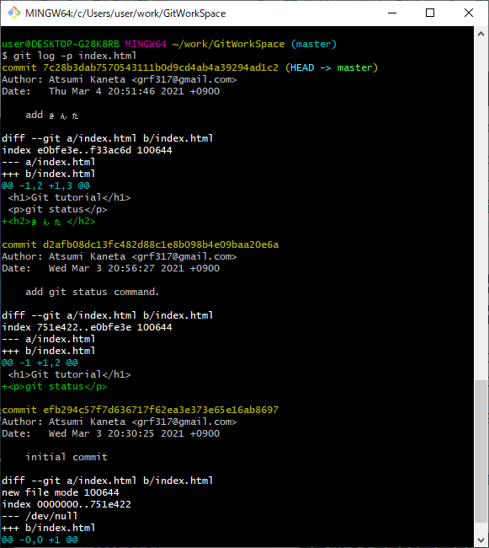
Command “git log”
git log -p filename
>> it shows change history of the file
Commit ID
(Hash value)
Change details
It’s hard to see...

Slide 10
Push - Upload a branch to a remote repository
Add -> Commit -> Push
Remote
Push
Remote Repository
Local
Local Repository
Commit
Note:
Push is done for each branch.
Add
Stage
Work directory

Slide 11
Command “git push”
git push [RemoteRepositoryURL] [BranchName]
[RemoteRepositoryURL] : exp. https://github.com/xxxx/yyyy.git
[BranchName] : exp. master

Slide 12
Command “git remote add”
・git remote add [ShortCutName] [RemoteRepositoryURL]
ShortCutName : exp. origin
RemoteRepositoryURL : exp. https://github.com/xxxx/yyyy.git
>> You can use the command “git push” as below.
git push [ShortCutName] [BranchName]

Slide 13
Cancel changes of files
Repository
Stage
git checkout -- filename
Work directory
Changes

Slide 14
Command “git checkout” with file name
・git commit
>> Text editor is launched to input Commit Message.
・git commit -m “Commit Message”
>> Input Commit Message without text editor.
・git commit -v
>> before commit, it shows change details on text editor.
Draft

Slide 15
Cancel staging
Repository
git reset HEAD
Stage
IndexFile
Changes
Work directory

Slide 16
Command “git reset HEAD”
・git reset HEAD FileName
・git reset HEAD DirectoryName
>> Cancel all staged file in the directory
・git reset HEAD .
>> Cancel all staged file
*“HEAD” means the newest commit.

Slide 17
Amend commit
Changes1
Repository
git commit --amend
Changes2
Stage
IndexFile
Changes2
git add
Work directory
Changes2

Slide 18
Command “git commit --amend”
*At first, you have to stage what you want to amend.
If not so, only commit messages will be amended.
・git commit --amend
>> Text editor is launched to input Commit Message.
・git commit --amend -m [Commit Message]
>> Input commit message without text editor.

Slide 19
Branch
Repository
*HEAD: pointer to active branch
HEAD*
. . .
Commit3
Commit4
Commit5
master branch
branch1
CompF -> 123.txt
CompD -> 789.txt
CompA -> 456.txt
. . .
Tree3
Tree4
Tree5
Branch is a pointer to latest commit.
CompF
Snap shot

Slide 20
Branch after new commit -1
Repository
HEAD
master branch
Commit5

Slide 21
Branch after new commit -1
Repository
HEAD
master branch
Commit5
branch1
Create a new branch.

Slide 22
Branch after new commit -2
HEAD
Repository
master branch
Commit6
Commit5
branch1

Slide 23
Branch after new commit -3
Repository
master branch
Commit6
Commit5
You have switched branch.
branch1
HEAD

Slide 24
Branch after new commit -4
Repository
master branch
Commit6
Commit5
Commit7
branch1
HEAD

Slide 25
Branch after new commit -5
Repository
master branch
Commit6
Commit5
Commit7
Commit8
branch1
HEAD

Slide 26
Branch after new commit -6
Repository
Project A
master branch
Commit6
Commit5
Commit7
Commit8
branch1
Project B

Slide 27
Command “git branch” -1
・git branch [Branch name]
[Branch name] : exp. Branch1
>> Create a new branch.

Slide 28
Command “git branch” -2
・git branch
>> Show branch list.
exp.
branch1 main remotes/origin/HEAD remotes/origin/main

Slide 29
Command “git checkout”
・git checkout [Branch name]
[Branch name] : exp. Branch1
>> switch to Branch1.

Slide 30
Merge
Draft

Slide 31
Command “git merge”
・git checkout [Branch name]
[Branch name] : exp. Branch1
>> switch to Branch1.
Draft

Slide 32
Pull - Upload a branch to a remote repository
Add -> Commit -> Push
Remote
Draft
Push
Remote Repository
Local
Local Repository
Commit
Note:
Push is done for each branch.
Add
Stage
Work directory

Slide 33
Fetch - Upload a branch to a remote repository
Add -> Commit -> Push
Remote
Draft
Push
Remote Repository
Local
Local Repository
Commit
Note:
Push is done for each branch.
Add
Stage
Work directory

Slide 34
Pull or Fetch?
Fetch is recommended.
You use Pull with great caution.

Slide 35
Memo - TortiseGit
Revision graph:
すべてのブランチとタグが表示され、ブランチ構造の大まかな 概要が示されます。

Slide 36
Memo - About commit
Commit means “to record changes”.
Changes means below.
・Changes
・Create new
・Delete

Slide 37
Memo - About Commit Message
The following must be included in Commit Message
・Main points of change
・Reason of change
・Simple expression

Slide 38
Memo - Create remote repository (In case of using Github)
Create empty repository “ShareDocs” on Github.
Check repository URL “https://github.com/acchi17/ShareDocs.git”.
On git client,
git push -u https://github.com/acchi17/ShareDocs.git main
git remote add origin

Slide 39
Memo - git bash setting
New:
git config --global user.name 'Atsumi Kaneta'
git config --global user.email 'xxxyyyzzz@gmail.com'
Change:
git config --global user.name 'AKaneta'
git config --global user.email 'aaabbbccc@gmail.com'
Show:
git config --list

