Slide 1
Git Study Session
Atsumi Kaneta

Slide 2
Table of contents
Git overview
Clone
Add
Commit
Branch
Merge
Rebase
Push
Fetch
Pull
Development flow

Slide 3
Git overview

Slide 4

Git on Local & Remote
Remote
Remote Repository
Local
Local Repository
Stage
Work directory

Slide 5
Local
Repository
Commit
Stage
Add (Staging)
Prepare changes to commit
Work directory
Change file

Slide 6
Remote
Remote Repository
Push
Local Repository
Clone
Fetch
Pull

Slide 7
Clone

Slide 8
Clone - Download copy of remote repository
Remote Repository
Clone
Local Repository ( A directory with the same name as the remote repository ）

Slide 9
Command “git clone”
・git clone [RemoteRepositoryURL]
RemoteRepositoryURL : exp. https://github.com/xxxx/yyyy.git

Slide 10
Add

Slide 11
Add (Staging) - prepare changes to commit
Repository
CompF
( Compressed 123.txt)
(2)
Stage
IndexFile
CompF -> 123.txt
CompD -> 789.txt
CompA -> 456.txt
CompF is added to IndexFile.
(1)
Work directory
123.txt
Change
file
456.txt
789.txt

Slide 12
Command “git add”
・git add [FileName]
>> A file will be staged.
・git add [DirectoryName] >> A directory and files in it will be staged.

Slide 13
Commit

Slide 14
Commit - update a local repository
Repository
CompF
Tree5
(2)
Commit5
(1)
CompF -> 123.txt
CompD -> 789.txt
CompA -> 456.txt
Tree : Tree5
Parent : Commit4
Author : Kaneta
Date : 2021/03/17
Commit Msg : xxxxx
Stage
IndexFile
CompF -> 123.txt
CompD -> 789.txt
CompA -> 456.txt
Work directory
123.txt
456.txt
789.txt

Slide 15
Command “git commit”
・git commit
>> Text editor is launched to input commit message.
・git commit -m [CommitMessage]
>> Input commit message without text editor.
・git commit -v
>> before commit, it shows change details on text editor.

Slide 16
Branch

Slide 17
Branch
Repository
*HEAD: pointer to working branch
HEAD*
. . .
Commit3
Commit4
Commit5
master branch
branch1
CompF -> 123.txt
CompD -> 789.txt
CompA -> 456.txt
. . .
Tree3
Tree4
Tree5
Branch is a pointer to latest commit.
CompF
Snap shot

Slide 18
Branch after new commit -1
Repository
HEAD
master branch
Commit5

Slide 19
Branch after new commit -1
Repository
HEAD
master branch
Commit5
branch1
Create a new branch.

Slide 20
Branch after new commit -2
HEAD
Repository
master branch
Commit6
Commit5
branch1

Slide 21
Branch after new commit -3
Repository
master branch
Commit6
Commit5
You have switched branch.
branch1
HEAD

Slide 22
Branch after new commit -4
Repository
master branch
Commit6
Commit5
Commit7
branch1
HEAD

Slide 23
Branch after new commit -5
Repository
master branch
Commit6
Commit5
Commit7
Commit8
branch1
HEAD

Slide 24
Branch after new commit -6
Repository
Project A
master branch
Commit6
Commit5
Commit7
Commit8
branch1
Project B

Slide 25
Command “git branch” -1
・git branch [Branch name]
[Branch name] : exp. Branch1
>> Create a new branch.

Slide 26
Command “git branch” -2
・git branch
>> Show branch list.
exp.
branch1 main remotes/origin/HEAD remotes/origin/main

Slide 27
Command “git checkout”
・git checkout [Branch name]
[Branch name] : exp. Branch1
>> switch to specified branch.

Slide 28
Merge

Slide 29
Merge - Fast Forward -1
Repository
HEAD
master branch
Commit5

Slide 30
Merge - Fast Forward -2
Repository
HEAD
master branch
Commit5
hotfix branch

Slide 31
Merge - Fast Forward -3
Repository
master branch
Commit5
Commit6
hotfix branch
HEAD

Slide 32
Merge - Fast Forward -4
Repository
HEAD
master branch
Commit5
Commit6
hotfix branch

Slide 33
Merge - Fast Forward -5
Repository
Merge latest commit of hotfix branch into HEAD branch ( = master branch).
HEAD
Merge
hotfix branch
HEAD
master branch
master branch
Commit5
Commit6
hotfix branch

Slide 34
Merge - Auto Merge -1
Repository
HEAD
master branch
Commit5

Slide 35
Merge - Auto Merge -2
Repository
HEAD
master branch
Commit5
branch1

Slide 36
Merge - Auto Merge -3
Repository
HEAD
master branch
Commit6
Commit5
branch1

Slide 37
Merge - Auto Merge -4
Repository
master branch
Commit6
Commit5
branch1
HEAD

Slide 38
Merge - Auto Merge -5
Repository
master branch
Commit6
Commit5
Commit7
branch1
HEAD

Slide 39
Merge - Auto Merge -6
Repository
HEAD
master branch
Commit6
Commit5
Commit7
branch1

Slide 40
Merge - Auto Merge -7
Repository
Merge latest commit of branch1 into HEAD branch ( = master branch).
HEAD
HEAD
master branch
master branch
Merge
branch1
Commit6
Commit6
Commit8
Commit5
Commit5
Commit7
Commit7
Merged automatically, new commit created.
branch1
branch1

Slide 41
Merge conflict
Repository
HEAD
HEAD
aaa.txt
master branch
master branch
Commit6
Change the same parts
on the same files.
Commit6
Commit5
Commit5
Commit7
Commit7
Merge failed.
aaa.txt
branch1
branch1

Slide 42
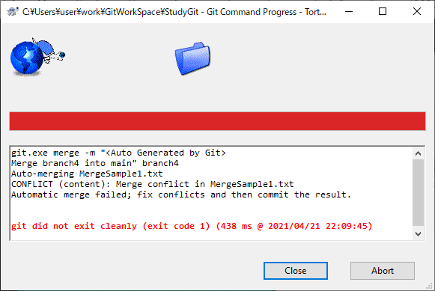
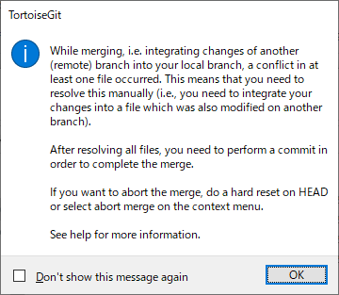
Merge conflict on TortoiseGit

Slide 43
Command “git merge”
・git merge [Branch name]
[Branch name] : exp. branch1
>> Merge latest commit of branch1 into working branch.

Slide 44
Rebase

Slide 45
Rebase -1
Repository
HEAD
master branch
Commit6
Commit5
Commit7
branch1

Slide 46
Rebase -2
Repository
New commit(6-1) is created,commit7 is merged into it, and commit6 ie deleted.
HEAD
master branch
Rebase
branch1
HEAD
Commit6
Commit6
master branch
Commit5
Commit5
Commit7
Commit7
Commit6-1
branch1
branch1

Slide 47
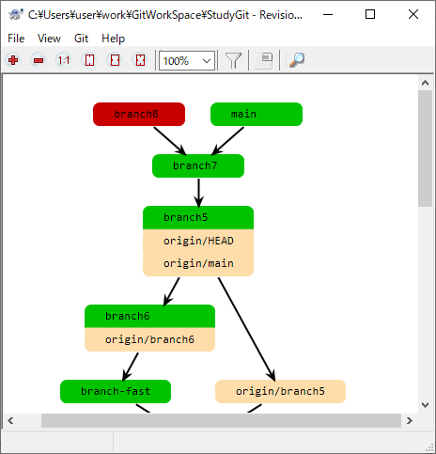
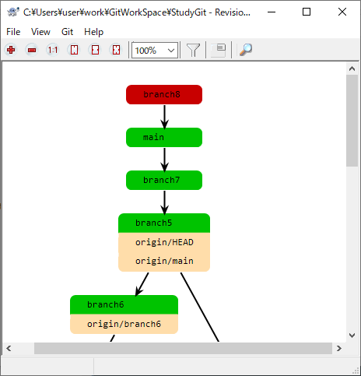
Rebase -TortoiseGit
Rebase main
@branch8

Slide 48
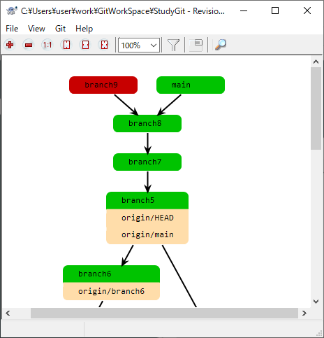
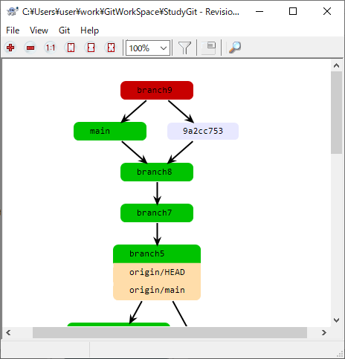
Merge -TortoiseGit
Merge main
@branch9

Slide 49
Command “git rebase”
・git rebase [Branch name]
[Branch name] : exp. branch1
>> Merge latest commit of branch1 into working branch, and move working branch to the position that points to branch1.

Slide 50
Push

Slide 51
Push - Upload a branch to a remote repository
Add -> Commit -> Push
Remote
Push
Remote Repository
Local
Local Repository
Commit
Note:
Push is done for each branch.
Add
Stage
Work directory

Slide 52
Push branches to remote repository -1
Remote Repository
Local Repository
Commit4
Commit5
master

Slide 53
Push branches to remote repository -2
Remote Repository
master
Commit4
Commit5
Push master
Local Repository
Commit4
Commit5
master

Slide 54
Push branches to remote repository -3
branch1
Remote Repository
master
Commit6
Commit4
Commit5
Push branch1
Local Repository
Commit6
Commit4
Commit5
branch1
master

Slide 55
Command “git push”
・git push [Remote name] [BranchName]
[Remote name] : exp. origin
[BranchName] : exp. master
>> Specified branch will be added to remote repository.

Slide 56
Fetch

Slide 57
Fetch from remote repository -1
Remote Repository ( Name: origin )
Commit6
master
HEAD
Commit5
Commit7
branch1
master
Local Repository
Commit5
Commit8
branch2
HEAD

Slide 58
Fetch from remote repository -2
Remote Repository ( Name: origin )
Commit6
master
HEAD
Commit5
Commit7
branch1
Fetch
master
Commit6
Local Repository
remotes/origin/master
remotes/
origin/HEAD
Commit5
Commit7
remotes/origin/branch1/
Commit8
branch2
HEAD

Slide 59
Command “git fetch”
・git fetch [Remote name]
[Remote name] : exp. origin
>> All remote branches* will be added to your local repository.
*Remote branch name format: remotes / [Remote repos name] / [branch name]

Slide 60
Pull

Slide 61
Pull from remote repository -1
Remote Repository ( Name: origin )
Commit6
master
HEAD
Commit5
Commit7
branch1
master
Local Repository
Commit5
Commit8
branch2
HEAD

Slide 62
Pull from remote repository -2
Remote Repository ( Name: origin )
Commit6
master
HEAD
Commit5
Commit7
branch1
Pull branch1
master
Merge
Remote branch1 into branch2 and
new commit created.
Local Repository
Commit5
Commit7
Commit9
Commit8
branch2
HEAD

Slide 63
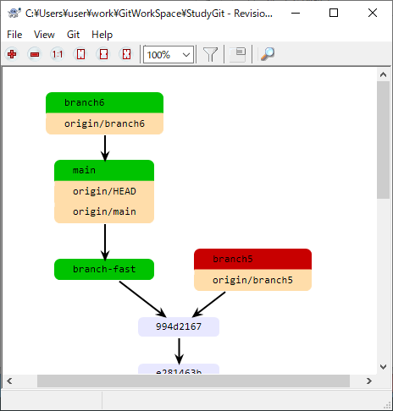
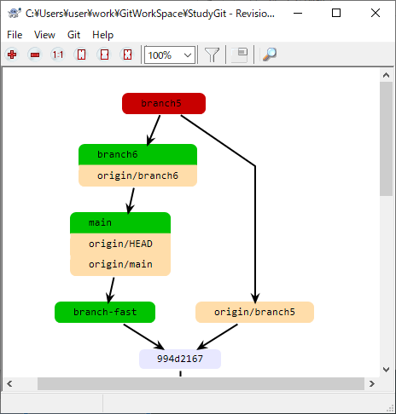
Pull befor after on TortoiseGit
Pull
other branch

Slide 64
Command “git pull”
・git pull [Remote name] [Branch name]
[Remote name] : exp. Origin [Branch name ] : exp. branch2
>> Specified remote branch will be added and merged to your working branch.

Slide 65
Development flow

Slide 66
Basic development flow -1
Remote Repository
release
Commit10
Local Repository

Slide 67
Basic development flow -2
Remote Repository
release
Commit10
develop1
Local Repository

Slide 68
Basic development flow -3
Remote Repository
release
Commit10
develop1
Clone
Local Repository
release
Commit10
develop1

Slide 69
Basic development flow -4
Remote Repository
release
Commit10
develop1
Local Repository
release
mybranch
Commit10
develop1

Slide 70
Basic development flow -2
Remote Repository
release
Commit10
develop1
Local Repository
release
Commit10
Commit11
develop1
mybranch1

Slide 71
Basic development flow -2
Remote Repository
release
Commit10
Commit11
develop1
mybranch1
Local Repository
Push
release
Commit10
Commit11
develop1
mybranch1

Slide 72
Basic development flow -2
Remote Repository
Commit12
release
Commit10
Commit11
develop1
Merge mybranch to develop1
mybranch1
Local Repository
release
Commit10
Commit11
develop1
mybranch1

Slide 73
Basic development flow -2
Remote Repository
Commit12
Do
system test
@Commit12
release
Commit10
Commit11
develop1
mybranch1
Local Repository
release
Commit10
Commit11
develop1
mybranch1

Slide 74
Basic development flow -2
Remote Repository
Commit13
Commit12
release
Commit10
Commit11
develop1
Merge develop1 to release
mybranch1
Local Repository
release
Commit10
Commit11
develop1
mybranch1

Slide 75
Basic development flow -2
Remote Repository
Commit13
Commit12
release
release
Commit10
Commit11
develop1
Release
Commit13
mybranch1
Delete branches for development
Local Repository
release
Commit10
Commit11
develop1
mybranch1

Slide 76
End

Slide 77
Reference information

Slide 78
Cancel changes of files
Repository
Stage
checkout filename
Work directory
Changes

Slide 79
Command “git checkout”
・git checkout [FileName]
・git checkout [DirectoryName]
>> Restore files in working directory to ones of the latest commit .

Slide 80
Cancel staging
Repository
git reset HEAD
Stage
IndexFile
Changes
Work directory

Slide 81
Command “git reset HEAD”
・git reset HEAD [FileName]
・git reset HEAD [DirectoryName]
>> Cancel all staged file in the directory
・git reset HEAD .
>> Cancel all staged file
*“HEAD” means the newest commit.

Slide 82
Amend commit
Changes1
Repository
Amend
Changes2
Stage
IndexFile
Changes2
Add
Work directory
Changes2

Slide 83
Command “git commit --amend”
*At first, you have to stage what you want to amend.
If not so, only commit messages will be amended.
・git commit --amend
>> Text editor is launched to input Commit Message.
・git commit --amend -m [Commit Message]
>> Input commit message without text editor.

Slide 84
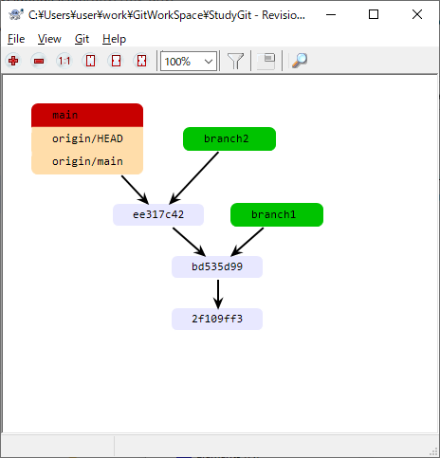
Memo - TortoiseGit
Revision graph:
すべてのブランチとタグが表示され、ブランチ構造の大まかな 概要が示されます。

Slide 85
Command “git status”
git status
>> it shows files containing below.
1) Changes to be added
2) Changes to be committed
Repository
git commit
Stage
git add
(Staging)
2) Changes
to be committed
Work directory
1) Changes to be added

Slide 86
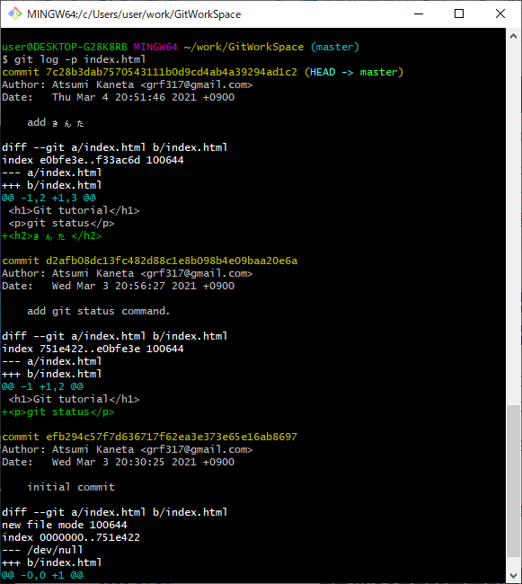
Command “git log”
git log -p [FileName]
>> it shows change history of the file
Commit ID
(Hash value)
Change details
It’s hard to see...

Slide 87
Memo - About Commit Message
The following must be included in Commit Message
・Main points of change
・Reason of change
・Simple expression

Slide 88
Command “git remote add”
・git remote add [ShortCutName] [RemoteRepositoryURL]
ShortCutName : exp. origin
RemoteRepositoryURL : exp. https://github.com/xxxx/yyyy.git
>> You can use the command “git push” as below.
git push [ShortCutName] [BranchName]

Slide 89
Memo - git bash setting
New:
git config --global user.name 'Atsumi Kaneta'
git config --global user.email 'xxxyyyzzz@gmail.com'
Change:
git config --global user.name 'AKaneta'
git config --global user.email 'aaabbbccc@gmail.com'
Show:
git config --list

Slide 90
Memo - Create remote repository (In case of using Github)
Create empty repository “ShareDocs” on Github.
Check repository URL “https://github.com/acchi17/ShareDocs.git”.
On git client,
git push -u https://github.com/acchi17/ShareDocs.git main
git remote add origin

