Slide 1
Sample Quarto Document

Slide 2
Sample Quarto Document
Feature | Description | Status
Export to DOCX | Generate Word documents | ✅
Export to PPTX | Generate PowerPoint presentations | ✅
Mermaid Diagrams | Create flowcharts and diagrams | ✅
Math Equations | LaTeX math rendering | ✅
This is a sample document that demonstrates the power of Quarto integration in this documentation system.
Features Demonstrated
1. Rich Text Formatting
You can use bold text, italic text, and code snippets in your content.
2. Code Blocks
def hello_world(): print("Hello, World!") return True # This code will be syntax highlighted result = hello_world()
3. Tables

Slide 3
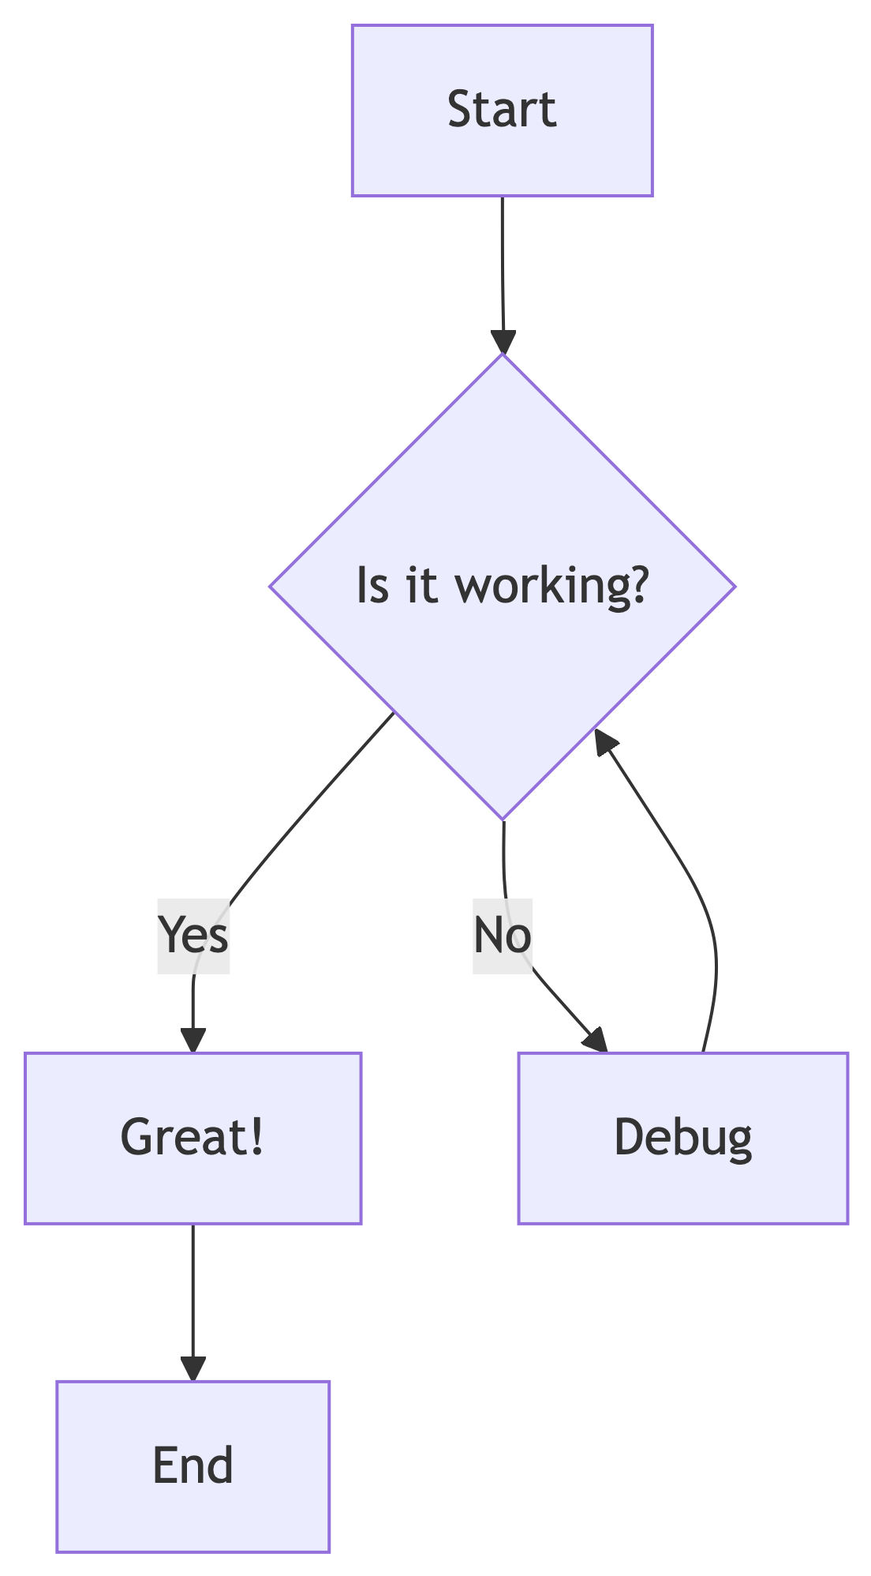
4. Lists
Ordered Lists: 1. First item 2. Second item 3. Third item
Unordered Lists: - Bullet point one - Bullet point two - Nested bullet - Another nested bullet
5. Diagrams

Slide 4
6. Math Equations
You can include inline math like $E=mc^{2}$ or display math:
$$\int_{−∞}^{∞}{e^{−x^{2}}}dx=\sqrt{π}$$
7. Blockquotes
This is a blockquote. It can be used to highlight important information or quotes from other sources.
8. Links and References
Hugo Documentation
Quarto Documentation
Mermaid Documentation
Export Options
This document can be exported to: - DOCX: Click the DOCX button above to download a Word document - PPTX: Click the PPTX button above to download a PowerPoint presentation - Print: Click the Print button for a clean, formatted print version
Conclusion
This documentation system combines the best of both worlds: - Hugo’s fast static site generation - Quarto’s powerful document processing and export capabilities
Start creating your own documentation by replacing this sample content with your own files!

